Slide 1
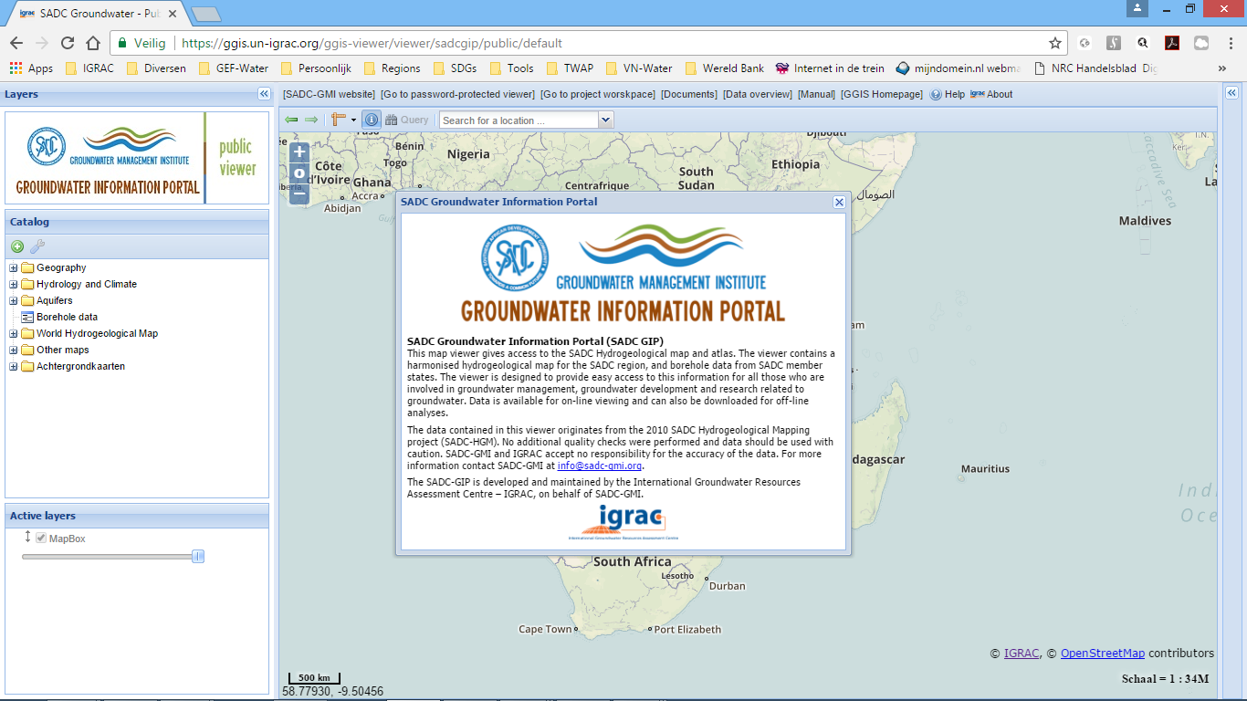
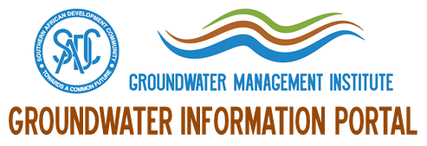
SADC Groundwater Information Portal
SADC-GIP
Brighton Munyai (SADC GMI)
Geert-Jan Nijsten (IGRAC)
3rd Regional meeting on Tools for sustainable management of transboundary aquifers
Gaborone, 6 – 9 March 2018

Slide 2
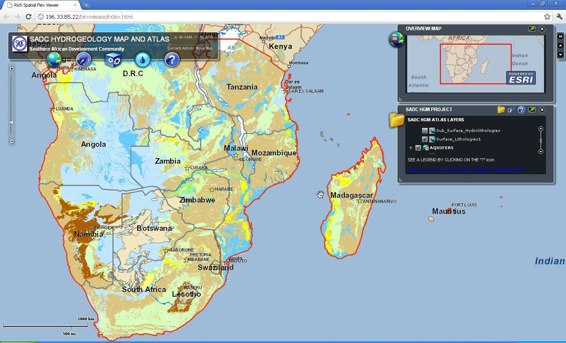
SADC Groundwater Information Portal - SADC-GIP -
SADC Hydrogeological Mapping Project (SADC et.al., 2010)
Website
Atlas with documents
SADC-harmonised Hydrogeological Map
Transboundary aquifers in SADC region
Borehole database
Web-viewer
Off-line in 2014

Slide 3
SADC Groundwater Information Portal - SADC-GIP -
www.sadc-gip.un-igrac.org
2017 SADC-GMI:
Resuscitating the
SADC Hydrogeological Map

Slide 4
SADC Groundwater Information Portal - SADC-GIP -
www.sadc-gip.un-igrac.org
Hydrogeological maps:
Aquifer type classifications
Aquifer yields
Aquifer rock types
Transboundary aquifers

Slide 5
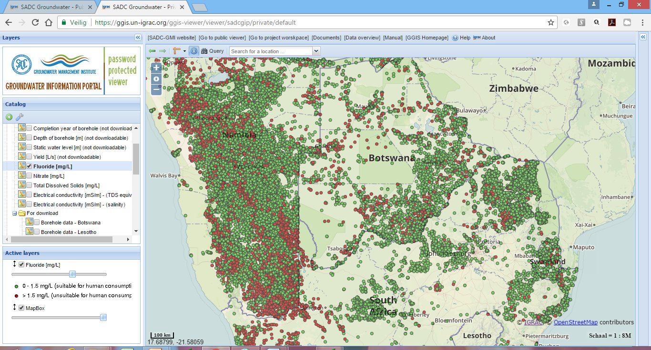
SADC Groundwater Information Portal - SADC-GIP -
www.sadc-gip.un-igrac.org
Borehole database (>300 000 BHs):
Depth of borehole
Static water level
Borehole yield
Electrical conductivity and TDS
Fluoride concentrations
Nitrate concentrations
Etc.

Slide 6
SADC Groundwater Information Portal - SADC-GIP -
www.sadc-gip.un-igrac.org
World Hydrogeological Map:
Recharge estimates
Groundwater vulnerability map
Groundwater related wetlands
Etc

Slide 7
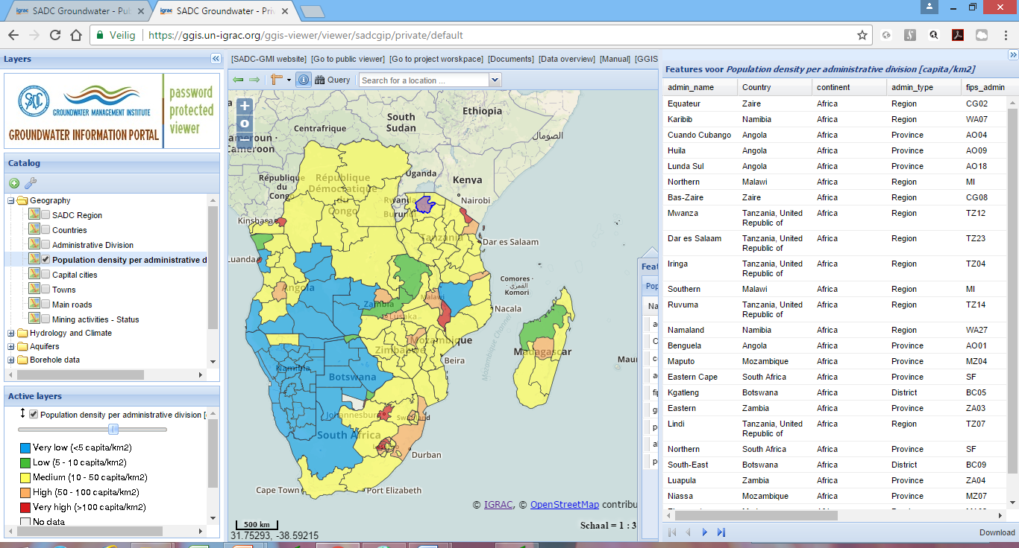
SADC Groundwater Information Portal - SADC-GIP -
www.sadc-gip.un-igrac.org
Geographical data:
Population density data
Administrative units
Mining activities
Etc.

Slide 8
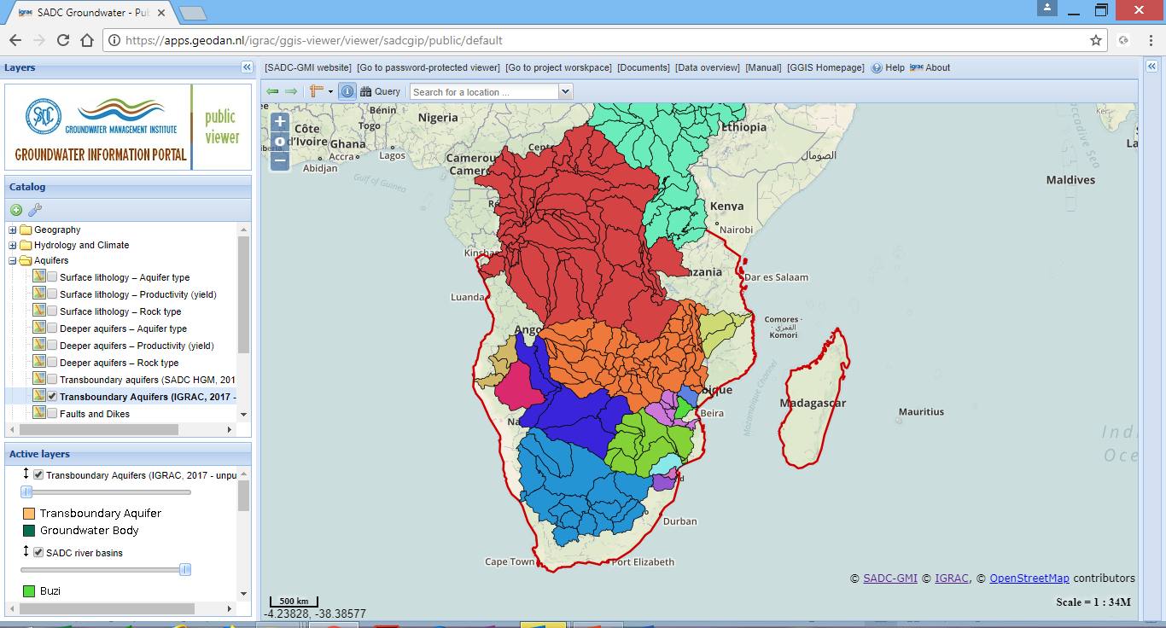
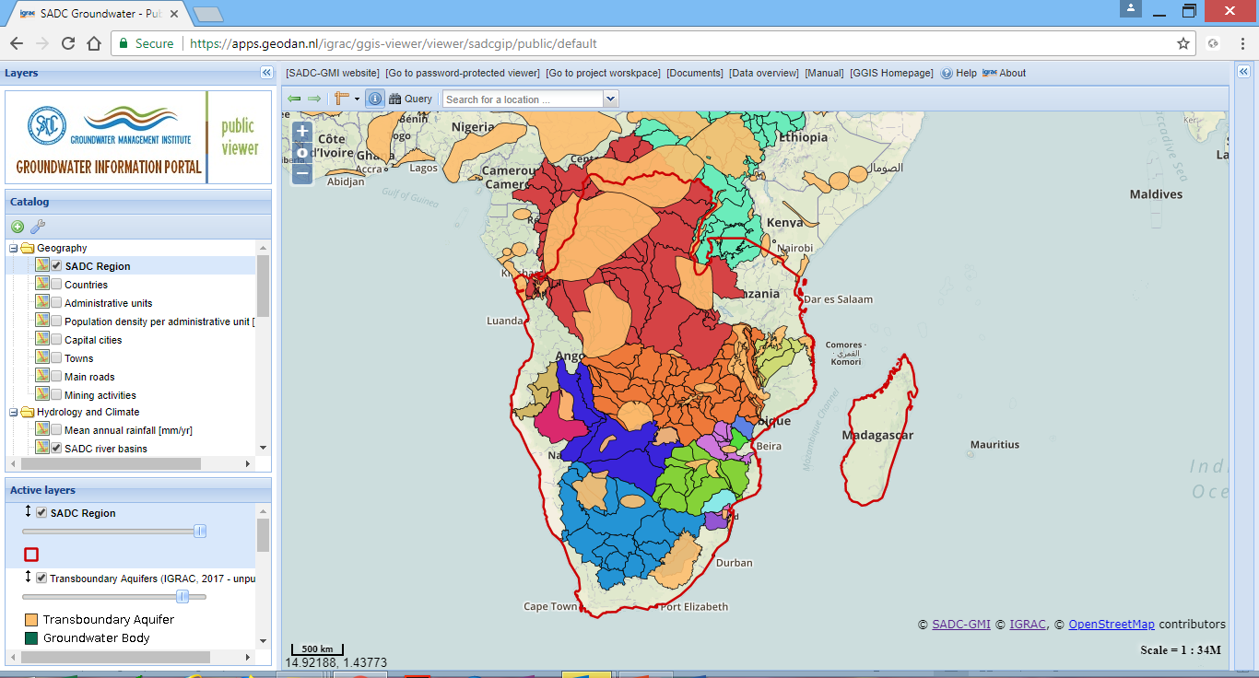
SADC Groundwater Information Portal - SADC-GIP -
www.sadc-gip.un-igrac.org
SADC River basins
SADC River basins
SAD Transboundary Aquifers

Slide 9
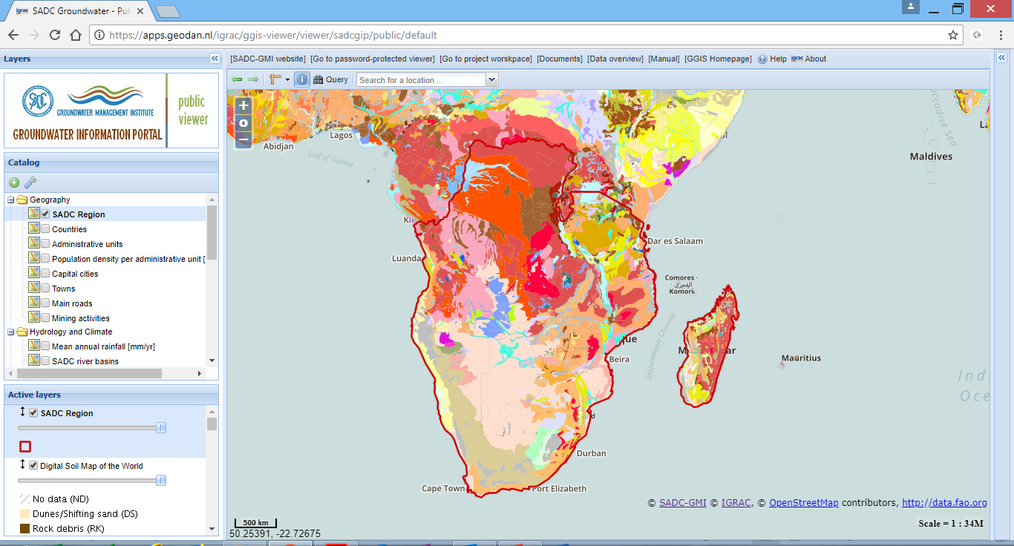
SADC Groundwater Information Portal - SADC-GIP -
www.sadc-gip.un-igrac.org
Hydrology and Climate
Rainfall map
Surface water features
Other thematic maps
Soil map
Land use
Irrigation from groundwater
Climate zones

Slide 10
Thank you for your attention
web: www.sadc-gmi.org
web: www.gip.sadc-gmi.org
mail: info@sadc-gmi.org
Bloemfontein – South Africa

