Slide 1
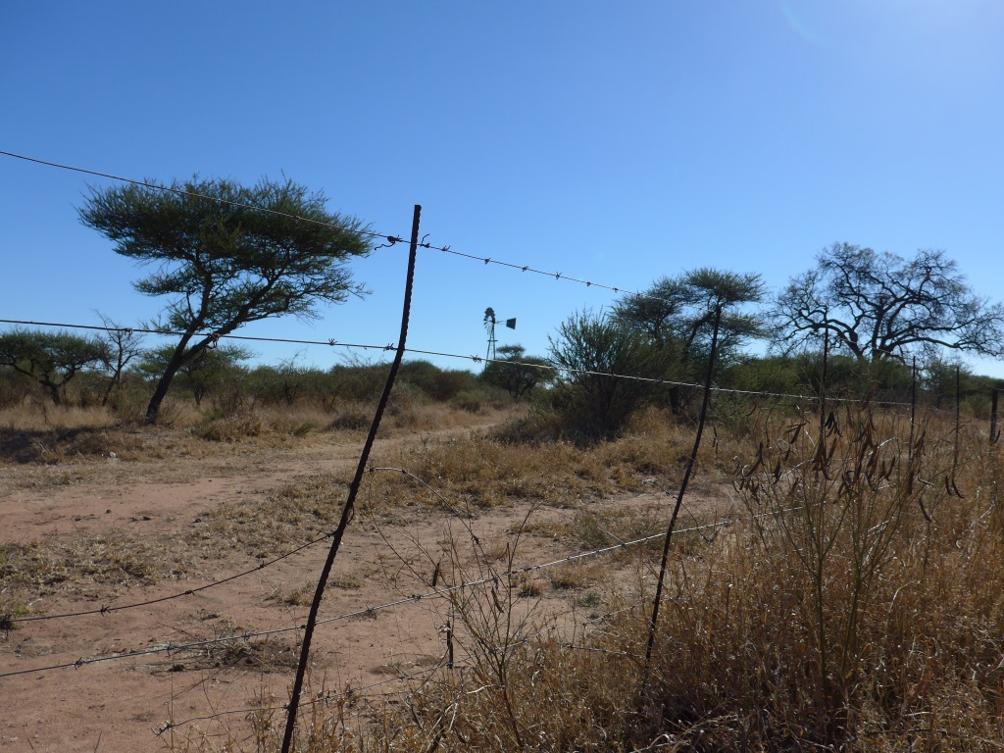












RAMOTSWA PROJECT
RAMOTSWA 2:- Joint Strategic Action Plan / Linkages to RBOs – 06 March 2018
Piet Kenabatho
University of Botswana
3rd Regional Meeting on Tools for the Sustainable Management of Transboundary Aquifers
06-09 March 2018, Gaborone, Botswana

Slide 2
Presentation outline
Overview of SAP Process
JSAP vision and framework
Key Actions in the SAP and linkages to RBOs
Potential role of Advisory Committee
Launch of the Committee

Slide 3
Overview of SAP Process
SAP-a Strategic Action Plan can be defined as a tool or framework for identifying investments and interventions that help improve water use and increase the composite benefits derived therefrom.
Can also be a tool that describes the framework for management of the water and related land resources in the basin (GWP, 2012).
The scale at which SAPs are undertaken often correspond to a hydrologic unit such as a basin, sub-basin or an aquifer.
Given that such units often cross borders, SAPs are often transboundary in nature, where they are often jointly developed by involved states, hence the term Joint Strategic Action Plan (JSAP).

Slide 4
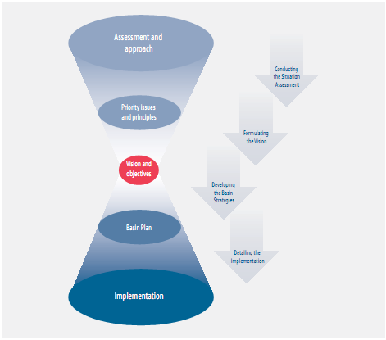
A SAP typically builds on previous identification of priority issues, and normally begins with convergence toward a vision and objectives
Consultative and Participatory Approach
From TDA to Basin Plan/ SAP (Pegram et al., 2013

Slide 5
Rationale for a JSAP in the The Ramotswa Transboundary Aquifer Area (RTBAA)
The RTBAA Joint SAP (JSAP) is undertaken to identify and prioritize investments and actions that can be pursued to enhance the benefits derived from the shared water resource
Investments and actions will respond to key challenges identified in the baseline report (Altchenko et al., 2016)
but will also consider ways to harness opportunities accruing from integrated management of the RTBAA system
Ultimately, strategic formulation of interventions in the RTBAA is expected to contribute to optimizing management of the aquifer,
And contribute to broader developmental goals in the area such as resilience-strengthening and socioeconomic development, which are the overall goals of the RAMOTSWA-2 project.

Slide 6
JSAP PROCESS IN THE RTBAA
As far back in Sept. 2016 in Mafikeng, South Africa
conceptualizing SAP vision and framework
identifying and considering actions
reviewing compatibility of actions with existing institutional frameworks
filtering and prioritizing actions; estimating cost and feasibility
recommendations for the next steps
Steps for Developing the Joint Strategic Action Plan

Slide 7
Conceptualizing a shared vision and framework
Development of the JSAP framework was focused on identifying the set of components, into which priority actions can be logically orgnanised
The last quarter of 2016 was devoted to finalizing the Vision and framework.
Important first steps in JSAP development, involved i) generating an overarching vision for the joint transboundary management of the RTBAA, and ii) working toward a framework within which particular actions would fall
Focus was on validating key challenges to sustainable use of the RTBAA as identified in the baseline report.

Slide 8
Some lessons learnt from local workshops
There is a need for verification of current groundwater use
Need for verification of current groundwater use
Need for improved zoning of land use to control contamination
Enforcement of water quality by-laws.
Investing in infrastructure that promotes multiple water use
Maintain and regularly update water supply databases of local authority and water board.
Factor in future water use in planning – economic growth and agricultural potential.
Address acid mine water drainage (AMD) in local mines..

Slide 9
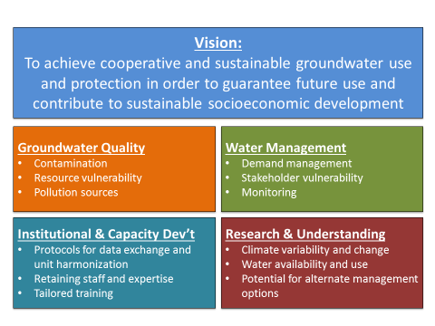
JSAP Vision and Framework
Based on consultations in Botswana

Slide 10
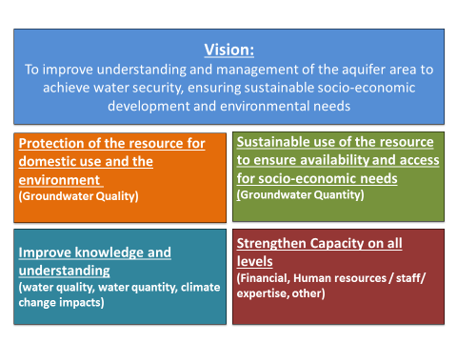
JSAP Vision and Framework
Based on consultations in South Africa

Slide 11
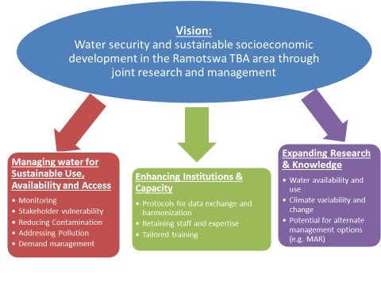
Joint Vision and Framework
Objectives Targets Actions

Slide 12
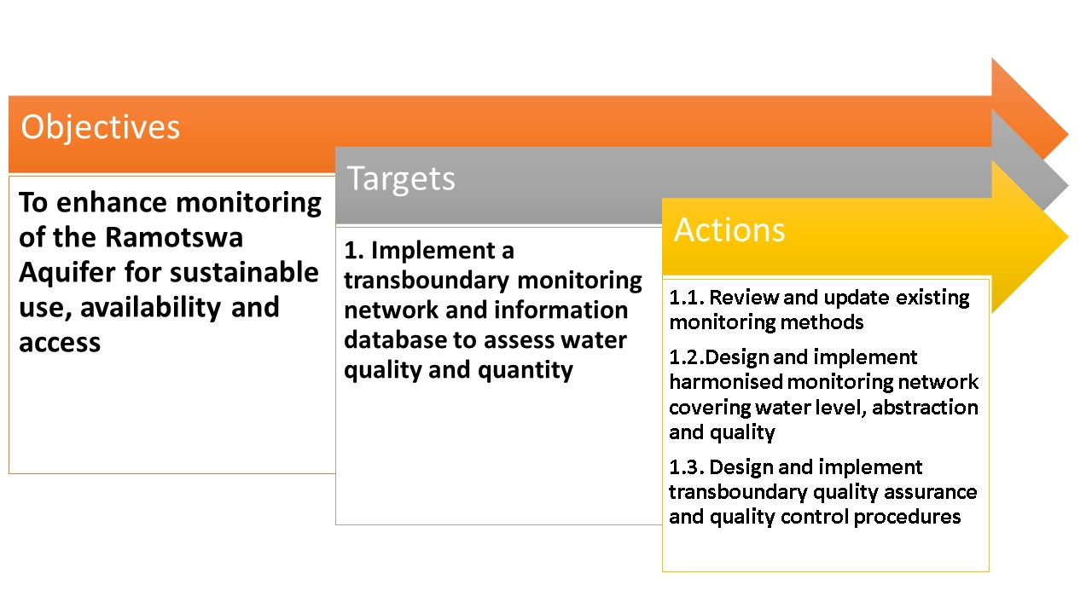
Key actions in the JSAP and linkages to RBOs
Example

Slide 13
Potential role of Advisory Committee
Advise on the project’s strategic direction and prioritization of key areas and topics
Foster incremental transition from project committee to standalone working committee, securing support from national authorities and endorsement from the JPTC
Report to the Joint Permanent Technical Committee (JPTC) on key areas of progress
Provide advice and possible solutions to challenges identified by the project management and associated team

Slide 14
Potential role of Advisory Committee
Highlight challenges identified in the project management team and how they can be addressed
Help match investment opportunities identified by the project with available resources
Support and guide outcomes of the SAP
Promote awareness of transboundary groundwater management risks and opportunities

Slide 15
Composition of the Advisory Committee
SADC (Water): Phera Ramoeli/Ken Msibi
JPTC (SA Member)
JPTC (Botswana Member)
DWA (Botswana; co-chair): Keodumetse Keetile
DWS (South Africa: co-chair): Sakhile Mndaweni
LIMCOM: Sergio Sitoe
IWMI: Karen Villholth/Jonathan Lautze
All invited for a meeting on Wednesday at 4PM

Slide 16
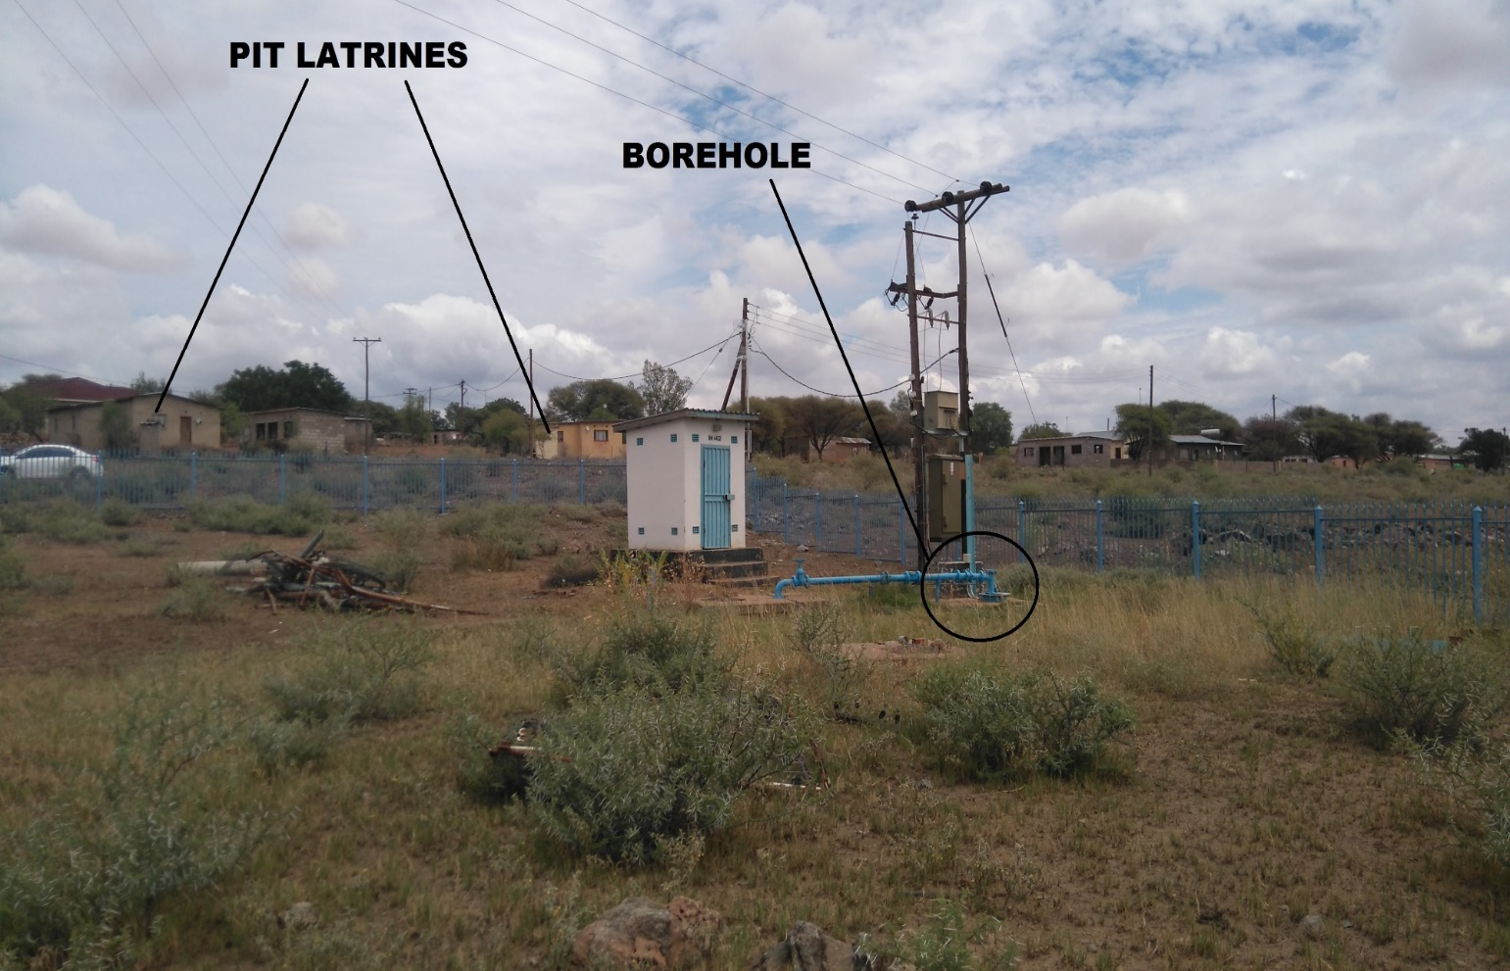
Thank You
http://ramotswa.iwmi.org/
Photo by Y. ALtchenko

