Slide 1
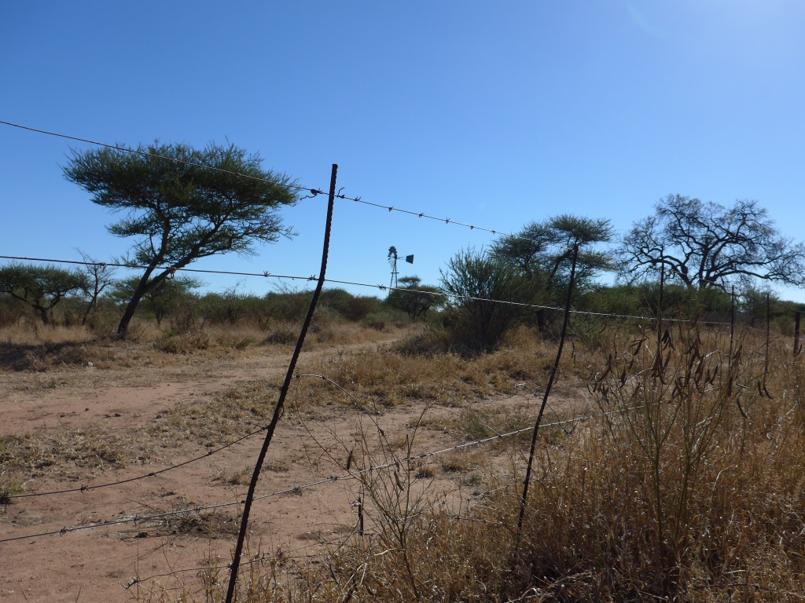







RAMOTSWA 2:The Potential Role of the Transboundary Ramotswa Aquifer
Kwazikwakhe Majola/Sakhile Mndaweni
Department of Water and Sanitation, RSA
3rd Regional Meeting on Tools for the Sustainable Management of Transboundary Aquifers
06 – 09 March 2018, Gaborone, Botswana

Slide 2
Presentation Outline
Project Objective
Locality
Phase 1 achievements
Ramotswa Phase 2 Objectives
Components
Main findings and achievements

Slide 3
RAMOTSWA project specific Objectives (Phase 1)
Increase awareness of the importance and vulnerability of the transboundary Ramotswa Aquifer.
Improve understanding of the socioeconomic importance of the aquifer area, and the inequalities in water access and security across the population.
Improve understanding of the extent and hydrogeology of the transboundary aquifer resources under present and future climate and population projections.
Establish national and cross-border dialogue and cooperation on the Ramotswa Aquifer, and further encourage international cooperation on transboundary aquifers in the Southern African Development Community (SADC) region.
Develop tools for shared and harmonized management and monitoring of groundwater resources, aligned with the national water resources management processes.
Develop human and institutional capacity for shared and harmonized management and monitoring of groundwater resources.

Slide 4
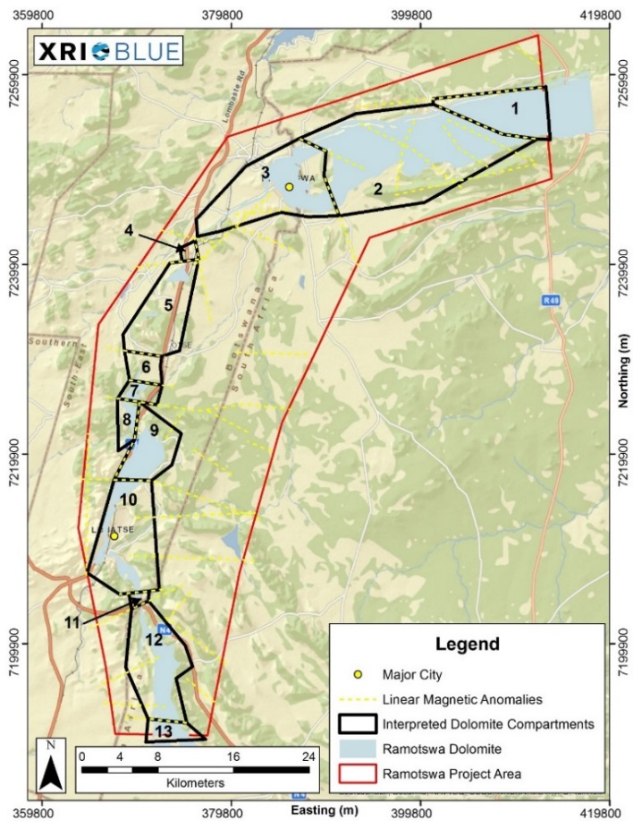
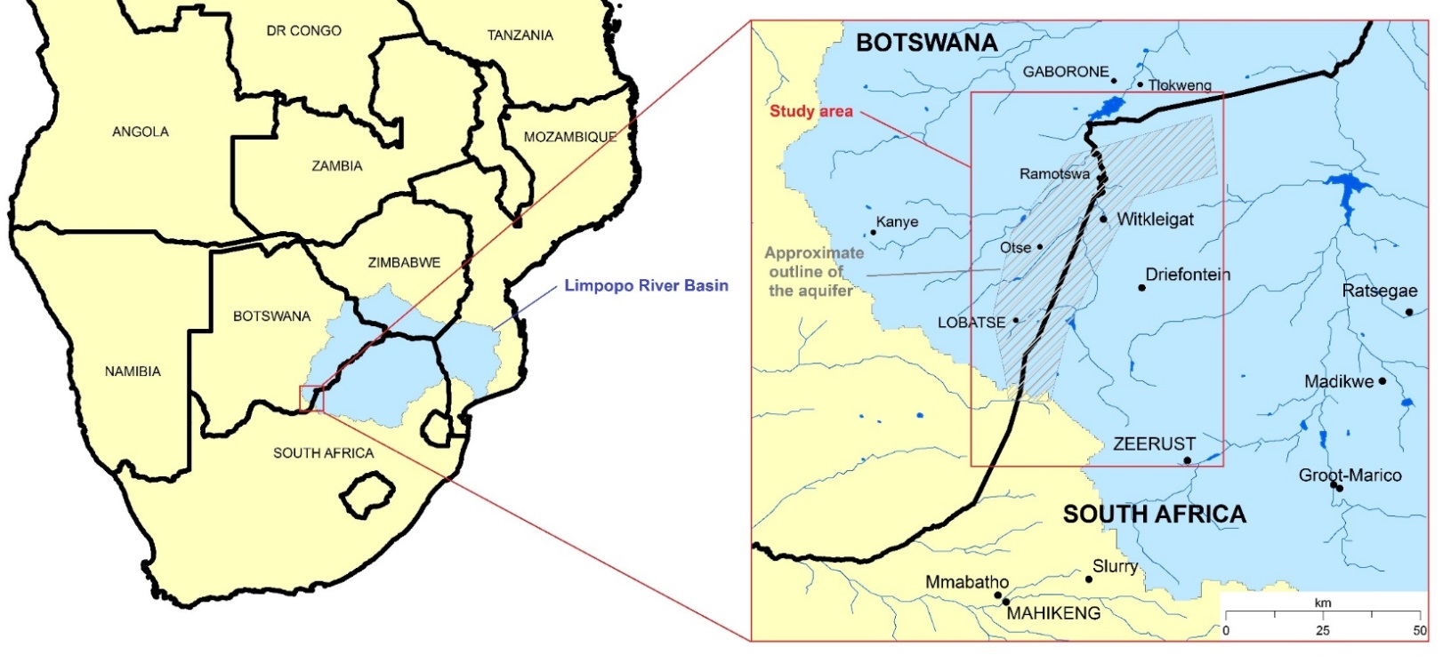
Ramotswa Aquifer – Limpopo Basin

Slide 5
Approach
Defining system boundaries
Collection and analysis of data / information
Identification and prioritisation of threats and transboundary issues
Determination of environmental and socio-economic impacts
Development of thematic reports
Baseline
report
Thematic reports
(e.g. hydrogeology)
Strategic Action Plan (SAP)

Slide 6
Phase 1 – Key findings (Baseline Report)
Understanding the resource Substantial data gaps…Management parameters related to groundwater recharge and withdrawal remain uncertain. Broader data needs cut across different areas, including climate, hydrology, hydrogeology, socioeconomics and water supply and sanitation.
Groundwater contamination and vulnerability to pollution One of the major issues concerns the risks associated with the proximity of pit latrines to boreholes.
Incongruity between water requirements and available water The discrepancy between local water availability and aggregate water requirements poses challenges to water security.
Limited policy implementation Challenges in the implementation of policies and institutional compliance have hampered the effectiveness of water management. Such challenges may result from
a lack of capacity rooted in limited staff and financial resources, as well as
constraints regarding the technical skills and expertise of staff.
Access to water and sanitation for vulnerable people Inadequate water and sanitation access for vulnerable people refers to the lack of financial resources to ensure sufficient and continuous service during drought conditions or infrastructure/service delivery failure.

Slide 7
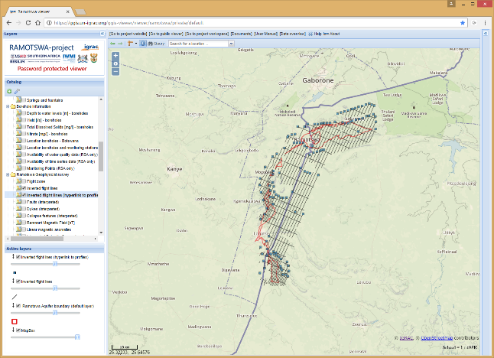
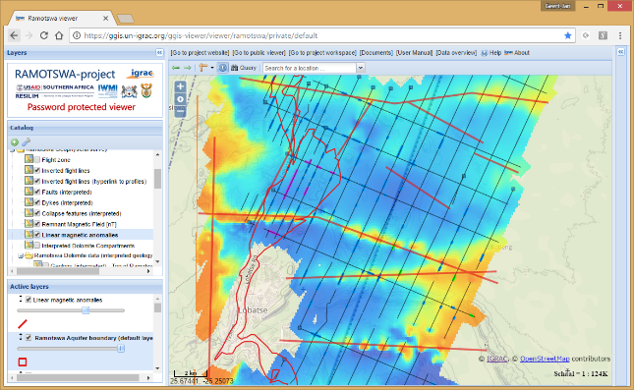
RAMOTSWA Joint Information Management System (RIMS) – A tool for improving groundwater management cooperation
RIMS is a GIS-based online viewer, which allows visualising data for easy understanding (public & p-protected view)
Developed by IGRAC
RIMS is harmonised and displays merged country-based data on groundwater as well as socio-economics and environment
Creates foundation for optimal, systematic decision-making based on hydrologic boundaries
https://ggis.un-igrac.org/ggis-viewer/viewer/ramotswa/public/default

Slide 8
RAMOTSWA Phase 2 - Objectives
Assess the feasibility and best options for Managed Aquifer Recharge (MAR) for securing the buffer and controlling the water quality, using wastewater, flood and/or storm water
Assess the feasibility and best options for small-scale irrigation development (ag-water solutions)
Develop tools for joint and harmonized management and monitoring of the groundwater resources, aligned with national water resources management processes and taking into account
  present and future climate, and
  demographic changes
Enhance national and cross-border dialogue and cooperation on the Ramotswa Aquifer and encourage international cooperation on transboundary aquifers in the SADC region
Contribute towards development of human and institutional capacity for shared and harmonized management and monitoring of the groundwater resources

Slide 9
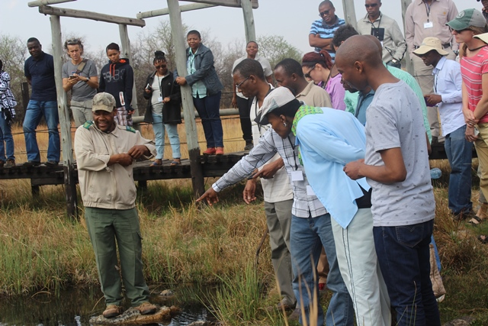
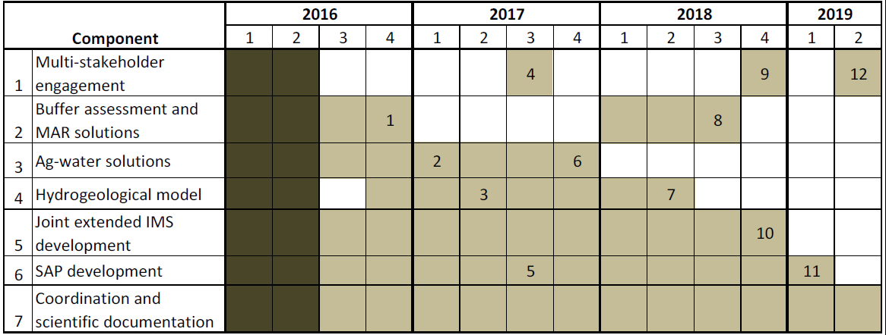
RAMOTSWA Phase 2 - COMPONENTS
Hydrogeological modelling
  Conceptual model
  Recharge, withdrawal
MAR potential assessment
  Sites, applications, water sources
Ag-Water Solutions
  Introducing technologies
RIMS expansion
  Expansion, ownership & sustainability
Joint Strategic Action Plan (SAP)

Slide 10
RAMOTSWA Phase 2 - Activities
Hydrogeological Modelling
Provide understanding of the aquifer properties as well as boundary conditions
Understand the aquifer behaviour in terms of:
  Recharge
  Flow
  Storage
  Transport process
Managed Aquifer Recharge (MAR) Solutions
Identify and map the potential for different MAR applications
  MAR potential map(s)
Identify water sources
Identify best option (economic and social feasibility)

Slide 11
RAMOTSWA2 - Activities
Ag-water Solutions
Contribute to the capacity development of smallholder farmers towards sustainable use of the groundwater resource by:
  Identifying and testing the most appropriate agricultural water management solutions
  Generating suggestions for out-scaling such solutions
  Addressing social inequalities and other constraints to agricultural production systems
Joint Ramotswa Information Management System (RIMS)
Improve, enhance and harmonise data
Capacitate RIMS managers
Long-term management
  Widely advertising
  Institutionalizing (DWA & DWS)
  Formalising the RIMS

Slide 12
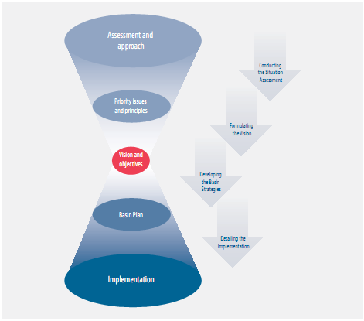
RAMOTSWA2 - Activities
Training
Training and capacity enhancement
  Training workshops
  Institutionalizing the RIMS
  Groundwater monitoring
Joint Strategic Action Plan (SAP)
Develop joint, mutually-agreed vision and framework
Set actions to improve conditions in the aquifer area
  Elaborate and prioritise particular actions and investments
Iterative process with partners and stakeholders

Slide 13
Main Achievements
  Strengthening cross-border dialogue including engagements with the Joint Permanent Technical Committee (JPTC) and Limpopo Watercourse Commission (LIMCOM)
    Inception workshop held in June 2017 to look into project work plans, develop working groups for each component, advance Ramotswa Advisory Committee and provide updates to the Strategic Action Plan
    Presentations have been made to the Joint Permanent Technical Committee (JPTC) between Botswana and South Africa, and to the Limpopo Watercourse Commission (LIMCOM) on overall project objectives and proposed Advisory Committee
    Recognition of the Ramotswa project by the JPTC, thus allowing for standing agenda item

Slide 14
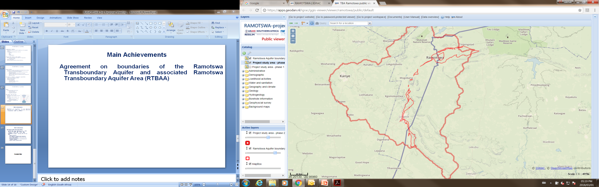
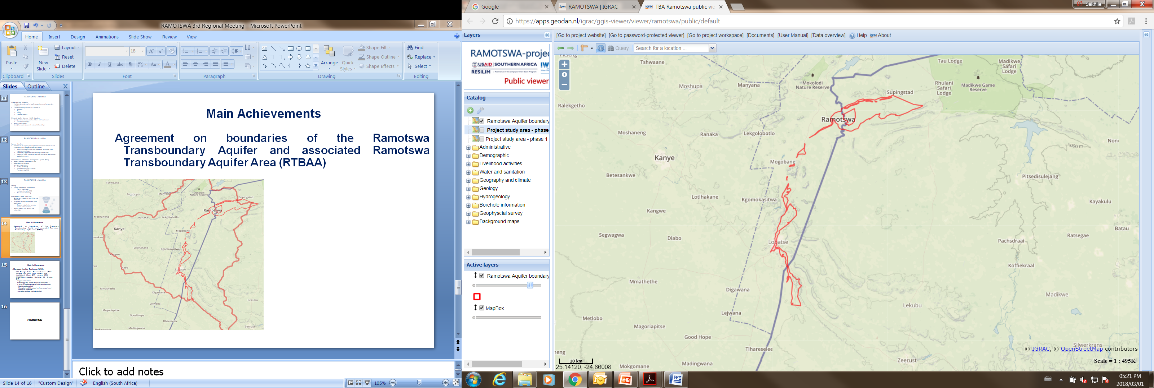
Main Achievements
  Agreement on boundaries of the Ramotswa Transboundary Aquifer and associated Ramotswa Transboundary Aquifer Area (RTBAA)

Slide 15
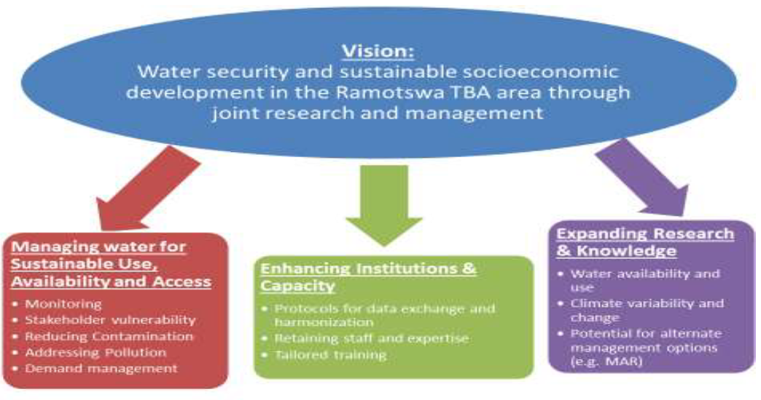
Main Achievements
  Stakeholder Engagement activities
    Joint Strategic Action Plan (SAP) consultations held from March 2017 to January 2018 with DWA (Botswana) and DWS (RSA), and these included other stakeholders looking at the joint vision and framework and elaborating on specific actions of the three components

Slide 16
Main Achievements
  Managed Aquifer Recharge
  Review and synthesize MAR practice in Africa
    More than 40 case studies from eight African studies obtained from the Global MAR Portal
    There are good examples of more than 30 of MAR practice in Southern and Northern Africa
  Develop MAR Suitability Map for Ramotswa Transboundary Aquifer Area
    MAR suitability assessment was carried out by applying a Multi-Criteria Analysis using Geographic Information System (GIS), to enable initial assessment MAR in the Ramotswa transboundary Aquifer Area (RTBAA) and support the follow-up work of MAR feasibility assessment using hydrogeological model
    MAR may not be feasible at all sites due to hydrogeological, environmental, social and cost limitations.
    52% of Ramotswa Aquifer Flight Area are suitable for MAR
    About 26% of the Ramotswa Aquifer Flight Area falls in the very suitable class
    The next step is a feasibility study through hydrogeological modelling

Slide 17
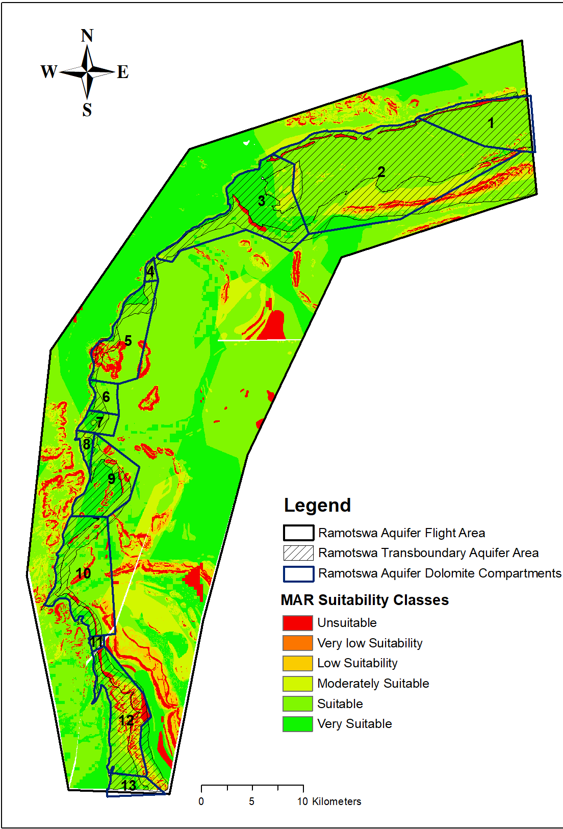

Slide 18
Main Achievements
Hydrogeological Modelling
Steady-state hydrogeological model was developed using MODFLOW 2005 in MODELMUSE modelling environment, on Compartment 3.
The modelled area covers a 61 km² compartment that encompasses the Ramotswa village and wellfield area.
The model is calibrated against average water level data observed during the period of 2000-2012, NO pumping during this period.
Results: Model produced;
  Comparable groundwater gradient with the overall regional groundwater flow direction
  Diffuse Recharge from rainfall estimated at 28 mm/day
  Focused Recharge is almost twice of diffuse Recharge rate
  Approximately 80% of the recharge entering the aquifer exits as Groundwater Evapotranspiration
  Recharge estimated by the model suggests good groundwater potential.

Slide 19
Main Achievements
Ag-Water Solutions
Three Irrigation Schemes were selected and evaluated
Testing of water sensing technologies
Training of farmers to operate and interpret the technologies in selected plots

Slide 20
Main Achievements
Strategic Action Plan
  Identified more than 100 actions that can improve water management in the RTBAA
  Institutional framework was compatible with these
  More than one-third of these actions were regarded as low hanging fruit – actions which hold hope of implementation in the near-term at minimal expense.
  Of these actions half of them were judged to be transboundary in nature
  There were more short-term in two frameworks; namely;
    institution and capacity and
    expanding research knowledge

Slide 21
The End…
I THANK YOU !
KE A LEBOGA!

