Slide 1
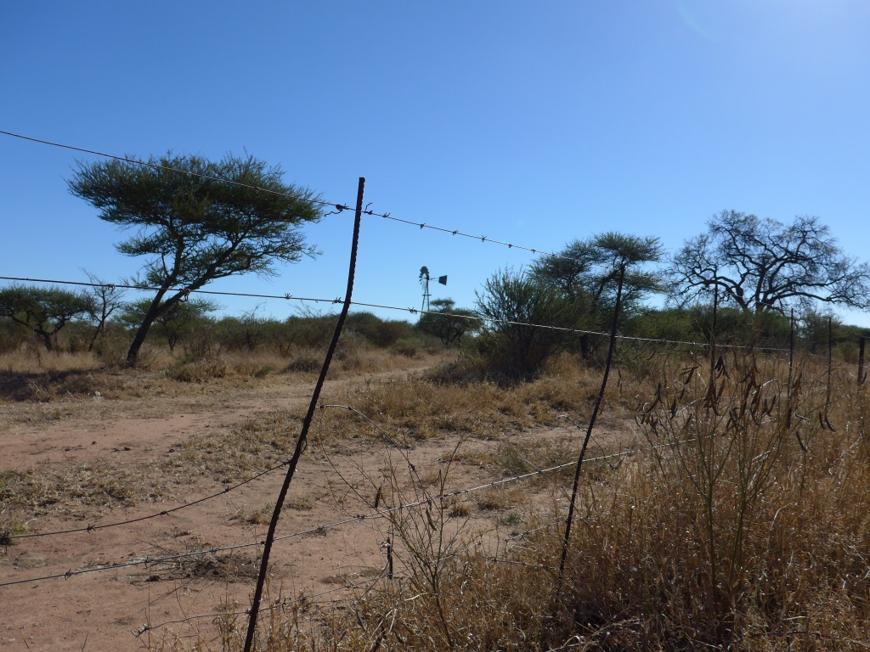







The RAMOTSWA Project:
Overview & Links to Workshop Objectives
Jonathan Lautze (IWMI)
Transboundary Aquifer Workshop, 6 March, Gaborone

Slide 2
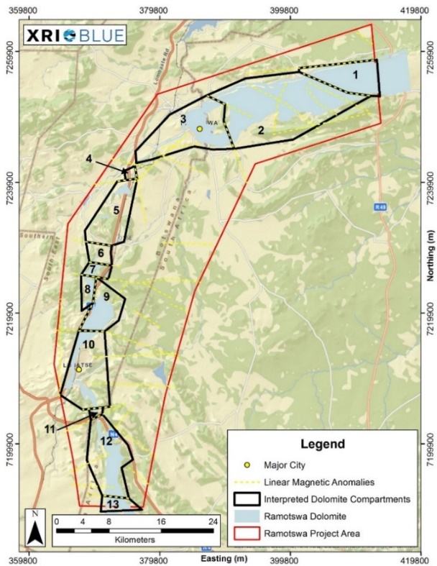
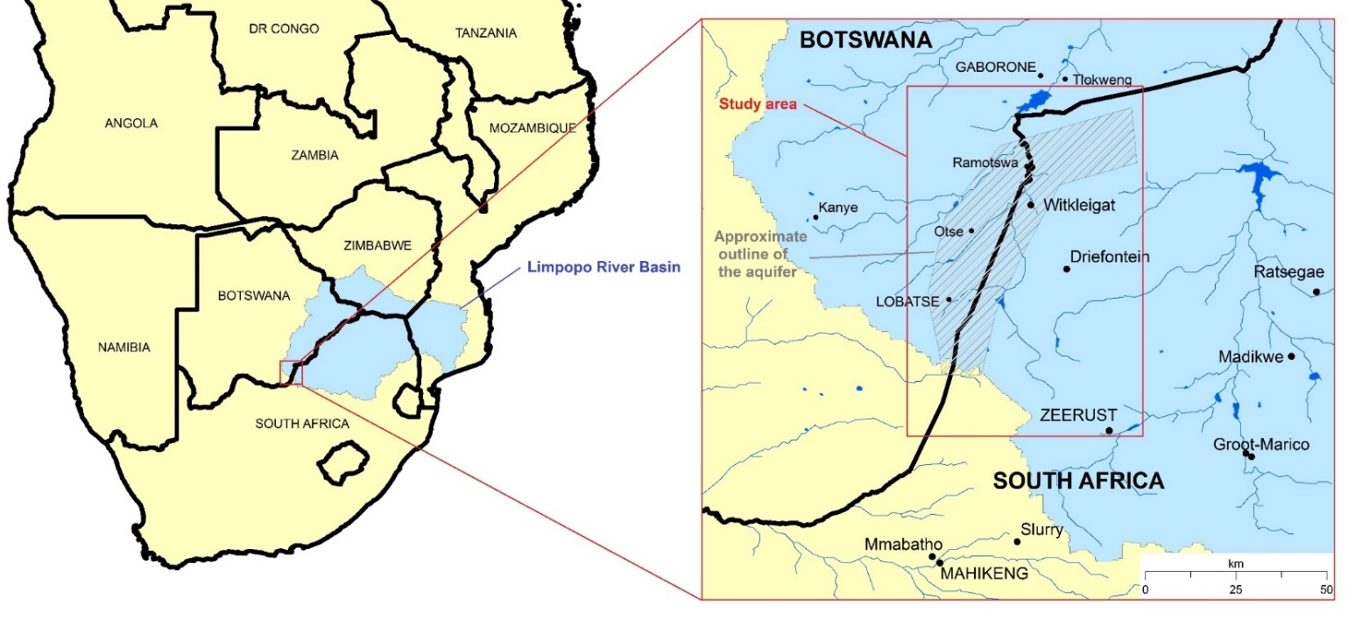
Ramotswa Aquifer – Limpopo Basin
Aims: To generate and use scientific/technical knowledge to foster joint management of the Shared Ramotswa Aquifer

Slide 3

RAMOTSWA: Phase 1 (2015-2017)
Baseline Report
+/-Year-long effort to collect, compile, synthesize hydrogeological and socio-economic data in the RBTAA
Distilled data into five key issues
Geophysical Work
Identification of the faults, dikes and collapse features
Tentative delineation of dolomite compartments
RIMS
RIMS is a GIS-based online viewer, which allows visualising data for easy understanding

Slide 4
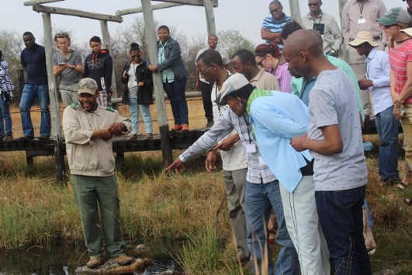
RAMOTSWA: Phase 2 (2017-2019)
Major components of phase 2
Hydrogeological modelling
  Conceptual model
MAR potential assessment
  Suitability, feasibility, water sources
Ag Water Solutions
  Introducing two technologies (WFD, chameleon)
RIMS expansion
  Expansion, ownership. sustainability
Joint Strategic Action Plan

Slide 5
Moving Forward
A lot of progress, need to house this somewhere
Where does transboundary GW fit?
  LIMCOM
  JPTC
  Ramotswa-focused Committee
Or how does transboundary GW fit?
  Not an either-or
  Should Ramotswa be covered in different ways by each of these organizations? (if yes, how?)
Questions not unique to Ramotswa
Hopefully this workshop can begin to address these questions

Slide 6
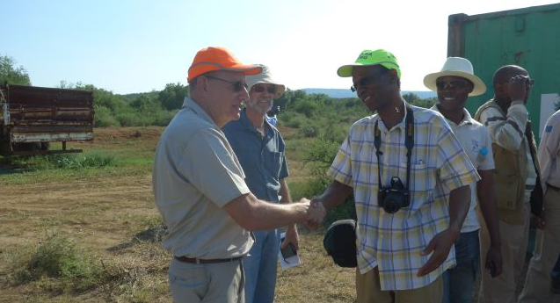
Thank You
Project website: http://ramotswa.iwmi.org/

