Slide 1
TRANSBOUNDARY WATERS COOPERATION AND THE SDGs
3rd Regional Meeting on Tools for the Sustainable Management of Transboundary Aquifers
6-9 March 2018
Gaborone, Botswana
Tales Carvalho Resende
UNESCO International Hydrological Programme (IHP)

Slide 2
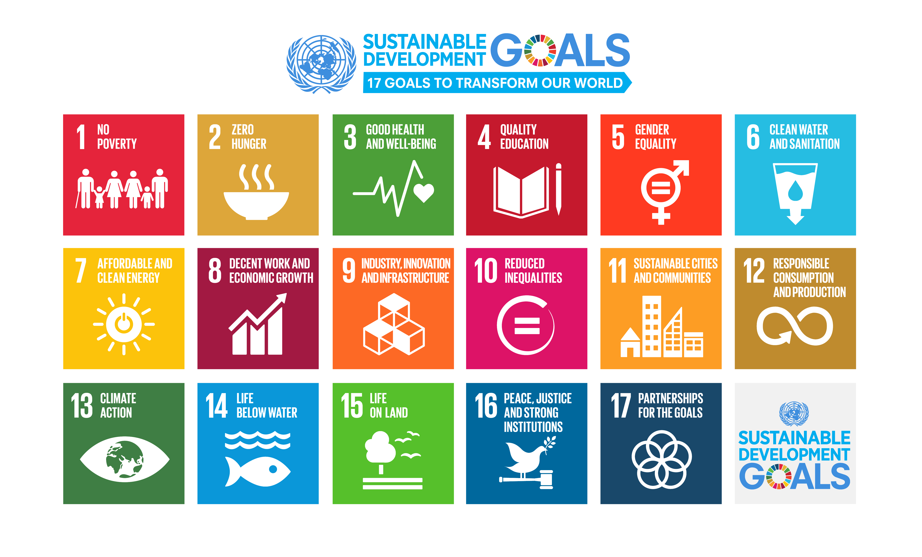
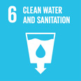
The 2030 Agenda for Sustainable Development:
In September 2015, global heads of state gathered in New York to adopt the 2030 Agenda for Sustainable Development.
The Agenda includes 17 goals for the world’s future, through 2030 and 169 targets
A dedicated goal on water and sanitation (SDG 6) calls on states to “Ensure availability and sustainable management of water and sanitation for all”.
Notes:
The 2030 to adresses challenges of 21st century: SDGs are about finding solutions and IHP enhance capacity of Member States to better adresse water security and to implement SDgs.

Slide 3
SDGs Process 2015-2017
2015
Establishment of the Inter-agency Expert Group on SDG Indicators (IAEG-SDGs) by the UNSD to develop an indicator framework for the monitoring of the Goals and targets ‘
UNESCO and UNECE were appointed in 2015 by IAEG-SDGs as co-custodian agencies for the monitoring of the SDG 6 - Target 5 - Indicator 6.5.2. and were requested to formulate the indicator and prepare the methodology to measure it
2016
UNESCO and UNECE : Formulation of the indicators under the UN-Water umbrella
2017
The global indicator framework adopted by the UN General Assembly.

Slide 4
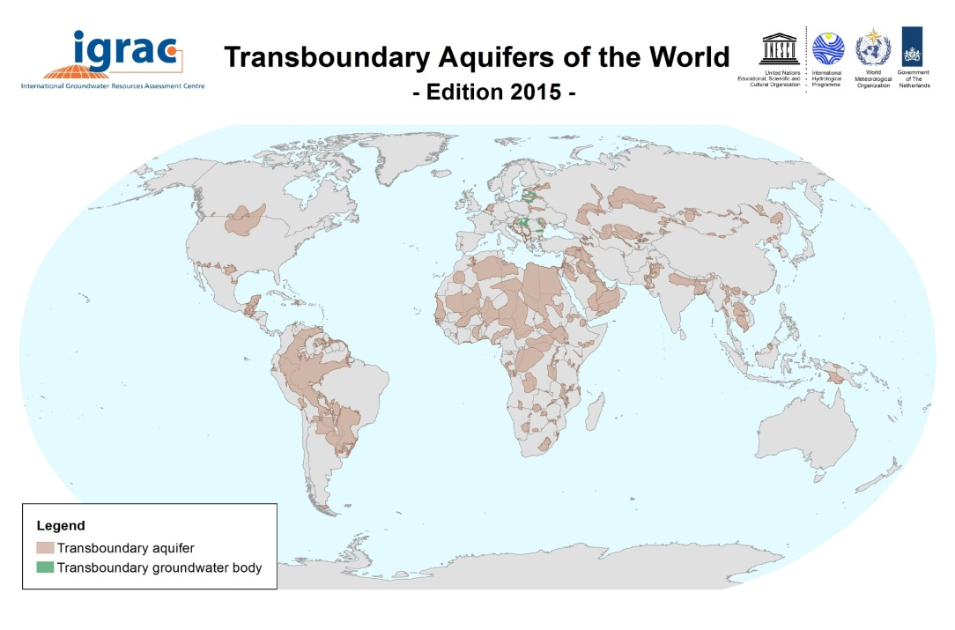
Target 6.5: By 2030, implement integrated water resources management at all levels, including through transboundary cooperation as appropriate.
Indicator 6.5.2: Proportion of transboundary basin area with an operational arrangement for water cooperation.
RATIONALE
Transboundary Aquifers (UNESCO IHP)
Most of the world’s water resources are shared: UNESCO IHP has inventoried 592 transboundary aquifers
Around 300 transboundary lake and river basins cover nearly one half of the Earth’s land surface and account for an estimated 60% of global freshwater
Approximately 90% of the world’s population lives in countries that share basins.

Slide 5
SDG Indicator 6.5.2
SDG 6 - Target 5:
By 2030, implement integrated water resources management at all levels, including through transboundary cooperation as appropriate
Indicator 6.5.2:
The indicator is defined as: the “Percentage of transboundary basin area (surface water and aquifers) with an operational arrangement for transboundary cooperation”
.

Slide 6
SDG Indicator 6.5.2
Criteria for verifying whether the cooperation arrangement is operational:
1. Existence of a joint body, joint mechanism or commission for transboundary cooperation;
2. Regularity (at least once per year) of formal communication in form of meetings (either at the political or technical level);
3. Existence of joint or coordinated water management plan(s), or of joint objectives;
4. Regular exchange of information and data (at least once per year)
If any of the conditions is not met, the cooperation arrangement cannot be considered operational.

Slide 7
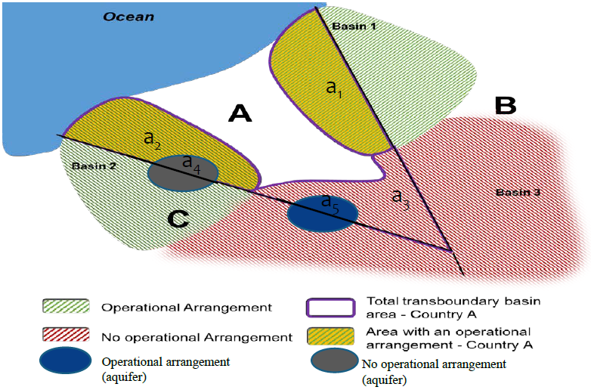
SDG Indicator 6.5.2
Indicator for country A =
(a1 + a2 + a5) / (a1 + a2 + a3 + a4 + a5) x 100%
a1 + a2 + a3: Total surface area of transboundary basins of rivers & lakes (km²)
a4 + a5: Total surface area of transboundary aquifers (km²)
a1 + a2: Total surface area of transboundary basins of rivers & lakes managed by operational arrangements (km²)
a5: Total surface area of transboundary aquifers covered by operational arrangements (km²)

Slide 8
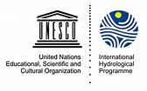
Process: 2017-2018
2017
First round of reporting SDG 6.5.2:
- Questionnaires were sent to 153 MS sharing surface water and groundwater resources
- Feedbacks with Focal Points
January: Finalization of validation process
February: All data received and validated by 16th of February will be sent to the UNSD to be included in the GLOBAL SDG’s Data Base -Preparation of the UN Secretary General’s SDG report
July: Presentation of the UN Secretary General 2018 SDG report at the High-Level Political Forum "Transformation towards sustainable and resilient societies“
July - August: UNESCO-UNECE report on 6.5.2
2018

Slide 9
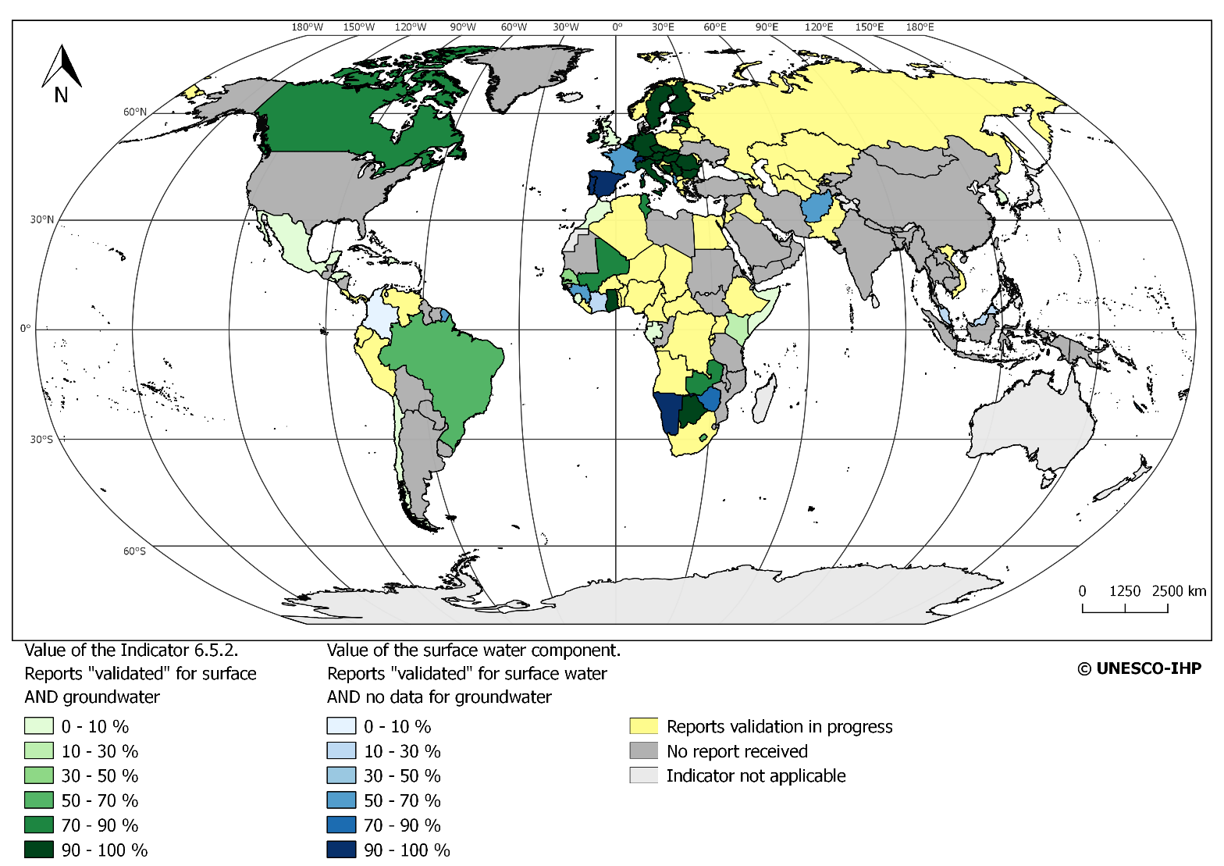
Process: 2017-2018
Among the 153 countries sharing transboundary waters 103 responded to the questionnaire
Number of validated reports:
- 60 for Surface water and Groundwater
- 79 for Surface Water
- 62 for Groundwater
Notes:
Lessons learned
High participation in the exercise despite the sensitive topic, but gaps in Asia and Latin America
Validation requires intensive engagement with countries and shows needs for capacity building on the indicator
Build capacity on groundwater is a major challenge and focus of future work (UNESCO)
Reporting has already triggered follow-up actions in countries

Slide 10
Process: 2017-2018
Lessons learned
High participation in the exercise despite the sensitive topic
Validation requires intensive engagement with countries and shows needs for capacity building on the indicator
Build capacity on groundwater is a major challenge and focus of future work (UNESCO)
Reporting has already triggered follow-up actions in countries
Notes:
Lessons learned
High participation in the exercise despite the sensitive topic, but gaps in Asia and Latin America
Validation requires intensive engagement with countries and shows needs for capacity building on the indicator
Build capacity on groundwater is a major challenge and focus of future work (UNESCO)
Reporting has already triggered follow-up actions in countries

Slide 11
Results from the SADC region
12 SADC countries identified* with international river basins and / or international groundwater systems.
*Source: Map River and Groundwater Basins of the World (2012, WHYMAP – BGR UNESCO)
8 countries responded to the questionnaire:
8 countries providing info on river & lake basins
5 countries on aquifers.
Number of validated reports: 5
Calculated SDG 6.5.2 for Angola, Botswana, Lesotho, Namibia, Zambia
3 reports have insufficient data to calculate SDG 6.5.2 due to missing data on shared groundwater systems;
4 countries have not (yet) responded
Notes:
Lessons learned
High participation in the exercise despite the sensitive topic, but gaps in Asia and Latin America
Validation requires intensive engagement with countries and shows needs for capacity building on the indicator
Build capacity on groundwater is a major challenge and focus of future work (UNESCO)
Reporting has already triggered follow-up actions in countries

Slide 12
Results from the SADC region
- SADC Regional Average SDG 6.5.2 = 80%
- 8 countries report cooperation on shared river basins
- 3 country reports cooperation on groundwater
- 2 countries have no operational arrangement (=0%) for transboundary cooperation on groundwater
SW = surface water / GW = groundwater / SDG = SDG 6.5.2 indicator value

Slide 13
Main findings from SADC region
Lessons learned
Participation to the survey in SADC is higher then global average
Validation of data requires intensive engagement with countries and shows needs for capacity building on the indicator
Availability of information + interpretation of groundwater is a major challenge and focus of future work (UNESCO)
Reporting has already triggered follow-up actions in countries
Challenges & opportunities
Current response rate: 67%
Current rate of reports with sufficient data: 42%;
Data on groundwater cooperation is lacking; and in some cases the current form of cooperation does not meet all the criteria
For TBA aquifers, there is one specific arrangement (Stampriet Aquifer System with ORASECOM)

Slide 14
Process: 2018-2024
Indicator 6.5.2
2018-2019
In depth work with the MS.
Series of Sub-regional meetings
Technical Seminar Meeting - 153 Focal points at UNESCO HQs, Paris.
2020
January : Second round reporting- Invitation to MS
March (TBC): Comprehensive review of the indicator framework by the Statistical Commisssion (See A/RES/71/313)
2021
February: inputs to the Global SDG database and the 2018 SDG Reports Storyline
July: High-Level Political Forum with Focus on SDG 6
2024
The SDG 6 is on review each 3 years

Slide 15
SADC Focal Points
Country | Focal Points
Angola | Manuel Quintino quintmanuel@gmail.com ; Narciso Ambrosio narciso.ambrosio@inrh.gv.ao
Botswana | Tracy Molefi trsmolefi@gov.bw; Thatayaone Dedede tdedede@gov.bw
Democratic Republic of Congo | jergal2001@yahoo.fr; Georges Ilunga forourdyingplanet@gmail.com; Lungu Malutshi lungumalutshi@gmail.com; florentinmugula@gmail.com
Lesotho | Mahlalele Tlali tlalimahlalele@yahoo.com
Malawi | No Focal Point. Questionnaires sent to: opc@opc.gov.mw; rexkanjedza@gmail.com; jamesdaire@ymail.com; bandapbc@gmai.com; mission.malawi@ties.itu.int
Mozambique | No Focal Point. Questionnaires sent to: egovate@dnaguas.gov.mz; egovate@gmail.com; iolandabilaa@gmail.com
Namibia | Maria Amakali Maria.Amakali@mawf.gov.na
South Africa | Mark Bannister BannisterM@dws.gov.za; Deborah Mochotlhi MochotlhiD@dws.gov.za
Swaziland | No Focal Point. Questionnaires sent to: energyswa@realnet.co.sz larshmkhonta@gmail.com
United Republic of Tanzania | No Focal Point. Questionnaires sent to: psmw@maji.go.tz; b.mrindoko@gmail.com; sapudekambo@gmail.com; gjkisaka@yahoo.co.uk; mwakabengele@yahoo.co.uk; mission.tanzania@ties.itu.int
Zambia | Mutinta Diangamo mutinta.diangamo@mewd.gov.zm; mutintad@gmail.com
Zimbabwe | zmanyangadze@hotmail.com

Slide 16
Thank you

