Slide 1
Basics of the Stampriet Transboundary Aquifer System (STAS) numerical model
7 September 2017

Slide 2
Background
GGRETA Phase 1:
Development of a joint harmonized borehole database
GGRETA Phase 2:
Development of the STAS numerical model using open access FREEWAT platform.
Joint harmonized borehole database is crucial for groundwater modelling.
FREEWAT platform = QGIS platform that calls a MODFLOW code plug-in (i.e. data in MODFLOW is added using shapefiles and rasters).
Detailed tutorial for the utilization of the model is currently being developed.

Slide 3
Overview of the STAS

Slide 4
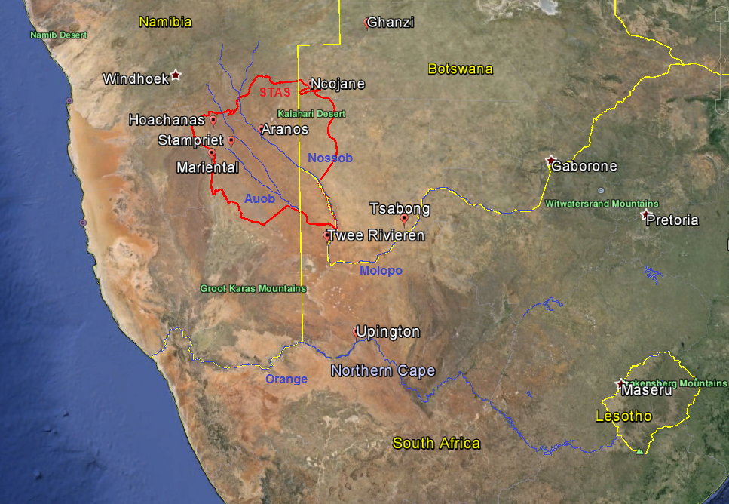
Delineation and general features of the STAS
The Stampriet Transboundary Aquifer System (STAS) stretches from Central Namibia into Western Botswana and South Africa’s Northern Cape Province, and lies within the Orange River Basin.
The STAS covers a total area of 86 647km², of which 73% of the area is in Namibia, 19% in Botswana, and 8% in South Africa.
The STAS was delineated based on the occurrence of geological formations belonging to the so-called Ecca Group within the Auob and Nossob river basins.
2 ephemeral rivers (Auob and Nossob) that never reach the Orange river

Slide 5
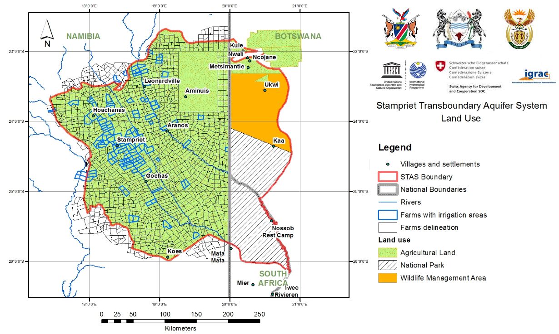
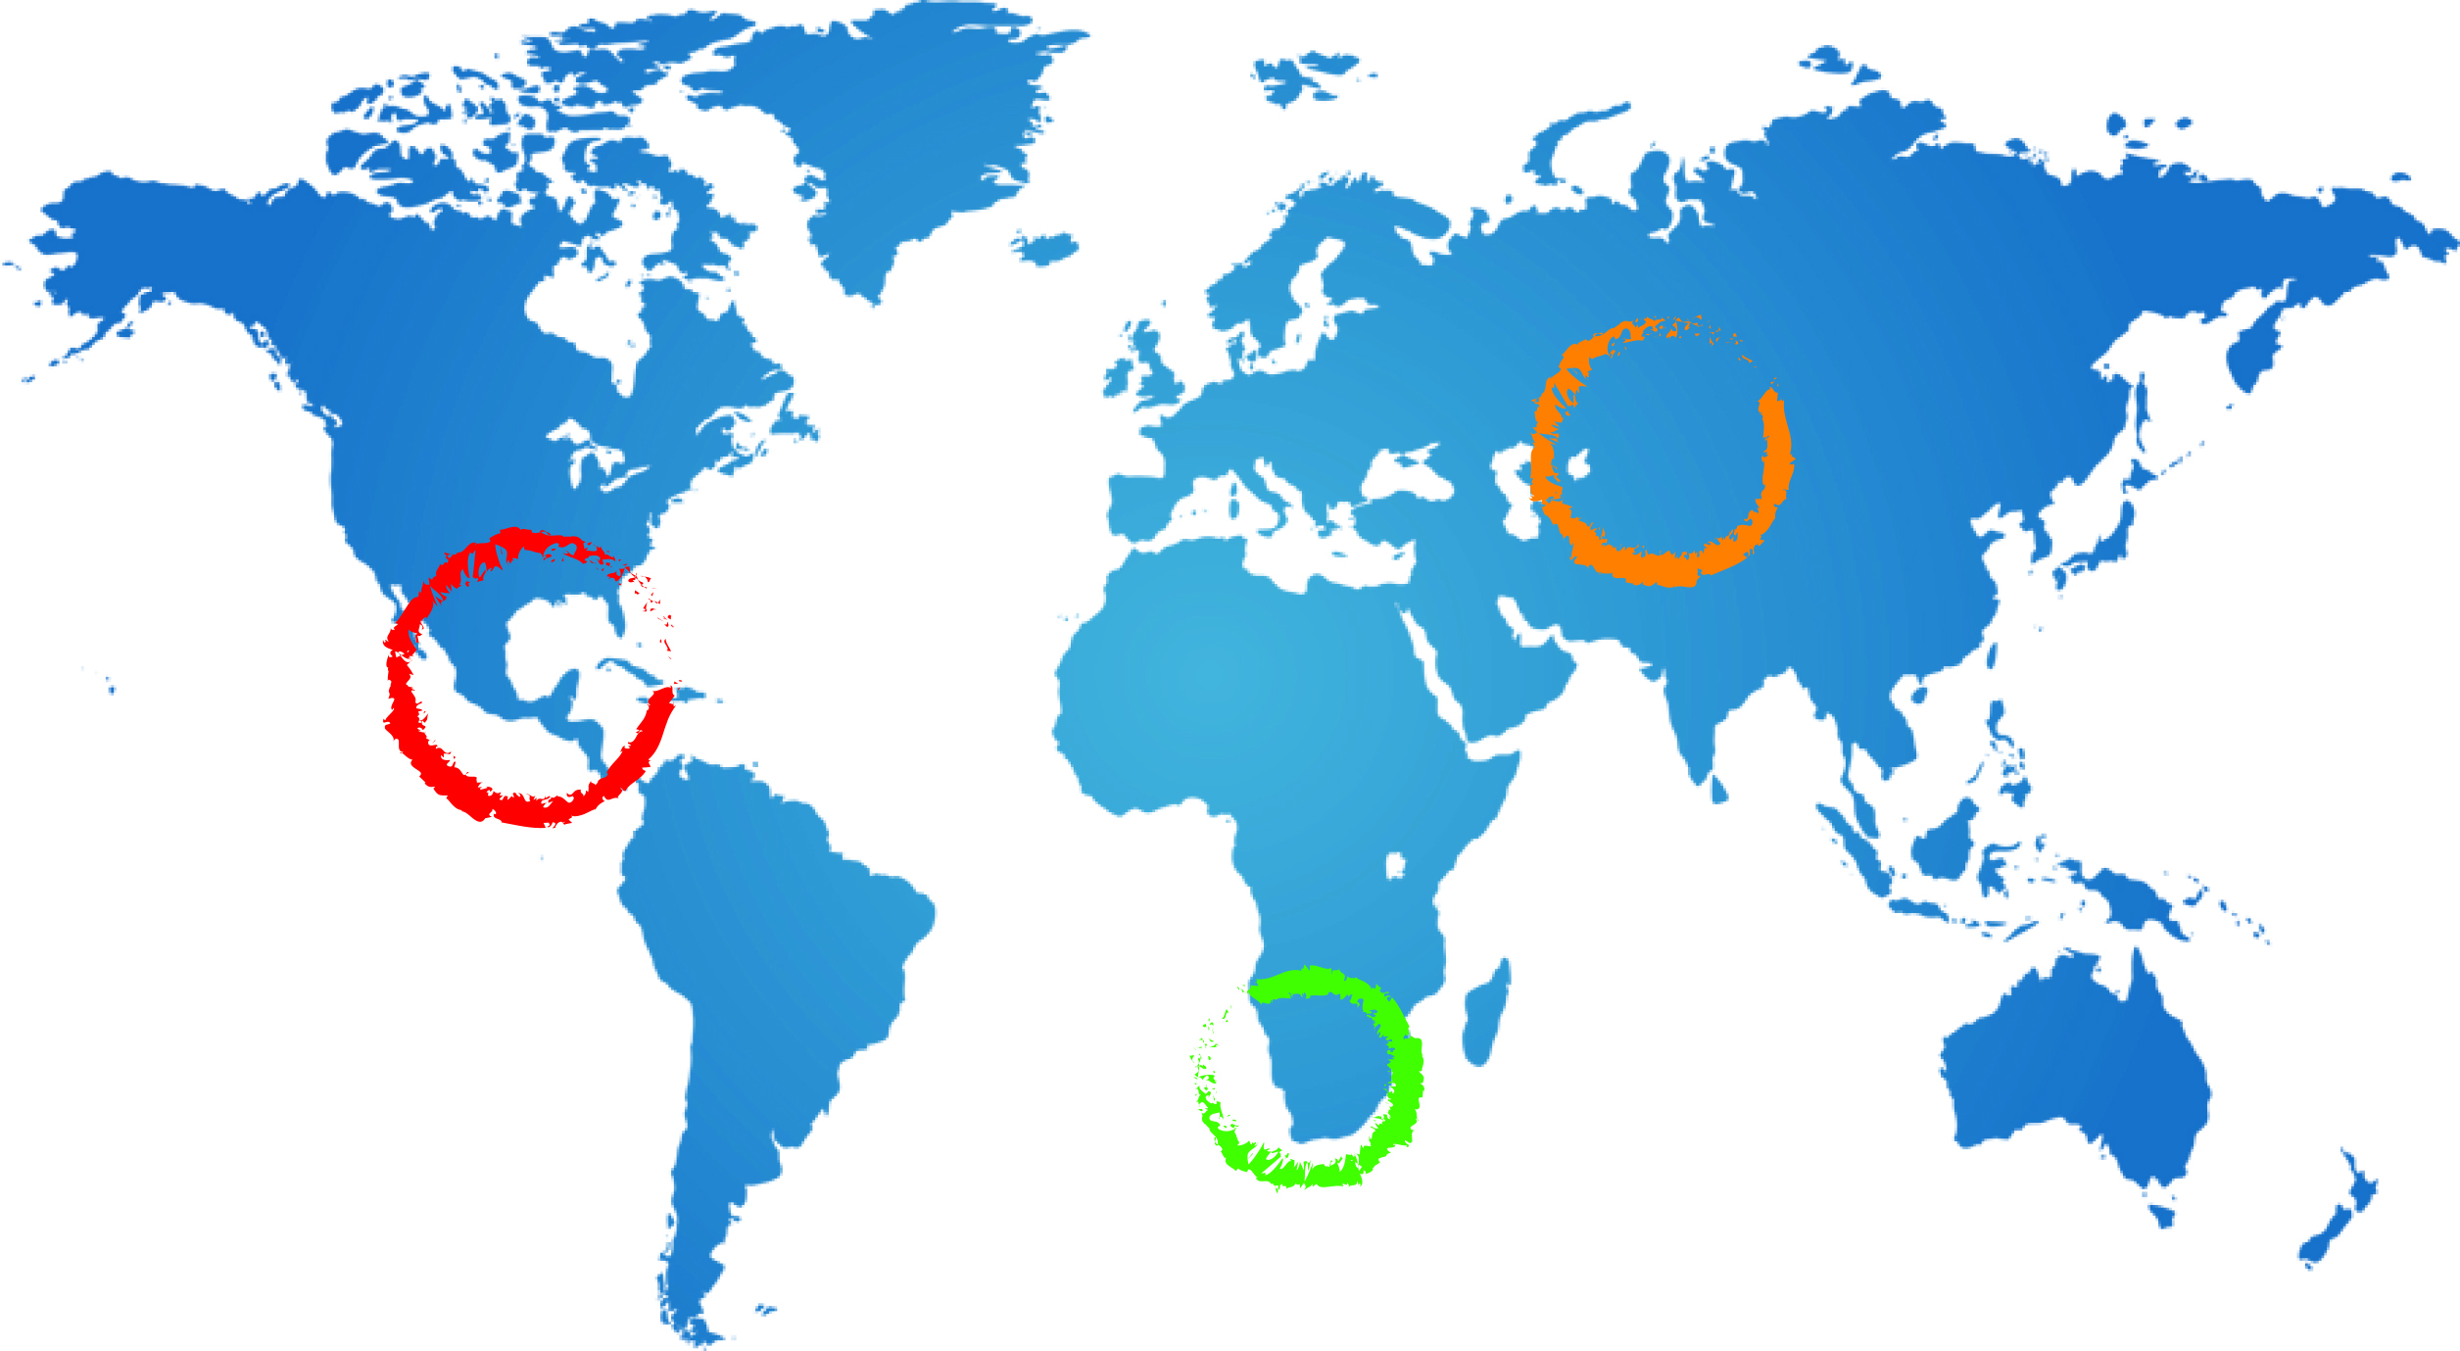
Land use in the STAS
The STAS is a large farming area with approximately 1200 farms (mostly in Namibia), out of which 80 are irrigation farms
Groundwater use: 52% irrigation, 32% stock watering, 16% domestic use
No mining and industrial activities
Area lightly populated (approximately 50 000 inhabitants)
Annual groundwater abstraction: 20Mm³ (around 70% in the Stampriet area)
5

Slide 6
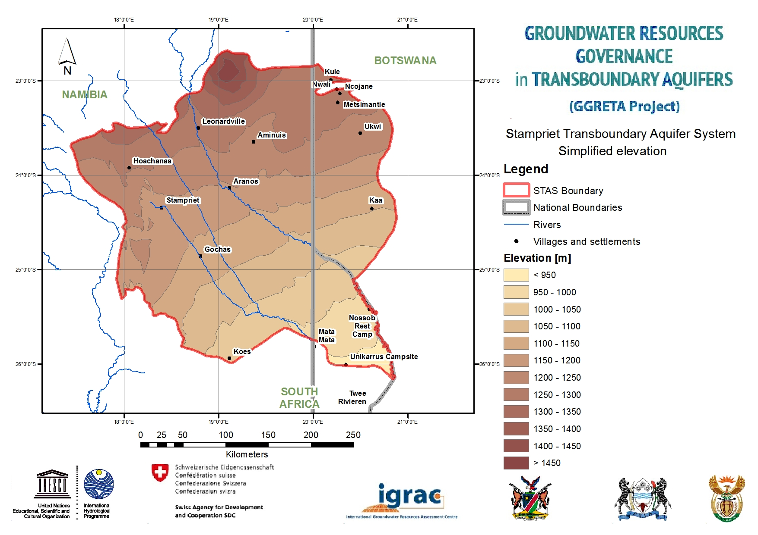
Topography
The STAS is relatively flat with an elevation gradient of 1400m to 900m above mean sea level from the northwest to the southeast
6

Slide 7
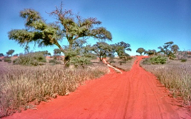
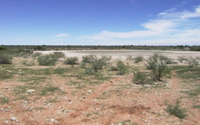
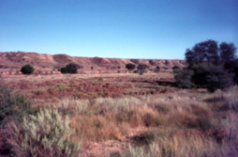
Landscapes
The STAS is characterized by various landscapes, including sand dunes in Namibia and South Africa, calcrete/sandy surface area with shrubs and in some cases thick bushes. Seasonal pans are also important features found across the STAS.
Common landscapes in the STAS: dune area stretching from the Auob to the Nossob
River (top left), calcrete/sandy surface where pans are quite common (top right),
deep cut in the Auob and Nossob Rivers (bottom center) (Source: J. Kirchner)

Slide 8
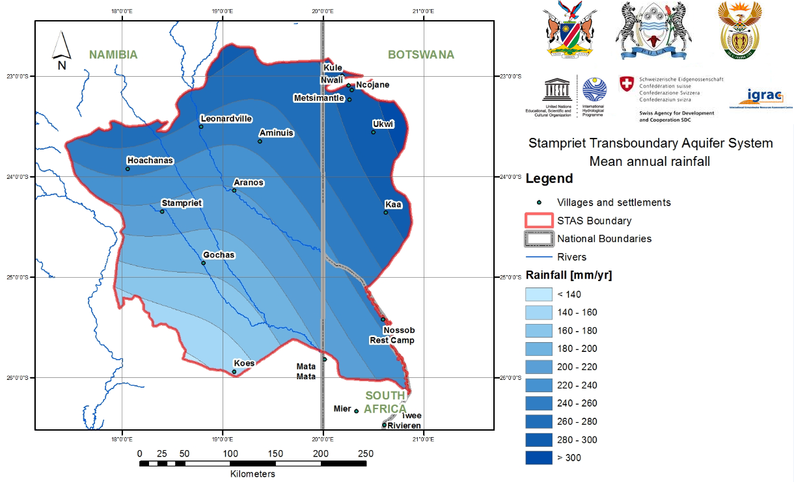
Climate
Temperature:
High temperature time fluctuates owing to the semi-arid conditions
Mean temperature: 19-22°C
Winter (July) mean minimum temperature: 1-12°C
Summer (January) mean maximum temperature: 26-36°C
Average rainfall: 150 - 310 mm/y
8

Slide 9
Groundwater occurrence
STAS = unconfined aquifers (Kalahari) + Confined aquifers (Auob and Nossob)
STAS is not hydraulically connected to the Orange River
STAS = unconfined aquifers (Kalahari) + Confined aquifers (Auob and Nossob)
STAS is not hydraulically connected to the Orange River
Kalahari aquifers
Impermeable layer
Auob aquifer
Impermeable layer
Nossob aquifer
Basement
Unconfined
Confined
Confined

Slide 10
Volumes abstracted

Slide 11
Groundwater occurrence
Kalahari aquifers:
Hundreds of individual aquifers more or less loosely connected forming an unconfined aquifer system
Thickness varies from 0 to 250m although it generally does not exceed 100m.
Transmissivity values range from 0.1 (STAS south-east area) to 6 (STAS central area) and 30m2/d (STAS south-west area)

Slide 12
Groundwater occurrence
Auob aquifer:
Confined aquifer with isolated outcrops in the extreme western part of the STAS in Namibia
Depths varying from 0 to over 300m.
Thickness varies from 0 to 150m.
Transmissivity values generally range from 0.1 to 200m2/d with maximum values going up to 1240m2/d (STAS north-west area)

Slide 13
Groundwater occurrence
Nossob aquifer:
Confined aquifer with isolated outcrops in the extreme western part of the STAS in Namibia
Depths varying from 0 to more than 400m
Thickness varies from 0 to 60m in Namibia and from 0 to 20 in South Africa
Transmissivity values generally range from 0.1 to 100m2/d with maximum values going up to 1480m2/d (STAS central area)

Slide 14
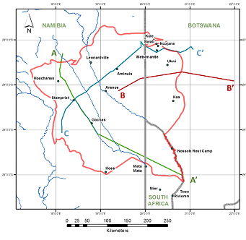
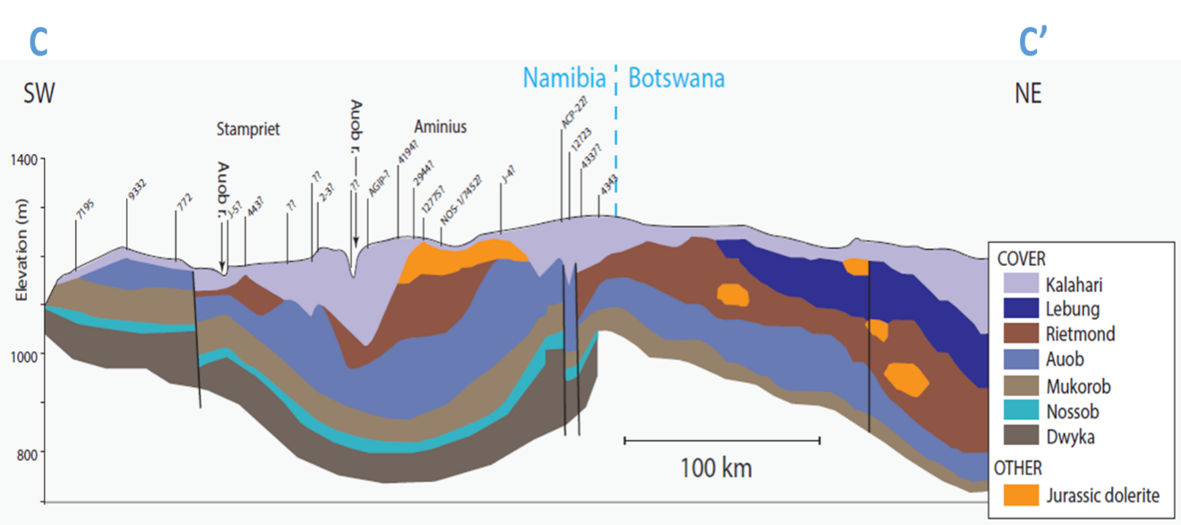
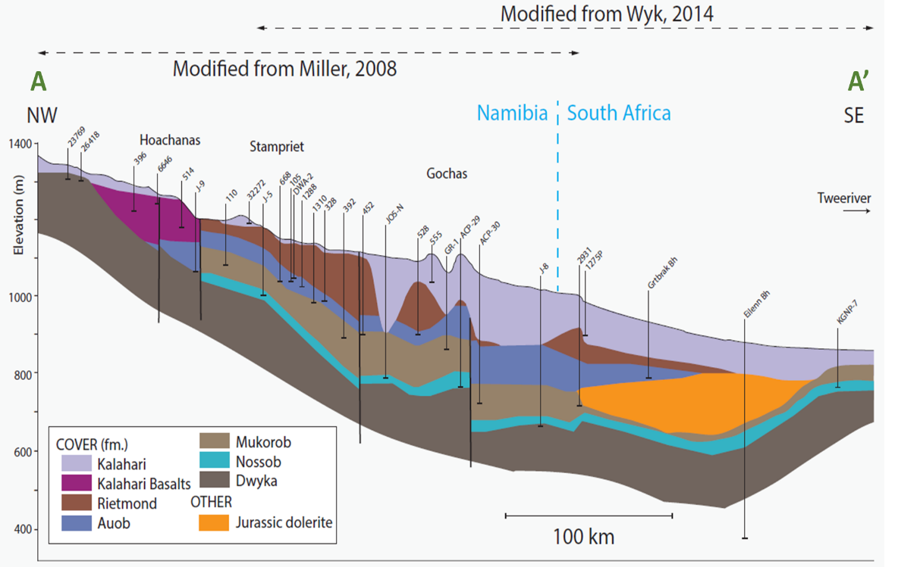
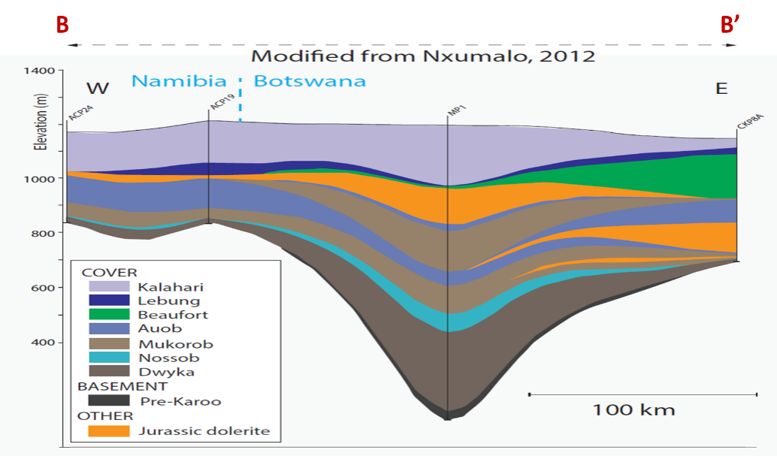
Cross-sections
14

Slide 15
Conceptual model
Recharge:
Kalahari aquifers = 0.5% of rainfall (3% of rainfall in heavier rainfall events)
Auob aquifer = almost non-existent (3% of rainfall in heavier rainfall events)
Nossob aquifer = almost non-existent (fossil water)
Discharge:
Kalahari aquifers = evaporation
Auob and Nossob aquifers = draining into Kalahari aquifers (Salt Block)
Groundwater flow:
Auob and Nossob aquifers = from northwest to southeast
It usually takes 30 000 years for water to flow from recharge areas to discharge areas

Slide 16
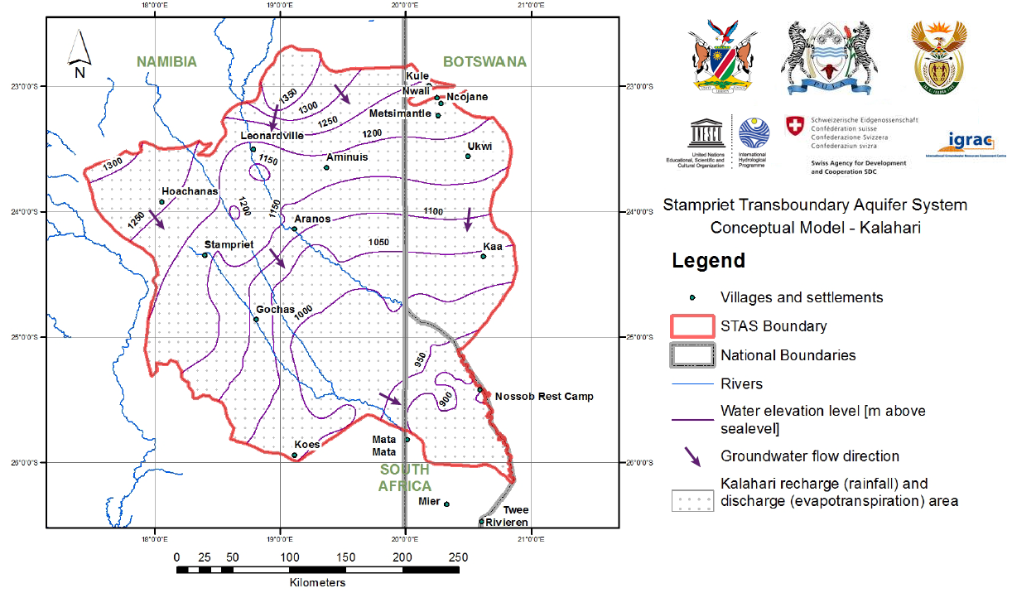
Conceptual model
Kalahari aquifers (unconfined):
16

Slide 17
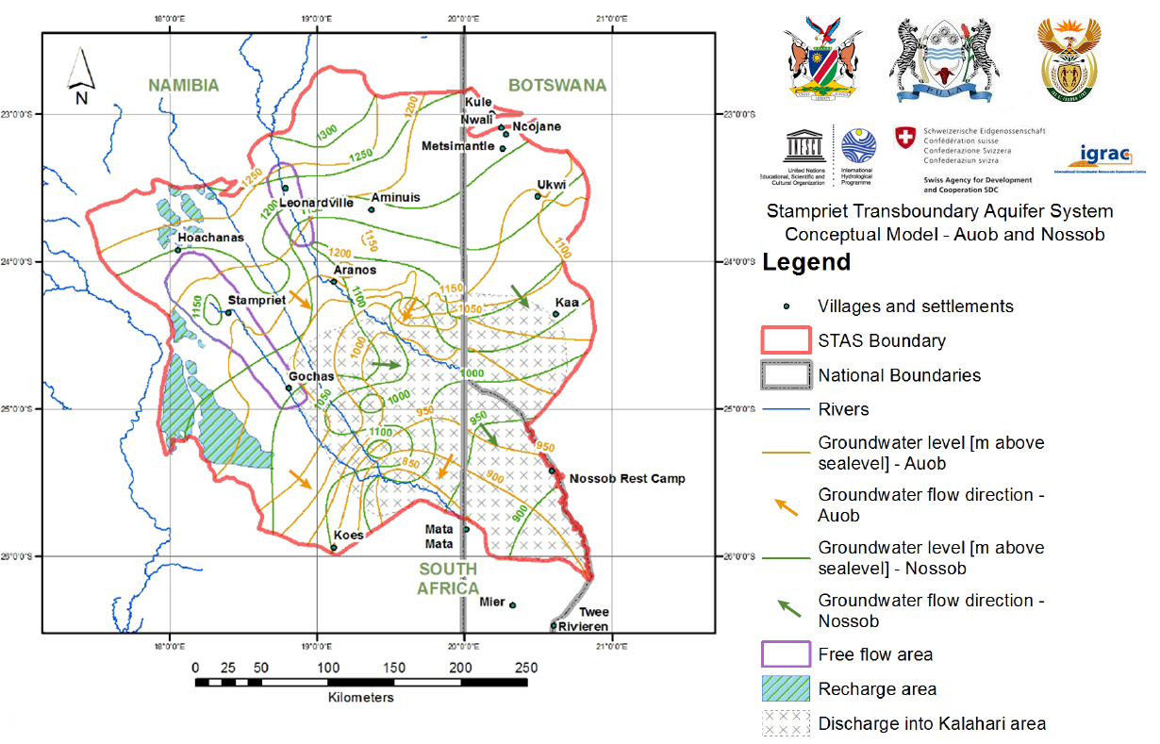
Conceptual model
Auob and Nossob aquifers (confined):
17

Slide 18
Borehole data for modelling

Slide 19
Borehole data
Joint database of 6167 boreholes
5844 in Namibia (Hydrocensus, 2000; JICA, 2002; Tredoux, 2002)
155 in South Africa (Van Wyk, 1987; DWS, 2015)
168 in Botswana (Matsheng, 2008; DWA, 2015)
Information on water quality, yield, depth, transmissivity, porosity.

Slide 20
Available maps
KALAHARI | AUOB | NOSSOB
1.1. Location boreholes | 2.1. Location boreholes | 3.1. Location boreholes
 | 2.2. Free flow area | 3.3. Free flow area
1.2. Recharge and discharge areas | 2.3. Recharge area | 3.3. Recharge area
 | 2.4. Discharge area | 3.4. Discharge area
1.3. Groundwater level [m above sea level] | 2.5. Groundwater level [m above sea level] | 3.5. Groundwater level [m above sea level]
1.4. Borehole yield [m3/h] | 2.6. Borehole yield [m3/h] | 3.6. Borehole yield [m3/h]
1.5. Water strike [m above sea level] | 2.7. Water strike [m above sea level]
1.6.1. Total dissolved solid [mg/l] - boreholes | 2.8.1. Total dissolved solid [mg/l] - boreholes | 3.7.1. Total dissolved solid [mg/l] - boreholes
1.6.2. Total dissolved solid [mg/l] | 2.8.2. Total dissolved solid [mg/l] | 3.7.2. Total dissolved solid [mg/l]
1.7.1. Nitrate [mg/l] - boreholes | 2.9.1. Nitrate [mg/l] - boreholes | 3.8.1. Nitrate [mg/l] - boreholes
1.7.2. Nitrate [mg/l] | 2.9.2. Nitrate [mg/l] | 3.8.2. Nitrate [mg/l]
1.8.1. Fluoride [mg/l] - boreholes | 2.10.1. Fluoride [mg/l] - boreholes | 3.9.1. Fluoride [mg/l] - boreholes
1.8.2. Fluoride [mg/l] | 2.10.2. Fluoride [mg/l] | 3.9.2. Fluoride [mg/l]
1.9.1. Sulphate [mg/l] - boreholes | 2.11.1. Sulphate [mg/l] - boreholes | 3.10.1. Sulphate [mg/l] - boreholes
1.9.2. Sulphate [mg/l] | 2.11.2. Sulphate [mg/l] | 3.10.2. Sulphate [mg/l]
1.10.1. Water quality unsuitable for human consumption | 2.12. Water quality unsuitable for human consumption | 3.11.1. Water quality unsuitable for human consumption
1.10.2. Water quality unsuitable for stock watering |  | 3.11.2. Water quality unsuitable for stock watering

Slide 21
Introduction to MODFLOW

Slide 22
Introduction to MODFLOW
MODFLOW = Modular computer code that solves the groundwater flow equation

Slide 23
Introduction to MODFLOW
Modular:
Modules grouped into packages that perform calculations either specific to the behavior of a geohydrologic feature or a numerical modeling task
Packages allow:
Examination of specific hydrologic features independently
Facilitates development of additional capabilities
Main packages to be considered for the STAS numerical model:
WEL – well package (“the abstraction package”): user introduces the locations and flow rates of wells.
RCH – recharge package: user introduces recharge rates and locations.

Slide 24
Introduction to MODFLOW
Groundwater flow equation:
The equation is solved in grid cells (i.e., N grid cells = N equations)
Grid cells can be active (closed circle) and inactive cells (open circles)
Values assigned to grid cells represent the geometry, aquifer properties, boundary conditions, initial conditions, and stresses on a groundwater system to build a representation of field conditions.

Slide 25
Introduction to MODFLOW
BASIC INPUT ITEMS INCLUDE:
Grid
Time stepping
Hydraulic parameters
Boundary Conditions
Stresses
Solution parameters

Slide 26
Introduction to MODFLOW
BASIC OUTPUT ITEMS:
Hydraulic Heads
Drawdown
Flow rates
Mass Balance
Optional info at specified times
Iteration information
Underscore files describing various model inputs/outputs
Binary files containing output in compressed form

Slide 27
The STAS numerical model

Slide 28
STAS Conceptual Model
The aquifer system is dominated by storage
Limited inflow from northern and western areas
Outflow in the southern area

Slide 29
From conceptual to numerical model: Defining the grid
123 225 km² active domain
25 km² square cells
5 layers

Slide 30
Defining layer’s thickness
Before March 2017: Layers’ thickness from JICA Model
After March 2017: Revision of layer’s thickness based on new stratigraphy data provided by borehole completion reports from Namibia and Botswana
Production of new cross sections based on Kriging interpolation

Slide 31
Cross-sections (GGRETA 1)
31

Slide 32
New cross-sections

Slide 33
New cross-sections (A-A’)

Slide 34
New cross-sections (B-B’)

Slide 35
New cross-sections (C-C’)

Slide 36
New cross-sections (D-D’)

Slide 37
New cross-sections (E-E’)

Slide 38
New cross-sections (F-F’)

Slide 39
New cross-sections (G-G’)

Slide 40
New cross-sections (H-H’)

Slide 41
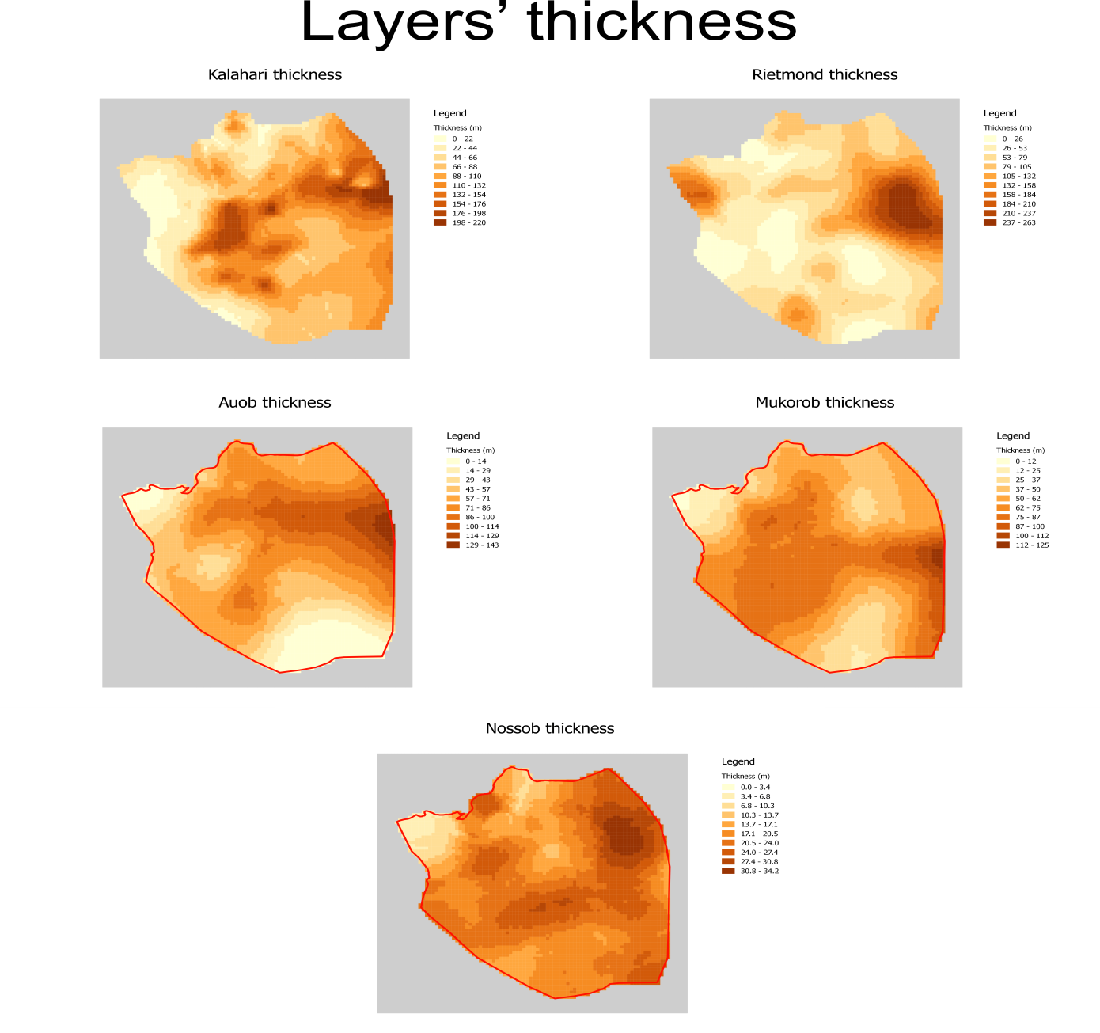
Defining layer’s thickness

Slide 42
Defining hydrodynamic parameters
Horizontal hydraulic conductivity has been defined on the basis of point data (transmissivity), groundwater level contours, layer thickness and available knowledge (recharge/discharge zones)

Slide 43
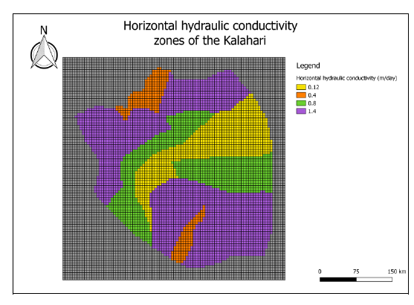
Defining hydrodynamic parameters

Slide 44
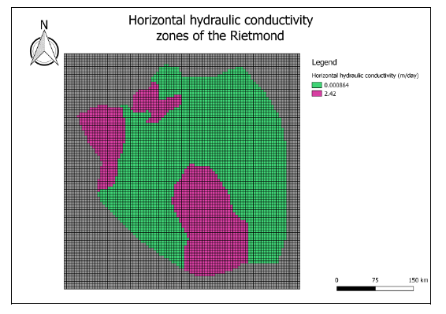
Defining hydrodynamic parameters

Slide 45
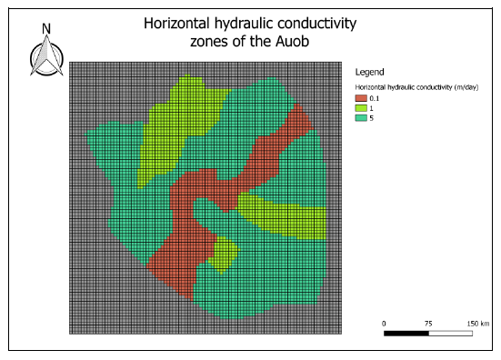
Defining hydrodynamic parameters

Slide 46
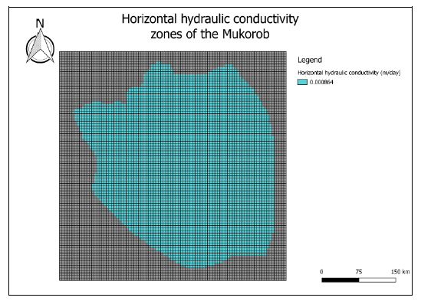
Defining hydrodynamic parameters

Slide 47
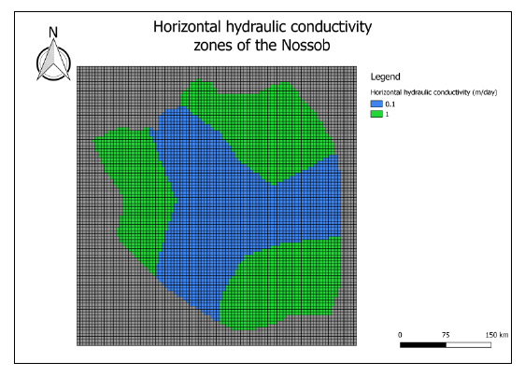
Defining hydrodynamic parameters

Slide 48
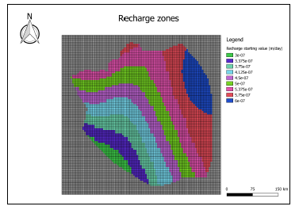
Defining recharge
Package to be modified in the short term by STAS model users.

Slide 49
Defining abstraction
4 different abstraction terms:
Irrigation,
Livestock,
Domestic,
Prosopis
Group exercise: prepare the STAS abstraction file for the model

