Slide 1
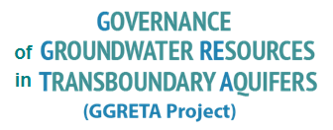
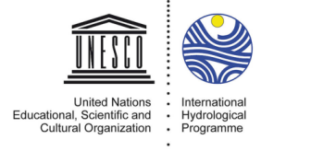
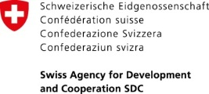
LEGAL AND INSTITUTIONAL ARRANGEMENTS FOR TRANSBOUNDARY AQUIFERS -
5 September 2017
Tunis, Tunisia
Stefano Burchi, UNESCO
Stefano Burchi UNESCO
Francesco Sindico, Strathclyde

Slide 2
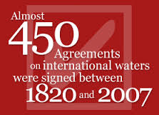
The law of transboundary aquifers
The law of transboundary freshwater bodies, including most aquifers, is crystallized in the:
UN Convention on the law of the non-navigational uses of international watercourses, adopted by the UNGA (New York) on 21 May 1997, in force since August 2014
It lays down a number of norms of inter-State behaviour reflecting the practice of States in the matter (“international customary law”)

Slide 3
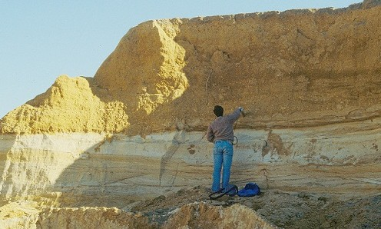
The law of transboundary aquifers
The UN Convention covers – in addition to surface watercourses – all transboundary aquifers which are physically linked to a surface water system
As a result, non-recharging (also known as “fossil”) aquifers escape the scope of the Convention, and fall in a legal limbo

Slide 4
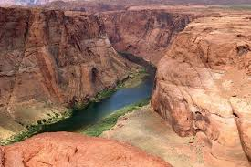
The law of transboundary aquifers
This is why the UN adopted in 2008 Resolution 63/124, carrying “Draft Articles on the law of transboundary aquifers”
The Draft Articles carry a body of basic norms reflecting the practice of States (“customary law”, binding on all States)
They also provide additional, innovative (non-binding) norms as regards:

Slide 5
The law of transboundary aquifers
“uses” of the aquifer (include extraction of heat & minerals, storage, & substances disposal)
obligation to preserve the ecosystem-support function of aquifers
obligation to care for the recharge and discharge zone
obligation to maximize long-term benefits of groundwater exploitation (fossil aquifers)
obligation of regular aquifer monitoring

Slide 6
The law of transboundary aquifers
2002 –UNILC begins work on ”shared natural resources” (oil, gas and groundwater)
2003 – UNILC focusses on transboundary aquifers with UNESCO technical & legal support
2008 – A/RES/63/124
2013 – A/RES/68/470
2016 – A/RES/71/150

Slide 7
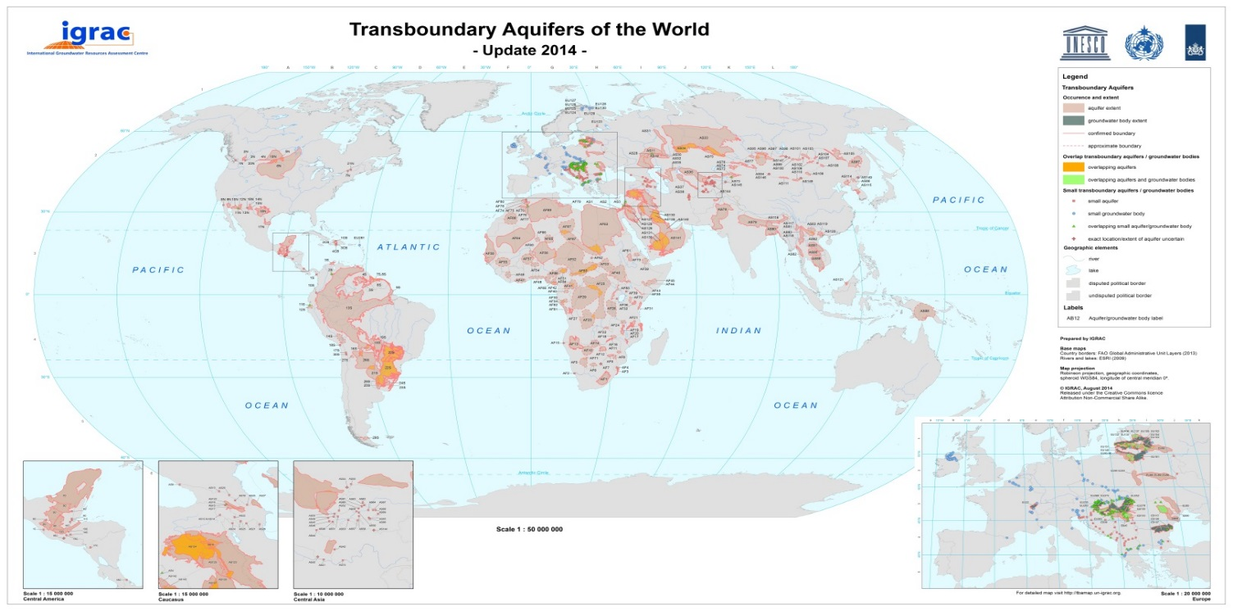
The law of transboundary aquifers
Transboundary aquifers & agreements – how many?
Only 6 of the nearly 600 surveyed transboundary aquifers are governed by an agreement/joint institution
With the Stampriet Aquifer System (STAS) in Southern Africa destined to become the 7th in the list

Slide 8
The law of transboundary aquifers
The “core”norms of international water law crystallize the substantive rights and obligations of States
Right to an equitable and reasonable utilization
Obligation not to cause significant harm

Slide 9
The law of transboundary aquifers
Factors to be considered together
Population
Socio-economic needs
Natural characteristics
Contribution to formation and recharge
Actual and potential use
Transboundary impact
Availability of alternatives
Cost/benefit analyis
Ecosystem requirements
Factors relevant to equitable & reasonable utilization determinations regarding transboundary aquifers

Slide 10
The law of transboundary aquifers
Procedural norms, and relationship to substantive norms
Equitable & reasonable utilization
Obligation not to cause significant harm
General obligation to cooperate
Regular exchange of information & data
Prior notification of planned measures, consultation and good-faith negotiation with a view to reaching agreement
These norms give effect to the rights and obligations posited by substantive norms

Slide 11
Agreements on transboundary aquifers
There exist a handful bi-lateral and regional agreements on specific transboundary aquifers
The Genevese Aquifer Agreement (2008, France, Switzerland)
The Guaraní Aquifer Agreement (2010, Argentina, Brazil, Paraguay, Uruguay)
The Joint Authority for the Study & Development of the Nubian Sandstone Aquifer (Chad, Egypt, Libya, Sudan)(1992)
The Al-Disi Aquifer Agreement (Saudi Arabia, Jordan (2015)
MOU on a Consultation Mechanism for the Iullemeden Taoudeni/Tanezrouft Aquifer (7 countries in the Sahara-Sahel region) (2014)
MOU on a Consultation Mechanism for the Northern Sahara Aquifer System (2008, Algeria, Libya, Tunisia)

Slide 12
Local-level arrangements for transboundary aquifers
There exist a few known arrangements between or among units of local-level government or local authorities, concerning a transboundary aquifer
MoU between the water supply companies of El Paso (Texas) and Cd Juarez (Mexico) re: the Hueco Bolson aquifer (1999)
In Europe local governments have made arrangements for the management of small transboundary aquifers, based on a Framework Convention on transfrontier local-level cooperation (1980)
The French contracting Parties of the Genevese Aquifer Agreement are local government units
Local-level agreement in-the-works on the Ocotepeque-Citalá aquifer (Honduras/El Salvador, CA)

Slide 13
Transboundary aquifers in river/lake basin treaties
Transboundary aquifers underlying transboundary river/lake basins are beginning to attract the attention of relevant river/lake basin commissions – as for example:
:
the Senegal river basin commission (OMVS)
the Lake Chad basin commission
the Orange-Senqu river basin commission (ORASECOM), as regards the Stampriet Aquifer (Botswana, Namibia, South Africa)

Slide 14
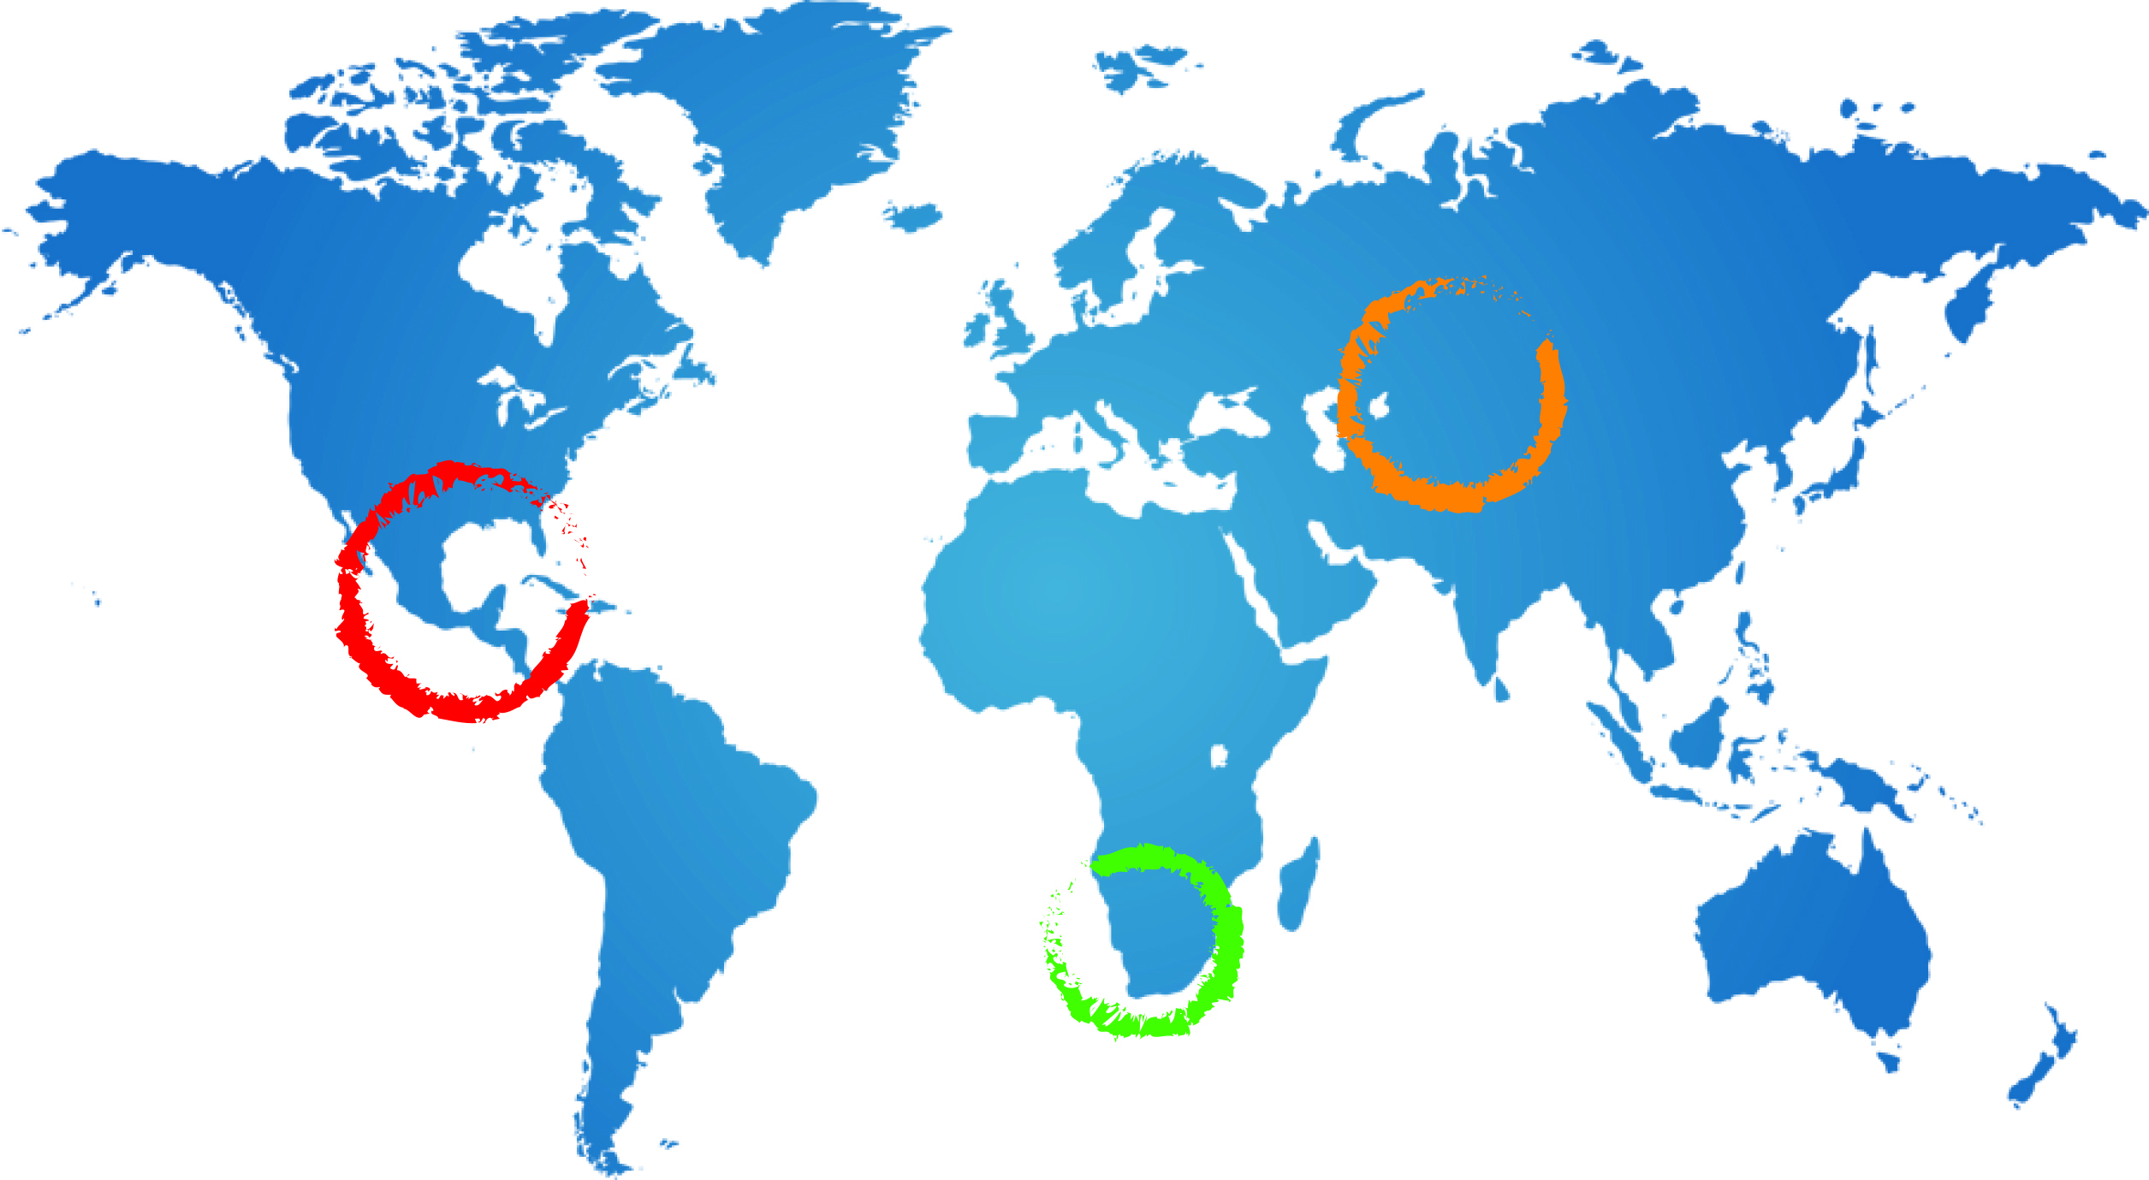
JOINT AUTHORITY FOR NUBIAN SANDSTONE AQUIFER
JOINT AUTHORITY FOR THE STUDY AND DEVELOPMENT OF THE NUBIAN SANDSTONE AQUIFER SYSTEM (NSAS)
PARTIES: CHAD, LIBYA, EGYPT, SUDAN
ESTABLISHED UNDER 1992 AGREEMENT
FUNCTIONS:
PREPARING AND EXECUTING STUDIES
COLLECTION ANALYSIS AND DISSEMINATION OF INFORMATION AND DATA
DEVELOPMENT AND EXECUTION OF A COMMON POLICY AND PLANS FOR GROUNDWATER DEVELOPMENT & USE
FOSTERING COOPERATION
14

Slide 15
JOINT AUTHORITY FOR NUBIAN SANDSTONE AQUIFER
FUNDING:
ANNUAL CONTRIBUTIONS FROM MEMBER STATES
DONATIONS FROM NATIONAL AND INTERNATIONAL INSTITUTIONS
STRUCTURE: SEE DIAGRAM
15

Slide 16
NSAS
JOINT AUTHORITY
(JASAD-NSAS)
BOARD OF DIRECTORS
(Each Member State appoints three ministerial-level members to the Board)
JOINT AUTHORITY HQs
(Tripoli – Libya)
EXECUTIVE DIRECTOR
ADMINISTRATION UNIT
FINANCE UNIT
TECHNICAL AFFAIRS
INFORMATION UNIT
JOINT AUTHORITY NATIONAL OFFICES
CHAD
N’Djamena Office
Management and technical Staff
EGYPT
Cairo Office
Management and technical Staff
LIBYA
Tripoli Office
Management and technical Staff
SUDAN
Khartoum Office
Management and technical Staff

Slide 17
JOINT TECHNICAL COMMITTEE FOR THE AL-DISI AQUIFER
JOINT TECHNICAL COMMITTEE FOR THE AL-SAG/AL-DISI AQUIFER
PARTIES: JORDAN, SAUDI ARABIA
PROVIDED FOR BY 2015 AGREEMENT
STRUCTURE:
FIVE REPRESENTATIVES EACH FROM JORDAN AND SAUDI ARABIA
MAY HIRE EXPERTS, ADVISERS AND EMPLOY ASSISTANTS
17

Slide 18
JOINT TECHNICAL COMMITTEE FOR THE AL-DISI AQUIFER
FUNCTIONS:
SUPERVISING IMPLEMENTATION OF 2015 AGREEMENT
MONITORING LEVEL & QUALITY OF AQUIFER WATER
MONITORING GROUNDWATER EXTRACTIONS
COLLECTION AND EXCHANGE OF INFORMATION AND DATA
FUNDING:
NOT MENTIONED IN 2015 AGREEMENT
18

Slide 19
GUARANI AQUIFER COMMISSION
GUARANI AQUIFER COMMISSION
PARTIES: ARGENTINA, BRAZIL, PARAGUAY, URUGUAY
PROVIDED FOR BY 2010 AGREEMENT (RATIFIED BY TWO COUNTRIES SO FAR, NOT IN FORCE YET)
STRUCTURE:
NOT MENTIONED IN THE 2010 AGREEMENT
FUNCTIONS:
COORDINATION OF COOPERATION FOR THE IMPLEMENTATION OF THE PRINCIPLES AND OBJECTIVES OF THE 2015 AGREEMENT
FUNDING:
NOT MENTIONED IN THE 2015 AGREEMENT
19

Slide 20
GENEVESE AQUIFER COMMISSION
GENEVESE AQUIFER COMMISSION
PARTIES: FRANCE, SWITZERLAND
ESTABLISHED UNDER 1978 AGREEMENT – RE-NEGOTIATED IN 2007
STRUCTURE:
THREE MEMBERS EACH FROM THE FRENCH AND THE SWISS SIDE
SECRETARIAT SERVICES PROVIDED BY GENEVA CANTON AQUIFER SERVICE AND FRENCH ANNEMASSE REGIONAL GOVERNMENT
20

Slide 21
GENEVESE AQUIFER COMMISSION
FUNCTIONS:
DRAWING UP YEARLY GROUNDWATER UTILIZATION PLANS
RECOMMENDING POLLUTION CONTROL MEASURES
ADVISING ON EXTRACTION PROJECTS, INCLUDING MODIFICATION OF EXISTING PROJECTS
AUDITING OF CONSTRUCTION AND O&M COSTS (FOR COST-SHARING)
INVENTORY OF GROUNDWATER RECHARGE EQUIPMENT & EXTRACTION WORKS
RECORD-KEEPING OF EXTRACTED VOLUMES AND OF WATER LEVELS
OVERSIGHT OF CONSTRUCTION OF NEW EQUIPMENT
SETTLEMENT OF DISPUTES (ARBITRATION)
FUNDING:
EACH PARTY BEARS THE EXPENSES OF ITS OWN SIDE OF THE COMMISSION
21

Slide 22
CONSULTATION MECHANISM FOR THE IULLEMEDEN, ETC.
CONSULTATION MECHANISM FOR THE IULLEMEDEN, TAOUDENI/TANEZROUFT AQUIFER SYSTEM (ITAS)
PARTIES: ALGERIA, BENIN, BURKINA FASO, MALI, MAURITANIA, NIGER, NIGERIA
PROVIDED FOR BY 2014 MOU (FOUR COUNTRIES HAVE SIGNED SO FAR, NOT IN FORCE YET)
FUNCTIONS:
FORMULATION OF PLANS AND PROGRAMMES
CONDUCTING JOINT STUDIES
COLLECTION ANALYSIS AND EXCHANGE OF INFORMATION AND DATA
MANAGEMENT OF RISKS
HARMONIZATION OF PROCEDURES AND METHODOLOGIES
SETTLEMENT OF DISPUTES
22

Slide 23
CONSULTATION MECHANISM FOR THE NWSAS
CONSULTATION MECHANISM FOR THE NORTH-WESTERN SAHARA AQUIFER SYSTEM (NWSAS-SASS)
PARTIES: ALGERIA, LIBYA, TUNISIA
ESTABLISHED IN TWO PHASES (2002 AND 2008 MOUs)
FUNCTIONS:
COLLECTION ANALYSIS AND DISSEMINATION OF INFORMATION AND DATA
AQUIFER MODELLING
PROMOTING AND EXECUTING STUDIES
23

Slide 24
The law of transboundary aquifers
Conclusions/1
The UN Draft Articles on the law of transboundary aquifers (2008) lay down:
Substantive rights & obligations
Procedural obligations
Rules for the settlement of disputes
The Draft Articles are not binding, however they serve as authoritative reference in the negotiation and formulation of aquifer-specific treaties and agreements
Moreover, all States are bound by the few “core” norms of the Draft Articles reflecting customary international law

Slide 25
The law of transboundary aquifers
The existing institutional arrangements for cooperation –be they at the State or local level, and be they aquifer-based or also nested in an existing river basin commission – reflect the commitment of States to cooperate in the management of aquifers and the groundwater stored in them
The experience suggests that such commitment is all the more robust when the benefits of cooperation are clearly perceived by all cooperating Parties
Conclusions/2

Slide 26
THANK YOU!
Stefano Burchi
Chairman, International Association for Water Law (AIDA), Rome, Italy
stefano.burchi@gmail.com

