Slide 1
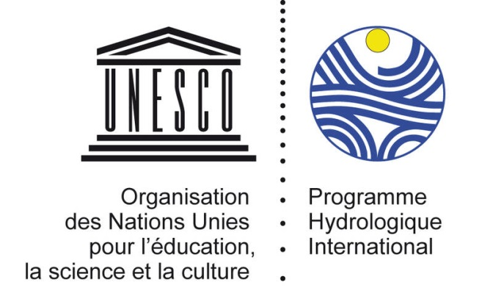
WHY SCIENCE IS NEEDED FOR BETTER DECISION-MAKING IN TRANBSOUNDARY GROUNDWATER GOVERNANCE?
Regional Meeting on Transboundary Aquifers Cooperation in Africa
5-8 September 2017, Tunis, Tunisia
Tales Carvalho Resende
UNESCO International Hydrological Programme (IHP)

Slide 2
Some hydrogeology basics…

Slide 3
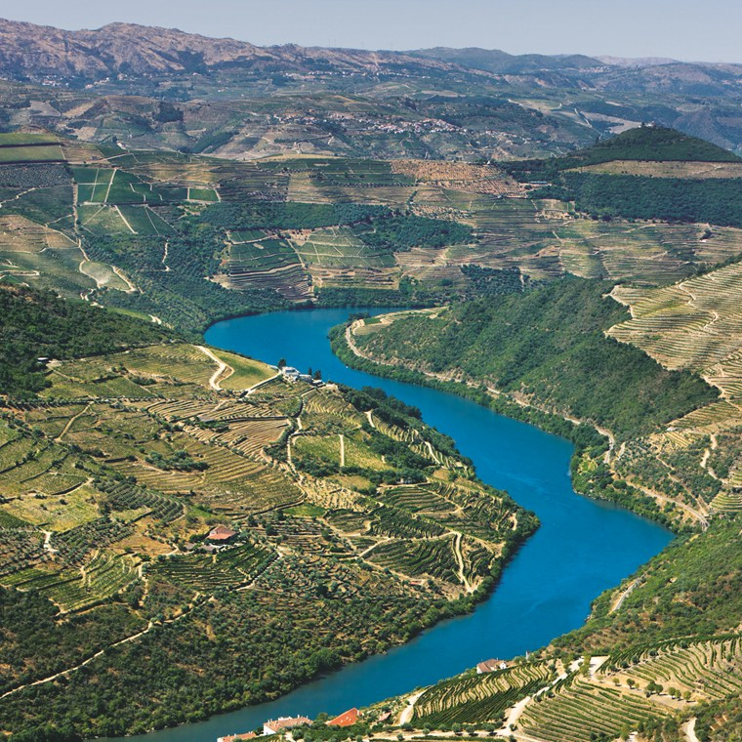
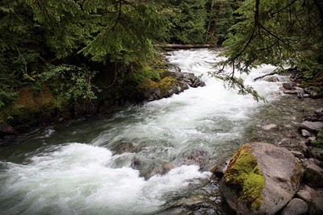
What do you see in these pictures?

Slide 4
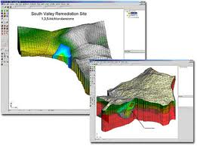
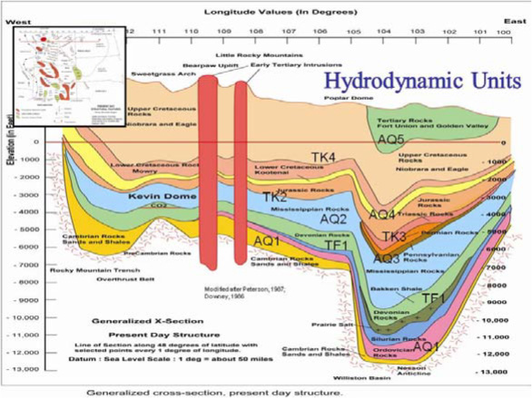
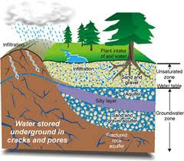
What do you see in these pictures?

Slide 5
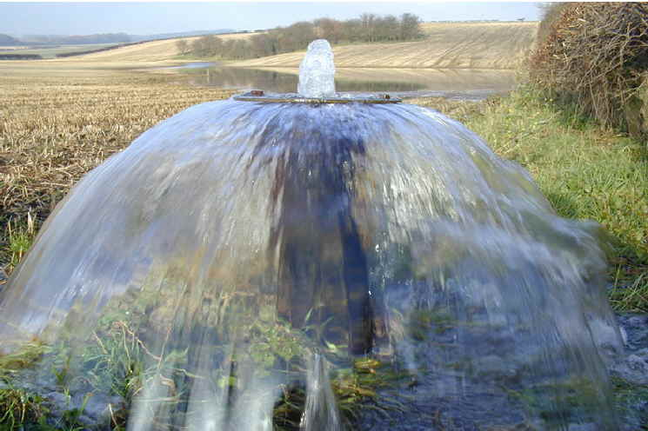
GROUNDWATER!!!
Let’s try to make visible the invisible!

Slide 6
The importance of groundwater
Groundwater provides drinking water to at least 50% of the world’s population and represents 43% of all of the water used for irrigation (UNESCO-WWAP, 2009 , Siebert et al. 2010).
Groundwater plays an important role in society’s adaptation to climate variability and change, especially because it is more resilient to the effects of climate change than surface water (Van der Gun, 2012, Taylor et al., 2013).
Groundwater unique buffer capacity provides a major strength to reduce the risk of temporary water shortage, and to create conditions for survival in areas were climate change is expected to cause water stress (e.g. semi-arid and arid regions).
Groundwater abstraction has increased by more than 300% over the past 50 years with major socioeconomic benefits, its development and use has often fallen outside of governance frameworks (Van der Gun, 2012 and FAO, 2015).

Slide 7
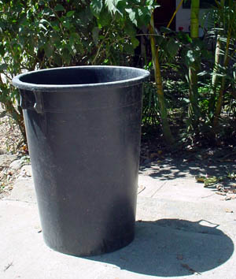
THE WORLD’S WATER RESOURCES
Imagine:
All the water on the planet =
150 litre container
150 LITRES
BUT JUST 4 LITRES ARE FRESH !!
The remaining 146 litres are SEAWATER
Source: Prof Ken Howard, Osaka Cut, 2003

Slide 8
Out of these 4 litres, 3 litres are frozen in the earth’s ice caps and in the permafrost regions, … leaving one lonely litre of freshwater
X
X
X
So, 99% of fresh, available water on this planet is GROUNDWATER!!!
It is essential that we protect and manage groundwater resources effectively!
99% GROUNDWATER
Source: Prof Ken Howard, Osaka Cut, 2003

Slide 9
What is an aquifer?
RECHARGE
DISCHARGE
Rainfall
Infiltration
Leakage
Injection
Evaporation
Spring discharge / Seepage
Base flow
Withdrawal
Lateral inflow
AQUIFER
Outflow
Upward
leakage
Downward
leakage

Slide 10
Rivers vs. Aquifers
Rivers | Aquifers
Long linear features | Bulk 3-dimensional systems
Use of resources generally limited to vicinity of the river channels | Resources may be extracted from and used extensively over outcrop & subcrop
Replenishment always from upstream sources | Replenishment may take place from any, or all of 3-dimensions
Rapid & time constrained gain from replenishment | Replenishment could be slow, net gain can be drawn upon over longer periods
Source: Puri, 2002

Slide 11
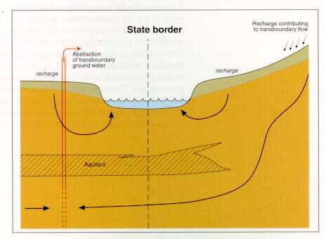
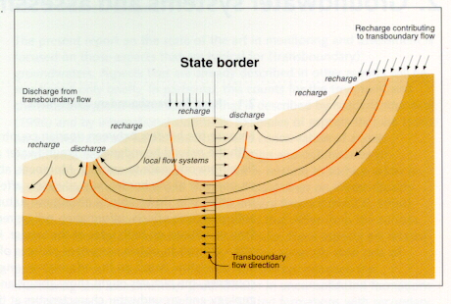
The key feature of transboundary aquifers is that the flow must cross an international boundary.
Many of these systems may recharge in one country and discharge in another…
…although local groundwater flow systems can be modified by human activities with impact on the direction of pollution paths
What is a transboundary aquifer?

Slide 12
Transboundary rivers vs. transboundary aquifers
Transboundary Rivers | Transaboundary Aquifers
Abstraction has an immediate downstream impact | Abstraction impact can be much slower - can be 10’s of years
Little impact on upstream riparian | Could have an equal impact on riparian
Pollution impacts transported | Slow movement of pollution down stream rapidly
Pollutant transport invariably downstream, upstream source may be unaffected | Pollutant transport controlled by local hydraulics. An operating well may induce ‘upstream’ movement toward itself
Source: Puri, 2002

Slide 13
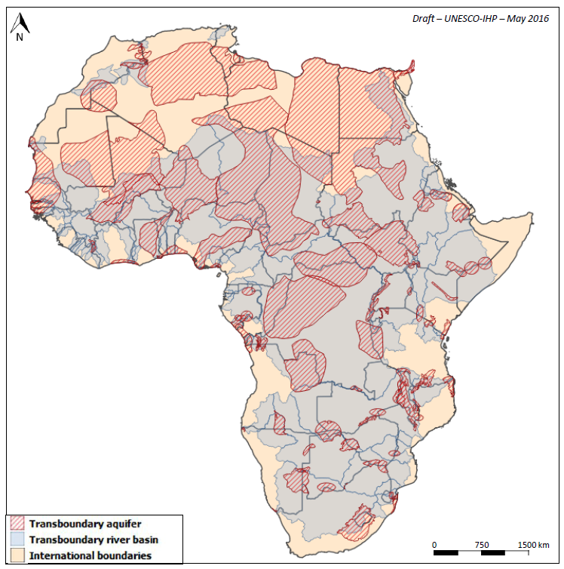
Transboundary waters governance in Africa
Boundaries of transboundary river basins and transboundary aquifers may differ considerably
Challenge for groundwater governance
Coherent management
required

Slide 14
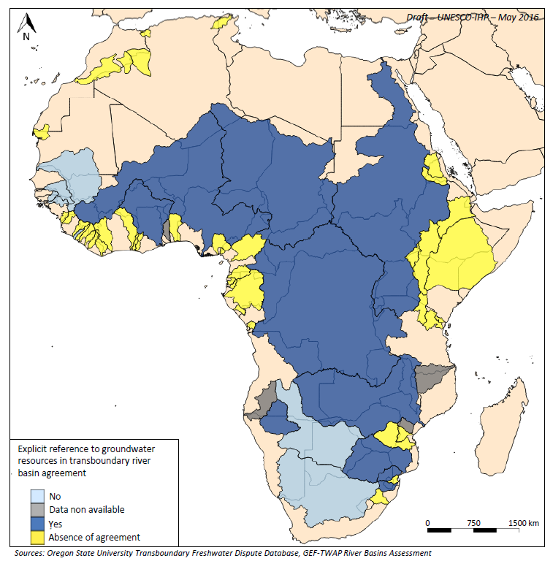
Transboundary waters governance in Africa
More than 60% of African transboundary river basins do not have an arrangement for water cooperation.
Out of those having an arrangement, 60% include explicit reference to groundwater resources

Slide 15
International Law and Transboundary aquifers

Slide 16
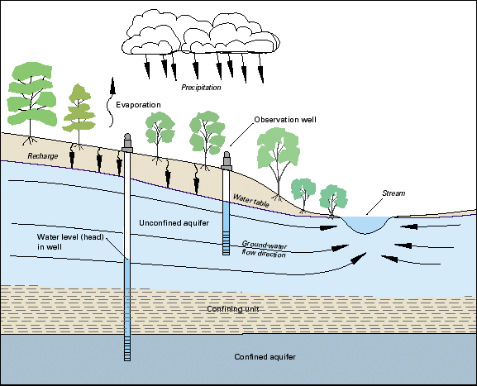
What is an aquifer?

Slide 17
Groundwater in the Water Conventions
1992 - UNECE Water Convention: “Transboundary waters” → Any surface or groundwaters which mark , cross or are located on boundaries between two or more States. 1997 – UN Watercourses Convention: “Watercourses” → system of surface waters and groundwaters constituting by virtue of their relationship a unitary whole and normally flowing into a common terminus. “International watercourses” → a watercourse, parts of which are situated in different States. ☛ Only considers groundwater connected to surface water bodies situated in different States

Slide 18
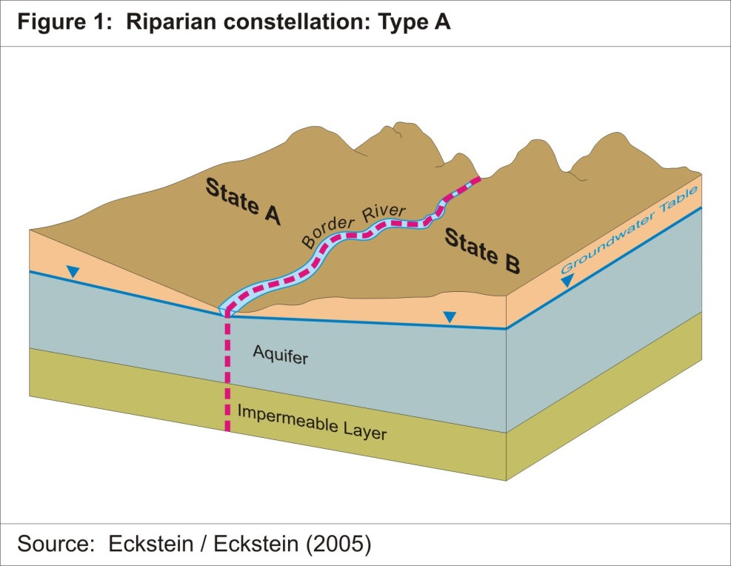
UNWC | YES
UNECE Water Convention | YES

Slide 19
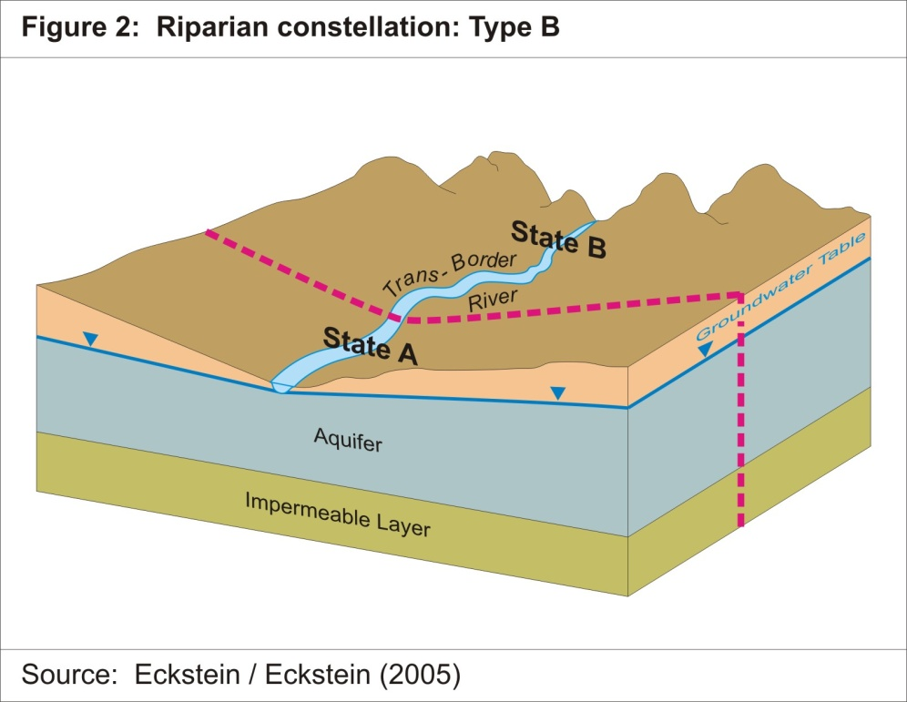
UNWC | YES
UNECE Water Convention | YES

Slide 20
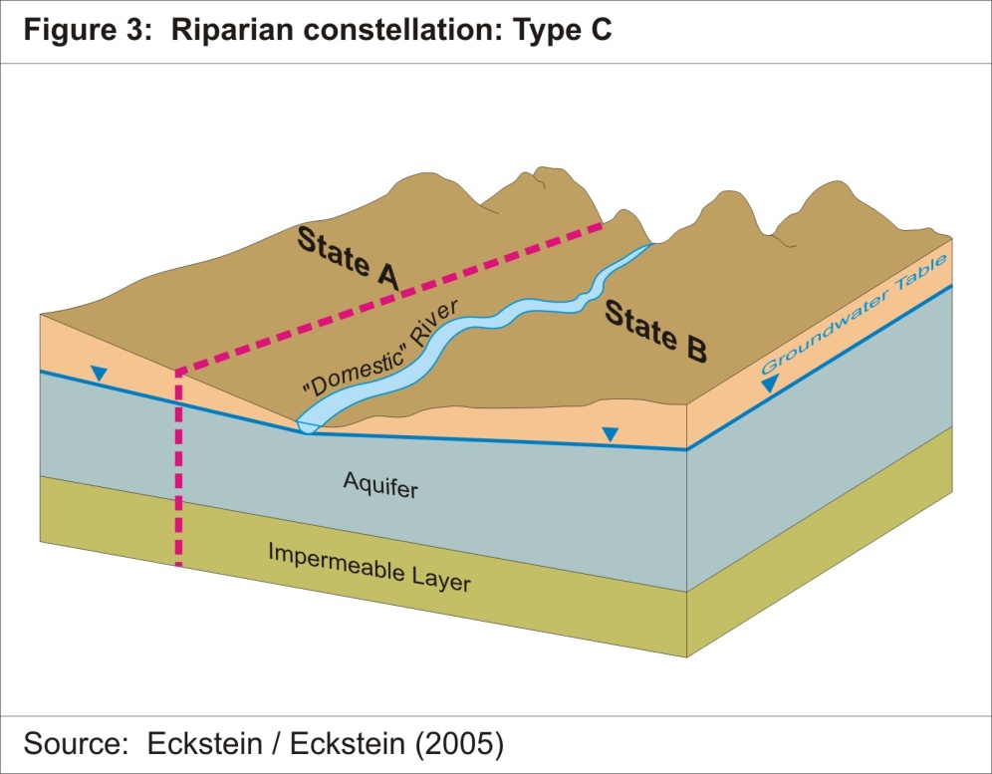
UNWC | NO
UNECE Water Convention | YES

Slide 21
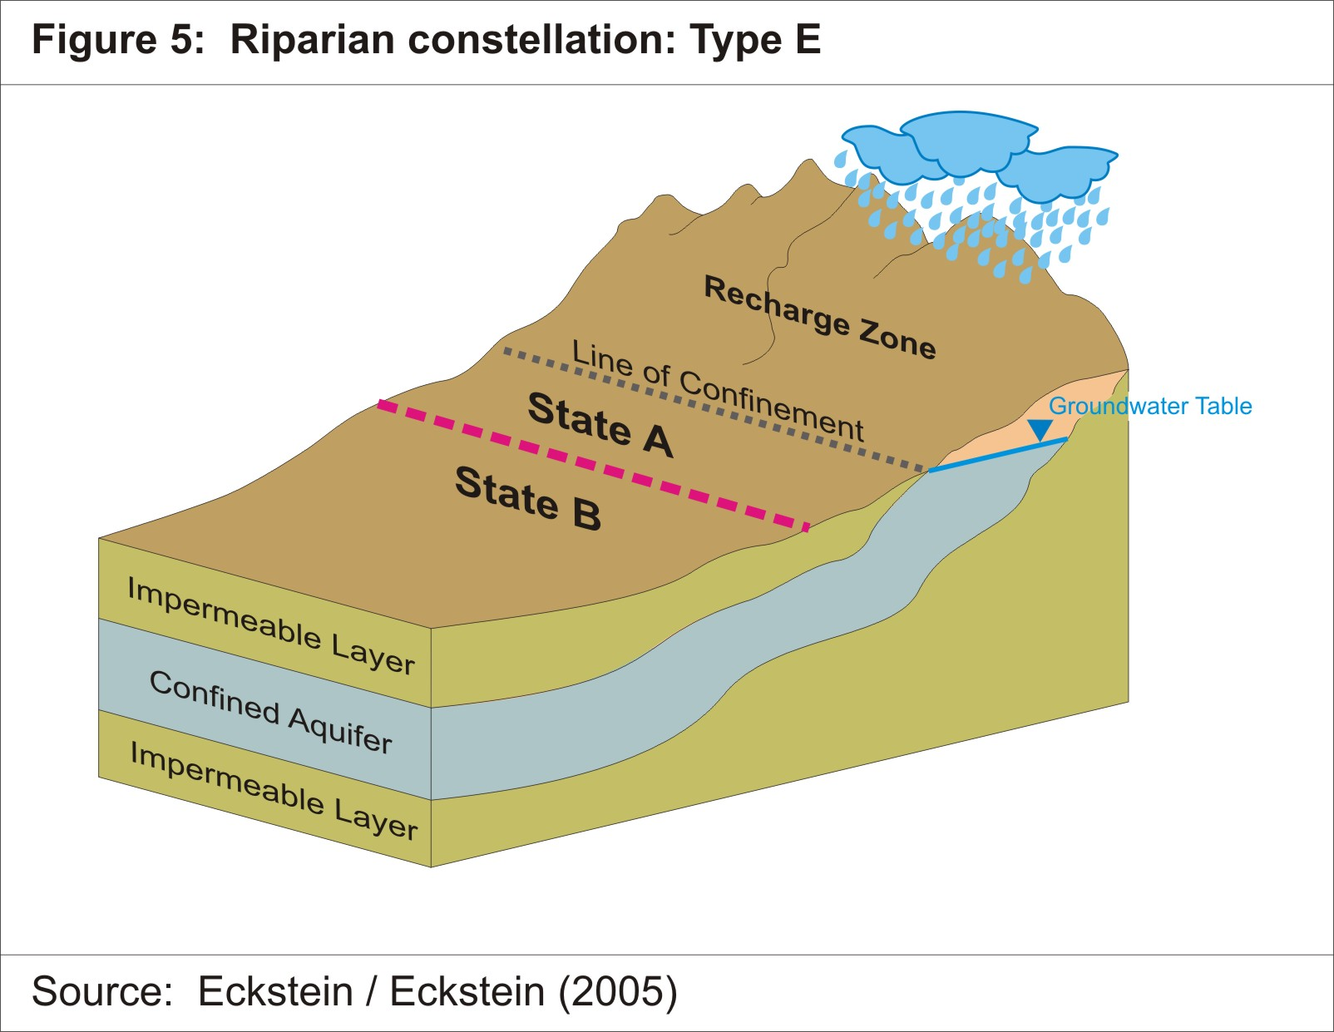
UNWC | NO
UNECE Water Convention | YES

Slide 22
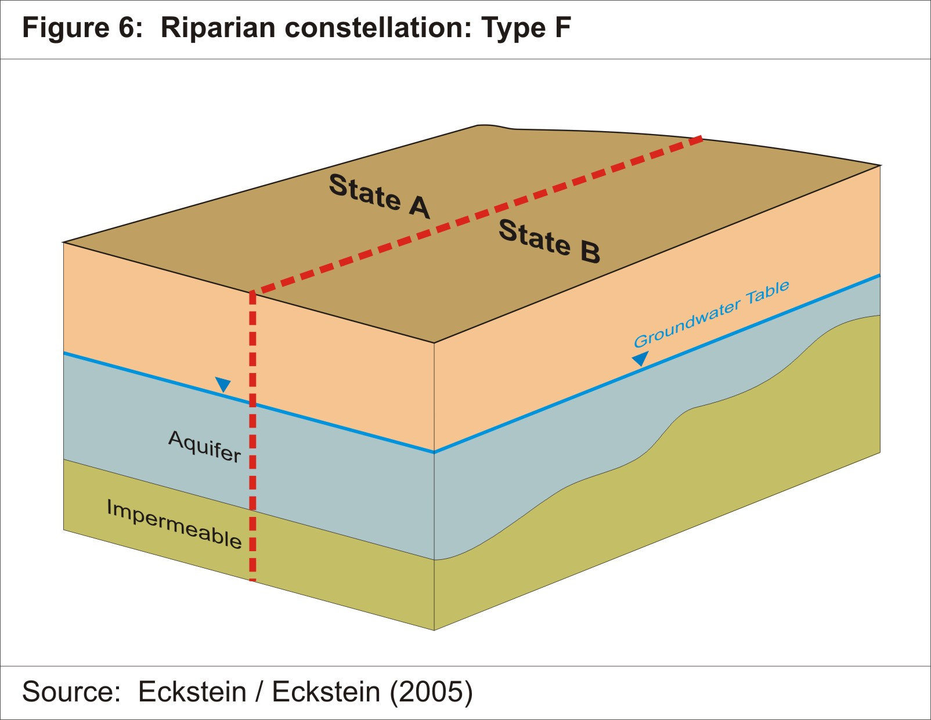
UNWC | NO
UNECE Water Convention | YES

Slide 23
Some conclusions…
☛ From a scientific point of view, the UN Watercourses Convention exclude a large number of TBAs (e.g. Northwestern Sahara Aquifer System and the Stampriet Transboundary Aquifer System) ☛ The “legal wording” of the UNECE Water Convention and the UN Watercourses do not provide a through scientific description of what is a transboundary aquifers. ☛ Why? One of the reasons is because at the time the Conventions were drafted, there was very little information on transboundary aquifers. ☛ Need for guidance instruments considering sound science!

Slide 24
Groundwater in the Water Conventions
☛ What happened next? 1997: IAH set up the Transboundary Aquifers Resource Management (TARM) Commission 2000: Establishment of the Internationally Shared Aquifers Resources Management (ISARM) programme at the 14th session of the IHP Council. 2002: ISARM Framework Document 2004 to present: Multiplication of ISARM activities across the globe 2008: Draft Articles on the Law of Transboundary Aquifers

Slide 25
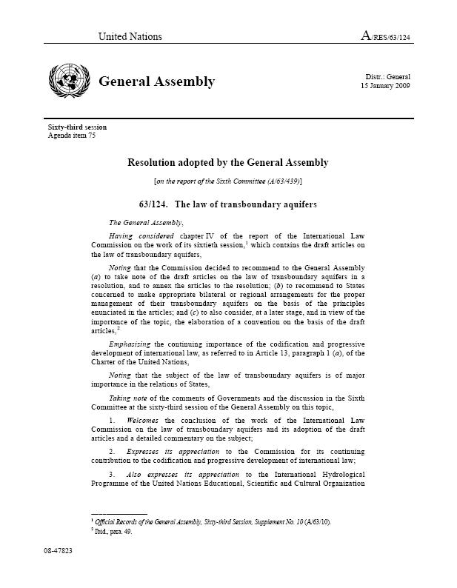
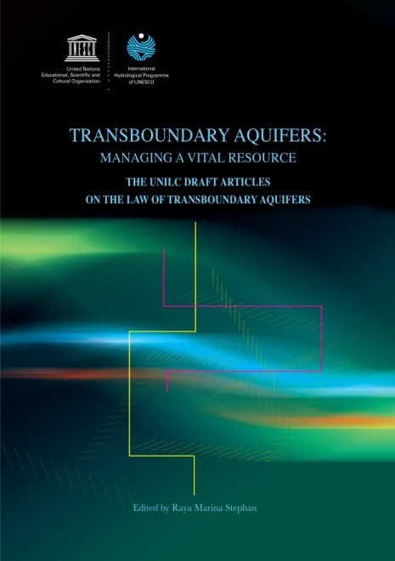
The Draft Articles on the Law of TBAs
Set of guiding principles (not binding) to complement the widely subscribed-to international law on surface waters.
Result of several years of interdisciplinary work with UNILC lawyers and UNESCO hydrogeology experts aimed at creating a common ground and language.
The Draft Articles have been developed in retrospect, acknowledging that the surface-water focused conventions is inadequate in addressing transboundary groundwater.
presently UNESCO-IHP provided scientific and technical support to the UN International Law Commission (UNILC) in the preparation of the 19 Articles on the Law on Transboundary Aquifers, endorsed by the UNGA in 2008.

Slide 26
The Draft Articles on the Law of TBAs
19 Articles
Aquifers: “a permeable water bearing geological formation underlain by a less permeable layer and the water contained in the saturated zone of the formation”, UN ILC Draft Articles, art. 2a)
An aquifer consists of two elements:
Underground geological formation (container / the rock)
Natural resources stored underground in the container (groundwater)

Slide 27
The Draft Articles on the Law of TBAs
Article 4 – provisions for equitable and reasonable utilization of transboundary aquifers
Article 5 – factors relevant to equitable and reasonable utilization
Article 6 – provisions on obligation not to cause significant corss-border harm
Article 11 – recharge and discharge zones
Article 12 – prevention, reduction and control of pollution
Article 15 – planned activities
Provisions have coincidence with SADC Water Protocol

Slide 28
The importance of the Draft Articles on the Law of TBAs
2010: The Guarani Aquifer Agreement explicitly took into consideration the Draft Articles
2012: UNECE Water Convention Model Provisions (set of model law provisions serving as a guidance for drafting bilateral or multilateral agreements or protocols on transboundary aquifers) was built upon the Draft Articles

Slide 29
Key messages and conclusions
1992 – UNECE Water Convention
1997 - UN Watercourses Convention
2008 – Draft Articles on the Law of TBAs
2012 - UNECE Model Provisions
2002 - Launch of ISARM
The science associated to the Draft Articles complement the widely subscribed-to international law on surface waters

Slide 30
Key messages and conclusions
UNWC: Treaty, but limited consideration of GW: Only surface water and connected groundwater with common terminus (International watercourses) Exclusion of a great number of TBA UNECE Water Convention: Treaty, and covers all GW “which mark, cross or are located on boundaries between two or more States” Draft Articles: Not a treaty, but only instrument covering TBAs
UNWC
Draft Articles
UNECE Water Convention
+
Model Provisions
INSTRUMENTS ARE COMPLEMENTARY

Slide 31
Thank you!
t.carvalho-resende@unesco.org

