Slide 1
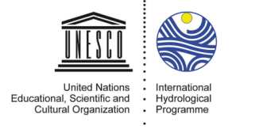
UNESCO EXPERIENCE ON TRANSBOUNDARY AQUIFERS COOPERATION
Regional Meeting on Transboundary Aquifers Cooperation in Africa
5-8 September 2017, Tunis, Tunisia
Tales Carvalho Resende
UNESCO International Hydrological Programme (IHP)

Slide 2
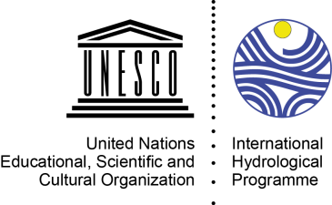
UNESCO International Hydrological Programme (IHP)
UNESCO-IHP is the only inter-governmental program of the UN system devoted to water research, water resources management and education and capacity building.

Slide 3
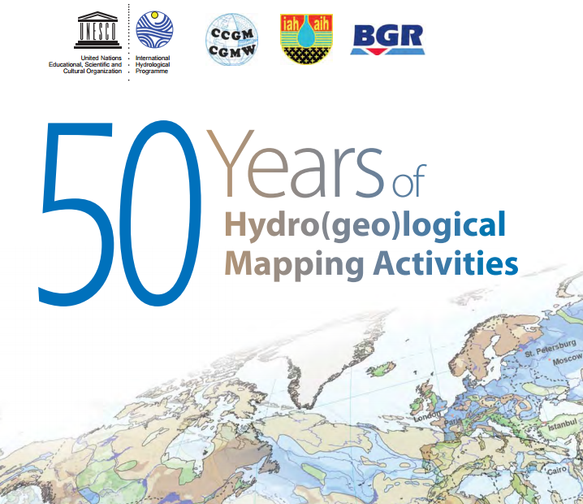
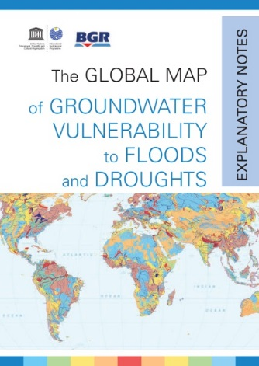
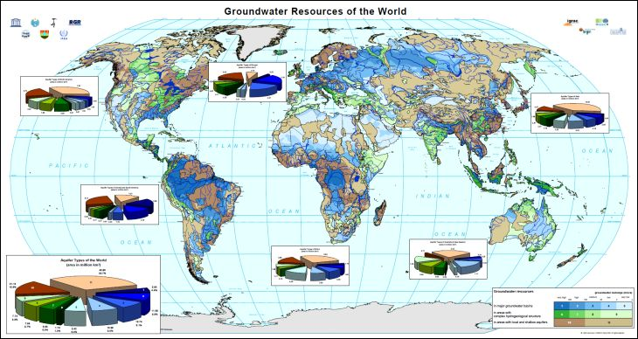
Groundwater at UNESCO - IHP
  www.whymap.org

Slide 4
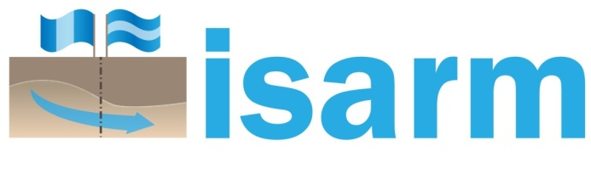
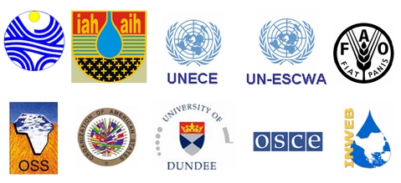
UNESCO-IHP and Transboundary Aquifers
UNESCO-IHP launched the International Shared Aquifer Resources Management (ISARM) programme in the year 2000 aiming at
undertaking the inventory of transboundary aquifers and develop
recommendations for improving their management and governance
considering scientific, socio-economic, legal, institutional and
environmental components

Slide 5
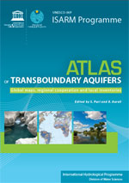
International Shared Aquifer Resources Management (ISARM) Programme
2000: Starting of the first Worldwide Inventory of Transboundary Aquifers (UNESCO-IHP Resolution XIV-12 - 2000)
2000: Framework document
2008: First TBAs Map
Regular update of the TBA Map since 2008

Slide 6
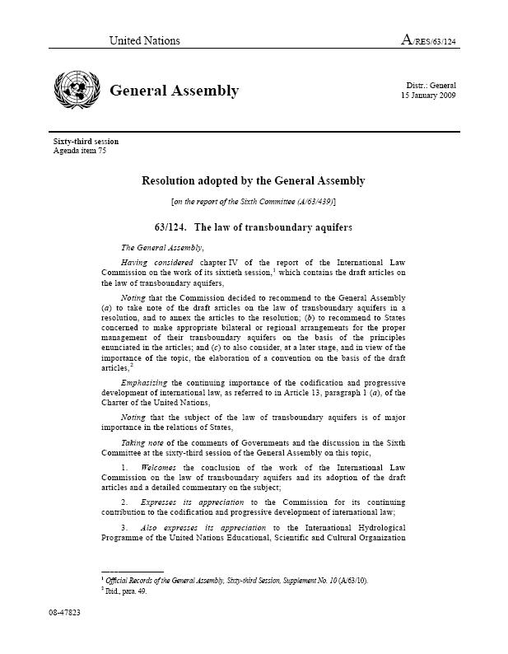
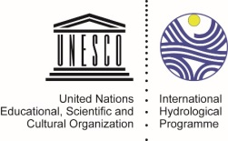
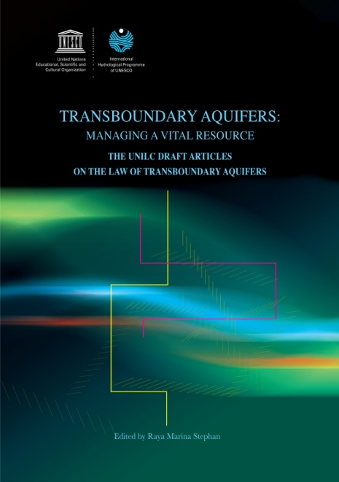
Legal Framework
UNESCO-IHP provided scientific and technical support to the UN International Law Commission (UNILC) in the preparation of the 19 Articles on the Law on Transboundary Aquifers, endorsed by the UNGA in 2008.
Several years of interdisciplinary work with UNILC lawyers and UNESCO hydrogeology experts were necessary to create a common ground and language.

Slide 7



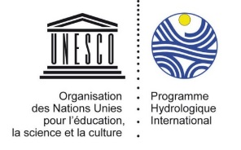
Transboundary Waters Assessment Programme (TWAP)
Two year project funded by the Global Environment Facility (GEF) (2013-2015), aimed at raising global attention the vulnerability of transboundary water systems, and catalyze action.
5 components:
  Transboundary Aquifers and SIDS Groundwater Systems,
  Transboundary River Basins,
  Transboundary Lake Basins,
  Large Marine Ecosystems,
  Open Ocean.
First-ever baseline assessment of groundwater resources with information of 199 transboundary aquifers and 42 SIDS
  Accessible online at the UNESCO Groundwater Portal www.groundwaterportal.net

Slide 8
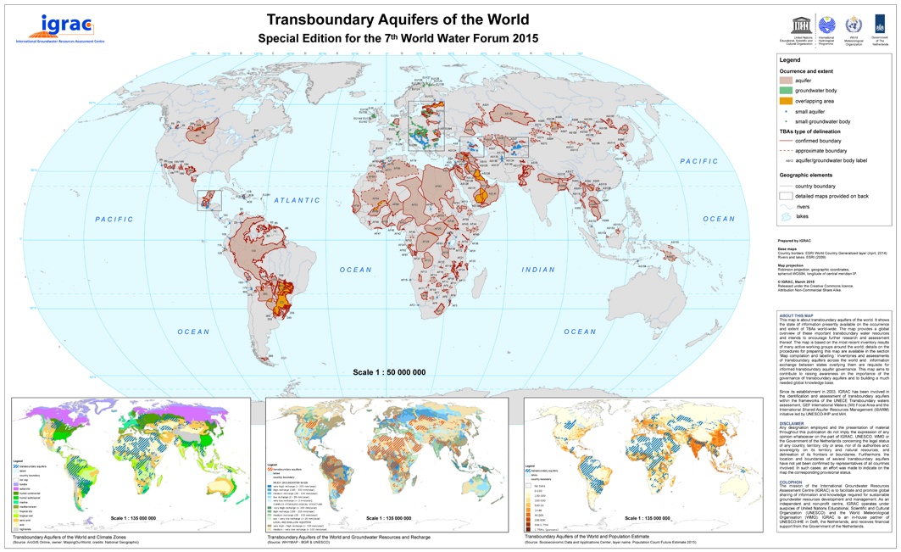
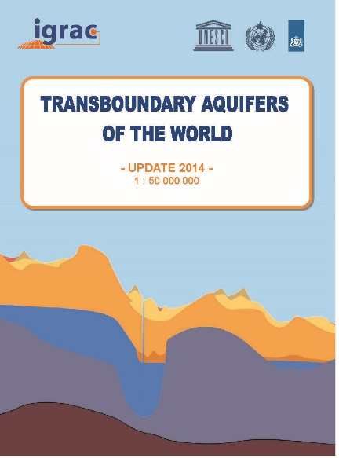


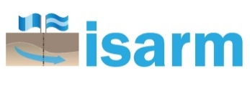
Transboundary Aquifers of the World
Worldwide inventory:
Updated position and delineation of
592 transboundary aquifers

Slide 9
How many transboundary aquifers are under an agreement?

Slide 10
- Genevese Aquifer (Switzerland, France)
- North Western Sahara Aquifer System (Algeria, Tunisia & Libya)
- Iullemen Aquifer System (Algeria, Mali, Niger and partly in Nigeria)
- Guarani Aquifer System (Argentina, Brazil, Paraguay and Uruguay)
- Al-Disi Aquifer (Jordan, Saudi Arabia)
- Nubian Sandstone Aquifer System (Egypt Libya, Sudan, Chad)
(Stampriet Transboundary Aquifer System (Botswana, Namibia, South Africa) )

Slide 11
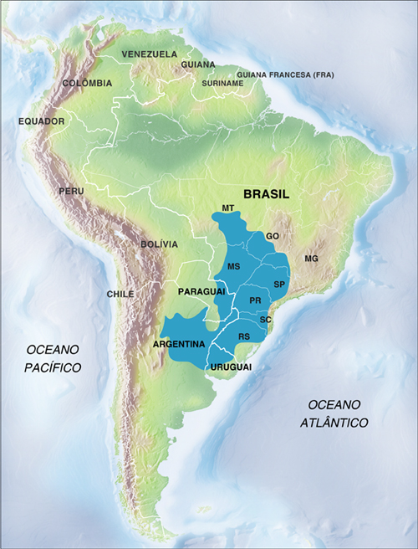
UNESCO contribution to Regional Cooperation: The Guarani Aquifer System
In 2010, Brazil, Uruguay, Argentina and Paraguay signed an Agreement on the Guarani Aquifer System
First agreement taking explicitly into account the Articles on the Law of Transboundary Aquifers prepared by UNILC with technical support from UNESCO-IHP

Slide 12
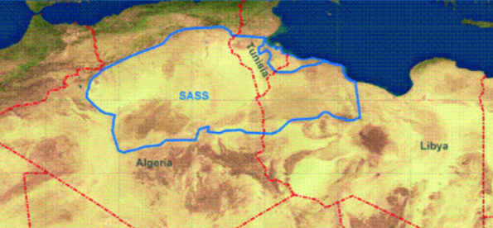
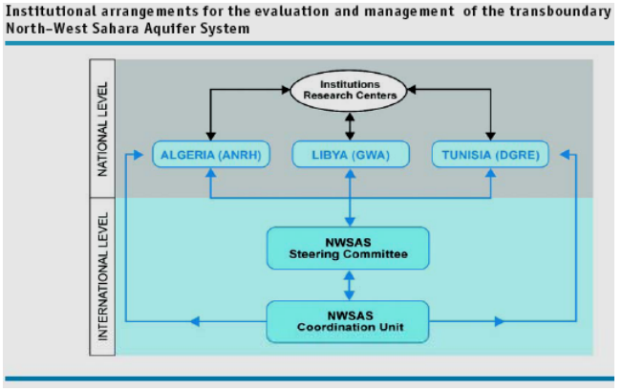


The North-Western Sahara Aquifer System (NWSAS)
First example of a “Consultation Mechanism” Agreement in Africa (2005)
The most important water resource in the desert and semi-desert area of North Western Sahara (1 million km²⁾ between Algeria, Libya, and Tunisia.
Large reserves of water however, mostly non-renewable and not fully exploitable, with a trend to increase abstraction of water.
UNESCO-IHP studies were the bases to set up a plan to establish a “Consultation Mechanism” to “coordinate, promote and facilitate the rational management of the aquifer water resources.”
UNESCO is member of the Steering Committee.

Slide 13
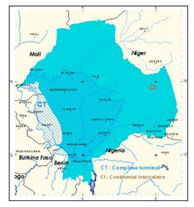
Iullemeden Aquifer System (IAS)
MoU and road map adopted by the Ministers for the establishment of a Consultation mechanism
One of the most important water resource in the Sahel (525 000 km²) between Mali, Niger, Nigeria. The basin population of approximately 15 million in Mali, Niger, Nigeria
Over the last 50 years the land use in the recharge areas has changed and affected the recharge to the upper Aquifer.
UNESCO-IHP contributed to:
  Establish the capacity to identify risks and uncertainty in groundwater use (e.g. hydrological model),
  Develop a mechanism to formulate policy towards sustainable management,
  Create a legal cooperative framework to manage the aquifer.
GEF-IW/UNESCO “Managing Hydrological Risks in the Iullemeden Aquifer System” (2004-2005)

Slide 14
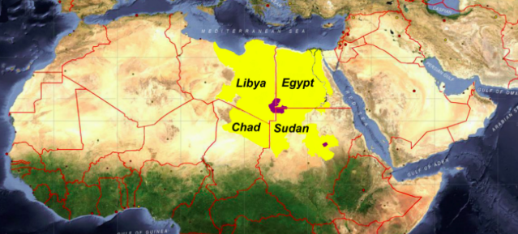

GEF/ UNDP/IAEA-UNESCO MSP : Formulation of an Action Programme for the Integrated Management of the Shared Nubian Aquifer (2006-2011)
Nubian Sandstone Aquifer System (NSAS)
Four countries : Chad, Egypt, Libya and Sudan
One of the largest aquifer systems in the world
Non-renewable groundwater
Extends over 2,000,000 km², contains about 540,000 km³ of water, out of which 15,340 km³ are exploitable

Slide 15
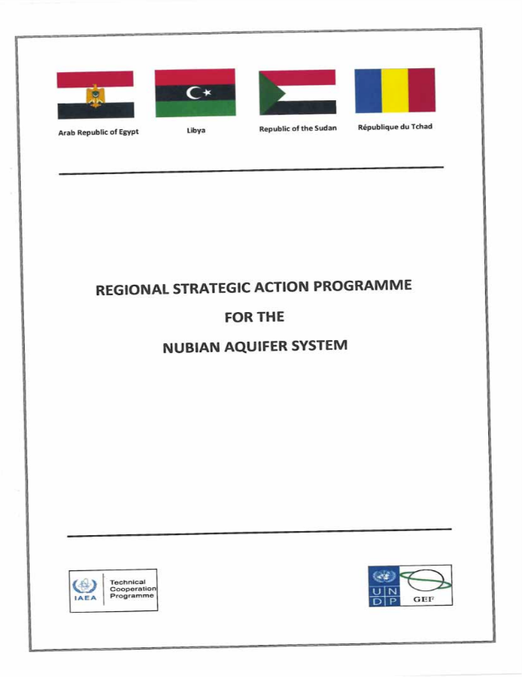
GEF/ UNDP/IAEA-UNESCO MSP : Formulation of an Action Programme for the Integrated Management of the Shared Nubian Aquifer (2006-2011)
Nubian Sandstone Aquifer System (NSAS)
UNESCO-IHP contributed to enhance the existing framework of Legal and Institutional Mechanism for the joint four-partite management and use of the shared NSAS
UNESCO-IHP contributed to identifying and drafting of policy, legislative and institutional actions (Strategic Action Programme – SAP) in line with the principles of the Law of transboundary aquifers

Slide 16
Nubian Sandstone Aquifer System (NSAS)
2017 – 2021: GEF-funded project
  UNESCO-IHP will facilitate the implementation of legal, policy and institutional reforms and addressing gaps identified in the SAP

Slide 17
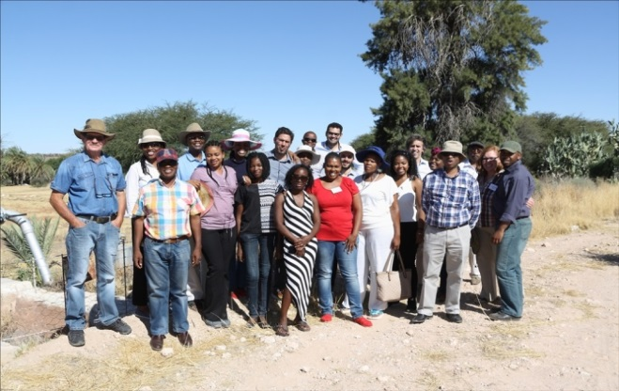
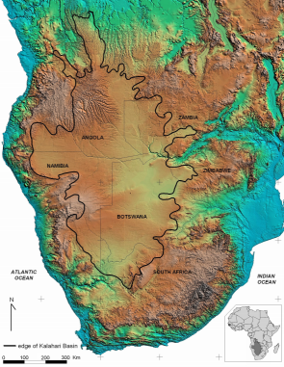
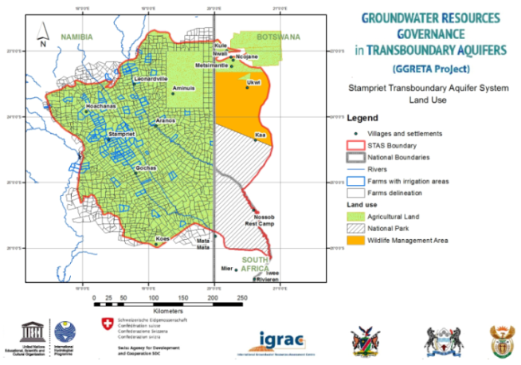

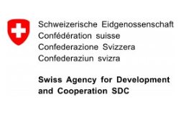
Stampriet Transboundary Aquifer System
(Botswana, Namibia, South Africa)
    First example of a cooperation mechanism for the governance of a transboundary aquifer in Southern Africa
    First example of a cooperation mechanism nested in a river basin organization.
SDC/UNESCO “Governance of Groundwater Resources in Transboundary Aquifers) (2013-present)

Slide 18
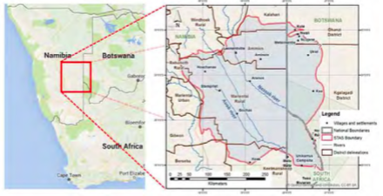
Stampriet Transboundary Aquifer System
(Botswana, Namibia, South Africa)
Area: 86 000 km2
Rainfall: 150-300 mm/yr
Population: 50 000
Human dependency on groundwater: 100%
Increased interannual variability (more floods + more droughts)
Main economic activity: Agriculture and livestock (highly climate change dependent)
70% of abstraction occurs from shallow and highly vulnerable aquifers
Notes:
We all know about international rivers and treatees have long been in place to manage them.
The latest survey shows that there is at least 600 transboundary aquifers around the world.
Yet only a handful of international agreements on transboundary aquifers have been signed.
We need to put more emphasis groundwater governance, policies both at national and international level

Slide 19
Governance of Groundwater Resources in Transboundary Aquifers (GGRETA) project
The Stampriet aquifer was assessed within the framework of the « Governance of Groundwater Resources in Transboundary Aquifers » (GGRETA) project funded by the Swiss Agency for Development and Cooperation (SDC)
Two other aquifers were assessed in GGRETA project:
  Trifinio in Central America,
  Pretashkent in Central Asia.
Main objective of the GGRETA project:
  Promote tools for improving the management of transboundary aquifers,
  Facilitate the implementation of Multi-Country Consultation Mechanisms (MCCM).

Slide 20
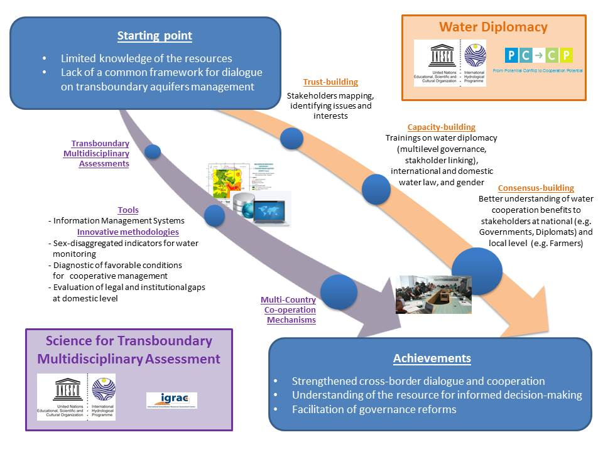
Governance of Groundwater Resources in Transboundary Aquifers (GGRETA) project

Slide 21
Science for Transboundary Multidisciplinary Assessment
Indicator-based methodology aimed at conveying a simple and straight forward message to policy makers (>30 indicators)
Multidisciplinary assessment:
  Hydrogeological
  Socio-economic & Environmental (including gender)
  Legal & Institutional (including gender)
Proposals of Multi Country Consultative Mechanisms
Data collection
(mainly existing)
Data harmonisation
TBA
assessment

Slide 22
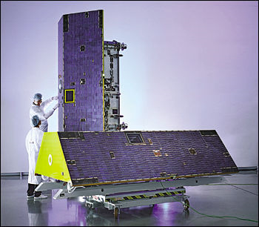


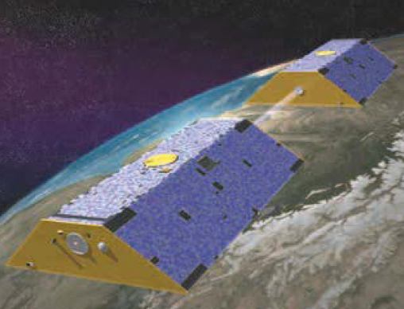
Science for Transboundary Multidisciplinary Assessment: Application of innovative tools
Gravity Recovery and Climate Experiment (GRACE):
  First satellite mission able to monitor total water storage changes (including groundwater) remotely
Objective:
  Assess the impact of climate variability in recharge despite the lack of data to support sound management strategies

Slide 23
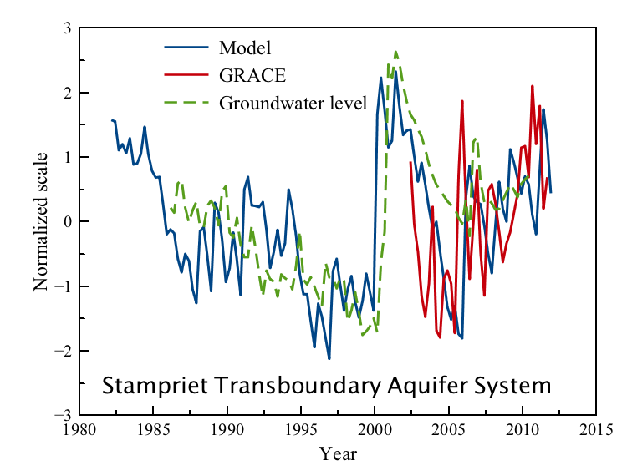
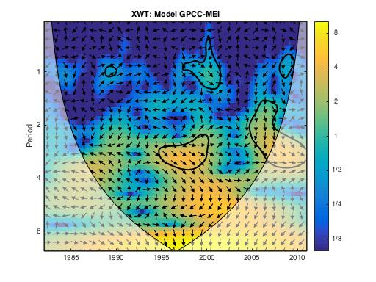
Science for Transboundary Multidisciplinary Assessment: Application of innovative tools
Main findings:
Shallow aquifers are highly responsive to rainfall
Strong correlation between ENSO and groundwater levels
El Niño years: falling water table
La Niña years: rising water table
Key messages:
La Niña
La Niña
Need to strengthen links with metereological agencies
Work will provide further guidelines for agriculture and livestock planning (especially during drought periods)
The concept of “groundwater depletion” should be interpreted carefully
El Niño

Slide 24
Science for Transboundary Multidisciplinary Assessment: Importance of capacity-building
Trainings on the development of shared management tools (e.g. databases…)
  Compilation of a joint STAS borehole database (around 6000 boreholes).
  Preparation of 60 thematic maps providing information on groundwater levels, quality, …
  Data is being uploaded to a web-based Information Management System (IHP-WINS).
Trainings on hydrogeology and groundwater modeling:
  Agreement on the name and delineation of the aquifer system.
  Agreement on a hydrogeological conceptual model (covering recharge and discharge areas and rates, groundwater flow, and potential pollution risk areas).

Slide 25
Science for Transboundary Multidisciplinary Assessment: Importance of capacity-building
Trainings on groundwater modeling:
  Development of a numerical model is currently on-going
  Build capacity of Member States in groundwater modeling including surface water – groundwater interaction
  « Training for trainers » approach

Slide 26

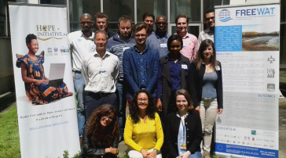

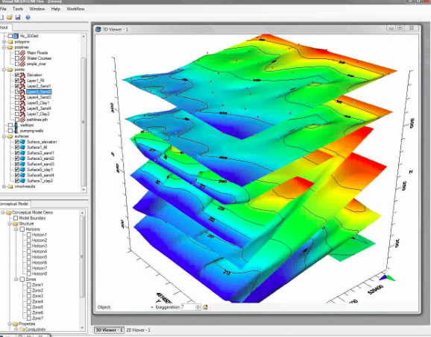
Science for Transboundary Multidisciplinary Assessment: Importance of capacity-building
APPLICATION OF THE FREEWAT PLATFORM
SOFTWARE DEVELOPMENT AND CAPACITY BUILDING
Objective: Producing policies!
STAS model simulations and scenarios (participatory approach)
National trainings
STAS model implementation and calibration
(participatory approach)
Preparation of data for STAS model
Training the trainers
Preparation of FREEWAT Platform (including QGIS, Modflow, etc…)
September – December 2016
January – September 2017

Slide 27
Science for Transboundary Multidisciplinary Assessment: Importance of capacity-building
Training for trainers:
  Regional trainings were held in July 2016 and March 2017
  3 trainees per country (Focal points nominated by Member States)
  Trainees come from academia and Department of Water Affairs
National trainings will be delivered by trainees (Starting in May 2017)

Slide 28
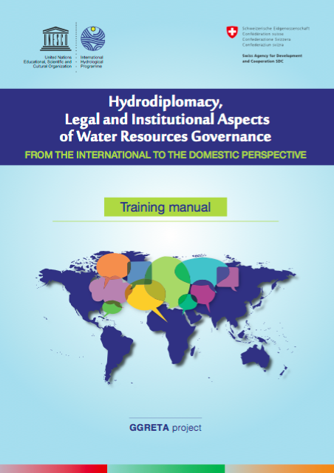
The importance of a Water Diplomacy approach
A Water Diplomacy approach was a key factor to create the “Stampriet Family”
Trust-building:
  Stakeholder mapping, identifying issues and interest
Capacity-building trainings on Water Diplomacy:
  Focus on:
    international water law,
    enhancing negotiation and dispute resolution skills,
  Capacity-building trainings developed that they can be easily replicated
Consensus building:
  6 regional meetings held in the three countries of the STAS in a rotation basis,
  2 stakeholder consultation meetings which counted with the participations of a broader audience (e.g. regional organizations, farmers, NGOs, …)
www.groundwaterportal.org

Slide 29

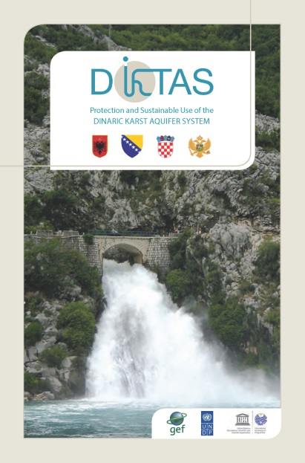
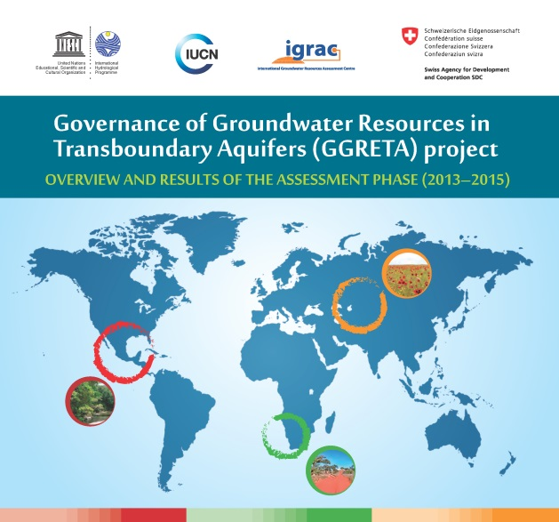

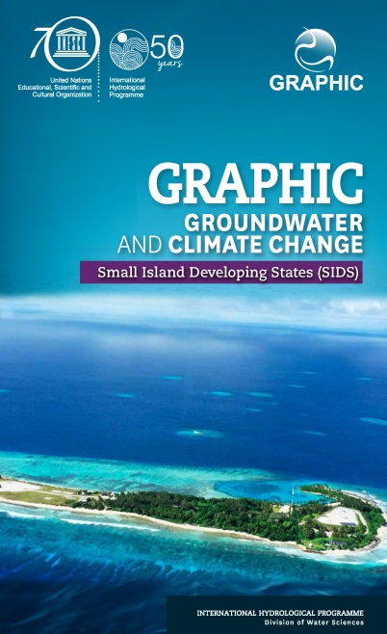
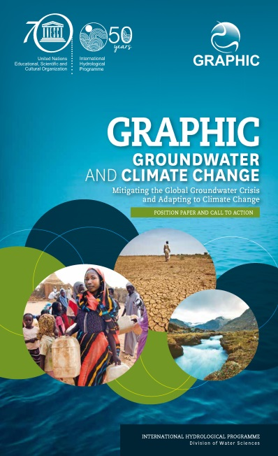
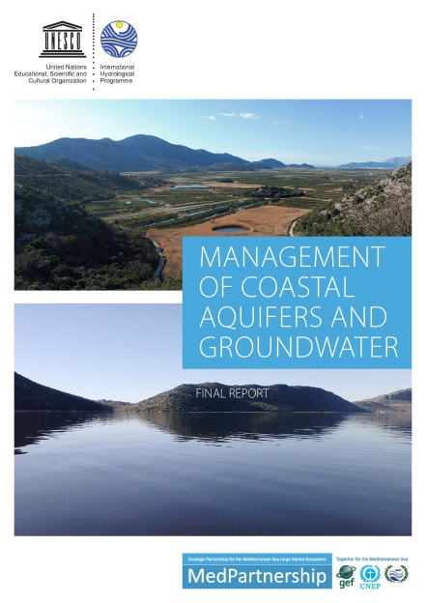
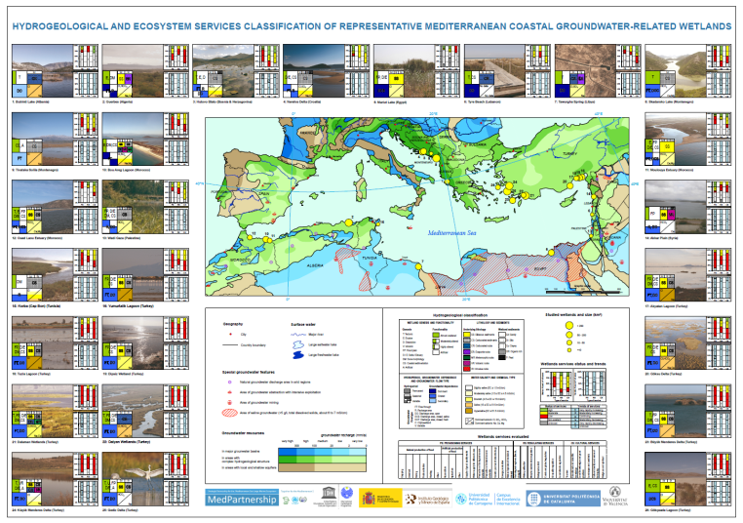

Slide 30

Thank you!
t.carvalho-resende@unesco.org

