Slide 1
Visit to the Observatory of the Sahara and the Sahel (OSS), Tunis, Tunisia
Presentation of the Orange-Senqu River Basin Commission (ORASECOM)
5-6 September 2017,
Tunis, Tunisia
By Rapule Pule,
Water Resources Specialist,
ORASECOM Secretariat

Slide 2
Structure of Presentation
Introduction of the Basin (11 Slides)
Programmes Uundertaken thus Far (6 Slides)
Ground Water in the Context of the Orange-Senqu River Basin (20 Slides)

Slide 3
Shared River Basins
Oued Bon Naima
Medjerda
INTRODUCTION (1 of 11)
Guir
Tafna
Daoura
Dra
Atui
Baraka
Senegal
Niger
Gash
Gambia
Lake Chad
Awash
Geba
Volta
Nile
Corubal
Great Scarcies
Little Scarcies
Moa
Juba-Shibeli
Mana-Morro
Cross
Loffa
Akpa Yao
St. Paul
Komoe
Sanaga
Congo
Lake Turkana
St. John
Bia
Ntem
Lotagipi Swamp
Cestos
Tano
Benito
Umba
Cavally
Mono
Utamboni
Pagani
Sassandra
Oueme
Ogooue
Lake Natron
Nyanga
Rovuma
Africa’s 63 shared river basins contain:
65 % of the area
75 % of the people
93 % of the surface water
Chiloango
Cunene
Zambezi
Cuvelai
Okavango/
Makgadikgadi
Pungué
Limpopo
Buzi
Save
Incomati
N
Orange
Umbeluzi
0
500
1000
Maputo
Kilometres
Thukela

Slide 4
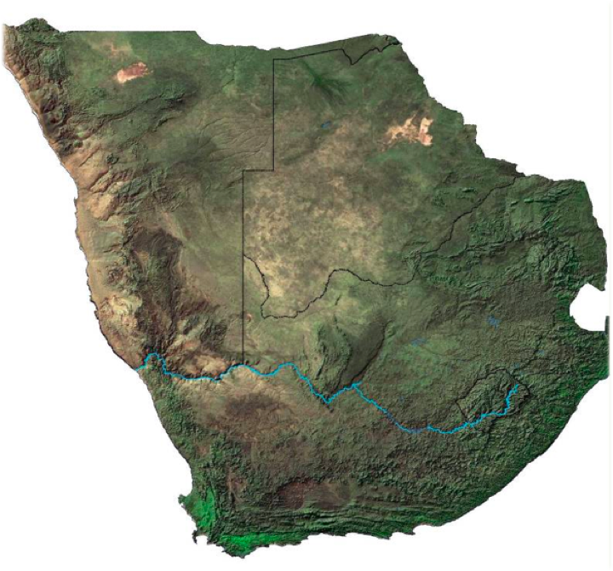
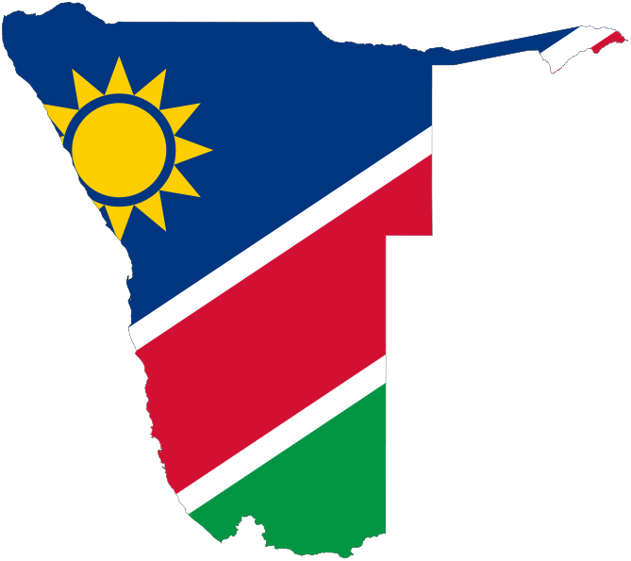
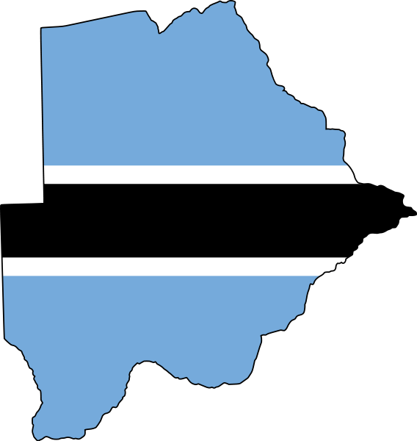
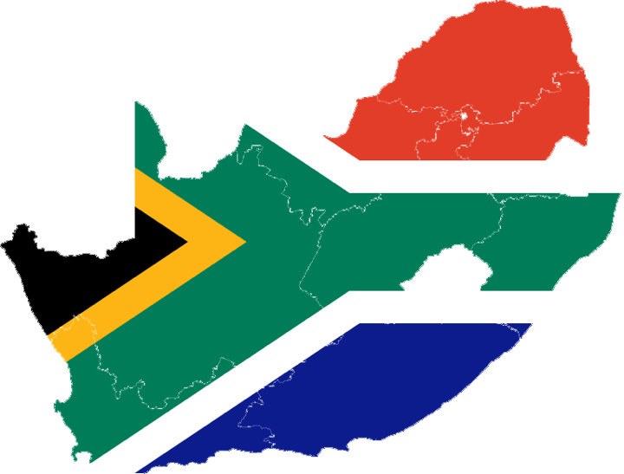
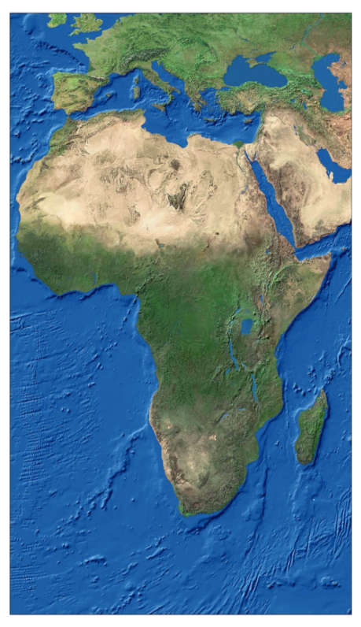
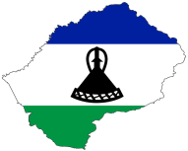

INTRODUCTION (2 OF 11)

Slide 5
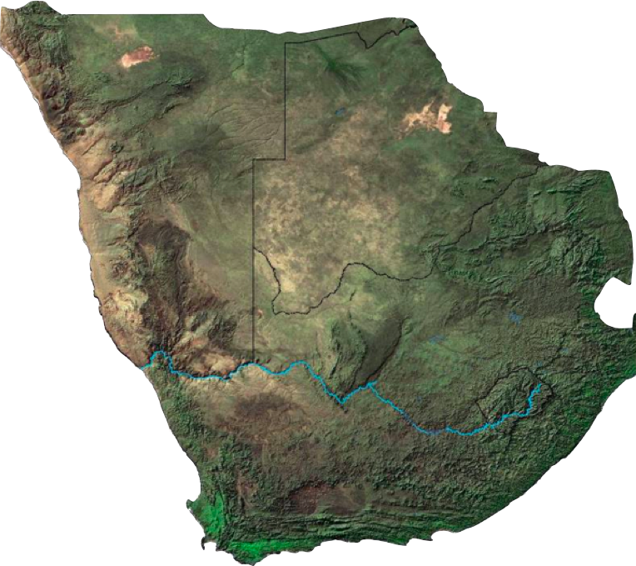
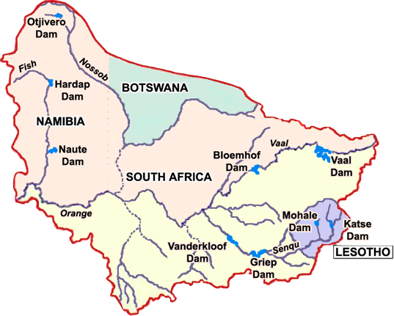
INTRODUCTION (3 OF 11)
Basin Area : 1 million sq km.
INTRODUCTION (3 OF 3)
Rain-fall : 1800mm in Lesotho highlands to 45mm at River mouth.
Population Depending on Basin Water: 19 million (Earle et al. 2004).
Precipitation: MAR = 11 900 Mm3 (377 M3/s = 0.9% of Mighty Congo River Flow (41000m3/s) , & about 30% of Total) reaches river mouth
Population Living Within Basin: 14,27 million
Basin States:
Botswana, Lesotho, Namibia and South Africa.

Slide 6
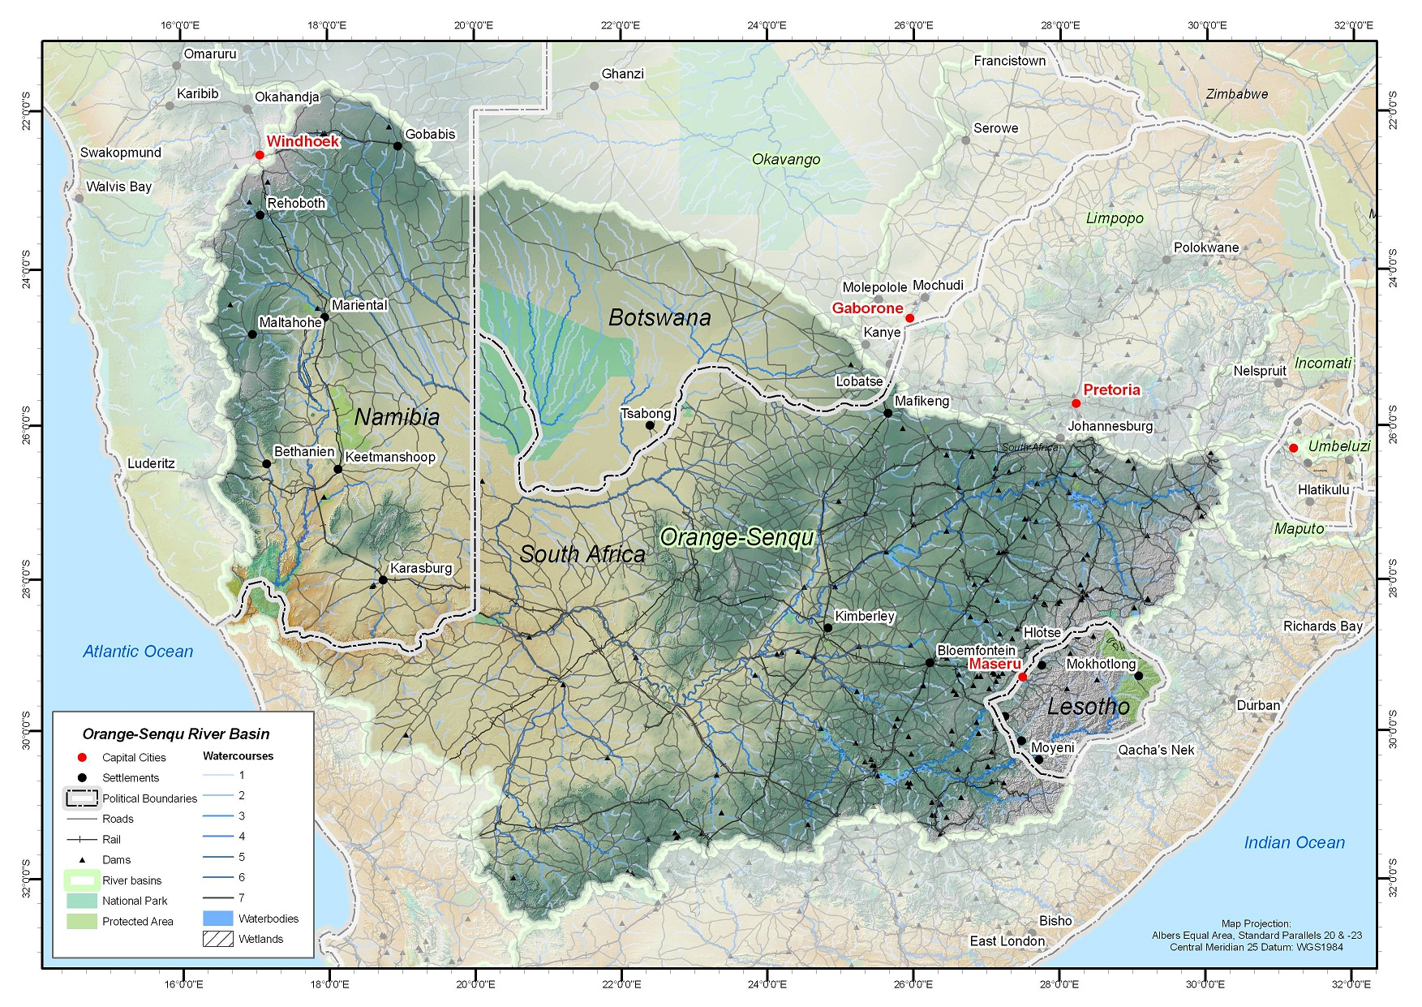
Natural Hydrology (4 of 11)
Botswana
MAR = 0.3%
Total basin area = 7.9%
Namibia
MAR = 5.2%
Total basin area = 24.5%
South Africa
MAR = 53%
Total basin area = 64.2%
Lesotho:
MAR = 41.5%
Total basin area = 3.4%
Source: Hatfield Consultants Africa, 2011
Notes:
Lesotho’s contribution to the Orange-Senqu River Basin in terms of mean annual run-off (MAR) is considerable, given that it provides 41.5% of water to the basin, from a mere 3.4% of total basin area. South Africa has the largest area of the basin within its territory i.e. 64.2% of total basin area, and contributes the most water i.e. 53% to the MAR. Botswana contributes 0.3% of water to the MAR from 7.9% of total basin area. Namibia contributes 5.2% to the basin’s MAR from 24.5% of the total basin area.

Slide 7
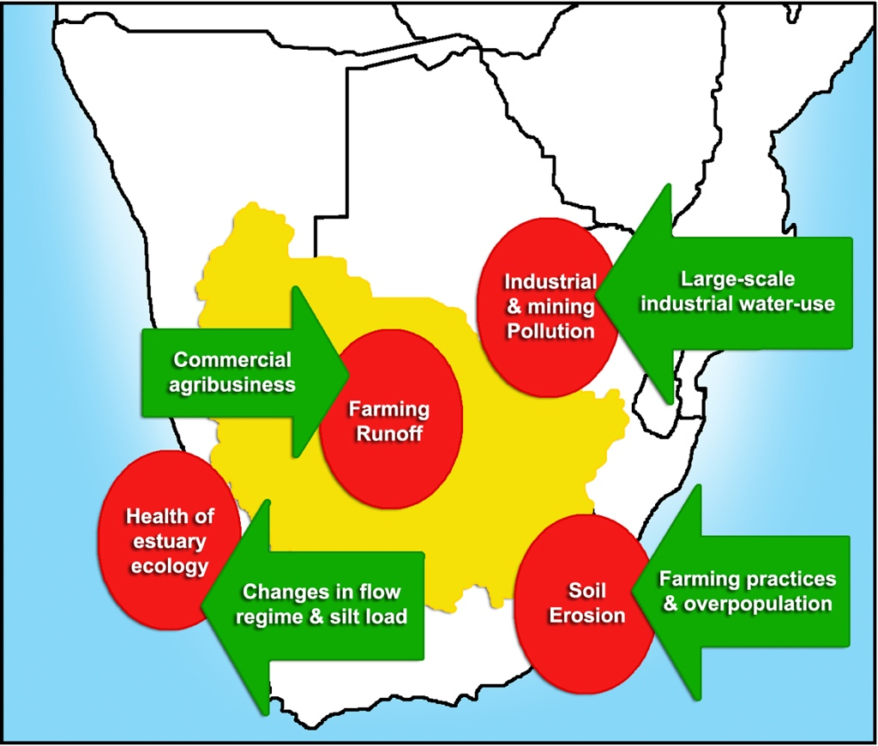
Key challenges in the Orange-Senqu basin
(Source: GTZ)
Introduction
(5 OF 11)

Slide 8





Introduction – 6 of 11)
Joint Technical Commission
1987
Permanent Water
Commission & Joint
Irrigation Authority
1992
2000
Joint Permanent Technical Committee
1983
Joint Technical Committee
1978
Joint Permanent Technical Commission
1986
Joint Permanent Water Committee
1990
Lesotho Highlands
Water Commission
1999
1975
2011
Botswana
Lesotho
Mandate: To advise Parties on matters related to development, utilisation and conservation of the water resources in the River system.
Namibia
South Africa

Slide 9
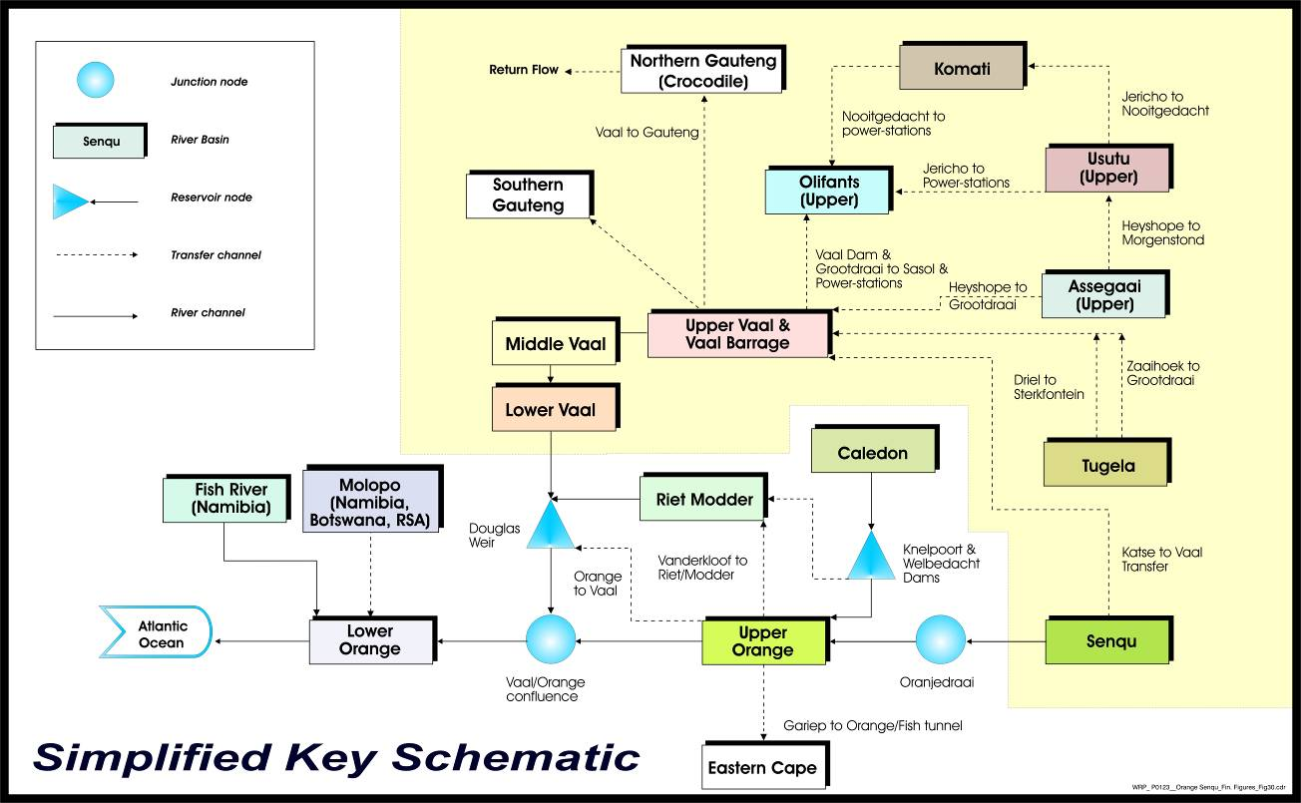
INTEGRATED ORANGE VAAL SYSTEM
INTRODUCTION (7 OF 11)
Support Sub-systems
Orange
Vaal
(LHWP) Senqu
Shared Resource
Notes:
This schematic diagram provides an overview of the larger dams and major inter-basin transfer schemes which allow water to be moved from one part of the basin to another as well as into and out of the neighbouring basins. These store and move bulk water to demand centres including the Gauteng Province industrial heartland of South Africa, large-scale irrigation and meet the domestic needs of the 19 million people. The dams and transfer schemes are mostly on the upper Orange–Senqu and Vaal river systems, but also supply water to irrigation schemes along the lower Orange where, away from the main river, groundwater is often the only source of water.
The Basin/system is regulated by more than 30 major dams, six of which have storage capacities over 1,000 Mm3, namely Gariep (5,342.9), Vanderkloof (3,187.1), Sterkfontein (2,617.0), Vaal (2,606.8), Katse (1,950.0), and Bloemhof (1,511.7). The most downstream of these dams, the Vanderkloof Dam is more than 1500 km upstream of the river mouth but since the contributions of tributaries downstream of this dam are either small or highly seasonal, the flow regime for much of the year is largely driven by releases from this dam.
The most significant inter-basin transfers include the transfer of water from the Lesotho highlands to the Vaal sub-basin, from the adjacent Tugela basin to the Sterkfontein Dam and from the Gariep Dam on the Orange River to the eastern Cape.
The tributaries downstream of the Orange and Vaal confluence are the:- (i) Molopo-Nossob sub-basin system which is ephemeral in nature, and (ii) the Fish River sub-basin, which is further downstream and entirely located within Namibia, and accounts for the two (Hardap, Naute Dams) of the seven dams regulating the flows from Namibia into the Orange River.
Infrastructure is used to control the availability of water during times of stress. Impounding water also allows more intensive use of water resources.

Slide 10
Introduction : 8 OF 11
IVRS Demand Distribution
Large Industries
12%
Losses 9%
Irrigation
29%
Urban & Industrial
50%
Total High Demand at 2014
3 088 million m³/a (Scen A)

Slide 11
Introduction : 9 OF 11
Vaal Small systems Demand distribution
Vaal Small sub-systems 880 million m³/a

Slide 12
Orange/Senqu Demand 4 550 million m³/a (Excluding Vaal)
Introduction : 10 OF 11
Without EWR total demand 4 260 million m³/a

Slide 13
Orange-Senqu GDP
Introduction : 11 OF 11
2%
100%
7%
20%
6%
Notes:
The relative GDP contribution of each Orange Senqu basin member state (with South Africa split into the Vaal and Orange River Basins) is shown in the slide above. As a result of the different GDP contributions of each sector, the water quality and quantity demands are likely to be different. The efficiency through which water is used is also likely to be different between sectors.

Slide 14
Programme Delivery (1 OF 6)
From 2004 to 2007, ORASECOM undertook Phase I of IWRM planning with support of GIZ, and focussed on collating existing information that then described the water resources of the Basin, covering the following topics:
  hydrology and water resource availability;
  economics and current use of economic tools in water resource management and allocation;
  demographics, water demand, and water resources development in the basin;
  water infrastructure in the basin;
  policy, legal and institutional frameworks related to water resources management in the basin;
  water quality and pollution;
  ground water availability and use; and
  environmental considerations.

Slide 15
Programme Delivery (2 OF 6)
From 2007 to 2009, Undertook the following Studies and Initiatives with support of FGEF:-
  Protection of Water Sources “Sponges” in the Highlands of Lesotho
  Feasibility Study of the Potential for Sustainable Water Resources Development in the Molopo-Nossob Watercourse
  Design and Planning Definitive Capacity Building Programme for Technical Staff/Experts/Commissioners And Stakeholders
  Feasibility Study for Development of Mechanism to Mobilize Funds for Catchment Conservation
  Groundwater Review of the Molopo-Nossob Basin for Rural Communities including Assessment of National Databases at the Sub-basin Level for Possible Future Integration
  Feasibility Study on the Potential Development and Use of Marginal Waters

Slide 16
Programme Delivery (3 OF 6)
From 2009 to 2013, Undertook Phase II of the ORASECOM IWRM planning programme with support of GIZ, focusing on filling knowledge gaps in the following six areas:-
  Water Resources Modelling
  Hydrological Studies
  Water Quality Management
  Climate Change
  Environmental Flow Requirements
  Irrigation Efficiency

Slide 17
Programme Delivery (4 OF 6)
From 2009 to 2013, Undertook work in following Six Result Areas with support of EU:
  Strengthening of ORASECOM on basin management, policy and legal issues
  Enhancing of Capacity for Shared Water Courses Management in all riparian states thru a number of training courses
  Development of a shared information system that promotes the development of a common understanding for decision-making e.g. development of a transboundary water quality monitoring programme for the Basin (JBSs 1 in 2010 and 2 in 2015. IDEA ALSO LEARNED FROM TWINING WITH THE ICPDR)
  Enhancing ORASECOM communication and awareness building processes e.g. development of a Communications Strategy and teasing out on how stakeholder participation could be implemented in the Basin given differing disparities and interests
  Dialoguing towards the Orange-Senqu Integrated Water Resources Management Plan e.g. a Number of Delphi Workshops were held discussing topics like what type of Plan is desired etc
  Activities on demonstrating water conservation and environmental strategies

Slide 18
Programme Delivery (5 OF 6)
From 2009 to 2013, Undertook Trans-boundary Diagnostic Analysis (TDA) of environmental sustainability impacts and causes of those, and development of a Basin Wide Strategic Action Plan (SAP) and National Action Plans (NAPs) to address identified environmental sustainability challenges and causes, with support of UNDP-GEF. The work also included the following other components:
  Institutional Strengthening of ORASECOM e.g. establishment of a Water Information System for ORASECOM
  Improving Communications and Public Participation
  Demonstration Projects i.e. environmental flows requirement assessment for the lower part of the Basin (downstream of Noordoewer/Vioolsdrift, Fish River in Namibia, and the river mouth), irrigation efficiency demonstration in some of the farms belonging to the Joint Irrigation Authority between Namibia and South Africa; and addressing land degradation and providing alternative livelihood for affected communities in Lesotho and Botswana.
Four environmental priority areas of concern identified in the TDA are:
    • Increasing water demand
    • Declining water resources quality
    • Changes to the hydrological regime
    • Land degradation.

Slide 19
Programme Delivery (6 OF 6)
From 2013 to 2015, Undertook Phase III of the ORASECOM IWRM planning programme focusing on the consolidation of a 10 year (2015 to 2024) IWRM Plan for the Basin based on all work done since Establishment of ORASECOM in 2000
New information in the following further knowledge Gap Areas were also included:-
  Economic Accounting of Water
  Water Demands Infrastructure
  Water Resources Modelling
  Environmental Flows and Water Quality
  Economic Instruments

Slide 20
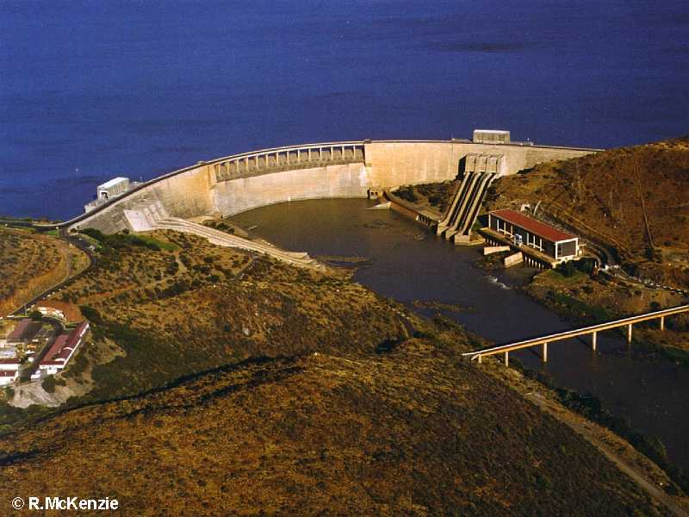
Legal Context –ORASECOM AGREEMENT (1 OF 20)
ARTICLE 4 (2000) : MANDATE: ORASECOM serves as advisor to State Parties on matters related to development, utilisation and conservation of water resources in the River system.
Revised Agreement: Article (8) (1) – Objects of the Commission:- (1) The object of the Commission shall be to initiate, enhance, and maintain greater collaboration between the Parties on matters relating but not limited to— (e) groundwater management and use
ARTICLE 5 : FUNCTIONS: ORASECOM to advice Parties on measures such as:-
  Standardized form of collection, processing and dissemination of data and information with regards of all aspects of the river
ARTICLE 7.4 : OBLIGATIONS OF THE PARTIES and Article 4 (1) ( e) of Revised Agreement :
Parties shall exchange available information and data regarding the hydrological, hydrogeological, water quality, meteorological and
environmental condition of the River System

Slide 21
GW Supporting Institnal Arrangements
(2 OF 20)
Forum of the Parties (Ministers)
Council of Commissioners
Task Teams (4)
Secretariat
Technical
Legal
Finance
Communications
Water Resources Quality Working Group
Ground Water Hydrology Committee
& Surface Water Hydrology Working Group
Executive Secretary
National Seconded Staff (2)
Legal Expert
Core Staff (7 including E.S.)
Water Resources Economist
Water Resources Specialist
Programme Coordinator
Communications and Knowledge Management Specialist
Finance and Administration Officer
Policy Analyst
Administration Assistant

Slide 22
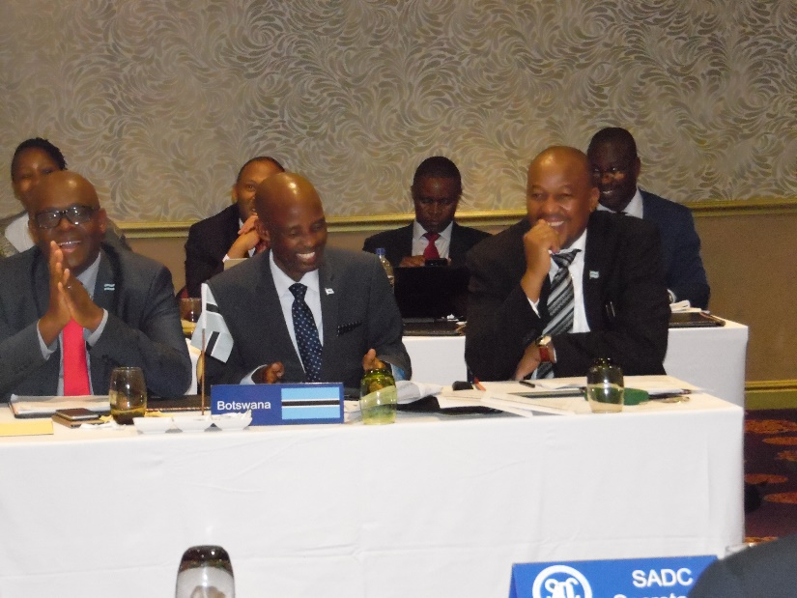
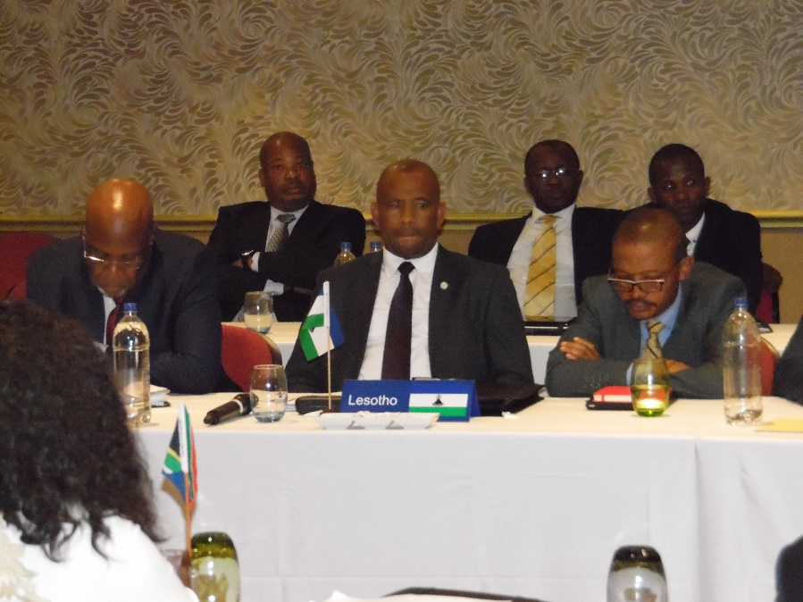
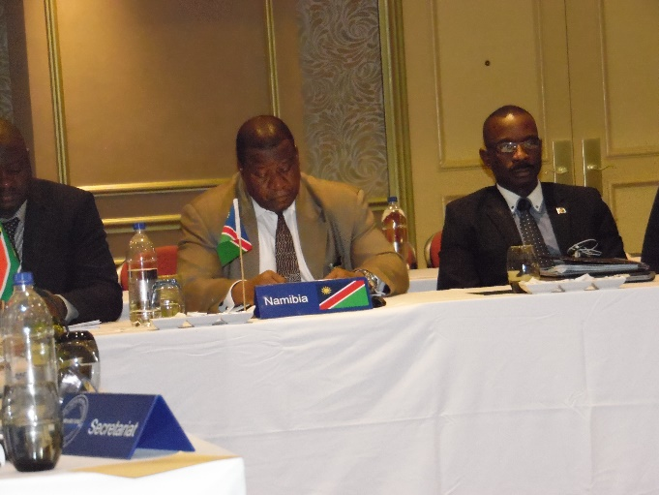
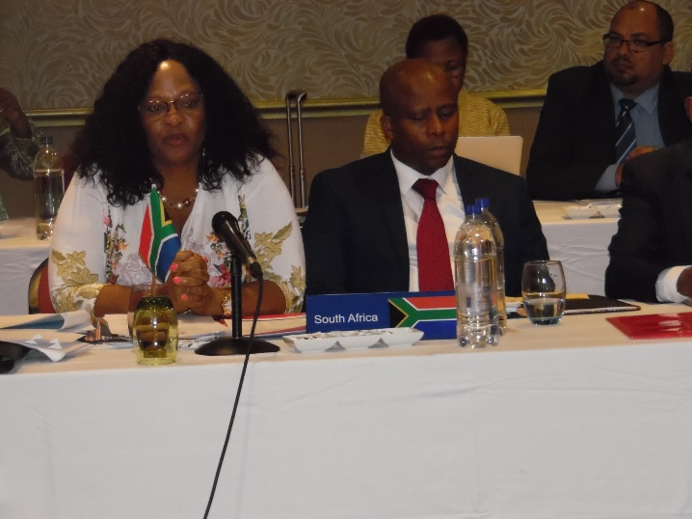
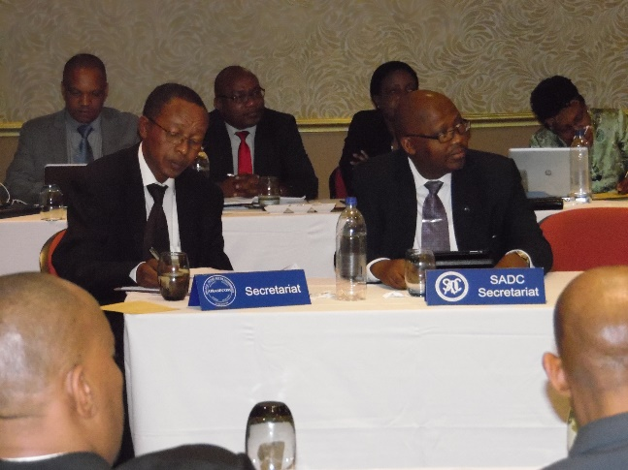
GW Supporting Institnal Arrangements (3 OF 20)

Slide 23
IWRM Plan (2015 to 2024) (4 OF 20)
Central strategic Objectives | Enabling strategic objectives | Cross-cutting strategic objectives
Ensure the optimized sustainable management of the basins water resources Support socioeconomic upliftment and eradication of poverty in the basin Ensure that the adverse effects of catchment degradation are reduced and the sustainability of resource use is improved Maximize security from water-related disasters (especially flood and drought) | Put an adequate knowledge base in place Build sufficient capacity and institutional strength Promote high level of stakeholder engagement Ensure appropriate financing mechanisms are in place Promote adaptive management and effective monitoring and evaluation systems. | Promote the mainstreaming of adaptation to potential impacts of climate change into planned actions Ensure the mainstreaming of gender considerations into planned actions

Slide 24
Strategic/Specific Actions in IWRM Plan
(6 OF 20)
1.1.2: Improve assessments of aquifers (storage capacities, recharge rates, sustainable yields and other characteristics)
1.2.1.4: Incorporate groundwater resources into the overall planning model starting with transboundary aquifers and (potential) conjunctive use aquifers
5.1.3.1: Improved monitoring of transboundary aquifers aimed at better quantification of resource (SAP PCN 2 - O1.1)
5.1.3.2: Development of a common platform for the sharing of data on transboundary aquifers
5.1.3.3: Improve monitoring of key national aquifers and sharing of data, including the impacts of fracking

Slide 25
Projects Being Mobilised - IWRM Plan Implementation –GW Components (7 OF 20)
Improved understanding of groundwater systems in the basin, with support of GIZ. To include:-
  Documenting groundwater recharge in transboundary aquifers as well as significant national aquifers of the basin. An aquifer may be deemed signif-icant according to its performance and level of dependence by users.
  Development of a framework for monitoring of important features and characteristics of transboundary aquifers in the basin
  Establishing a groundwater focused information system at the Secretariat, with agreed parameters for monitoring by mandated agencies at national level.
  Conducting joint familiarisation survey of one transboundary aquifer by the recently established groundwater committee of ORASECOM
Support to the Orange-Senqu River Strategic Action Programme Implementation (being negotiated with UNDP-GEF)
  OUTCOME 2.3: quantity and quality of groundwater resources determined and low-cost groundwater desalination plants piloted in Botswana

Slide 26
Trans Boundary Aquifers in SADC (2011)
(8 OF 20)

Slide 27
Institutional Arrangements
(9 OF 20)

Slide 28
Monitoring boreholes Molopo-Nossob Basin
(10 OF 20)

Slide 29
Springs (11 OF 20)

Slide 30
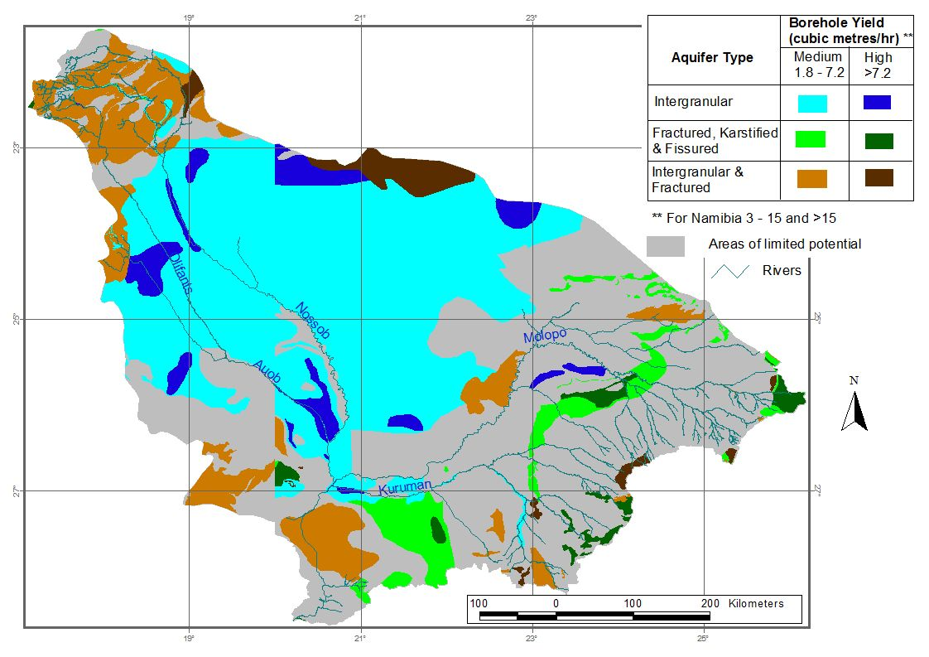
Groundwater Potential Map over Molopo-Nossob Basin
(12 OF 20)

Slide 31
Recharge map (CMB)
(13 OF 20)

Slide 32
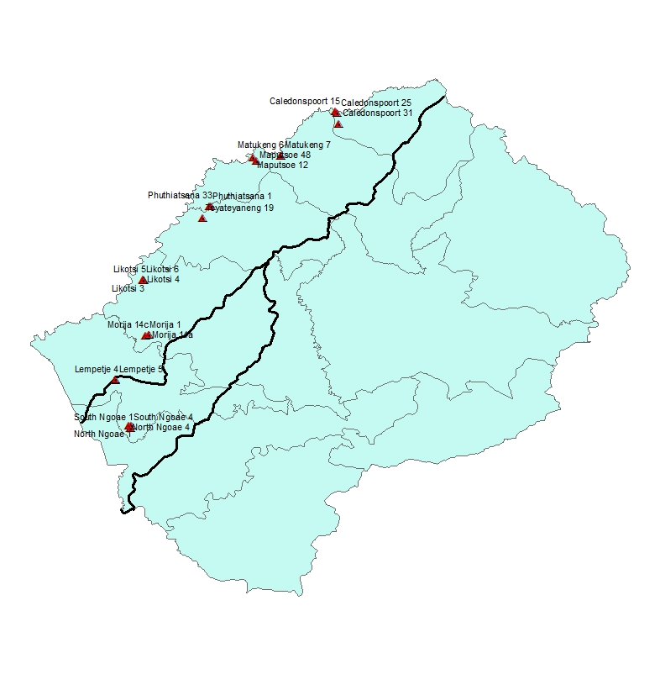
Key Monitoirng Boreholes in Lesotho Part of the Basin
(14 OF 20)

Slide 33
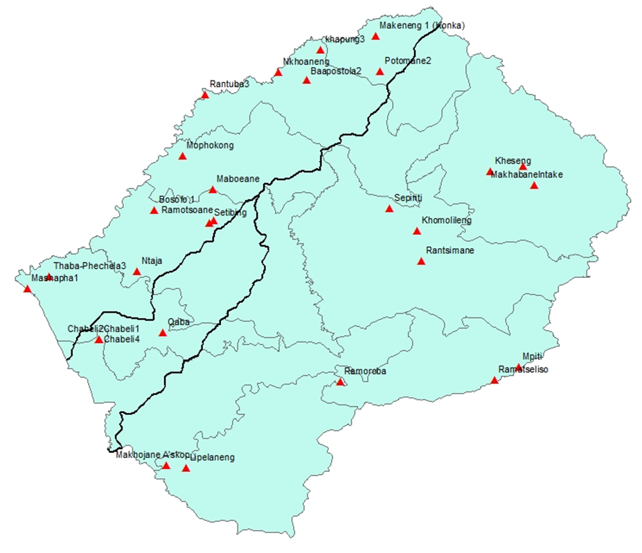
Key monitoring springs in Lesotho Part of the Basin (15 OF 20)

Slide 34
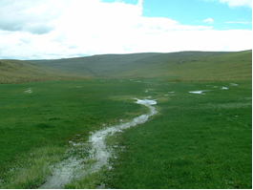
unspoiled wetland (16 OF 20)

Slide 35
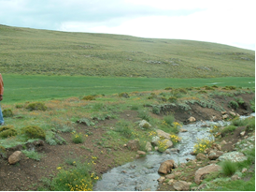
degraded wetlands (17 OF 20)

Slide 36
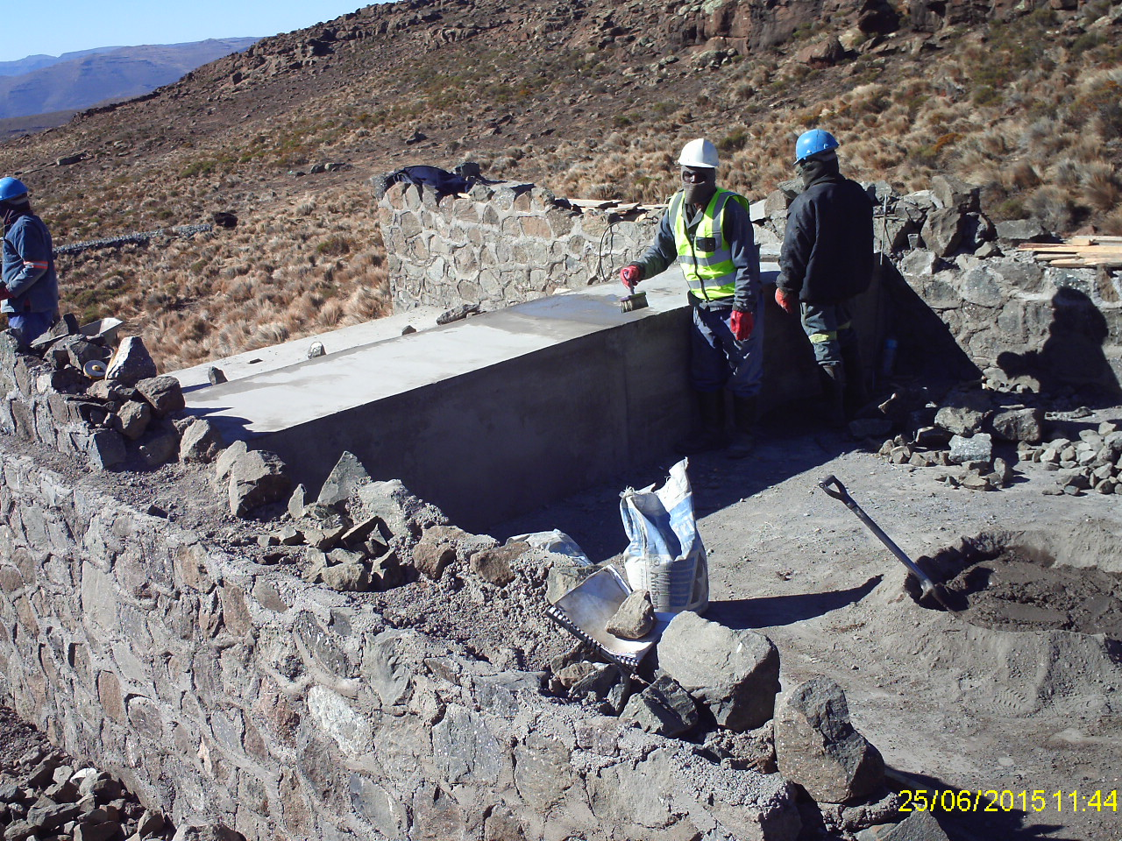
Wetland Rehabilitation with weir (18 OF 20)

Slide 37
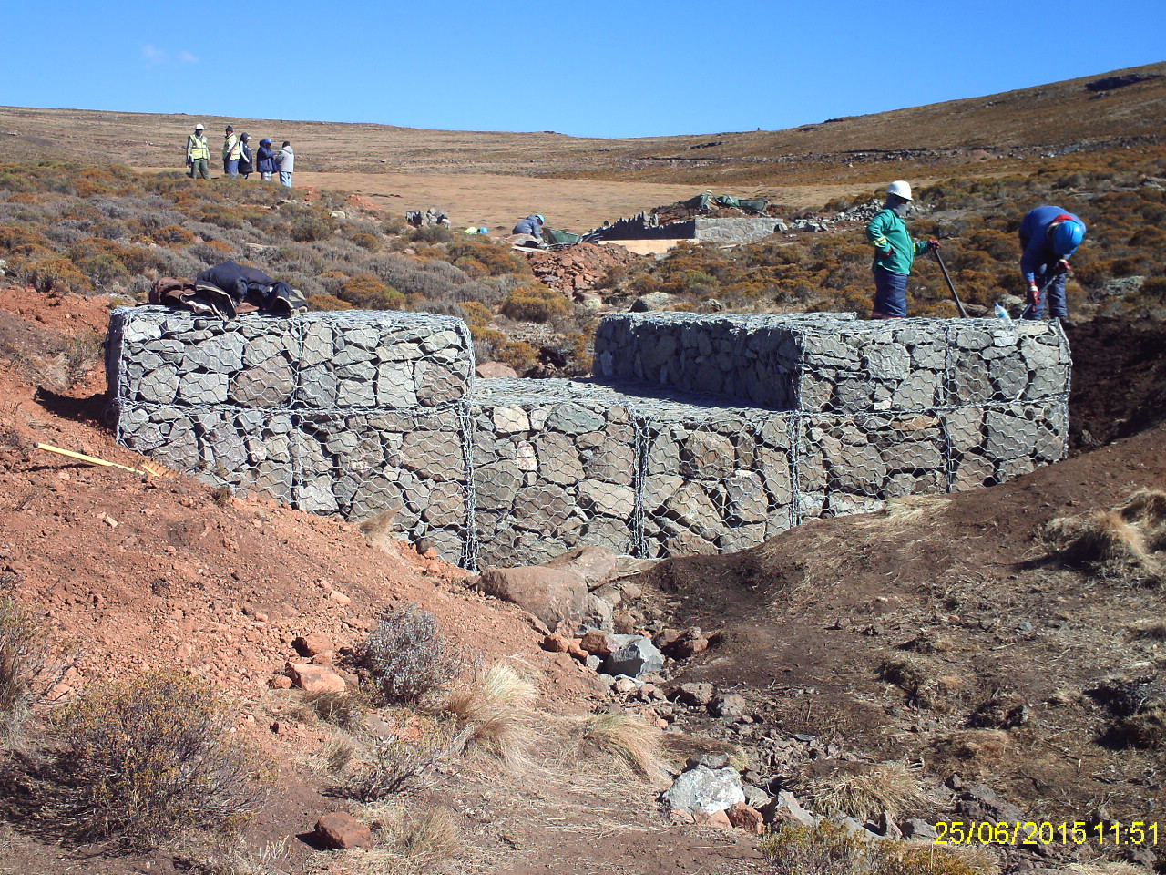
Wetland Rehabilitation with gabions (19 OF 20)

Slide 38
TRAINING ON “INTEGRATION OF GROUNDWATER MANAGEMENT INTO AFRICAN BASIN ORGANISATIONS” ORANGE-SENQU RIVER COMMISION (ORASECOM), 23-27 Sept. 2013, Wits University, Joburg, South Africa (20 OF 20)
Partners:
AFGWN
BGR
IWMI
Wits University
SADC
WRC
UWC
Process:
Basic GW Mngt Concepts & Strategies, wif connection to CC, Food Security, etc
Group Exerciese, role plays, field visit to AMD Site, Randfontein, East Gauteng

Slide 39
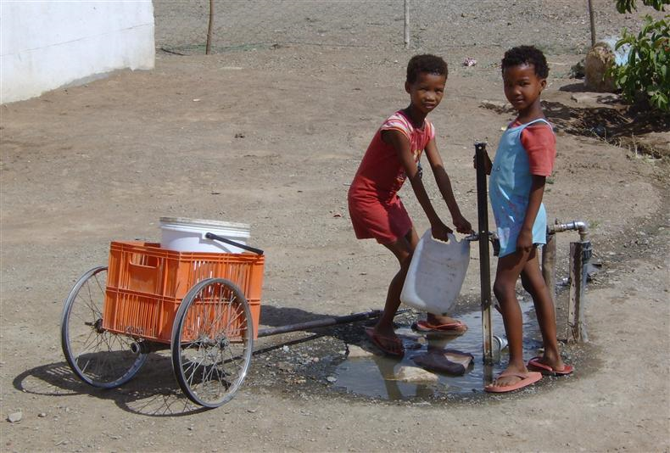
Thank you.
www.orasecom.org
Thank you.
www.orasecom.org

