Slide 1
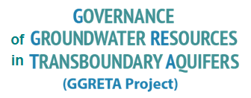
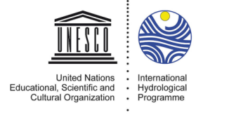
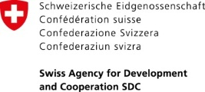
Stampriet Transboudnary Aquifer System (STAS) assessment
Main achievements –
Regional Meeting on Transboundary Aquifers in Africa
5-8 September 2017, Tunis
Dr Piet Kenabatho, University of Botswana
GGRETA Assessment Report Coordinator
6 September 2017
Tunis, Tunisia

Slide 2
The GGRETA Project (Governance of Groundwater Resources in Transboundary Aquifers )
The project’s overall objectives
Improve the knowledge and recognition of the importance and vulnerability of transboundary groundwater resources
Strengthen cross-border dialogue and cooperation,
Develop shared management tools
Facilitate governance reforms focused on improving livelihoods, economic development and environmental sustainability.

Slide 3
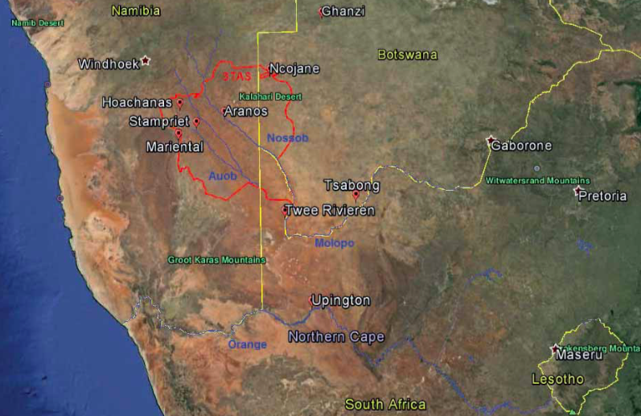
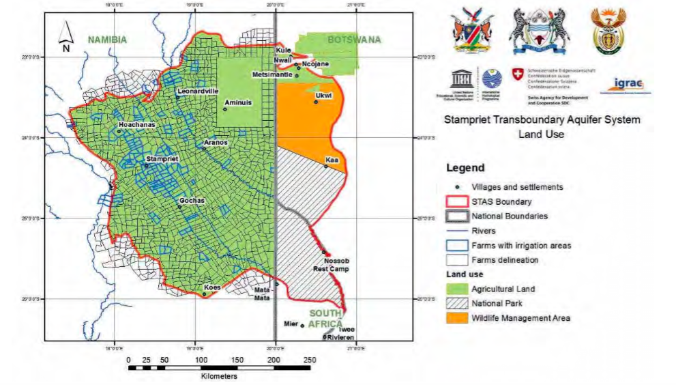
The importance of STAS
Area: 86 000 km²
Rainfall: 150-300 mm/yr
Population: 50 000
Main economic activity: Agriculture and livestock
Human dependency on groundwater:
100%
Considered as one of the 5 TBA hotspots in Southern Africa (SADC, 2016)

Slide 4
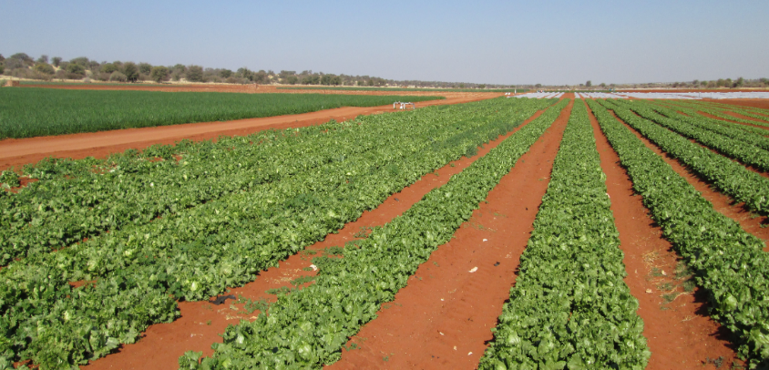
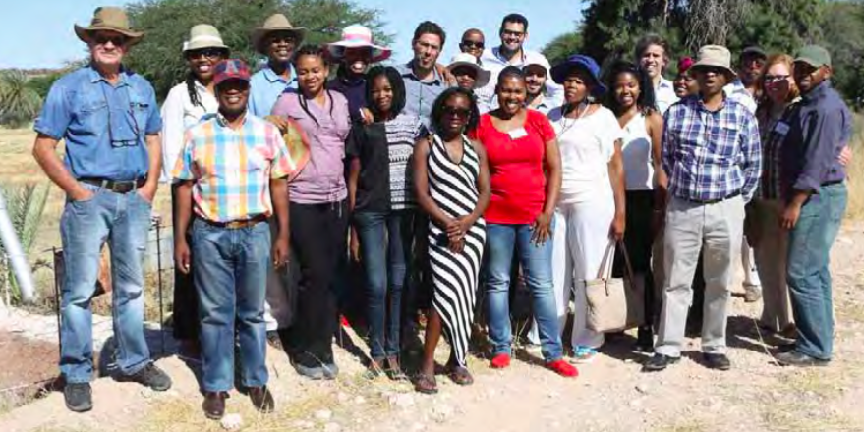
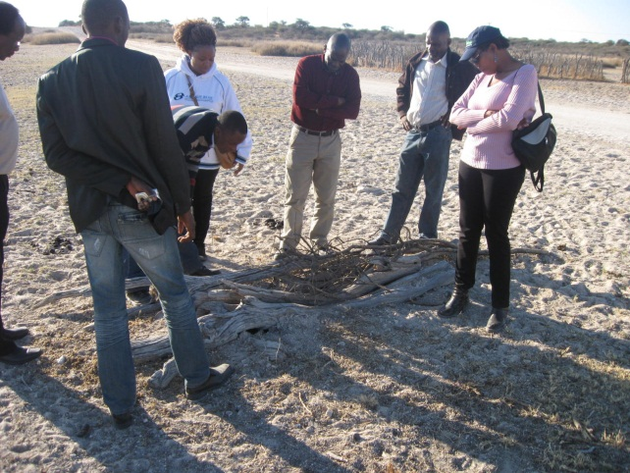
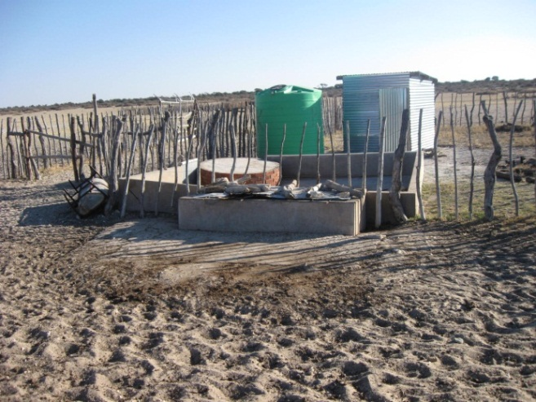
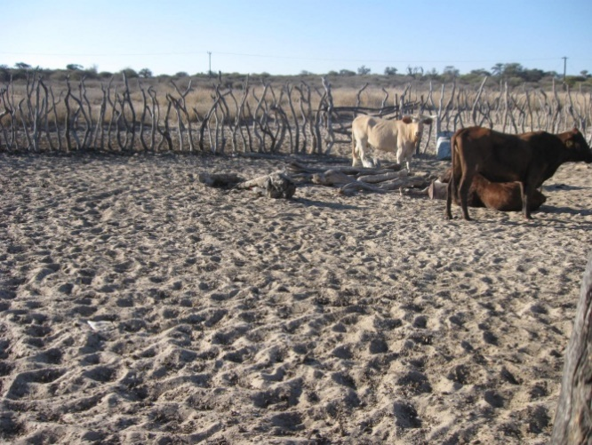
One of the irrigation farms in the STAS area (Namibia)
Group Photo @ Mariental, Namibia
Hand dug wells and Properly equipped water storage, Phepane, Botswana

Slide 5
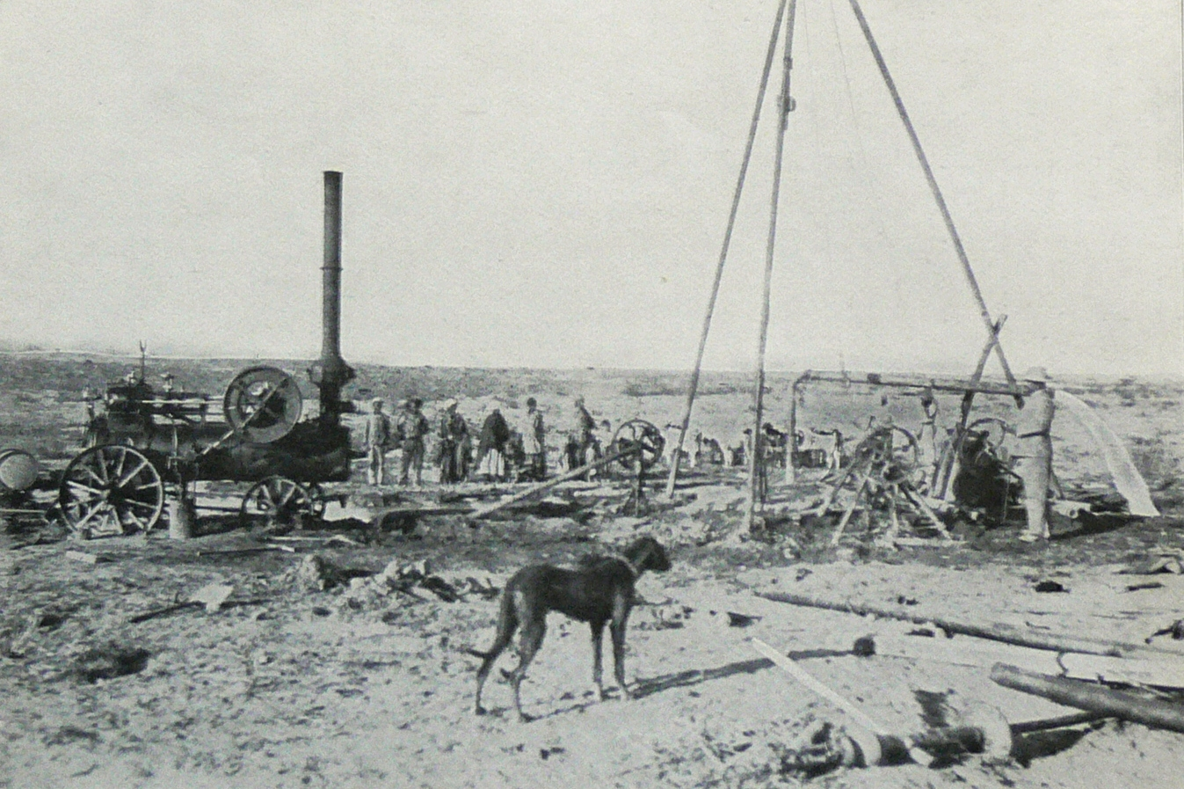
Historical background
1912: In the search for coal, Dr. Paul Range discovered struck artesian water in the Stampriet Artesian Basin (SAB): a borehole at Stamprietfontein (Namibia).
After World War I: farms were developed for South African ex-soldiers along the Auob River.
After World War II: further farms were developed for South African ex-soldiers, this time in the farther east lying Nossob River area.
1960s to 80s: Groundwater investigations and exploration for hydrocarbons
1970s and early 80s: Hydrochemistry investigations
From 1980s onwards: JICA study (2002) in Namibia and Matsheng study (2008) in Botswana
First artesian water was struck in 1912 (110m³/hr free flowing artesian borehole)

Slide 6
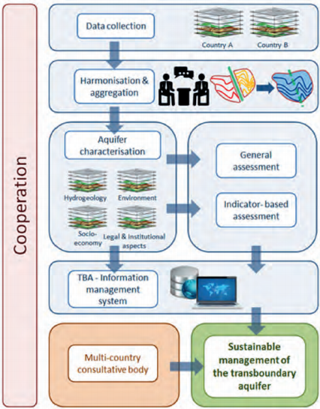
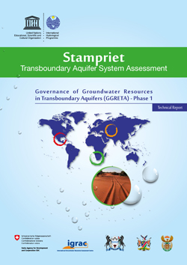
STAS GGRETA 1 – Main objective
Multi-disciplinary in-depth assessment
Hydrogeological aspects
Environmental issues
Socio-economic aspects
Institutional setting
Legal framework

Slide 7
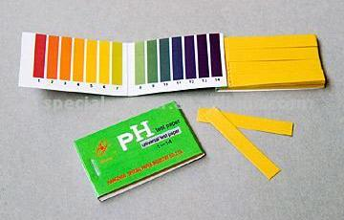
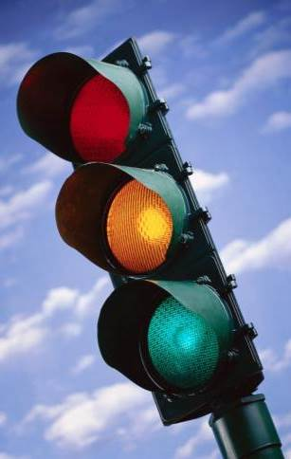
STAS GGRETA 1 assessment indicators
Indicators: - Smart combinations of variables in order to describe the complex aquifer system in 20 easy to understand and intuitive indicators
- UNESCO’s methodology based on measurable and monitorable indicators proved to be a springboard to facilitate the formulation of policy reforms

Slide 8
STAS GGRETA 1 structure

Slide 9
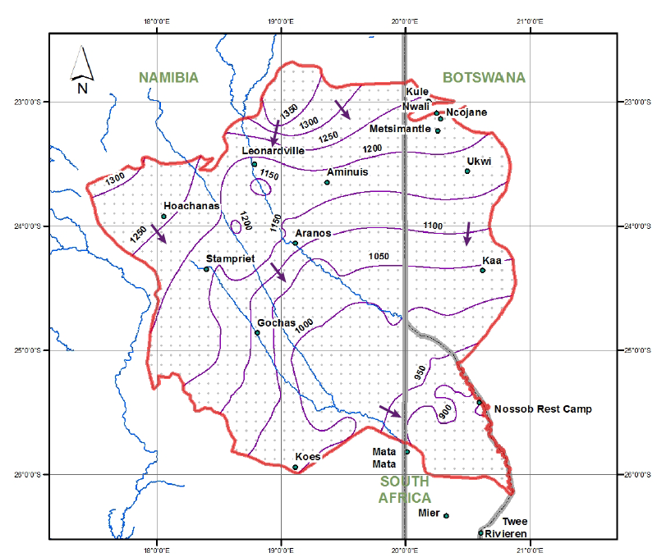
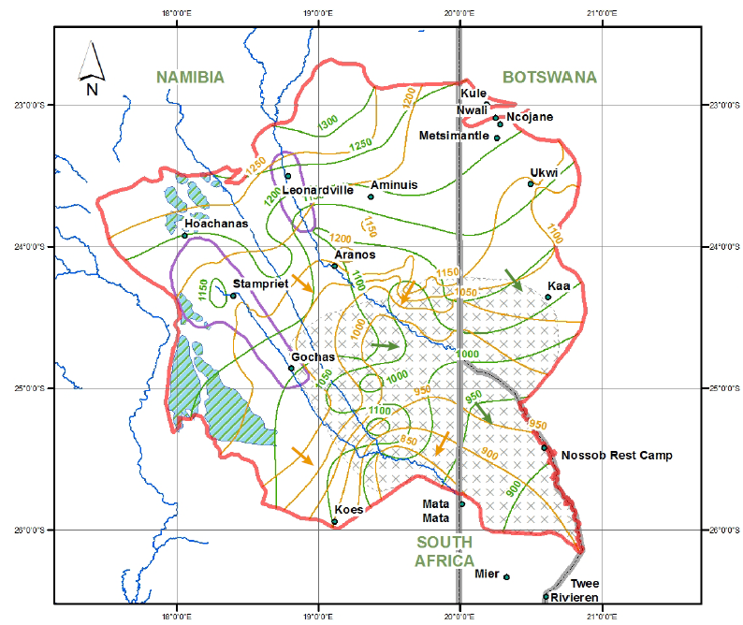
Main achievements
A step towards better cooperation and improved trust between the 3 countries
Improved knowledge and recognition of the importance and vulnerability of transboundary groundwater resources:
Agreement on the delineation of the STAS.
Agreement on a STAS hydrogeological conceptual model (covering recharge and discharge areas and rates, groundwater flow, and potential pollution risk areas).
Kalahari
Auob and Nossob

Slide 10
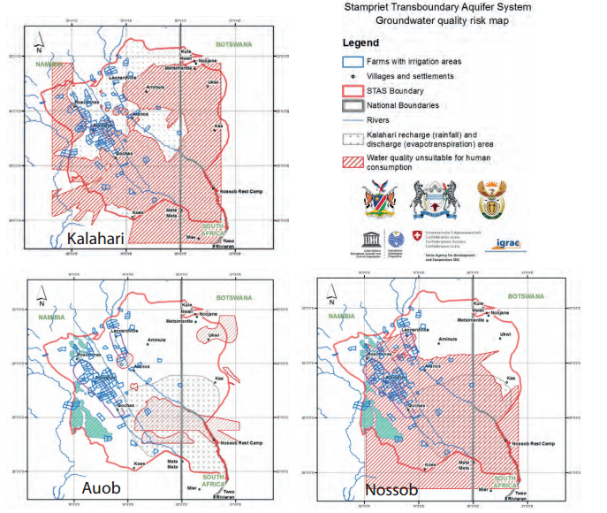
Main achievements
Development of shared management tools (IMS)
Compilation of a joint STAS borehole database (around 6000 boreholes).
Preparation of 60 thematic maps providing information on groundwater levels, quality

Slide 11
Main achievements
Strengthened cross‐border dialogue and cooperation:
Organization of 6 regional meetings held in the three countries of the STAS on a rotation basis, including 2 stakeholder consultation meetings which constituted participants of a broader audience (e.g. regional organizations, farmers, NGOs, …).
Recognition by SADC that the assessment of transboundary aquifers in the region should follow the same approach and methodology similar to the one applied to the STAS.
Application of GGRETA lessons learnt in the assessment of the Ramotswa Transboundary Aquifer shared by Botswana and South Africa.

Slide 12
Main achievements
Facilitation of governance reforms focused on improving livelihoods, economic development and environmental sustainability:
Presentation of two models for the establishment of a Co-operation Mechanism aimed at facilitating cooperation for the management and governance of the STAS.
Capacity-building trainings:
International water law: Focused on the principles and practice of international water law; linkages between international water law and domestic water legislation.
Water diplomacy: Focused on enhancing negotiation and dispute resolution skills, as well as on trust and consensus building.
Information Management System (IMS): Focused on the GGRETA project IMS functionalities.
Notes:
Please be clear that:
The proposal the Countries discussed in the first phase for the cooperation mechanism were only examples. It is now in this phase that the Countries themselves have to set up a Working Group of officials that will decide about the methodology they want for the coordination mechanism supported by experts of UNESCO and by lawyers from their Ministries of Foreign Affairs and other experts selected by them
Discussions about the IMS will happen already here I guess SO you start immediately saying that the second phase will take care to work on funding the data bases at national level to set up the coordination mechanism data base – information system that will then be managed by them as tool for coodination

Slide 13
Key findings and recommendations – Hydrogeology and S&E
The general perception is that there is until present no long-term groundwater depletion/pollution in the area
However, within the context of climate change, the fragility of the system could create conditions of stress in the future if there is overexploitation.
Measures to prevent or counteract potential depletion and pollution problems:
Rehabilitation of leaking wells, by introducing and implementing regulations on well construction and by effective well licensing procedures.
Improvement of the water and sanitation situation, including sewerage and wastewater treatment provisions.
Protection of key recharge zones that may contribute to conserving the resource.
Awareness Raising programs among the area’s inhabitants
Enhancement of the capacity of the institutions responsible for groundwater management in the area.

Slide 14
Key findings and recommendations – Hydrogeology and S&E
Measures to cope with uncertainties on the properties and present state of the aquifer system, in particular on how it behaves over time, in response to abstractions and climatic variation:
Implementing a monitoring system (groundwater levels and groundwater abstraction) is a priority.
Numerical simulation model of the STAS will prove to be indispensible to enable informed decisions on sustainable management of the area’s groundwater resources to be made.
SW-NE cross-section through Aminius, Ncojane (JICA, 2002; Matsheng, 2008).
Question marks indicate the absence of stratigraphic information

Slide 15
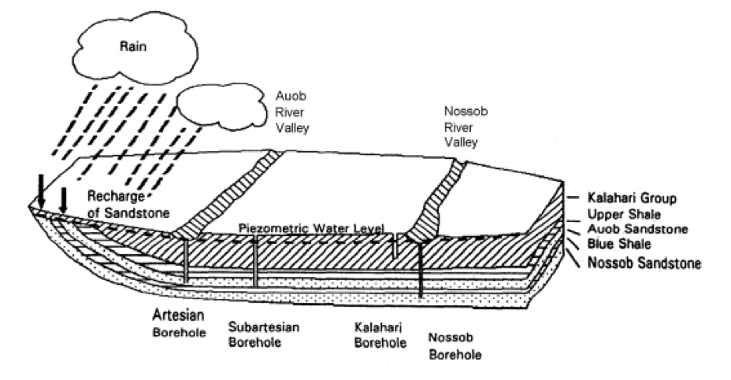
Conceptual Model of the STAS
Simplified conceptual model of the Stampriet Transboundary Aquifer System (STAS)

Slide 16
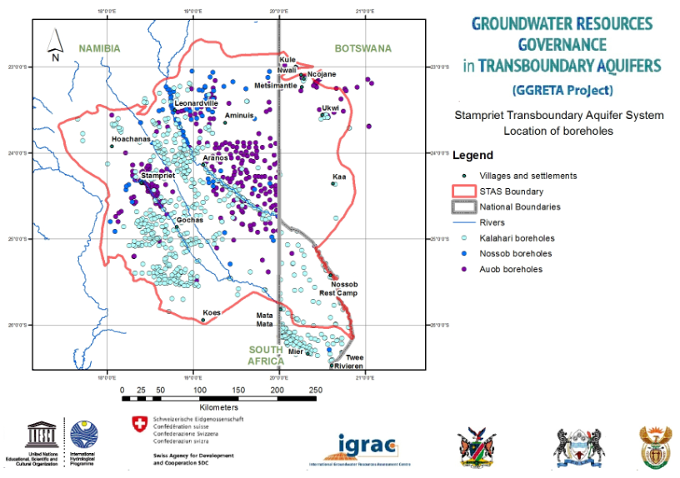
Examples-Gaps Identified-: Deep Boreholes
Boreholes known to penetrate into the Kalahari, Auob and Nossob aquifers in the STAS---Limited Information

Slide 17
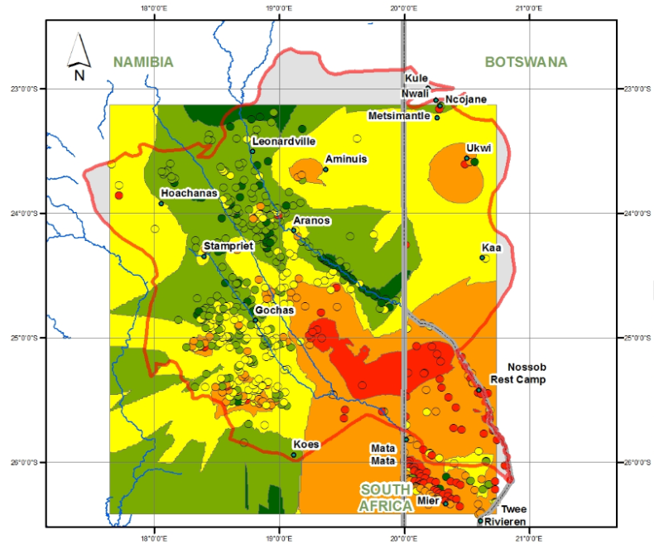
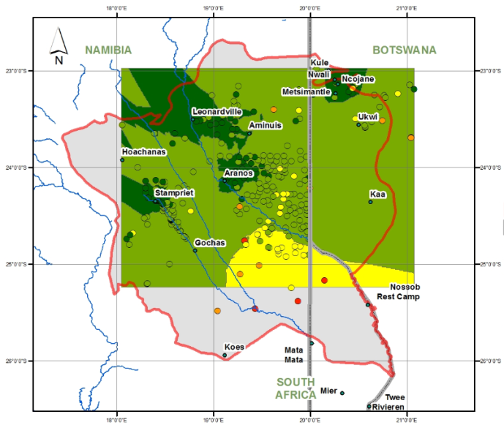
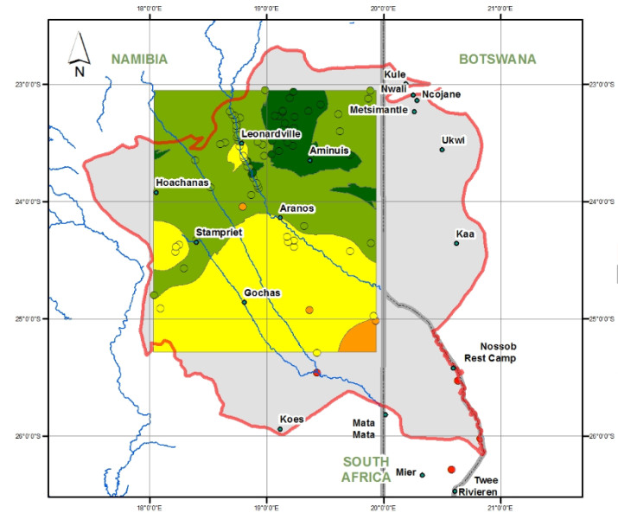
Examples: Gaps Identified-: Water Quality
Total Dissolved Solids (TDS) concentration [mg/l] in the Kalahari (up), Auob (bottom left) and Nossob (bottom right) aquifers in the STAS

Slide 18
Key findings and recommendations – Legal and Institutional
A domestic policy, legal and institutional framework for groundwater is in place in all the three STAS countries. The laws of the three countries regulate abstraction and potential point-source pollution through a permit system. When it comes to non-point source pollution control, other laws step in, typically environmental protection and mining Acts.
From the domestic legal and institutional perspective, it is fair to conclude that the laws in place in the STAS countries are adequate to deal with the challenges ahead of the aquifer.
Strengthening domestic capacities in implementation and enforcement is necessary to support cooperation for the management of the STAS.

Slide 19
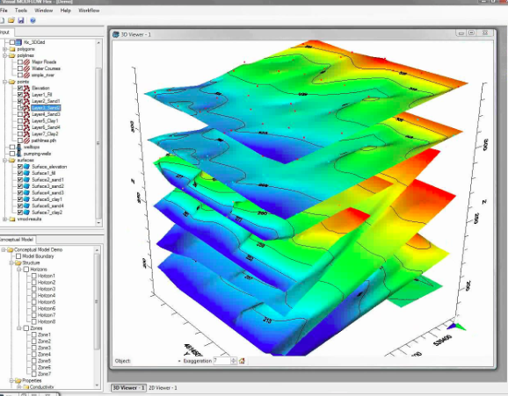
Stampriet Transboundary Aquifer System (STAS) assessment - Way forward (Phase 2)----

Slide 20
GGRETA Phase 2 – Main Objectives
As a continuation of Phase 1, the overall goals for Phase 2 are:
To enhance groundwater governance, develop water related gender-responsive approach, foster cooperation on water security.
Strengthen the technical capacity of the countries sharing the aquifer to consolidate the base for long term sustainable management of the aquifer.
Continuing the process for the establishment of a Multi-Country Cooperation Mechanism (MCCM).
Promote a regional dialogue on coordination and harmonization of groundwater governance frameworks and guiding principles both at national and transboundary levels

Slide 21
Relevance of GGRETA Phase 2
The establishment of a Multi-Country Cooperation Mechanism (MCCM) would be a direct contribution to SDG indicator 6.5.2 on transboundary water cooperation.
Follow up of the Paris Agreement: Direct contribution to National Determined Contributions (NDC)

Slide 22
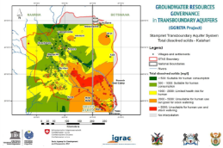
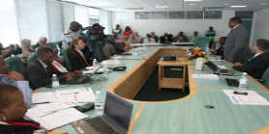
Starting point (GGRETA Phase 1)
In-depth Transboundary Multidisciplinary Assessment
Framework for dialogue on transboundary aquifers management: “STAS family”
Water Diplomacy
From Potential Conflict to Cooperation Potential
Trust-building
Stakeholders mapping, identifying issues and interests
Capacity-building modules: « training for trainers » approach for replication
Modelling
Groundwater governance
Gender
International and domestic water law
Capacity-building Trainings on water diplomacy (multilevel governance, stakholder linking)
Consensus-building
Better understanding of water cooperation benefits to stakeholders at national (e.g. Governments, Diplomats) and local level (e.g. Farmers)
Refinement of GGRETA Phase 1 assessments
Development and upgrade of innovative tools
Information Management Systems
Update of joint database
Data collection protocols
Multi-Country Co-operation Mechanisms
Science for Transboundary Multidisciplinary Assessment
Achievements
Strengthened cross‐border dialogue and cooperation
Understanding of the resource for informed decision-making
Facilitation of governance reforms

Slide 23
GGRETA Phase 2 – Organizational Chart
BOTSWANA
NAMIBIA
SOUTH AFRICA
Working Group for Multi-Country Cooperation Mechanism
Mr Thato Raphaka
Permanent Secretary
Ministry of Land Management, Water & Sanitation Services
Mr Abraham Nehemia
Deputy Permanent Secretary
Ministry of Agriculture, Water and Forestry
Ms Deborah Mochotlhi
Deputy Director General
Department of Water & Sanitation
Government Representatives
Mr Piet Kenabatho
University of Botswana
Ms Maria Amakali
Department of Water Affairs and Forestry
Mr Kwazikwakhe Majola
Department of Water & Sanitation
National Coordinators
Project Management Unit (UNESCO)
National Transboundary Technical Groups (NTTGs)
(Gender)
(Legal and institutional)
(Legal and institutional)
(Hydrogeology + Model)
(Hydrogeology + Model)
(Legal and institutional)
(Gender)
(Hydrogeology + Model)
(Gender)

Slide 24
Way forward in GGRETA Phase 2
Establishment of National Transboundary Technical Groups (NTTGs) for:
Modelling,
Legal and institutional aspects,
Gender aspects.
Establishment of a Working Group for Multi-Country Cooperation Mechamism (MCCM)

Slide 25
GGRETA Phase 2 – Outcomes
Outcome 1 – Improved resource knowledge and monitoring based on recognition of the importance and vulnerability of transboundary groundwater resources.
Outcome 2 - Enhanced cross-border dialogue and cooperation based on development of shared management tools, and recommendations for governance reforms focused on improving livelihoods, economic development, gender equality and environmental sustainability.
Outcome 3 – Improved capacity in groundwater governance, hydro-diplomacy and gender, and effective communication aiming at replication of project experiences and approaches.

Slide 26
GGRETA Project - Outcome 1
Outcome 1 – Improved resource knowledge and monitoring based on recognition of the importance and vulnerability of transboundary groundwater resources.
Main objectives
Upgrading and updating of joint database and monitoring protocols (e.g. time series data…)
Develop a model for filling existing knowledge gaps (e.g. estimations, …)

Slide 27
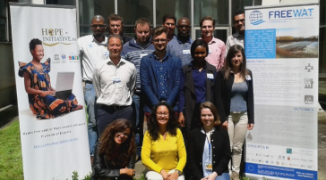
SOFTWARE DEVELOPMENT AND CAPACITY BUILDING
APPLICATION OF THE FREEWAT PLATFORM
Objective: Support Policy
STAS model simulations and scenarios (participatory approach)
Training the trainers and national trainings
STAS model implementation and calibration
Preparation of data for STAS model
Preparation of FREEWAT Platform (including QGIS, Modflow, etc…)
September – December 2016
January – April 2017
Model developed in partnership with FREEWAT project

Slide 28
GGRETA Project - Outcome 2
Outcome 2 - Enhanced cross-border dialogue and cooperation based on development of shared management tools, and recommendations for governance reforms focused on improving livelihoods, economic development, gender equality and environmental sustainability.
Main objectives
Setting-up of a Working Group for the establishment of a Multi-Country Consultation Mechanism
Increased Regional Dialogue on Conjunctive Surface and Groundwater Management in Transboundary Contexts
Notes:
Link can also be considered with AMCOW
We talked about to invite Bai Mass Tall

Slide 29
Working Group for the establishment of a Multi-Country Cooperation Mechanism
Working Group for the establishment of a Multi-Country Cooperation Mechanism (MCCM):
Formulate proposals for the structure, composition, mandate, funding, and functioning of a Multi-Country Consultation Mechanism for the governance and management of the STAS
Regional Dialogue on Conjunctive Surface and Groundwater Management in Transboundary Contexts:
Joint activities with AMCOW, SADC, IGAD, ORASECOM, LIMCOM

Slide 30
GGRETA Project - Outcome 3
Outcome 3 – Improved capacity in groundwater governance, hydro-diplomacy and gender, and effective communication aiming at replication of project experiences and approaches.
Main objectives
Capacity building modules on hydrogeology (modelling), international water law, domestic water legislation, and gender
Includes cross-cutting activities that will contribute to the achievement of Outcomes 1 and 2

