Slide 1
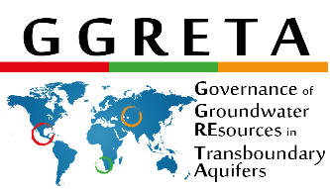
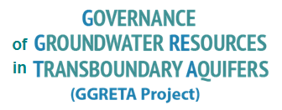
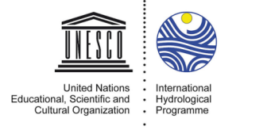
INTERNATIONAL WATER LAW
– A FOCUS ON TRANSBOUNDARY AQUIFERS -
3 April 2017
Pretoria, South Africa
Stefano Burchi, UNESCO
Francesco Sindico, University of Strathclyde
Stefano Burchi UNESCO
Francesco Sindico, Strathclyde

Slide 2
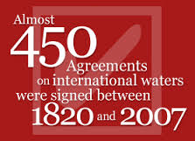
The law of international watercourses and aquifers
The law of international watercourses (and most aquifers) is crystallized in the:
UN Convention on the law of the non-navigational uses of international watercourses, adopted by the UNGA (New York) on 21 May 1997, in force since August 2014
It lays down a number of norms of inter-State behaviour reflecting the practice of States in the matter (“international customary law”)

Slide 3
The law of international watercourses and aquifers
The UN Convention covers – in addition to surface watercourses - all international aquifers which are physically linked to a surface water system
As a result, non-recharging (also known as “fossil”) aquifers escape the scope of coverage of the Convention, and fall in a legal limbo

Slide 4
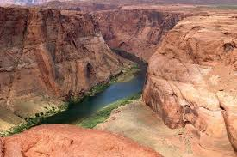
The law of international watercourses and aquifers
This is why the UN adopted in 2008 Resolution 63/124, carrying “Draft Articles on the law of transboundary aquifers”
The Draft Articles carry a body of norms of inter-State behaviour reflecting the practice of States in the matter (“international customary law”)
The Draft Articles are not binding – except for a few “core” norms

Slide 5
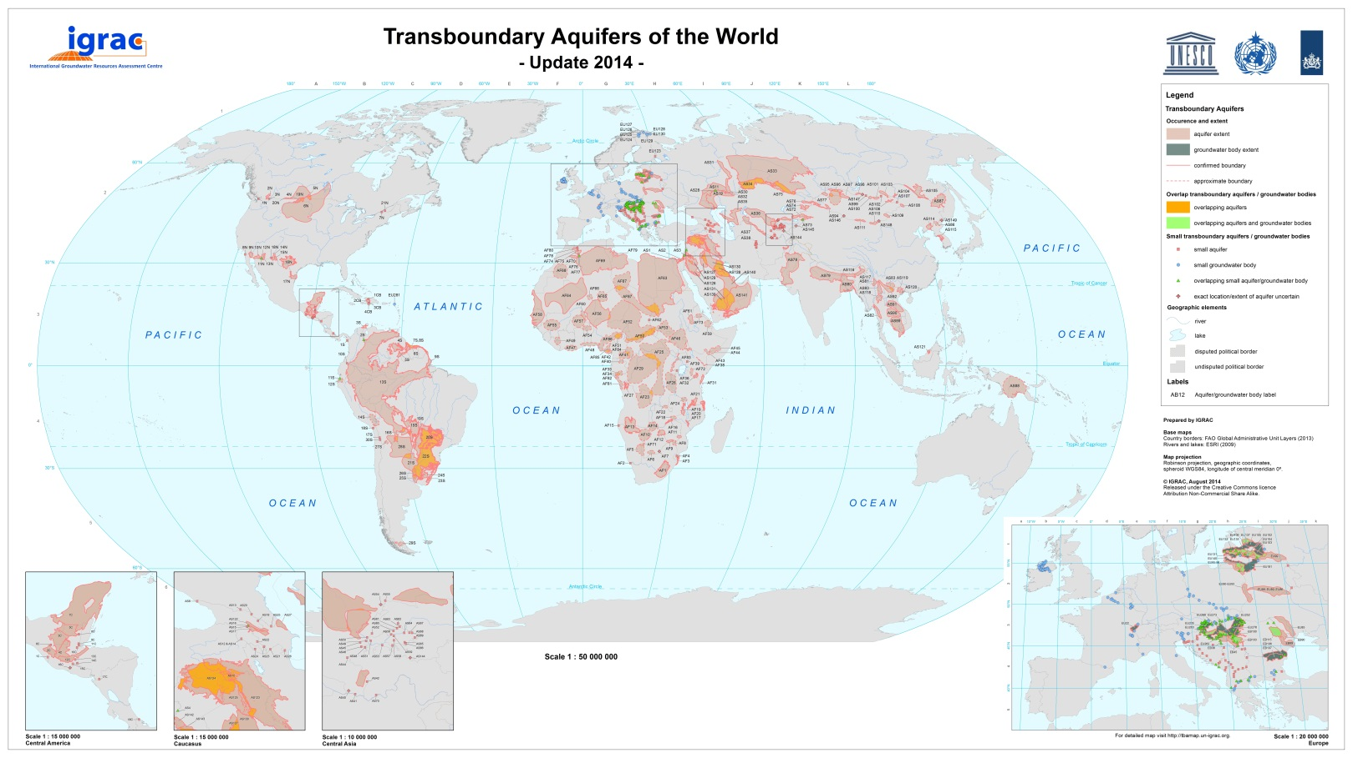
The law of international watercourses and aquifers
Transboundary aquifers & agreements – how many?
Only 6 of the nearly 600 surveyed transboundary aquifers are governed by a legally binding agreement
https://www.un-igrac.org/resource/transboundary-aquifers-world-map-2015

Slide 6
The law of international watercourses and aquifers
2002 –UNILC begins work on ”shared natural resources” (oil, gas and groundwater)
2003 – UNILC stops work on oil & gas, and focusses on transboundary aquifers
2008 – A/RES/63/124
2013 – A/RES/68/470
2016 – A/RES/71/150
1992 – 1996 / UNECE Helsinki Convention on Transboundary Watercourses & Lakes
1997 – UN Convention on the non-navigational uses of international watercourses
2012 – UNECE Model Provisions on Transboundary Groundwaters
2014 – Entry into force of UN Convention
2016 – UNECE Helsinki Convention open to accession by non-UNECE member countries (UNECE Convention goes global)

Slide 7
The law of international watercourses and aquifers
The “core”norms of international water law crystallize the substantive rights and obligations of States
Right to an equitable and reasonable utilization
Obligation not to cause significant harm

Slide 8
The law of international watercourses and aquifers
Criteria entering equitable & reasonable utilization determinations
All factors to be considered together
Natural (geogrraphic, etc…)
Socio-economic needs
Population
Transboundary impacts
Actual and potential uses
Cost/benefit analysis
Availability of alternatives

Slide 9
The law of international watercourses and aquifers
Factors to be considered together
Population
Socio-economic needs
Natural characteristics
Contribution to formation and recharge
Actual and potential use
Transboundary impact
Availability of alternatives
Cost/benefit analyis
Ecosystem requirements
Factors relevant to equitable & reasonable utilization determinations regarding transboundary aquifers

Slide 10
The law of international watercourses and aquifers
Procedural norms, and relationship to substantive norms
Equitable & reasonable utilization
Obligation not to cause significant harm
General obligation to cooperate
Regular exchange of information & data
Prior notification of planned measures, consultation and good-faith negotiation with a view to reaching agreement
These norms give effect to the rights and obligations posited by substantive norms

Slide 11
The law of international watercourses and aquifers
Substantive rights & obligations
Procedural obligations
States have discretion to establish joint mechanisms for the management of transboundary watercourses or aquifers
Bi-lateral or regional agreement/convention/treaty

Slide 12
Agreements on transboundary aquifers
There exist a handful bi-lateral and regional agreements on specific transboundary aquifers
The Genevese Aquifer Agreement (2008, France, Switzerland)
The Guaraní Aquifer Agreement (2010, Argentina, Brazil, Paraguay, Uruguay)
The Joint Authority for the Study & Development of the Nubian Sandstone Aquifer (Chad, Egypt, Libya, Sudan)(1992)
The Al-Disi Aquifer Agreement (Saudi Arabia, Jordan (2015)
MOU on a Consultation Mechanism for the Iullemeden Taoudeni/Tanezrouft Aquifer (7 countries in the Sahara-Sahel region) (2014)
MOU on a Consultation Mechanism for the Northern Sahara Aquifer System (2008, Algeria, Libya, Tunisia)

Slide 13
Local-level arrangements for transboundary aquifers
There exist a few known arrangements between or among units of local-level government or local authorities, concerning a transboundary aquifer
MoU between the water supply companies of El Paso (Texas) and Cd Juarez (Mexico) re: the Hueco Bolson aquifer (1999)
In Europe local governments have made arrangements for the management of small transboundary aquifers, based on a Framework Convention on transfrontier local-level cooperation (1980)
The French contracting Parties of the Genevese Aquifer Agreement are local government units
MoU between the cities of Concordia (Argentina) and Salto (Uruguay) on the use of Guaraní aquifer (thermal) waters (2015, not signed yet)

Slide 14
The law of international watercourses and aquifers
Conclusions/1
The UN Convention on the law of the non-navigational uses of international watercourses (1997) lays down:
Substantive rights & obligations
Procedural obligations
Rules for the settlement of disputes
The Convention only recently (2014) has come into effect, however it binds only the 36 States which have ratified it – not the others!
Still, all States are bound by the few “core” norms of the Convention reflecting customary international law

Slide 15
The law of international watercourses and aquifers
Likewise, the Draft Articles on the law of transboundary aquifers (UNGA Resolution 128 of 2008, re-iterated in 2013 and 2016) lay down:
Substantive rights & obligations
Procedural obligations
Rules for the settlement of disputes
The Draft Articles are not binding, however they serve as authoritative reference in the negotiation and formulation of aquifer-specific treaties and agreements
Still, all States are bound by the few “core” norms in the Draft Articles which reflect customary international law
Conclusions/2

Slide 16
The law of international watercourses and aquifers
Conclusions/3
In addition, there exist a few arrangements negotiated by local government units/authorities regarding transboundary aquifers
Such arrangements are based on the constitutional system of the relevant countries, and are valid to the extent permitted by it
In the EU context, local-level arrangements on transboundary aquifers are based on a specific Framework Convention (1980) enabling local governments and local authorities to make such arrangements

Slide 17
THANK YOU!
Dr Francesco Sindico
Director, Centre for Environmental Law and Governance
University of Strathclyde, Glasgow, Scotland, UK
Stefano Burchi
Chairman, International Association for Water Law (AIDA), Rome, Italy
Francesco.sindico@strath.ac.uk
Stefano.burchi@gmail.com

