Slide 1


Aquifer system simulation – the “science” that helps to make better decisions
UNESCO-SADC Training on Groundwater Modelling
Mar 2017
Intro lecture on aquifer Modelling
Shammy Puri
Former, Secretary General, International Association of Hydrogeologists
Chair IAH Commission on Transboundrary Aquifers

Slide 2
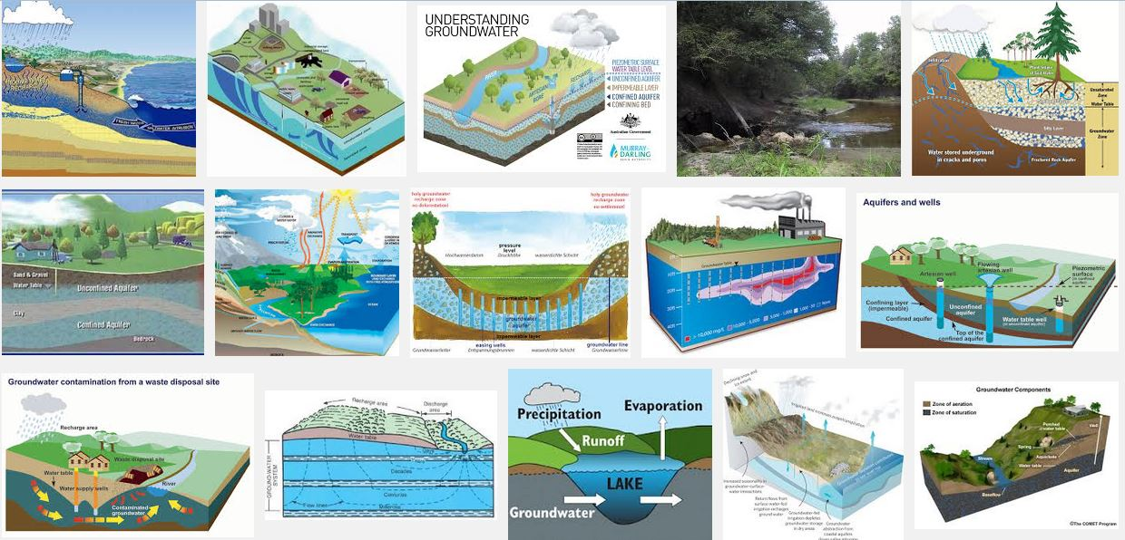
Many configurations of aquifers

Slide 3
What is a groundwater model ??
A model may be defined as a simplified version of a real-world system (here, a ground-water system) that approximately simulates the relevant excitation-response relations of the real-world system.
The first step in the modelling process is the construction of a conceptual model consisting of a set of assumptions that verbally describe the system’s composition

Slide 4
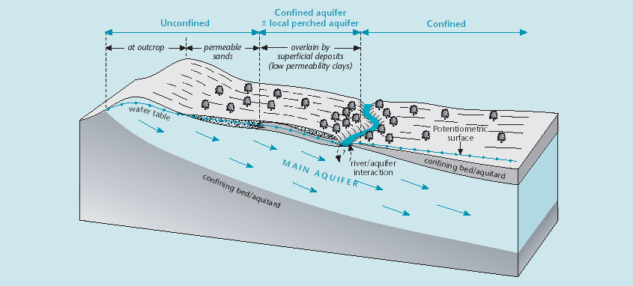
Aquifer systems – the basis
Key features: recharge – storage – discharge
Dependent ecosystems
Climate variability
Anthropogenic

Slide 5
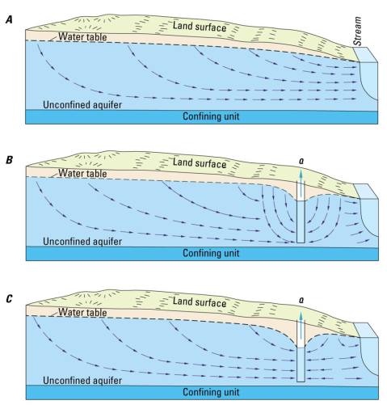
Conceptual understanding
A. Initial Steady State
B. All flow to well from storage
C. Changing gradients cause changes to flow system
Extreme case – flow previously toward stream reversed

Slide 6
Terms used quantitative analysis
Flow nets – sub division into aquifer ‘blocks’, hydraulic boundaries
Vertical & horizontal flows
Recharge & discharge areas
Hydrostatic head, confinement, piezometric heads, storativity variations
Atmospheric (barometric) pressure and head variations (diurnal, long term)
Depth distribution of temperature – geothermal gradient – temperature related coefficient of expansion, effect on SWL’s
Borehole geophysics, while drilling and on completion
Data loggers & depth variations

Slide 7
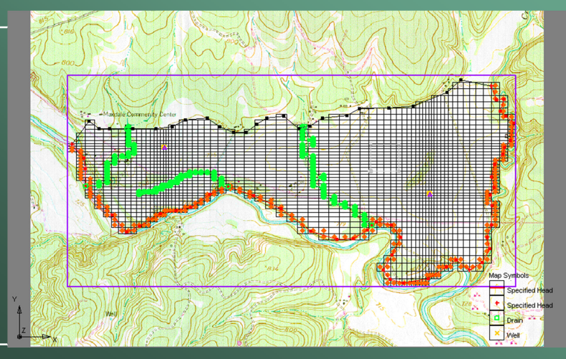
Terms used
Pumping tests and 3D near well hydraulics, hydraulic conductivity distribution
Anisotropy and regional aquifer parameter distributions
Quantification of flow nets
Mass balance of the system (input = output +/- Storage)

Slide 8
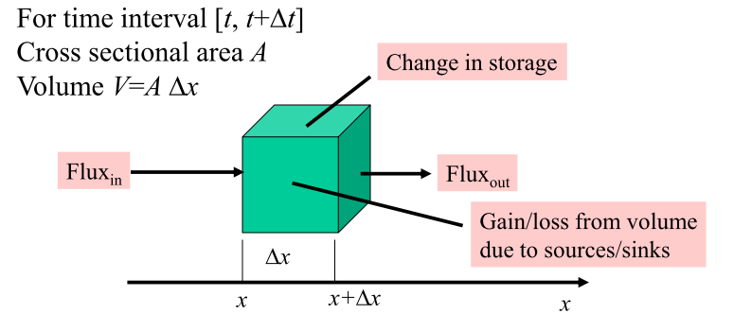
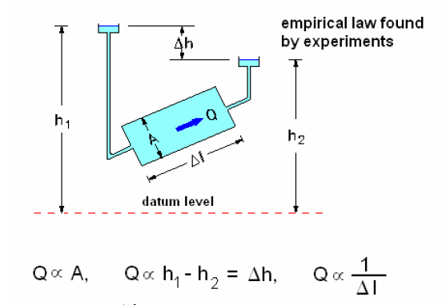
Terms used
System boundaries – redefined with mass balance checks
Naturalised flow system – steady state analysis
Transient flows – history match with level fluctuation data
Well hydraulics to system hydraulics
Geological – hydrological system quantification into models
Formation dips and their implication for depth to formation
The basic principle of groundwater flux and change of storage

Slide 9
Types of models
1. Predictive— Purpose is to predict system response to stresses. Requires calibration to heads, flow, etc. This is the type of model that most of us try to construct.
2. Interpretive— Purpose is to try to understand how a system works, organize field data. Not necessarily calibrated.
3. Generic— Purpose is to analyse dynamics of hypothetical systems that may incorporate important characteristics of actual systems.
“The purpose of computing is insight, not numbers” —R.W. Hamming

Slide 10
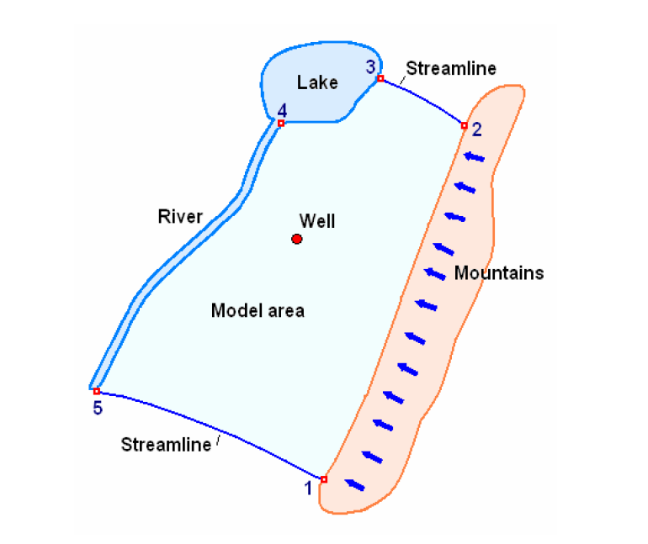
Defining the “system” for model analysis
Clockwise
Boundary 1-2: prescribed flux (non zero)
Boundary 2-3: zero flux
Boundary 3-4: prescribed head
Boundary 4-5: semi pervious
Boundary 5-1: zero flux

Slide 11
Content of a conceptual model
the geometry of the boundaries of the investigated aquifer domain;
the kind of solid matrix comprising the aquifer (with reference to its homogeneity, isotropy, etc.);
the mode of flow in the aquifer (e.g., one-dimensional,two-dimensional horizontal, or three-dimensional);
the flow regime (laminar or non laminar);
the properties of the water (with reference to its homogeneity, compressibility, effect of dissolved solids and/or temperature on density and viscosity, etc.);
the presence of assumed sharp fluid-fluid boundaries, such as a phreatic surface;
the relevant state variables and the area, or volume, over which the averages of such variables are taken;

Slide 12
Conceptual model
sources and sinks of water and of relevant contaminants, within the domain and on its boundaries (with reference to their approximation as point sinks and sources, or distributed sources);
initial conditions within the considered domain; and
the conditions on the boundaries of the considered domain that express the interactions with its surrounding environment.

Slide 13
Answers required from MODFLOW…. And example
For the Stampriet aquifer System, we need to understand the following…. (j brief)
“Volumes of the resource, Degree of natural replenishment, Forecast of “Business as Usual”, Forecast of Business with Interventions, among others….”
In order that we can develop a ‘joint consultative mechanism’ for countries to jointly manage their transboundary aquifer

Slide 14
Content of a mathematical model
a definition of the geometry of the considered domain and its boundaries;
an equation (or equations) that expresses the balance of the considered extensive quantity (or quantities);
flux equations that relate the flux(es) of the considered extensive quantity(ies) to the relevant state variables of the problem;

Slide 15
Content if a mathematical model
constitutive equations that define the behavior of the fluids and solids involved;
an equation (or equations) that expresses initial conditions that describe the known state of the considered system at some initial time; and
an equation (or equations) that defines boundary conditions that describe the interaction of the considered domain with its environment.

Slide 16
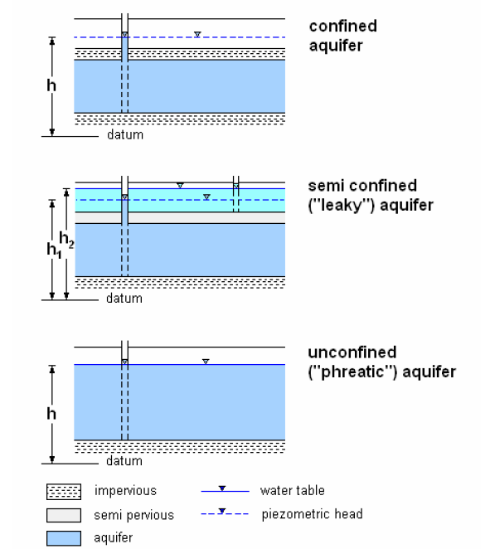
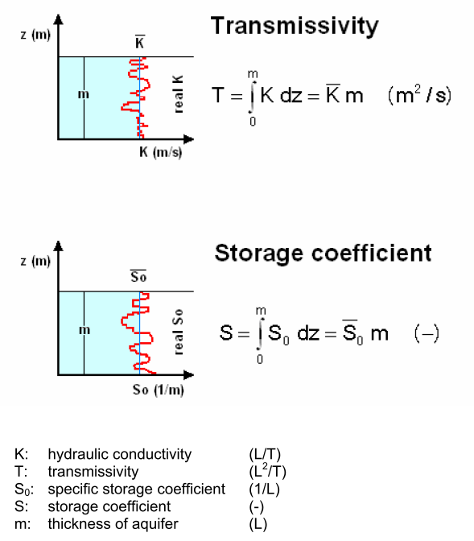
Fundamentals for model development

Slide 17
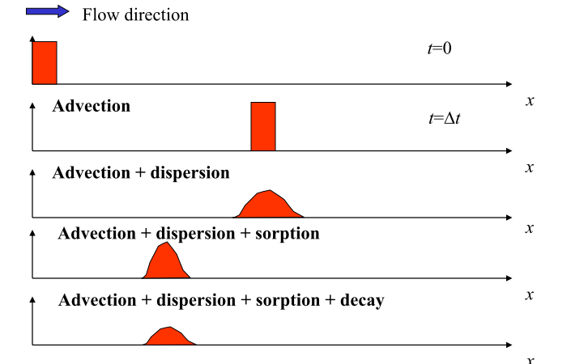
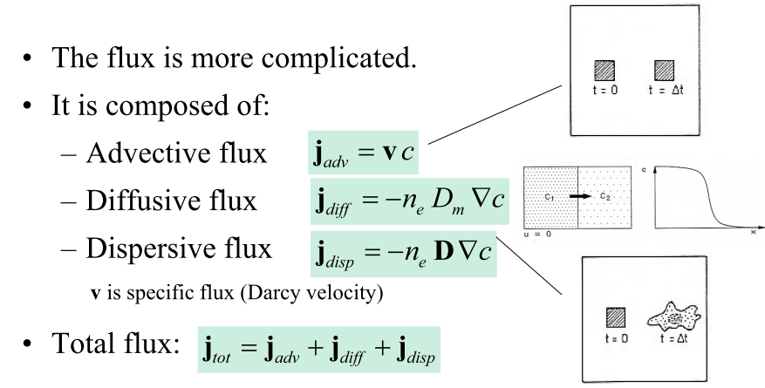
Transport of solutes

Slide 18
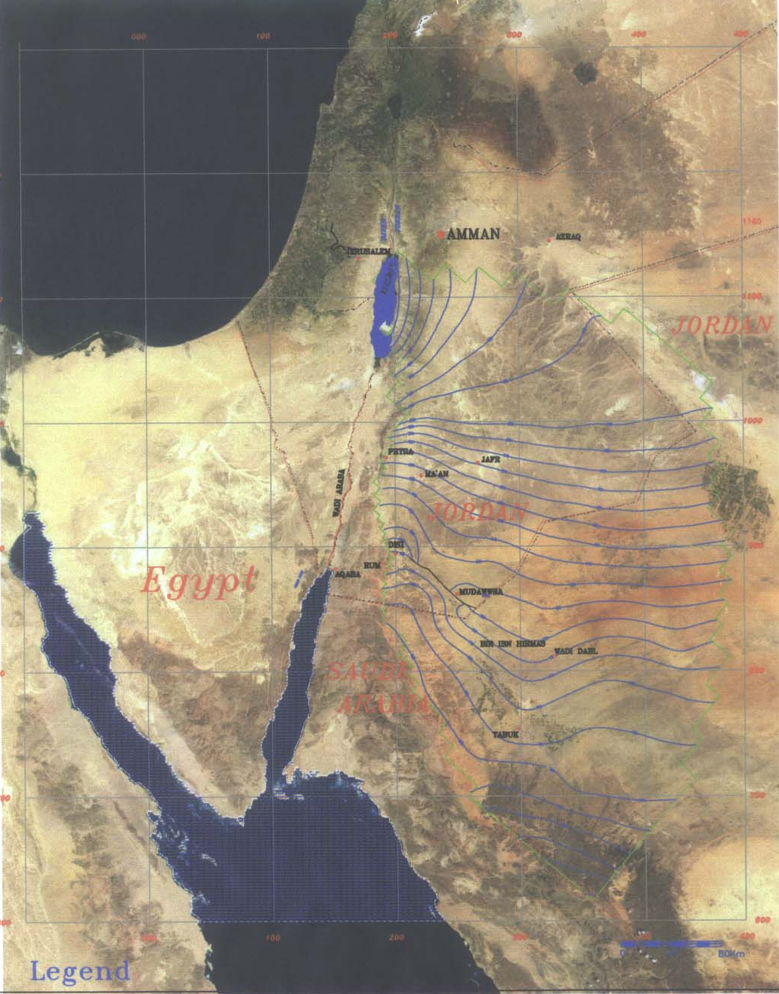
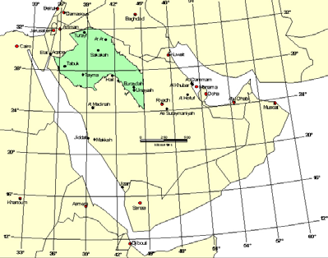
Rum-saq aquifer
Jordan & Saudi
Arabia

Slide 19
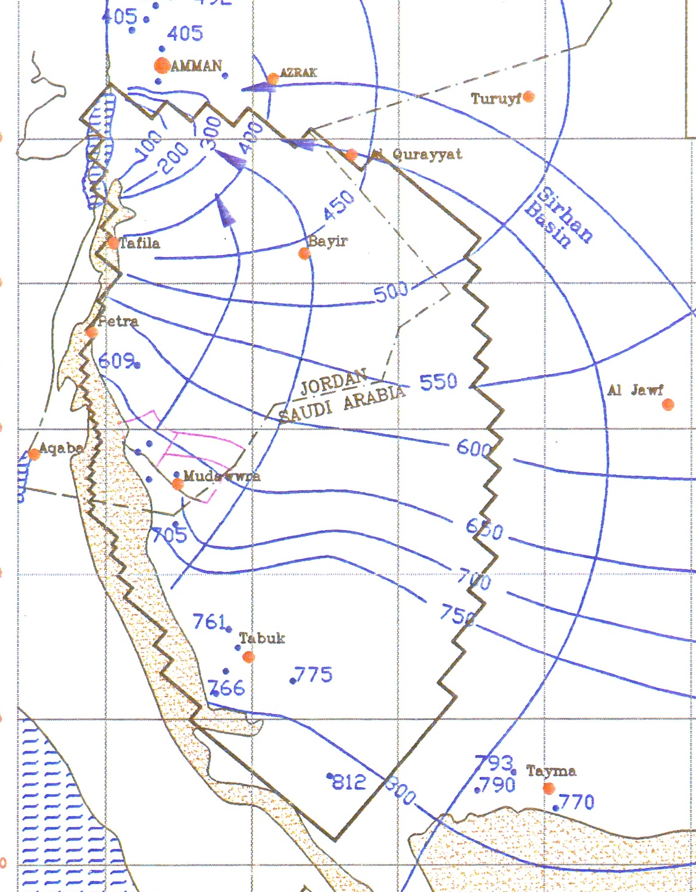
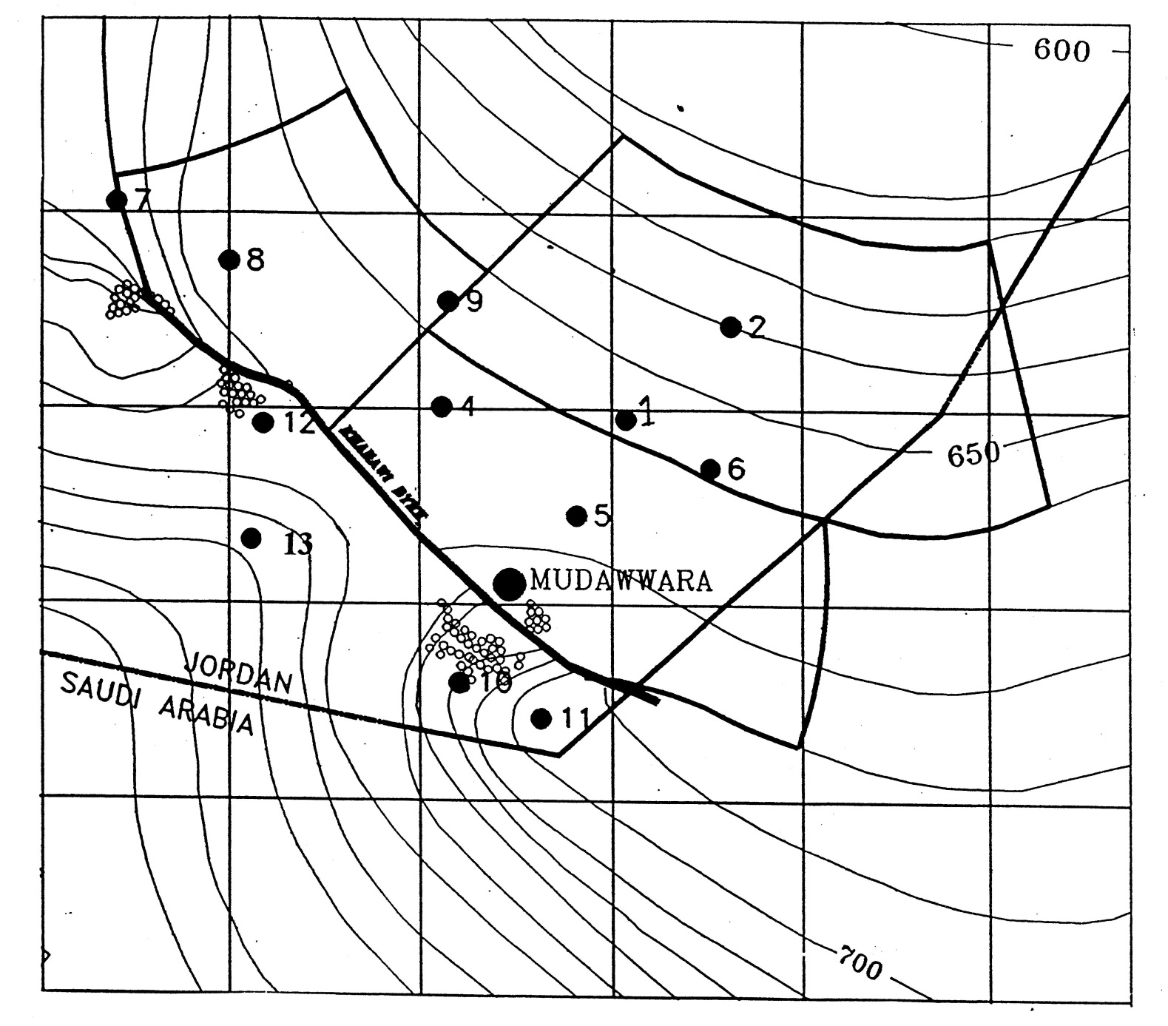
Area for detailed investigation

Slide 20
Multiple pump testing & quality analysis

Slide 21
Step pump tests

Slide 22
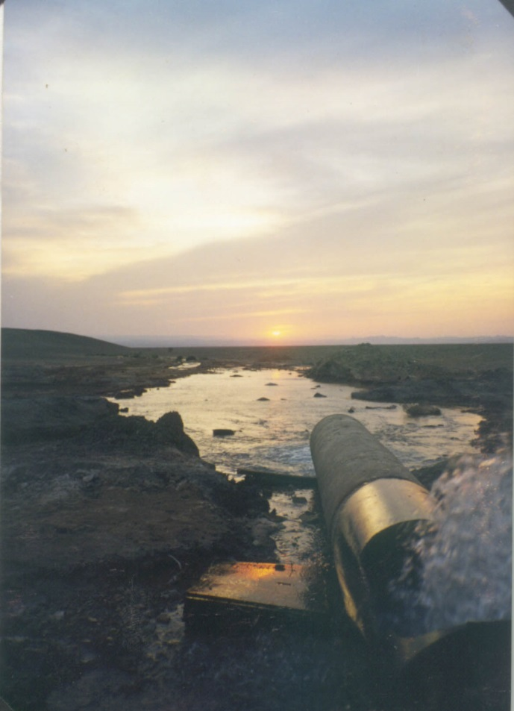
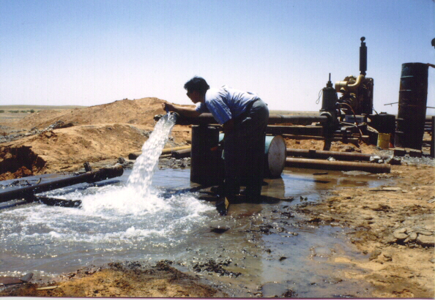
Analysis of long term pump & recovery tests

Slide 23
Water Quality from selected wells
Water Quality Long term Monitoring Test Wells
Data from existing well at Dubaydib drilled 2002
Note: Typical Average Values for Dubaydib area
Ec ranges about 300 – 550 us/cm
Notes:
Water quality monitoring data from 1982 to 2002 indicates little changes to the EC and slightly drop in pH to a more neutral water of 7.
The trend of EC of the existing wells in Dubaydib conforms to matches the EC and pH taken of the water samples from the pumping tests for the wells drilled and tested by MWI in 2000 to confirm the technical specifications for the Disi BoT

Slide 24
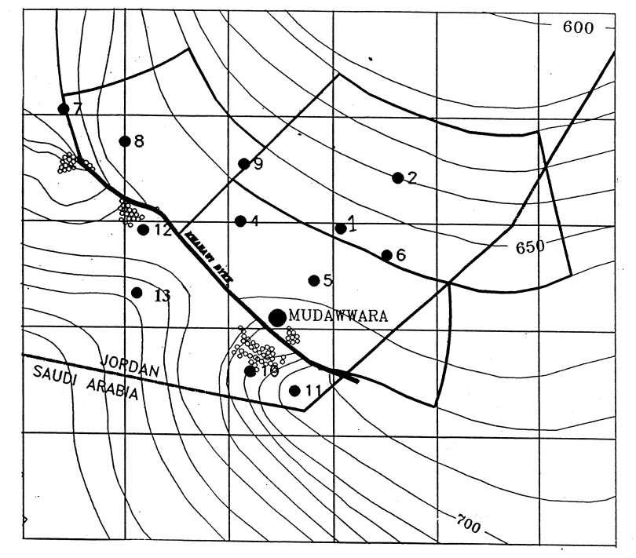
Interpretation & Analysis of drilling DatA

Slide 25
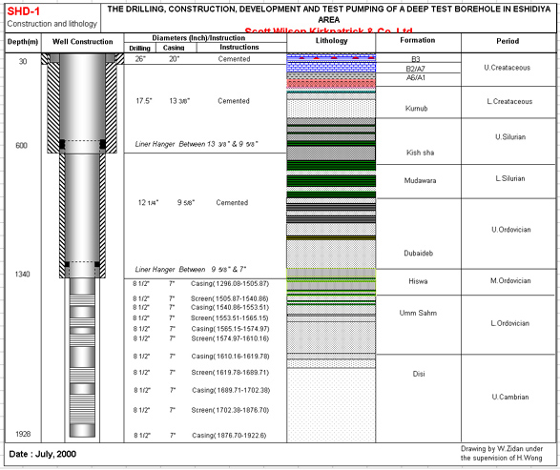
geothermal gradient at 1500m depth
At BH2 bottom hole water temperature reached over 60oC
Hot water caused problems with measurement equipment
Special pump had to be acquired for the pump test
Coefficient of expansion of water affected readings
Taking water samples of the hot water was a problem

Slide 26
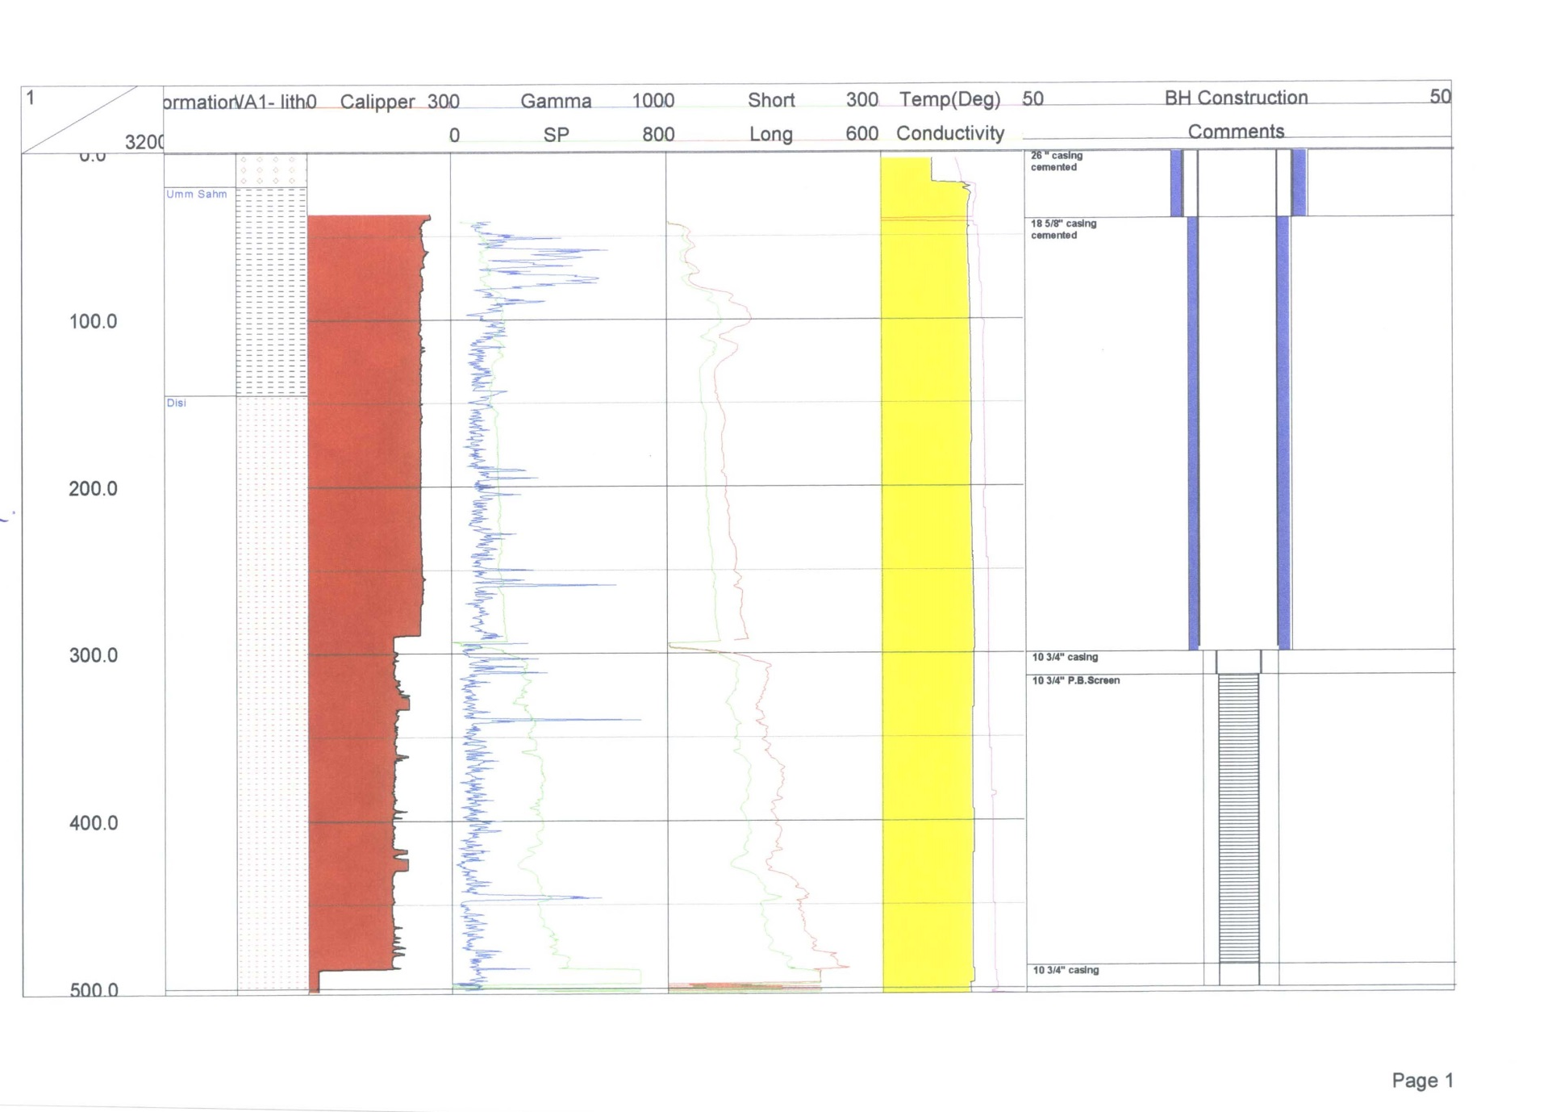
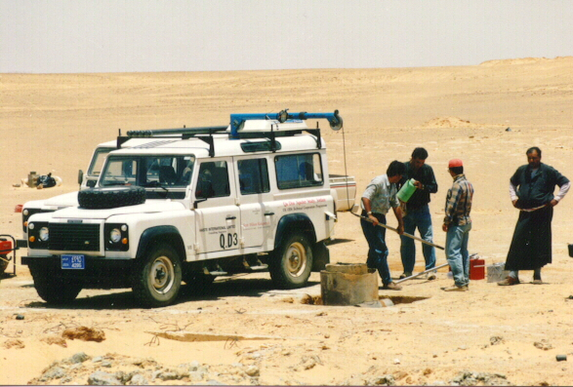
Borehole geophysics,
Gamma ray log – excellent marker, but sometimes contrast masked

Slide 27
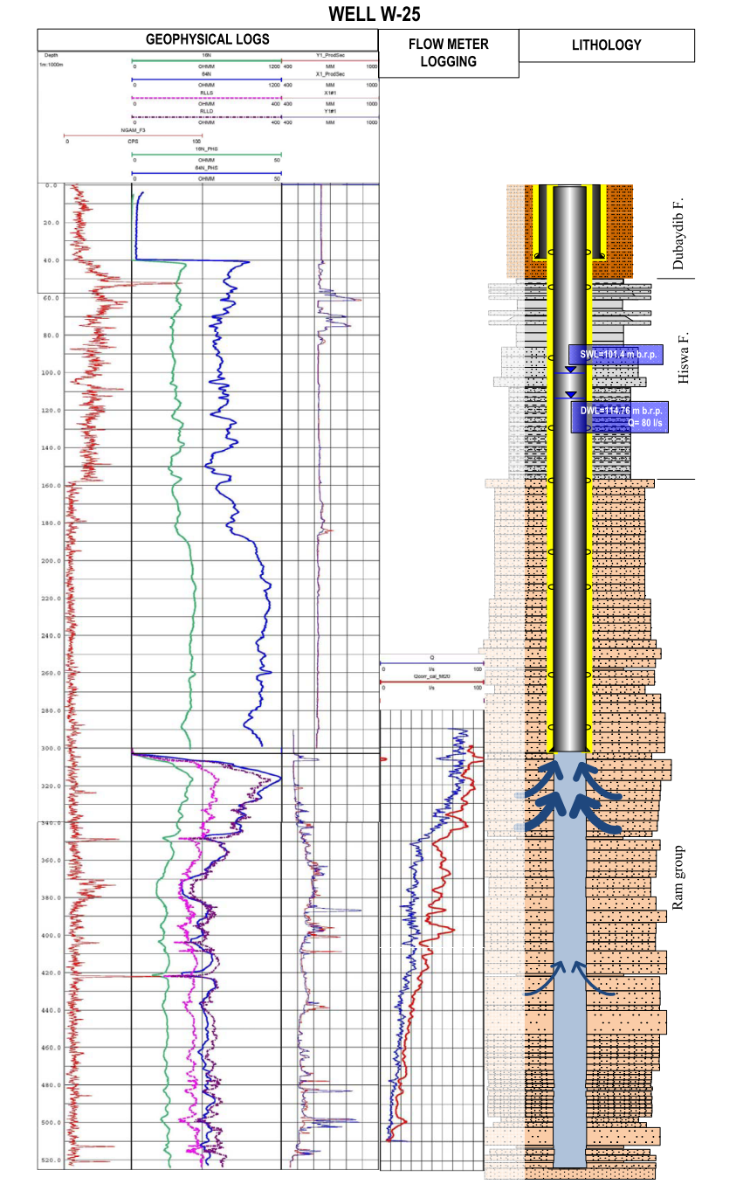
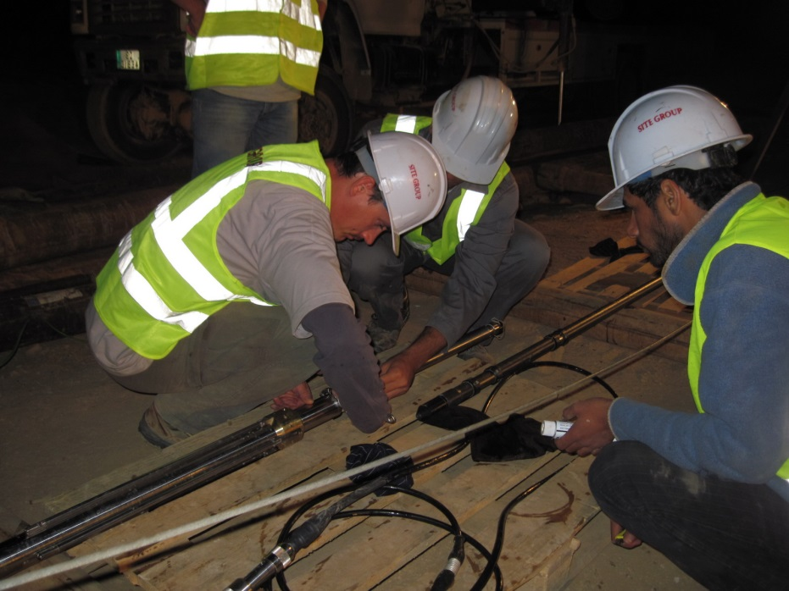
In borehole water flow velocities
Logging after clearing well of drilling fluid
Uphole & downhole runs in static and dynamic condition
Identifies major fracture zones and the potential for sand pumping
Decisions on need for screen / gravel pack
Identifies screen intervals required
Confirms screen slot sizes appropriate

Slide 28
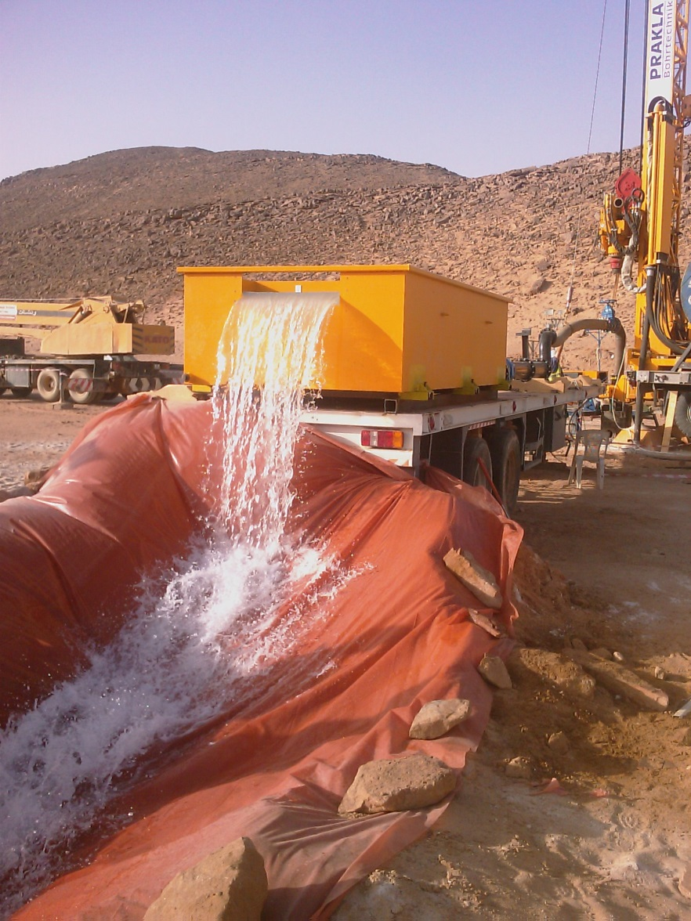
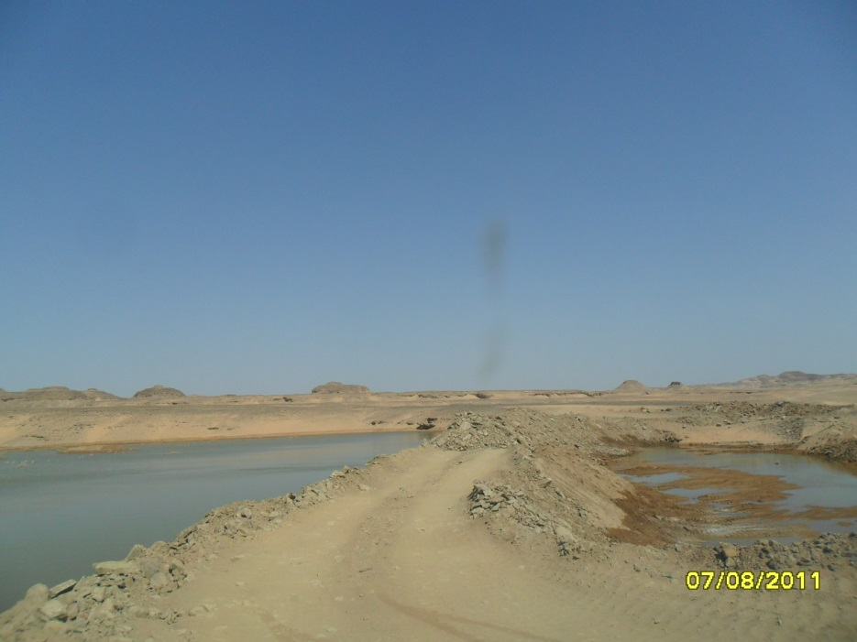
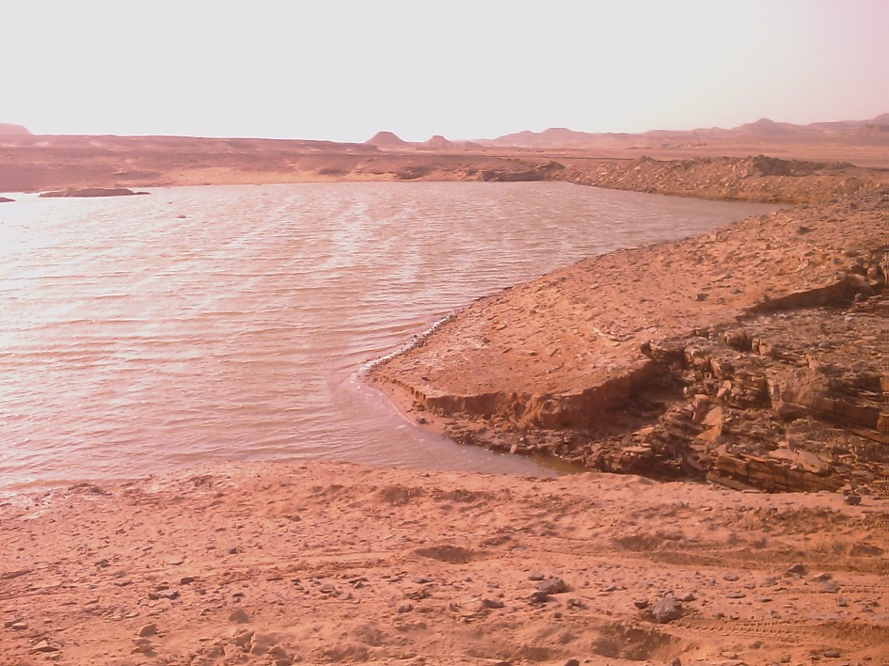
Pumping tests and 3D near-well hydraulics, hydraulic conductivity distribution

Slide 29
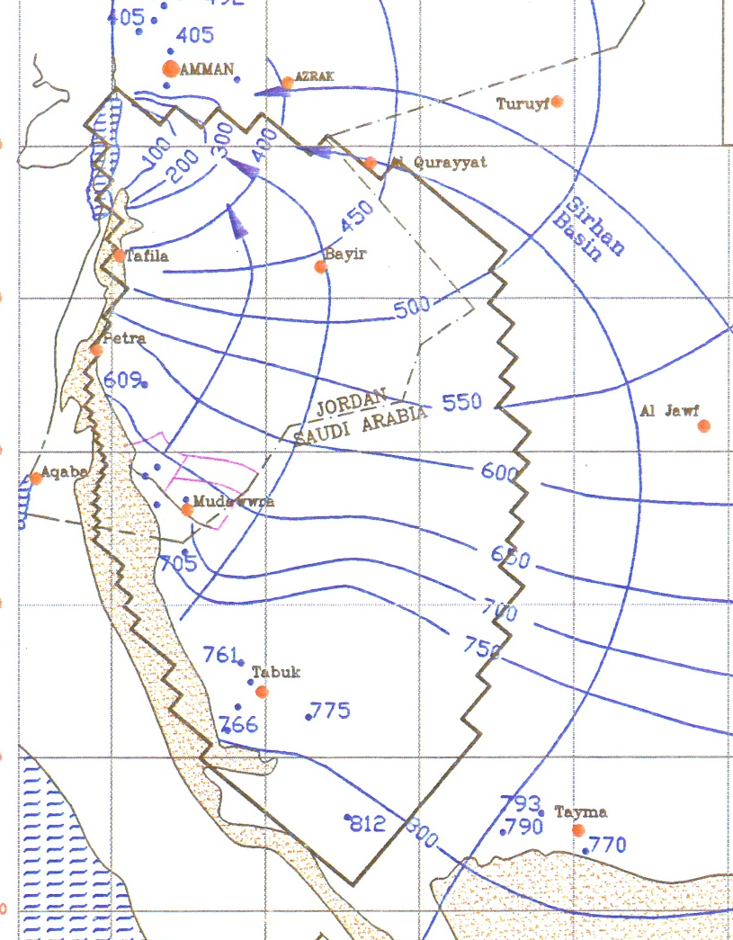
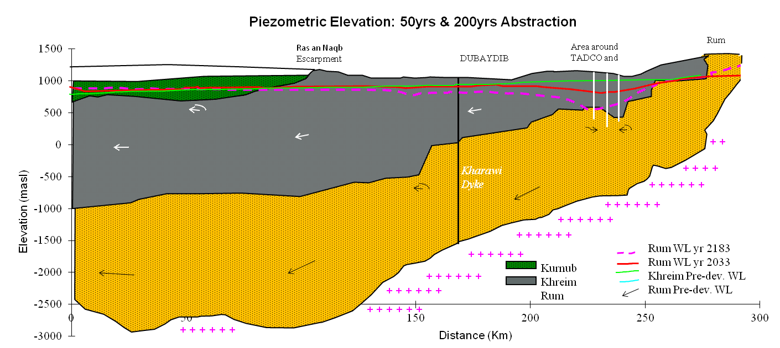
Full field 3D hydraulic interactions

Slide 30
Horizontal & vertical flow system
Pumping test analysis – Hantush & Boutlon-Strelsova – BH5 constant rate test

Slide 31

Interpreting data – what have we modelled?
Thank you for your attention
Question ??

