Slide 1
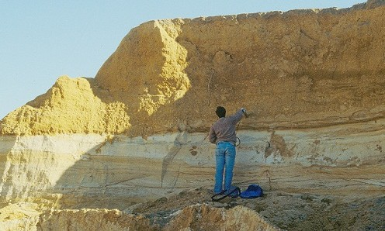
International Water Law Francesco Sindico, University of Strathclyde Law School
2nd Regional meeting on Tools for Sustainable Management of Transboundary Aquifers, Johannesburg, 29 November 2016

Slide 2
SCELG’s work on Transboundary Aquifers
Training / Projects / Partnerships
GGRETA training on IWL (Stampriet/Ocotopeque Citala)
Project on the legal dimensions of the management of the Guarani Aquifer System
British Council project on Groundwater Governance in Salto, Uruguay
Collaboration with UNESCO-IHP in the framework of SDG 6.5
Publications
“The Law of Transboundary Aquifers: Many Ways of Going Forward, but Only One Way of Standing Still”, RECIEL (2014), with G Eckstein
“The Guarani Aquifer Agreement and Transboundary Aquifer Law in the SADC: Comparing Apples and Oranges?”, RECIEL (2015) with S Hawkins
R. Martin-Nagle, “Transboundary offshore aquifers: A search for a governance regime”
Knowledge Exchange events
2010/2011 Conferences on the Guarani (UK and Brazil)
2013 Glasgow Conference on TBAs and International Water Cooperation
2015/16 World Water Congress and World Water Week
2016 Groundwater Governance workshop at Strathclyde

Slide 3
To clarify the emerging international law applicable to transboundary aquifers and its potential “practical” role in the context of bilateral/regional TBA management
To discuss its relationship with international law applicable to transbounary surface water
To present some aspects of the few bilateral and regional agreements and arrangements dealing with the management of transboundary aquifers
Objectives

Slide 4
Groundwater and transboundary aquifers
Transboundary surface water law and transboundary aquifers
Content

Slide 5
97% of available freshwater resources
Groundwater and TBAs

Slide 6
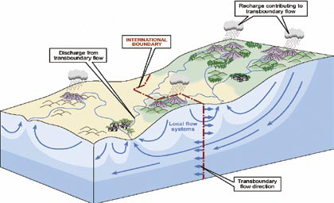
What is an aquifer?
Groundwater and TBAs
Aquifers: “a permeable water bearing geological formation underlain by a less permeable layer and the water contained in the saturated zone of the formation”, UN ILC Draft Articles, art. 2a).

Slide 7
What is an aquifer?
Groundwater and TBAs
An aquifer consists of two elements: Underground geological formation (container / the rock) Natural resources stored underground in the container (groundwater) An aquifer can be renewable or non-renewable (fossil aquifer)

Slide 8
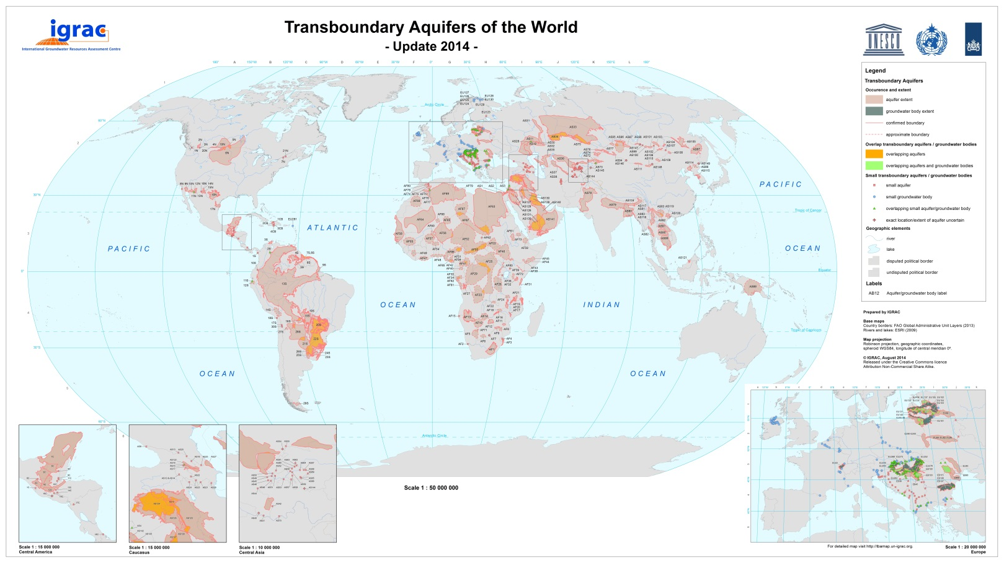
How prominent are transboundary aquifers?
Groundwater and TBAs

Slide 9
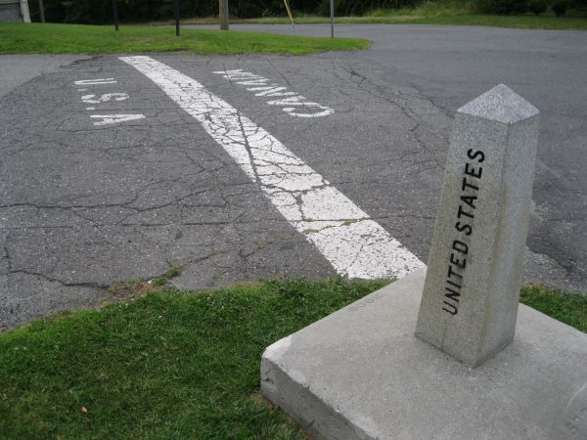
Aquifer uses and challenges
Groundwater and TBAs
Uses of aquifers Extraction of water Extraction of heat Extraction of minerals Storage and disposal of any substance (CCS/flood management) Challenges to aquifers Overexploitation Challenges over different uses Pollution

Slide 10
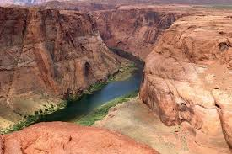
(Transboundary) rivers and (transboundary) aquifers are similar natural resources, but not identical!
Groundwater and TBAs
Flow of a river vs flow of groundwater in an aquifer Depth of groundwater in an aquifer Does international law acknowledge this difference?

Slide 11
Groundwater and transboundary aquifers
Transboundary surface water law and transboundary aquifers - Emerging TBA normative framework - Treaties, custom, legally binding obligations, voluntary contributions - Transboundary surface water law: a model for TBAs?
Content

Slide 12
Transboundary surface water and TBAs
Emerging TBA normative framework
2002 – UNILC starts working on the topic of “shared” natural resources” transboundary groundwater, oil and gas
2003 – UNILC drops oil and gas, and focuses only on transboundary “aquifers”
2008 – A/RES/63/124
2013 – A/RES/68/470
2016 – New UNGA Resolution

Slide 13
Side by side with existing and developing transboundary surface water law normative framework
Transboundary surface water and TBAs
Emerging TBA normative framework
1992/ 1996 – UNECE Water Convention
1997 - UNWC
2012 – UNECE Model Provisions
2014 – UNWC Entry into force
2016 – UNECE Water Convention “goes global”

Slide 14
Synergies or conflicts?
Transboundary surface water and TBAs
Emerging TBA normative framework
UNWC: treaty, but not universal participation UNECE Water Convention: Pan-European Draft Articles: not a treaty… Model Provisions: Pan-European and a decision of a Meeting of the Parties
UNWC
Draft Articles
UNECE Water Convention
Model Provisions

Slide 15
Groundwater and transboundary aquifers
Transboundary surface water law and transboundary aquifers - Emerging TBA normative framework - Treaties, custom, legally binding obligations, voluntary contributions - Transboundary surface water law: a model for TBAs?
Content

Slide 16
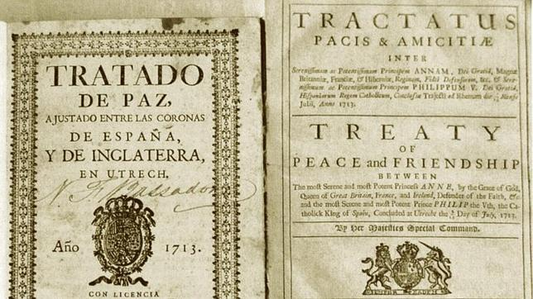
Transboundary surface water and TBAs
Treaties, custom, etc…
Convention
Treaty (Multilateral Environmental Agreement) that establishes a Conference of the Parties
Draft Articles of the United Nations International Law Commission
UN General Assembly Resolution
Decision of a Meeting of the Parties
Agreement between local municipalities

Slide 17
Transboundary surface water and TBAs
Treaties, custom, etc…
Not legally binding between States
Draft Articles
Binding between the Parties in a Treaty
Convention
Binding on all members of the international community
International Costumary Law
UNGA Resolution
Agreement between local municipalities
Treaty (MEA)
MOP Decision

Slide 18
Transboundary surface water and TBAs
Treaties, custom, etc…
Customary International Law
Objective element (state practice)
Subjective element (opinio juris)

Slide 19
Transboundary surface water and TBAs
Treaties, custom, etc…
Not legally binding between States
Draft Articles
Binding between the Parties in a Treaty
Convention
Binding on all members of the international community
International Costumary Law
UNGA Resolution
Agreement between local municipalities
Treaty (MEA)
MOP Decision

Slide 20
Transboundary surface water and TBAs
Treaties, custom, etc…
Practical implications
If a provision of a legal instrument reflects a relationship between two States (obligations and rights) of a customary international law nature, it will be binding upon ALL States even if it is found in a non-legally binding document.
SADC Revised Protocol on Shared Watercourses, art. 3.3 “State Parties undertake to respect the existing rules of customary or general international law relating to the utilisation and management of the resources of shared watercourses.”

Slide 21
Transboundary surface water and TBAs
Treaties, custom, etc…
But do not forget that we are talking of Public International Law
Provisions can be legally binding, but in most cases these will be “due diligence” obligations
Provisions can be legally binding, but within a framework that usually does not have a dispute settlement system akin to national legal systems

Slide 22
Groundwater and transboundary aquifers
Transboundary surface water law and transboundary aquifers - Emerging TBA normative framework - Treaties, custom, legally binding obligations, voluntary contributions - Transboundary surface water law: a model for TBAs?
Content

Slide 23
What differences/similarities should there be between the normative framework (obligations/rights) applicable to a transboundary river and to a transboundary aquifer?
Transboundary surface water and TBAs
A model for TBAs

Slide 24
Transboundary surface water and TBAs
A model for TBAs
Substantive obligations and rights
Procedural obligations
Institutional mechanism

Slide 25
Transboundary surface water and TBAs
A model for TBAs - substantive
International customary law
Reflects principle 2 of the Rio Declaration
Confirmed by the International Court of Justice
Present in many MEAs
(Rights) Equitable and reasonable utilization
(Obligations) No harm principle

Slide 26
Transboundary surface water and TBAs
A model for TBAs - substantive
Equitable and reasonable utilization, UNWC Art. 5.2
Watercourse states shall participate in the use, development and protection of an international watercourse in an equitable and reasonable manner.
Such participation includes both (1) the right to utilise the watercourse and (2) the duty to cooperate in the protection and development thereof, as provided in the present Convention.
What does equitable and reasonable mean?

Slide 27
Transboundary surface water and TBAs
A model for TBAs - substantive
Equitable and reasonable utilization
Should the “utilisation” of transboundary aquifers take into account some particular “hydroegological” aspects of the aquifer?
Recharge and discharge zones Geological formation Precautionary approach

Slide 28
Transboundary surface water and TBAs
A model for TBAs - substantive
Equitable and reasonable utilization
Should the “utilisation” of transboundary aquifers take into account some particular “socio-economic” aspects of the aquifer?
Groundwater dependent ecosystem services Economic activities Climate change Etc…

Slide 29
Transboundary surface water and TBAs
A model for TBAs - substantive
Equitable and reasonable utilization, UNWC Art. 6 (SADC, art. 3.8a, ORASECOM, art. 7.2, ZAMCOM, art. 13.3)
Utilisation of an international watercourse in an equitable and reasonable manner within the meaning of Article 5 requires taking into account all relevant factors and circumstances, including:
Geographic, hydrographic, hydrological, climatic, ecological and other factors of a natural character;
The social and economic needs of the watercourse states concerned;
The population dependent on the watercourse in each watercourse state;
The effects of the use or uses of the watercourses in one watercourse State on other watercourse states;
Existing and potential uses of the watercourse;
Conservation, protection, development and economy of use of the water resources of the watercourse and the costs of measures taken to that effect;
The availability of alternatives, of comparable value, to a particular planned or existing use.

Slide 30
Transboundary surface water and TBAs
A model for TBAs - substantive
Factors to be considered together
Factors of a natural character
social and economic needs
population dependent
Transboundary effects
uses of the watercourse
Cost-effective analysis
Availability of alternatives
Equitable and reasonable utilization, UNWC Art. 6.3 (SADC, art. 3.8b, ZAMCOM, art. 13.3)
The weight to be given to each factor is to be determined by its importance in comparison with that of other relevant factors. In determining what is a reasonable and equitable use, all relevant factors are to be considered together and a conclusion reached on the basis of the whole.

Slide 31
Transboundary surface water and TBAs
A model for TBAs - substantive
Equitable and reasonable utilization, UNWC Art. 6
Should the equitable and reasonable utilization of a transboundary aquifer by determined by any further factor? Should a factor be prioritised (be more important) under international law?
Vital human needs vs socio-economic needs

Slide 32
Transboundary surface water and TBAs
A model for TBAs
Substantive obligations and rights
Procedural obligations
Institutional mechanism

Slide 33
Transboundary surface water and TBAs
A model for TBAs - procedural
General obligation to cooperate (Art. 8)
Duty not to cause significant harm
Utilization (reasonable and equitable)
Relationship between substantive and procedural provisions/obligations
Regular exchange of data and information, UNWC Art. 9 & SADC, art. 4.1a
Planned measures (exchange of information, notification, consultation and negotiations) UNWC Art. 11 ff & SADC, art. 4.1
Obligation to undertake an environmental impact assessment (UNWC, art. 12 & SADC, art. 4.1b)

Slide 34
Transboundary surface water and TBAs
A model for TBAs - procedural
International customary law?
Confirmed by the ICJ in the Pulp Mills Case
Present in many MEAs
Relationship between substantive and procedural provisions/obligations
Regular exchange of data and information, UNWC Art. 9 & SADC, art. 4.1a
Planned measures (exchange of information, notification, consultation and negotiations) UNWC Art. 11 ff & SADC, art. 4.1
Obligation to undertake an environmental impact assessment (UNWC, art. 12 & SADC, art. 4.1b)

Slide 35
Transboundary surface water and TBAs
A model for TBAs - procedural
To what extent does the equitable and reasonable utilization of an aquifer require “specific” procedural obligations, different from the ones used for transboundary surface water
Exchange of information (costs?) Prior notification (time?)

Slide 36
Transboundary surface water and TBAs
A model for TBAs
Substantive obligations and rights
Procedural obligations
Institutional mechanism

Slide 37
Transboundary surface water and TBAs
A model for TBAs – institutional mechanism
Obligation to cooperate, UNWC Art. 8
“In determining the manner of such cooperation, watercourse States may consider the establishment of joint mechanisms or commissions, as deemed necessary by them, to facilitate cooperation on relevant measures and procedures in the light of experience gained through cooperation in existing joint mechanisms and commissions in various regions.”

Slide 38
Transboundary surface water and TBAs
A model for TBAs - institutional mechanism
To what extent could TBA mechanisms / institutions be developed under the framework of already existing transboundary surface water agreements and institutions?
Potential advantages (mutual supportiveness) Potential disadvantage (focus on surface water)

Slide 39
Conclusions
Groundwater and surface water similar, but not the same…. Transboundary aquifer law and transboundary surface water law should follow the same trend
The emerging international law applicable to TBAs is framed around the UNILC Draft Articles, the UNWC the UNECE Water Convention and customary international
The UNWC has substantive, procedural and institutional elements
The extent to which these elements reflect the needs of TBAs will be further discussed

Slide 40
Francesco Sindico
Director, Strathclyde Centre for Environmental Law and Governance
Reader in International Environmental Law
University of Strathclyde Law School
Level 3, Lord Hope Building
141 St James Road Glasgow
G4 0LT
www.facebook.com/SCELG/
www.linkedin.com/groups/8297435
@scelg
SCELG
w: www.strath.ac.uk/scelg/

