Slide 1
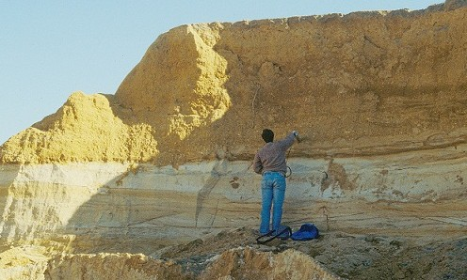
International Water Law II Francesco Sindico, University of Strathclyde Law School
2nd Regional meeting on Tools for Sustainable Management of Transboundary Aquifers, Johannesburg, 29 November 2016

Slide 2
To discuss whether the emerging international law applicable to TBAs responds to the specificities of TBAs vis a vis transboundary surface water
To present some aspects of the few bilateral and regional agreements and arrangements dealing with the management of transboundary aquifers
Objectives
To highlight the “practical” role of the UNILC Draft Articles on the Law of Transboundary Aquifers

Slide 3
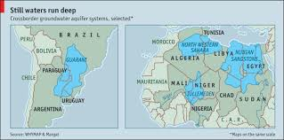
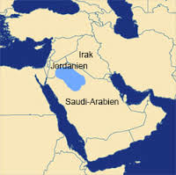
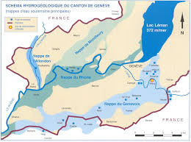
Background
592 TBAs
6 legal agreements/arrangements
UNILC Draft Articles on the Law of TBAs

Slide 4
International Law of TBAs
Substantive obligations and rights
Procedural obligations
Institutional mechanism
Bilateral or regional agreement/arrangement

Slide 5
International Law of TBAs
Substantive
Equitable and reasonable utilization
Should the “utilisation” of transboundary aquifers take into account some particular “hydroegological” aspects of the aquifer?
Recharge and discharge zones Geological formation Precautionary approach

Slide 6
International Law of TBAs
Substantive
Equitable and reasonable utilization
Should the “utilisation” of transboundary aquifers take into account some particular “socio-economic” aspects of the aquifer?
Groundwater dependent ecosystem services Economic activities Climate change Etc…

Slide 7
International Law of TBAs
Substantive
Equitable and reasonable utilization, UNILC Draft Articles , art. 5.1
“Utilization of a transboundary aquifer or aquifer system in an equitable and reasonable manner within the meaning of draft article 4 requires taking into account all relevant factors, including: (a) the population dependent on the aquifer or aquifer system in each aquifer State; (b) the social, economic and other needs, present and future, of the aquifer States concerned; (c) the natural characteristics of the aquifer or aquifer system; (d) the contribution to the formation and recharge of the aquifer or aquifer system; (e) the existing and potential utilization of the aquifer or aquifer system; (f) the actual and potential effects of the utilization of the aquifer or aquifer system in one aquifer State on other aquifer States concerned; (g) the availability of alternatives to a particular existing and planned utilization of the aquifer or aquifer system; (h) the development, protection and conservation of the aquifer or aquifer system and the costs of measures to be taken to that effect; (i) the role of the aquifer or aquifer system in the related ecosystem.

Slide 8
International Law of TBAs
Substantive
Equitable and reasonable utilization
Should the equitable and reasonable utilization of a transboundary aquifer by determined by any further factor? Should some of these factors be given special attention (be more important?) under international law?
Vital human needs vs socio-economic needs

Slide 9
International Law of TBAs
Substantive
Special regard to some factors in determining equitable and reasonable utilization
A/RES/63/124 The Law of Transboundary Aquifers, art. 5.2
The weight to be given to each factor is to be determined by its importance with regard to a specific transboundary aquifer or aquifer system in comparison with that of other relevant factors. In determining what is equitable and reasonable utilization, all relevant factors are to be considered together and a conclusion reached on the basis of all the factors. However, in weighing different kinds of utilization of a transboundary aquifer or aquifer system, special regard shall be given to vital human needs.
UNWC, art. 10
In the absence of agreement or custom to the contrary, no use of an international watercourse enjoys inherent priority over other uses. In the event of a conflict between uses of an international watercourse, it shall be resolved with reference to articles 5 to 7, with special regard being given to the requirements of vital human needs.

Slide 10
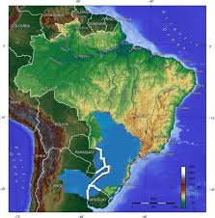
International Law of TBAs
Substantive
Factors considered in determining equitable and reasonable utilization – Guarani Aquifer Agreement
“When the Parties intend to undertake studies, activities or work related to parts of the Guarani Aquifer System that are located in their respective territories, and that may have effects beyond their respective boundaries, they shall act in agreement with the principles and norms of applicable international law.” – Art. 5
“Taking into account also the Resolution 63/124 of the United Nations General Assembly on the Law of Transboundary Aquifers” - Preamble

Slide 11
International Law of TBAs
Substantive
Priority of uses of a TBA, Al-Sag / Al-Disi Aquifer, art. 2.6
“The use of groundwaters extracted from the Management Area shall be exclusively limited for municipal purposes in the two States.”

Slide 12
International Law of TBAs
Substantive
(Rights) Equitable and reasonable utilization
(Obligations) No harm principle
Sovereignity

Slide 13
International Law of TBAs
Substantive
A/RES/63/124, art. 3 “Each aquifer State has sovereignty over the portion of a transboundary aquifer or aquifer system located within its territory. It shall exercise its sovereignty in accordance with international law and the present draft articles.”
A/RES/63/124, art. 6.1/2 “Aquifer States shall, in utilizing transboundary aquifers / in undertaking activities other than utilization of a transboundary aquifer in their territories, take all appropriate measures to prevent the causing of significant harm to other aquifer States or other States in whose territory a discharge zone is located.

Slide 14
International Law of TBAs
Substantive
Guarani Aquifer Agreement art. 2 “Each Party exercises sovereign territorial control over their respective portions of the Guarani Aquifer System, in accordance with their constitutional and legal arrangements, and in agreement with the norms of applicable international law.”
Guarani Aquifer Agreement, art. 6 “Parties that perform activities or work for utilizing the water resources of the Guarani Aquifer System, in their respective territories, shall adopt all the necessary measures to avoid causing significant harm to the other Parties or the environment.”
“Taking into account also the Resolution 63/124 of the United Nations General Assembly on the Law of Transboundary Aquifers” - Preamble

Slide 15
International Law of TBAs
Substantive obligations and rights
Procedural obligations
Institutional mechanism
Bilateral or regional agreement/arrangement

Slide 16
International Law of TBAs
Procedural
To what extent does the equitable and reasonable utilization of an aquifer require “specific” procedural obligations, different from the ones used for transboundary surface water
Exchange of information (costs?) Prior notification (time?)

Slide 17
International Law of TBAs
Procedural
Scenario 1
Countries do not know everything of the aquifer

Slide 18
International Law of TBAs
Procedural
Scenario 1
Countries do not know everything about the aquifer
UNILC Draft Articles, art. 8.2
“Where knowledge about the nature and extent of a transboundary aquifer or aquifer system is inadequate, aquifer States concerned shall employ their best efforts to collect and generate more complete data and information relating to such aquifer or aquifer system, taking into account current practices and standards. They shall take such action individually or jointly and, where appropriate, together with or through international organizations.

Slide 19
International Law of TBAs
Procedural
Scenario 1
Countries do not know everything about the aquifer
UNILC Draft Articles, art. 8.3
“If an aquifer State is requested by another aquifer State to provide data and information relating to an aquifer or aquifer system that are not readily available, it shall employ its best efforts to comply with the request. The requested State may condition its compliance upon payment by the requesting State of the reasonable costs of collecting and, where appropriate, processing such data or information.”

Slide 20
International Law of TBAs
Procedural
Guarani Aquifer Agreement, art. 8
“The Parties shall proceed to adequately exchange technical information about studies, activities and works that contemplate the sustainable utilization of the Guarani Aquifer System water resources.”
Art. 12
“The Parties shall establish cooperation programs with the purpose of extending the technical and scientific knowledge on the Guarani Aquifer System, promoting the exchange of information and management practices, and developing joint projects.”
Scenario 1 (in the Guarani Aquifer Agreement)
Countries do not know everything about the aquifer

Slide 21
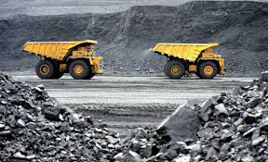
International Law of TBAs
Procedural
Scenario 2
One country is considering to develop an activity that may cause significant harm to the neighboring country

Slide 22
International Law of TBAs
Procedural
State A’s planned activity
“reasonable grounds for believing that a particular planned activity in its territory may affect a transboundary aquifer”
“assess the possible effects of such activity”
Scenario 2
One country is considering to develop an activity that may cause significant harm to the neighboring country (Article 15)
“it shall provide that State with timely notification thereof”
NOTIFICATION:
technical data
information
environmental impact assessment
“If the notifying and the notified States disagree on the possible effect of the planned activities, they shall enter into consultations”
“may utilize an independent fact-finding body”

Slide 23
International Law of TBAs
Procedural
Art. 9
Notification
Scenario 2 (in the Guarani Aquifer Agreement)
One country is considering to develop an activity that may cause significant harm to the neighboring country
Art. 10
Environmental Impact Assessment
Art. 11
Consultations and negotiations
Injunction
Reversal of the burden of proof

Slide 24
International Law of TBAs
Substantive obligations and rights
Procedural obligations
Institutional mechanism
Bilateral or regional agreement/arrangement

Slide 25
International Law of TBAs
Institutional mechanism
To what extent could TBA mechanisms / institutions be developed under the framework of already existing transboundary surface water agreements and institutions?
Potential advantages (mutual supportiveness) Potential disadvantage (focus on surface water)

Slide 26
International Law of TBAs
Institutional mechanism
“in order to attain equitable and reasonable utilization” – art. 7.1 / arts. 4 y 5
“Aquifer States shall cooperate” (art. 7.1)
“aquifer States should establish joint mechanisms of cooperation” (art. 7.2)
“For the purpose of paragraph 1”

Slide 27
International Law of TBAs
Institutional mechanism
“Aquifer States shall establish and implement plans for the proper management of their transboundary aquifers or aquifer systems.” (Draft Articles, art. 14)
General obligation to cooperate in the framework of TBAs – institutional elements
Protection and preservation of ecosystems (art. 10)
Recharge and discharge zones (art. 11)
Prevention, reduction and control of pollution (Art. 12)
“A joint management mechanism shall be established, wherever appropriate.” (art. 14)

Slide 28
International Law of TBAs
Institutional mechanism
General obligation to cooperate in the framework of TBAs – institutional elements in bilateral/regional agreements/arrangements
Genevois Aquifer Management Commission
Joint Authority for the Study and Development of the Nubian Sandstone Aquifer Waters
Joint Saudi/Jordanian Technical Committee
Consultation Mechanism for the Integrated Management of the Water Resources of the Iullemeden Taoudeni/Tanezrouft Aquifer System (OSS)
Consultation Mechanism for the Northwestern Sahara Aquifer System (OSS)
Commission under the Treaty of the River Plate Basin

Slide 29
International Law of TBAs
Institutional mechanism
General obligation to cooperate in the framework of TBAs – institutional elements in bilateral/regional agreements/arrangements
Joint Saudi/Jordanian Technical Committee (Al-Sag/Al-Disi Aquifer Agreement, art. 3)
10 members (5 from each Party)
Headed by he Undersecretary of the Ministry of Water and Electricity (Saudi) and by the Secretarry-General of the Ministry of Water and Irrigation
Meetings every 6 months
Mandate
Supervision of the implementation of the Agreement
Supervision of the quantity and quality groundwater control
Collection and exchange of information

Slide 30
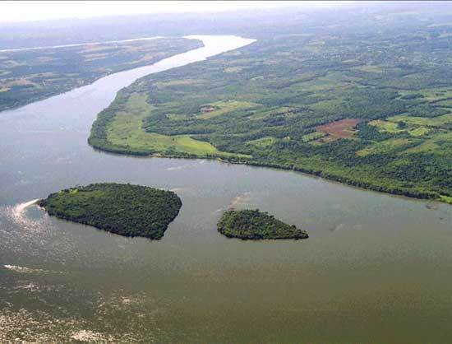
International Law of TBAs
Institutional mechanism
General obligation to cooperate in the framework of TBAs – institutional elements in bilateral/regional agreements/arrangements
Commission under the Treaty of the River Plate Basin (Guarani Aquifer Agreement, art. 15)
Mandate
Coordinate the cooperation among the Parties
Mediation in case of conflict

Slide 31
To discuss whether the emerging international law applicable to TBAs responds to the specificities of TBAs vis a vis transboundary surface water
To present some aspects of the few bilateral and regional agreements and arrangements dealing with the management of transboundary aquifers
Objectives
To highlight the “practical” role of the UNILC Draft Articles on the Law of Transboundary Aquifers

Slide 32
International Law of TBAs
Substantive obligations and rights
Procedural obligations
Institutional mechanism
Bilateral or regional agreement/arrangement

Slide 33
International Law of TBAs
The potential role of the Draft Articles
“For the purpose of managing a particular transboundary aquifer or aquifer system, aquifer States are encouraged to enter into bilateral or regional agreements or arrangements among themselves.” Draft Articles, art. 9
Draft UNGA Resolution, 4/11/2016, para 1: “Commends to the attention of Governments the draft articles on the law of transboundary aquifers annexed to its resolution 68/118 as guidance for bilateral or regional agreements and arrangements for the proper management of transboundary aquifers.”

Slide 34
International Law of TBAs
The potential role of the Draft Articles
Two countries that share a TBA and wish to move forward together in managing the aquifer may want to consult a tool that could guide them
The UNGA has confimed again that the UNILC Draft Articles can be considered as a guide in the negotiation and adoption of future TBA agreements and/or arrangements.
Are there any examples where the Draft Articles have been considered as a guide?
Guarani Aquifer Agreement(2010)
UNECE Model Provisions on Transboundary Groundwaters (2012)
Memorandum of Understanding for the Establishment of a Consultation Mechanism for the Integrated Management of the Water Resources of the Iullemeden, Taoudeni/Tanezrouft Aquifer System(2014)

Slide 35
International Law of TBAs
The potential role of the Draft Articles
Indicator 6.5.1 Degree of integrated water resources management (IWRM) implementation
Indicator 6.5.2 Proportion of transboundary basin area with an operational arrangement for water cooperation
SDG 6.5 “By 2030, implement integrated water resources management at all levels, including through transboundary cooperation as appropriate.”
TBA
Agreement/arrangement (potential “guiding” role of the Draft Articles)
SDG implementation (not just SDG 6)

Slide 36
Conclusions
The UNILC Draft Articles complete International Water Law by covering all TBAs and by focusing more specific on TBA peculiarities
The UNILC Draft Articles can be seen as a “flexible tool”: its general and framework nature should be seen as an advantage
The UNILC Draft Articles is a tool in the hands of those States that decide to start engaging in talks about the future management of a TBA
They provide “guidance” and can be tailored to the specific needs and characteristic of the countries sharing the TBA

Slide 37
Francesco Sindico
Director, Strathclyde Centre for Environmental Law and Governance
Reader in International Environmental Law
University of Strathclyde Law School
Level 3, Lord Hope Building
141 St James Road Glasgow
G4 0LT
www.facebook.com/SCELG/
www.linkedin.com/groups/8297435
@scelg
SCELG
w: www.strath.ac.uk/scelg/

