Slide 1
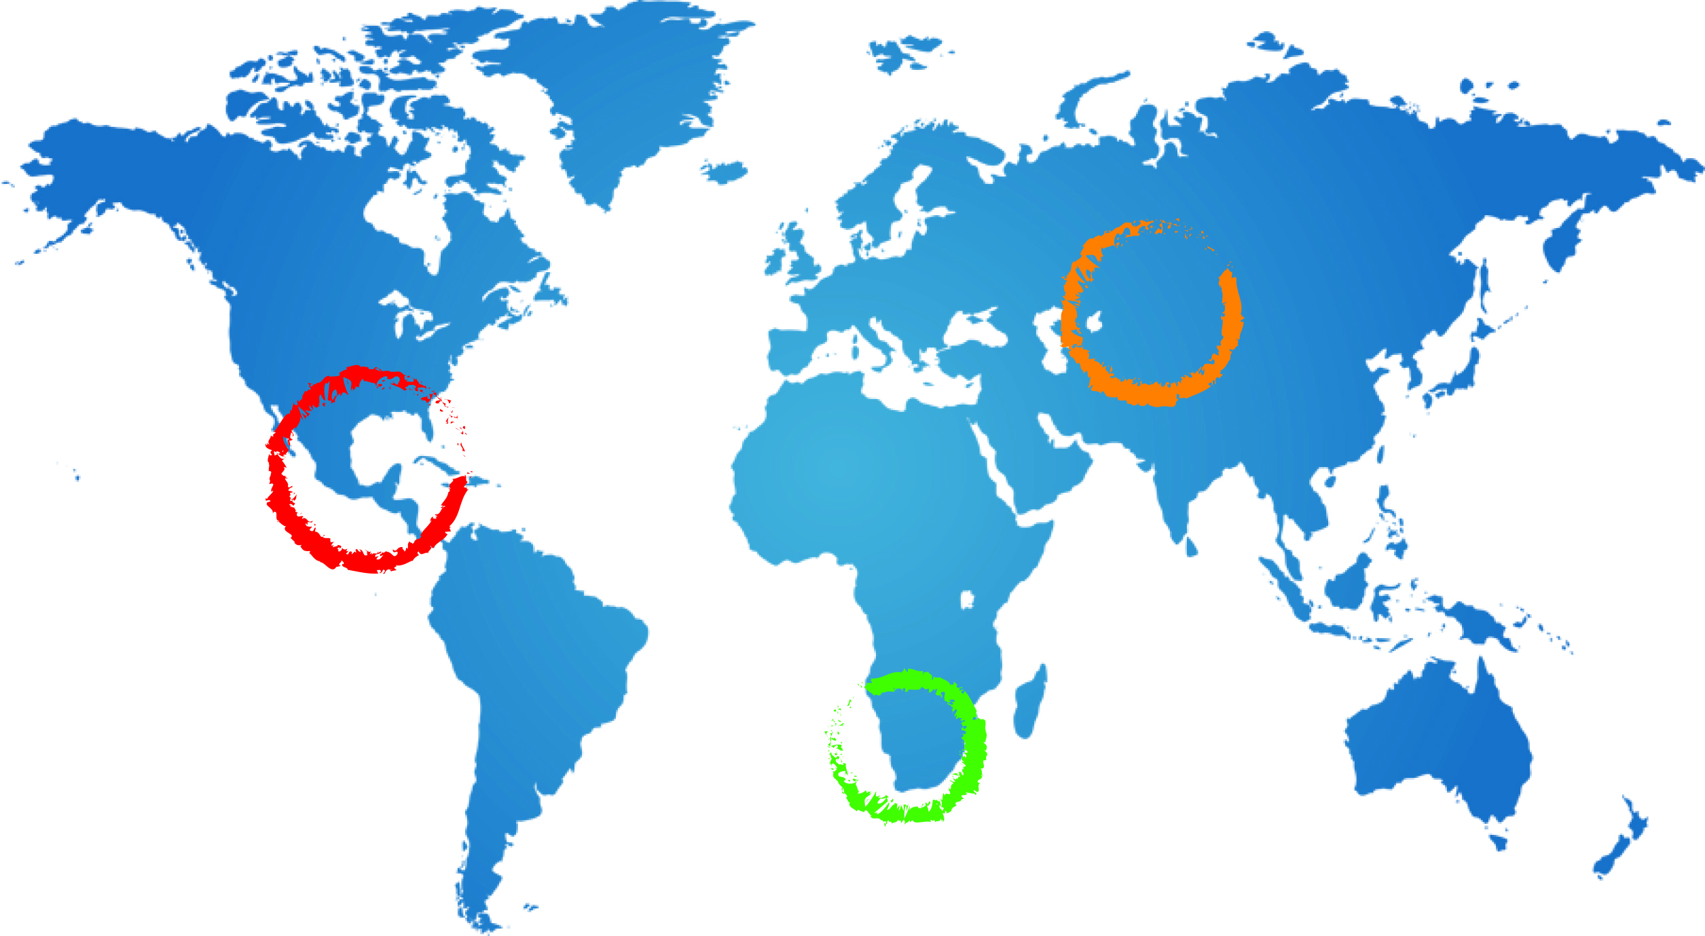
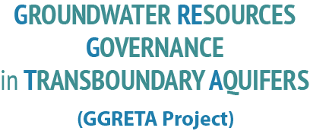
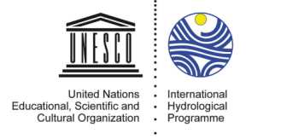
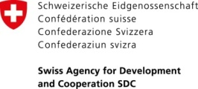
GGRETA PROJECT PHASE 2
LEGAL & INSTITUTIONAL ASPECTS
Stefano Burchi UNESCO
28 November 2016
Johannesburg, South Africa

Slide 2
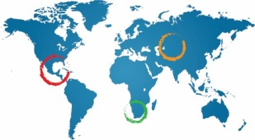
GGRETA-1 OUTPUTS
ANALYSIS & ASSESSMENT OF THE LEGAL & INSTITUTIONAL FRAMEWORK FOR TRANSBOUNDARY COOPERATION RELEVANT TO THE STAS
ANALYSIS & ASSESSMENT OF THE LEGAL & INSTITUTIONAL FRAMEWORK FOR GROUNDWATER IN THE STAS COUNTRIES
THE ABOVE BASED ON AN ORIGINAL INDICATOR-BASED METHODOLOGY DEVELOPED BY GGRETA
PRELIMINARY MODELS FOR A MULTI-COUNTRY COOPERATION OR CONSULTATION MECHANISM SKETCHED OUT
Notes:
Es una formación geológica semipermeable, que conteniendo apreciables cantidades de agua la transmiten muy lentamente, por lo que no son aptos para el emplazamiento de captaciones de aguas subterráneas, sin embargo bajo condiciones especiales permiten una recarga vertical de otros acuíferos

Slide 3
L&I Assessment methodology - Questionnaire
Questionnaire of fifty questions teasing out YES/NO answers aimed to map out the range, scope and performance of legal and institutional frameworks in place for the governance of TBAs
3

Slide 4
L&I Assessment methodology - Indicators
Sixteen indicators selected to characterize the range, scope and performance of legal and institutional frameworks in place for TBAs:
two for assessment of transboundary frameworks
fourteen for assessment of domestic frameworks
Transboundary indicators measure:
existence and comprehensiveness of treaties/agreements, and
existence, extent of mandate, and presumed capacity of transboundary institutions
4

Slide 5
L&I Assessment methodology – Indicators (2)
Domestic indicators measure:
Existence of policy framework for GW
Existence of legislation on GW (in the statute books)
Ownership status of groundwater
Existence of legislation on GW planning mechanisms
Existence and degree of articulation of regulatory framework for GW extraction & use
Existence and degree of articulation of regulatory framework for the protection of GW from point-source pollution
5

Slide 6
L&I Assessment methodology – Indicators (3)
Existence and degree of articulation of regulatory framework for the protection of GW from non-point-source (“diffuse”) pollution
Existence and degree of articulation of regulatory framework for the protection of GW recharge processes from man-made interference
Perfomance of GW regulatory legislation, measured by
kind and frequency of administrative implementation activity
kind and frequency of law enforcement activity
How articulate statutory response to customary rights is (if any)
6

Slide 7
L&I Assessment methodology – Indicators (4)
Each L&I indicator is scored incrementally, with the aim of quantifying qualitative-type data
Certain transboundary indicators have been attributed weighted scores to avoid distorted results
Indicators and relevant scoring presented in table form
L&I assessment table used by NLCs, and feedback used to adjust and fine-tune original Indicators table
7

Slide 8
CONCLUSIONS – TRANSBOUNDARY COOPERATION
THERE IS NO LEGAL INSTRUMENT OR INSTITUTION DEDICATED TO GROUNDWATER AT REGIONAL (SADC) OR STAS LEVEL
THE POTENTIAL OF SADC PROTOCOL AND OF ORASECOM AGREEMENT & COMMISSION TO REACH OUT TO STAS MERITS FURTHER INVESTIGATION IN THE LIGHT OF TREATY LANGUAGE & ACTUAL STATE PRACTICE
Notes:
Es una formación geológica semipermeable, que conteniendo apreciables cantidades de agua la transmiten muy lentamente, por lo que no son aptos para el emplazamiento de captaciones de aguas subterráneas, sin embargo bajo condiciones especiales permiten una recarga vertical de otros acuíferos

Slide 9
CONCLUSIONS – DOMESTIC LEGAL & INSTITUTIONAL FRAMEWORKS
A DOMESTIC POLICY, REGULATORY AND INSTITUTIONAL FRAMEWORK FOR WATER RESOURCES IS IN PLACE IN ALL THREE STAS COUNTRIES
NATIONAL LAWS AND THE GOVERNMENT WATER ADMINISTRATIONS REGULATE GROUNDWATER EXTRACTION AND POINT-SOURCE POLLUTION
IMPLEMENTATION AND ENFORCEMENT NEED ATTENTION
Notes:
Es una formación geológica semipermeable, que conteniendo apreciables cantidades de agua la transmiten muy lentamente, por lo que no son aptos para el emplazamiento de captaciones de aguas subterráneas, sin embargo bajo condiciones especiales permiten una recarga vertical de otros acuíferos

Slide 10
GGRETA-2 ACTIVITIES IN SUPPORT OF TRANSBOUNDARY COOPERATION
STRENGTHENING OF NATIONAL CAPACITY IN INTERNATIONAL WATER LAW (TRAINING WORKSHOPS)
FACILITATING DIALOGUE AMONG STAS COUNTRIES RE: A COOPERATION OR CONSULTATION MECHANISM FOR THE STAS – IN THE SPECIFICS:
Notes:
Es una formación geológica semipermeable, que conteniendo apreciables cantidades de agua la transmiten muy lentamente, por lo que no son aptos para el emplazamiento de captaciones de aguas subterráneas, sin embargo bajo condiciones especiales permiten una recarga vertical de otros acuíferos

Slide 11
GGRETA-2 ACTIVITIES IN SUPPORT OF TRANSBOUNDARY COOPERATION
AWARENESS-RAISING WORKSHOPS AIMED AT POLICYMAKERS, DECISIONMAKERS, MPs
FURTHER DISCUSSION OF MODELS FOR A COOPERATION/CONSULTATION MECHANISM
EXAMPLES OF COOPERATION MECHANISMS FOR TRANSBOUNDARY AQUIFERS (IN EUROPE, AFRICA, THE AMERICAS, THE MIDDLE EAST)
Notes:
Es una formación geológica semipermeable, que conteniendo apreciables cantidades de agua la transmiten muy lentamente, por lo que no son aptos para el emplazamiento de captaciones de aguas subterráneas, sin embargo bajo condiciones especiales permiten una recarga vertical de otros acuíferos

Slide 12
ACTIVITIES AIMED AT STRENGTHENING THE DOMESTIC LEGAL & INSTITUTIONAL FRAMEWORK FOR GROUNDWATER
STRENGTHENING OF CAPACITY IN CONNECTION WITH THE DOMESTIC LEGAL FRAMEWORK FOR WATER RESOURCES (TRAINING WORKSHOPS IN DOMESTIC WATER LEGISLATION)
TECHNICAL ASSISTANCE IN (THE CONCEPTUALIZATION, DRAFTING, IMPLEMENTATION OF) DOMESTIC WATER LEGISLATION - UPON THE REQUEST OF CONCERNED COUNTRIES
Notes:
Es una formación geológica semipermeable, que conteniendo apreciables cantidades de agua la transmiten muy lentamente, por lo que no son aptos para el emplazamiento de captaciones de aguas subterráneas, sin embargo bajo condiciones especiales permiten una recarga vertical de otros acuíferos

