Slide 1
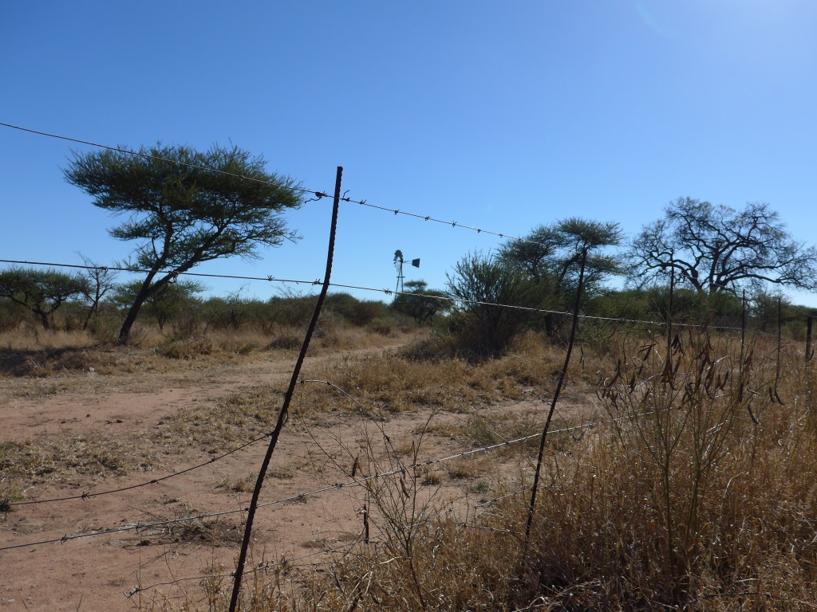





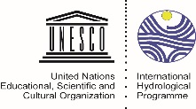






RAMOTSWA
An Evolving Case of Transboundary Aquifer Management
Karen Villholth
Principal Researcher,
Coordinator of RAMOTSWA
IWMI
2nd Regional Meeting on Tools for the Sustainable Management of Transboundary Aquifers
28 November – 02 December, Johannesburg, South Africa

Slide 2



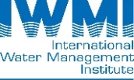





The RAMOTSWA Project - Partners
IWMI, International Water Management Institute, South Africa office
IGRAC, International Groundwater Resources Assessment Centre, Netherlands
XRI-Blue, Exploration Resources International , USA
Dept. of Water Affairs, Botswana
Dept. of Water and Sanitation, South Africa
University of Botswana, Botswana
University of the Free State
University of Pretoria
University of the Witwatersrand, South Africa

Slide 3
What is a Transboundary Aquifer (TBA)?
DEFINITION
  A transboundary aquifer (TBA) or a transboundary aquifer system is defined as ‘an aquifer or aquifer system, parts of which are situated in different States’
  (UN International Law Commission - UNILC)
(UNESCO/ISARM, 2001)

Slide 4
Transboundary Groundwater Resources in SADC
33 TBAs identified in SADC
TBAs area ranges from less than 400 km² to more than 300 000 km²
If properly and conjunctively developed, shared, recharged, and managed as part of ongoing joint collaboration between the states, groundwater can support:
  Domestic water supply
  Drought and flood resilience
  Urban expansion
  Small-scale agriculture
(IGRAC, 2015)

Slide 5
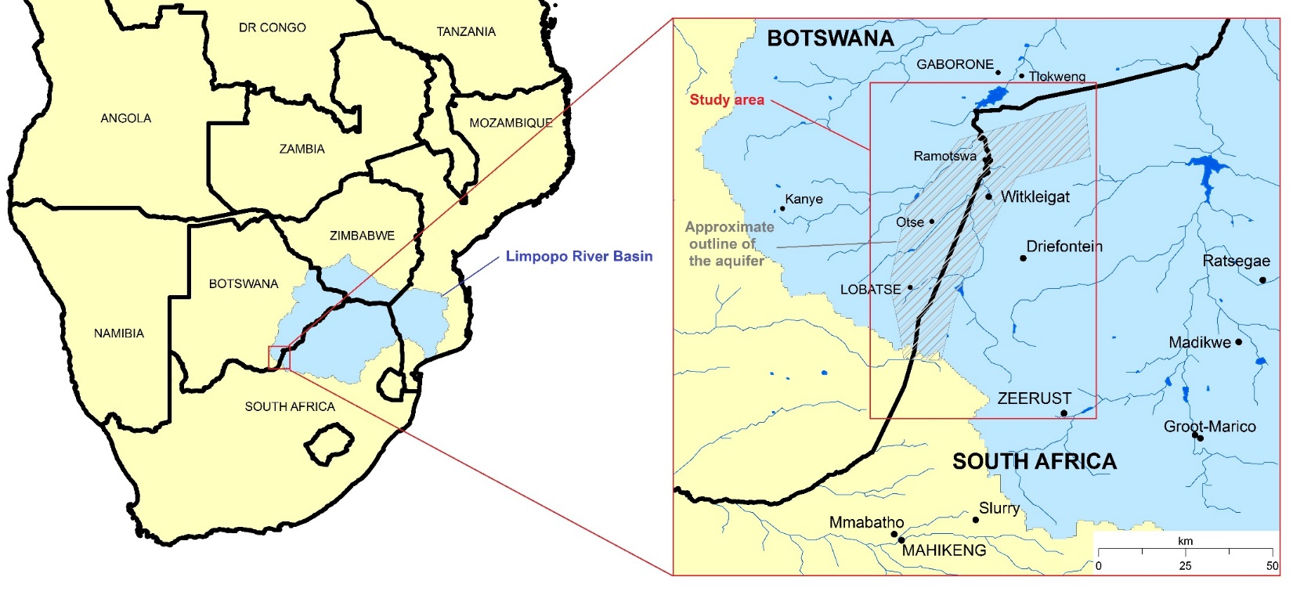
Ramotswa Aquifer – Limpopo Basin
To be completed

Slide 6
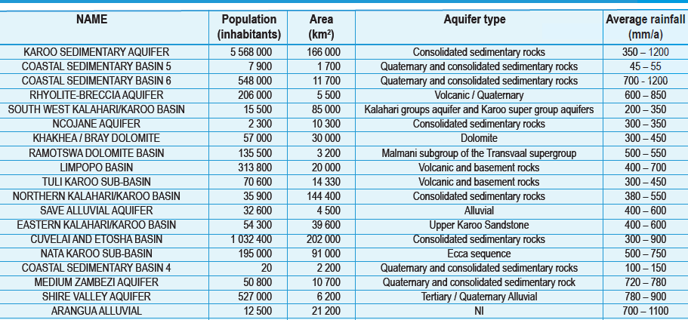
Stampriet vs. Ramotswa

Slide 7
The RAMOTSWA Project – Objectives
Overall objectives:
To support a long-term joined vision and cooperation on the shared groundwater resources of the Upper Limpopo region, where the states share significant and valuable underground freshwater resources as well as space for enhanced subsurface water storage.
To facilitate and promote joint management and better groundwater governance focused on coordination, scientific knowledge, social redress and environmental sustainability, in order to reduce poverty and inequity, increase prosperity, and improve livelihoods and water and food security in the face of climate change and variability.
Diplomacy objectives:
To contribute to the building of trust and transparency in the development and use of groundwater resources in the border region
To encourage the states to enter into agreements on their shared aquifer(s).

Slide 8
The RAMOTSWA project – specific objectives
Increase awareness of the importance and vulnerability of the transboundary Ramotswa Aquifer.
Improve understanding of the socioeconomic importance of the aquifer area, and the inequalities in water access and security across the population.
Improve understanding of the extent and hydrogeology of the transboundary aquifer resources under present and future climate and population projections.
Establish national and cross-border dialogue and cooperation on the Ramotswa Aquifer, and further encourage international cooperation on transboundary aquifers in the Southern African Development Community (SADC) region.
Develop tools for shared and harmonized management and monitoring of groundwater resources, aligned with the national water resources management processes.
Develop human and institutional capacity for shared and harmonized management and monitoring of groundwater resources.

Slide 9
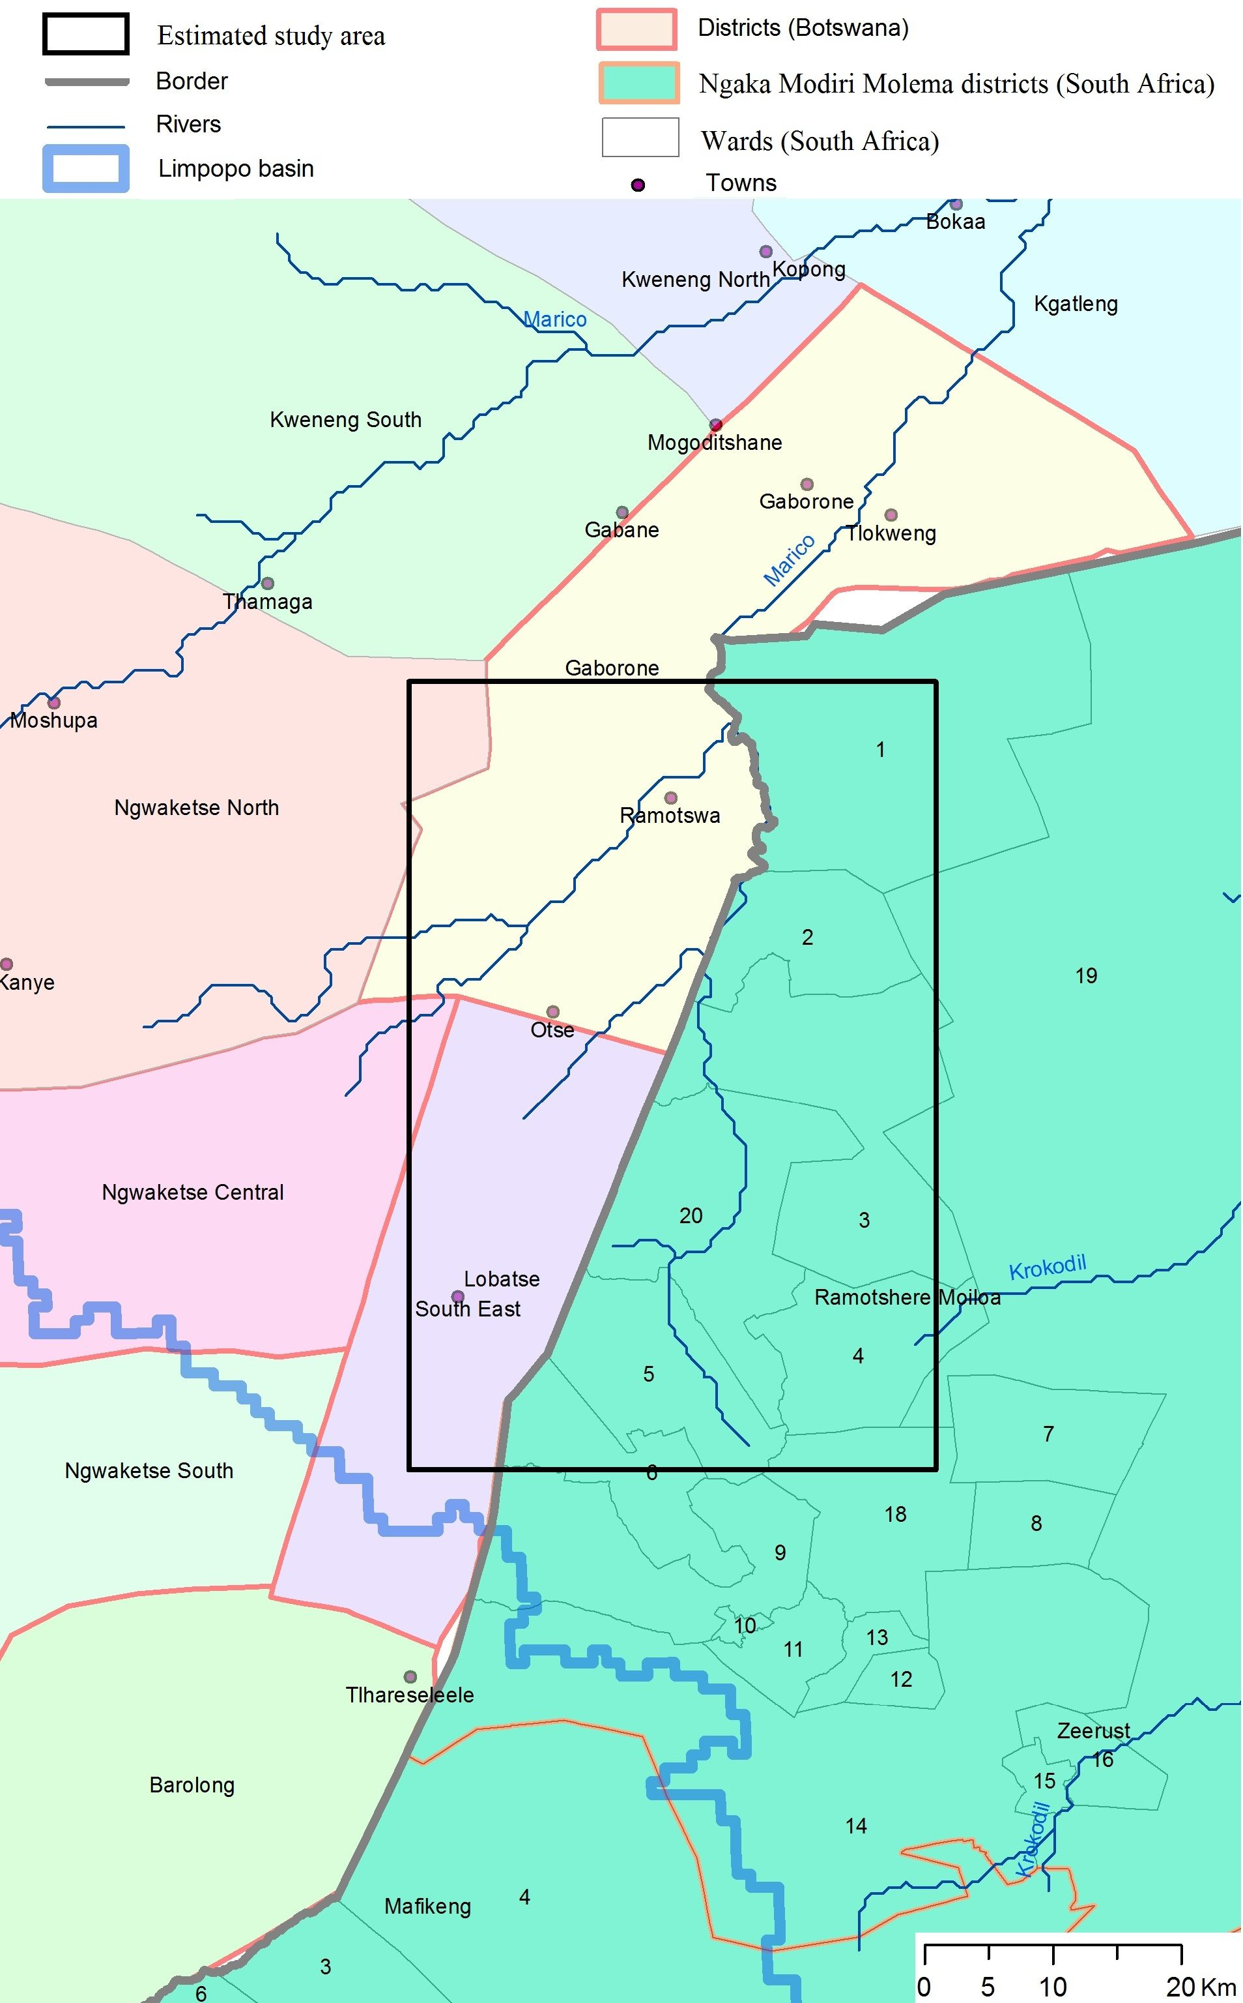
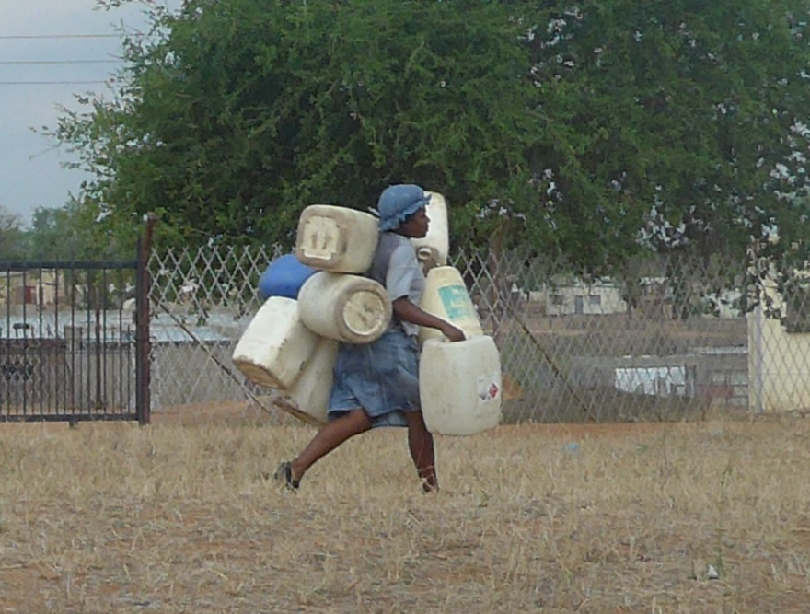
Socio-economics
46 (39.3) %
Poverty level (%)
in district
2007 (2010)
33 (18.4) %
62.1 (67.0) %
24 (19.6) %
46 (20.6) %

Slide 10
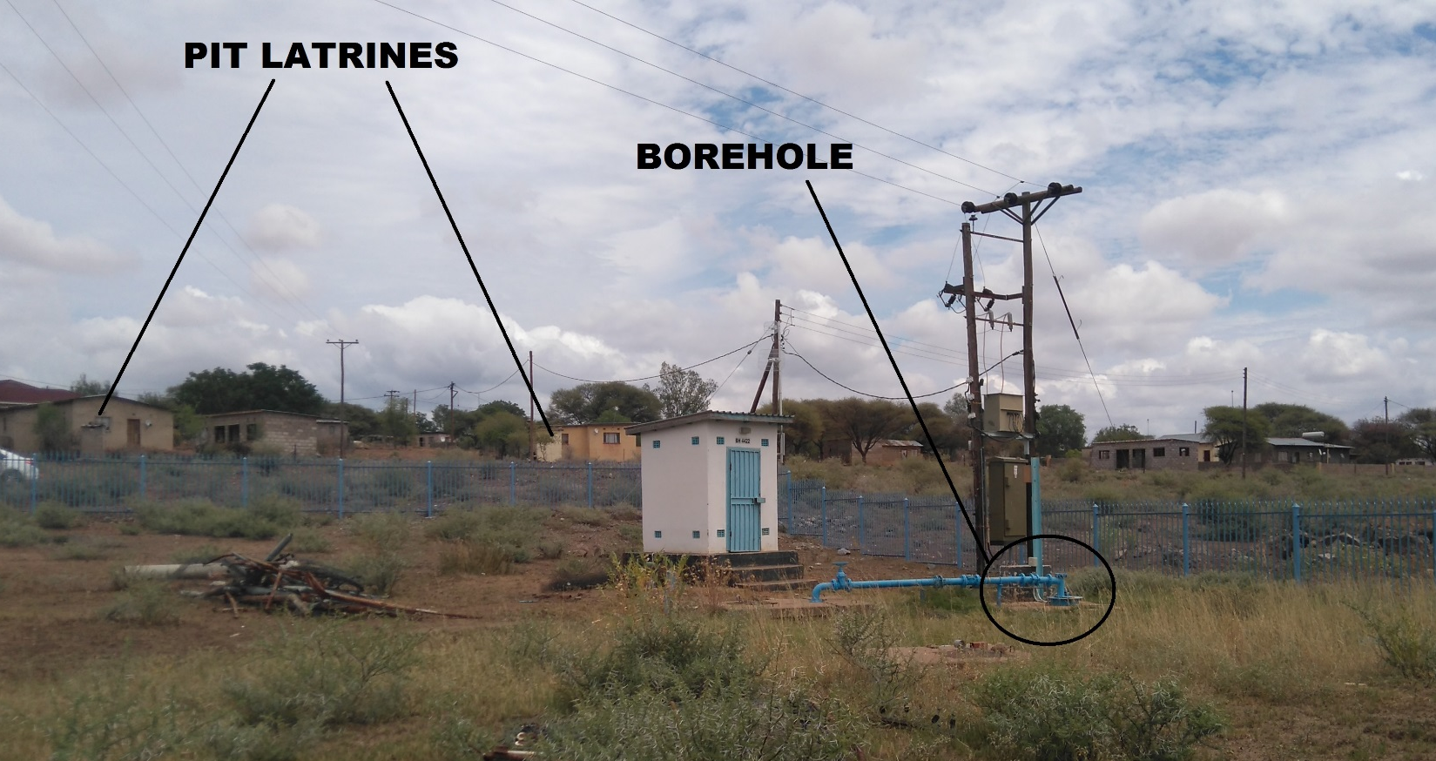
Contamination
Photo by Y. ALtchenko

Slide 11
Methodology
Defining system boundaries
Collection and analysis of data / information
Identification and prioritisation of threats and transboundary issues
Determination of environmental and socio-economic impacts
Development of thematic reports
Baseline
report
Thematic reports
(e.g., hydrogeology)
Strategic Action Plan (SAP)
Notes:
SAP = negotiated policy document that should be endorsed at the highest level of all relevant sectors. It establishes clear priorities for action (for example, policy, legal, institutional reforms, or investments) to resolve the priority problems identified in the TDA. The preparation of a SAP should be a highly cooperative and collaborative process among the countries of the region. Vision/goals/idea and opportunities/ priorisatising alternatives / consultation / implementation strategies / action plan /drafting
To contribute to the building of trust and transparency in the development and use of groundwater resources in the border region
To encourage and facilitate the states to enter into agreements on their shared aquifer(s).

Slide 12
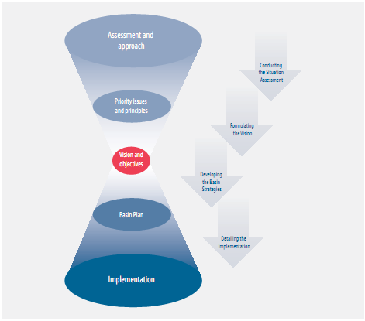
Strategic Action Plan (SAP)

Slide 13
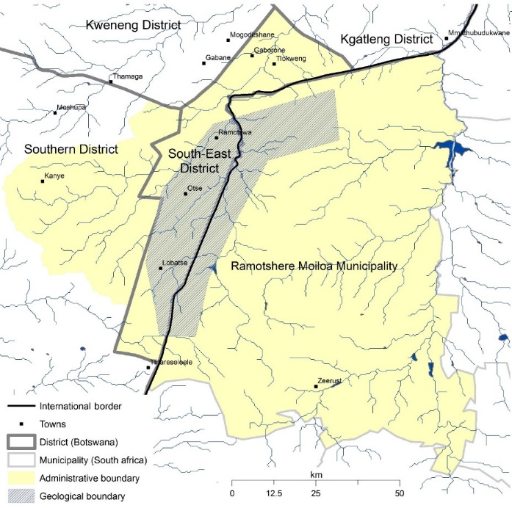
Delineation of Study Area
Biophysical conditions of the aquifer and interaction surface/ground water
Socio-economic importance of groundwater in a wider area

Slide 14
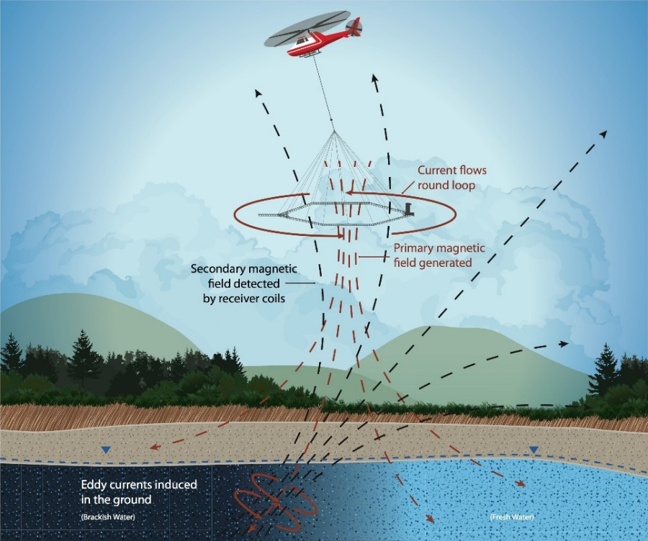
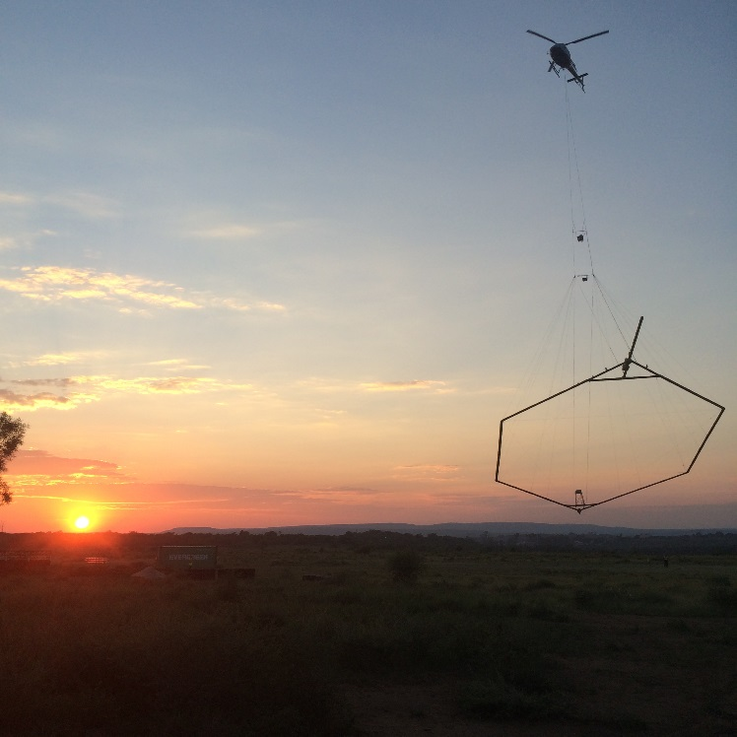
Airborne SkyTEM – Understanding the Subsurface – from the Sky

Slide 15
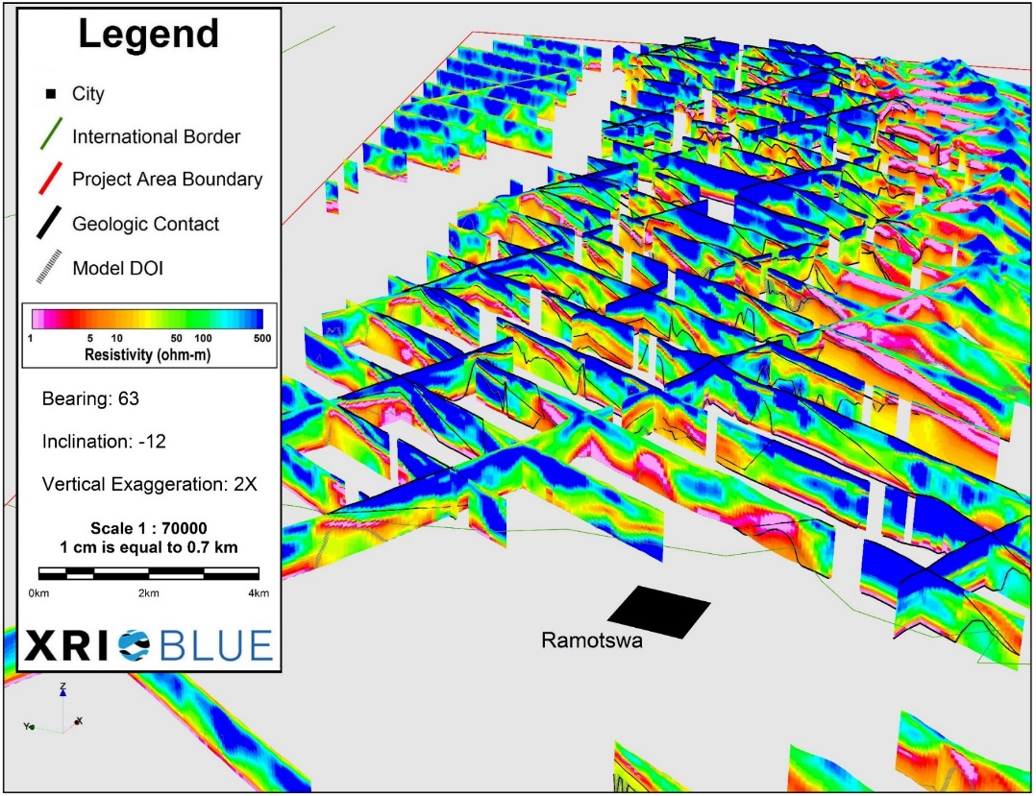
3D Geological Model in the Northern Portion of the RTBAA

Slide 16
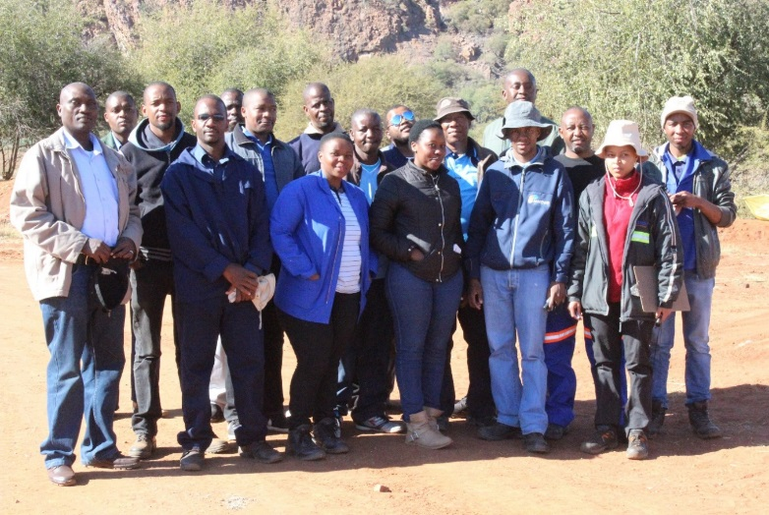
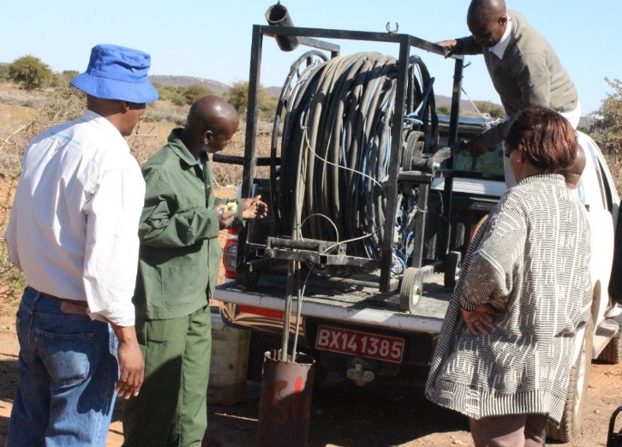
Joint Field Work and Student Involvement
Students and Interns:
Jonathan Otene, Nigeria
Sima Baqa, South Africa
Oudi Moudisha, South Africa
Bakang Mpeo , Botswana
Kelly Goodman, USA
Bonnie McGill, USA

Slide 17
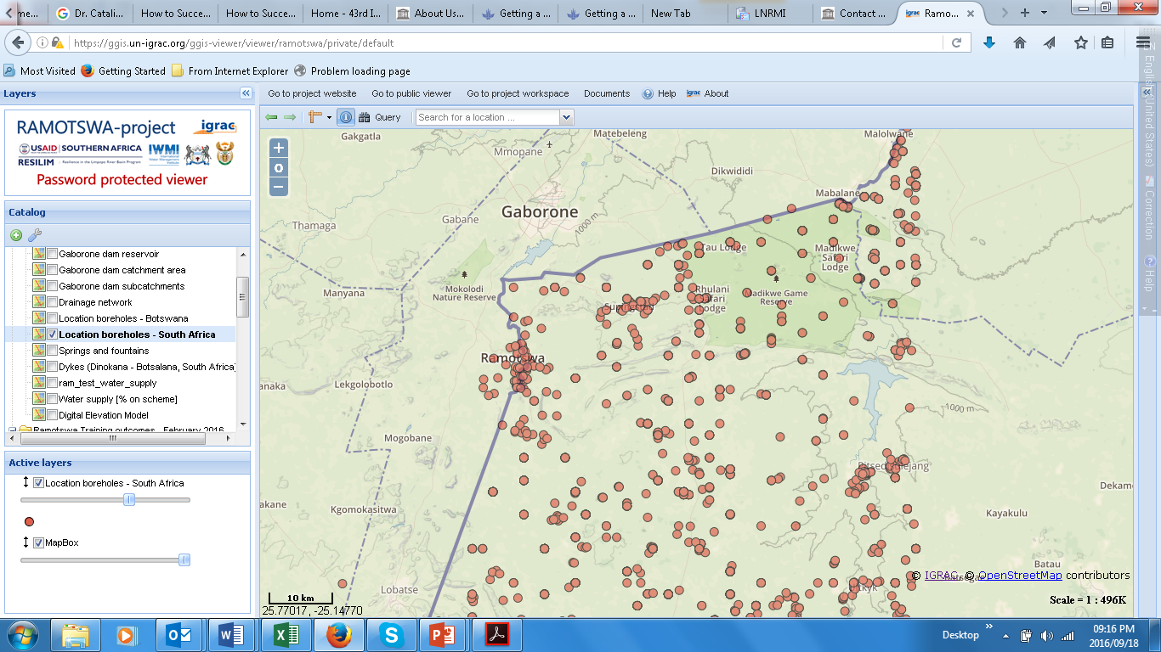
RAMOTSWA Joint Information Management System (RIMS)

Slide 18
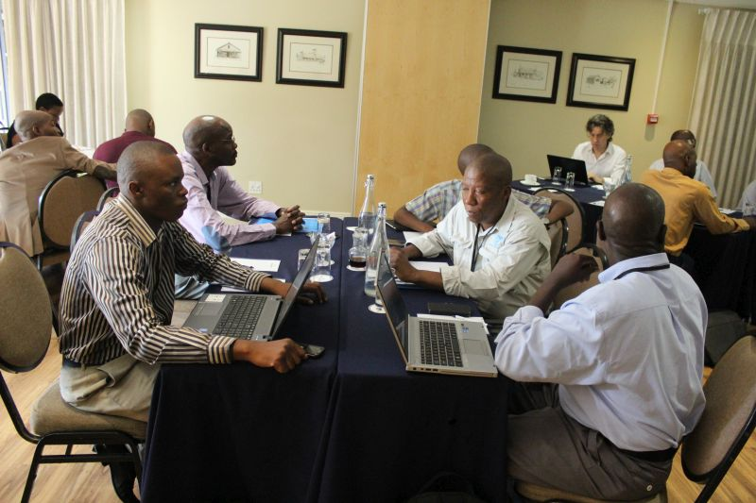
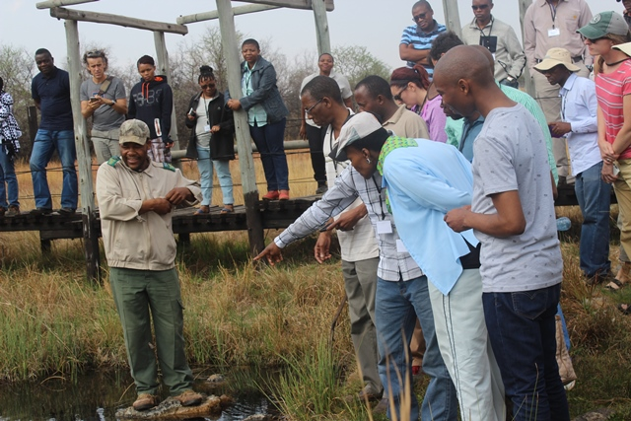
Training and Field Visits

Slide 19
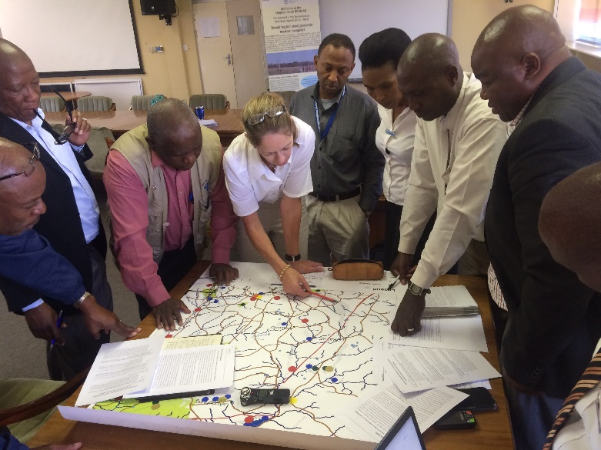
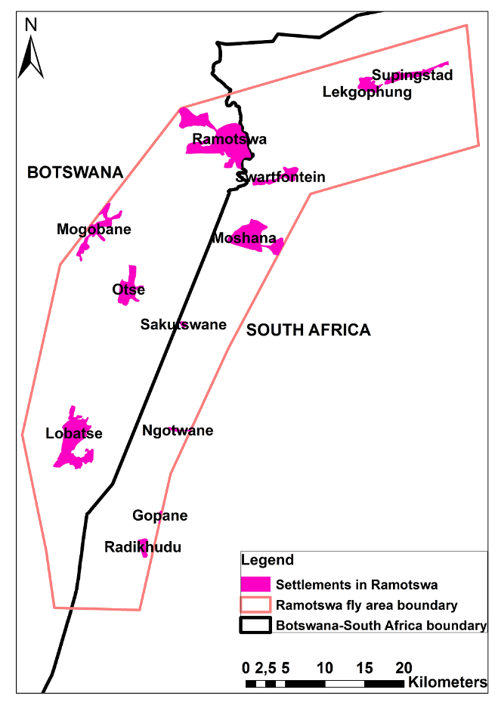
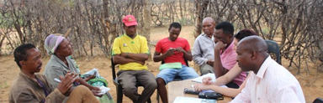
Focal Group Discussions

Slide 20
Institutional Self-assessment
Capacity Needs Assessment (CAN): A process and tool that enable assessment of capacity and capabilities related to policies, regulatory framework, management, organizations and ‘enabling environment’ that would be required to effectively manage transboundary groundwater in the public interest
Need identified: transboundary groundwater management is now emerging in national goals but capacity is required to mainstream in institutions
Purpose of the CNA: to assess baseline and improvements in capacity and capabilities
Type of tool: Facilitated self-assessment
Demand: Requested by RSA national partners

Slide 21
Institutional self-assessment
Progress to date:
Reviewed methods and tools for good practices to guide a CNA process
Developed draft instrument and proposed steps
Received feedback on tool and process
Revised tool
Next steps:
Further feedback on tool by partners and key organizations during workshop
Review potential to integrate into the SAP
Identify organizations to lead process
Agreement on process and final tool

Slide 22
Transboundary Institutions
Transboundary agreements and regional level policies:
Revised SADC protocol on Shared Watercourses (2000)
Agreement for Establishment of the Limpopo Water Commission (LIMCOM) in 2003 and establishment of a Secretariat in 2011
Joint Permanent Technical Committee (JPTC) (1987)
Revised TSWANA agreement on the Molatedi Dam (1998, 2014)

Slide 23
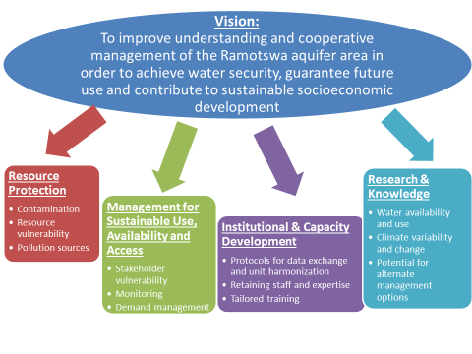
Progress on SAP

Slide 24
References
Altchenko, Y. and K.G. Villholth (2013). Transboundary aquifer mapping and management in Africa: a harmonised approach. Hydrogeol. J. 21(7), 1497-1517. DOI 10.1007/s10040-013-1002-3.
Altchenko, Y., Lefore, N., Villholth, K.G., Ebrahim, G., Genco, A., Pierce, K., Woolf, R., Mosetlhi, B.B.T., Moyo, T., Kenabatho, P., and Nijsten, G. (2016). Resilience in the Limpopo basin: the potential role of the transboundary Ramotswa aquifer. Baseline report. 15 June 2016.
IGRAC http://www.un-igrac.org,
UNESCO/ISARM (2001). Internationally Shared (Transboundary) Aquifer Resources Management – Their significance and sustainable management. A framework document, IHP-VI, Series on Groundwater No 1.
Project website: http://ramotswa.iwmi.org/
RIMS: https://ggis.un-igrac.org/ggis-viewer/viewer/ramotswa/public/default

Slide 25
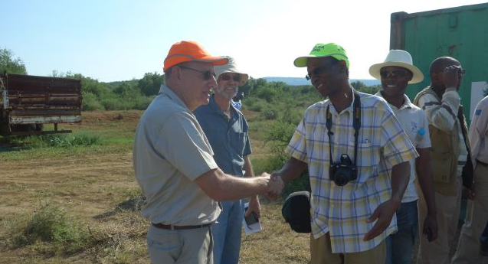
Thank You
Karen Villholth: k.villholth@cigar.org

