Slide 1

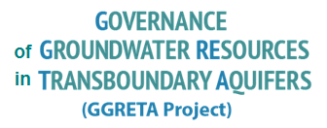
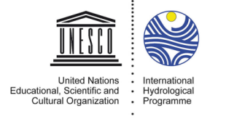
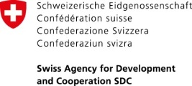



Sharing experiences and lessons learnt on transboundary aquifer cooperation in the SADC region:
the Stampriet Transboundary Aquifer System (STAS) assessment
2nd Regional Meeting on Tools for the Sustainable Management of Transboundary Aquifers
28 November – 02 December 2016
Tales Carvalho Resende
28 November 2016
Johannesburg, South Africa

Slide 2
  Background

Slide 3
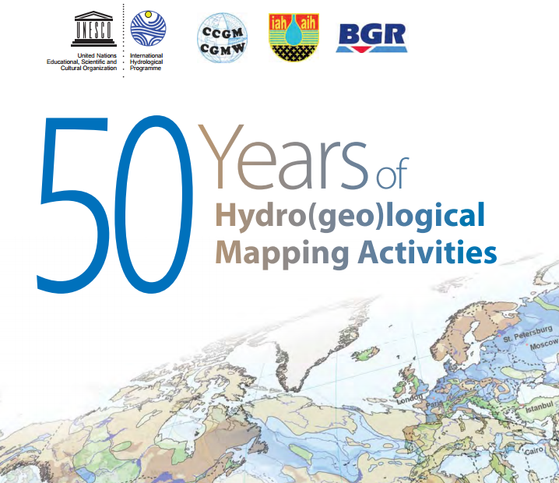
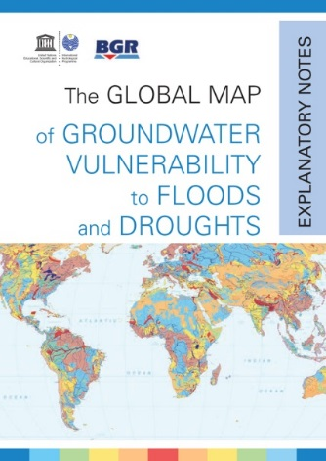
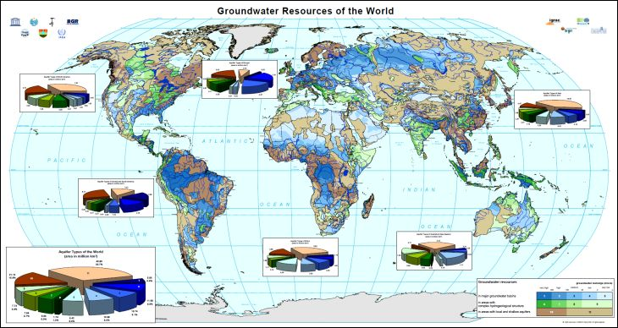
Groundwater at UNESCO-IHP
UNESCO International Hydrological Programme (IHP):
  Only intergovernmental programme of the UN system devoted to help improve understanding of water resources and foster effective water management
More than 50 years of hydrogeological mapping activities
  www.whymap.org

Slide 4

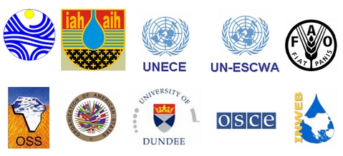
International Shared Aquifer Resources Management (ISARM) Programme
UNESCO-IHP launched the ISARM initiative in the year 2000 aiming at
undertaking the inventory of transboundary aquifers and develop
recommendations for improving their management and governance
considering scientific, socio-economic, legal, institutional and
environmental components

Slide 5
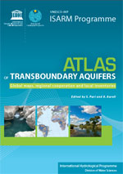
International Shared Aquifer Resources Management (ISARM) Programme
2000: Starting of the first Worldwide Inventory of Transboundary Aquifers (UNESCO-IHP Resolution XIV-12 - 2000)
2000: Framework document
2008: First TBAs Map

Slide 6
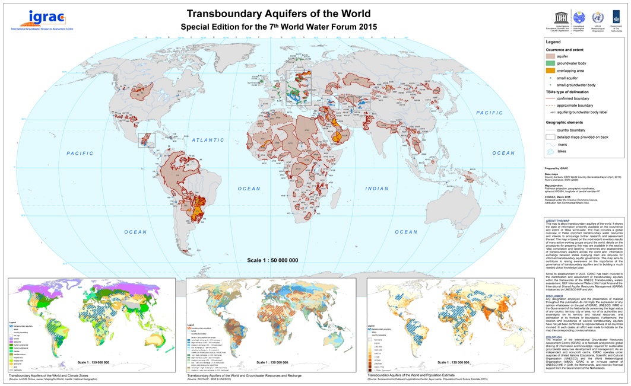
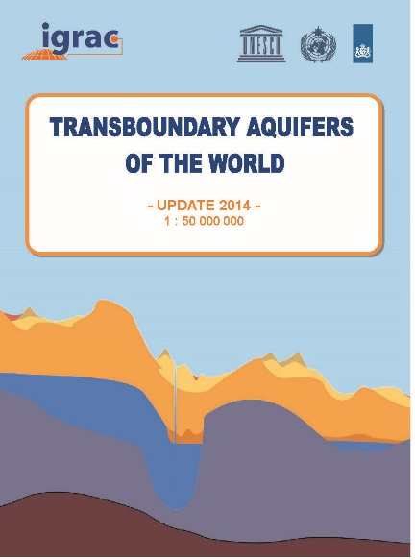



Transboundary Aquifers of the World
Worldwide inventory:
Updated position and delineation of
592 transboundary aquifers

Slide 7
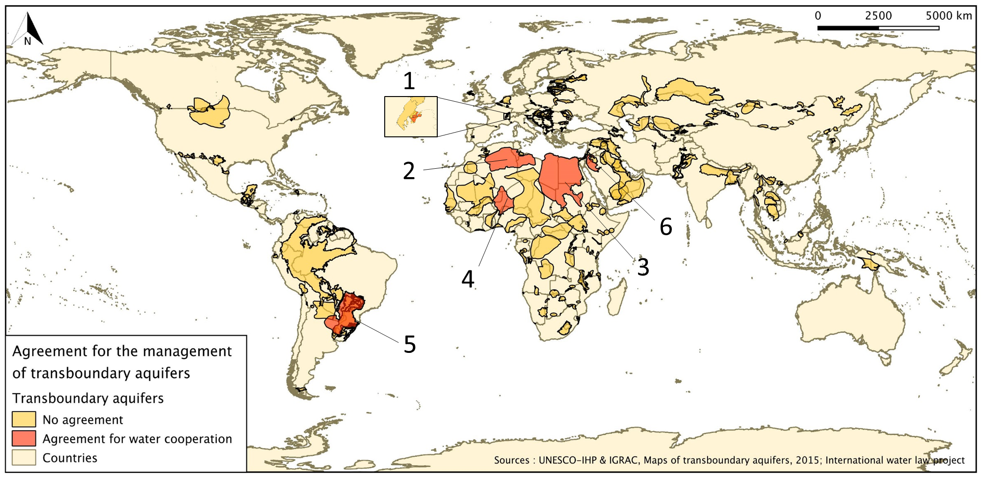
Transboundary Aquifers agreements
Only 6 TBAs are subjected to an arrangement for water cooperation

Slide 8

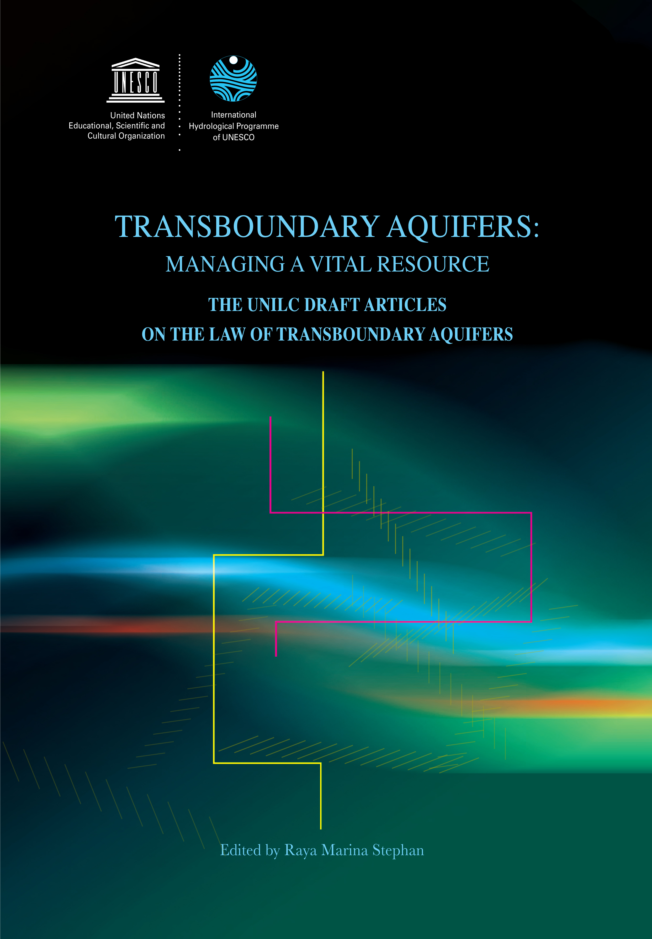
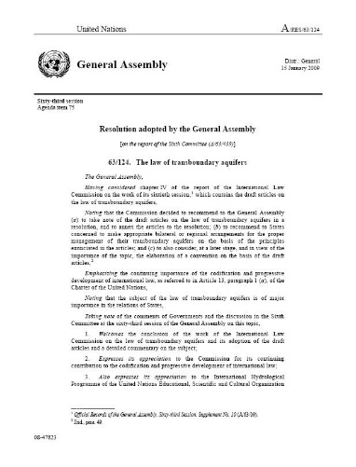
UNESCO and legal & institutional frameworks
Resolution adopted by the UN General Assembly (2008):
Draft Articles on the
Law of Transboundary Aquifers
UNESCO provided scientific support to the UN International Law Commission

Slide 9
UNGA Resolution (A/C.6/68/L.25,2013)
§ 1. Commends to the attention of Governments the draft articles on the law of transboundary aquifers annexed to the present resolution as guidance for bilateral or regional agreements and arrangements for the proper management of transboundary aquifers;
§ 2 Encourages the International Hydrological Programme of the United Nations Educational, Scientific and Cultural Organization to continue its contribution by offering further scientific and technical assistance to the States concerned;
“Decides to include in the provisional agenda of its seventy-first session the item entitled “The law of transboundary aquifers”.

Slide 10
  Stampriet Transboundary Aquifer System (STAS)
  GGRETA 1 Assessment

Slide 11

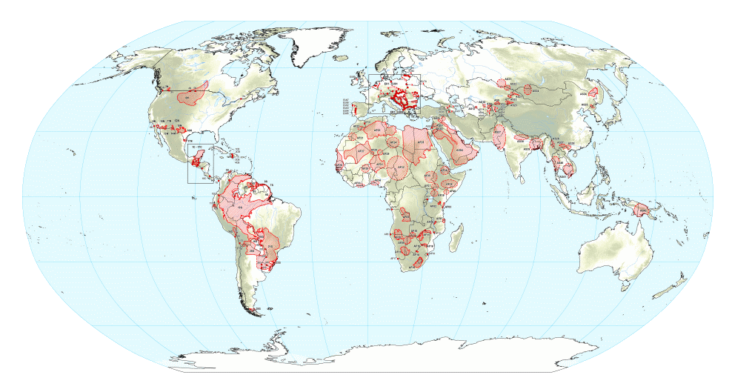

Presentation of GGRETA Phase 1
Where does GGRETA come from?
  ISARM (2000-) → TWAP (2013-2015) → GGRETA (2013-2015)
ISARM (International Shared Aquifers Resources Management) :
  - UNESCO-IHP Initiative → Inventory of Transboundary Aquifers (TBAs)
TWAP (Transboundary Waters Assessment Programme):
  - Follow up of ISARM
  - 1st ever global assessment of 199 TBAs
  - Indicator-based assessment
GGRETA:
  Run in parallel of TWAP
  In-depth assessment of case studies
  Extended number of indicators
Stampriet Transboundary Aquifer
(Orange-Senqu River Basin)

Slide 12
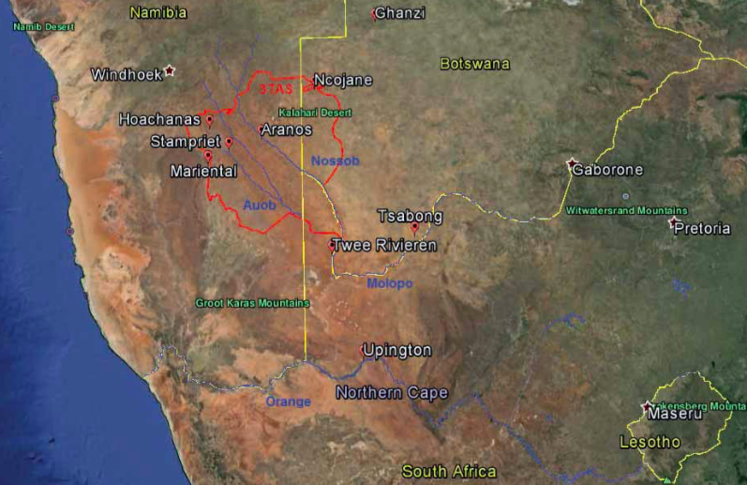
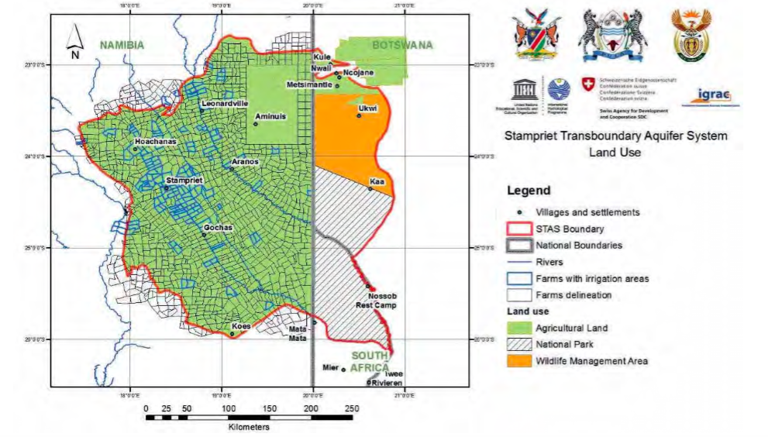
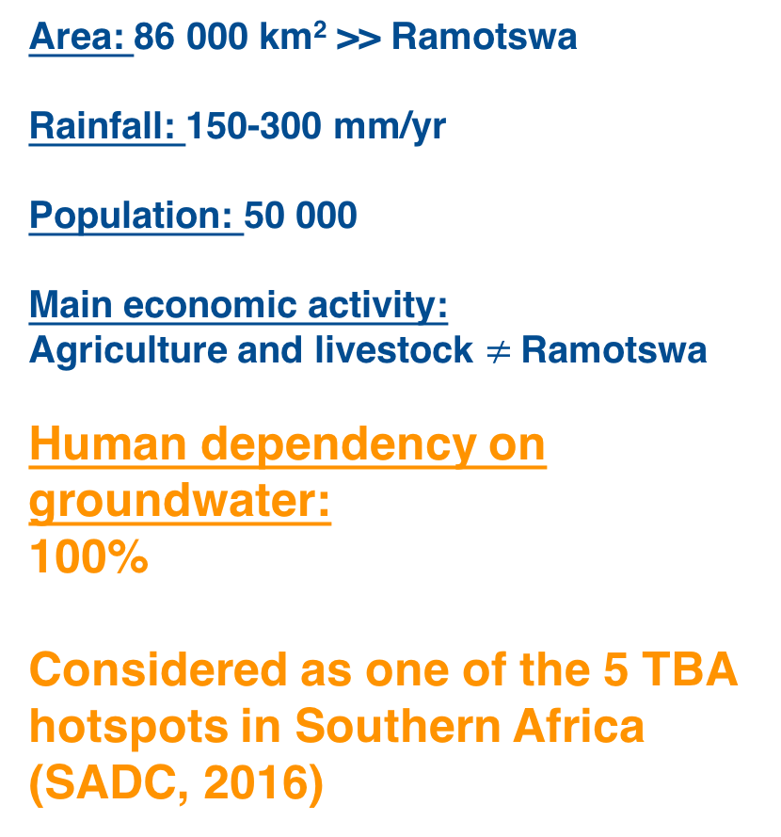
Stampriet Transboundary Aquifer System
Area: 86 000 km² >> Ramotswa
Rainfall: 150-300 mm/yr
Population: 50 000
Main economic activity:
Agriculture and livestock $≠$Ramotswa
Human dependency on groundwater:
100%
Considered as one of the 5 TBA hotspots in Southern Africa (SADC, 2016)

Slide 13
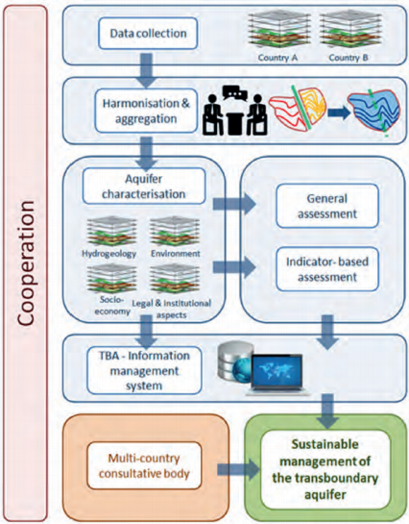
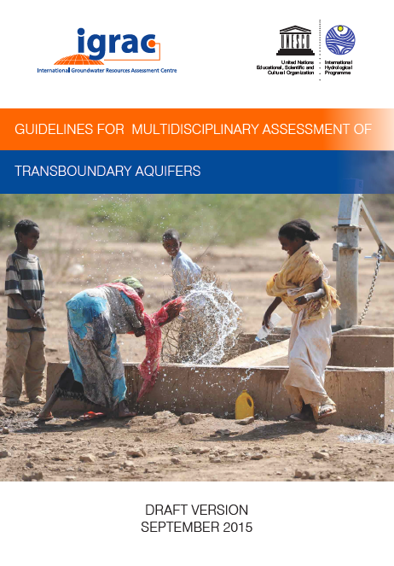
STAS GGRETA 1 assessment
  Multi-disciplinary in-depth assessment
    Hydrogeological aspects
    Environmental issues
    Socio-economic aspects
    Institutional setting
    Legal framework
  Guidelines applicable at transboundary and national scale
  www.groundwaterportal.org/ggreta

Slide 14
Before the assessment…
  Stakeholder mapping is needed (1 year)
    Governments through responsible Ministries are the initiators of the assessment.
    Considering the multi-disciplinary character of the assessment and the complexity of domestic groundwater resources institutional setting, it is desirable that various Ministries (Environment, Agriculture, Foreign Affairs, etc…) and other organization (knowledge centres, water boards) should be involved in the assessment.
    Preliminary study on data availability

Slide 15
Before the assessment…
  Setting up the baseline for the assessment (6 months)
    Suggested organigram for a multidisciplinary assessment team

Slide 16
Data collection process
  Agreement between aquifer states needed on:
    Boundaries of the study, especially relevant when dealing with large aquifers such as the STAS
    Aquifers/hydrogeological units to be assessed
    If sufficient data are available to assess multiple aquifer layers individually
    Are national aquifer(s) included in the assessment?
  Data collection process for the STAS → 1 year
    The process could have been optimized if experts had been acquainted with a map overlying the boundaries + administrative units → importance of GIS expertise
  Main source of data is existing data → identification of data gaps at national level

Slide 17
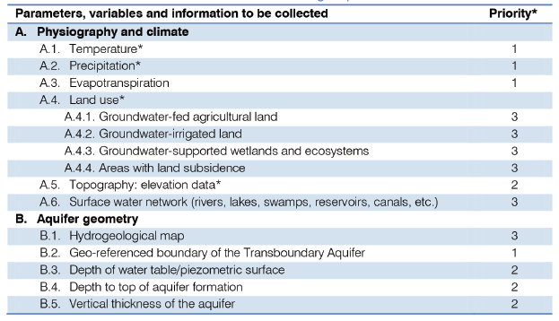
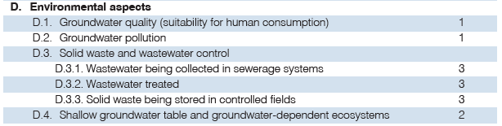
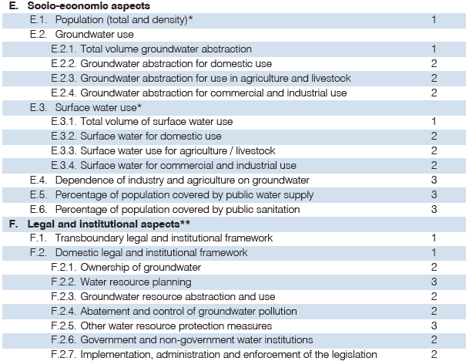
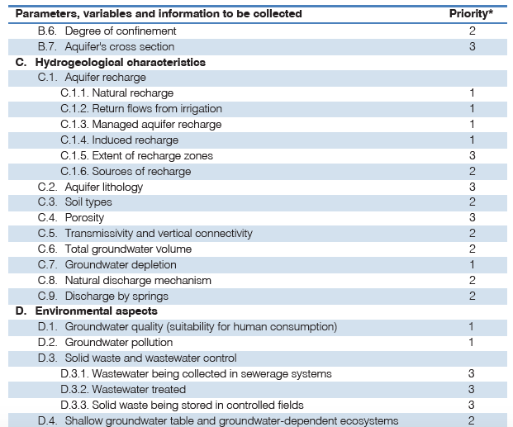
Type of data needed for the assessment
  Data is collected by teams of national experts
    Information needs to be compiled in a structured way (templates, questionnaires) in order to make it comparable with the data collected by the other aquifer states

Slide 18
Harmonization and aggregation

Slide 19
Harmonization and aggregation
  The most crucial and challenging phase
    Most data is generated at national level, based on standards of the national institutions.
    Based on the data collected at national level, it is necessary that countries agree on a common standard for the purpose of the transboundary aquifer assessment.
  Common standard → STAS joint borehole database
    Agreement on the joint borehole database was crucial for the production of thematic maps.
    Simple joint borehole database
      → Excel table with information for around 6000 boreholes → 20 columns providing information on water level, water quality, borehole yield, transmissivity, etc…).
    More than 50 thematic maps where produced.

Slide 20
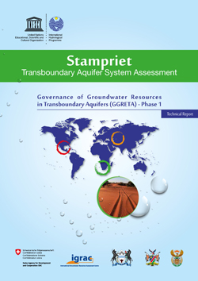
Aquifer Assessment

Slide 21
Aquifer Assessment
  Advantages of an indicator-based assessment
    Indicators are very strong in passing a message. They summarise in a nutshell a number of very important aspects of the system considered and bring them under attention of decision-makers, planners and other persons that do not read the entire report.
    Indicators may help integrating information from different disciplines and thus support the development of a holistic view. In particular, they may integrate hydrogeological with socio-economic and ecological aspects. The wider, holistic view will contribute to a more successful dialogue between the different categories of scientists involved and other stakeholders.
    Indicators may help differentiating between issues of major concern and secondary issues.
    Indicators are strong on summarizing briefly whether and why the aquifer is so important that significant governance and management attention is required.

Slide 22
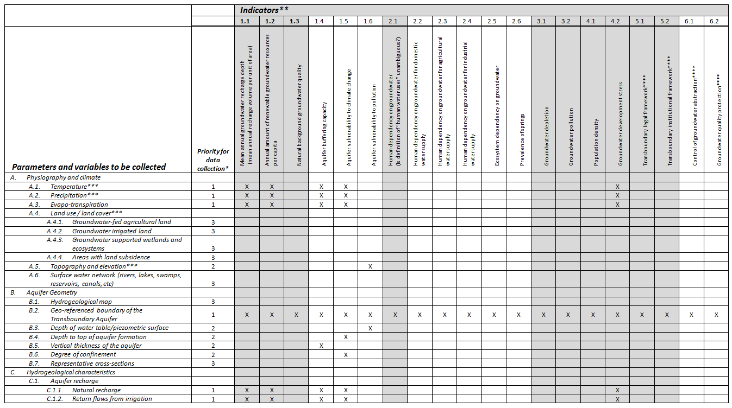
Aquifer Assessment
2. Indicators calculated from data collected
1. Data to be collected

Slide 23
Aquifer Assessment
  However, indicators do not provide the whole picture, especially when dealing large aquifers → Need for a diagnostic
  Diagnostic – DPSIR framework → understand the processes of change:
    Driving forces or drivers (D): root-cause of change.
    Pressures (P): immediate cause of change inside a water resources system, originating under influence of drivers (D) and/or human responses (R).
    State (S): the quantity, quality and other measurable conditions of water inside the water resources systems
    Impacts (I): negative or positive effect of changes in state on human society, ecosystems and/or the environment
    Responses (R): human action triggered by observed or expected undesired changes in state (S) or impacts (I).

Slide 24

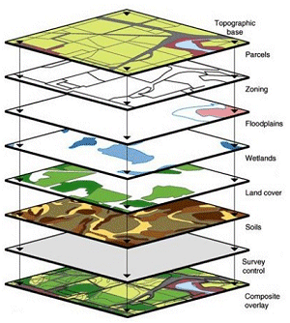
Data Management
  Not a database for ‘raw’ data, but a system which enable users to access interpreted data and documents.
  By combining / creating overlays of thematic maps new information is generated.
  Information Management System → creates institutional memory

Slide 25
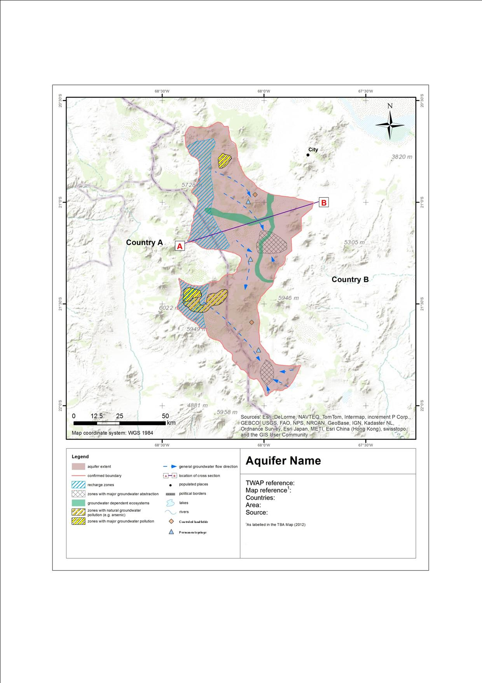
Data Management
  Thematic maps

Slide 26
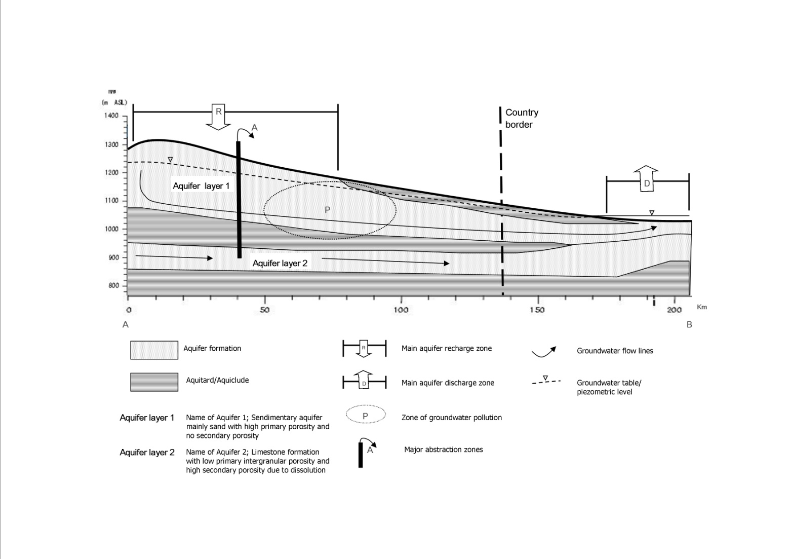
Data Management
  Simplified cross-sections

Slide 27
  The importance of Water Diplomacy

Slide 28


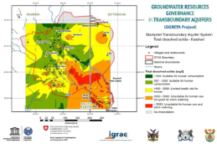

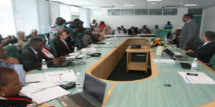

The importance of Water Diplomacy
Water Diplomacy
Starting point
Limited knowledge of the resources
Lack of a common framework for dialogue on transboundary aquifers management
From Potential Conflict to Cooperation Potential
Trust-building
Stakeholders mapping, identifying issues and interests
Capacity-building
Trainings on water diplomacy (multilevel governance, stakholder linking), international and domestic water law, and gender
Transboundary Multidisciplinary Assessments
Consensus-building
Better understanding of water cooperation benefits to stakeholders at national (e.g. Governments, Diplomats) and local level (e.g. Farmers)
Innovative methodologies and tools
Sex-disaggregated indicators for water monitoring
Diagnostic of favorable conditions for cooperative management
Evaluation of legal and institutional gaps at domestic level
Information Management System
Multi-Country
Co-operation Mechanisms
Science for Transboundary Multidisciplinary Assessment
Achievements
Strengthened cross‐border dialogue and cooperation
Understanding of the resource for informed decision-making
Facilitation of governance reforms

Slide 29
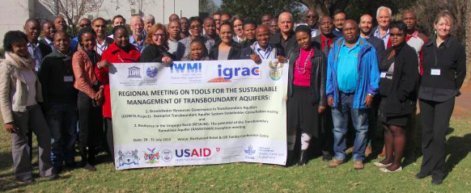
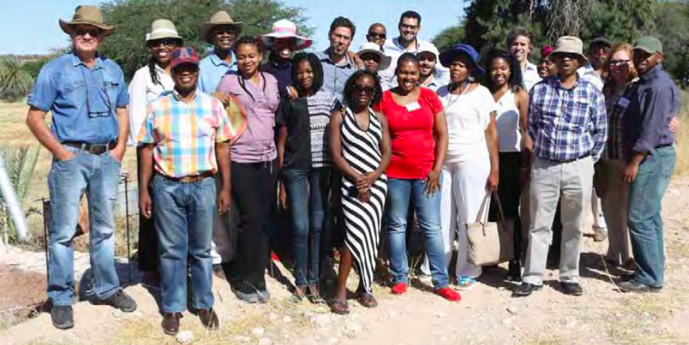
The importance of Water Diplomacy
  Organization of 6 regional meetings held in the three countries of the STAS in a rotation basis, including 2 stakeholder consultation meetings which counted with the participations of a broader audience (e.g. regional organizations, farmers, NGOs, …)

Slide 30
Main messages
  Define study boundaries as soon as possible
  Harmonization is the most crucial phase of the assessment
  Data collection, harmonization common protocols are crucial (templates, tables…)
  Do not underestimate the power of maps!
  It’s all about people!

Slide 31
  Way forward

Slide 32
GGRETA Phase 2 – Main Objectives
As a continuation of Phase 1, the overall goals for Phase 2 are:
To enhance groundwater governance, develop water related gender-responsive approach, foster cooperation on water security.
Strengthen the technical capacity of the countries sharing the aquifer to consolidate the base for long term sustainable management of the aquifer.
Towards institutionalizing cooperation: Continuing the process for the establishment of a Multi-Country Cooperation Mechanism (MCCM).
Promote a regional dialogue on coordination and harmonization of groundwater governance frameworks and guiding principles both at national and transboundary levels

Slide 33
GGRETA Phase 2 – Organizational Chart
BOTSWANA
NAMIBIA
SOUTH AFRICA
Working Group for Multi-Country Cooperation Mechanism
Mr Thato Raphaka
Permanent Secretary
Ministry of Land Management, Water & Sanitation Services
Mr Abraham Nehemia
Deputy Permanent Secretary
Ministry of Agriculture, Water and Forestry
Ms Deborah Mochotlhi
Deputy Director General
Department of Water & Sanitation
Government Representatives
Mr Piet Kenabatho
University of Botswana
Ms Maria Amakali
Department of Water Affairs and Forestry
Mr Kwazikwakhe Majola
Department of Water & Sanitation
National Coordinators
Project Management Unit (UNESCO)
National Transboundary Technical Groups (NTTGs)
???
(Gender)
???
(Legal and institutional)
???
(Legal and institutional)
???
(Hydrogeology + Model)
???
(Hydrogeology + Model)
???
(Legal and institutional)
???
(Gender)
???
(Hydrogeology + Model)
???
(Gender)

Slide 34
Way forward in GGRETA Phase 2
  • Establishment of National Transboundary Technical Groups (NTTGs) for:
    Modelling,
    Legal and institutional aspects,
    Gender aspects.
  • Establishment of a Working Group for Multi-Country Cooperation Mechamism (MCCM)

Slide 35
Starting point (GGRETA Phase 1)
In-depth Transboundary Multidisciplinary Assessment
Framework for dialogue on transboundary aquifers management: “STAS family”
Water Diplomacy
From Potential Conflict to Cooperation Potential
Trust-building
Stakeholders mapping, identifying issues and interests
Capacity-building modules: « training for trainers » approach for replication
Modelling
Groundwater governance
Gender
International and domestic water law
Capacity-building
Trainings on water diplomacy (multilevel governance, stakholder linking)
Consensus-building
Better understanding of water cooperation benefits to stakeholders at national (e.g. Governments, Diplomats) and local level (e.g. Farmers)
Refinement of GGRETA Phase 1 assessments
Development and upgrade of innovative tools: the STAS model
Information Management Systems
Update of joint database
Data collection protocols
Multi-Country
Co-operation Mechanisms
Science for Transboundary Multidisciplinary Assessment
Achievements
Strengthened cross‐border dialogue and cooperation
Understanding of the resource for informed decision-making
Facilitation of governance reforms

Slide 36
  Thank you for your attention!
  t.carvalho-resende@unesco.org

Slide 37
GGRETA Phase 2 – Outcomes
Outcome 1 – Improved resource knowledge and monitoring based on recognition of the importance and vulnerability of transboundary groundwater resources.
Outcome 2 - Enhanced cross-border dialogue and cooperation based on development of shared management tools, and recommendations for governance reforms focused on improving livelihoods, economic development, gender equality and environmental sustainability.
Outcome 3 – Improved capacity in groundwater governance, hydro-diplomacy and gender, and effective communication aiming at replication of project experiences and approaches.

Slide 38

GGRETA Project - Outcome 1
Outcome 1 – Improved resource knowledge and monitoring based on recognition of the importance and vulnerability of transboundary groundwater resources.
Main objectives
Upgrading and updating of joint database and monitoring protocols (e.g. time series data…)
Develop a model for filling existing knowledge gaps (e.g. estimations, …)

Slide 39

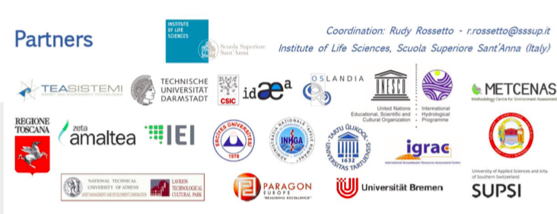
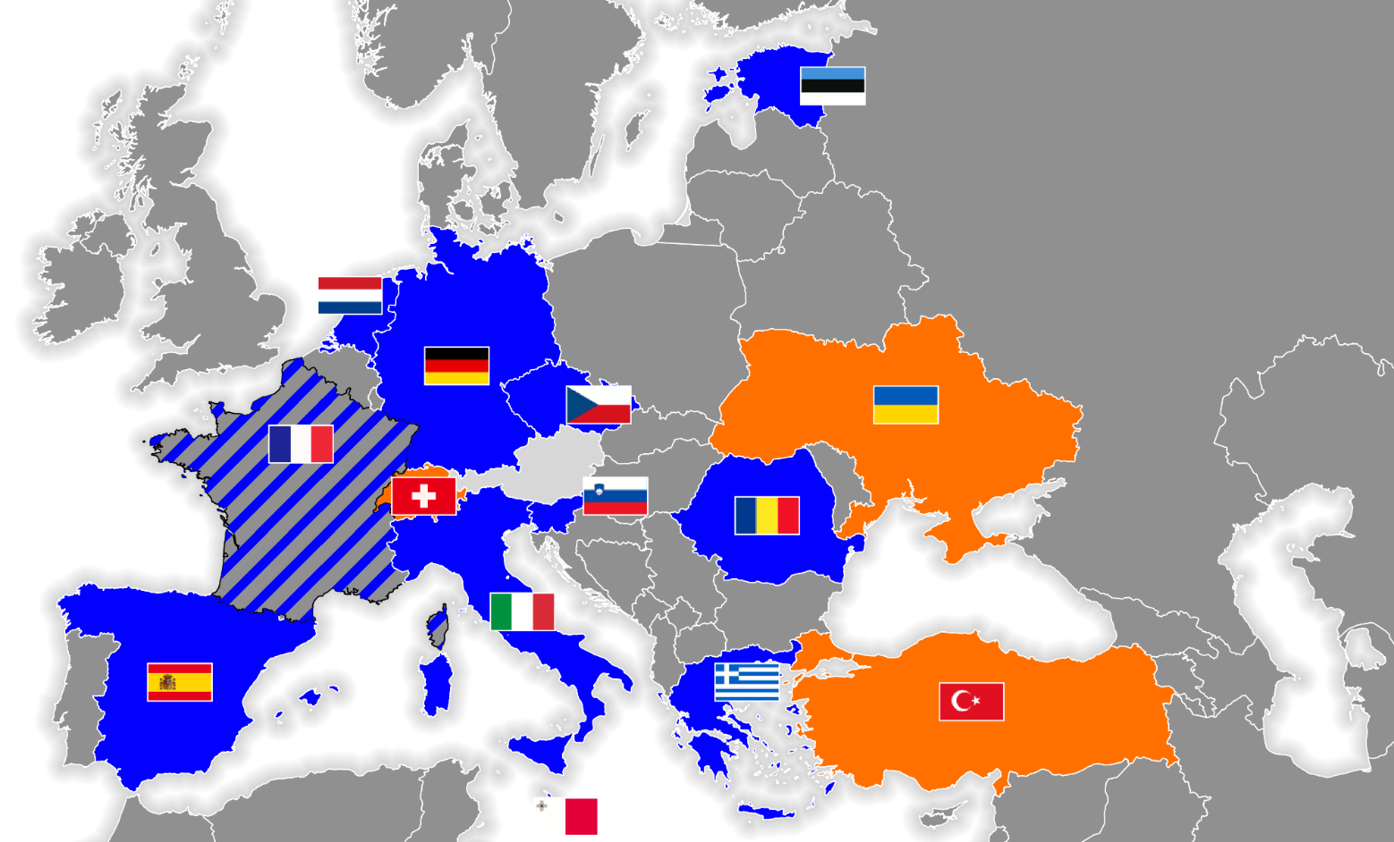
FREEWAT Project & STAS Model
FREEWAT (2015-2018) is an ICT project funded by the European Commission for improving Water Resources Management through a public domain GIS integrated modelling platform (i.e. free software tools).
www.freewat.eu

Slide 40
FREEWAT Project & STAS Model
Main objectives:
  Integrate existing software modules for water management in one single environment (FREEWAT platform).
  Develop simulation models for surface water and groundwater quantity and quality, including management scenarios.
  To conduct an innovative participatory approach gathering technical staff and relevant stakeholders (policy and decision makers) in designing scenarios for proper application of water policies.
Application:
  10 case studies in the EU
  3 in neighboring countries (Switzerland, Turkey and Ukraine)
  The Stampriet Transboundary Aquifer System (Botswana, Namibia and South Africa).

Slide 41
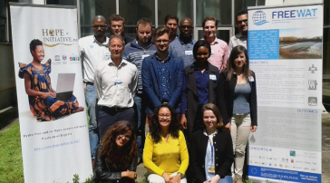

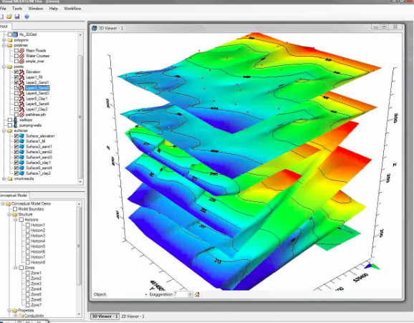
FREEWAT Project & STAS model
APPLICATION OF THE FREEWAT PLATFORM
SOFTWARE DEVELOPMENT AND CAPACITY BUILDING
Objective: Producing policies!
STAS model simulations and scenarios (participatory approach)
National trainings
STAS model implementation and calibration
(participatory approach)
Preparation of data for STAS model
Training the trainers
Preparation of FREEWAT Platform (including QGIS, Modflow, etc…)
September – December 2016
January – April 2017

Slide 42
FREEWAT Project: Capacity building
Training for trainers:
  3 trainers per country (NTTGs to be nominated by Member States)
  First training was held in July 2016
  Next training will be held in early 2017
National trainings by trainers:
  Working groups of 20 people (UNESCO-IHP would provide support)
  Trainings to be held in March- April 2017

Slide 43
Workplan (September 2016 – April 2017) – Outcome 1

Slide 44
GGRETA Project - Outcome 2
Outcome 2 - Enhanced cross-border dialogue and cooperation based on development of shared management tools, and recommendations for governance reforms focused on improving livelihoods, economic development, gender equality and environmental sustainability.
Main objectives
Setting-up of a Working Group for the establishment of a Multi-Country Consultation Mechanism
Regional Dialogue on Conjunctive Surface and Groundwater Management in Transboundary Contexts
Notes:
Link can also be considered with AMCOW
We talked about to invite Bai Mass Tall

Slide 45
Working Group for the establishment of a Multi-Country Cooperation Mechanism
Working Group for the establishment of a Multi-Country Cooperation Mechanism (MCCM):
Formulate proposals for the structure, composition, mandate funding, and functioning of a Multi-Country Consultation Mechanism for the governance and management of the STAS
Regional Dialogue on Conjunctive Surface and Groundwater Management in Transboundary Contexts:
Joint activities with AMCOW, SADC, IGAD, ORASECOM, LIMCOM

Slide 46
Workplan (September 2016 – April 2017) – Outcome 2

Slide 47
Outcome 3
Outcome 3 – Improved capacity in groundwater governance, hydro-diplomacy and gender, and effective communication aiming at replication of project experiences and approaches.
Main objectives
Capacity building modules on hydrogeology, international water law, domestic water legislation, and gender
  Includes cross-cutting activities that will contribute to the achievement of Outcomes 1 and 2

Slide 48
Outcome 3 – Capacity building modules
International Water Law:
  3-day training during the Regional Meeting on Tools for the Sustainable Management of Transboundary Aquifers (in partnership with SADC and IWMI) (28-30 November 2016)
  Objectives:
    Expose participants to the principles and practice of international water law, with special attention to the law of transboundary aquifers (UN draft Articles 2008);
    Illustrate the linkages and interaction between water law and domestic water legislation.

Slide 49
Outcome 3 – Capacity building modules
Domestic water legislation:
  1-2 day training in each Country (March-April 2017)
  Objectives:
    Expose participants to the principles and practice of conceptualizing and implementing/enforcing domestic water resources legislation, and to the relevant contemporary issues, against the backdrop of compliance with transboundary water-related obligations.

Slide 50
Outcome 3 – Capacity building modules
Hydrogeology:
  Training for trainers + national trainings in partnership with FREEWAT
Gender:
  Trainings in each Country covering:
    A module on sex-disaggregated data collection for field surveys,
    A module on engendering national water policy.

Slide 51
Workplan (September 2016 – April 2017) – Outcome 3

Slide 52
Thank you for your attention

