Slide 1



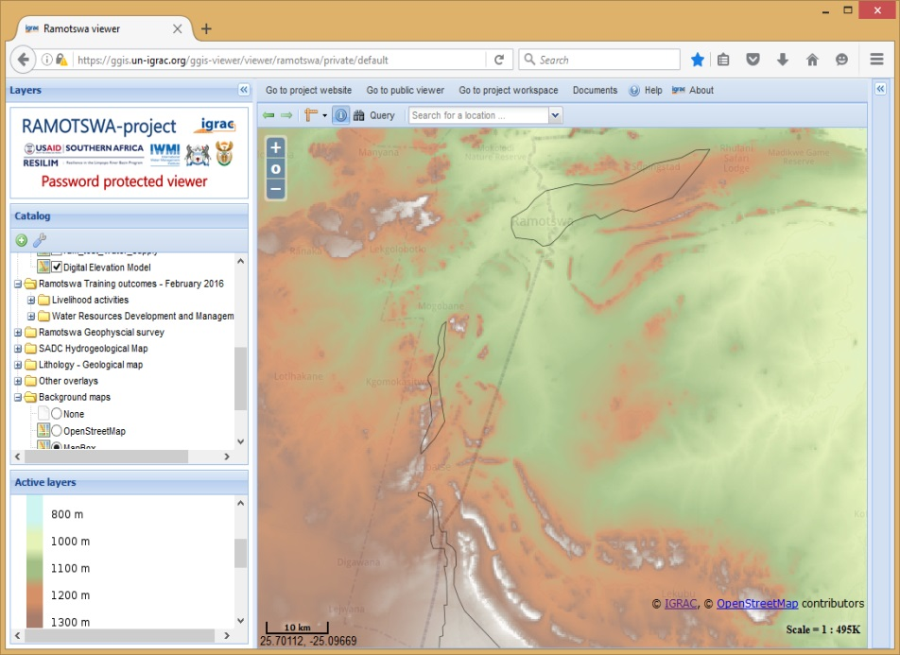
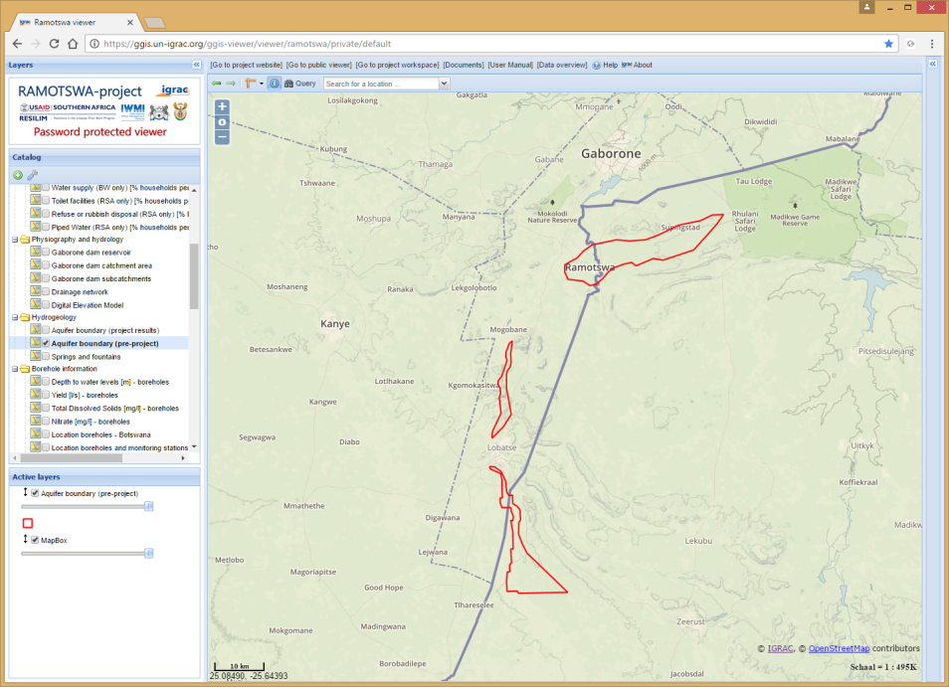
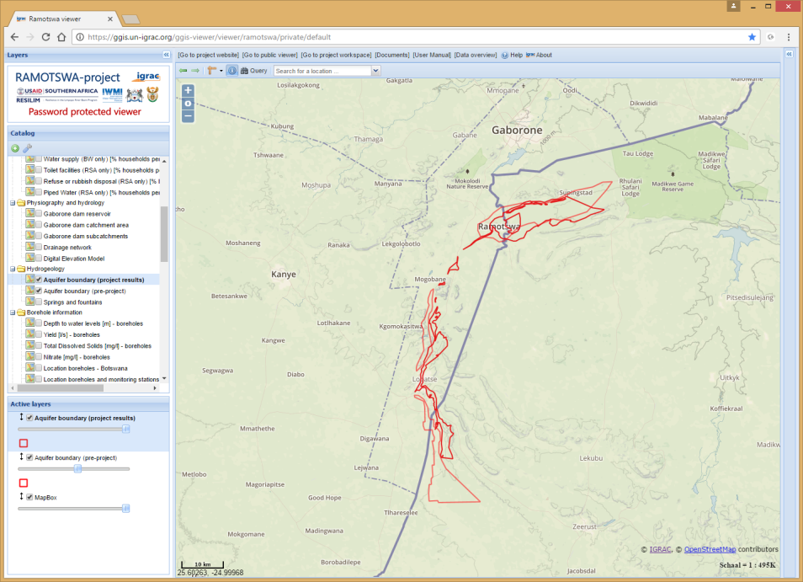
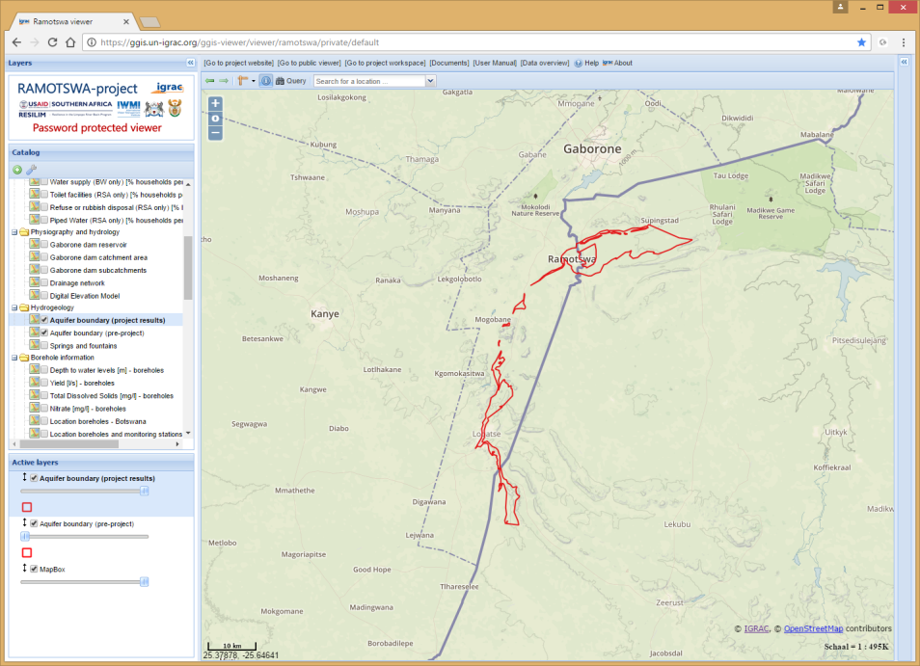
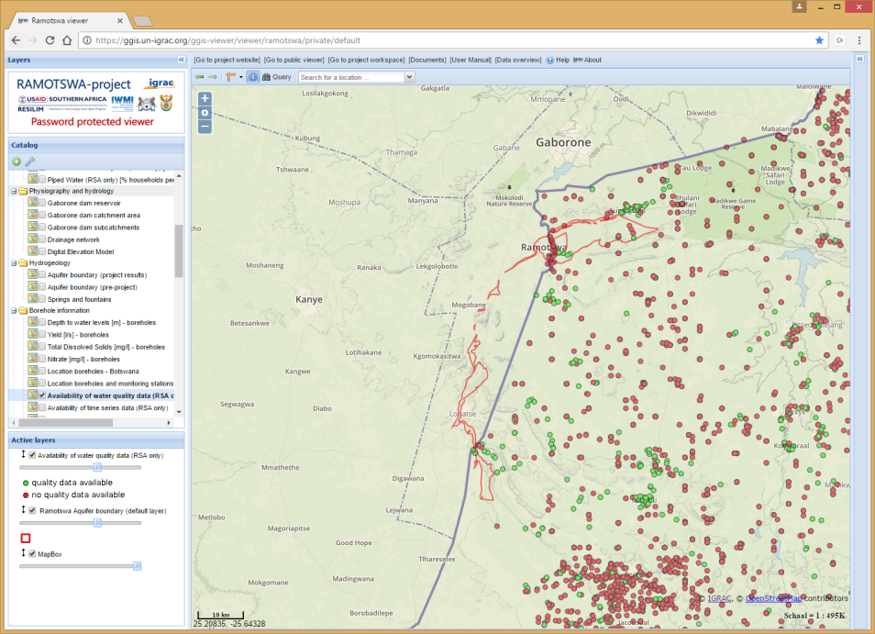
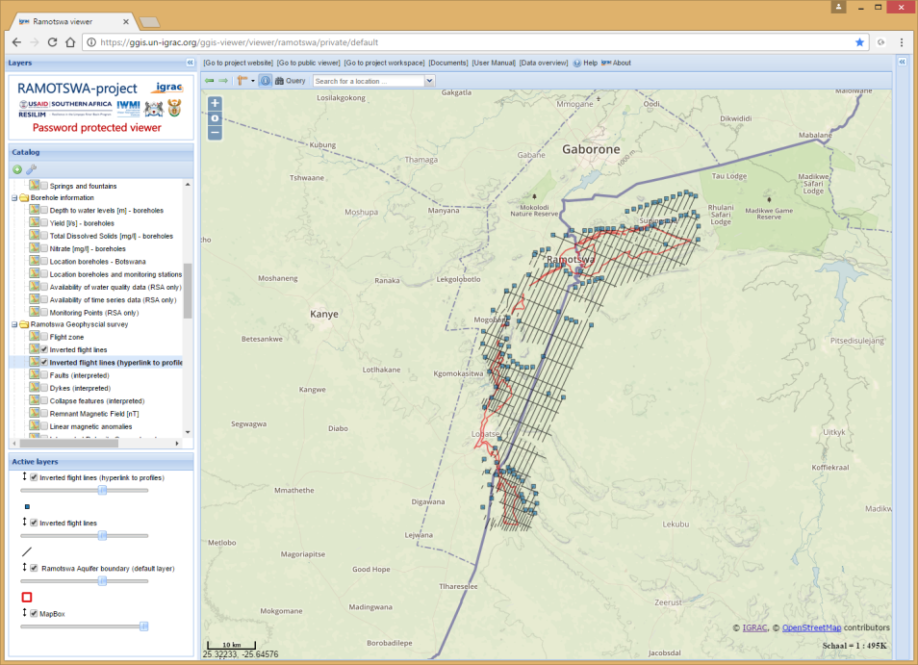
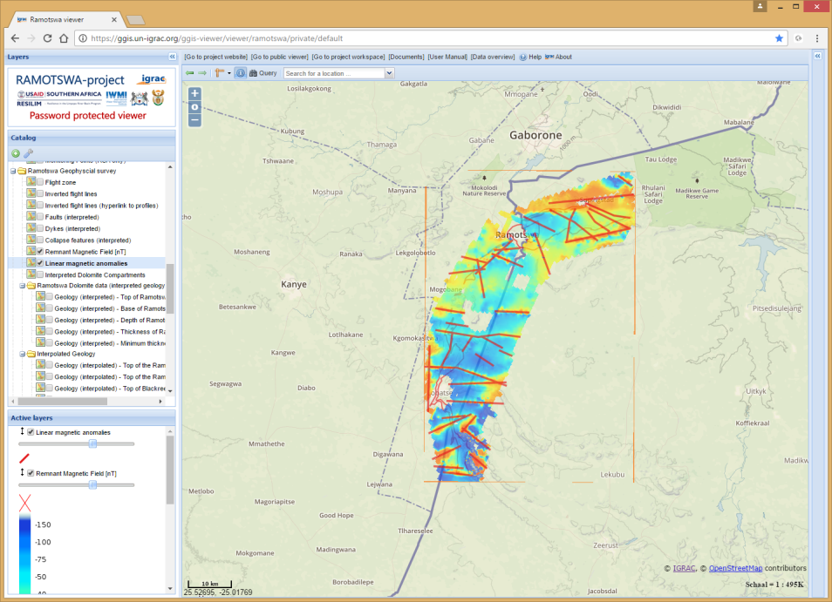
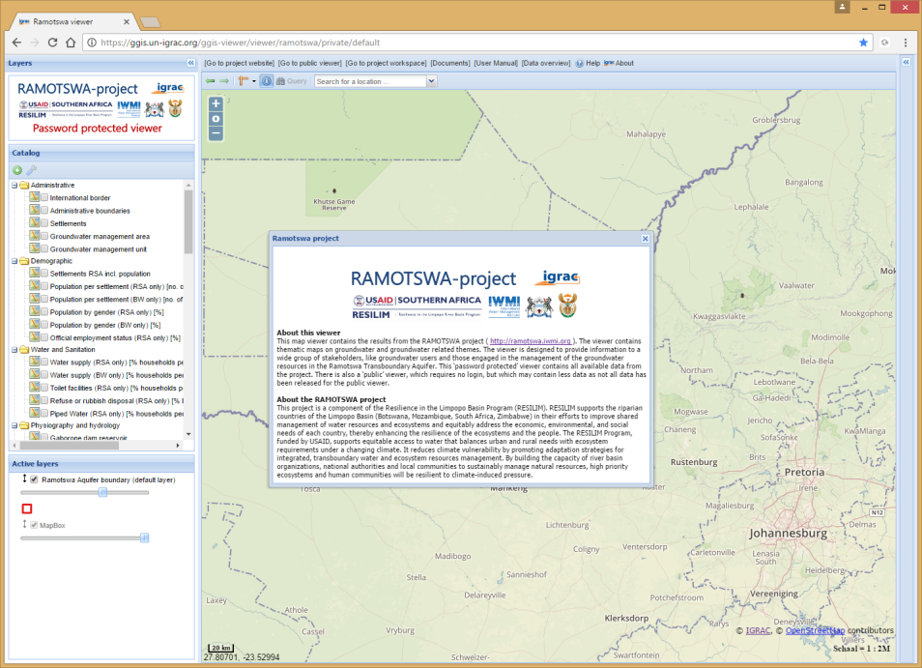








RAMOTSWA project
The Potential Role of the Transboundary Ramotswa Aquifer
Ramotswa Information Management System – RIMS
Geert-Jan Nijsten
IGRAC - International Groundwater Resources Assessment Centre
2nd Regional Meeting on Tools for the Sustainable Management of Transboundary Aquifers
Johannesburg, South Africa
28 November 2016

Slide 2

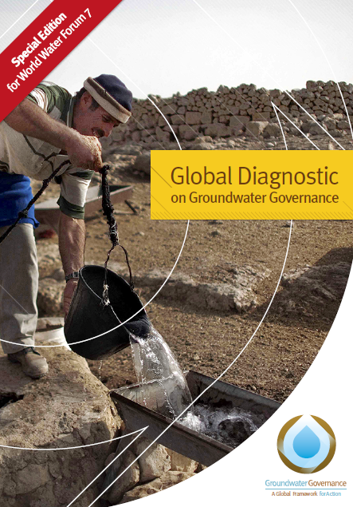

GEF Groundwater Governance Programme
www.groundwatergovernance.org

Slide 3
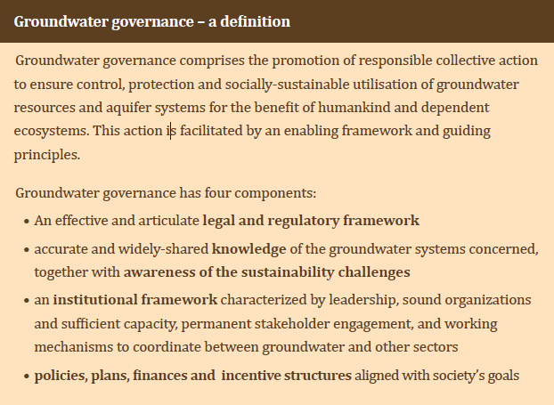
Governance and access to Information

Slide 4
Organizing data collection, information generation and knowledge sharing
– 1 of 4 crucial components of Groundwater Governance –
Good aquifer management requires good information
Information will include both snapshots of static features and monitoring of dynamic changes
Information needs to be converted to knowledge in order to enable stakeholders to take informed management decisions
The resulting information and knowledge should be shared widely with all stakeholders
The four information and knowledge tasks – data acquisition, analyses, information sharing and dissemination of useful knowledge – are key steps to guide groundwater management
www.groundwatergovernance.org

Slide 5
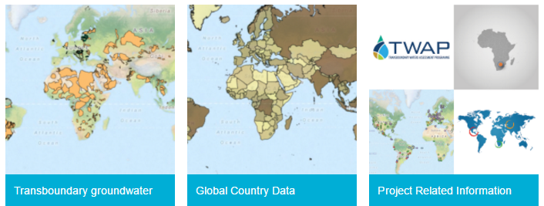
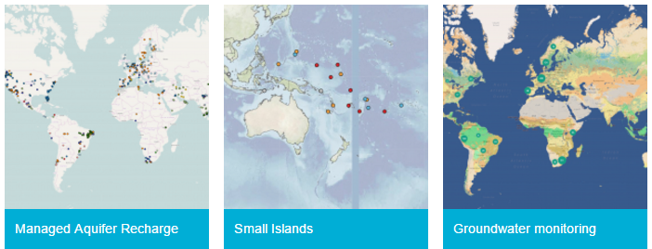
Web- based
Geographical Information Systems
IGRAC GGIS:
Web portals
Map based
Open standards
Flexible
Public & password protected viewers
Data in one place

Slide 6
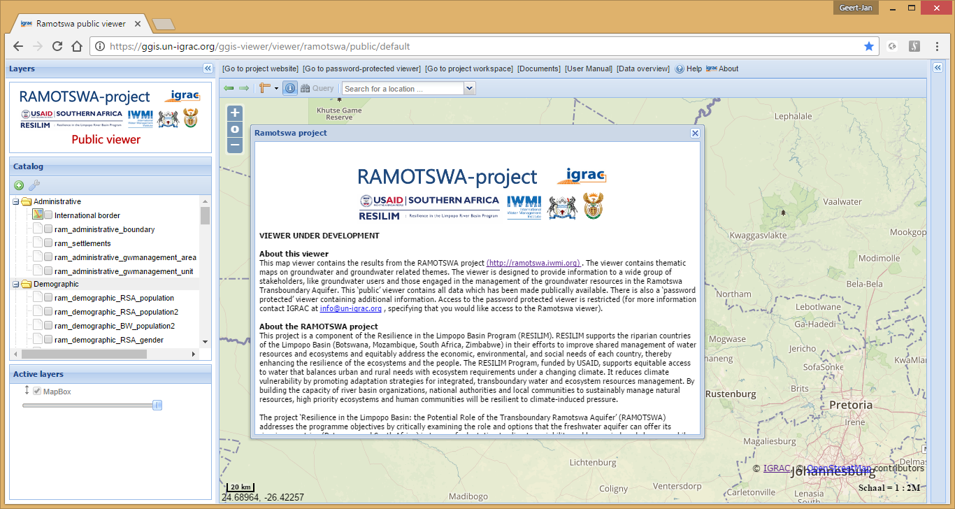
Impressions from the RIMS viewer
https://ramotswa.un-igrac.org

Slide 7
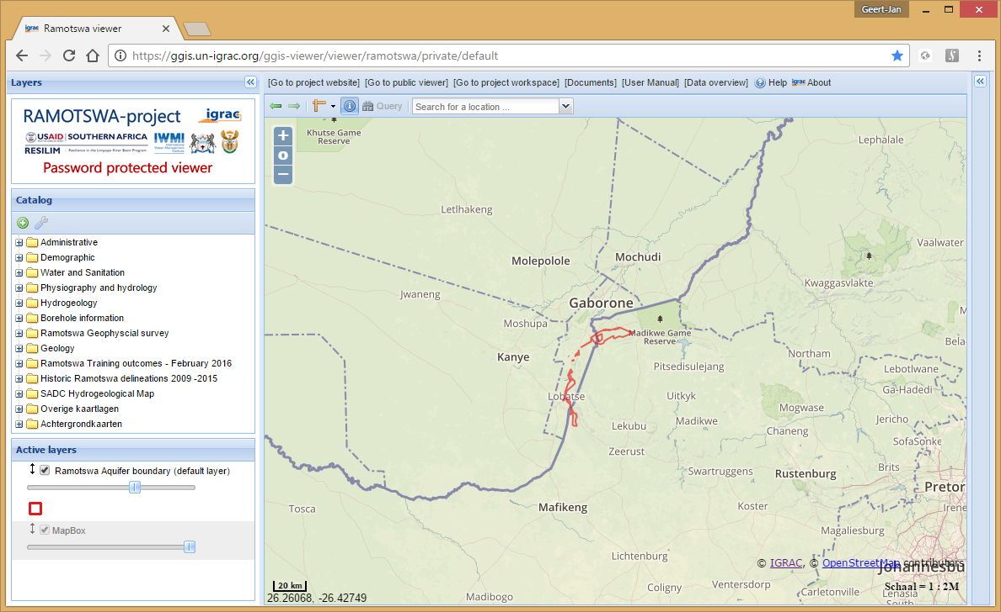
Impressions from the RIMS viewer
Easy navigation to:
Other RIMS modules
RIMS manual
Data overview document
Relevant literature components, project website etc.

Slide 8
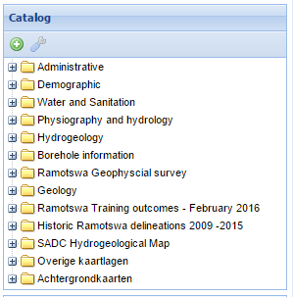
All maps from Ramotswa project available
More than 80 thematic maps
Under different themes

Slide 9

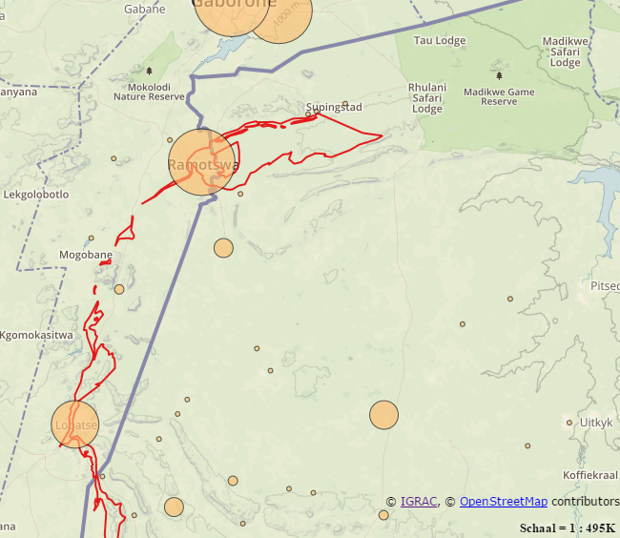
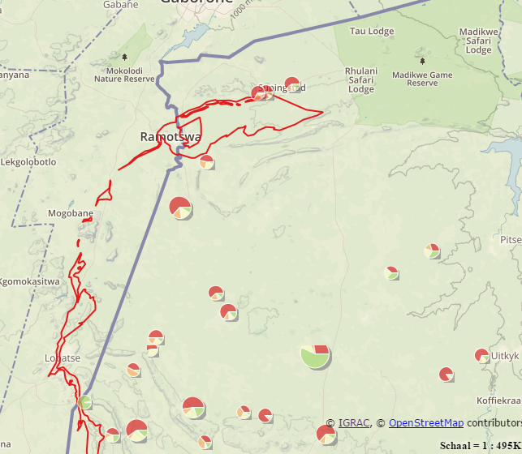
Data from Statistics offices
Population - Employment
Population pressure on Botswana-side clearly visible
Challenging economical situation

Slide 10
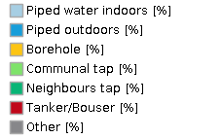
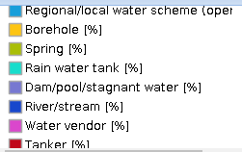
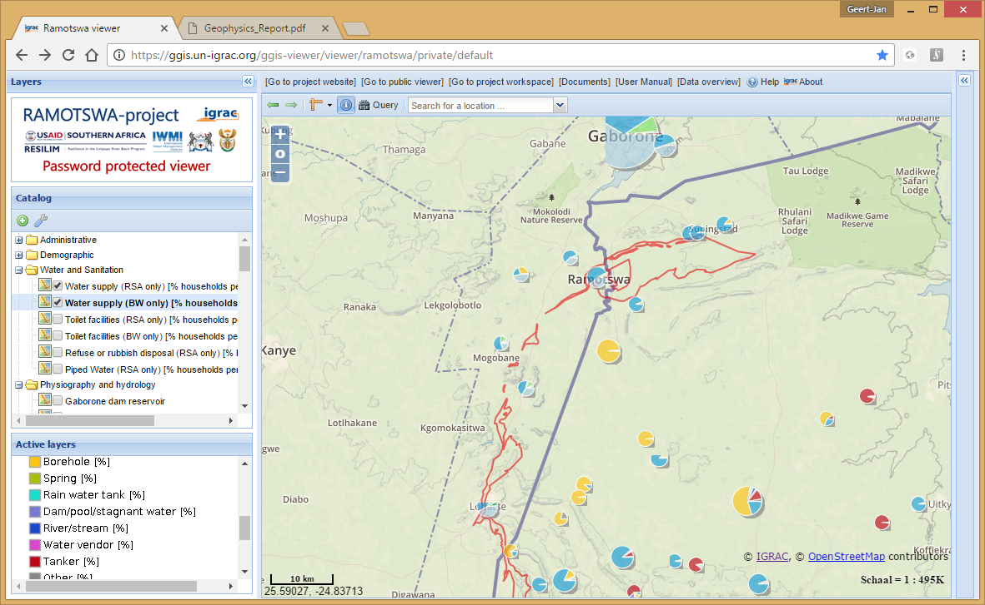
Water supply (households)
Sustainable development goals

Slide 11
Further harmonisation needed
Botswana
Piped indoors
Piped outdoors
Neighbours tap
Communal tap
Borehole
Tanker
Other
South Afrfica
Regional/local water scheme (operated by municipality or other water services provider)
Borehole
Rain water tank
Water tanker
Water vendor
Spring
River/stream
Dam/pool/stagnant water
Other
?
Botswana | South Afrfica
1. Piped indoors Piped outdoors Neighbours tap Communal tap | 1. Regional/local water scheme
2. Borehole | 2. Borehole
3. Tanker | 3. Water tanker Water vendor
4. Other | 4. Rain water tank, Spring, River/stream Dam/pool/stagnant water Other

Slide 12
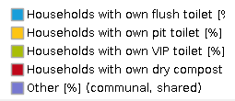
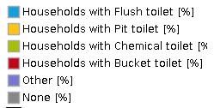
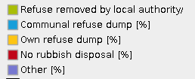
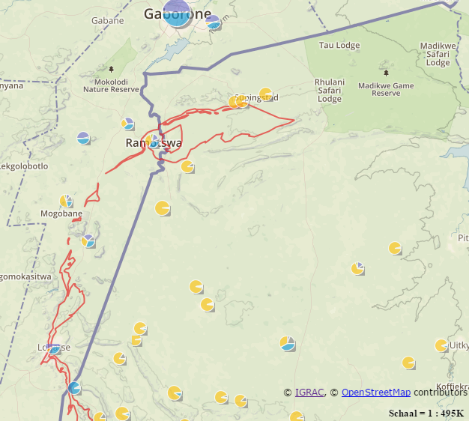
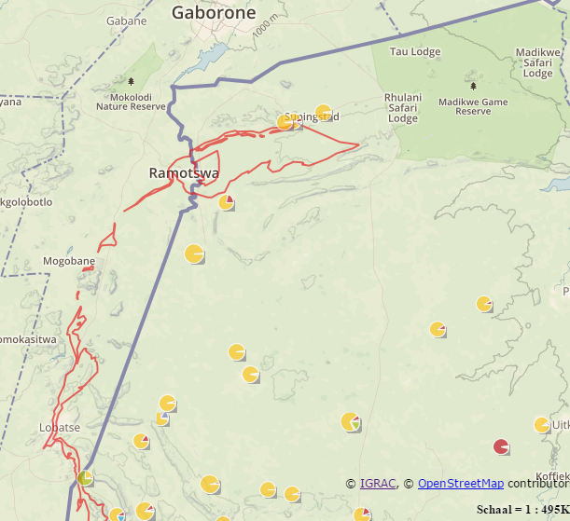
Toilet facilities – Waste disposal
Pollution risks…
Sustainable development goals

Slide 13
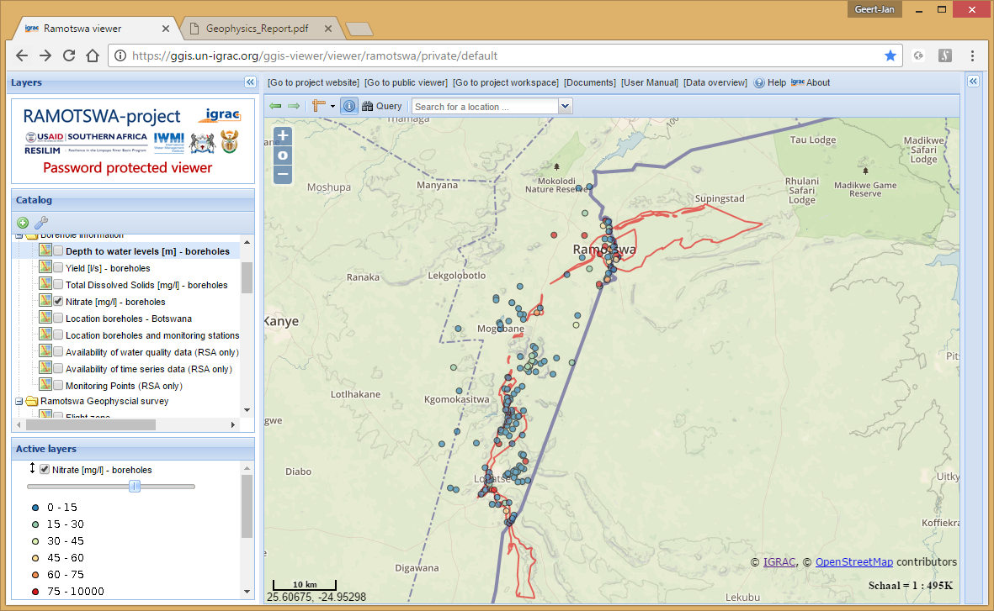
Borehole data
Locations of boreholes
Depth to water levels
Yield
Total Dissolved Solids
Nitrate
Etc.
Next phase:
Time series & quality data?

Slide 14
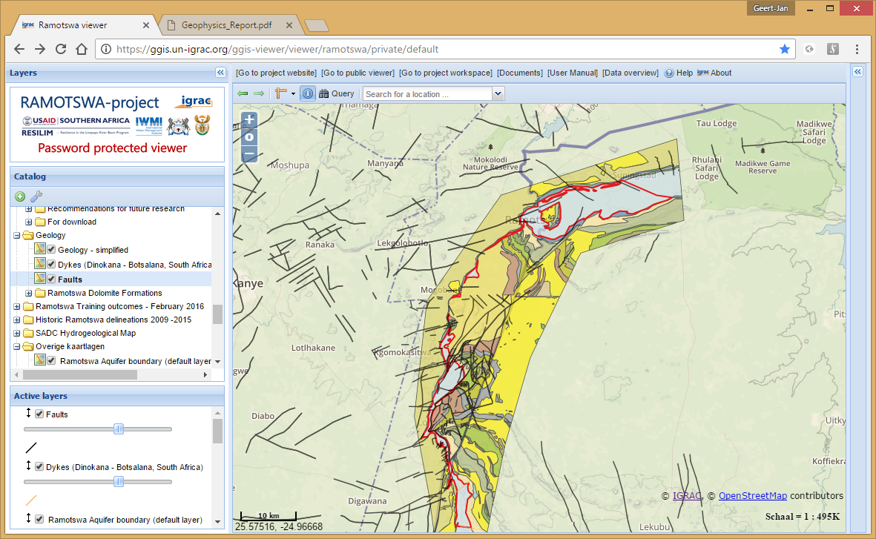
Simplified geology

Slide 15
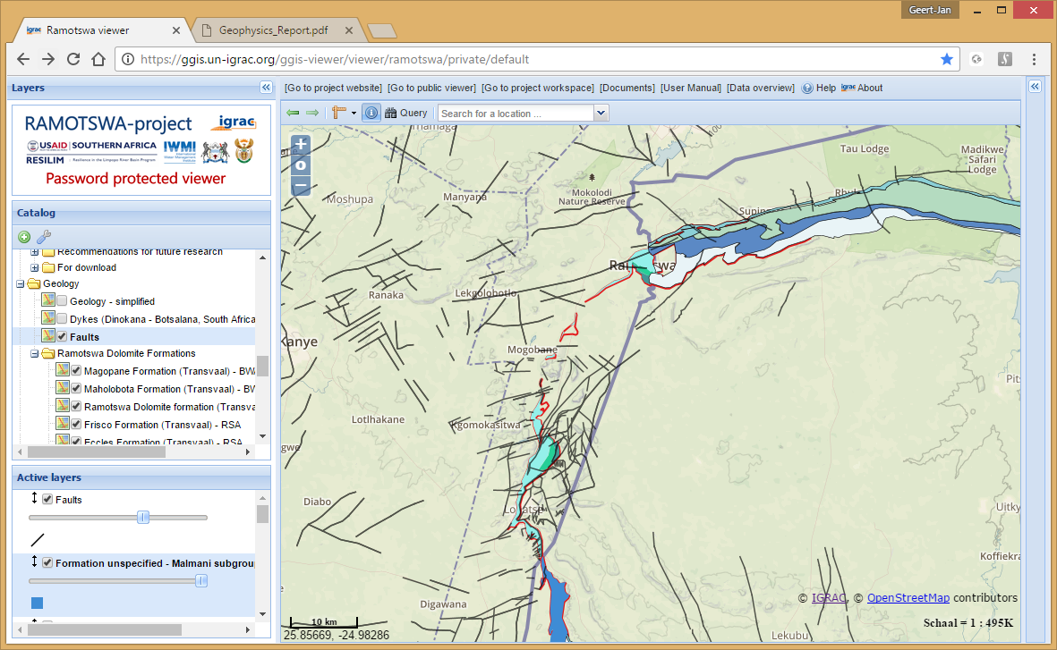
Individual Dolomite formations

Slide 16
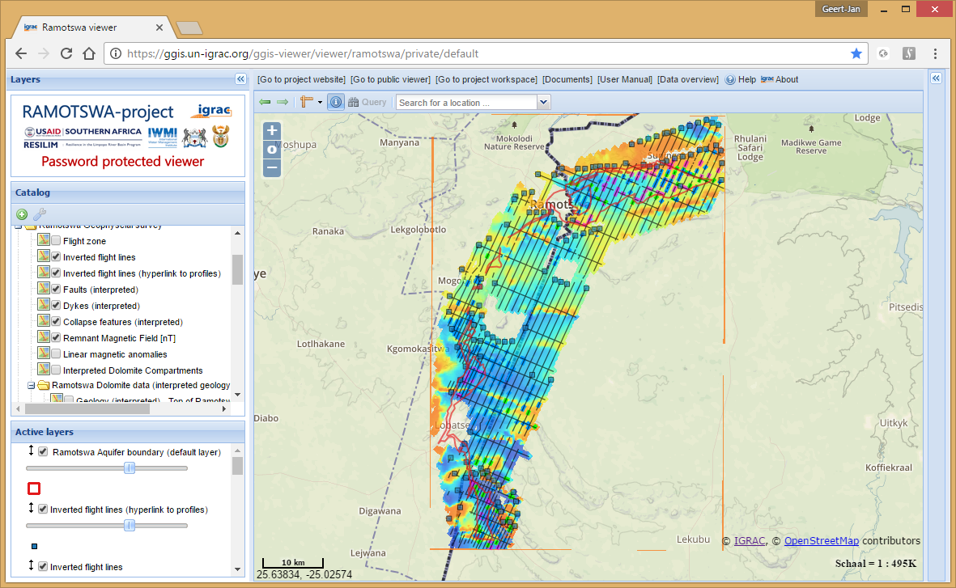
Results from geophysics

Slide 17
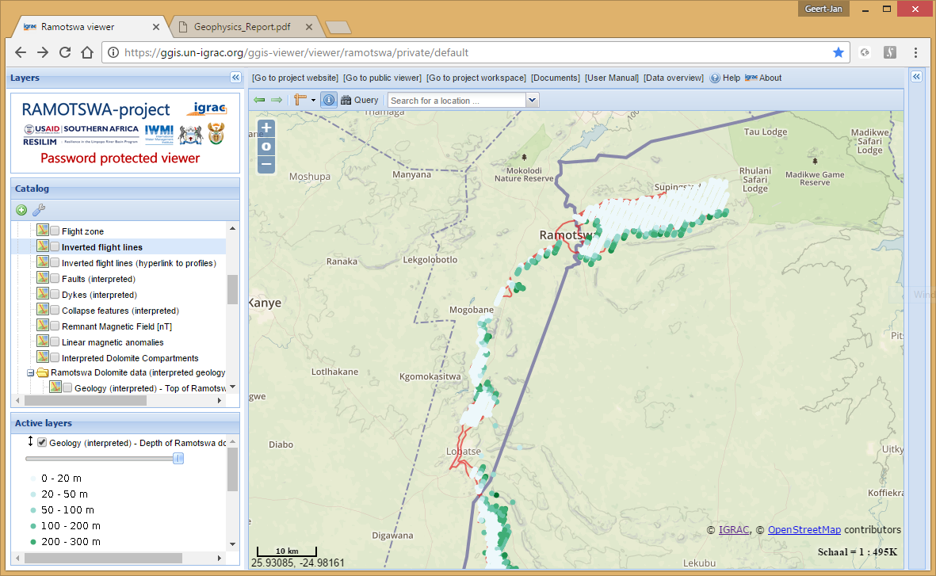
Results from geophysics
(drilling) Depth to dolomite
Thickness of dolomite
Top of dolomite
Base of dolomite
And of all other formations…
Collapse features
Faults
Dykes
Etc.

Slide 18
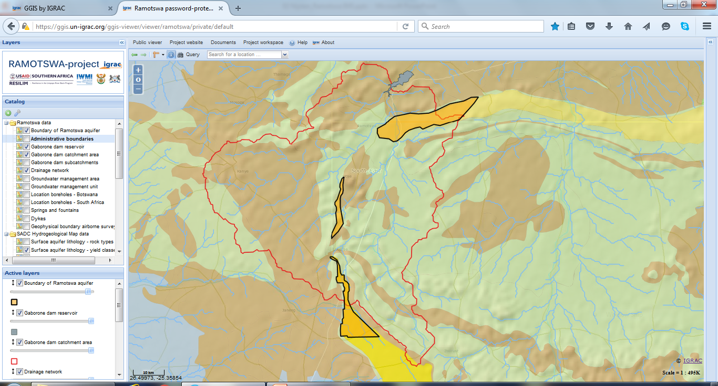
RIMS Functionality

Slide 19
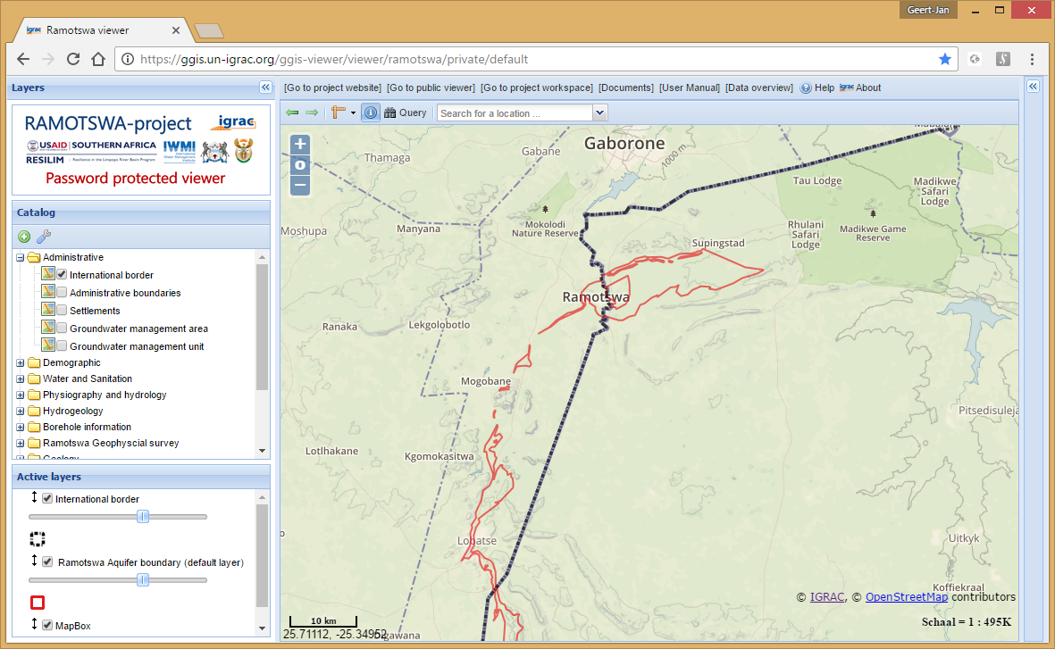
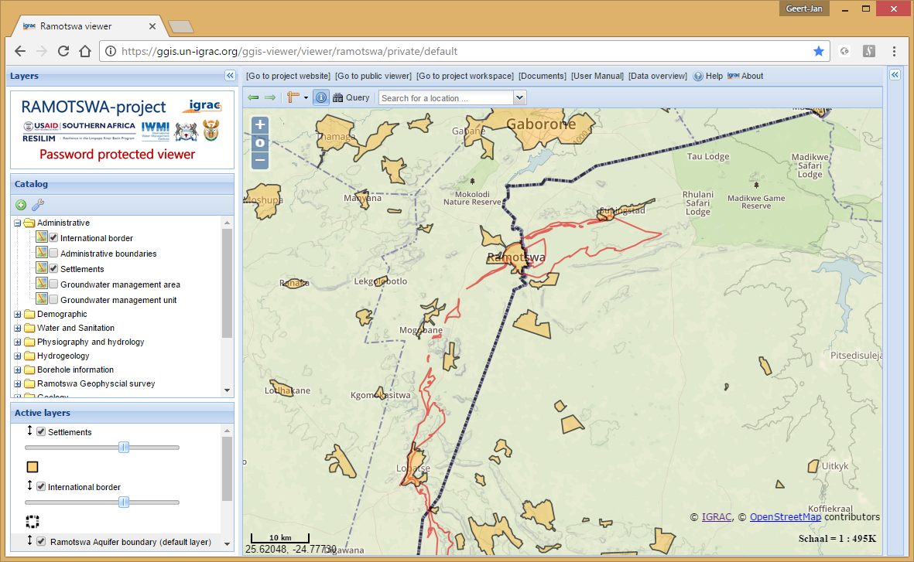
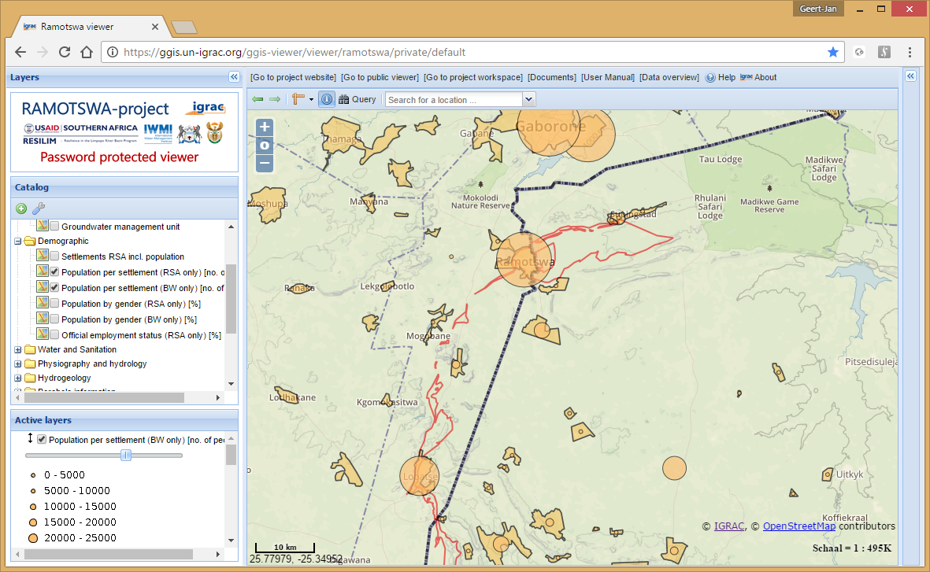
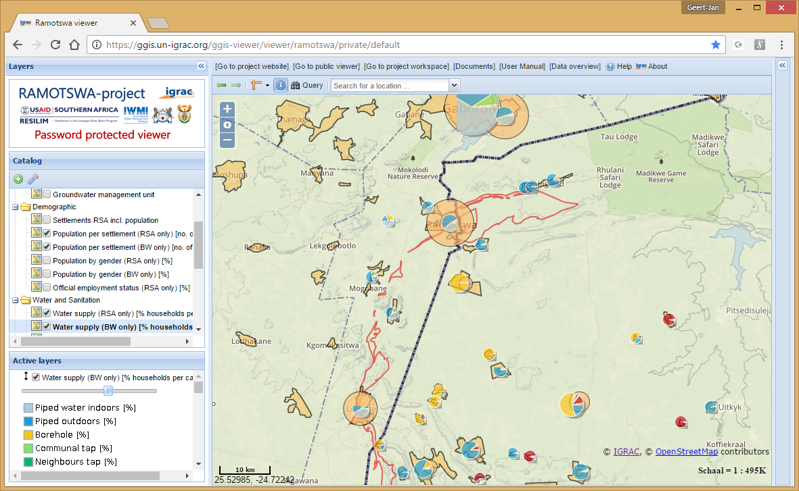
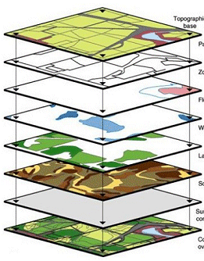
Create your own maps - overlays
Location of Settlements
Location of Settlements
Population per settlement
Location of Settlements
Population per settlement
Access to water per settlement
Create new insights by making
overlays of thematic maps

Slide 20
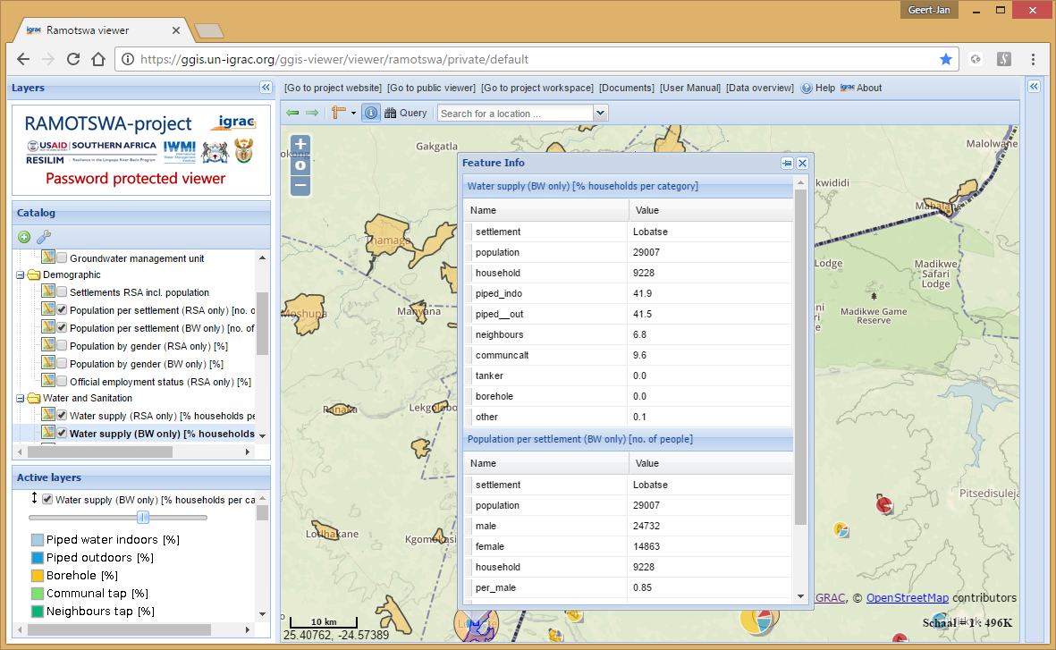
Get information behind the map

Slide 21
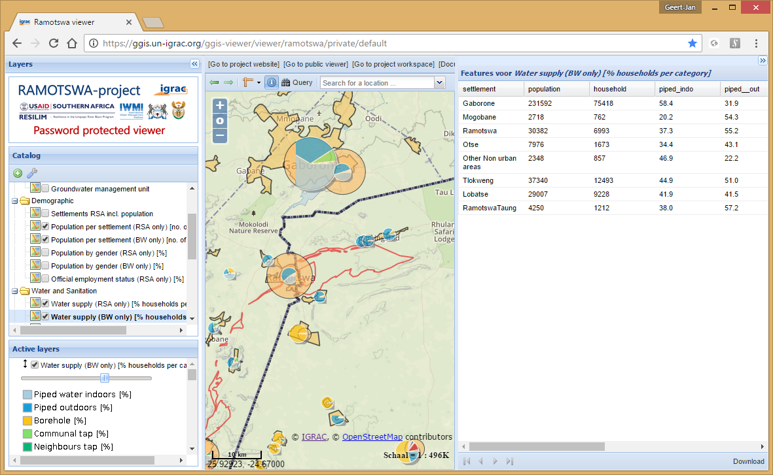
Get information behind the map

Slide 22
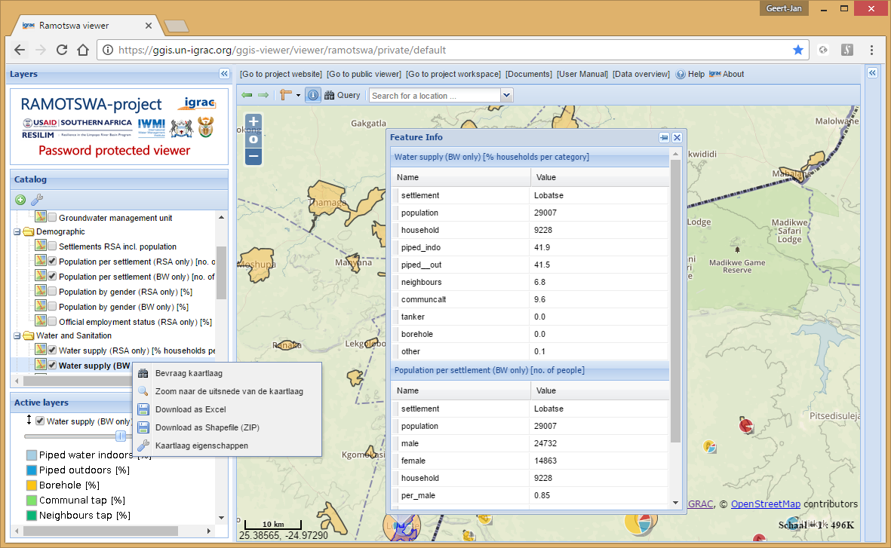
Download tables / shapefiles
See layer properties
Download excel file
Download shapefile
Query layer

Slide 23
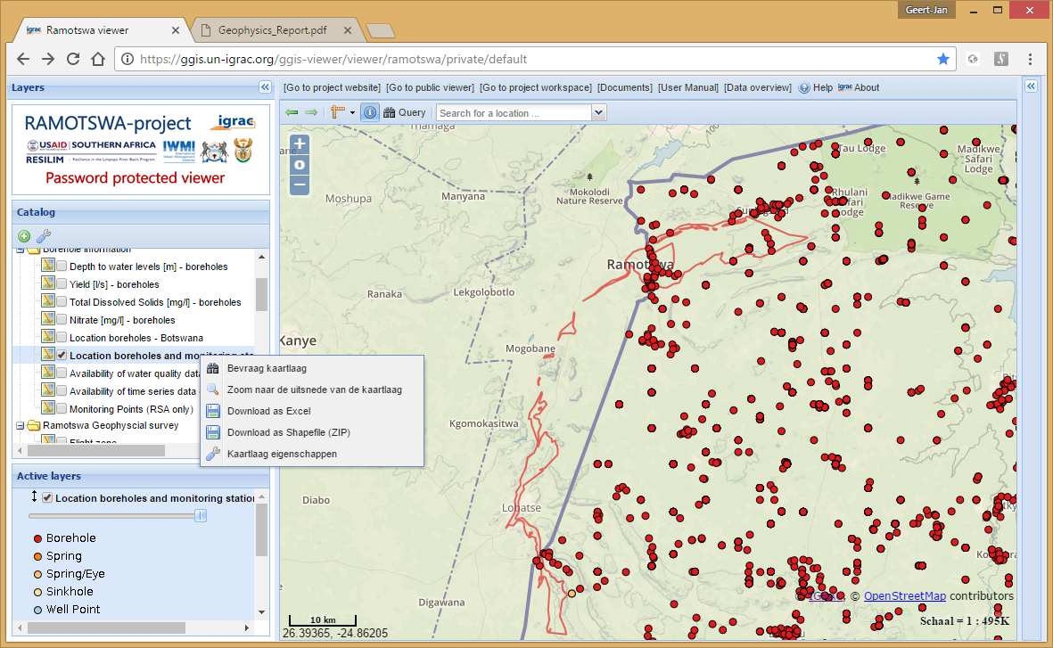
Query layers / Filter data

Slide 24
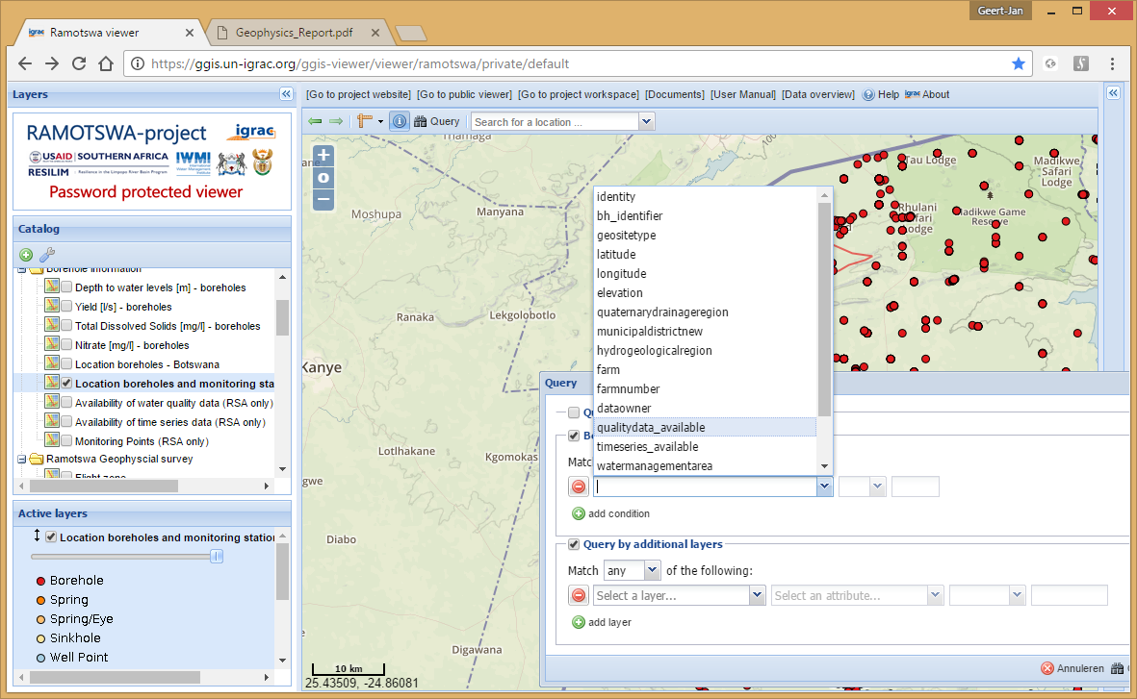
Query layers / Filter data

Slide 25
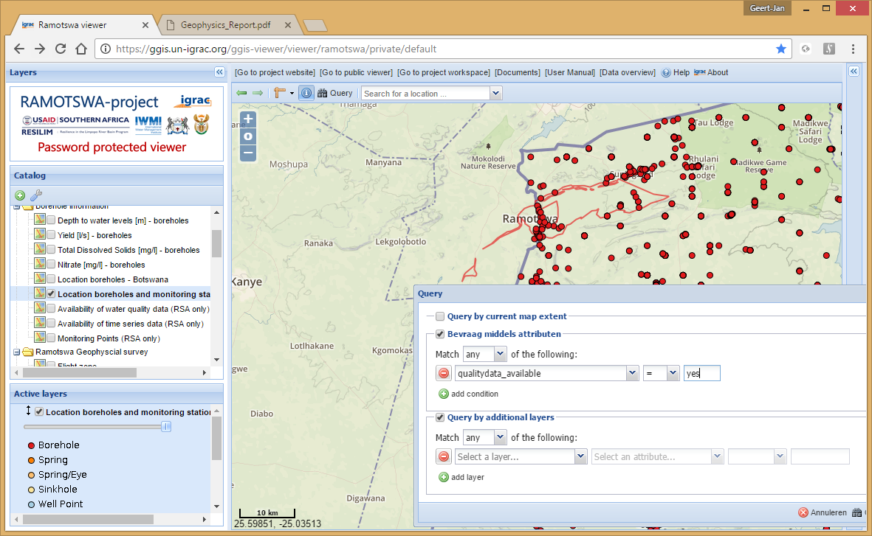
Query layers / Filter data

Slide 26
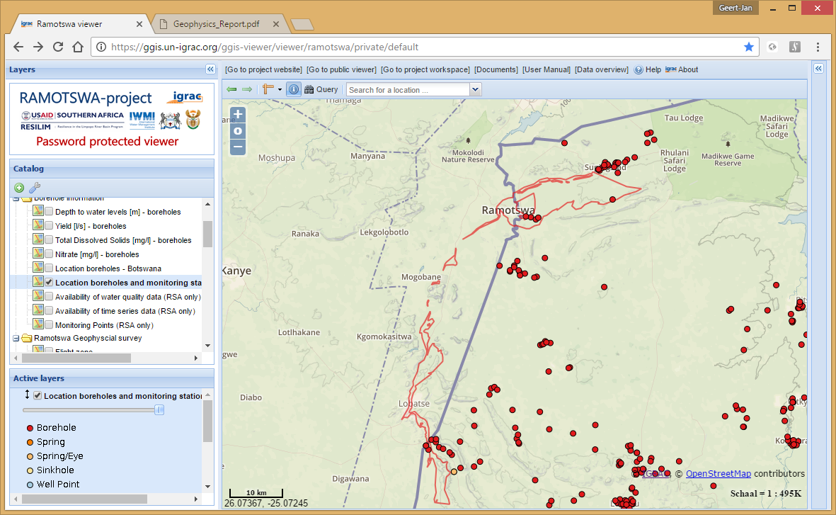
Query layers / Filter data

Slide 27
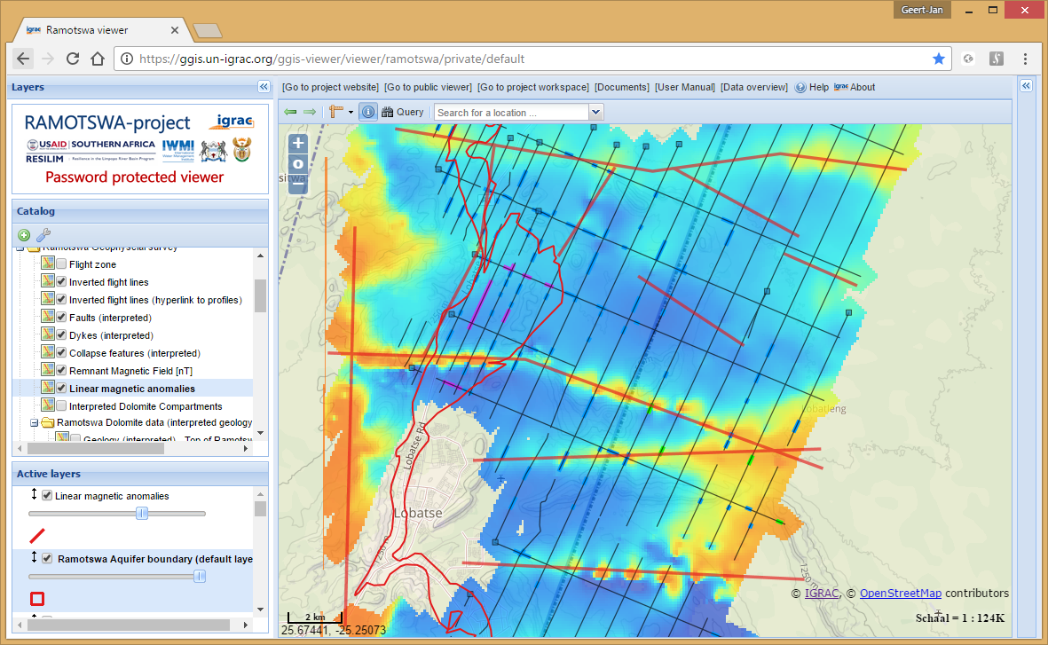
View interpreted cross-sections

Slide 28
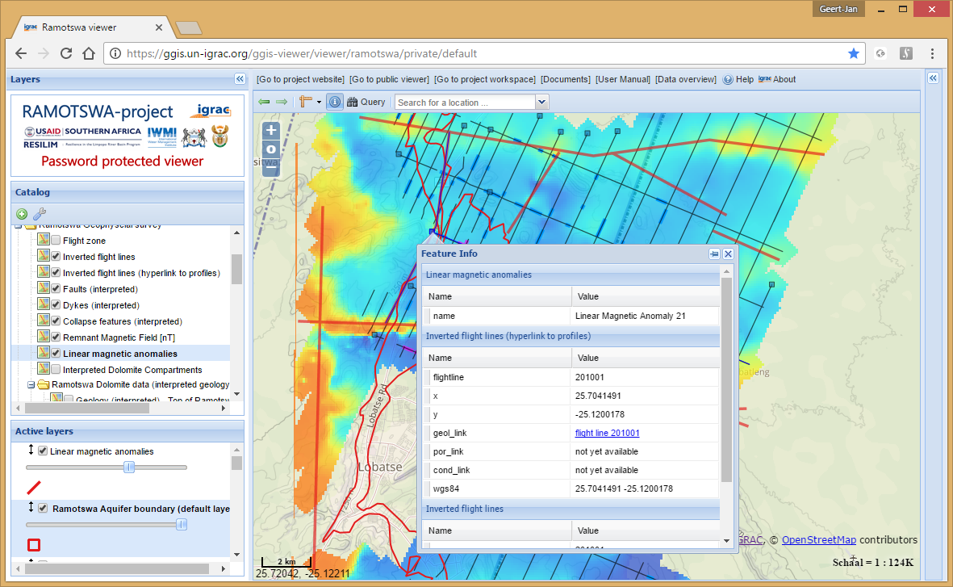
View interpreted cross-sections

Slide 29
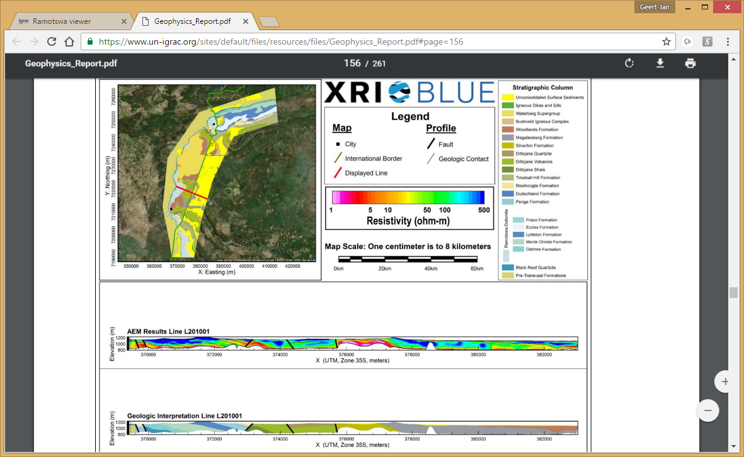
View interpreted cross-sections

Slide 30
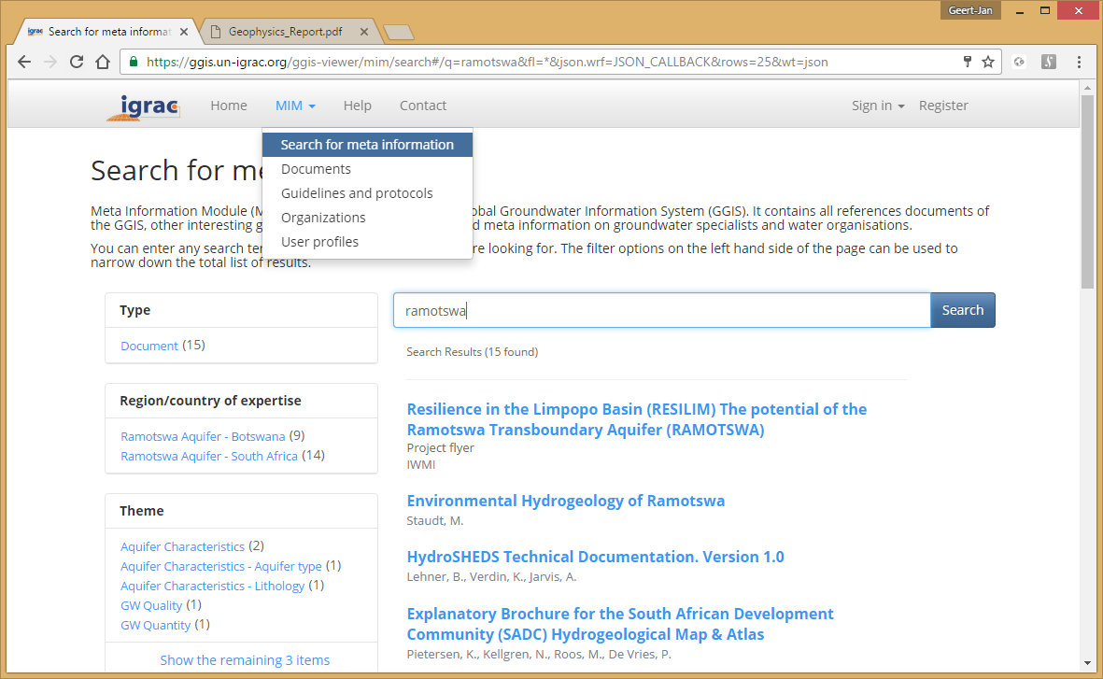
Storing and sharing relevant literature

Slide 31
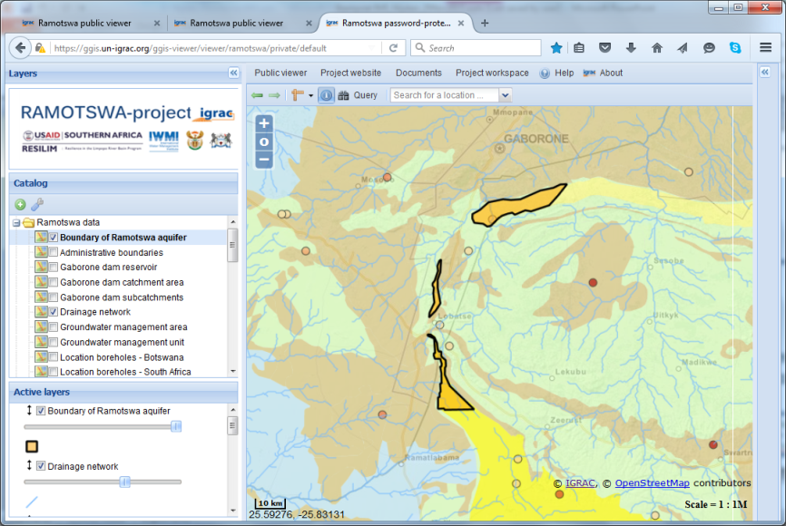
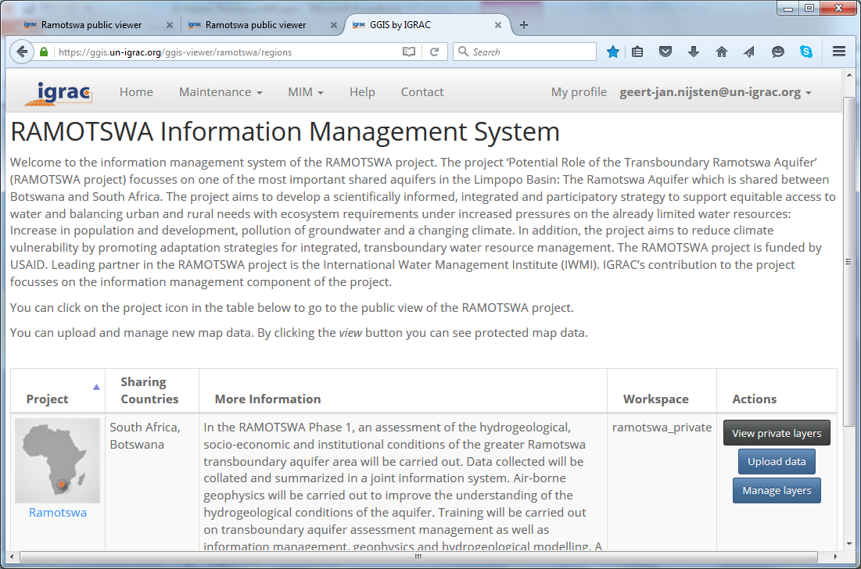
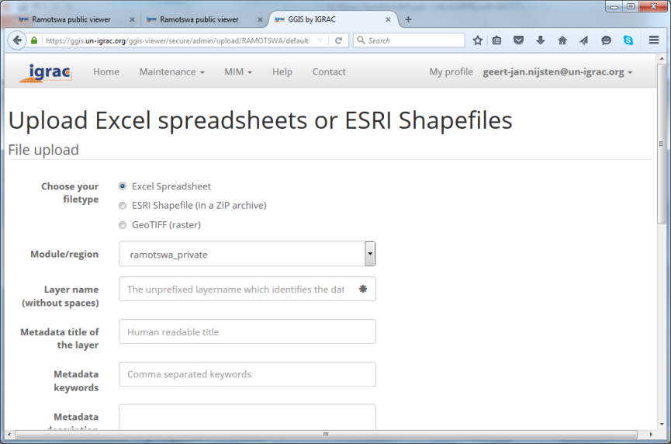

Ramotswa password protected environment
Password-protected viewer
Password-protected workspace
to share draft or sensitive maps between registered partners
to share draft or sensitive maps between registered partners
to upload data
to share draft or sensitive maps between registered partners
to upload data
to manage data

Slide 32

RIMS user roles and Authorisations
* : Upload of documents, maps and legends
** : Move map layers to/from public view, delete map layers
*** : Assign user roles/authorisations
to registered users
Guest account (temporary):
Ramotswa.guest@un-igrac.org
Password: r@mproject

Slide 33

Thank you for your attention

