Slide 1
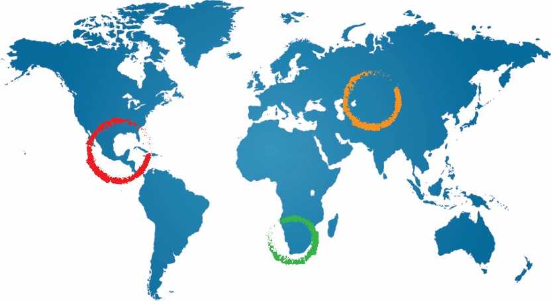
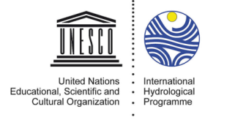
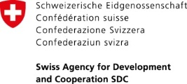
GGRETA Phase 1 main findings and achievements
Stampriet Aquifer High Level Meeting
3-4 November 2016, UNESCO HQs
Dr Piet Kenabatho, University of Botswana
GGRETA Assessment Report Coordinator
4 November 2016
Paris, France

Slide 2
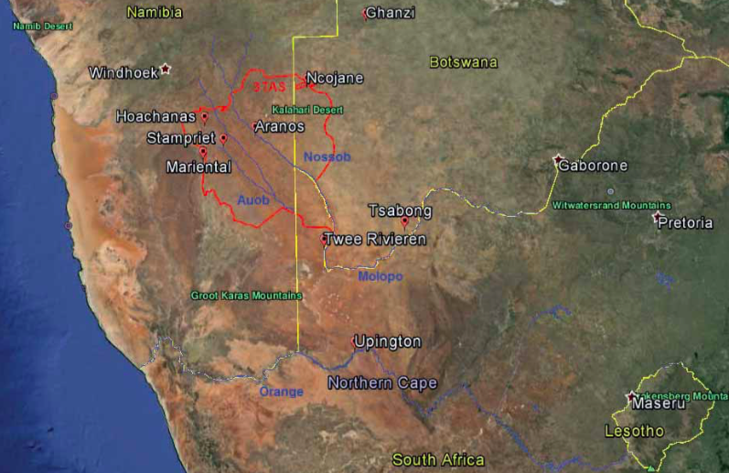
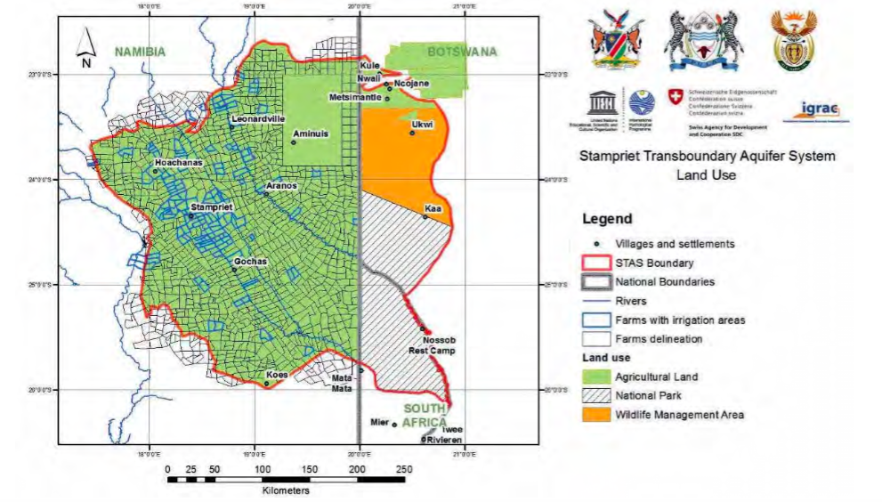
The importance of STAS
Area: 86 000 km²
Rainfall: 150-300 mm/yr
Population: 50 000
Main economic activity: Agriculture and livestock
Human dependency on groundwater:
100%
Considered as one of the 5 TBA hotspots in Southern Africa (SADC, 2016)

Slide 3
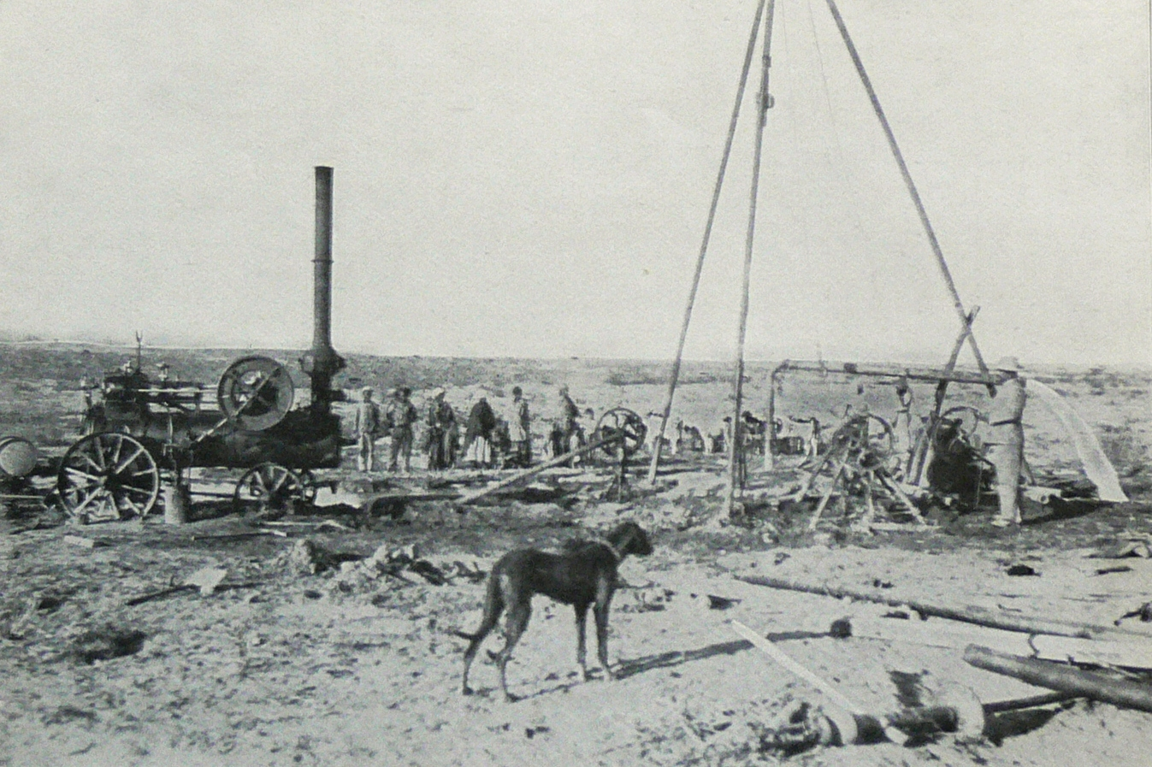
Historical background
1912: In the search for coal, Dr. Paul Range discovered struck artesian water in the Stampriet Artesian Basin (SAB): a borehole at Stamprietfontein (Namibia).
After World War I: farms were developed for South African ex-soldiers along the Auob River.
After World War II: further farms were developed for South African ex-soldiers, this time in the farther east lying Nossob River area.
1960s to 80s: Groundwater investigations and exploration for hydrocarbons
1970s and early 80s: Hydrochemistry investigations
From 1980s onwards: JICA study (2002) in Namibia and Matsheng study (2008) in Botswana
First artesian water was struck in 1912 (110m³/hr free flowing artesian borehole)

Slide 4
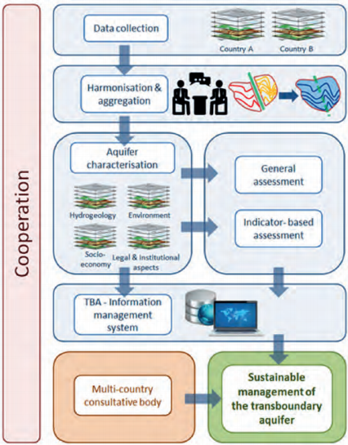
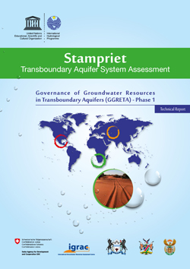
STAS GGRETA 1 assessment
Multi-disciplinary in-depth assessment
Hydrogeological aspects
Environmental issues
Socio-economic aspects
Institutional setting
Legal framework

Slide 5
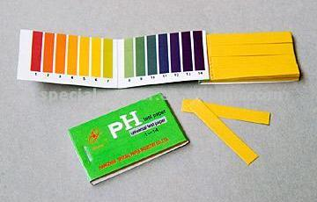
STAS GGRETA 1 assessment indicators
Indicators: - Smart combinations of variables in order to describe the complex aquifer system in 20 easy to understand and intuitive indicators
- UNESCO’s methodology based on measurable and monitorable indicators proved to be a springboard to facilitate the formulation of policy reforms

Slide 6
STAS GGRETA 1 structure

Slide 7
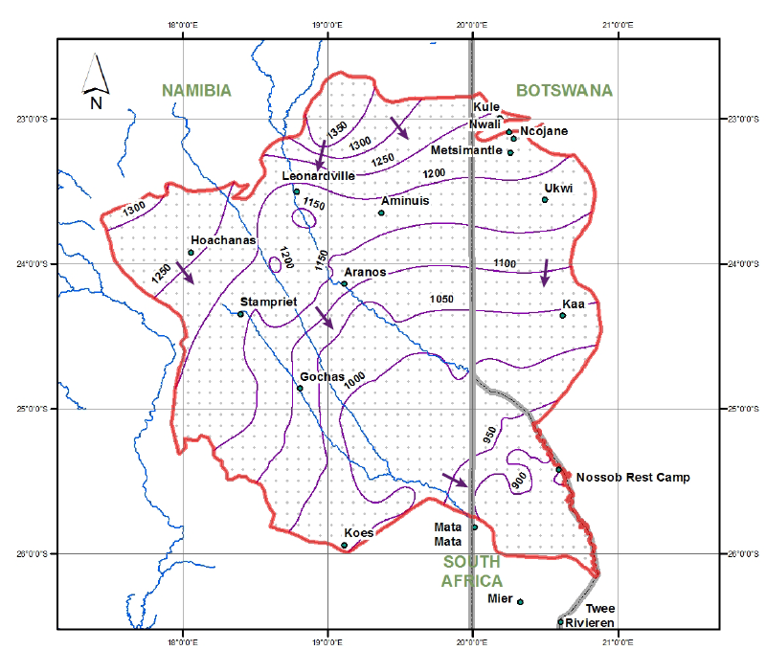
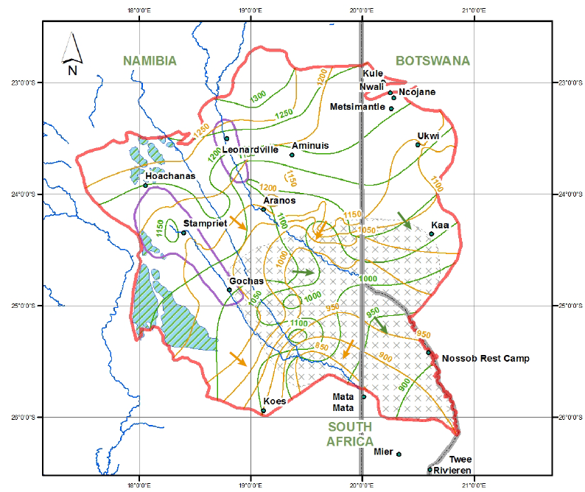
Main achievements
A step towards better cooperation and improved trust between the 3 countries
Improved knowledge and recognition of the importance and vulnerability of transboundary groundwater resources:
Agreement on the delineation of the STAS.
Agreement on a STAS hydrogeological conceptual model (covering recharge and discharge areas and rates, groundwater flow, and potential pollution risk areas).
Kalahari
Auob and Nossob

Slide 8
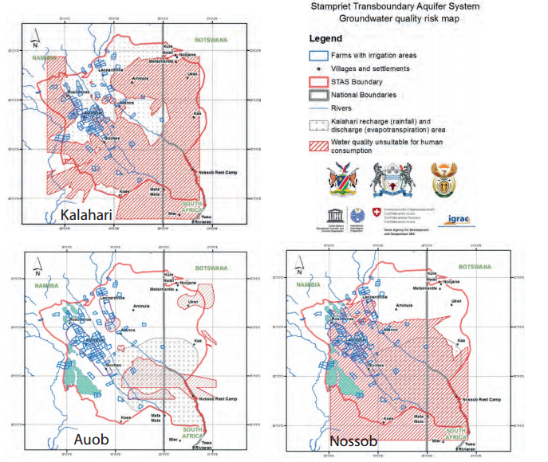
Main achievements
Development of shared management tools (IMS)
Compilation of a joint STAS borehole database (around 6000 boreholes).
Preparation of 60 thematic maps providing information on groundwater levels, quality

Slide 9
Main achievements
Strengthened cross‐border dialogue and cooperation:
Organization of 6 regional meetings held in the three countries of the STAS on a rotation basis, including 2 stakeholder consultation meetings which constituted participants of a broader audience (e.g. regional organizations, farmers, NGOs, …).
Recognition by SADC that the assessment of transboundary aquifers in the region should follow the same approach and methodology similar to the one applied to the STAS.
Application of GGRETA lessons learnt in the assessment of the Ramotswa Transboundary Aquifer shared by Botswana and South Africa.

Slide 10
Main achievements
Facilitation of governance reforms focused on improving livelihoods, economic development and environmental sustainability:
Presentation of two models for the establishment of a Co-operation Mechanism aimed at facilitating cooperation for the management and governance of the STAS.
Capacity-building trainings:
International water law: Focused on the principles and practice of international water law; linkages between international water law and domestic water legislation.
Water diplomacy: Focused on enhancing negotiation and dispute resolution skills, as well as on trust and consensus building.
Information Management System (IMS): Focused on the GGRETA project IMS functionalities.
Notes:
Please be clear that:
The proposal the Countries discussed in the first phase for the cooperation mechanism were only examples. It is now in this phase that the Countries themselves have to set up a Working Group of officials that will decide about the methodology they want for the coordination mechanism supported by experts of UNESCO and by lawyers from their Ministries of Foreign Affairs and other experts selected by them
Discussions about the IMS will happen already here I guess SO you start immediately saying that the second phase will take care to work on funding the data bases at national level to set up the coordination mechanism data base – information system that will then be managed by them as tool for coodination

Slide 11
Key findings and recommendations – Hydrogeology and S&E
The general perception is that there is until present no long-term groundwater depletion/pollution in the area
However, the fragility of the system could create conditions of stress in the future if there is overexploitation.
Measures to prevent or counteract potential depletion and pollution problems:
Rehabilitation of leaking wells, by introducing and implementing regulations on well construction and by effective well licensing procedures.
Improvement of the water and sanitation situation, including sewerage and wastewater treatment provisions.
Protection of key recharge zones that may contribute to conserving the resource.
Awareness Raising programs among the area’s inhabitants
Enhancement of the capacity of the institutions responsible for groundwater management in the area.

Slide 12
Key findings and recommendations – Hydrogeology and S&E
Measures to cope with uncertainties on the properties and present state of the aquifer system, in particular on how it behaves over time, in response to abstractions and climatic variation:
Implementing a monitoring system (groundwater levels and groundwater abstraction) is a priority.
Numerical simulation model of the STAS will prove to be indispensible to enable informed decisions on sustainable management of the area’s groundwater resources to be made.
SW-NE cross-section through Aminius, Ncojane (JICA, 2002; Matsheng, 2008). Question marks indicate the absence of stratigraphic information

Slide 13
Key findings and recommendations – Legal and Institutional
A domestic policy, legal and institutional framework for groundwater is in place in all the three STAS countries. The laws of the three countries regulate abstraction and potential point-source pollution through a permit system. When it comes to non-point source pollution control, other laws step in, typically environmental protection and mining Acts.
From the domestic legal and institutional perspective, it is fair to conclude that the laws in place in the STAS countries are adequate to deal with the challenges ahead of the aquifer.
Strengthening domestic capacities in implementation and enforcement is necessary to support cooperation for the management of the STAS.

