Slide 1
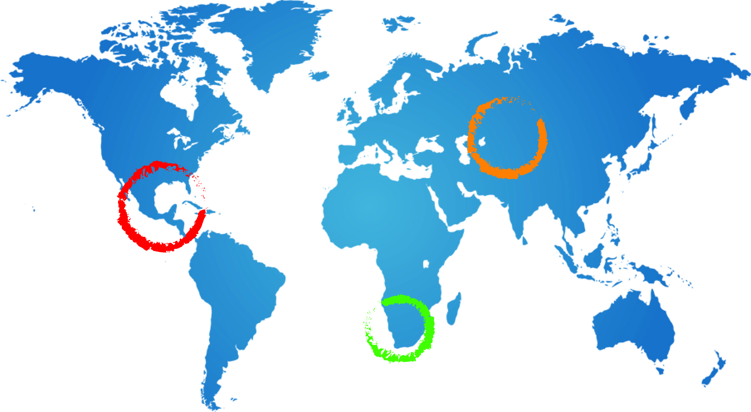
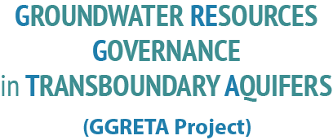
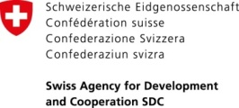
SELECT MULTI-COUNTRY ARRANGEMENTS FOR TRANSBOUNDARY AQUIFER GOVERNANCE -
AN OVERVIEW
Stefano Burchi UNESCO
4 November 2016
UNESCO HQ, Paris

Slide 2
CONTEXT: THE UN DRAFT ARTICLES
THE DRAFT ARTICLES ON THE LAW OF TRANSBOUNDARY AQUIFERS (UNGA RES.63/124 OF 2008) PROVIDE THAT “STATES SHOULD ESTABLISH JOINT MECHANISMS OF COOPERATION” (ARTICLE 7)
THE FEW EXISTING MULTI-COUNTRY ARRANGEMENTS FOR TRANSBOUNDARY AQUIFER GOVERNANCE SUBSTANTIATE THE ABOVE (CONDITIONAL) OBLIGATION
2

Slide 3
CONSULTATION MECHANISM FOR THE NWSAS
CONSULTATION MECHANISM FOR THE NORTH-WESTERN SAHARA AQUIFER SYSTEM (NWSAS-SASS)
PARTIES: ALGERIA, LIBYA, TUNISIA
ESTABLISHED IN TWO PHASES (2002 AND 2008 MOUs)
FUNCTIONS:
COLLECTION ANALYSIS AND DISSEMINATION OF INFORMATION AND DATA
AQUIFER MODELLING
PROMOTING AND EXECUTING STUDIES
3

Slide 4
CONSULTATION MECHANISM FOR THE NWSAS
FUNDING:
EQUAL CONTRIBUTIONS FROM THE MEMBER STATES
STRUCTURE: SEE DIAGRAMS
4

Slide 5
TECHNICAL LEVEL
RESEARCH
INSTITUTIONS
FOCAL POINT
ALGERIA
(ANRH)
RESEARCH
INSTITUTIONS
RESEARCH
INSTITUTIONS
STEERING COMMITTEE
FOCAL POINT
LIBYA
(GWA)
FOCAL POINT
TUNISIA
(DGRE)
COORDNATION UNIT
(OSS)

Slide 6
INSTITUTIONAL LEVEL
COUNCIL OF WATER MINISTERS
(ALGERIA, LIBYA, TUNISIA)
PERMANENT TECHNICAL COMMITTEE
(ANRH, GWA, DGRE)
NATIONAL COMMITTEES
ALGERIA
LIBYA
AD HOC WORKING GROUPS
COORDINATION UNIT
(OSS)
TUNISIA

Slide 7
JOINT AUTHORITY FOR NUBIAN SANDSTONE AQUIFER
JOINT AUTHORITY FOR THE STUDY AND DEVELOPMENT OF THE NUBIAN SANDSTONE AQUIFER SYSTEM (NSAS)
PARTIES: CHAD, LIBYA, EGYPT, SUDAN
ESTABLISHED UNDER 1992 AGREEMENT
FUNCTIONS:
PREPARING AND EXECUTING STUDIES
COLLECTION ANALYSIS AND DISSEMINATION OF INFORMATION AND DATA
DEVELOPMENT AND EXECUTION OF A COMMON POLICY AND PLANS FOR GROUNDWATER DEVELOPMENT & USE
FOSTERING COOPERATION
7

Slide 8
JOINT AUTHORITY FOR NUBIAN SANDSTONE AQUIFER
FUNDING:
ANNUAL CONTRIBUTIONS FROM MEMBER STATES
DONATIONS FROM NATIONAL AND INTERNATIONAL INSTITUTIONS
STRUCTURE: SEE DIAGRAM
8

Slide 9
NSAS
JOINT AUTHORITY
(JASAD-NSAS)
BOARD OF DIRECTORS
(Each Member State appoints three ministerial-level members to the Board)
JOINT AUTHORITY HQs
(Tripoli – Libya)
EXECUTIVE DIRECTOR
ADMINISTRATION UNIT
FINANCE UNIT
TECHNICAL AFFAIRS
INFORMATION UNIT
JOINT AUTHORITY NATIONAL OFFICES
CHAD
N’Djamena Office
Management and technical Staff
EGYPT
Cairo Office
Management and technical Staff
LIBYA
Tripoli Office
Management and technical Staff
SUDAN
Khartoum Office
Management and technical Staff

Slide 10
CONSULTATION MECHANISM FOR THE IULLEMEDEN, ETC.
CONSULTATION MECHANISM FOR THE IULLEMEDEN, TAOUDENI/TANEZROUFT AQUIFER SYSTEM (ITAS)
PARTIES: ALGERIA, BENIN, BURKINA FASO, MALI, MAURITANIA, NIGER, NIGERIA
PROVIDED FOR BY 2014 MOU (FOUR COUNTRIES HAVE SIGNED SO FAR, NOT IN FORCE YET)
STRUCTURE: SEE DIAGRAM
10

Slide 11
ITAS
MINISTER’S COUNCIL
PERMANENT TECHNICAL AND SCIENTIFIC COMMITTEE
EXECUTIVE SECRETARIAT
NATIONAL TECHNICAL AND SCIENTIFIC COMMITTEE
NATIONAL TECHNICAL AND SCIENTIFIC COMMITTEE
NATIONAL TECHNICAL AND SCIENTIFIC COMMITTEE
NATIONAL TECHNICAL AND SCIENTIFIC COMMITTEE
NATIONAL TECHNICAL AND SCIENTIFIC COMMITTEE
NATIONAL TECHNICAL AND SCIENTIFIC COMMITTEE
NATIONAL TECHNICAL AND SCIENTIFIC COMMITTEE
MALI
BEN
BF
NIGER
MAU
MAU
NIGERIA
COORDINATION UNIT
(OSS)

Slide 12
CONSULTATION MECHANIMS FOR THE IULLEMEDEN, ETC.
FUNCTIONS:
FORMULATION OF PLANS AND PROGRAMMES
CONDUCTING JOINT STUDIES
COLLECTION ANALYSIS AND EXCHANGE OF INFORMATION AND DATA
MANAGEMENT OF RISKS
HARMONIZATION OF PROCEDURES AND METHODOLOGIES
SETTLEMENT OF DISPUTES
FUNDING:
ANNUAL CONTRIBUTIONS FROM MEMBER STATES (OPERATIONAL BUDGET)
DONATIONS FROM NATIONAL AND INTERNATIONAL INSTITUTIONS
12

Slide 13
JOINT TECHNICAL COMMITTEE FOR THE AL-DISI AQUIFER
JOINT TECHNICAL COMMITTEE FOR THE AL-SAG/AL-DISI AQUIFER
PARTIES: JORDAN, SAUDI ARABIA
PROVIDED FOR BY 2015 AGREEMENT
STRUCTURE:
FIVE REPRESENTATIVES EACH FROM JORDAN AND SAUDI ARABIA
MAY HIRE EXPERTS, ADVISERS AND EMPLOY ASSISTANTS
13

Slide 14
JOINT TECHNICAL COMMITTEE FOR THE AL-DISI AQUIFER
FUNCTIONS:
SUPERVISING IMPLEMENTATION OF 2015 AGREEMENT
MONITORING LEVEL & QUALITY OF AQUIFER WATER
MONITORING GROUNDWATER EXTRACTIONS
COLLECTION AND EXCHANGE OF INFORMATION AND DATA
FUNDING:
NOT MENTIONED IN 2015 AGREEMENT
14

Slide 15
GUARANI AQUIFER COMMISSION
GUARANI AQUIFER COMMISSION
PARTIES: ARGENTINA, BRAZIL, PARAGUAY, URUGUAY
PROVIDED FOR BY 2010 AGREEMENT (RATIFIED BY TWO COUNTRIES SO FAR, NOT IN FORCE YET)
STRUCTURE:
NOT MENTIONED IN THE 2010 AGREEMENT
FUNCTIONS:
COORDINATION OF COOPERATION FOR THE IMPLEMENTATION OF THE PRINCIPLES AND OBJECTIVES OF THE 2015 AGREEMENT
FUNDING:
NOT MENTIONED IN THE 2015 AGREEMENT
15

Slide 16
GENEVESE AQUIFER COMMISSION
GENEVESE AQUIFER COMMISSION
PARTIES: FRANCE, SWITZERLAND
ESTABLISHED UNDER 1978 AGREEMENT – RE-NEGOTIATED IN 2007
STRUCTURE:
THREE MEMBERS EACH FROM THE FRENCH AND THE SWISS SIDE
SECRETARIAT SERVICES PROVIDED BY GENEVA CANTON AQUIFER SERVICE AND FRENCH ANNEMASSE REGIONAL GOVERNMENT
16

Slide 17
GENEVESE AQUIFER COMMISSION
FUNCTIONS:
DRAWING UP YEARLY GROUNDWATER UTILIZATION PLANS
RECOMMENDING POLLUTION CONTROL MEASURES
ADVISING ON EXTRACTION PROJECTS, INCLUDING MODIFICATION OF EXISTING PROJECTS
AUDITING OF CONSTRUCTION AND O&M COSTS (FOR COST-SHARING)
INVENTORY OF GROUNDWATER RECHARGE EQUIPMENT & EXTRACTION WORKS
RECORD-KEEPING OF EXTRACTED VOLUMES AND OF WATER LEVELS
OVERSIGHT OF CONSTRUCTION OF NEW EQUIPMENT
SETTLEMENT OF DISPUTES (ARBITRATION)
FUNDING:
EACH PARTY BEARS THE EXPENSES OF ITS OWN SIDE OF THE COMMISSION
17

