Slide 1
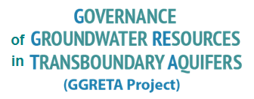
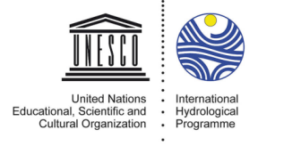
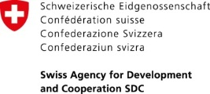
Overview of GGRETA Phase 2 activities
Stampriet Aquifer High Level Meeting
3-4 November 2016, UNESCO HQs
Tales Carvalho Resende
4 November 2016
Paris, France

Slide 2
GGRETA Phase 1 Final Meeting (15-16/Dec 2015) – Main decisions
Results of the project and data view mode:
It was decided that all the information approved on the assessment report will be for public view, and that all other information should be specifically approved by Countries before going public.
Multi-Country Cooperation Mechanisms (MCCM):
Examples of MCCM models were presented to Government Officials, Permanent Delegations to UNESCO, Representatives of Regional Organisations and technical teams,
Government officials from the Department of Water Affairs in Botswana, Namibia and South Africa decided to set up adequate actions in the second phase of the GGRETA project aiming at identification of an MCCM.
Recommendations for GGRETA project Phase 2:
Outcomes of GGRETA Phase 2 should be generated from the assessment report and decided at an Inception Meeting. It was agreed that activities under each outcome will be further developed as per country’s need, without limiting to GGRETA project Phase 2 funds, but also considering co-funding from Countries and existing SADC projects.
Notes:
without limiting to GGRETA project Phase 2 funds, but also considering co-funding from Countries and existing SADC projects.
This is a crucial issue that you have to take time to explore.
We should have made reference to it in our letters. Do not forget to do it in the letters that we will send with the short summary of this meeting

Slide 3
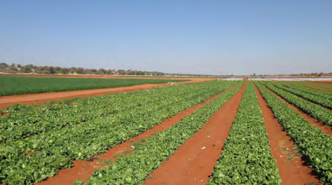
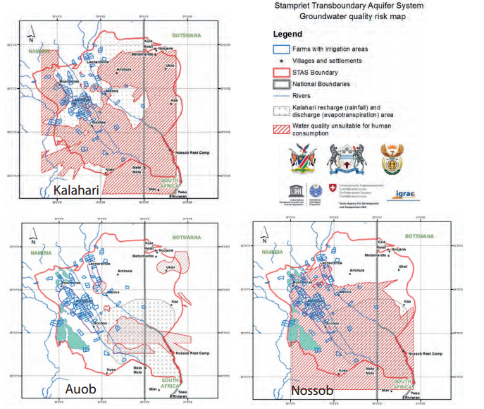
Key findings and recommendations – Hydrogeology and S&E
The general perception is that there is until present no long-term groundwater depletion/pollution in the area
However, given the fragility of the system, conditions of stress in the future could occur if there is overexploitation.
Horticulture drip-irrigation farm close to Stampriet (Namibia)
Groundwater quality in the STAS

Slide 4
Key findings and recommendations – Hydrogeology and S&E
Measures to prevention or counteract potential depletion and pollution problems:
Rehabilitation of leaking wells, by introducing and implementing regulations on well construction and by effective well licensing procedures.
Improvement of the water and sanitation situation, including sewerage and wastewater treatment provisions.
Protection of key recharge zones that may contribute to conserve the resources.
Raising awareness programs among the area’s inhabitants (e.g. invasive species)
Enhancement of the capacity of the institutions responsible for groundwater management in the area.
Prosopis covered Nossob River upstream of Leonardville (Namibia)
Borehole leakage

Slide 5
Key findings and recommendations – Hydrogeology and S&E
Measures to cope with uncertainties on the properties and present state of the aquifer system, in particular on how it behaves over time, in response to abstractions and climatic variation:
Implementing a monitoring system (groundwater levels and groundwater abstraction) is a priority.
Numerical simulation model of the STAS will prove to be indispensible to enable informed decisions on sustainable management of the area’s groundwater resources to be made.

Slide 6
Key findings and recommendations – Legal and Institutional
A domestic policy, legal and institutional framework for groundwater is in place in all the three STAS countries. The laws of the three countries regulate abstraction and potential point-source pollution through a permit system. When it comes to non-point source pollution control, other laws step in, typically environmental protection and mining Acts.
From the domestic legal and institutional perspective, it is fair to conclude that the laws in place in the STAS countries are adequate to deal with the challenges ahead of the aquifer.
Strengthening domestic capacities in implementation and enforcement is necessary to support cooperation for the management of the STAS.

Slide 7
GGRETA Phase 2 – Main Objectives
As a continuation of Phase 1, the overall goals for Phase 2 are:
To enhance groundwater governance, develop water related gender-responsive approach, foster cooperation on water security.
Strengthen the technical capacity of the countries sharing the aquifer to consolidate the base for long term sustainable management of the aquifer.
Continuing the process for the establishment of a Multi-Country Cooperation Mechanism (MCCM).
Promote a regional dialogue on coordination and harmonization of groundwater governance frameworks and guiding principles both at national and transboundary levels

Slide 8
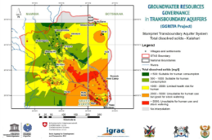
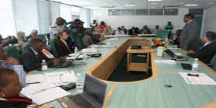
Starting point (GGRETA Phase 1)
In-depth Transboundary Multidisciplinary Assessment
Framework for dialogue on transboundary aquifers management: “STAS family”
Water Diplomacy
From Potential Conflict to Cooperation Potential
Trust-building
Stakeholders mapping, identifying issues and interests
Capacity-building modules: « training for trainers » approach for replication
Modelling
Groundwater governance
Gender
International and domestic water law
Capacity-building Trainings on water diplomacy (multilevel governance, stakholder linking)
Consensus-building
Better understanding of water cooperation benefits to stakeholders at national (e.g. Governments, Diplomats) and local level (e.g. Farmers)
Refinement of GGRETA Phase 1 assessments
Development and upgrade of innovative tools
Information Management Systems
Update of joint database
Data collection protocols
Multi-Country Co-operation Mechanisms
Science for Transboundary Multidisciplinary Assessment
Achievements
Strengthened cross‐border dialogue and cooperation
Understanding of the resource for informed decision-making
Facilitation of governance reforms

Slide 9
Way forward in GGRETA Phase 2
• Establishment of National Transboundary Technical Groups (NTTGs) for:
Modelling,
Legal and institutional aspects,
Gender aspects.
• Establishment of a Working Group for Multi-Country Cooperation Mechamism (MCCM)

Slide 10
GGRETA Phase 2 – Organizational Chart
BOTSWANA
NAMIBIA
SOUTH AFRICA
Working Group for Multi-Country Cooperation Mechanism
Mr Thato Raphaka
Permanent Secretary
Ministry of Land Management, Water & Sanitation Services
Mr Abraham Nehemia
Deputy Permanent Secretary
Ministry of Agriculture, Water and Forestry
Ms Deborah Mochotlhi
Deputy Director General
Department of Water & Sanitation
Government Representatives
Mr Piet Kenabatho
University of Botswana
Ms Maria Amakali
Department of Water Affairs and Forestry
Mr Kwazikwakhe Majola
Department of Water & Sanitation
National Coordinators
Project Management Unit (UNESCO)
National Transboundary Technical Groups (NTTGs)
???
(Gender)
???
(Legal and institutional)
???
(Legal and institutional)
???
(Hydrogeology + Model)
???
(Hydrogeology + Model)
???
(Legal and institutional)
???
(Gender)
???
(Hydrogeology + Model)
???
(Gender)

Slide 11
GGRETA Phase 2 – Outcomes
Outcome 1 – Improved resource knowledge and monitoring based on recognition of the importance and vulnerability of transboundary groundwater resources.
Outcome 2 - Enhanced cross-border dialogue and cooperation based on development of shared management tools, and recommendations for governance reforms focused on improving livelihoods, economic development, gender equality and environmental sustainability.
Outcome 3 – Improved capacity in groundwater governance, hydro-diplomacy and gender, and effective communication aiming at replication of project experiences and approaches.

Slide 12
GGRETA Project - Outcome 1
Outcome 1 – Improved resource knowledge and monitoring based on recognition of the importance and vulnerability of transboundary groundwater resources.
Main objectives
Upgrading and updating of joint database and monitoring protocols (e.g. time series data…)
Develop a model for filling existing knowledge gaps (e.g. estimations, …)

Slide 13
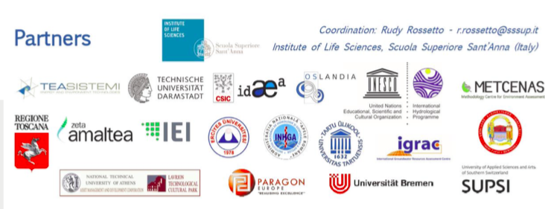
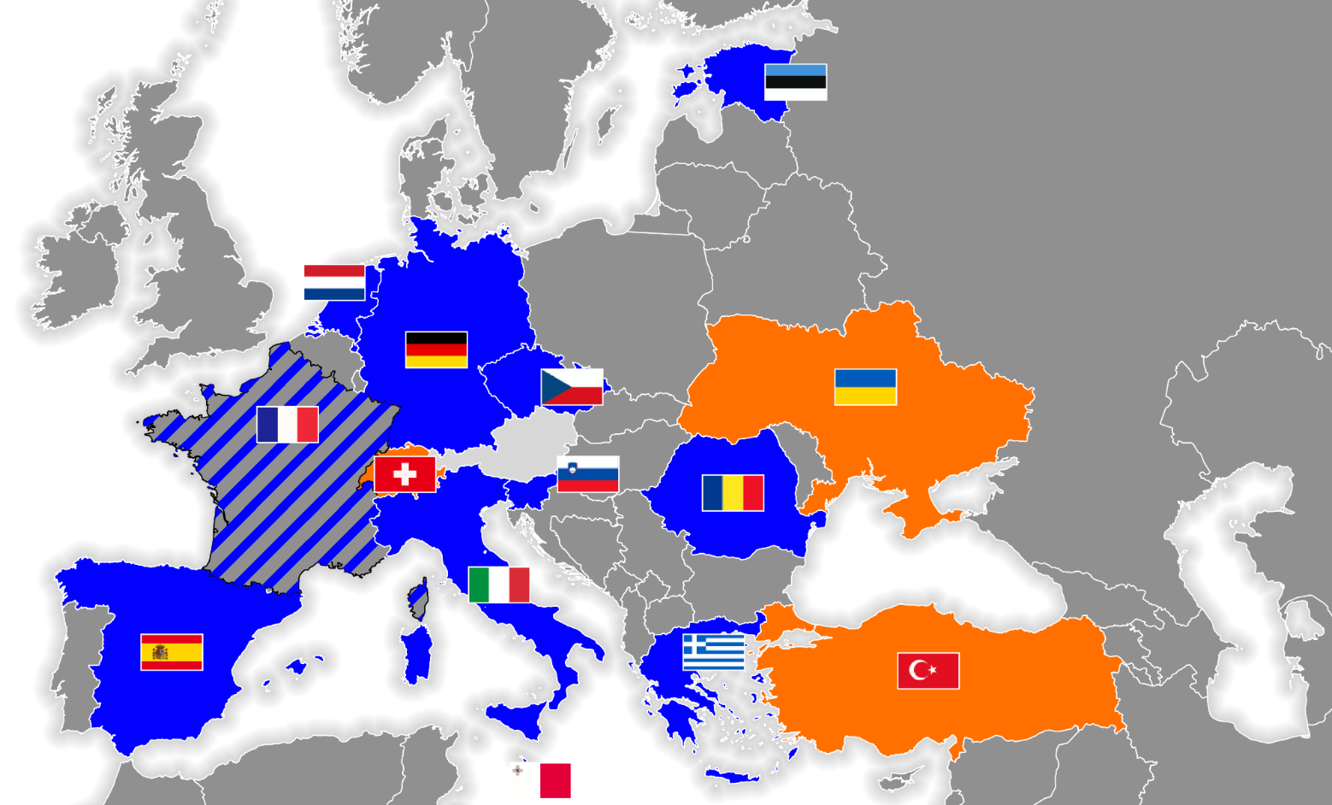
FREEWAT Project & STAS Model
FREEWAT (2015-2018) is an ICT project funded by the European Commission for improving Water Resources Management through a public domain GIS integrated modelling platform (i.e. free software tools).
www.freewat.eu

Slide 14
FREEWAT Project & STAS Model
Main objectives:
Integrate existing software modules for water management in one single environment (FREEWAT platform).
Develop simulation models for surface water and groundwater quantity and quality, including management scenarios.
To conduct an innovative participatory approach gathering technical staff and relevant stakeholders (policy and decision makers) in designing scenarios for proper application of water policies.
Application:
10 case studies in the EU
3 in neighboring countries (Switzerland, Turkey and Ukraine)
The Stampriet Transboundary Aquifer System (Botswana, Namibia and South Africa).

Slide 15
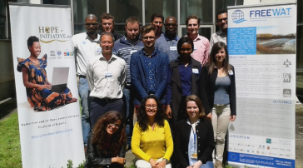
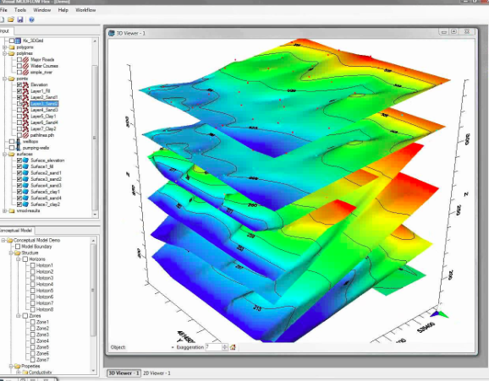
FREEWAT Project & STAS model
APPLICATION OF THE FREEWAT PLATFORM
SOFTWARE DEVELOPMENT AND CAPACITY BUILDING
Objective: Producing policies!
STAS model simulations and scenarios (participatory approach)
National trainings
STAS model implementation and calibration
(participatory approach)
Preparation of data for STAS model
Training the trainers
Preparation of FREEWAT Platform (including QGIS, Modflow, etc…)
September – December 2016
January – April 2017

Slide 16
FREEWAT Project: Capacity building
Training for trainers:
3 trainers per country (NTTGs to be nominated by Member States)
First training was held in July 2016
Next training will be held in early 2017
National trainings by trainers:
Working groups of 20 people (UNESCO-IHP would provide support)
Trainings to be held in March- April 2017

Slide 17
Workplan (September 2016 – April 2017) – Outcome 1

Slide 18
GGRETA Project - Outcome 2
Outcome 2 - Enhanced cross-border dialogue and cooperation based on development of shared management tools, and recommendations for governance reforms focused on improving livelihoods, economic development, gender equality and environmental sustainability.
Main objectives
Setting-up of a Working Group for the establishment of a Multi-Country Consultation Mechanism
Regional Dialogue on Conjunctive Surface and Groundwater Management in Transboundary Contexts
Notes:
Link can also be considered with AMCOW
We talked about to invite Bai Mass Tall

Slide 19
Working Group for the establishment of a Multi-Country Cooperation Mechanism
Working Group for the establishment of a Multi-Country Cooperation Mechanism (MCCM):
Formulate proposals for the structure, composition, mandate funding, and functioning of a Multi-Country Consultation Mechanism for the governance and management of the STAS
Regional Dialogue on Conjunctive Surface and Groundwater Management in Transboundary Contexts:
Joint activities with AMCOW, SADC, IGAD, ORASECOM, LIMCOM

Slide 20
Workplan (September 2016 – April 2017) – Outcome 2

Slide 21
Outcome 3
Outcome 3 – Improved capacity in groundwater governance, hydro-diplomacy and gender, and effective communication aiming at replication of project experiences and approaches.
Main objectives
Capacity building modules on hydrogeology, international water law, domestic water legislation, and gender
Includes cross-cutting activities that will contribute to the achievement of Outcomes 1 and 2

Slide 22
Outcome 3 – Capacity building modules
International Water Law:
3-day training during the Regional Meeting on Tools for the Sustainable Management of Transboundary Aquifers (in partnership with SADC and IWMI) (28-30 November 2016)
Objectives:
Expose participants to the principles and practice of international water law, with special attention to the law of transboundary aquifers (UN draft Articles 2008);
Illustrate the linkages and interaction between water law and domestic water legislation.

Slide 23
Outcome 3 – Capacity building modules
Domestic water legislation:
1-2 day training in each Country (March-April 2017)
Objectives:
Expose participants to the principles and practice of conceptualizing and implementing/enforcing domestic water resources legislation, and to the relevant contemporary issues, against the backdrop of compliance with transboundary water-related obligations.

Slide 24
Outcome 3 – Capacity building modules
Hydrogeology:
Training for trainers + national trainings in partnership with FREEWAT
Gender:
Trainings in each Country covering:
A module on sex-disaggregated data collection for field surveys,
A module on engendering national water policy.

Slide 25
Workplan (September 2016 – April 2017) – Outcome 3

Slide 26
Thank you for your attention

