Slide 1


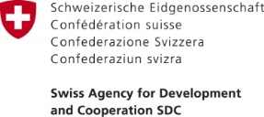
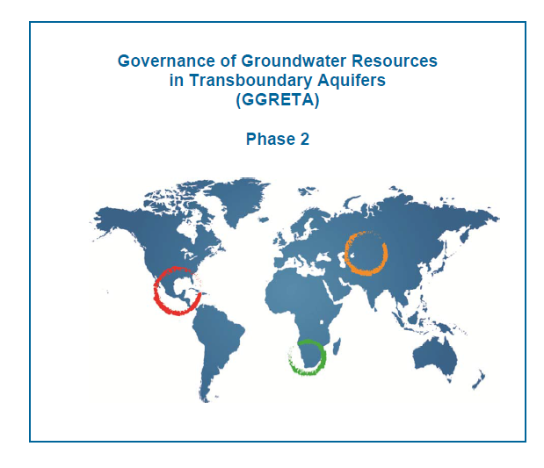
PROPOSAL for a Second PHASE

Slide 2

PROPOSED GGRETA Phase 2 Objectives
Duration of the Phase 2 of the GGRETA Project
Duration: 3 years (2016, 2017, 2018)
As following from the Phase 1, the overall goal for Phase 2 is:
To enhance groundwater governance, develop water related gender-responsive approach, foster cooperation on water security. Setting up of Cooperation Mechanisms.
COUNTRIES : El Salvador, Honduras, South Africa, Botswana, Namibia, Kazakhstan, Uzbekistan

Slide 3
PROPOSED GGRETA Phase 2 Objectives/Outcomes
Outcome 1 – Improved resource knowledge and monitoring based on recognition of the importance and vulnerability of transboundary groundwater resources.
Outcome 2 - Enhanced cross-border dialogue and cooperation based on development of shared management tools, and recommendations for governance reforms focused on improving livelihoods, economic development, gender equality and environmental sustainability.
Outcome 3 – Improved capacity in groundwater governance, hydro-diplomacy and gender, and effective communication aiming at replication of project experiences and approaches.

Slide 4
In each project aquifer, specific actions will be implemented to reach the above outcomes as follows:
-Central America: Improve groundwater governance at the domestic and regional levels and set a first example in the region of cooperative management of a transboundary aquifer. El Salvador -Honduras
-Southern Africa: Promote regional coordination and harmonization on transboundary surface and groundwater management frameworks, and set a first example of cooperative management of transboundary aquifer in the SADC region, and strengthen domestic groundwater governance capacity.
-Central Asia: Improve technical, scientific, legal and institutional, and hydro-diplomacy skills to facilitate transboundary waters cooperation and groundwater resources management.

Slide 5
