Slide 1
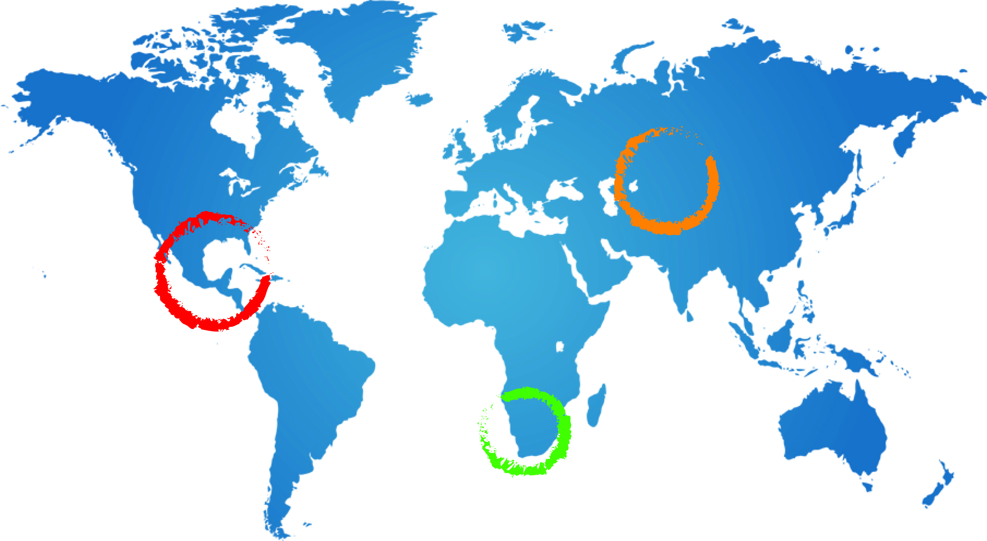
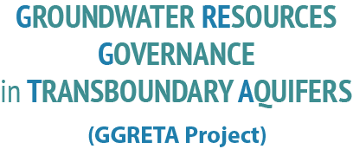
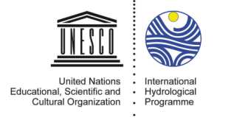
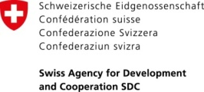
Sex-disaggregated water enquiry: Preliminary results
Tales Carvalho Resende
8 December 2015
COP21, Le Bourget

Slide 2
Objectives of the project
Multi Country Consultative Body
Sustainable management of TBA
Data collection (mainly existing)
Data harmonisation
TBA assessment
Proposal for harmonised monitoring
2

Slide 3
GGRETA Project: a gender sensitive assessment
3

Slide 4
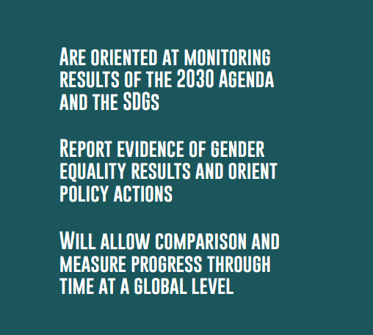
SEX DISAGGREGATED WATER DATA
4

Slide 5
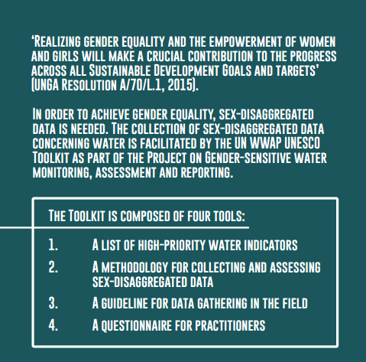

Slide 6
THE WWAP TOOLKIT

Slide 7
GGRETA Project: a gender sensitive assessment
Integration of UN WWAP/UNESCO TOOLKIT on sex-disaggregated water indicators and methodology
GGRETA project is the first ever multi-country and multi-regional water-monitoring project with comparable sex-disaggregated data .
Results will be useful for the formulation of informed decisions on water resource management, use and access in the areas of interest of GGRETA
The sex-disaggregated data overview will also prove the importance to get such data on a global scale, in view of the post-2015/SDGs monitoring strategy. WWAP provided the GGRETA project results as a dataset example for the monitoring of SDG 6.5.1 ( on IWRM and Transboundary Water) in the future
7

Slide 8
GGRETA Project: a gender sensitive assessment
Mid 2014: Experts received methodology and a list of 50 indicators
End 2014: Experts provided preliminary feedback on the availability of data
Lack of data
Different resolutions (district / settlement level)
Need to go to the field
Early 2015: Sub-selection of a core-set of indicators to be gathered by all participating countries
WWAP was avoiding the risk of non-comparability of data
WWAP worked for ensuring the presence of both qualitative and quantitative data
Mid 2015: Field surveys were undertaken based on tailor-made questionnaires provided to experts.
8

Slide 9
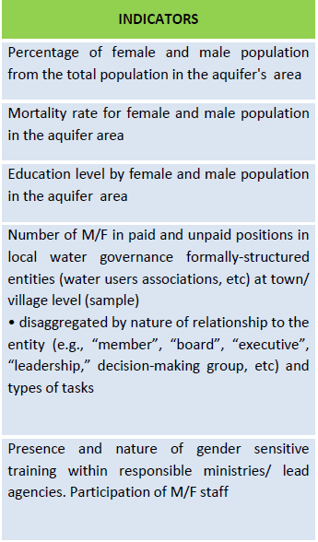
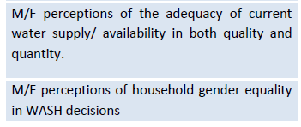
Safe Drinking Water, Sanitation And Hygiene
Decision Making And Knowledge Production
M/F perceptions of household gender equality in water decisions
Water Governance
Water For Income Generation For Industrial And Agricultural Uses, Including Unaccounted-for Labour
Decision-makers and participants in household-based decision-making process regarding irrigation
Decision-makers and participants in community-based decision-making process (if any) regarding irrigation (M/F informants/ perceptions, decisions re-allocation of time and financial resources; crops to be irrigated.

Slide 10
Preliminary results
(Stampriet Transboundary Aquifer System)
10

Slide 11
Water Governance
11

Slide 12
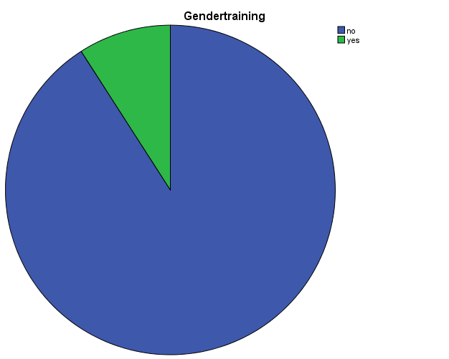
Water Governance
Number of M/F in paid and unpaid positions in local water governance formally-structured entities
No local water committees in the aquifer area
Presence and nature of gender sensitive training within responsible ministries/ lead agencies.
More than 90% of respondents never had the opportunity to be invited to any training on gender issues
Local authorities and settlements do not have gender-specific objectives or Gender strategies to guide their operations.
However National Development Plans provide guidance to local authorities
ExBotswana Analysis of participants who attended Gender Training : 90% did not attend
12

Slide 13
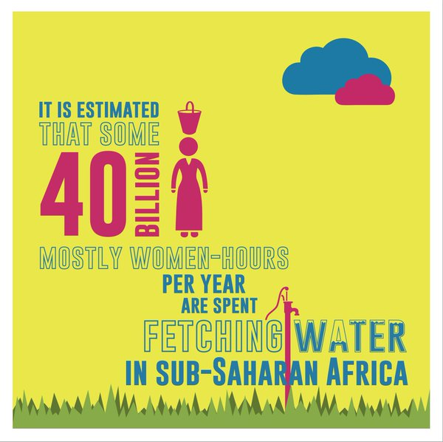
Safe drinking water, sanitation and hygiene
13

Slide 14
Safe drinking water, sanitation and hygiene
54% of households do not have access to any toilet facilities
In some settlements in Namibia it can go up to 80%
Namibia: All the respondents expressed dissatisfaction with the sanitation situation. During the day the residents use the bush. It was reported that the bush system exposes women and children to sexual abuse, and snakebites.
Only 15% of households are directly connected to water
Distances travelled by households (mainly women >70%) to communal standpipes varies and as such the burden of collecting water for household varies as well
More than 90% of respondents do not purify water
M/F perceptions of the adequacy of current water supply/availability in both quality and quantity
Botswana: 65% of respondents where satisfied with current water supply/availability (mark > 8/10)
Namibia: Distance is the main limiting factor and consequently quantity is also perceived as inadequate. Studies indicate that reduction of 15min in water collection time increase under-five survival and girl’s attendance at school
14

Slide 15
Decision making and knowledge production
15

Slide 16
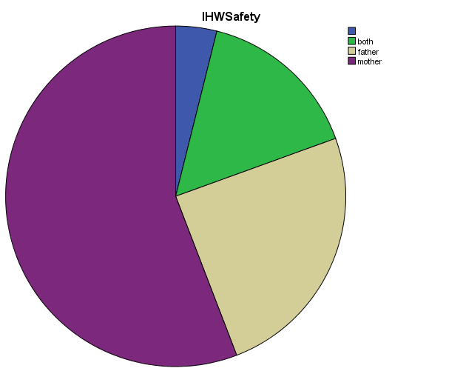
Decision making and knowledge production
M/F perceptions of household gender equality in water decisions
Approximately 25% of households are run by women
Women or mothers are the ones responsible for monitoring water quality once water is home (> 70% of respondents)
Example of In House water decisions from Botswana
The Mother is the main decision maker in the household
16

Slide 17
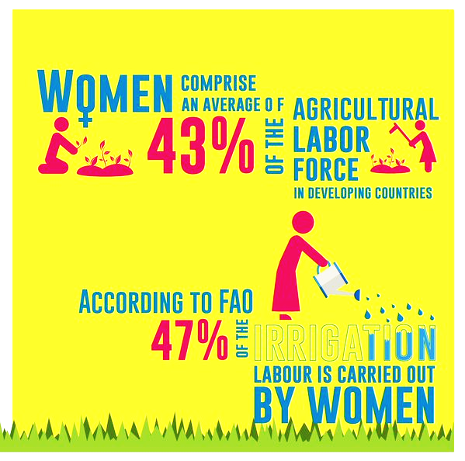
Income generation for agricultural uses
17

Slide 18
Perceptions regarding management systems
Income generation for agricultural uses
Women usually contribute to food production for their families through back yard gardening (more often involved in small-scale and rain-fed subsistence farming).
Namibia Demographic Health Survey (2014) revealed that at the national level, 36% of women who work in agriculture are not paid at all for their work
In contrast, male farmers are more involved in medium to large-scale irrigation and stock farming (95% are male).
Planning and management of farming processes are predominantly male dominated
Farmers associations:
White, male commercial farmers dominate (90% of member)
18

Slide 19
Preliminary results
TRIFINIO AQUIFER
19

Slide 20
Decision making and knowledge production
WHAT ARE THE ROLES OF MEN AND WOMEN IN THE MANAGEMENT AND DECISION-MAKING?
Number of M/F in paid and unpaid positions in local water governance formally-structured entities (water users associations, etc) at town/ village level
It was not possible to disclose this information for experts in the field, because the majority of “comités de agua, juntas de agua, y COCODEs” are non paid positions.
At the municipal level, every unit has a municipal office who is a woman , and who is working with gender issues in order to empower the female sector and to promote their participation in productive activities
20

Slide 21
Water Governance
At the regional level, the Plan Trifinio Trinational Committee executes its strategic plan with the function of promoting the construction of a territorial border management model for sustainable development and gender policies applied transversely to achieve its mission.
Presence and nature of gender sensitive training within responsible ministries/ lead agencies
- there have been a series of training with the aim of contributing to establishing the steps of how to diagnose the application of the gender analysis to local development plans at the Municipal Office of Women and the Municipal Offices Environment ( Sept. and Dec 2015)
(attended by representatives of the municipalities of La Palma, San Ignacio, Citalá, The Salvador, Sinuapa, Santa Fe and New Ocotepeque, Honduras, and Guatemala Esquipulas, with a total of 15 people (56% women and 44% men)
- planning and implementation of plans, programs and projects are limited
21

Slide 22
Water Governance
EXISTENCE AND NATURE OF GENDER-SPECIFIC OBJECTIVES AND COMMITMENTS (OR GENDER STRATEGY) IN NATIONAL AND SECTORAL WATER POLICIES
Guatemala has a specific cabinet of women and by law each of the NGOs have to have a gender department to promote equal participation of men and women and train female sector . In other local-level governments by law every municipality must have a Municipal Office for Women and has been assigned a small percentage (0.05%) of the Municipal budget which allows for a starting point to initiate activities.
El Salvador also has a public policy that promotes the participation of women which is the Special Law for a Life Free of Violence for Women, Law of Equality, Equality and Elimination of Discrimination against Women and the Law Against Domestic Violence that prevents the unequal distribution of power and asymmetrical relations
In the case of Honduras is the Law Against Domestic Violence and the Law on Equal Opportunities for Women and the Law of the National Institute of Women (INAM) in 1999 which was a major step in creating the institute. The country had made much progress in this area but in the last year had a delay the disappearance of the National Institute for Women, so for its support in training and budget now no longer exists
22

Slide 23
Income generation for agricultural uses
THE PRESENCE OF WOMEN IN COOPERATIVES AND INDUSTRIES RELATED TO WATER
In the area of ​​the aquifer Trifinio the presence or participation of women in cooperatives it has been made in recent years
these institutions have opened coverage, specifically in cooperatives that are related to the cultivation of coffee
questions inheritance or lack of presence in the house were limiting the process in the past
women have assumed this responsibility in terms of coffee production and the livelihood of their family
They take part both as a partner or director’s positions
23

Slide 24
PERCEPTIONS OF M / F ON THE ADEQUACY OF THE CUPERCEPTIONS OF M / F ON THE ADEQUACY OF THE CURRENT SUPPLY / WATER AVAILABILITY IN QUALITY AND QUANTITY RRENT SUPPLY / WATER AVAILABILITY IN QUALITY AND QUANTITY
Safe drinking water, sanitation and hygiene
PERCEPTIONS OF M / F ON THE ADEQUACY OF THE CURRENT SUPPLY / WATER AVAILABILITY IN QUALITY AND QUANTITY
Both men and women who were interviewed agreed on the perception on the current water supply in terms of quantity and quality
PERCEPTIONS M / F GENDER EQUALITY IN HOUSEHOLD DECISIONS WASH
In the Trifinio Aquifer area especially
--in rural communities, the perception is that decisions about safe use of water, sanitation and hygiene activities are taken by women, and women are responsible for ensuring housecleaning.
Men are not involved, their activities are outdoors a lot and the little time that is at home is dedicated to other tasks.
--in urban areas the perception has changed in such a way that man has begun to be involved in decisions on this issue and now both women and men provide safe water to keep the home and household hygiene and sanitation.

Slide 25
Preliminary results
PRETASHKENT AQUIFER ( Kazakhstan Segment)
25

Slide 26
Decision making and knowledge production
What are the roles of men and women in the management and decision-making?
In general, women
-do not participate in the management of Association of Farmers
-do not participate to Water Consumer Associations
Regarding decision making according to the survey data, all the important questions including water safety and water supply are solved by men (90%). But women are taking care of water quality (90%) as long as they are involved in household’s activity.
26

Slide 27
Decision making in transboundary institutions
As for International level in water resources management, according to the data of Joint Commissions for protection and use of Transboundary Rivers, there are also women who are participating in their works
In the course of negotiations of joint commissions for use and protection of transboundary rivers and at the stage of making decisions the opinions of women in accordance with their positions are taken into account equally with the opinions of men. Therefore, contribution of women and men in the processes of making decisions could be announced as equal.
Gender goals and obligations in transboundary agreements and measurements are not considered.
That is why gender-sensitive indicators are not determined and not estimated. Correspondingly transboundary agreements and measurements are not including analysis of gender results

Slide 28
Decision making in transboundary context
Job category | Top level No. M/No. F | Middle level No. M/No. F | Lower level No. M/No. F
Executive | M- 5 F - 2 | M -7 F - 3
Consultant | M -1 | M -1 | M -4 F- 2
Technician |  | M- 5 F - 2
Administrative |  | M -1
Tab. 1 Data of distribution of members of commission by gender,
position and type of activity.

Slide 29
Water Governance
Number of M/F in paid and unpaid positions in local water governance formally-structured entities :
- there are 6 times more men then women in Water Management Institutions ( formally structured): Women’s Committee of Uzbekistan filed the above inquiry on the Tashkent and Tashkent Region
- in Water Consumer Associations
There are 749 women out of 8,596 specialists in the Water Consumer Associations in Uzbekistan;of them, only 3 women are members of the management board. There are no women managers in the Water Consumer Associations within Tashkent and Tashkent Region. There are 1,505 Water Consumer Associations in Uzbekistan.
-
29

Slide 30
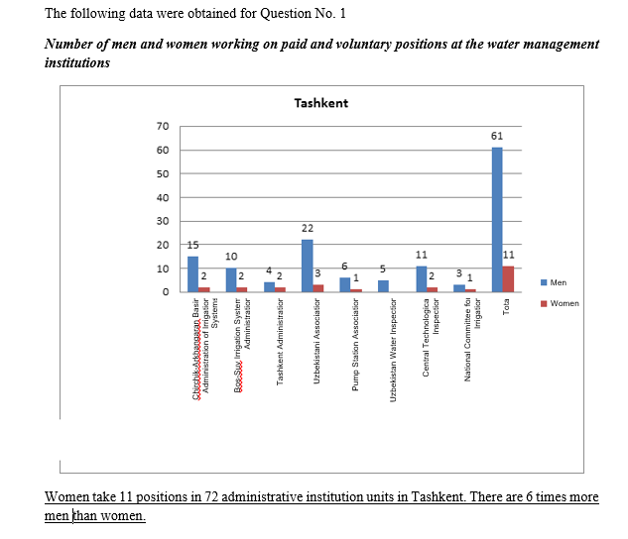

Slide 31
Water Governance
Presence and nature of gender sensitive training within responsible ministries/ lead agencies
Hardly anyone has ever participated in gender trainings. Such subject was known only to the specialists from the Women’s Committee and nongovernmental organizations.
No particular events for gender integration have been held.
Standard of knowledge of regulations and gender component of these issues is very low.
COMMENTS FROM EXPERTS IN THE FIELD
“This issue should be regularly risen by both officials and population.
They should develop a procedure for implementation of educational programs for managers, officials, and population.
This data collected and presented material may be of interest for initiation and development of the projects for increase in awareness of those people, who make decisions in the field of the use, access to, and management of water resources.”
31

Slide 32
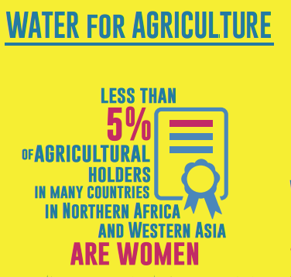

Slide 33
Income generation for agricultural uses
NUMBERS ARE WORST THAN THE GLOBAL OUTLOOK IN THE MENA REGION
- women have no private property to be pledged for loans regarding agriculture
- there are only 5 women of 287 farmers in Okhangaron District females ( less than 2%)
there are12 women of 264 farmers in Zangiata District ( 4.5% of women)
Irrigative systems are managed mostly by men.
Women are practically not involved in the process of management of irrigative systems.
Interesting opinion from experts in the field:
What are the perceptions of male farmers and female farmers in respect of the use of water resources and management system?
“Having water means having good harvest and be prosperous. That is why we can see such issues as corruption, nepotism, and violence in distribution of water. Irrigation activities are associated with many conflicts. In such a case, women are in more complicated situation. “
33

Slide 34
CONCLUSIONS/ preliminary gender analysis
STAMPRIET
TRIFINIO
PRETASHKENT
Good Legislative framework for gender in Namibia
do not have gender-specific objectives or Gender strategies to guide their operations at local level
No gender-specific trainings in the area
54% of households do not have access to any toilet facilitiesIn some settlements in Namibia it can go up to 80%
Namibia: All dissatisfaction with the sanitation situation.
bush system exposes women and children to sexual abuse, and snakebites
Distance is the main limiting factor
36% or women active in agriculture are NOT paid for their work
Irrigation is male dominated
Good Institutional framework at local level and national legislation of each country
Good training
Interesting how WASH issues are participated by men only in urban settings
In the area of ​​the aquifer Trifinio the presence or participation of women in cooperatives it has been made in recent years
No participation of women in water management ( local water committees and regional institutions)
Good gender equality in decision making at high-level positions when women do reach such positions ( rarely)
No gender-specific objectives at TB level
No gender training is implemented
Serious issue in land tenure, land ownership rights: women are not entitled to own land
Serious issue with irrigation management: it is not participated by women
there are from 2% to 4% of female farmers ( less than global data for MENA region)
Women are practically not involved in the process of management of irrigative systems

Slide 35
THANK YOU FOR YOUR ATTENTION!
f.greco@unesco.org
35

