Slide 1
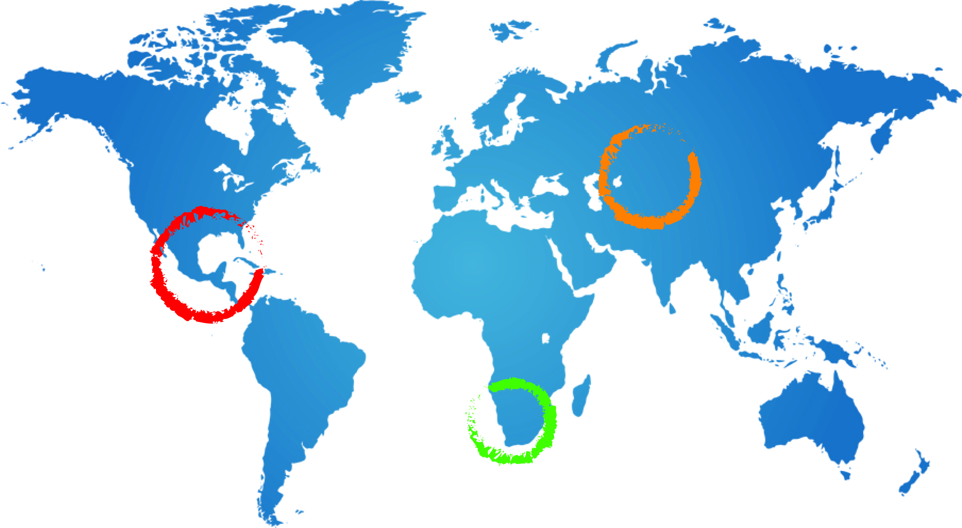
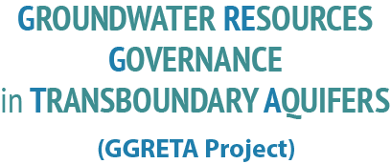
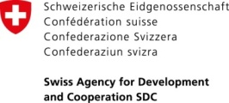
MODELS FOR A MCCM FOR THE
Stampriet Aquifer System (STAS)
Stefano Burchi, UNESCO
15 December 2015
UNESCO HQ, Paris

Slide 2
Rationale for a STAS MCCM
Over-arching objective: transitioning from project-driven cooperation to institutionalized cooperation beyond project
Short-term objective: continue joint study & characterization of STAS, and generate flow of data feeding STAS IMS
Long-term objective: move from data collection & exchange to joint strategizing/advising STAS countries on management of STAS resources
Value-added –
STAS vision/perspective
consistency of direction & purpose of domestic actions
joint control of data & information feeding IMS
2

Slide 3
MODEL 1 – Coordinating STAS Committee
3

Slide 4
RESEARCH
INSTITUTIONS
(?)
GMI
SADC
SECRETARIAT
STEERING COMMITTEE
ORASECOM
FOCAL POINT
BOTSWANA
(DWA)
FOCAL POINT
NAMIBIA
(DWAF)
FOCAL POINT
SOUTH AFRICA
(DWS)
RESEARCH
INSTITUTIONS
(?)
RESEARCH
INSTITUTIONS
(WRC)
4

Slide 5
Core tasks
Data collection & exchange
Manage data flow feeding STAS IMS
Attract donor funding
Advise STAS countries on application of available/relevant SADC guidelines to the specifics of STAS
Liaise with SADC and ORASECOM
5

Slide 6
Legal arrangements & Funding
MOU signed by concerned Water Ministers should suffice
Art.1.4 of ORASECOM Agreement may be an issue (“subordination” of CC to ORASECOM)
Each STAS country would, on a rotation basis, bear the cost of –
hosting the regular meetings of Coordinating Committee, and
providing administrative support for duration of host duties
6

Slide 7
Advantages
Expeditiousness of implementation
Leanness of institutional architecture (no secretariat facility is required)
Economies of scale (CC will rely on support facilities provided by host Government department, on a rotation basis)
Strong ownership by STAS countries
High visibility
Independence from external support for functioning of CC
7

Slide 8
Dis-advantages
Dependence on priorities and political agendas of Government water administration hosting the Committee
8

Slide 9
MODEL 2 – MCCM nested in ORASECOM
(upgrading Geo-hydrology Sub-committee to Hydrogeology Task Team)
9

Slide 10
FOCAL POINT
BOTSWANA
(DWA)
FOCAL POINT
LESOTHO
(DWA)
FOCAL POINT
NAMIBIA
(DWAF)
FOCAL POINT
SOUTH AFRICA
(DWS)
ORASECOM
COUNCIL
TASK TEAMS
ORASECOM
SECRETARIAT
COMMUNICATIONS
FINANCIAL
LEGAL
TECHNICAL
HYDROGEOLOGY (STAS)
(STAS) HYDROGEOLOGY SUBCOMMITTEE
10

Slide 11
Core tasks, Legal arrangements & Funding
Same as in Option 1, but no liaison duties (these will be ensured by ORASECOM as a matter of course)
ORASECOM Council decision required
Each STAS country would bear the cost of its representative on the Task Team
11

Slide 12
Advantages
Expeditiousness of implementation
Leanness of institutional architecture (no secretariat facility is required)
Economies of scale (TT will rely on support facilities available in ORASECOM)
Cost to STAS countries limited to TT meetings
12

Slide 13
Dis-advantages
Subordination to ORASECOM agenda & priorities
Competition with Lesotho’s priorities
Competition for attention & resources from other known trans-boundary aquifers in the Orange-Senqu basin
13

