Slide 1
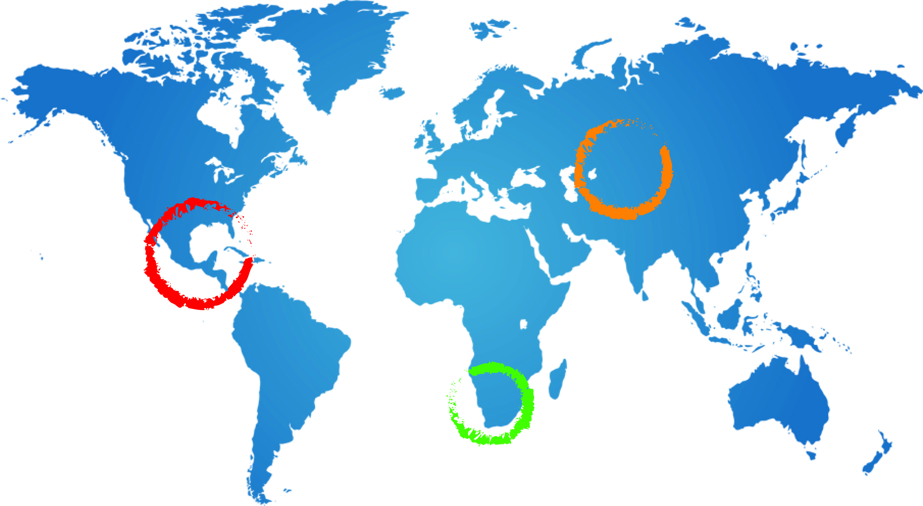
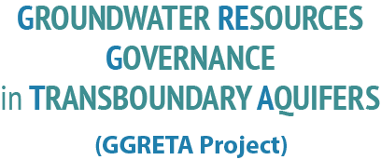
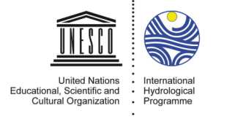
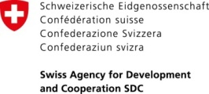
Stampriet Transboundary Aquifer System
2nd assessment stakeholder meeting - Mariental
GGRETA Information Management System
Benefits and Demonstration
Geert-Jan Nijsten – IGRAC
25 November 2015
Mariental

Slide 2
introduction
International Groundwater Resource Assessment Centre
UNESCO – category 2 centre & WMO – centre, with support from the Netherlands Government
Non-profit organisation
Based in the Netherlands at UNESCO-Institute for Water Education
IGRAC facilitates and promotes international sharing of data, information and knowledge required for sustainable development, management and governance of groundwater worldwide.
Focus on:
Information and knowledge management and sharing
Transboundary aquifers – assessment and governance
Groundwater monitoring
Notes:
Intro IMS: Goals → collected and analysed a lot of information resulting in the assessment report, but also been creating a lot of additional information like thematic maps, overview tables, graphics (cross-sections). The IMS has been designed to give easy access to this information. Maps can be uploaded to a publically accessible viewer which anyone with an internet connection can use. In addition to the public viewer there also is a pass word protected environment where registered users can view maps which are not publically accessible. This can be used to share drafts, but also for sensitive maps which still need to be shared between the countries, people involved

Slide 3
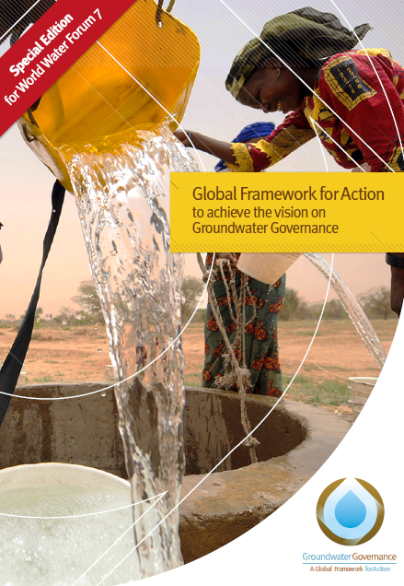
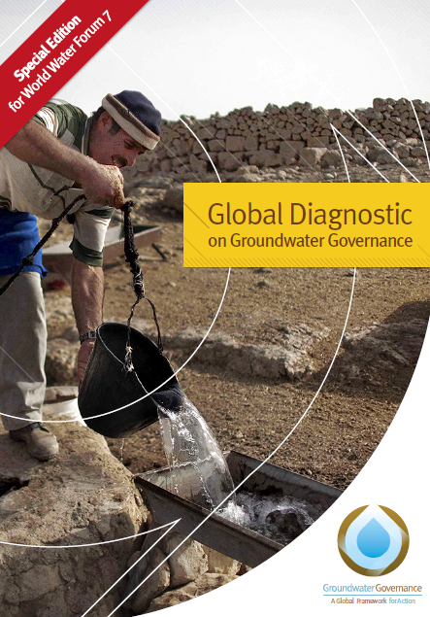
Role of information in Governance
GEF Groundwater Governance Programme
www.groundwatergovernance.org

Slide 4
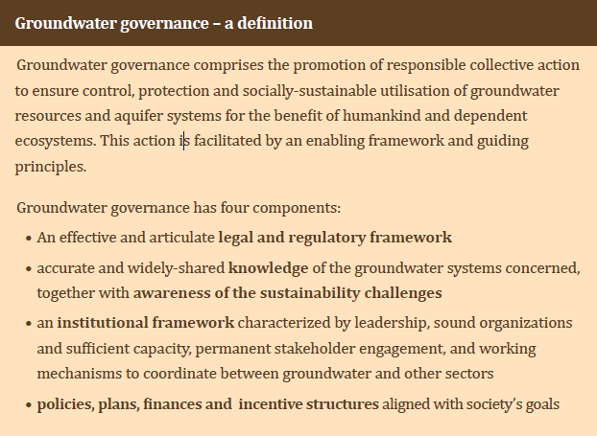
Role of information in Governance
Notes:
Intro IMS: Goals → collected and analysed a lot of information resulting in the assessment report, but also been creating a lot of additional information like thematic maps, overview tables, graphics (cross-sections). The IMS has been designed to give easy access to this information. Maps can be uploaded to a publically accessible viewer which anyone with an internet connection can use. In addition to the public viewer there also is a pass word protected environment where registered users can view maps which are not publically accessible. This can be used to share drafts, but also for sensitive maps which still need to be shared between the countries, people involved

Slide 5
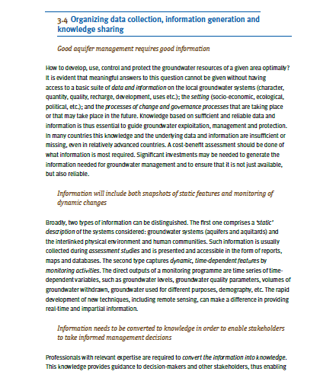

Slide 6
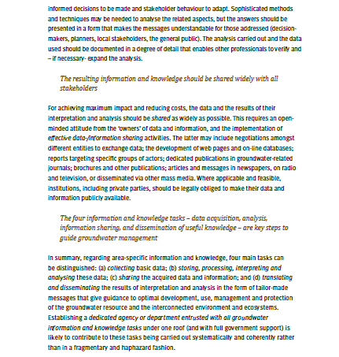

Slide 7
Role of information in TRANSBOUNDARY Governance
In a transboundary setting data sharing between nations is a prerequisite for cooperation and joint governance
United Nations Draft articles on the Law of Transboundary Aquifers
Article 8 - Regular exchange of data and information
… aquifer States shall, on a regular basis, exchange readily available data and information on the condition of their transboundary aquifers…..
….aquifer States concerned shall employ their best efforts to collect and generate more complete data and information ….. They shall take such action individually or jointly and, where appropriate, together with or through international organizations.
…
Aquifer States shall, where appropriate, employ their best efforts to collect and process data and information in a manner that facilitates their utilization by the other aquifer States to which such data and information are communicated.

Slide 8
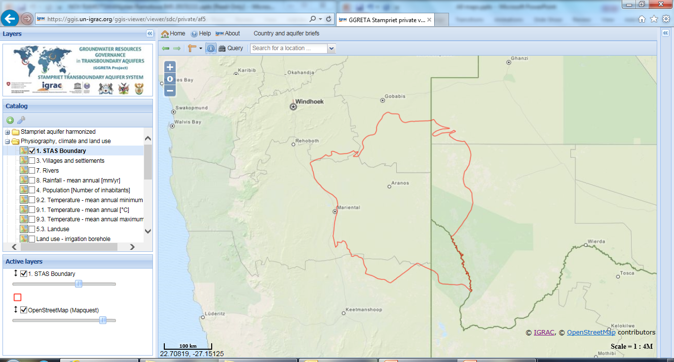
GGRETA – STAMPRIET
Information Management System

Slide 9
GGRETA Information Management System
Objectives:
Support tool for Governance of Transboundary aquifers, with access for all stakeholders
System for storing, sharing and analysing of project results
Characteristics
Map based web application
Public & Password protected viewers
Countries control content of system
Notes:
Intro IMS: Goals → collected and analysed a lot of information resulting in the assessment report, but also been creating a lot of additional information like thematic maps, overview tables, graphics (cross-sections). The IMS has been designed to give easy access to this information. Maps can be uploaded to a publically accessible viewer which anyone with an internet connection can use. In addition to the public viewer there also is a pass word protected environment where registered users can view maps which are not publically accessible. This can be used to share drafts, but also for sensitive maps which still need to be shared between the countries, people involved

Slide 10
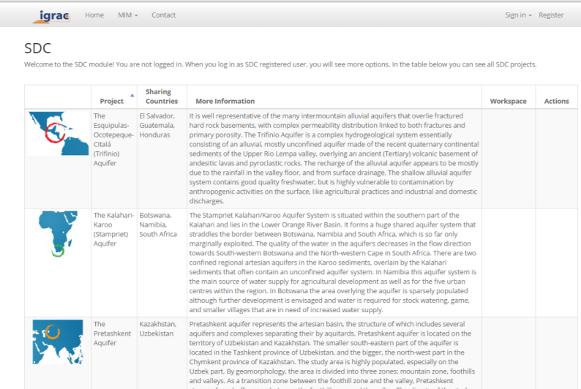
GGRETA: Public Access
Anyone with an internet connection can view and analyse the data in the public viewer
Notes:
System has been developed in the GGRETA project and is used for all three case studies in Central America – Trifinio, Central Asia – Pretashkent and for the Stampriet

Slide 11
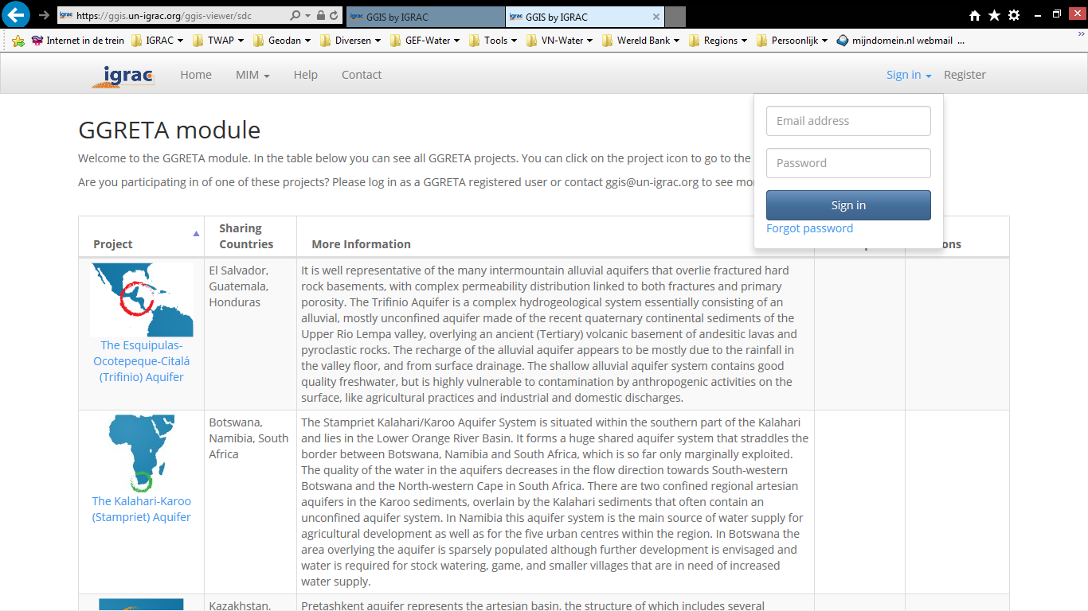
GGRETA Password Protected Workspace
Password protected workspace:
to upload data and
to share draft or sensitive maps between registered users
Notes:
Explain that functionality in public view and private view is the same. For now only maps have been uploaded to the private view.

Slide 12
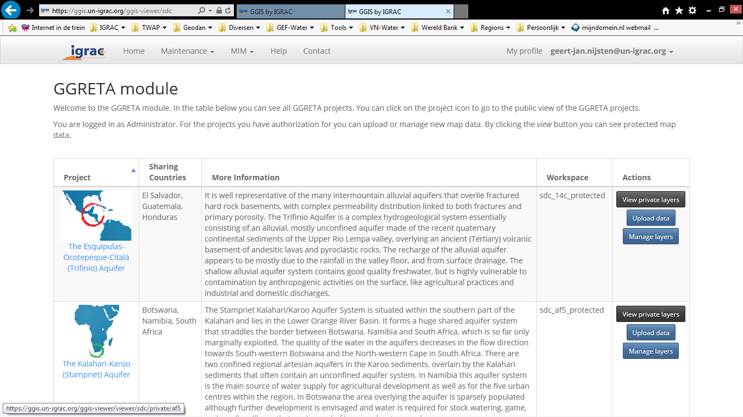
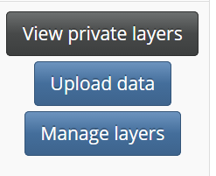
GGRETA Password Protected Workspace
Password protected workspace:
to upload data and
to share draft or sensitive maps between registered users

Slide 13
Folder structure and map view
Presently more than 50 maps
New maps can be added any time (Phase2…)
Folder structure can be modified according to the needs of users

Slide 14
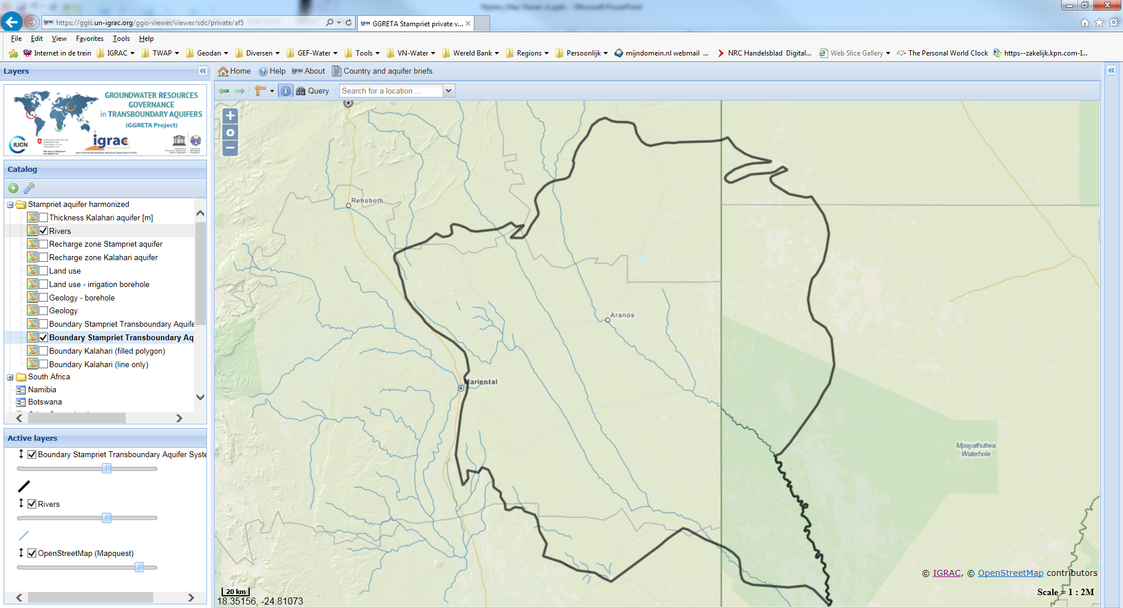
View maps - activate map layer

Slide 15
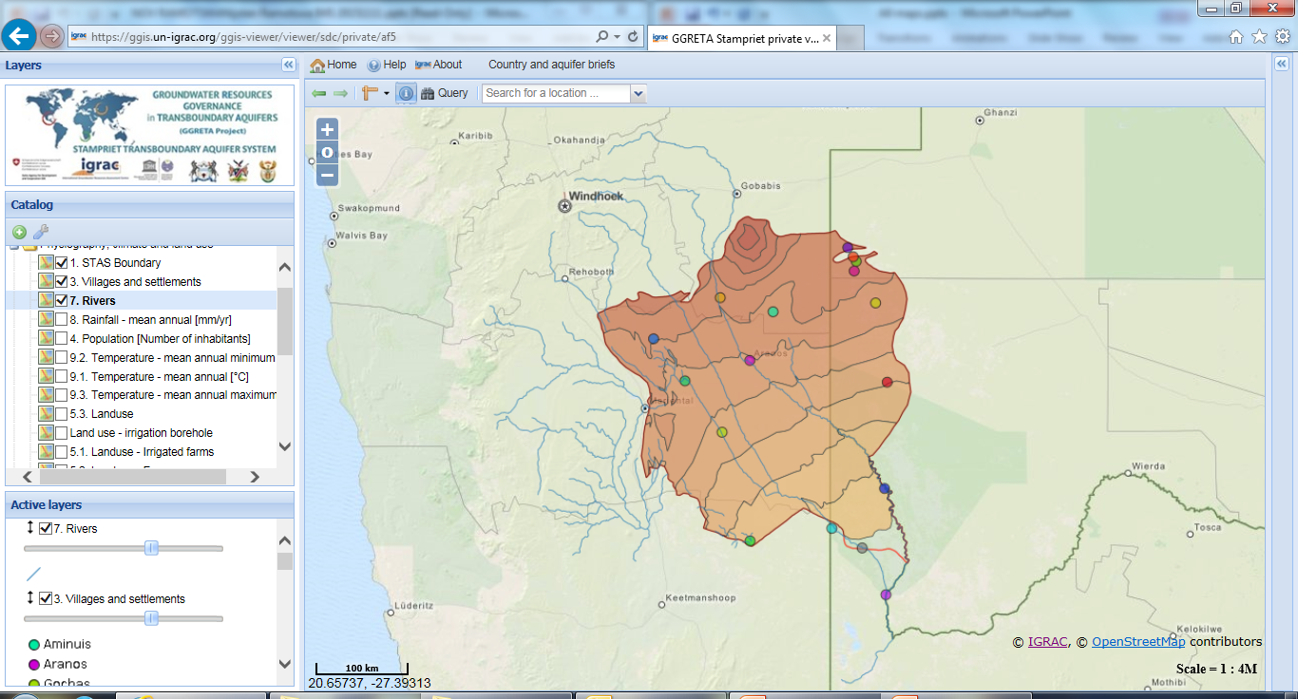
View maps – Elevation and settlements

Slide 16
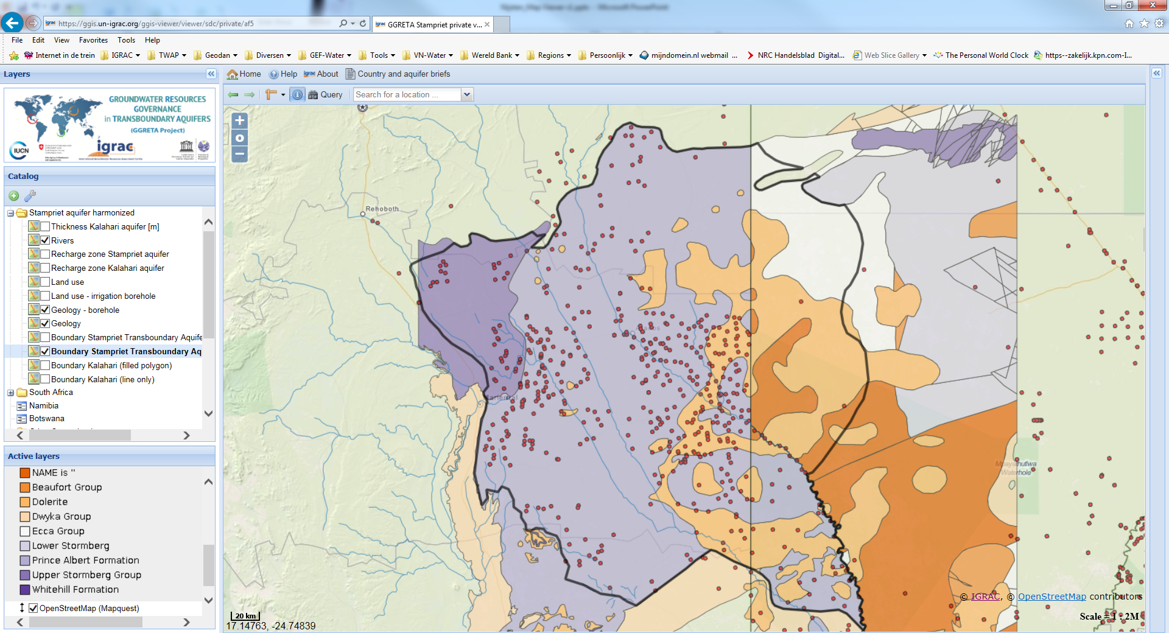
View maps – Geology

Slide 17
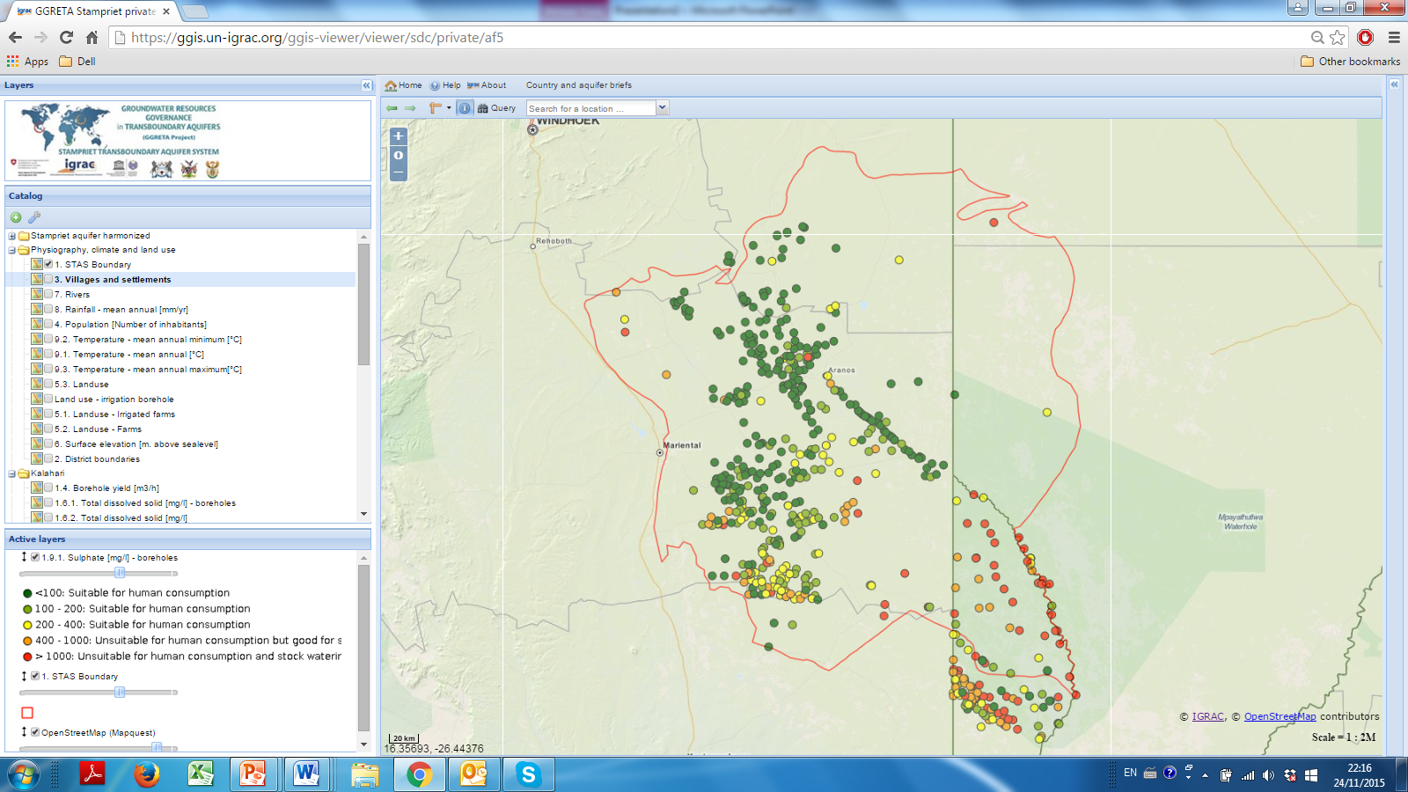
View maps – Sulphate concentration

Slide 18
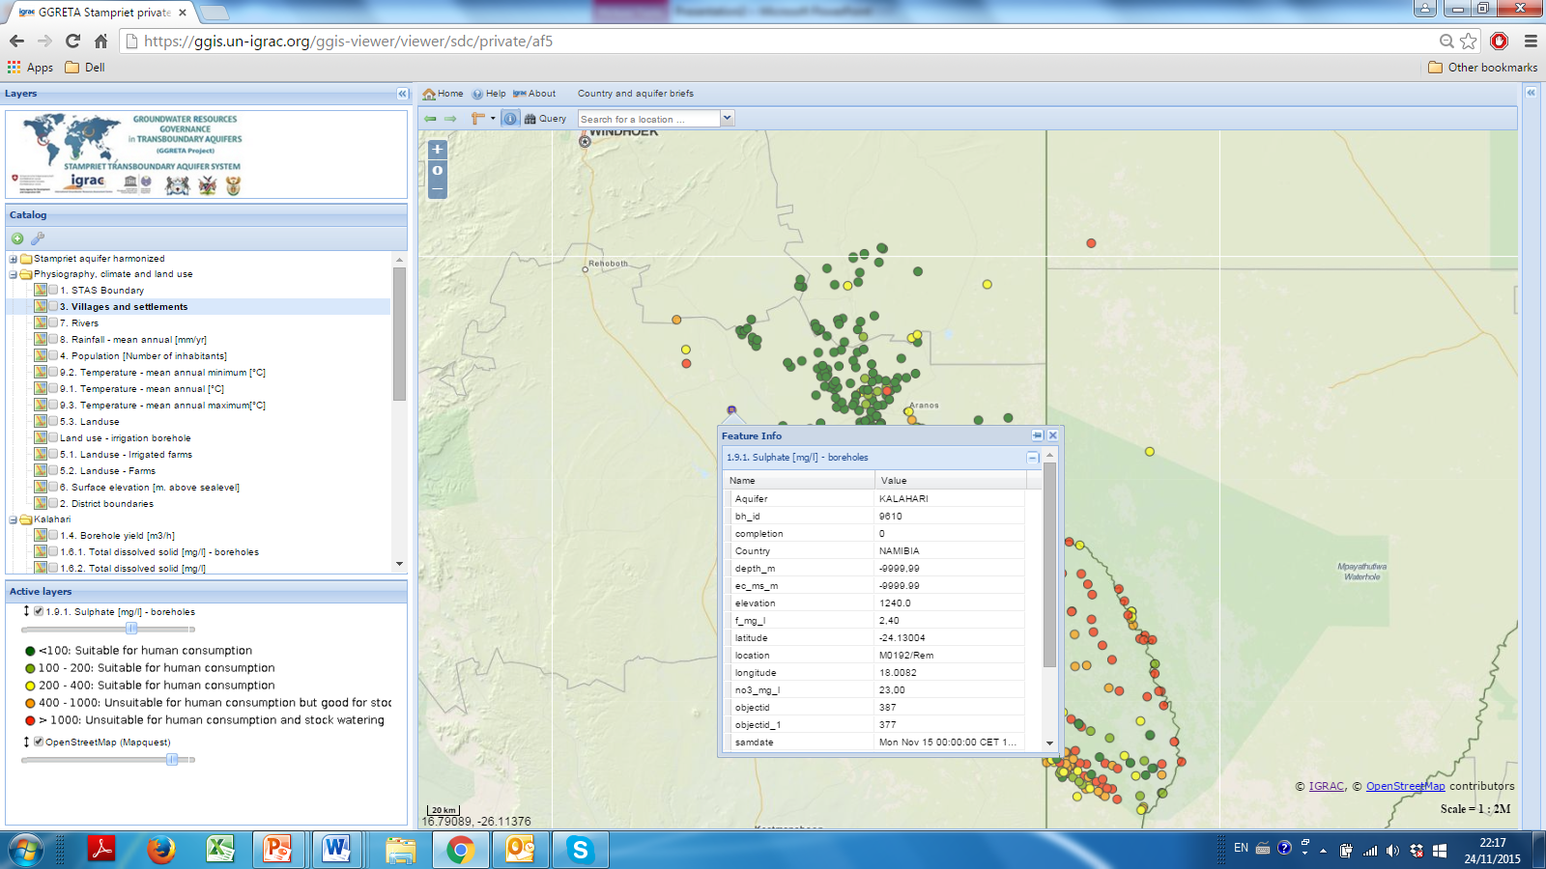
Get information from ‘behind’ the map
Retrieve additional information behind map elements: For example borehole specifics like borehole number, formation, owner, quality, etc.

Slide 19
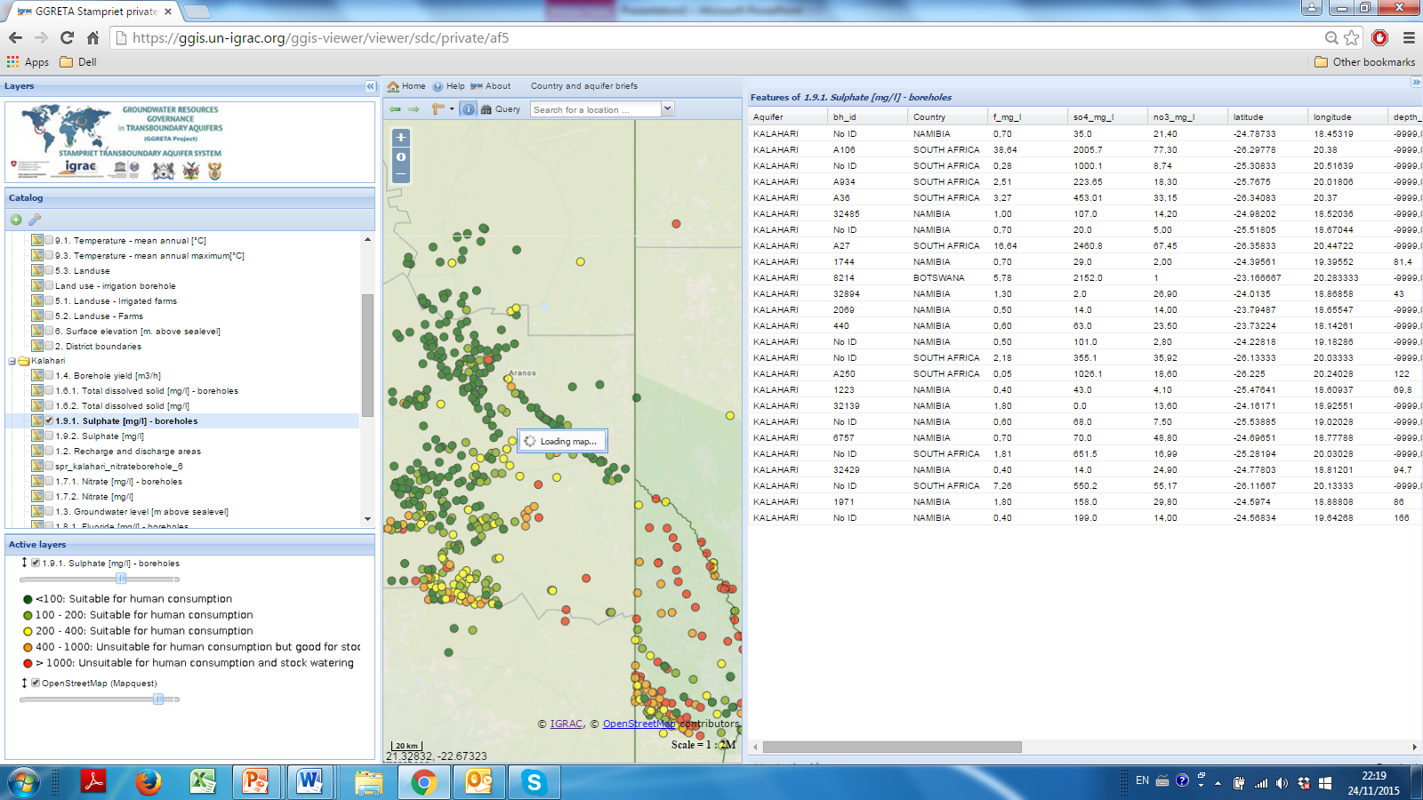
Get information from ‘behind’ the map
Download table with data for all points in the map: For example borehole specifics like borehole number, formation, owner, etc.

Slide 20
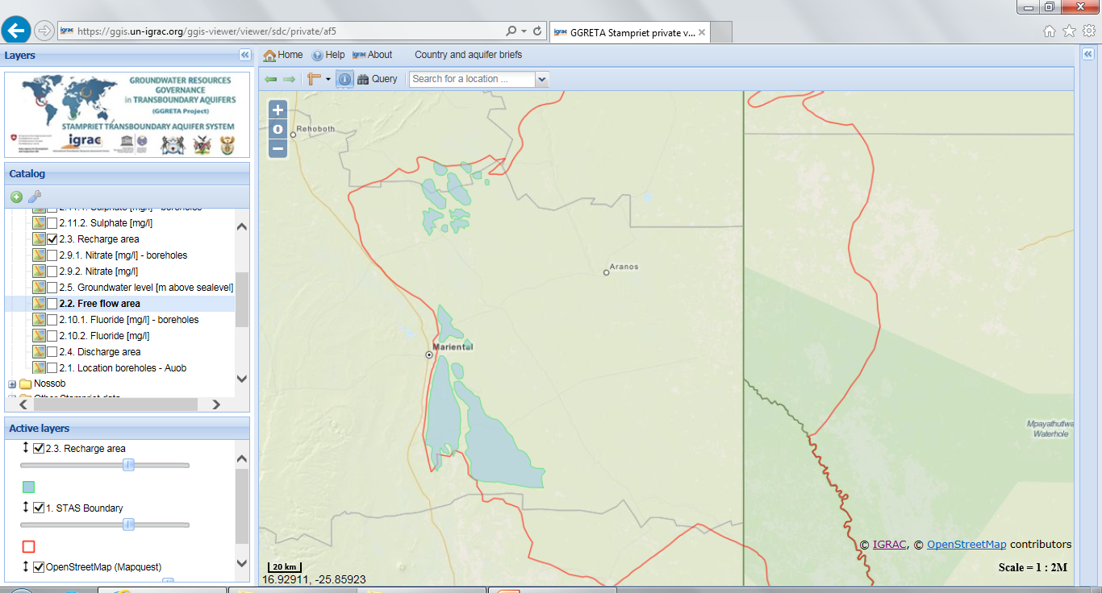
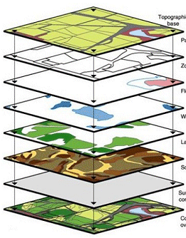
Create your own maps – overlays
Recharge
Create new insights by making
overlays of thematic maps

Slide 21
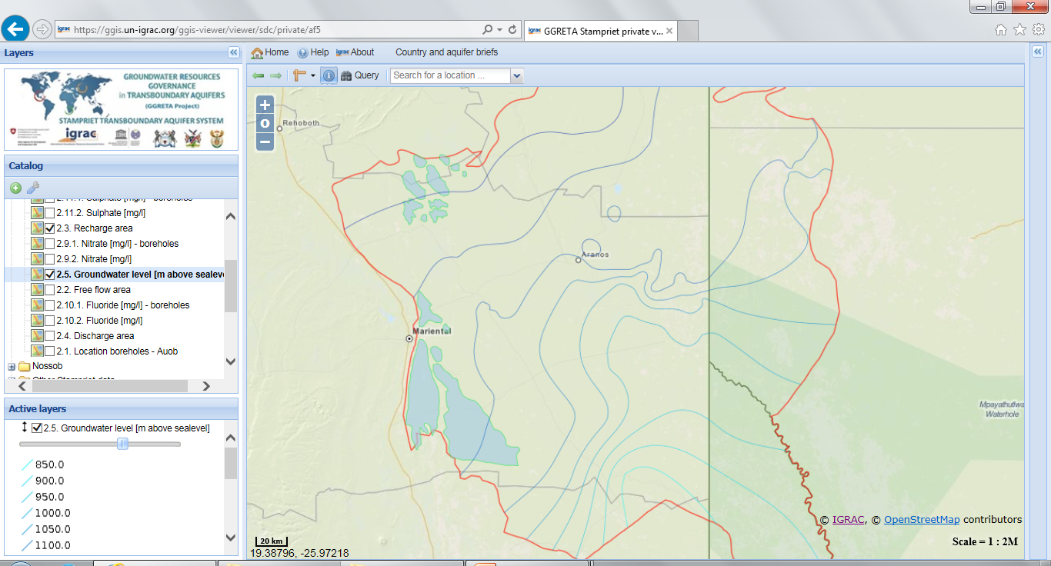
Create your own maps – overlays
Recharge + GWlevels
Create new insights by making
overlays of thematic maps

Slide 22
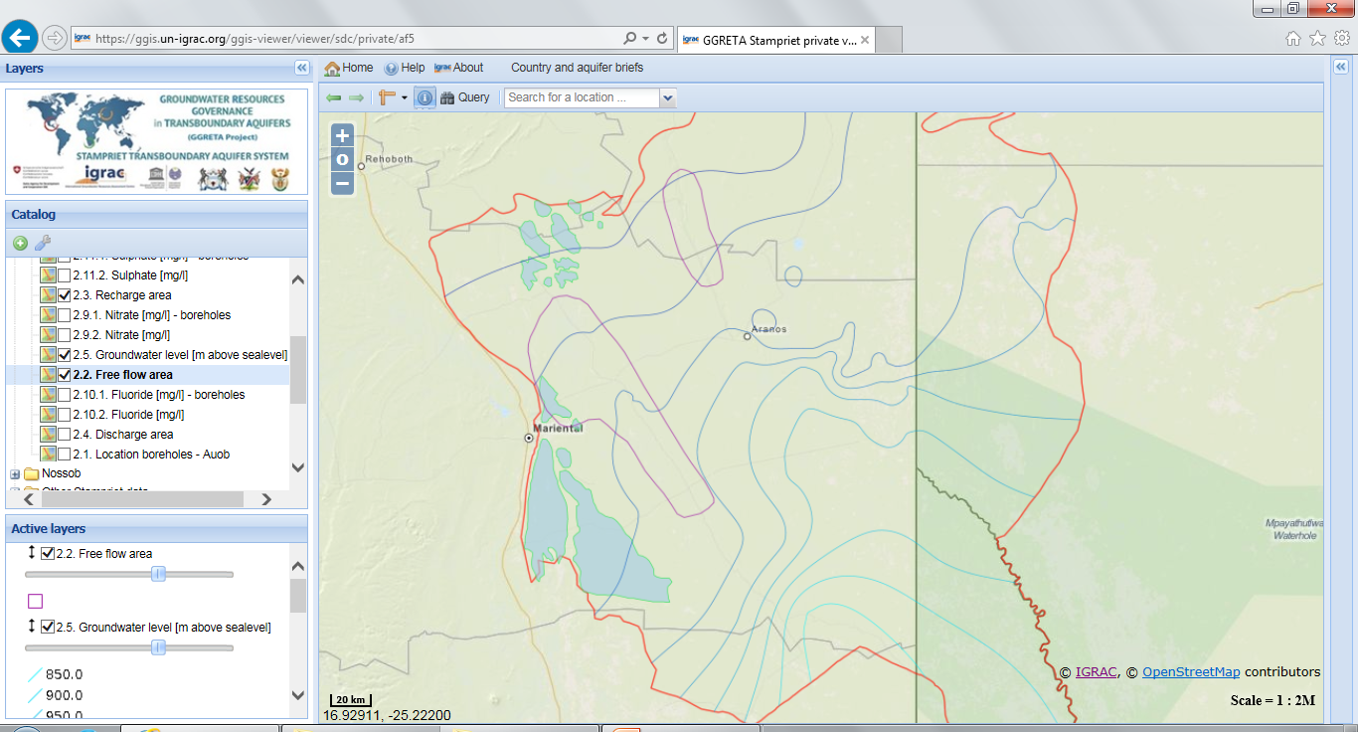
Create your own maps – overlays
Recharge + Gwlevels + Free flow
Create new insights by making
overlays of thematic maps

Slide 23
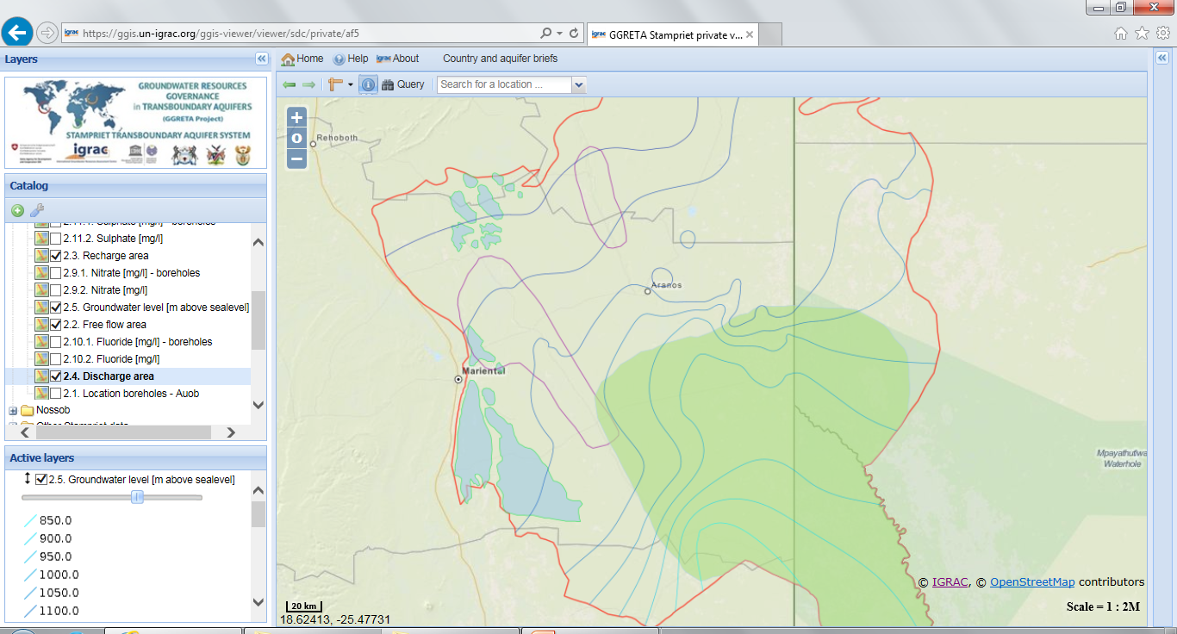
Create your own maps – overlays
Recharge + Gwlevels + Free flow + discharge
Create new insights by making
overlays of thematic maps

Slide 24
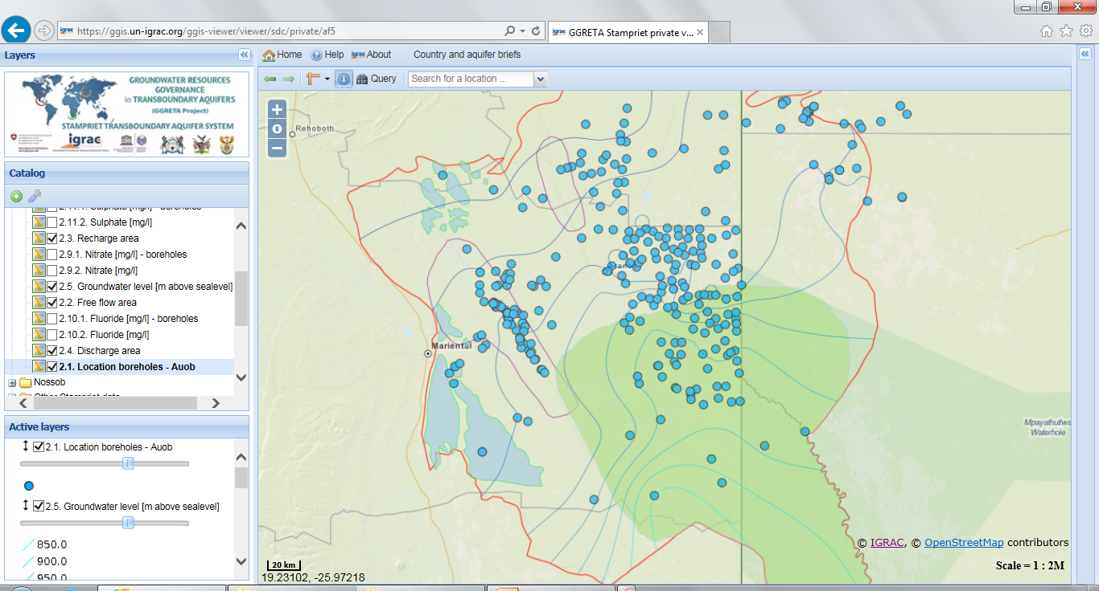
Create your own maps – overlays
Recharge + Gwlevels + Free flow + discharge + boreholes
Create new insights by making
overlays of thematic maps

Slide 25
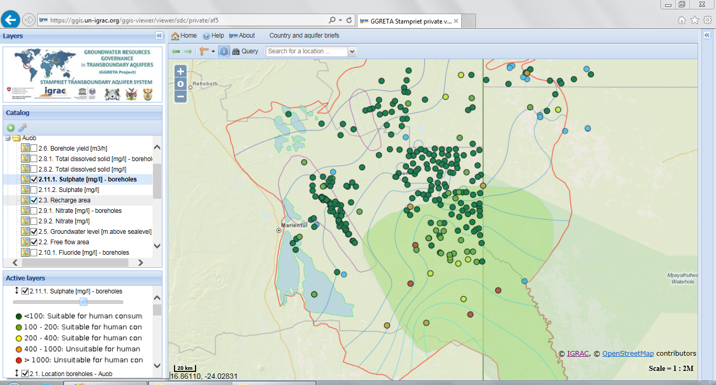
Create your own maps – overlays
Recharge + Gwlevels + Free flow + discharge + boreholes + sulphate
Create new insights by making
overlays of thematic maps

Slide 26
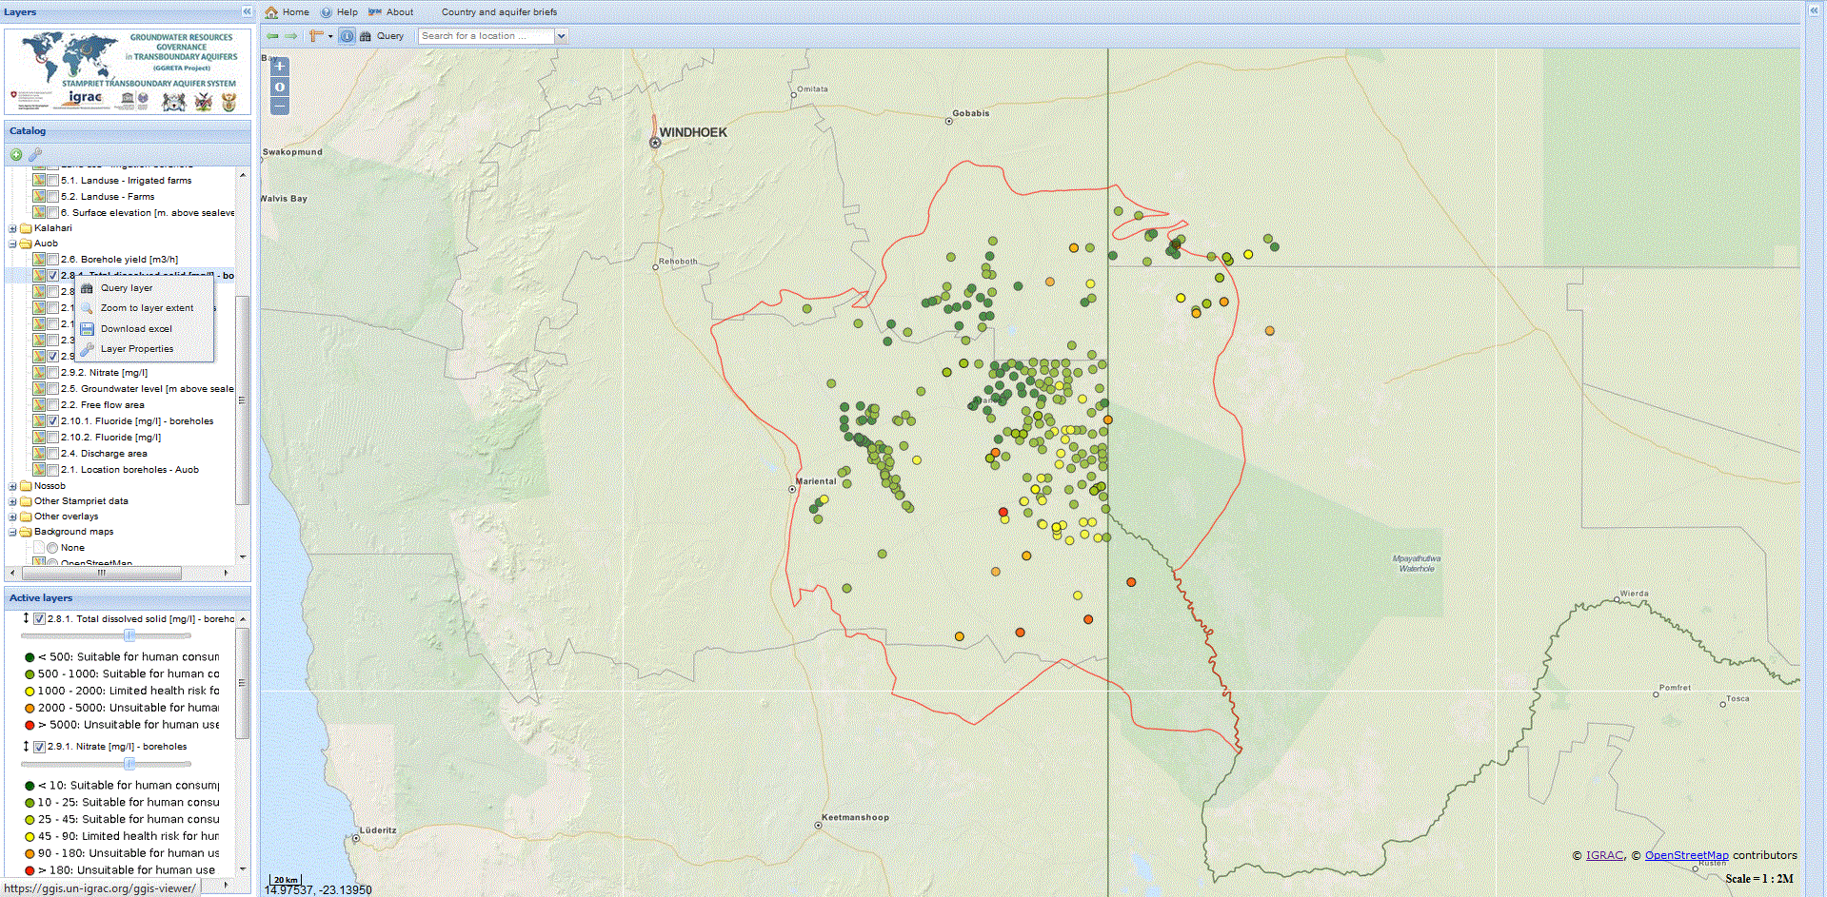
Query maps / filter content of maps
for specific purposes
Analyse (multiple) maps in detail

Slide 27
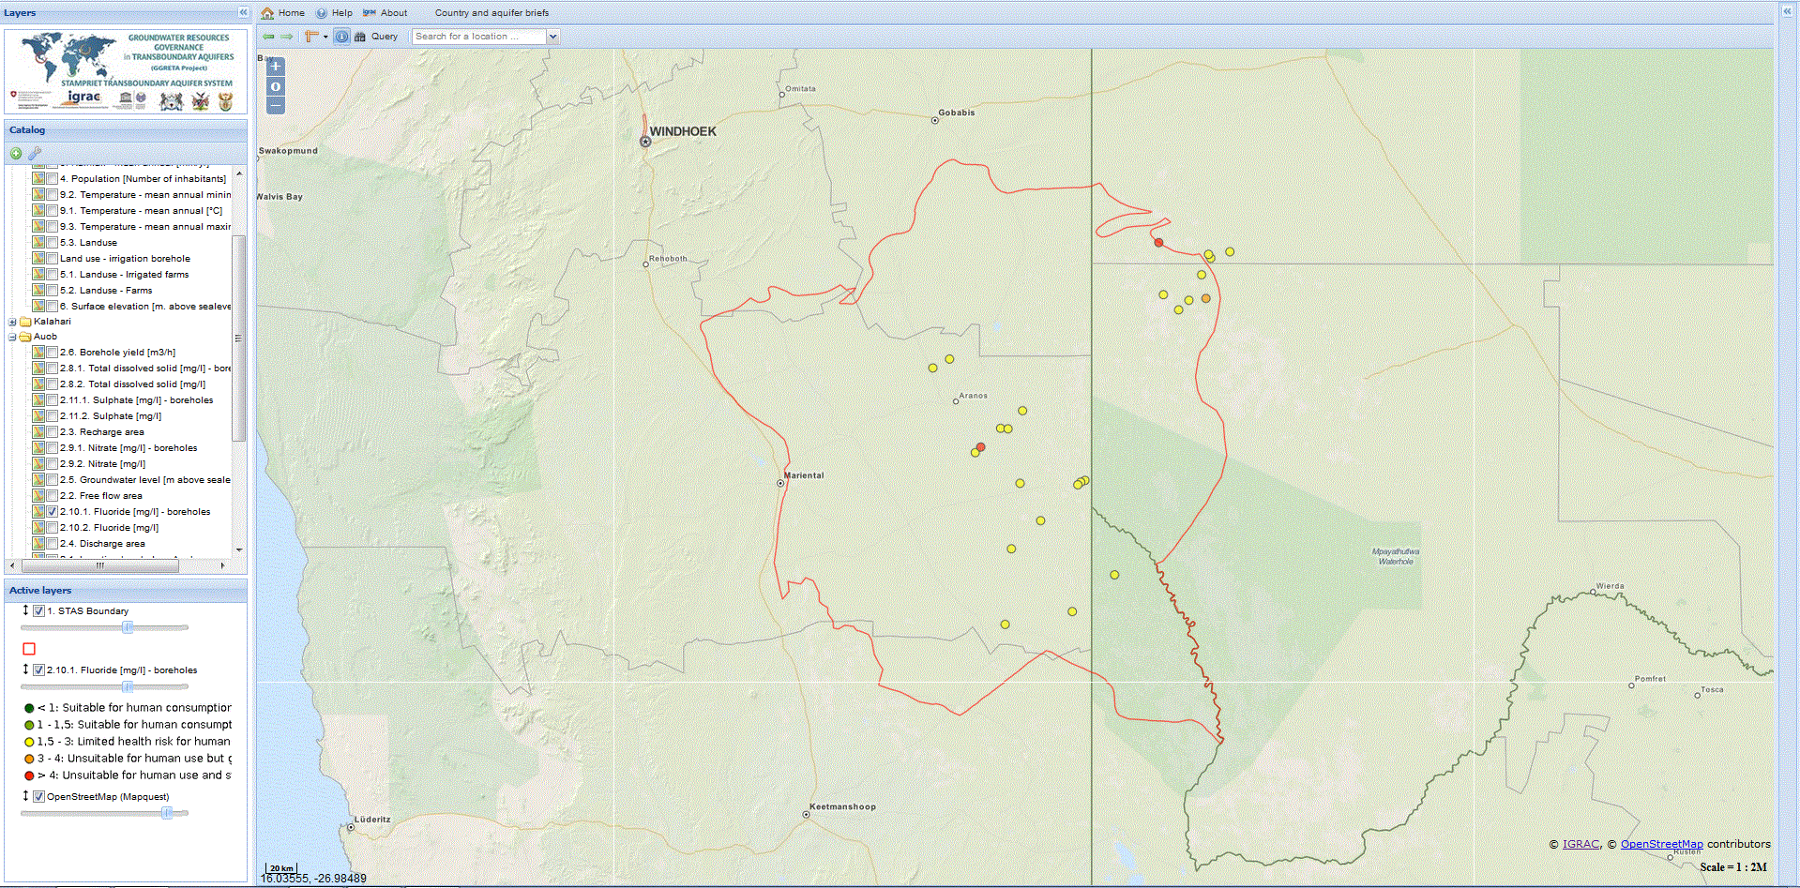
Query maps / filter content of maps
for specific purposes
All boreholes with Fluoride > 1,5 mg/l
Analyse (multiple) maps in detail

Slide 28
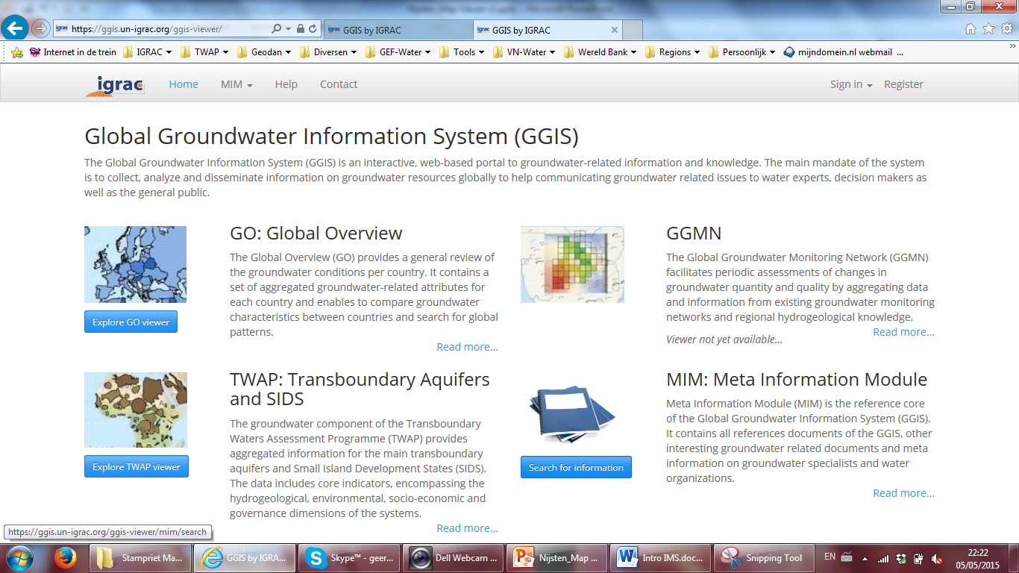
Storing and sharing of additional information

Slide 29
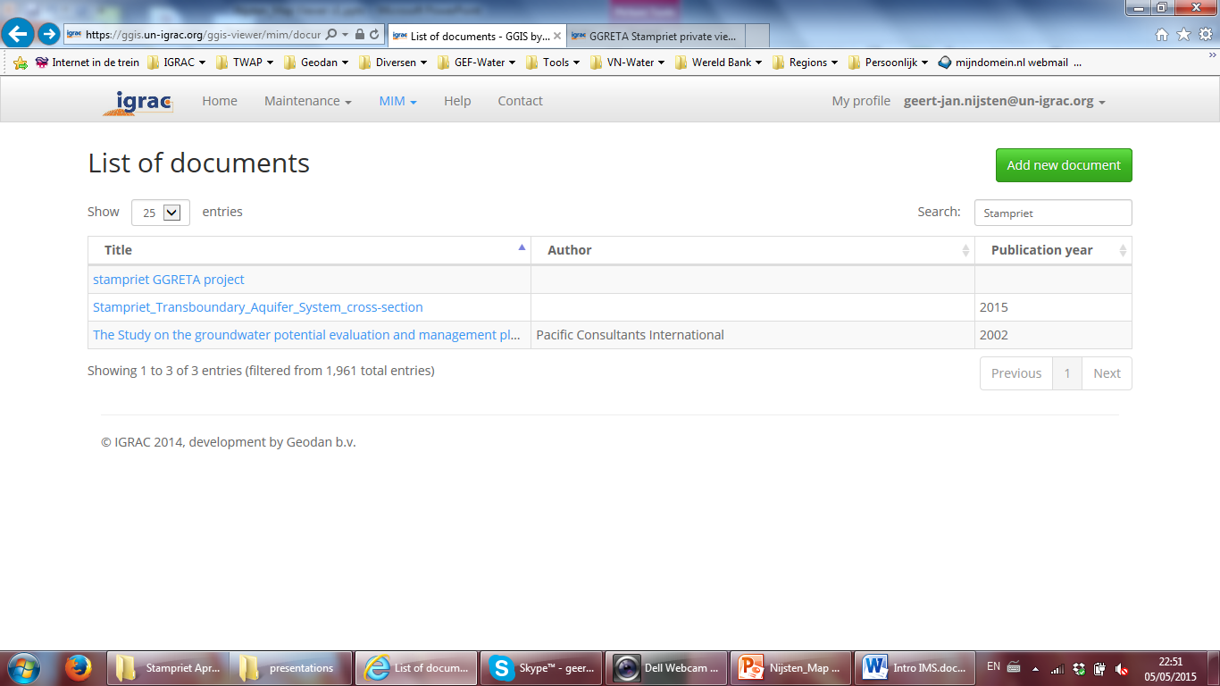
Storing and sharing of additional information

Slide 30
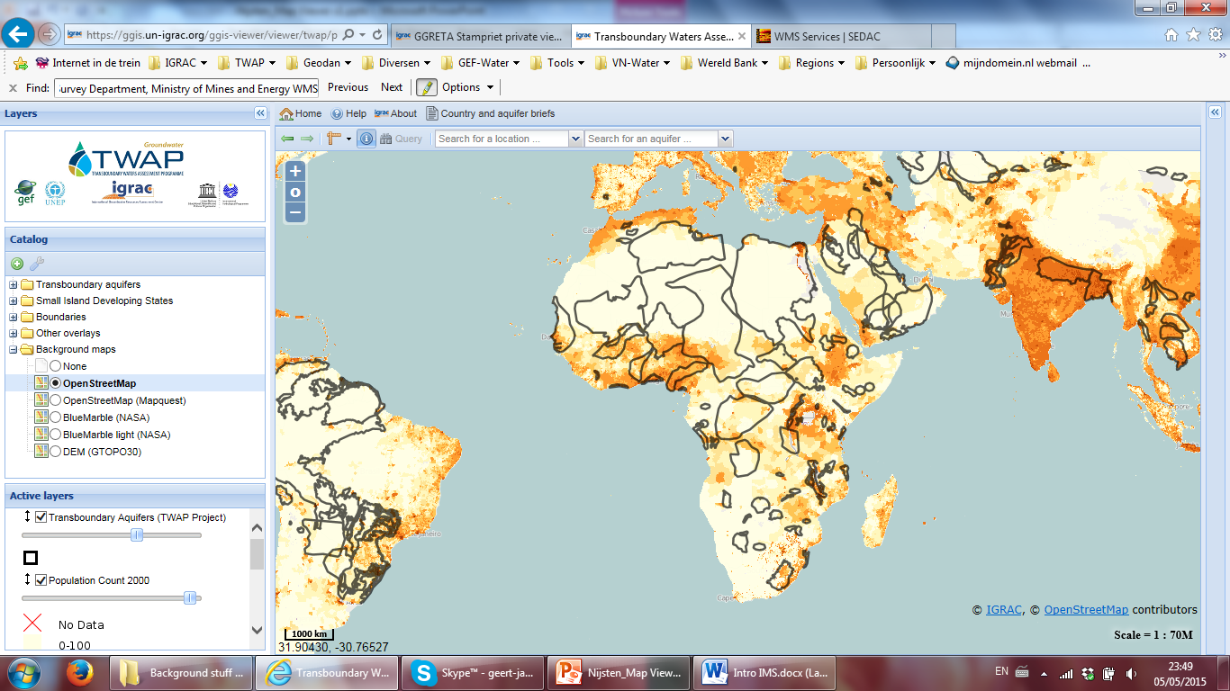
Add external data for analyses
International open standards (WMS/WFS),
enabling viewing of external maps.
For example from NASA database:
http://sedac.ciesin.columbia.edu/geoserver/wms

Slide 31
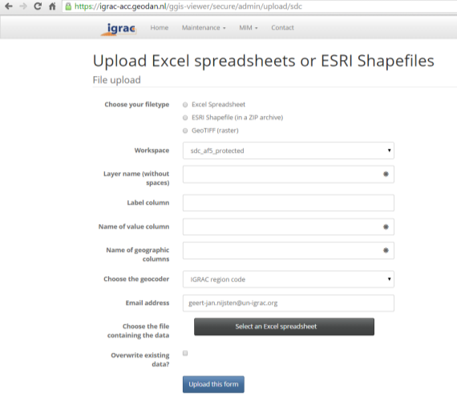
Data Upload – authorised users only
Point data (e.g. borehole locations with information on formation type, water quality): Excel spreadsheet
GIS-maps with points, lines and polygons (e.g: land use map): ESRI Shapefile
Geo-referenced images (e.g: satellite image, elevation data): geo-tiff
Documents: Reports, Images, etc.

Slide 32
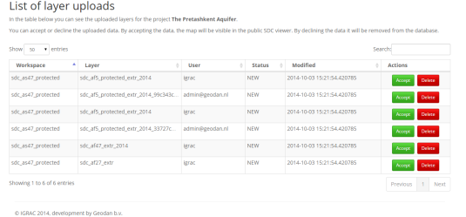
Publishing data – authorised users only copy maps from private to public viewer
Different roles can be defined. Currently:
GGRETA ‘Regional coordinator’ access protected viewer, upload data, manage data
GGRETA ‘National experts’ access protected viewer, upload data for their country

Slide 33
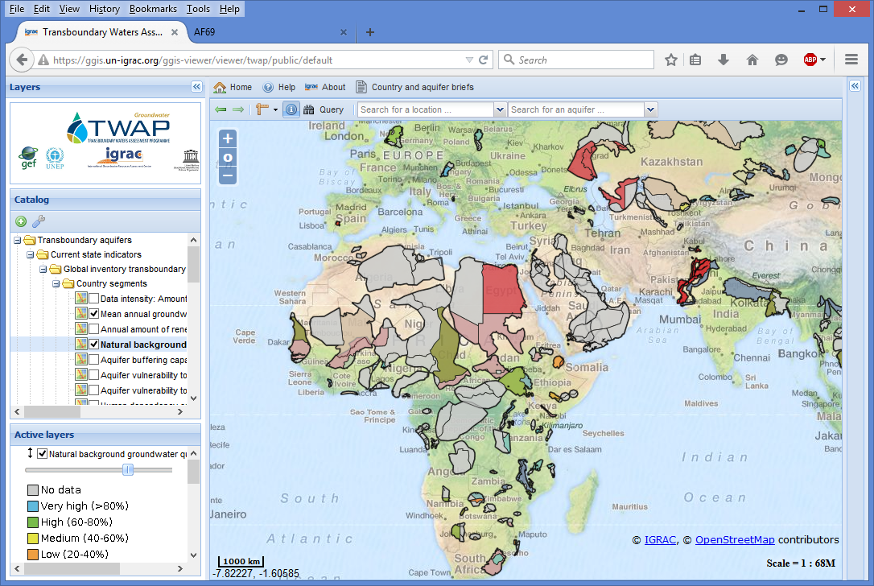
Integration into Global Groundwater Information System
https://ggis.un-igrac.org
GGRETA system is integrated into Global Groundwater Information System
Hosted & Maintained by IGRAC
Benefits:
Lots of groundwater data in one place
IGRAC committed to long term maintenance
Stampriet automatically benefits from future improvements

Slide 34
Thank you

