Slide 1
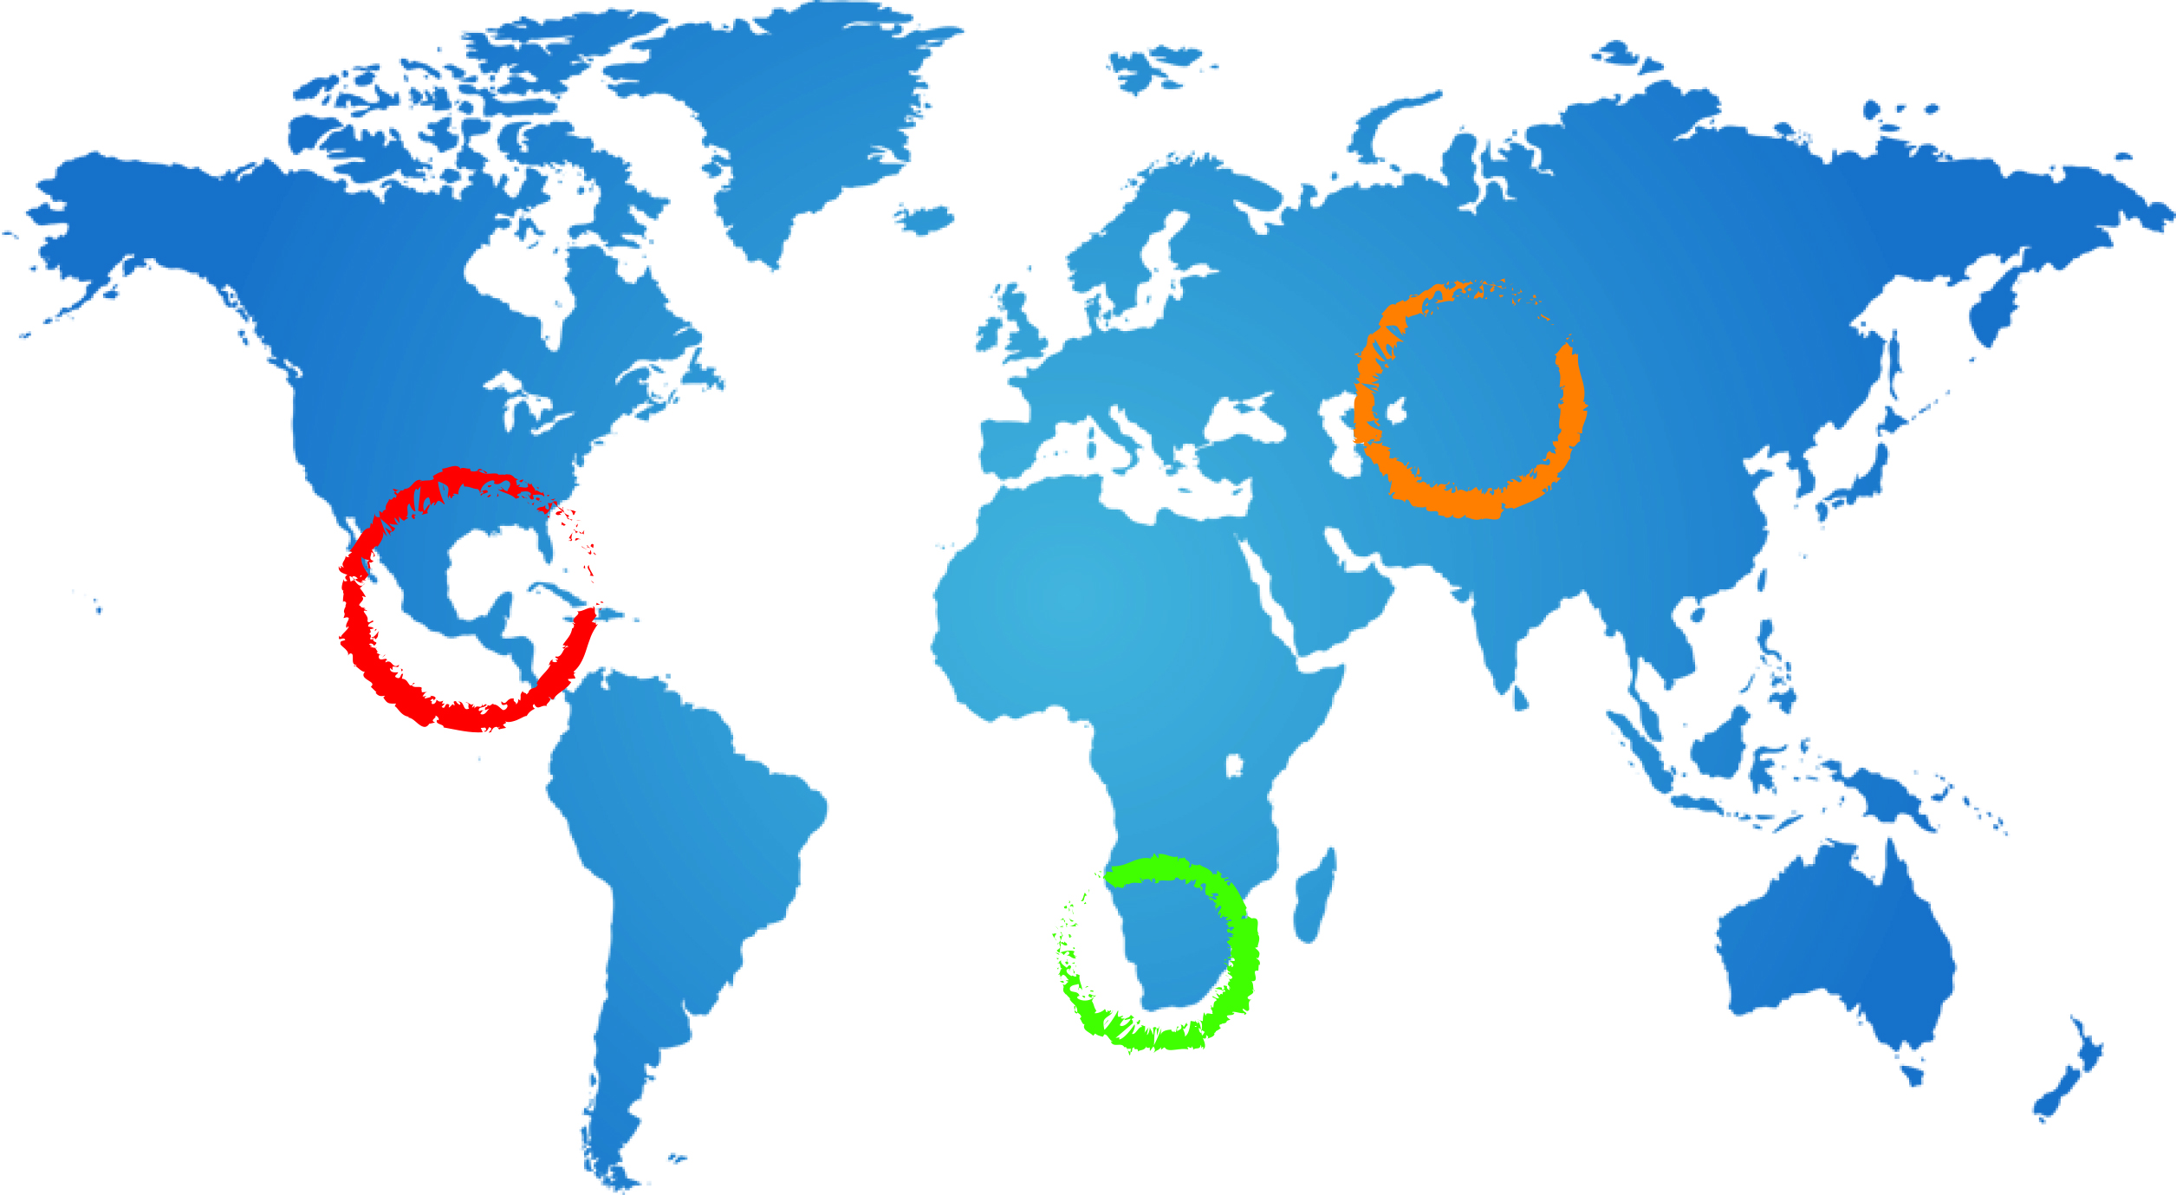
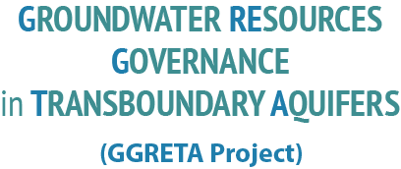
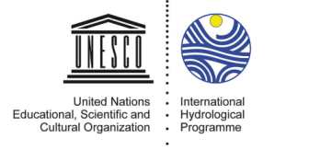
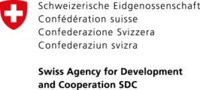




Stampriet Transboundary Aquifer System (STAS) assessment
Introduction
Tales Carvalho Resende
25 November 2015
Mariental, Namibia

Slide 2
Objectives of the meeting
Raise awareness and promote transboundary aquifer management cooperation in Southern Africa,
Share the results of the STAS assessment with a broader audience
Receive feedback of the STAS assessment
Discuss on a plan for further work on the STAS
2

Slide 3
Objectives of the meeting
Day 1:
  Presentation of the STAS assessment results
  Presentation of the Information Management System
  Discussion / Reactions on the results of the STAS assessment
  Game drive ☺
Day 2:
  Consensus-building workshop
  Update and discussion on a plan for further work for Phase 2 of the project
  Field visit (after lunch)
3

Slide 4
The GGRETA Project
4

Slide 5
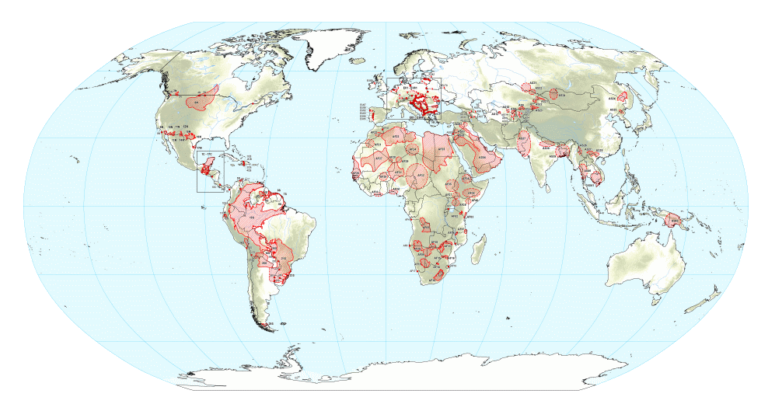
UNESCO’s leading role in transboundary groundwater governance
ISARM TWAP GGRETA (2013-2015)
ISARM:
  International Shared Aquifers Resources Management
  Inventory of Transboundary Aquifers (TBAs)
TWAP:
  TB waters assessment program
  Global assessment 166 TBAs & 43 SIDS
GGRETA:
  Groundwater Governance of
  Resources in Transboundary Aquifers
  In-depth assessment of TBA case studies
  Spatially differentiated info, maps
5

Slide 6
3 case studies
Stampriet Transboundary Aquifer System (STAS) – Botswana, Namibia and South Africa
Pretashkent (Kazakhstan, Uzbekistan)
Trifinio Aquifers Complex (El Salvador, Guatemala, Honduras)
6

Slide 7
Objectives of the project
Detailed assessment of the current conditions of the aquifers, including a diagnostic of transboundary concerns, conducted with the full participation of national experts.
A database and IMS for field data storage and elaboration, established for each aquifer.
Enhanced awareness of International Water Law
7

Slide 8
Objectives of the project
Multi Country
Consultative Body
Sustainable management of TBA
Data collection
(mainly existing)
Data harmonisation
TBA
assessment
Proposal for harmonised monitoring
8

Slide 9
Objectives of the project
Data collected in 3 major aspects:
  Hydrogeology
  Socio-economic and Environmental
  Legal and Institutional
9

Slide 10
Organogram
BOTSWANA
NAMIBIA
SOUTH AFRICA
Mr Obolokile Obakeng
Director of Department
of Water Affairs
Mr Abraham Nehemia
Acting Permanent Secretary
Department
of Water Affairs and Forestry
Ms Deborah Mochotlhi
Deputy Director General
Department of Water & Sanitation
Project Management Unit
(UNESCO/IGRAC)
Government Representatives
Coordination Focal Points (CFP)
Mr Piet Kenabatho
University of Botswana
Ms Aina Ileka
Chief Hydrologist at Department of Water Affairs
Mr Kwazi Majola
Senior Hydrogeologist Department of Water & Sanitation
Prof. Jurgen Kirchner
(Regional Coordinator)
National Technical TBA Group
(NTTG)
Ms Bothepha Mosetlhi
(Socioeconomic and environmental)
Mr Don Muroua and NNF (Socioeconomic and environmental)
Mr Bantu Hanise
(Socioeconomic and environmental)
Mr Gaolatlhe Lentswe
(Hydrogeology)
Ms Lydia Joel (Hydrogeology)
Ms Viviane Kinyaga
(Legal and institutional)
Ms M.H. Lebeloane
(Legal and institutional)
Mr Odirile Itumeleng
(Legal and institutional)
Ms Joyce Leshomo (Hydrogeology)
10

Slide 11
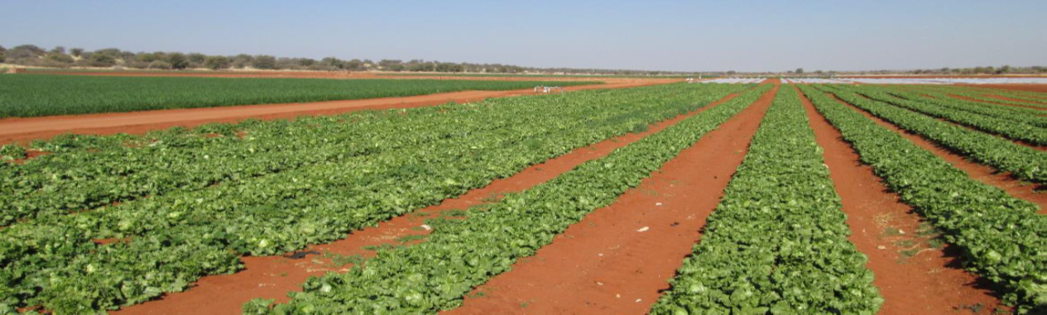
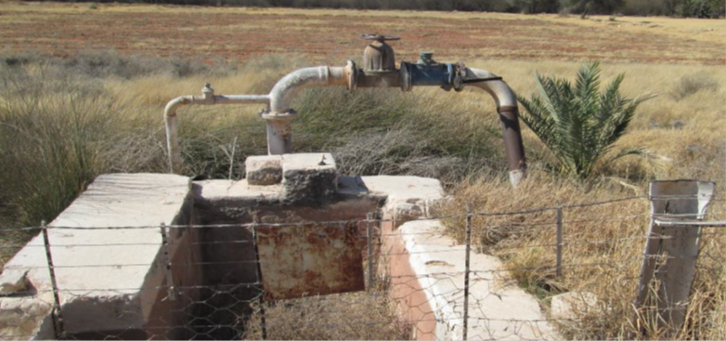
Working program
5 Regional workshops
2 Stakeholder Consultation Meetings
Field visits
11

