Slide 1
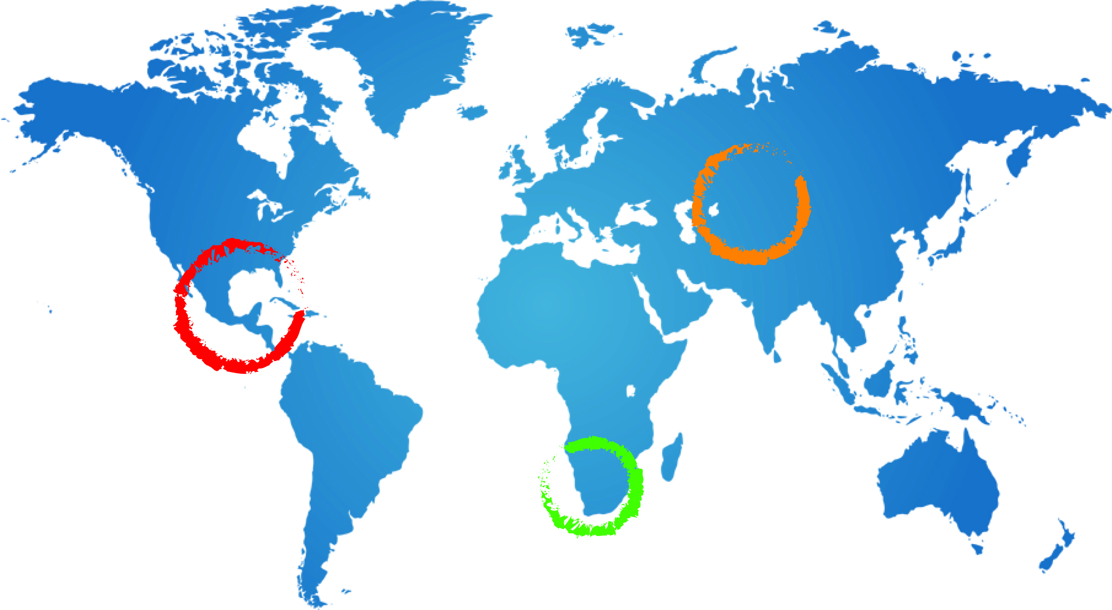
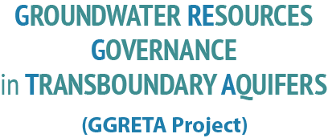
Stampriet Transboundary Aquifer System (STAS) assessment
Final findings
Tales Carvalho Resende
25 November 2015
Mariental, Namibia

Slide 2
Outline
The STAS area
Historical background
Delineation and general features of the STAS area
Climate
2. Overview of the STAS
Groundwater occurrence
Cross sections
Groundwater storage and exploitable volumes
Conceptual model
3. The role of groundwater in the STAS area
Numbers and distribution of boreholes
Groundwater level monitoring
Volumes abstracted
Groundwater use patterns
Water supply and sanitation
Economic activities
Groundwater quality: risks and actual pollution
Current and potential threats
4. Legal and Institutional assessment
Legal and institutional responses
Options of Multi-Country Consultation Mechanism
2

Slide 3
The STAS area
3

Slide 4
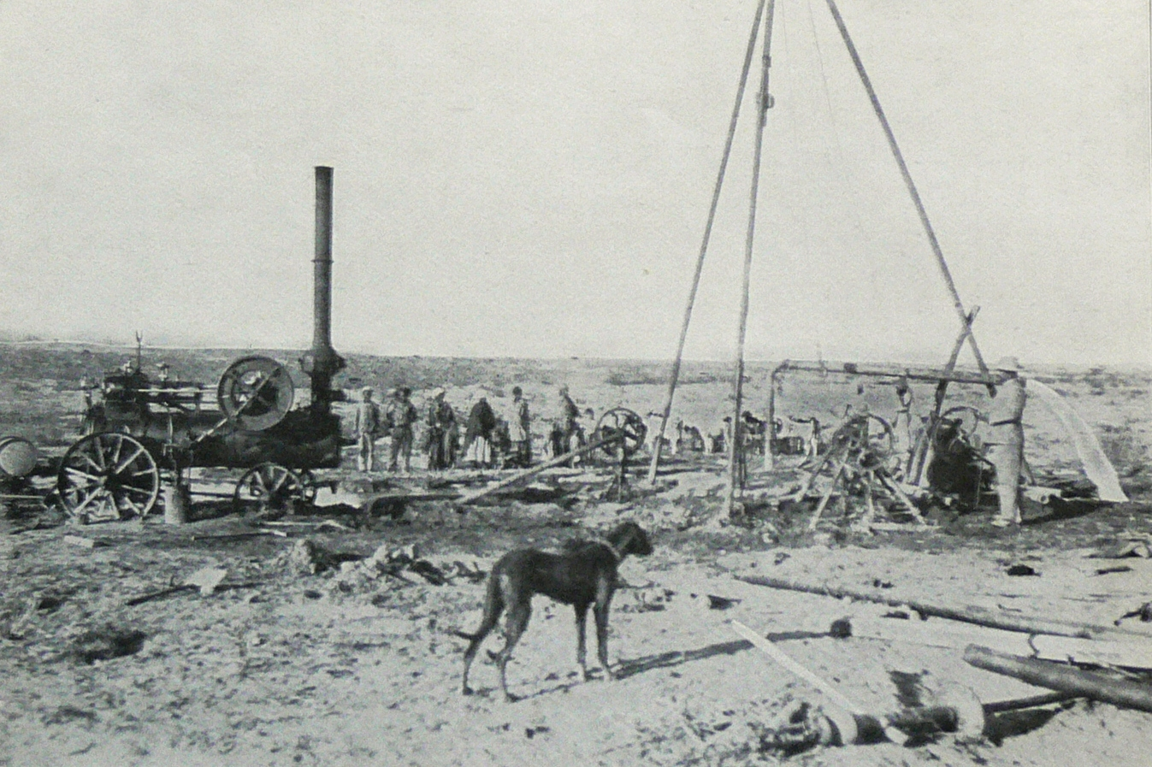
Historical background
1912: In the search for coal, Dr. Paul Range discovered struck artesian water in the Stampriet Artesian Basin (SAB): a borehole at Stamprietfontein (Namibia).
After World War I: farms were developed for South African ex-soldiers along the Auob River.
After World War II: further farms were developed for South African ex-soldiers, this time in the farther east lying Nossob River area.
1960s to 80s: Groundwater investigations and exploration for hydrocarbons
1970s and early 80s: Hydrochemistry investigations
From 1980s onwards: JICA study (2002) in Namibia and Matsheng study (2008) in Botswana
First artesian water was struck in 1912 (110m3/hr free flowing artesian borehole)
4

Slide 5
Delineation and general features of the STAS
The Stampriet Transboundary Aquifer System (STAS) stretches from Central Namibia into Western Botswana and South Africa’s Northern Cape Province, and lies within the Orange River Basin.
The STAS covers a total area of 86 647km², of which 73% of the area is in Namibia, 19% in Botswana, and 8% in South Africa.
The STAS was delineated based on the occurrence of geological formations belonging to the so-called Ecca Group within the Auob and Nossob river basins.
2 ephemeral rivers (Auob and Nossob) that never reach the Orange river
5

Slide 6
Delineation and general features of the STAS
Administration:
8 constituencies in Namibia (Kalahari, Aminuis, Mariental Rural, Gibeon, Rehoboth Rural, Keetmanshoop Rural, Berseba, and Windhoek Rural)
2 districts in Botswana (Kgalagadi and Ghanzi)
Kgalagadi Transfrontier Park (Botswana and South Africa)
Mariental Rural and Aminuis constituencies in Namibia cover at least 80% of the study area, and concentrate the largest population.
6

Slide 7
Delineation and general features of the STAS
7

Slide 8
Delineation and general features of the STAS
STAS is a large farming area with approximately 1200 farms (mostly in Namibia).
Small number of commercial farms (110) undertaking a system of mixed livestock (mainly sheep, but also cattle and other animals) and irrigated crop production.
Crops are dominated by fodder (lucerne), although some farmers have started switching to horticulture (e.g. melons, tomatoes, beans).
300 emerging commercial farmers (170 resettlements farms and 130 Affirmative Action Loan Scheme Farmers).
In Botswana there is a combination of pastoral, arable or residential land uses.
Tourism: Kgalagadi Transfrontier Park
8

Slide 9
Delineation and general features of the STAS
9

Slide 10
Delineation and general features of the STAS
The study area is lightly populated and its population is estimated at approximately 45 000
Namibia has the largest share of population with 91%, followed by Botswana at 8% and South Africa at 1%.
Early 1990s: 30 000 / Early 2000s: 38 000
Major settlements: Aranos, Koes and Stampriet in Namibia, Ncojane and Kule in Botswana, while Mier in the Kgalagadi Transfrontier Park is the sole settlement in South Africa
In Namibia, approximately 33% of the STAS area population lives in settlements, while 67% lives in the farming rural area.
In Botswana, the STAS area is inhabited by minority or small communities referred to as the Remote Area Dwellers (RADs) and their localities as RADs settlements.
In South African STAS area, population lives entirely in rural settlements
10

Slide 11
Delineation and general features of the STAS
11

Slide 12
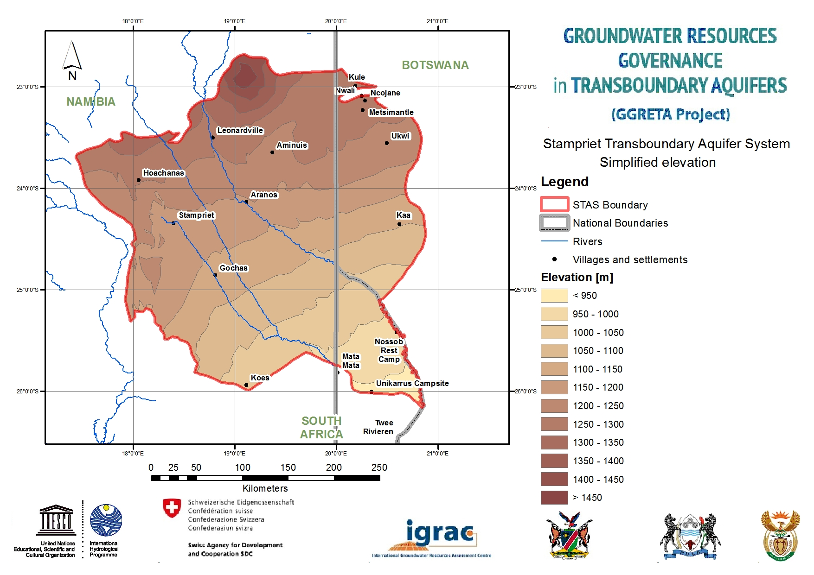
Delineation and general features of the STAS
The STAS is relatively flat with an elevation of 1400m-900m above mean sea level from the northwest to the southeast
12

Slide 13
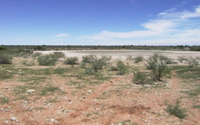
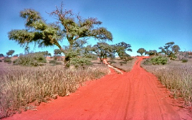
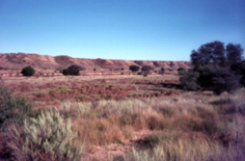
Delineation and general features of the STAS
The STAS is characterized by various landscapes, including sand dunes in Namibia and South Africa, calcrete/sandy surface area with shrubs and in some cases thick bushes. Seasonal pans are also important features found across the STAS.
Common landscapes in the STAS: dune area stretching from the Auob to the Nossob
River (top left), calcrete/sandy surface where pans are quite common (top right),
deep cut in the Auob and Nossob Rivers (bottom center) (Source: J. Kirchner)
13

Slide 14
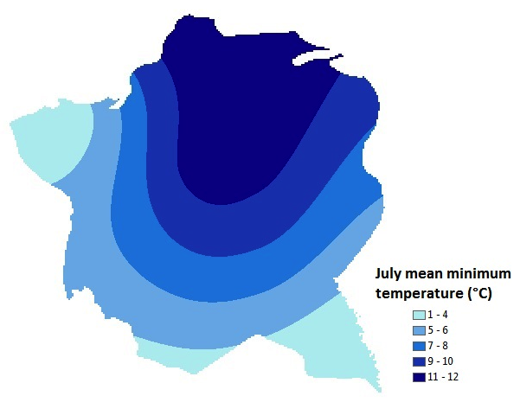
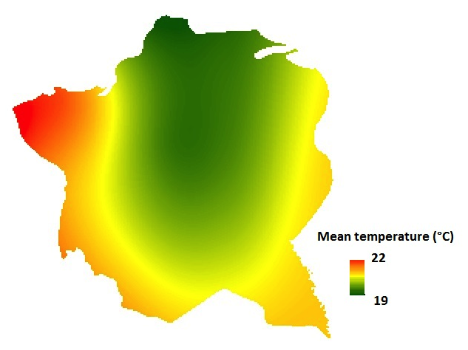
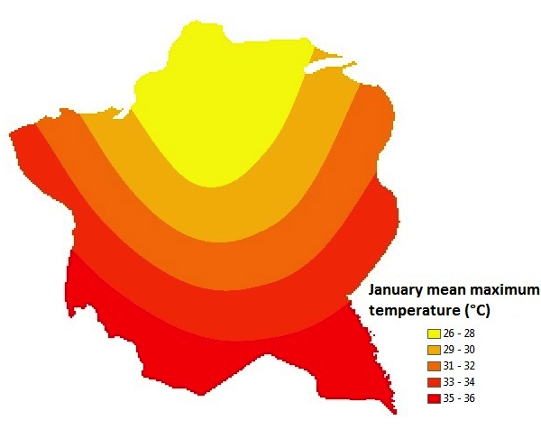
Climate
Temperature:
High temperature time fluctuations owing to the semi-arid conditions
Mean temperature: 19-22°C
July mean minimum temperature: 1-12°C
January mean maximum temperature: 26-36°C
Only 2 temperature stations within the study area (Aranos and Bitterwasser)
14

Slide 15
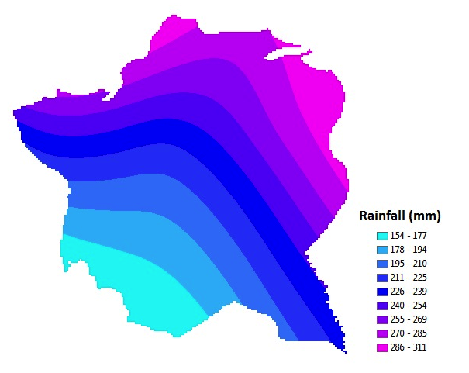
Climate
Rainfall:
The average rainfall for the STAS is 150 - 310 mm/y
Maxima of up to 310 mm/y in the north and northeast Botswana area of the STAS and decreases to about 150 mm/a in the South Africa and south-western Namibia portion of the study area.
From December to April: predominantly in the form of thunderstorms (high intensity and short duration).
Only 2 rainfall stations within the study area (Aranos and Ncojane)
15

Slide 16
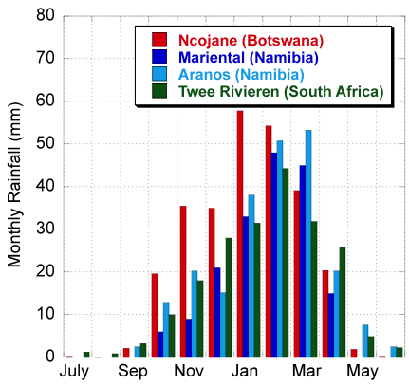
Climate
16

Slide 17
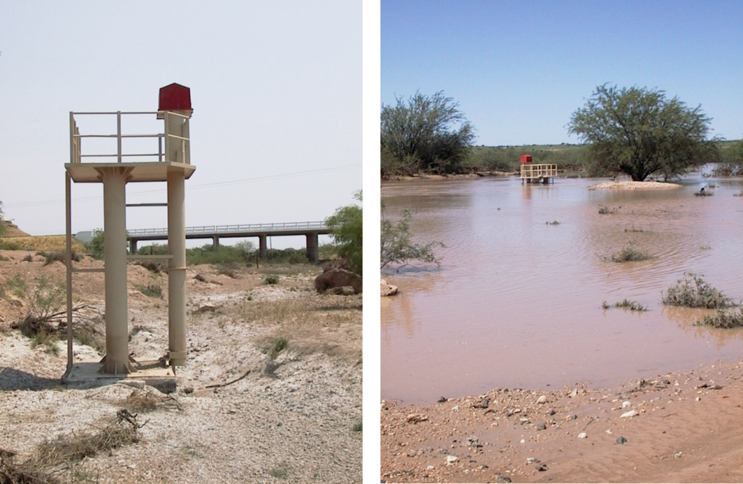
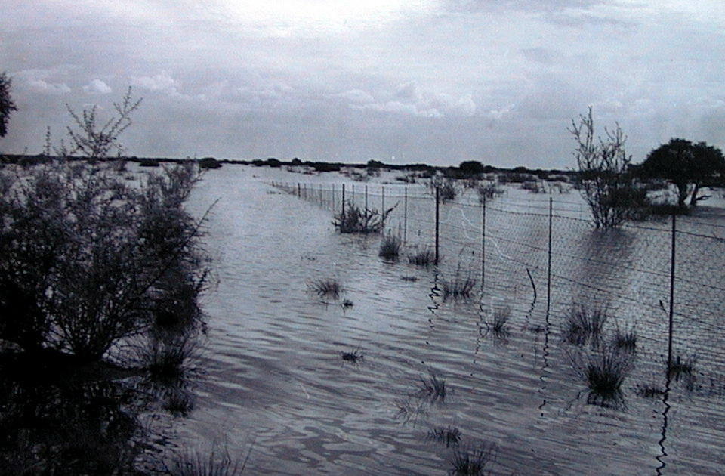
Climate
Mostly dry but can get flooded:
Heavy rainfall events can produce the annual rainfall within a few days, and might result in flooding in some areas. A cloud burst in central Namibia in 1960 produced up to 489 mm in just 24 hours (Schalk, 1961)
17

Slide 18
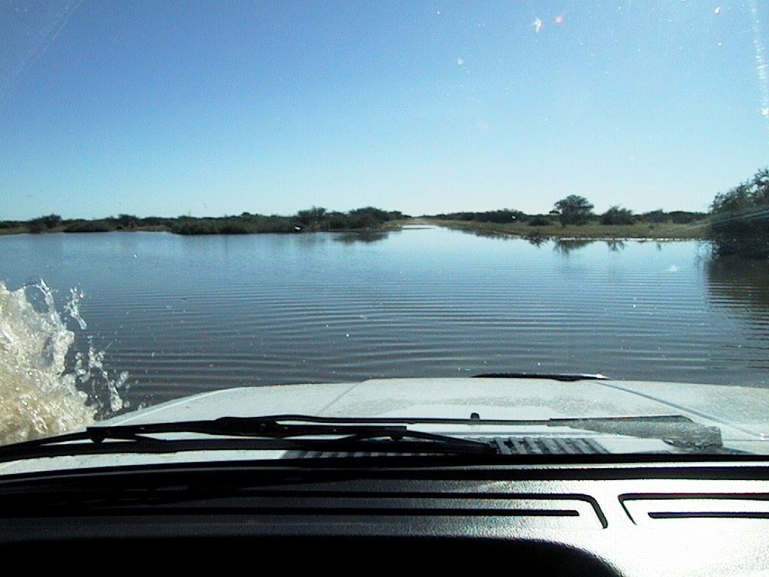
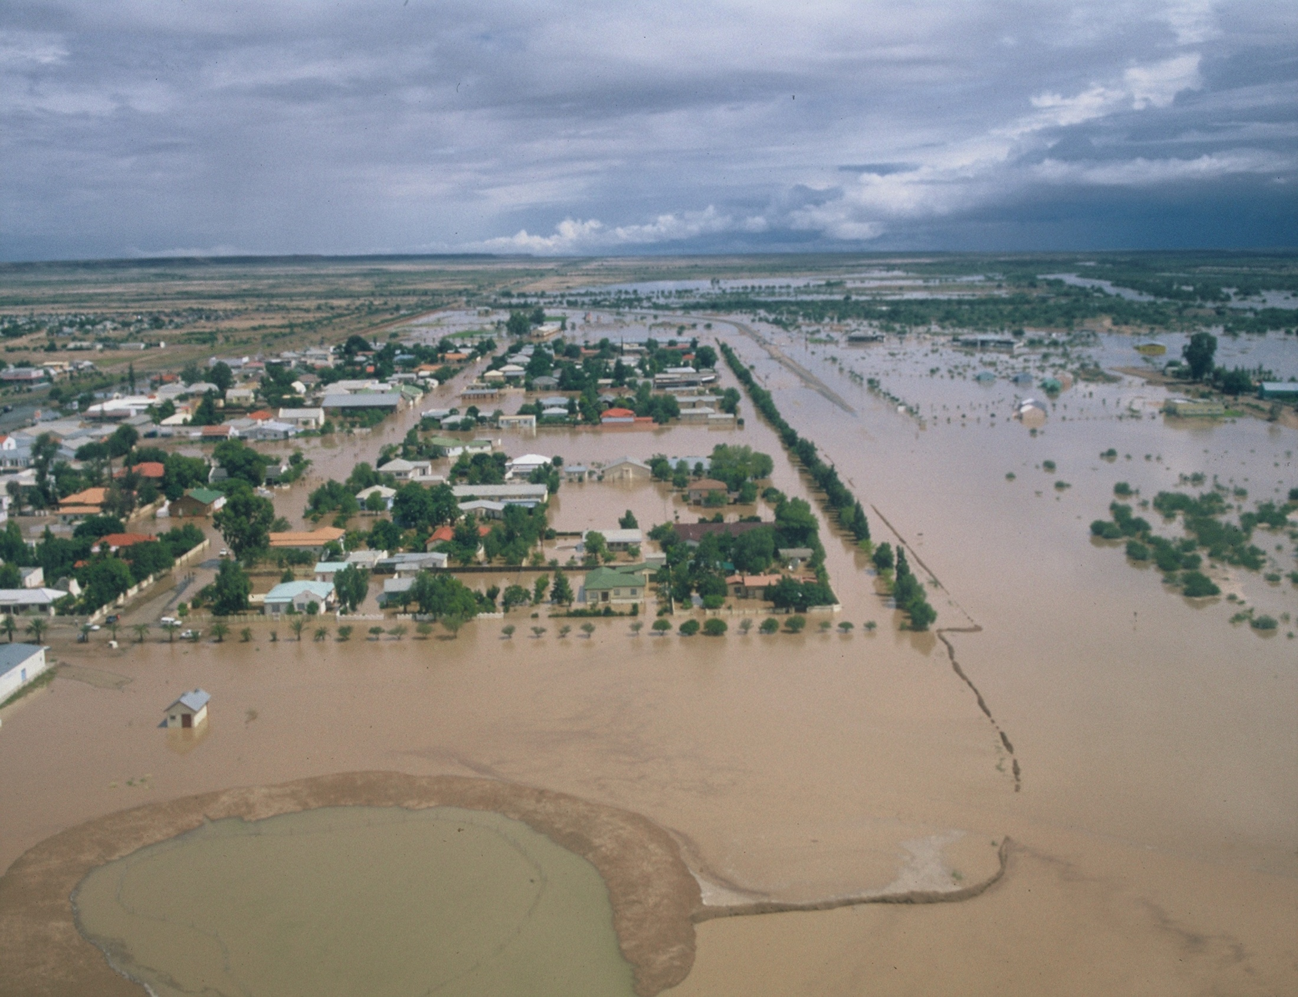
Climate
Rainfall during the mid-1970s (1974 and 1976) was also above normal and 600mm/y were recorded at Leonardville (Namibia) for 1974
Another good rainfall season occurred in 1999/2000, in which lakes were forming in the dune areas east of Kalkrand (Kirchner, 2012)
An important rainfall event led to flooding of Mariental (Namibia) in 2006
It is estimated by the local Namibian farmers that the 2010-2011 rainy season experienced about 3 times the annual average precipitation
2000
2006: Mariental
18

Slide 19
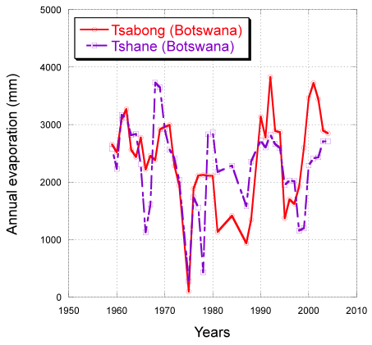
Climate
Evaporation:
Evapotranspiration is the STAS’ biggest water “consumer”
Evaporation in the study area is very high, and were measured in the early 2000s (in Namibia) to be between 3 000 mm/y in the north to 3 500 mm/y in the south of the STAS area.
Evaporation is difficult to measure from open water because it is not usually possible to distinguish between evaporation and seepage losses.
19

Slide 20
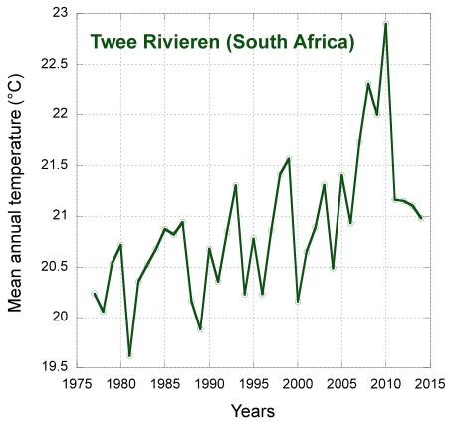
Climate variability and change
Temperature:
Accelerating warming trend since 1960, reaching +0.03 °C/year in Southern Africa ( The average rainfall for the STAS is 150 - 310 mm/y
International Panel on Climate Change (IPCC), projected temperature increases are likely to lead to increased open water and soil/plant evaporation
However, there is little agreement on the direction and magnitude of predicted evapotranspiration patterns (Barnett et al., 2008).
20

Slide 21
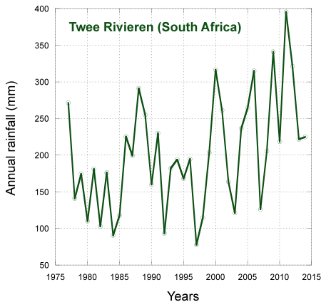
Climate variability and change
Rainfall:
Weak long-term trend has been noted in southern Africa, but increased interannual variability has, however, been observed in the post-1970 period, with higher rainfall anomalies and more intense and widespread droughts reported
The intra-decadal oscillations are recognized to be influenced by the El Niño Southern Oscillation (ENSO)
Increased internanual variability
21

Slide 22
Climate variability and change
Rainfall:
In the STAS area, below-normal rainfall can be expected during El Niño years, especially during the main December to March crop-growing period.
On the other hand, La Niña years seem to have positive effect on seasonal rainfall, especially after November and also seems to last until at least April, or even May.
Generally, the best seasonal total rainfall seems to coincide with La Niña conditions. Above normal rainfall events (e.g. early 1960s, mid 1970s, early 2000s) have occurred after very strong El Niño events (1957-1958, 1972-1973, and 1997-1998).
Understanding how El Niño/La Niña events may influence future climate variability in the STAS is therefore critical, and requires further research.
22

Slide 23
Overview of the STAS
23

Slide 24
Groundwater occurrence
STAS = unconfined aquifers (Kalahari) + confined aquifers (Auob and Nossob)
STAS is not hydraulically connected to the Orange River
Kalahari aquifers
Impermeable layer
Auob aquifer
Impermeable layer
Nossob aquifer
24

Slide 25
Groundwater occurrence
Kalahari aquifers:
Hundreds of individual aquifers more or less loosely connected forming an unconfined aquifer system - NOT TRANSBOUNDARY
Thickness varies from 0 to 250m although it generally does not exceed 100m.
Auob aquifer:
Confined aquifer with isolated outcrops in the extreme western part of the STAS in Namibia – TRANSBOUNDARY
Depths varying from 0 to over 300m.
Thickness varies from 0 to 150m.
Nossob aquifer:
Confined aquifer with isolated outcrops in the extreme western part of the STAS in Namibia – TRANSBOUNDARY
Depths varying from 0 to more than 400m
Thickness varies from 0 to 60m in Namibia and from 0 to 20 in South Africa
25

Slide 26
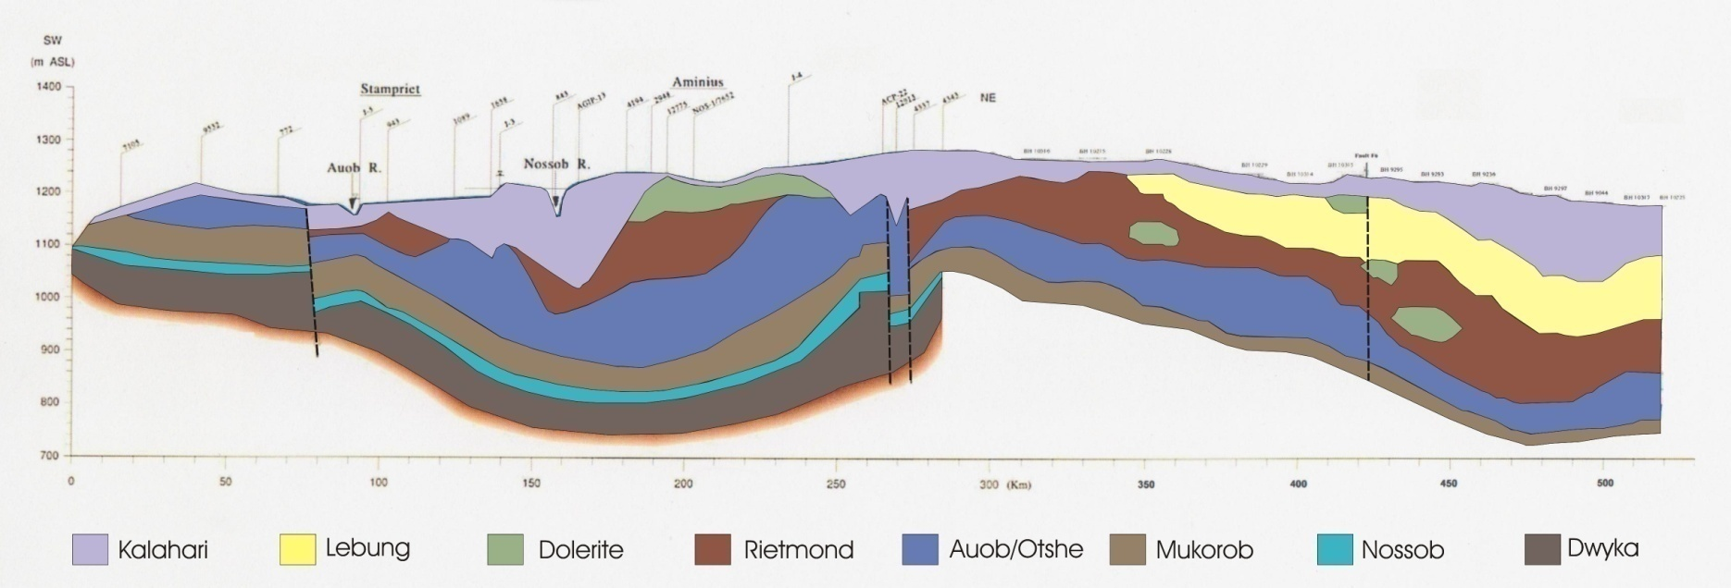
Cross-sections
A W-E Namibia-Botswana cross-section through Stampriet, Aminuis (Namibia) and Ncojane (Botswana)
Namibia
Botswana
Stampriet
Aminuis
Ncojane
?
?
?
?
?
?
?
?
?
?
26

Slide 27
Cross-sections
W-E Namibia-Botswana through the KTP
Namibia
Botswana
Ncojane
27

Slide 28
Cross-sections
N-S Namibia-South Africa cross-section through Hoachanas, Stampriet, and Gochas (Namibia) and the KTP (South Africa)
Namibia
South Africa
28

Slide 29
Groundwater storage and exploitable volumes
The Kalahari and Auob Aquifers have the highest exploitable potential, while the Nossob Aquifer shows the lowest potential
29

Slide 30
Conceptual model
Countries recommendation => treat aquifers separately
Recharge:
Kalahari aquifers = 0.5% of rainfall (3% of rainfall in heavier rainfall events)
Auob aquifer = almost non-existant (3% of rainfall in heavier rainfall events)
Nossob aquifer = almost non-existent (fossil water)
Discharge:
Kalahari aquifers = evaporation
Auob and Nossob aquifers = draining into Kalahari aquifers (Salt Block)
Groundwater flow:
Auob and Nossob aquifers = from northwest to southeast
It usually takes 30 000 years to water flow from recharge to discharge
30

Slide 31
Conceptual model
Kalahari aquifers:
31

Slide 32
Conceptual model
Auob and Nossob aquifers:
32

Slide 33
The role of groundwater in the STAS
33

Slide 34
Numbers, categories and distribution of boreholes
Joint database of 6167 boreholes
5844 boreholes in Namibia (Hydrocensus, 2000; JICA, 2002; Tredoux, 2002) => 95%
155 boreholes in South Africa (Van Wyk, 1987; DWS, 2015) => 3%
168 in Botswana (Matsheng, 2008; DWA, 2015) => 2%
It is estimated that approximately 80% of these borehole are currently in use
Data on the distribution of boreholes into the different aquifers is very limited as this information is available only for approximately 16% of the boreholes in the STAS
34

Slide 35
Numbers, categories and distribution of boreholes
35

Slide 36
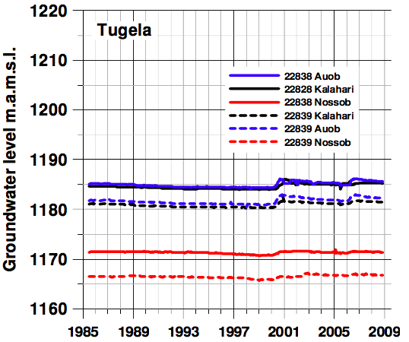
Groundwater level monitoring
The STAS experienced a falling water table in the Kalahari and Auob aquifers from early to late 1990s.
An extreme rainfall in 2001 restored the water table to levels previously observed
Water level in the Nossob aquifer remained relatively stable
36

Slide 37
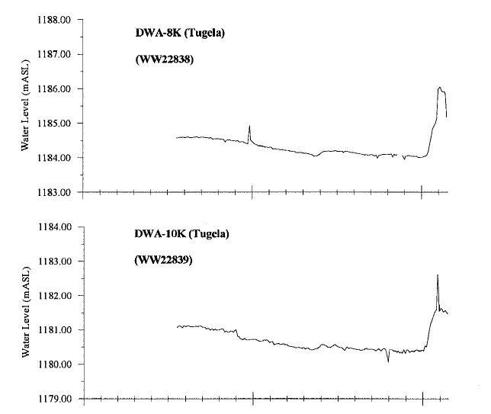
Groundwater level monitoring
Kalahari
Auob
37

Slide 38
Groundwater level monitoring
Most years contribute little or nothing to recharge to the aquifers, whereas few exceptional rainfall years may replenish the systems for years to come.
During the last 35 years substantial recharge occurred only three times, namely during the rainy season of the years 1974, 1976 and 2000.
Generally, exceptional rainfall coincides with La Niña conditions.
Exceptional rainfall events (e.g. early 1960s, mid 1970s, early 2000s) have occurred after very strong El Niño events (1957-1958, 1972-1973, and 1997-1998).
Understanding how El Niño / La Niña events may influence future climate variability in the STAS is therefore critical for groundwater level monitoring, and requires further research.
38

Slide 39
Volumes abstracted
Groundwater is the major only source of water in the STAS, to provide portable water to the people, livestock and for irrigation.
Total abstraction estimated at 20 Mm³/y
Approximately 97% of total abstraction occurs in Namibia
Abstraction has been stable over years
Stampriet region requires special monitoring
39

Slide 40
Volumes abstracted
40

Slide 41
Volumes abstracted
41

Slide 42
Profit and economic aspects of groundwater use
Farms:
1200 farms
110 commercial farms: livestock and irrigation
300 emerging commercial farms (resettlements + AALS): mainly livestock
Livestock:
Small: 1 200 000 (65% sheep, 14% goats)
Large: 110 000 (???)
Irrigation:
80 irrigation farms
Irrigated area: 610 ha
42

Slide 43
Profit and economic aspects of groundwater use
Employment:
10% of STAS population (and likely significantly more of the working-age population)
Livestock farms: 4000 employees
Irrigation farms: 700 employees (0.9 employees / irrigated ha)
600 employees in lodges
900 others commercial farms: livestock and irrigation
300 emerging commercial farms (resettlements + AALS): mainly livestock
43

Slide 44
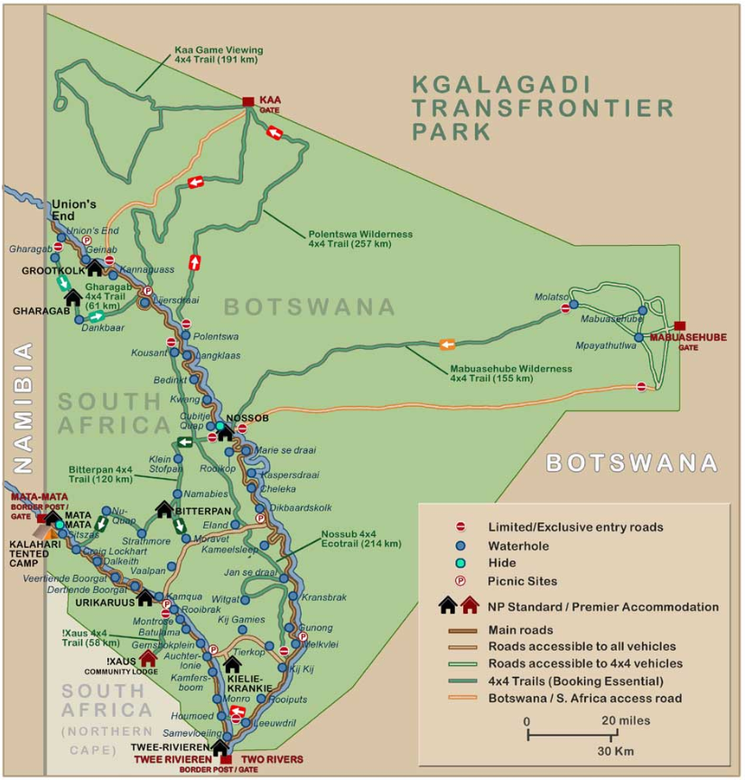
Profit and economic aspects of groundwater use
Tourism:
Namibia: around 10 lodges (10-15 rooms each)
Botswana and South Africa: Kgalagadi Transfrontier Park (KTP)
KTP:
Kgalagadi = “Thristland”
Park merged in 2000
40 000 visitors/year
10 tourist facilities (all in South Africa)
330 beds (bed occupancy = 70%)
Camping site occupancy = 80%
Land restitution program in South Africa (Mier community)
44

Slide 45
Groundwater quality: risks and actual pollution
45

Slide 46
Groundwater quality: risks and actual pollution
46

Slide 47
Groundwater quality: risks and actual pollution
47

Slide 48
Groundwater quality: risks and actual pollution
Conclusions:
General trend: Groundwater quality decreases southeasterly (Salt Block)
Kalahari aquifers:
Suitable for human consumption (Namibia – around Hoachanas, Stampriet and Leonarville)
Unsuitable for human consumption but good for livestock (Botswana and South Africa)
Auob aquifer:
Suitable for human consumption (most parts of Namibia and Botswana)
Unsuitable for human consumption but good for livestock (South Africa)
Nossob aquifer:
Suitable for human consumption (Namibia – around Hoachanas, Aminuis and Leonardville)
48

Slide 49
Groundwater quality: risks and actual pollution
Conclusions:
Pollution vulnerability in the STAS is generally negligible at the current levels of development
However, TDS levels have increased by 10% in the last 30 years
There are some localised potential sources of pollution to the Kalahari aquifers (close to settlements)
Special attention should be given to irrigation boreholes (along the Auob and Nossob rivers)
Recharge zones in Namibia should also be addressed.
49

Slide 50
Groundwater use patterns
Abstraction rate is not considered to increase considerably in the next years
Matsheng Water Transfer Scheme in Botswana:
Driven by the fact that Kalahari aquifers < Auob aquifer water quality
Cones of abstraction will not extend to such a degree that they will cause a noticeable drawdown on the Namibian side of the boundary
Scheme seems acceptable
Risk:
Yields may be reduced if decreasing water pressure from pumping
Prolonged pumping may lead to rising TDS levels
50

Slide 51
Current and potential threats
Prosopis trees are found in abundance along the Auob and Nossob Rivers, causing bush encroachment in some parts of the basin
Density of Prosopis in the Auob and Nossob River Basins is highest along the rivers (1000 trees/ha) compared to gravel plains (350 trees/ha) and dunes (<50 trees/ha) (Helmi et al, 2012)
The Nossob River upstream is infested by Prosopis, and has an effect on the availability of fresh water in the lower Nossob River as one Prosopis tree can take up to 50 litres per day (Maitre, 1999)
Prosopis density increases at 18% per annum, resulting in the invaded area to double every five years (Smit, 2005)
Prosopis covered Nossob River upstream of Leonardville (Namibia)
(Source: J. Kirchner)
51

Slide 52
Current and potential threats
High water losses, e.g. in Stampriet 60% loss as percent of water supply (DWA, 2006)
Non-optimal water use
Borehole leakages
Illegal abstraction occurs
52

Slide 53
Legal and Institutional assessment
53

Slide 54
Legal and Institutional responses
DOMESTIC LEGAL & INSTITUTIONAL RESPONSES: SOURCES
DOMESTIC-LEVEL RESPONSES MUST COME FROM –
THE DOMESTIC GROUNDWATER-RELEVANT LEGISLATION OF EACH STAS COUNTRY, AND
THE DOMESTIC GROUNDWATER-RELEVANT GOVERNMENT ADMINISTRATION IN EACH STAS COUNTRY
54

Slide 55
Legal and Institutional responses
LEGISLATIVE REPONSE
THE GW-RELEVANT LEGISLATION SHOULD RESPOND BY REGULATING AT A MINIMUM -
WELL DRILLING – THE LEGISLATION OF THE STAS COUNTRIES SEEMS ON TRACK
GROUNDWATER ABSTRACTION AND USE - THE LEGISLATION OF THE STAS COUNTRIES SEEMS ON TRACK
POLLUTION FROM “POINT” SOURCES - THE LEGISLATION OF THE STAS COUNTRIES SEEMS ON TRACK
AS A COMPLEMENT, LEGISLATION SHOULD ALSO RESPOND BY CONFERRING PUBLIC PROPERTY STATUS ON GROUNDWATER - THE LEGISLATION OF THE STAS COUNTRIES SEEMS ON TRACK ALSO ON THIS SCORE
55

Slide 56
Legal and Institutional responses
LEGISLATIVE REPONSE
ADDITIONALLY (AND IDEALLY) LEGISLATION SHOULD REGULATE –
POLLUTION FROM “NON-POINT” SOURCES
MAN-MADE INTERFERENCES WITH NATURAL RECHARGE OF GROUNDWATER
THESE ARE AREAS OF REGULATORY LEGISLATION WITH ROOM FOR IMPROVEMENT IN THE STAS COUNTRIES
56

Slide 57
Legal and Institutional responses
IMPLEMENTATION & ENFORCEMENT
THE RECORD OF
IMPLEMENTATION, AND
ENFORCEMENT
OF REGULATORY LEGISLATION IS MIXED IN ALL THREE STAS COUNTRIES, WITH ROOM FOR IMPROVEMENT VARYING IN EACH COUNTRY
57

Slide 58
Legal and Institutional responses
INSTITUTIONAL RESPONSE
A DOMESTIC-LEVEL RESPONSE INCLUDES A GOVERNMENT GROUNDWATER ADMINISTRATION CAPABLE OF
ADMINISTERING
IMPLEMENTING
ENFORCING
THE GW-RELEVANT REGULATORY LEGISLATION
58

Slide 59
Legal and Institutional responses
INSTITUTIONAL REPONSE
CONSOLIDATION OR COORDINATION OF MULTIPLE GOVERNMENT ACTORS ENGAGING WITH GROUNDWATER
ATTRACTION AND RETENTION OF SKILLED PERSONNEL IN THE GOVERNMENT GW ADMINISTRATION, AND
A STEADY FLOW OF FINANCIAL RESOURCES TO THE GOVERNMENT GW ADMINISTRATION
ARE PART OF A DOMESTIC-LEVEL INSTITUTIONAL RESPONSE
THE RELEVANT RECORD IS MIXED IN THE THREE STAS COUNTRIES, WITH ROOM FOR IMPROVEMENT VARYING IN EACH COUNTRY
59

Slide 60
Legal and Institutional responses
POINTERS FOR A LONG-TERM LEGAL & INSTITUTIONAL RESPONSE STRATEGY
A DOMESTIC-LEVEL LONG-TERM RESPONSE STRATEGY TO THE CHALLENGES AHEAD OF STAS COUNTRIES SHOULD FOCUS ON –
IMPROVING THE QUALITY AND THE PERFORMANCE ON THE GROUND (IMPLEMENTATION AND ENFORCEMENT) OF REGULATORY MECHANISMS AVAILABLE IN THE GW-RELEVANT LEGISLATION OF THE STAS COUNTRIES
IMPROVING THE QUALITY AND THE PERFORMANCE OF THE GOVERNMENT GROUNDWATER-RELEVANT ADMINISTRATION IN THE STAS COUNTRIES
60

Slide 61
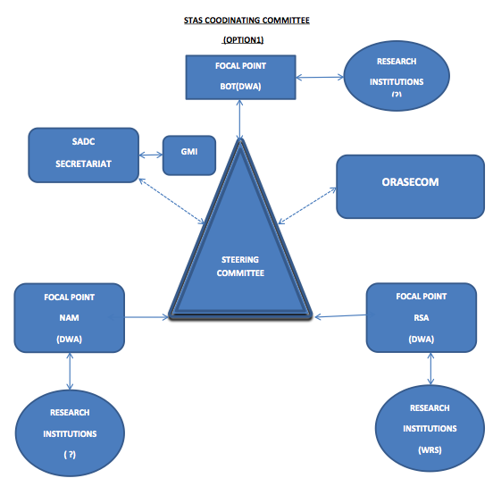
Options of Multi-Country Consultation Mechanism
2 options:
Option 1: Coordinating STAS Committee
Option 2: Standing ORASECOM Committee
61

Slide 62
THANK YOU FOR YOUR ATTENTION
62

Slide 63
What are the opportunities for developing the STAS? What sectors, regions? How will the demand for GW from the STAS develop in the next 10-15 years?
What are the main risks relating to development of the STAS?
What would be the consequences if the STAS was depleted or degraded?
Are current GW management measures sufficient to manage the STAS under possible future development scenarios?
What additional GW legislative, policy and institutional measures could be considered? What are the barriers to such measures?
63

