Slide 1
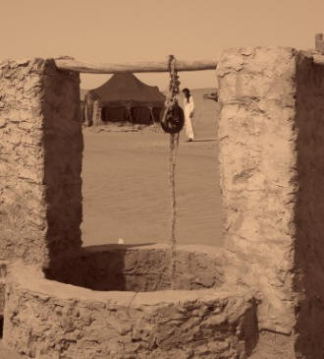

Groundwater Resources Governance in Transboundary Aquifers (GGRETA Project) Gaborone, 8 May 2015
International Water Law Training Group Exercise
Francesco Sindico Reader in International Environmental Law, University of Strathclyde Law School Director, Strathclyde Centre for Environmental Law and Governance

Slide 2
International Water Law Training
Scenario
The Plentiful Aquifer sits beneath Country A and Country B. In country A a vast reserve of coal has been identified and the government is keen to move forward and provide concessions for its further development. There are concerns that uncontrolled mining operations may cause significant harm to the Plentiful aquifer, both in terms of groundwater quality and in terms of groundwater quantity. In country B the main socio-economic activities in the Plentiful aquifer area are large scale farming and tourism. Irrigation practices have been slowly depleting the Plentiful aquifer for some time, and the increasing use of pesticides and chemicals is affecting groundwater quality. Tourism income comes mainly from a game park within a protected area that straddles the border with A and sits on top of the aquifer. The ecosystem of the park depends very much on groundwater. In both A and B surface water is scarce and further pressure on this resource is coming from climate change.

Slide 3
International Water Law Training
Exercise
Against this background, groups will be asked to identify and justify the selection of core principles that could inform a transboundary agreement based on the provisions present in the United Nations International Law Commission Draft Articles on the Law of Transboundary Aquifers, annexed to Resolution 68/470. There will be 6 people in each group and 3 people will represent country A and 3 people will represent country B. Every group will nominate one person who will report back on the core principles that have been agreed (or not) and on the negotiation process leading to the principles themselves. The core principles need not be too precise and should capture the key substantive and procedural principles/obligations that should govern the management of the aquifer.

Slide 4
International Water Law Training
Suggested time management
11:15 – 11:20 Presentation of the group exercise and groups formation 11:20 – 11:50 Representatives of countries A and B focus on the Draft Articles and take note of the chosen principles 11:50 – 12:15 Negotiation and agreement (or disagreement) on principles 12:15 – 12:45 Groups report back to the plenary 12:45 – 13:00 Conclusions

