Slide 1
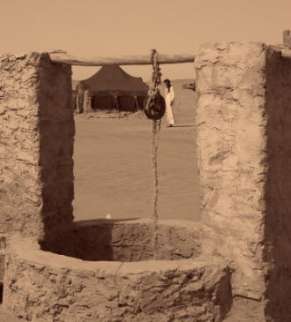
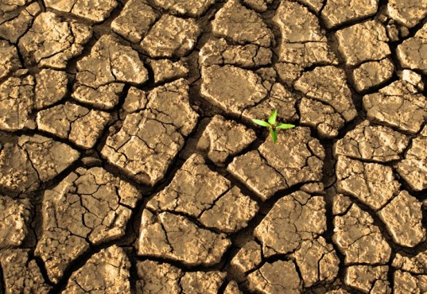
Groundwater Resources Governance in Transboundary Aquifers (GGRETA Project)
International Water Law Training
Francesco Sindico Reader in International Environmental Law, University of Strathclyde Law School Director, Strathclyde Centre for Environmental Law and Governance

Slide 2
International Water Law Training
Outline
Transboundary Aquifers and Transboundary Surface Water Transboundary Surface Water Law and Transboundary Aquifer Law Substantive obligations (Principle of equitable and reasonable utilisation) Procedural obligations (exchange of information and prior notification) Case Study: Guarani Aquifer Agreement, Institutions and Dispute Settlement Group Exercise

Slide 3
International Water Law Training Transboundary Aquifers and Transboundary Surface Water
Why is groundwater so relevant in the context of global water security?

Slide 4
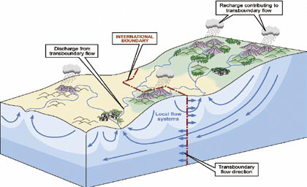
International Water Law Training Transboundary Aquifers and Transboundary Surface Water
What is a transboundary aquifer?
Aquifers: “a permeable water bearing geological formation underlain by a less permeable layer and the water contained in the saturated zone of the formation”, UN ILC Draft Articles, art. 2a).

Slide 5
International Water Law Training Transboundary Aquifers and Transboundary Surface Water
What is a transboundary aquifer?
An aquifer consists of two elements: Underground geological formation (container / the rock) Natural resources stored underground in the container (groundwater) An aquifer can be renewable or non-renewable (fossil aquifer)

Slide 6
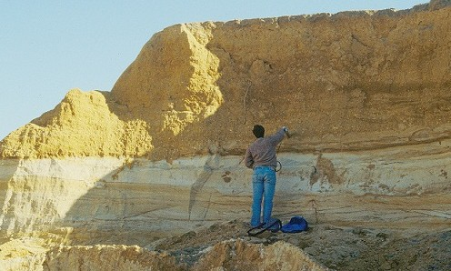
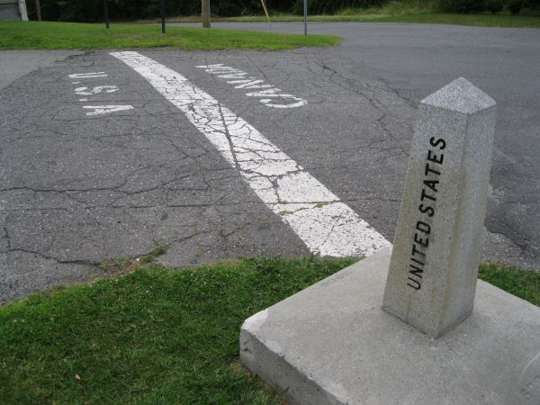
International Water Law Training Transboundary Aquifers and Transboundary Surface Water
What additional challenges do transboundary aquifers pose at the moment of their regulation, compared to other natural resources?

Slide 7
International Water Law Training Transboundary Aquifers and Transboundary Surface Water
What additional challenges do transboundary aquifers pose at the moment of their regulation, compared to other natural resources?
Uses of aquifers Extraction of water Extraction of heat Extraction of minerals Storage and disposal of any substance (CCS/flood management) Challenges to aquifers Overexploitation Challenges over different uses Pollution

Slide 8
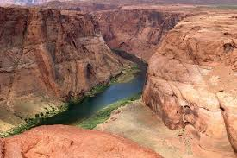
International Water Law Training Transboundary Aquifers and Transboundary Surface Water
Conclusion 1): Transboundary Aquifres and Transboundary Surface Water are similar, but not the same.

Slide 9
International Water Law Training
Outline
Transboundary Aquifers and Transboundary Surface Water Transboundary Surface Water Law and Transboundary Aquifer Law Substantive obligations (Principle of equitable and reasonable utilisation) Procedural obligations (exchange of information and prior notification) Debate and Questions and Answers Case Study: Guarani Aquifer Agreement, Institutions and Dispute Settlement Group Exercise Conclusion

Slide 10
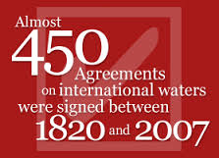
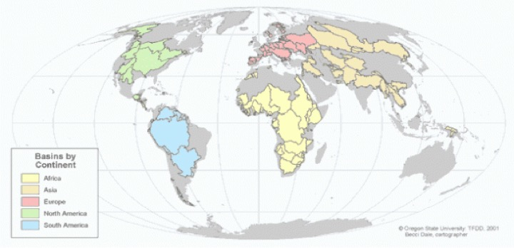
International Water Law Training Transboundary Surface Water Law and Transboundary Aquifer Law
Transboundary surface water vs transboundary aquifers

Slide 11
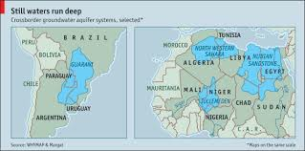
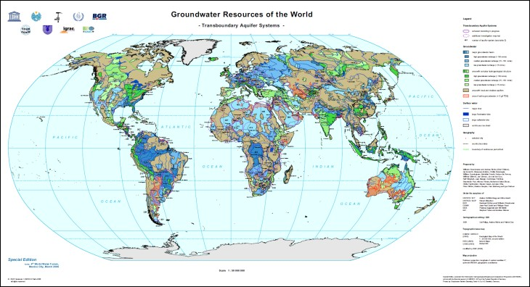
International Water Law Training Transboundary Surface Water Law and Transboundary Aquifer Law
Transboundary surface water vs transboundary aquifers

Slide 12
International Water Law Training Transboundary Surface Water Law and Transboundary Aquifer Law
Transboundary surface water vs transboundary aquifers
Conclusion 1): Transboundary Aquifers and Transboundary Surface Water are similar, but not the same.
International Law applicable to
Transboundary Aquifer
Transboundary Surface Water
Conclusion 2): The Law applicable to a TBA can be similar to international law applicable to TSW, but may warrant some differences linked to the “special” nature of a TBA, even in those cases when a TBA is hydrologically connected to surface water.

Slide 13
International Water Law Training Transboundary Surface Water Law and Transboundary Aquifer Law
Transboundary surface water vs transboundary aquifers
International Law applicable to
Transboundary Aquifer (Fossil)
Transboundry Surface Water
Conclusion 3): The Law applicable to a fossil TBA may warrant further differential treatment under International Law
Question: Has the International community taken action on these conclusions?

Slide 14
International Water Law Training Transboundary Surface Water Law and Transboundary Aquifer Law
2002 – UNILC starts working on the topic of “shared” natural resources” transboundary groundwater, oil and gas
2003 – UNILC drops oil and gas, and focuses only on transboundary “aquifers”
2008 – A/RES/63/124
2013 – A/RES/68/470
Question: Has the International community taken action on these conclusions?
1992/ 1996 – UNECE Water Convention
1997 - UNWC
2012 – UNECE Model Provisions
2014 – UNWC Entry into force

Slide 15
International Water Law Training Transboundary Surface Water Law and Transboundary Aquifer Law
Puzzle/messy picture
International Law applicable to
Transboundary Aquifer
Transboundry Surface Water

Slide 16
International Water Law Training Transboundary Surface Water Law and Transboundary Aquifer Law
Puzzle/messy picture
UNWC
Draft Articles
UNECE Water Convention
Model Provisions
UNWC: treaty, but not universal participation UNECE Water Convention: Pan-European Draft Articles: not a treaty… Model Provisions: Pan-European and a decision of a Meeting of the Parties

Slide 17
International Water Law Training
Outline
Transboundary Aquifers and Transboundary Surface Water Transboundary Surface Water Law and Transboundary Aquifer Law Substantive obligations (Principle of equitable and reasonable utilisation) Procedural obligations (exchange of information and prior notification) Debate and Questions and Answers Case Study: Guarani Aquifer Agreement, Institutions and Dispute Settlement Group Exercise Conclusion

Slide 18
International Water Law Training
Substantive and procedural obligations
Substantive | Procedural
Obligation not to cause significant harm (UNWC, art. 7) Protection, Preservation and Management (UNWC, Part IV) | Regular exchange of data and information (UNWC, art. 9)
Obligation to cooperate (UNWC, art. 8) | Prior notification (UNWC, arts. 12-16)
Equitable and reasonable utilization (UNWC, arts. 5 and 6)

Slide 19
International Water Law Training Substantive obligations
Equitable and reasonable utilization , UNWC Art. 5
Watercourse states shall in their respective territories utilise an international watercourse in an equitable and reasonable manner. In particular, an international watercourse shall be used and developed by watercourse states with a view to attaining optimal and sustainable utilisation thereof and benefits therefrom taking into account the interests of the watercourse states concerned, consistent with adequate protection of the watercourse. Watercourse states shall participate in the use, development and protection of an international watercourse in an equitable and reasonable manner. Such participation includes both the right to utilise the watercourse and the duty to cooperate in the protection and development thereof, as provided in the present Convention.

Slide 20
International Water Law Training Substantial obligations
Equitable and reasonable utilization and transboundary aquifer
Should the “utilisation” of transboundary aquifers take into account some particular “hydroegological aspects of the aquifer?
Recharge and discharge zones Geological formation Precautionary approach
Conclusion 2): The Law applicable to a TBA can be similar to international law applicable to TSW, but may warrant some differences linked to the “special” nature of a TBA, even in those cases when a TBA is hydrologically connected to surface water.

Slide 21
International Water Law Training Substantial obligations
Factors relevant to equitable and reasonable utilisation, UNWC Art. 6
Utilisation of an international watercourse in an equitable and reasonable manner within the meaning of Article 5 requires taking into account all relevant factors and circumstances, including: Geographic, hydrographic, hydrological, climatic, ecological and other factors of a natural character; The social and economic needs of the watercourse states concerned; The population dependent on the watercourse in each watercourse state; The effects of the use or uses of the watercourses in one watercourse State on other watercourse states; Existing and potential uses of the watercourse; Conservation, protection, development and economy of use of the water resources of the watercourse and the costs of measures taken to that effect; The availability of alternatives, of comparable value, to a particular planned or existing use.

Slide 22
International Water Law Training Substantive obligations
Factors relevant to equitable and reasonable utilisation, UNWC Art. 6
2. In the application of Article 5 or paragraph 1 of this article, watercourse states concerned shall, when the need arises, enter into consultations in a spirit of cooperation. 3. The weight to be given to each factor is to be determined by its importance in comparison with that of other relevant factors. In determining what is a reasonable and equitable use, all relevant factors are to be considered together and a conclusion reached on the basis of the whole.

Slide 23
International Water Law Training Substantive obligations
Factors to be considered together
Factors of a natural character
social and economic needs
population dependent
Transboundary effects
uses of the watercourse
Cost-effective analysis
Availability of alternatives
Factors relevant to equitable and reasonable utilisation, UNWC Art. 6

Slide 24
International Water Law Training Substantive obligations
Factors relevant to equitable and reasonable utilisation
Should the equitable and reasonable utilization of a transboundary aquifer by determined by any further factor? Should some of these factors be prioritised (be more important) under international law?
Vital human needs vs socio-economic needs

Slide 25
International Water Law Training
Outline
Transboundary Aquifers and Transboundary Surface Water Transboundary Surface Water Law and Transboundary Aquifer Law Substantive obligations (Principle of equitable and reasonable utilisation) Procedural obligations (exchange of information and prior notification) Case Study: Guarani Aquifer Agreement, Institutions and Dispute Settlement Group Exercise

Slide 26
International Water Law Training Procedural obligations
Exchange of information Prior notification Environmental Impact Assessment Public Participation

Slide 27
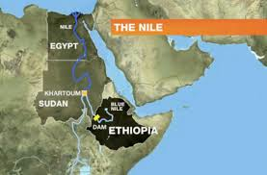
International Water Law Training Procedural obligations
Exchange of Information, Declaration of Principles over the Grand Renaissance Dam, Principle 7
“Egypt, Ethiopia and Sudan will provide the information and data required to conduct the studies of the national experts committees from the three countries in the proper time.”

Slide 28
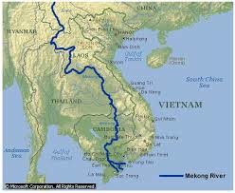
International Water Law Training Procedural obligations
Prior Notification, Mekong Agreement, art. 7 (Prevention and Cessation of Harmful Effects)
“To make every effort to avoid, minimize and mitigate harmful effects that might occur to the environment, especially the water quantity and quality, the aquatic (eco‑system) conditions, and ecological balance of the river system, from the development and use of the Mekong River Basin water resources or discharge of wastes and return flows. Where one or more States is notified with proper and valid evidence that it is causing substantial damage to one or more riparians from the use of and/or discharge to water of the Mekong River, that State or States shall cease immediately the alleged cause of harm until such cause of harm is determined in accordance with Article 8.”

Slide 29
International Water Law Training Procedural obligations
Exchange of information and prior notification
Should these procedural obligations differ in some way if the agreement covers a transboundary aquifer rather than a transboundary surface water?
Exchange of information: Costs? Prior notification: Time?

Slide 30
International Water Law Training Transboundary Surface Water Law and Transboundary Aquifer Law
Conclusion 2.1) The differences may be more pronounced in relation to scope/ coverage and substantive obligations rather than procedural obligations
Conclusion 2): The Law applicable to a TBA can be similar to international law applicable to TSW, but may warrant some differences linked to the “special” nature of a TBA, even in those cases when a TBA is hydrologically connected to surface water.

Slide 31
International Water Law Training Transboundary Surface Water Law and Transboundary Aquifer Law
Conclusion 3): The Law applicable to a fossil TBA may warrant differential treatment under International Law
Conclusion 3.2) The Draft Articles provide a “specific” international legal instrument capable of dealing with ALL transboundary aquifers
Conclusion 3.3) Puzzles can be solved… The Draft Articles and the UNWC can be mutually supportive, and there can be an interpretative role for the UNECE international water legal instruments

Slide 32
International Water Law Training Transboundary Surface Water Law and Transboundary Aquifer Law
Conclusions
1) Transboundary Aquifers and Transboundary Surface Water are similar, but not the same.
2) The Law applicable to a TBA can be similar to international law applicable to TSW, but may warrant some differences linked to the “special” nature of a TBA, even in those cases when a TBA is hydrologically connected to surface water. | 2.1) The differences may be more pronounced in relation to scope/ coverage and substantive obligations rather than procedural obligations
T3) he Law applicable to a fossil TBA may warrant differential treatment under International Law | 2.2) The Draft Articles provide that “specific” international legal instrument capable of dealing with ALL transboundary aquifers | 2.3) Puzzles can be solved… The Draft Articles and the UNWC can be mutually supportive, and there can be an interpretative role for the UNECE international water legal instruments

Slide 33
International Water Law Training
Outline
Transboundary Aquifers and Transboundary Surface Water Transboundary Surface Water Law and Transboundary Aquifer Law Principle of equitable and reasonable utilisation Overview of procedural obligations Debate and Questions and Answers Case Study: Guarani Aquifer Agreement, Institutions and Dispute Settlement Group Exercise

Slide 34
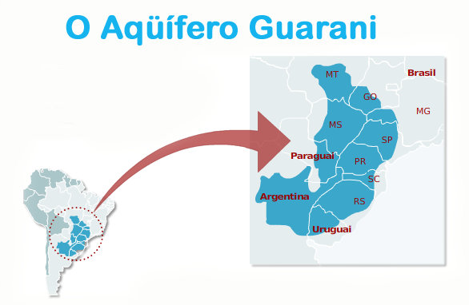
International Water Law Training The Guarani Aquifer Agreement
What trends can be seen, if any, from the management of the Guarani Aquifer System? Legal and institutional setting (some highlights)

Slide 35
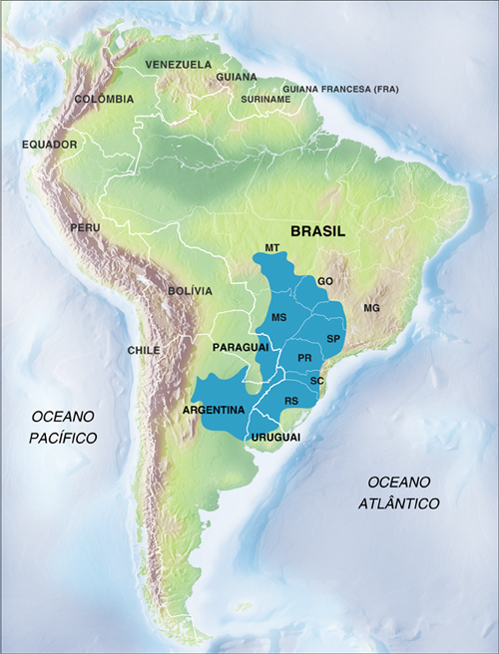
International Water Law Training The Guarani Aquifer Agreement
What trends can be seen, if any, from the management of the Guarani Aquifer System?
Lack of adequate understanding of the natural resource (1990s – 2003) International project bridges that gap and builds confidence amongst stakeholders and policymakers The Guarani Aquifer Agreement is signed in 2010 (not yet in force)
Science
Policy
Law

Slide 36
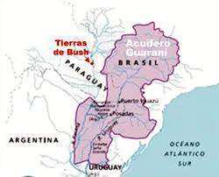
International Water Law Training The Guarani Aquifer Agreement
What trends can be seen, if any, from the management of the Guarani Aquifer System?
Underground rivers and other hydro myths

Slide 37
International Water Law Training The Guarani Aquifer Agreement
What trends can be seen, if any, from the management of the Guarani Aquifer System?
International project helped build confidence and trust between different scientific communities Spill over effect into politics

Slide 38
International Water Law Training The Guarani Aquifer Agreement
What trends can be seen, if any, from the management of the Guarani Aquifer System?
International project Science Socio-economics Management

Slide 39
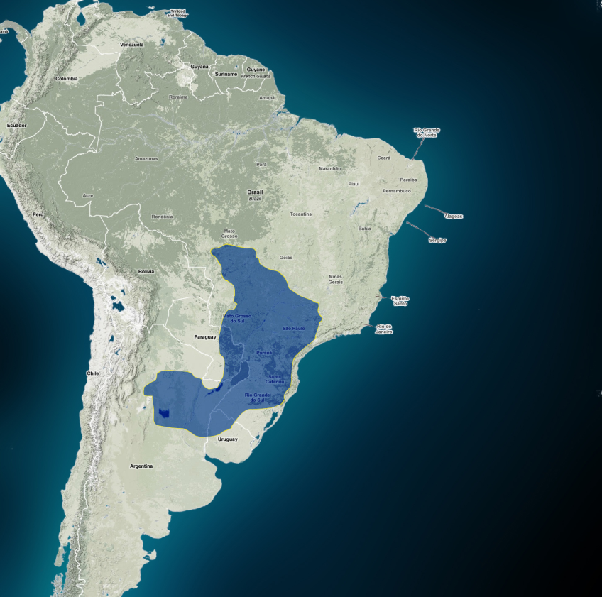
International Water Law Training The Guarani Aquifer Agreement
What trends can be seen, if any, from the management of the Guarani Aquifer System?
Science one of the factors leading to law (the 2010 Guarani Aquifer Agreement) The other two factors being The Draft Articles (informed by science) The Pulp Mills dispute

Slide 40
International Water Law Training The Guarani Aquifer Agreement
Legal and Institutional settings (highlights)
Special measures for special problems (art. 14) “The Parties shall cooperate in the identification of critical areas, especially boundary areas that require specific treatment measurements.”

Slide 41
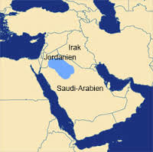
International Water Law Training The Guarani Aquifer Agreement
Legal and Institutional settings (highlights)
Disi Aquifer Agreement “The agreement identified a 10-kilometre buffer zone on both sides of the Jordanian-Saudi borderline where drilling wells for producing water is prohibited, while wells drilled beyond the buffer zone must adhere to shared technical standards, the official said.”

Slide 42
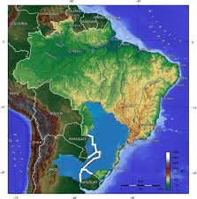
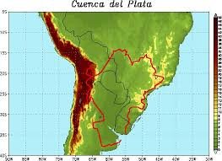
International Water Law Training The Guarani Aquifer Agreement
Legal and Institutional settings (highlights)
Institutional linkage with an already existing transboundary surface water institution, art. 15 of the Guarani Aquifer Agreement “It is established under the Treaty of the River Plate Basin, and in accordance with the Article VI of such Treaty, a Commission comprised by the four Parties, which shall coordinate the cooperation among such Parties for complying with the principles and objectives of this Agreement. The Commission shall elaborate its own regulations. ”

Slide 43
International Water Law Training The Guarani Aquifer Agreement
What trends can be seen, if any, from the management of the Guarani Aquifer System?
Patterns emerging Science capable of dispelling myths to policy leading to increased cooperation International project provided a platform between scientific communities and governments Management of the GAS relies on already existing institutions (surface water based) TBA is not a priority and science needs to continuously engage with politics
Science
Policy
Law

