Slide 1
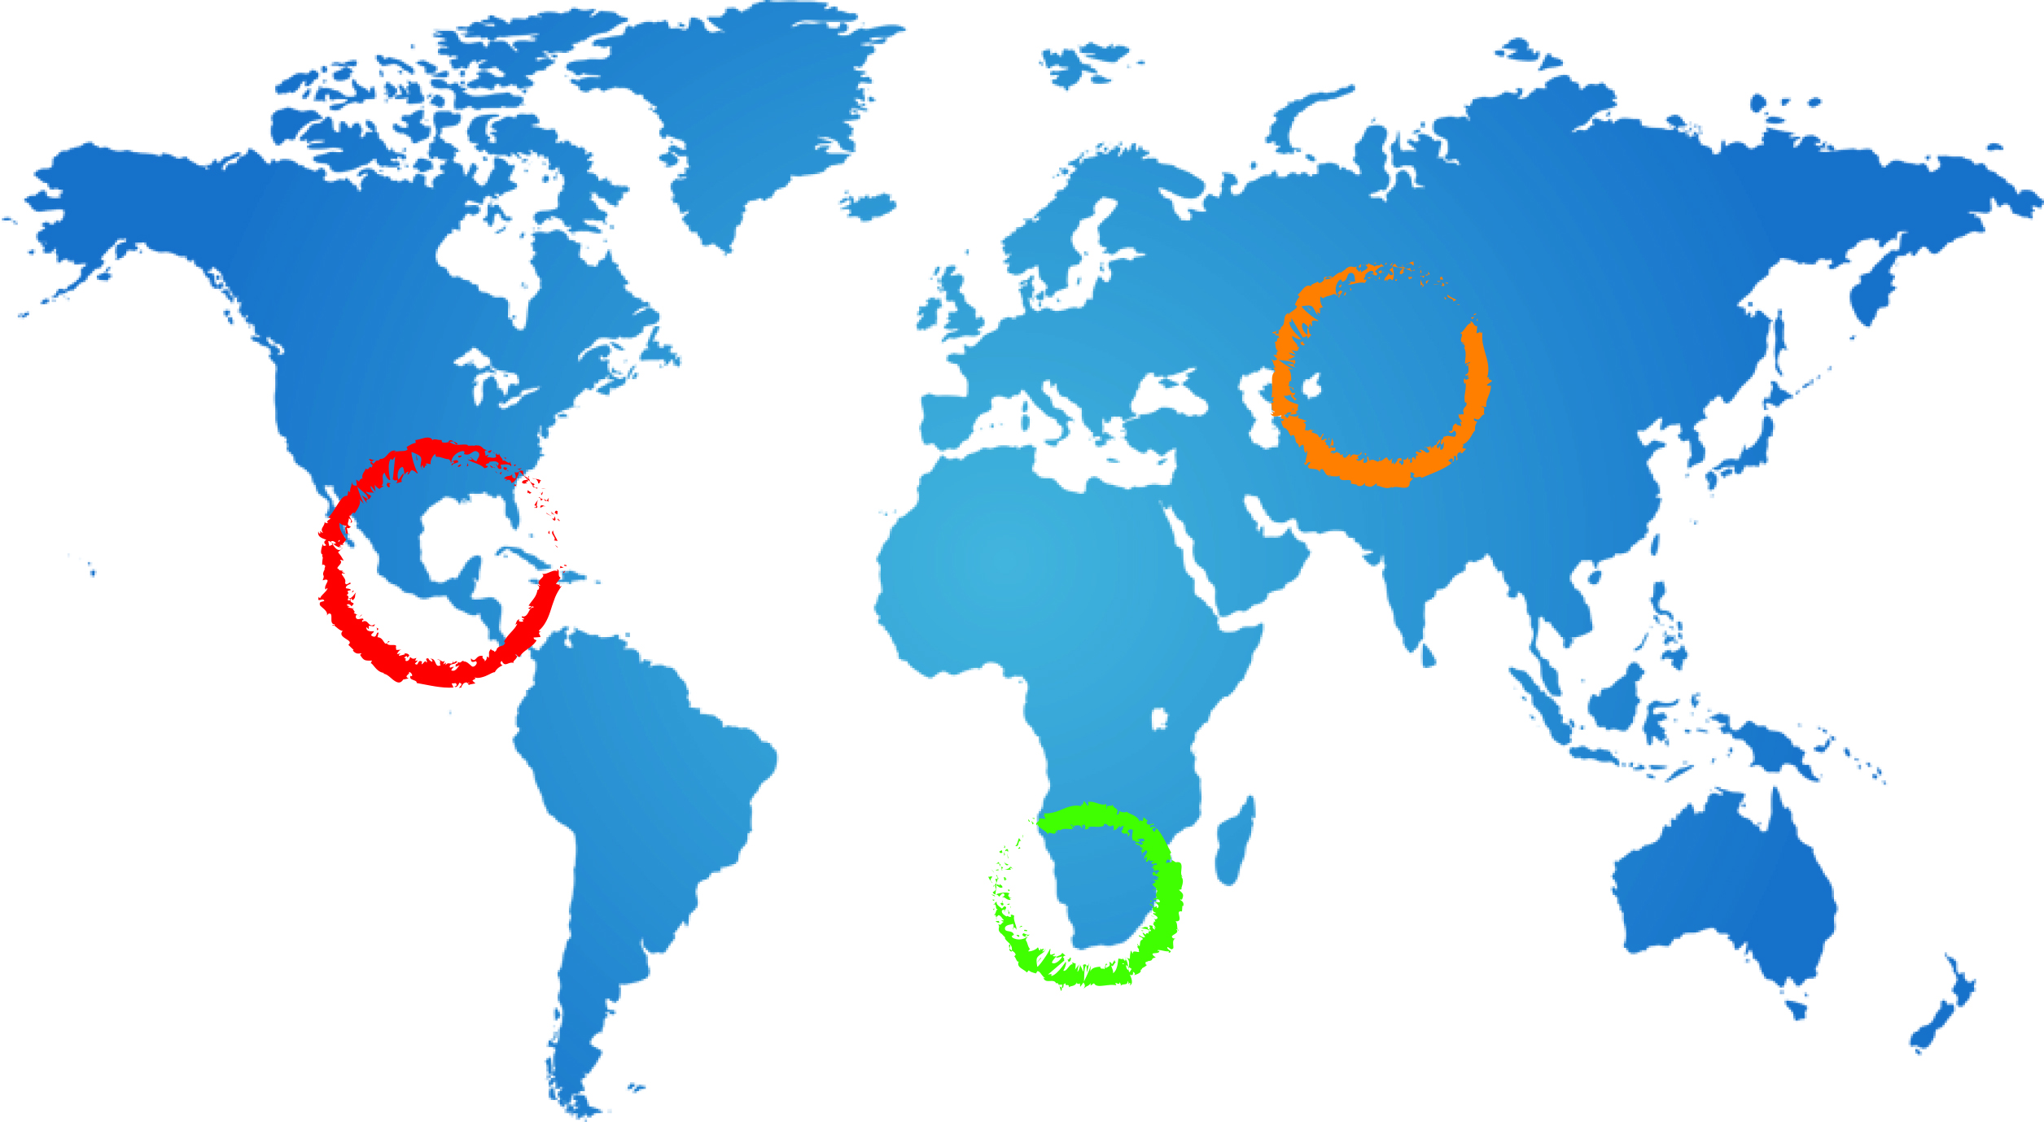
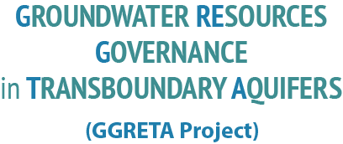

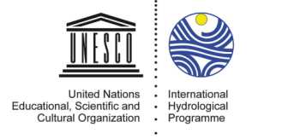





Stampriet – Kalahari/Karoo Aquifer Case Study
Fourth Regional Technical Workshop
GGRETA Information Management System
Benefits and Demonstration
Geert-Jan Nijsten – IGRAC
7 May 2015
Gaborone

Slide 2
GGRETA Information Management System
Objectives:
Support tool for Governance of Transboundary aquifers, with access for all stakeholders
System for storing, sharing and analysing of project results
Characteristics
Map based web application
Public & Password protected viewers
Countries control content of system
Notes:
Intro IMS: Goals → collected and analysed a lot of information resulting in the assessment report, but also been creating a lot of additional information like thematic maps, overview tables, graphics (cross-sections). The IMS has been designed to give easy access to this information. Maps can be uploaded to a publically accessible viewer which anyone with an internet connection can use. In addition to the public viewer there also is a pass word protected environment where registered users can view maps which are not publically accessible. This can be used to share drafts, but also for sensitive maps which still need to be shared between the countries, people involved

Slide 3
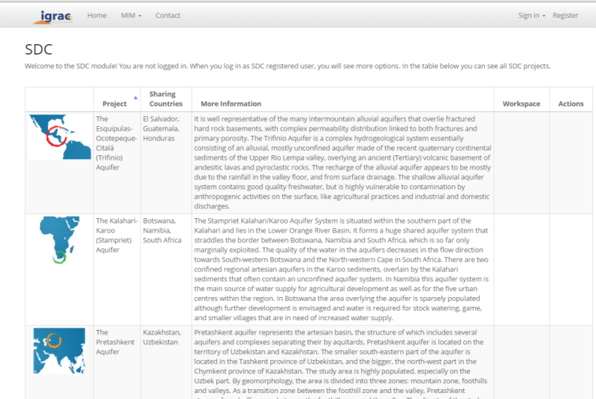
GGRETA: Public Access
Anyone with an internet connection can view and analyse the data in the public viewer
Notes:
System has been developed in the GGRETA project and is used for all three case studies in Central America – Trifinio, Central Asia – Pretashkent and for the Stampriet

Slide 4
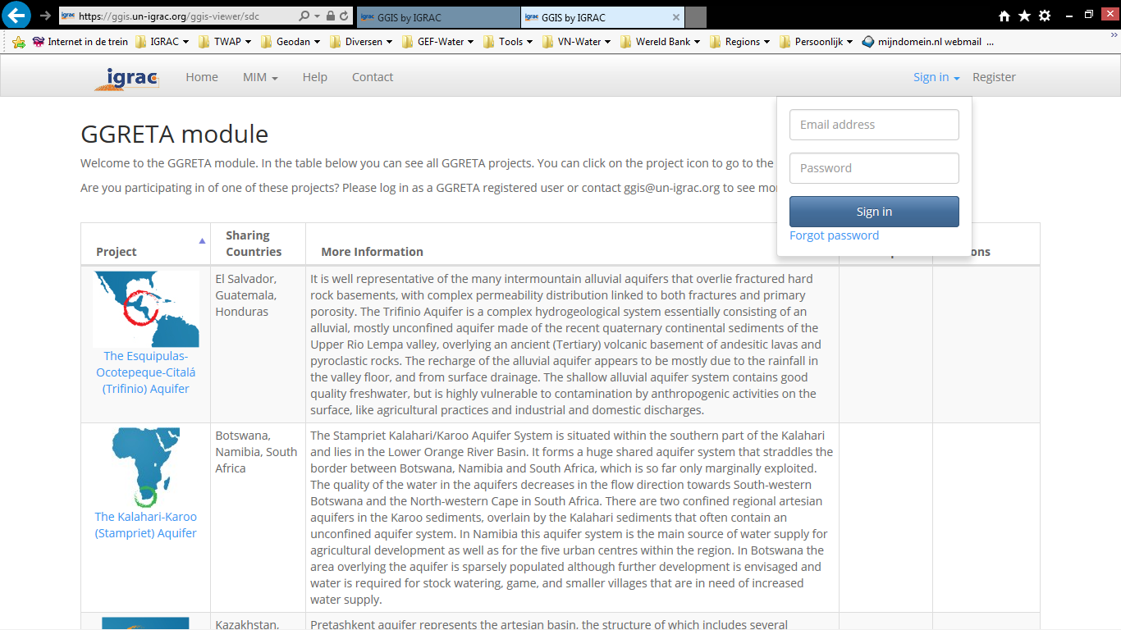
GGRETA Password Protected Workspace
Password protected workspace:
to upload data and
to share draft or sensitive maps between registered users
Notes:
Explain that functionality in public view and private view is the same. For now only maps have been uploaded to the private view.

Slide 5
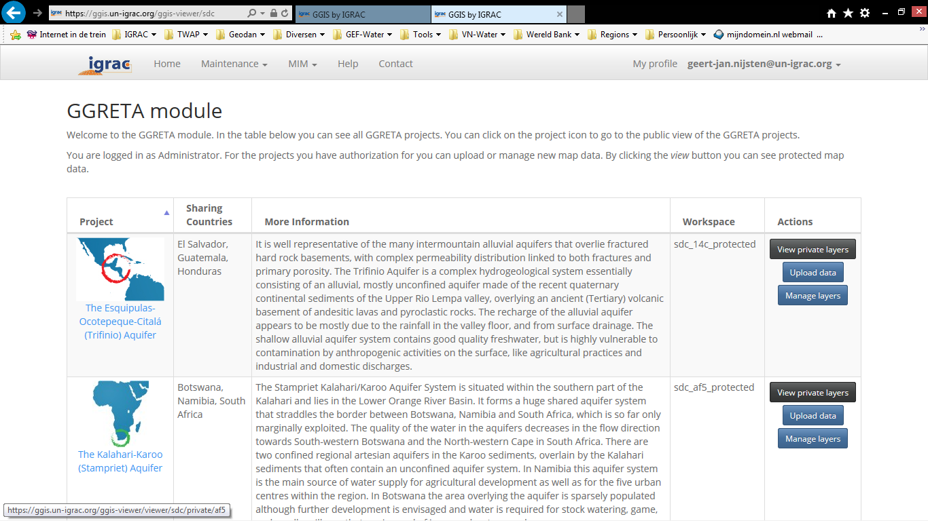
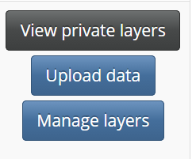
GGRETA Password Protected Workspace
Password protected workspace:
to upload data and
to share draft or sensitive maps between registered users

Slide 6
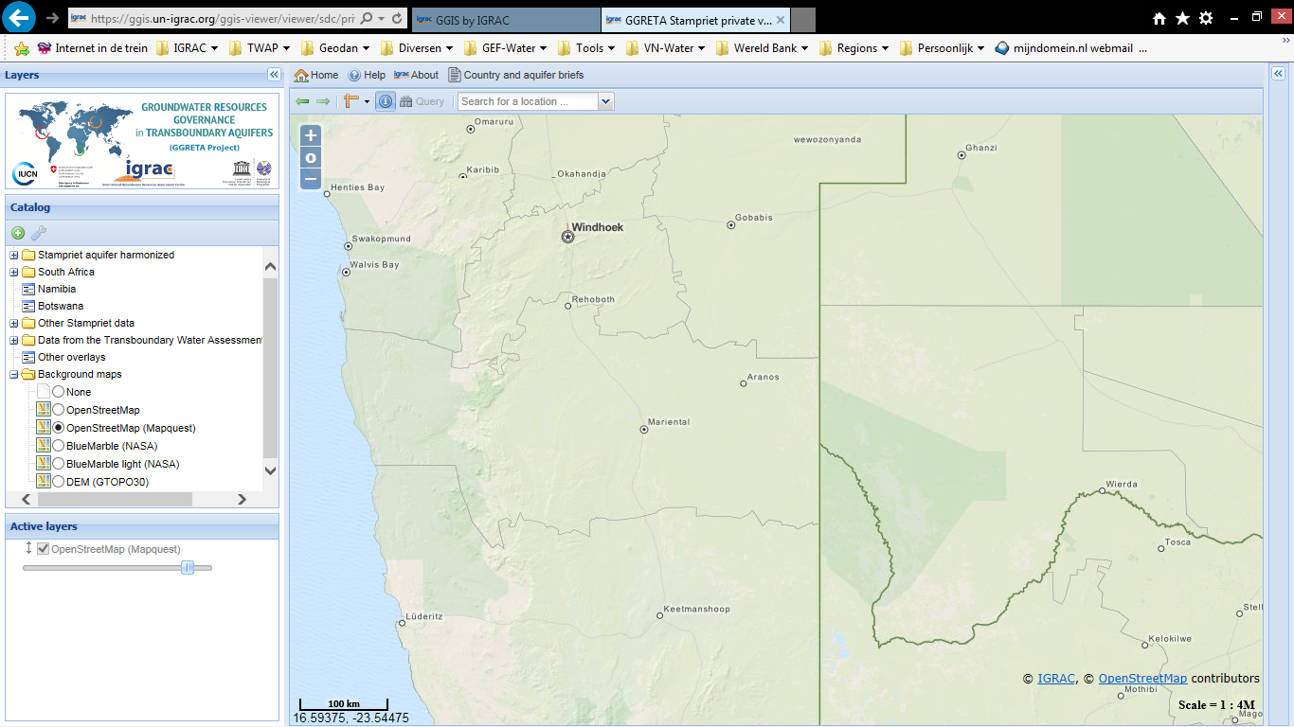

Folder structure and map view
Folder structure:
harmonized data
South Africa
Namibia
Botswana
Other data
Folder structure can be modified according to the needs of the project team

Slide 7
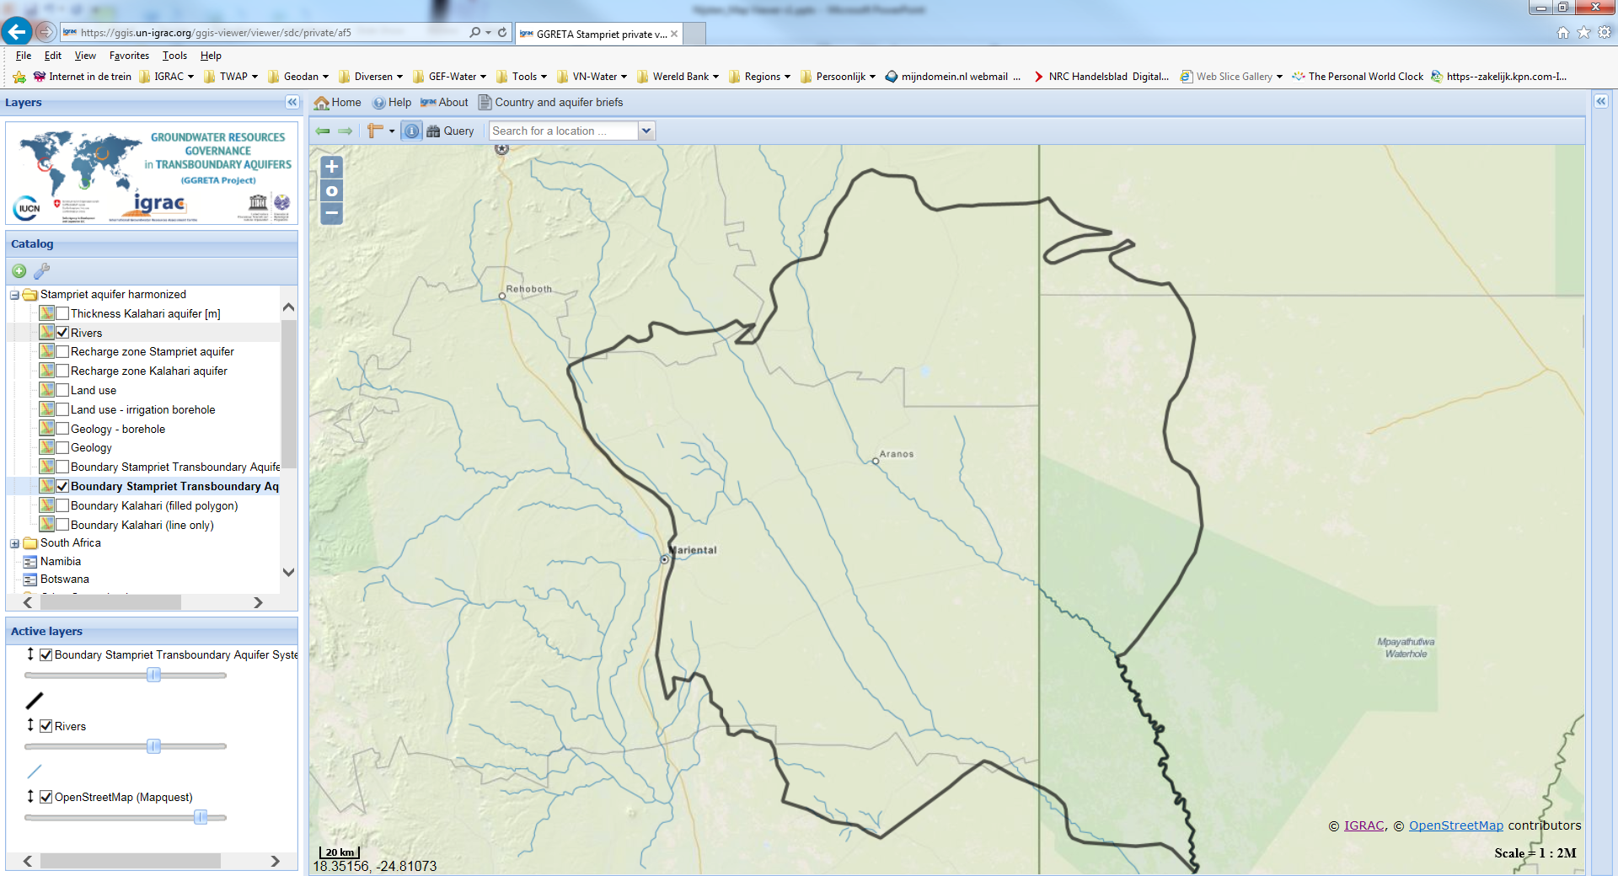
View maps - activate map layer

Slide 8
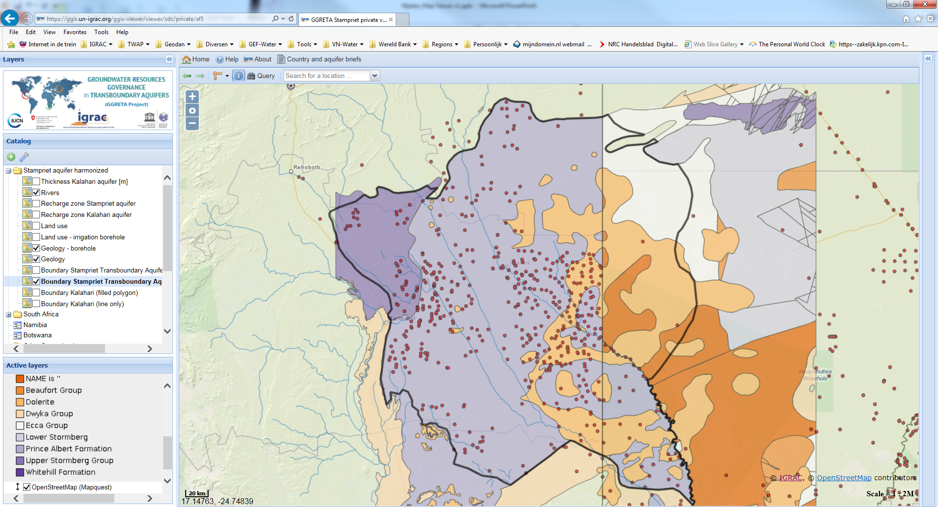
View maps – Geology

Slide 9
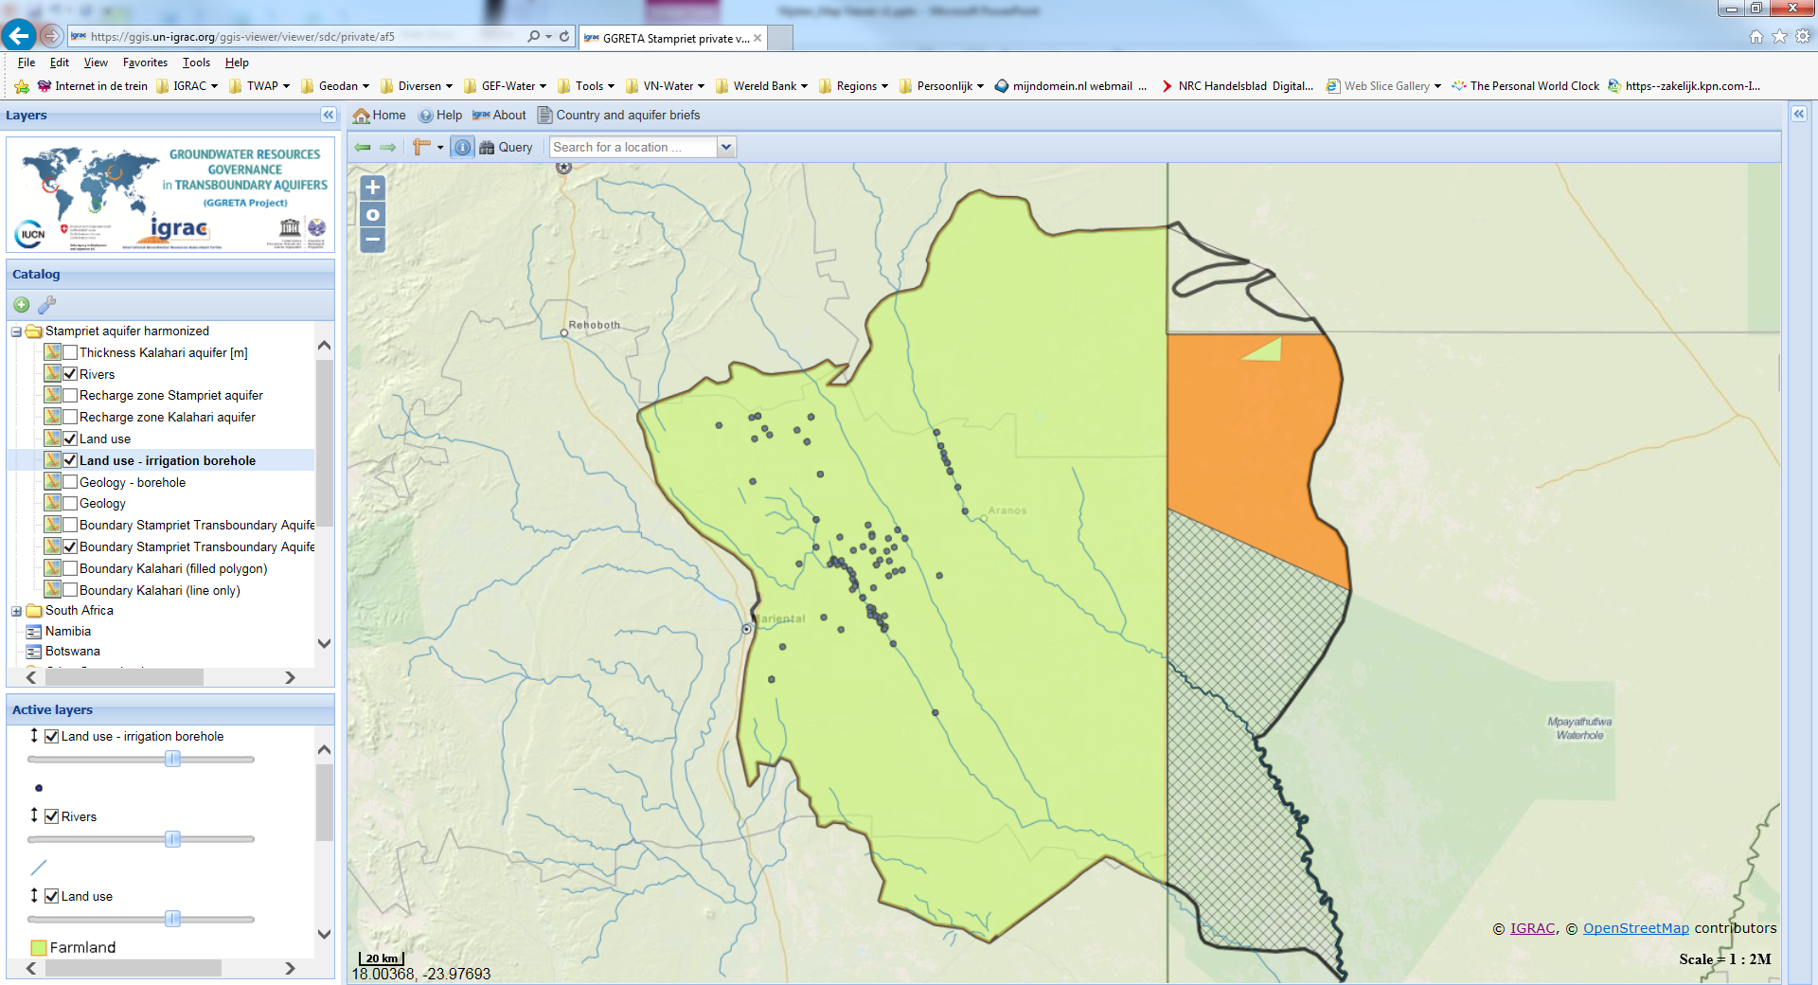
View maps – Land use

Slide 10
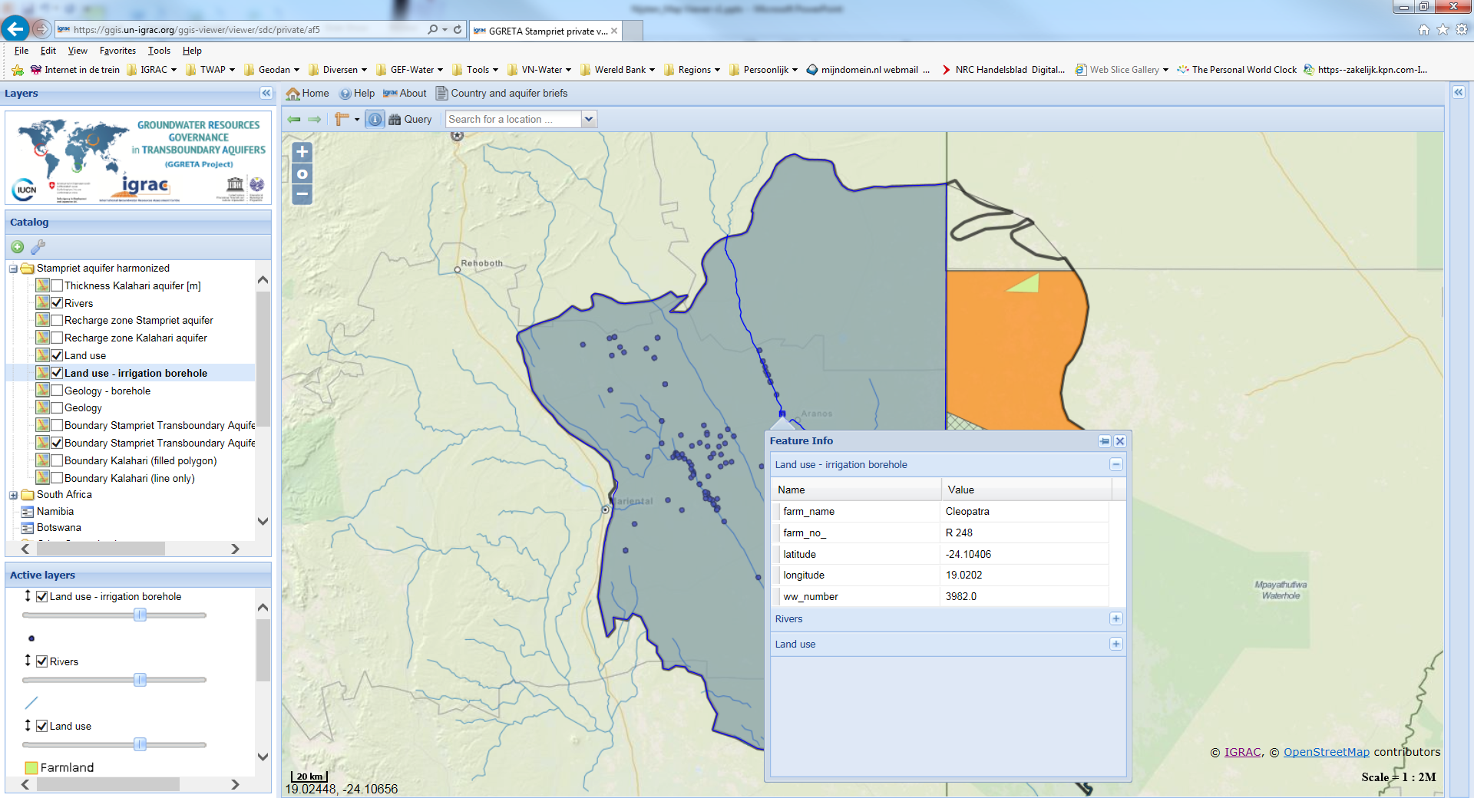
Get information from ‘behind’ the map
Browse additional information behind map elements:
For example borehole specifics like borehole number, formation, owner, etc.

Slide 11
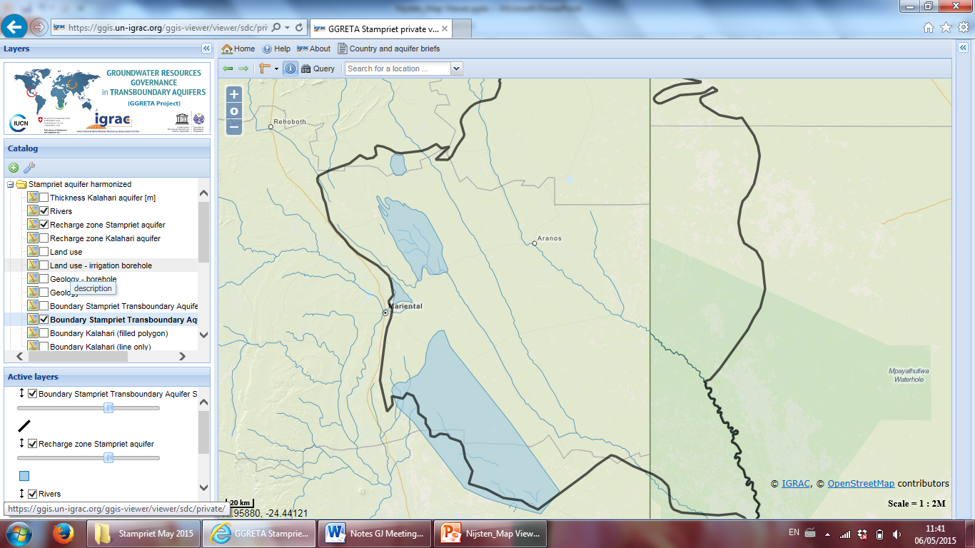
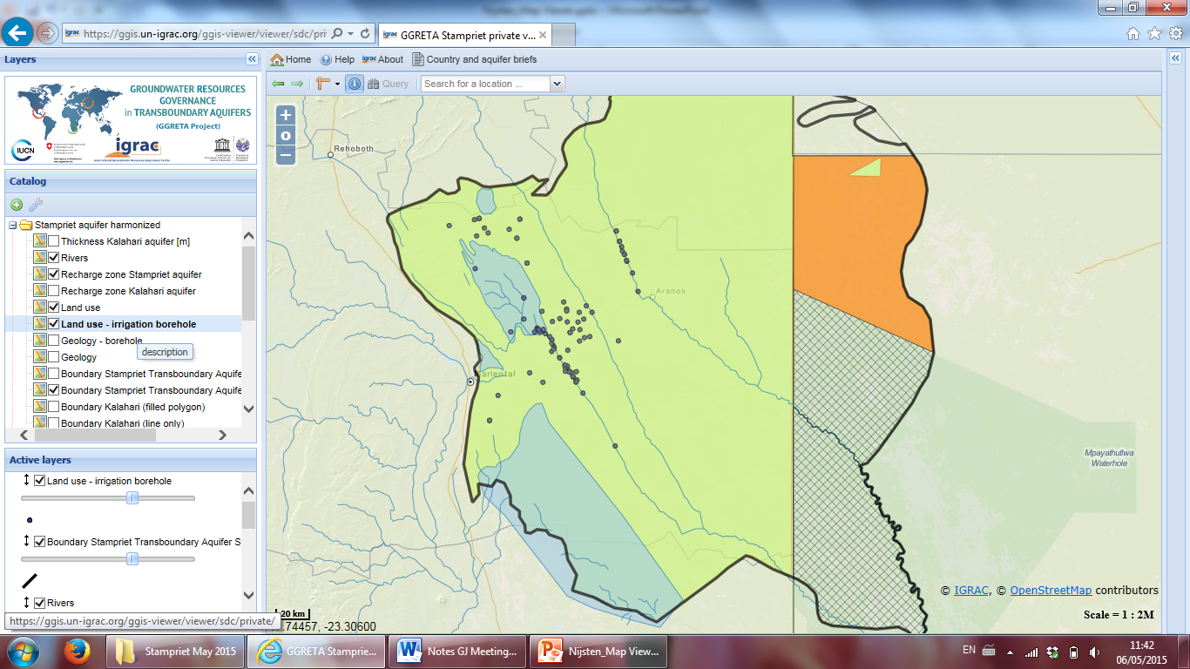
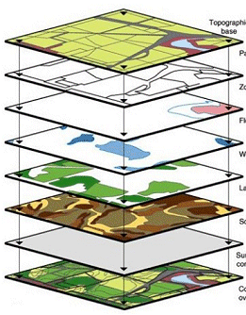
Create overlays e.g: recharge and land use
Create new insights by making
overlays of thematic maps

Slide 12
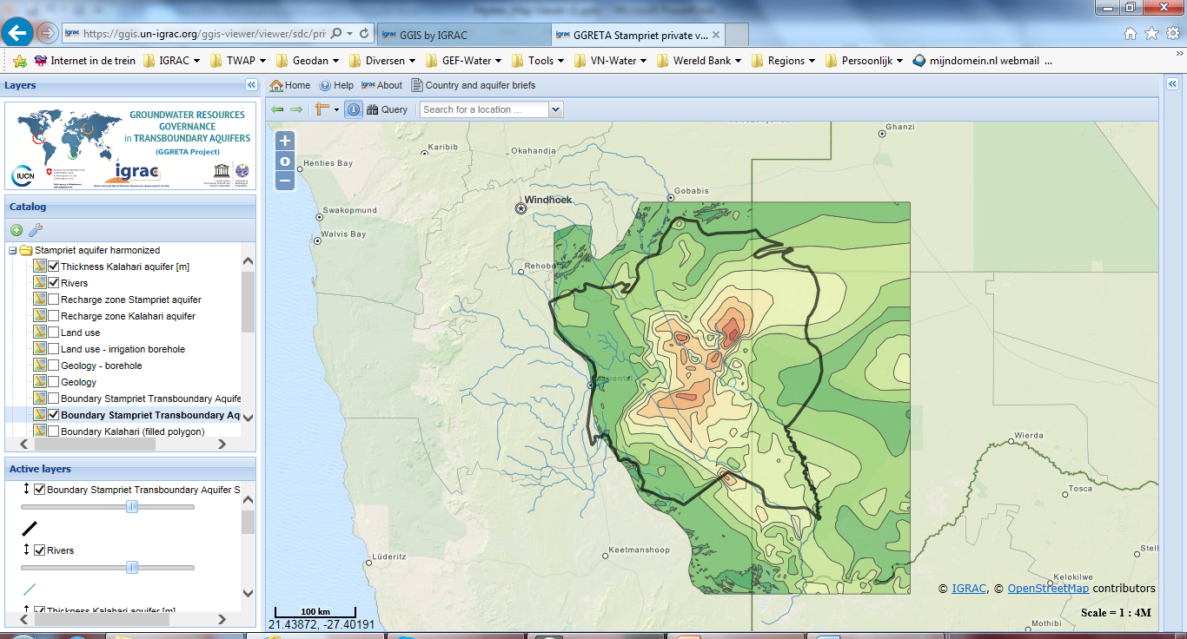

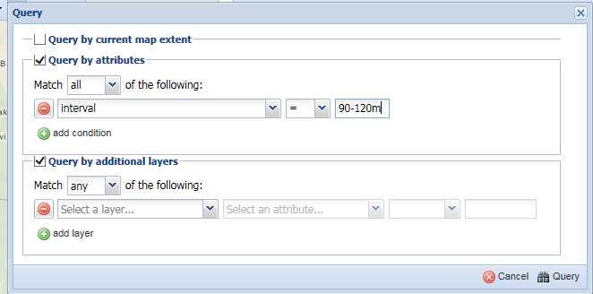
Query maps / filter content of maps
Analyse (multiple) maps in detail

Slide 13
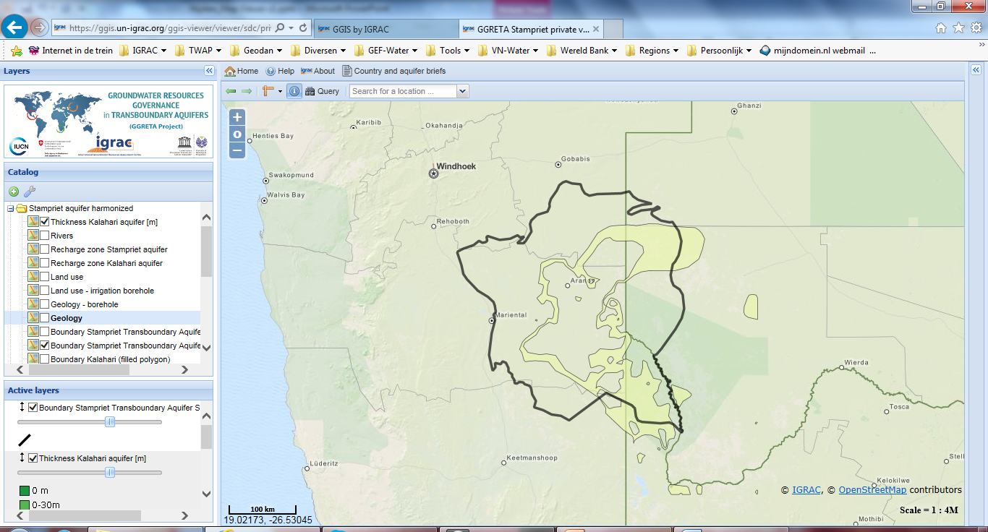
Query maps / filter content of maps
Query functionality becomes more & more useful with more maps in the system and when maps contain additional information

Slide 14
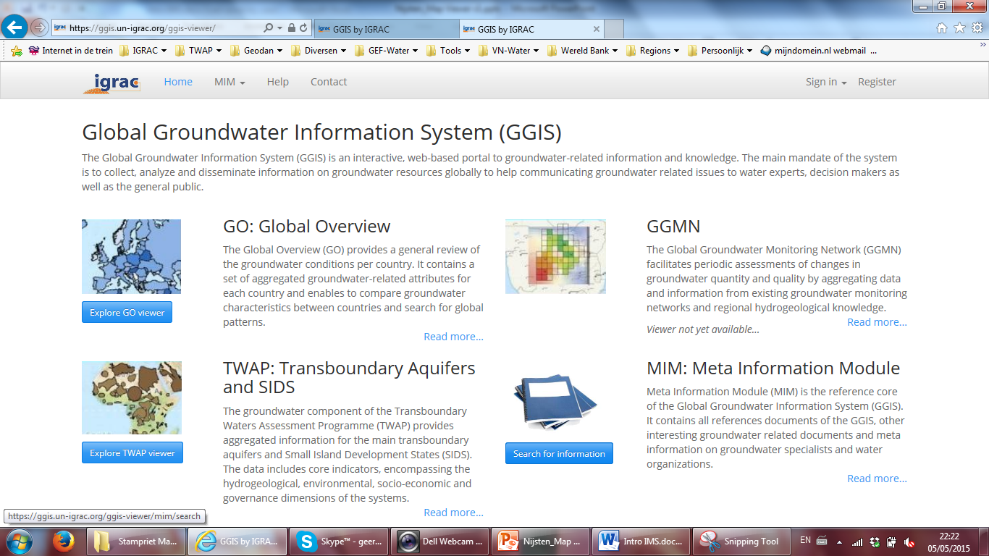
Storing and sharing of additional information

Slide 15
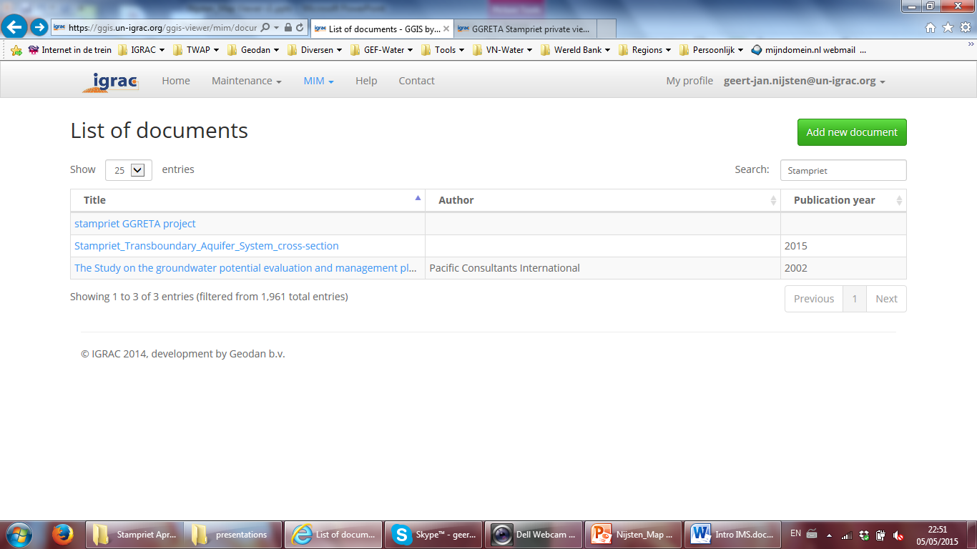
Storing and sharing of additional information

Slide 16
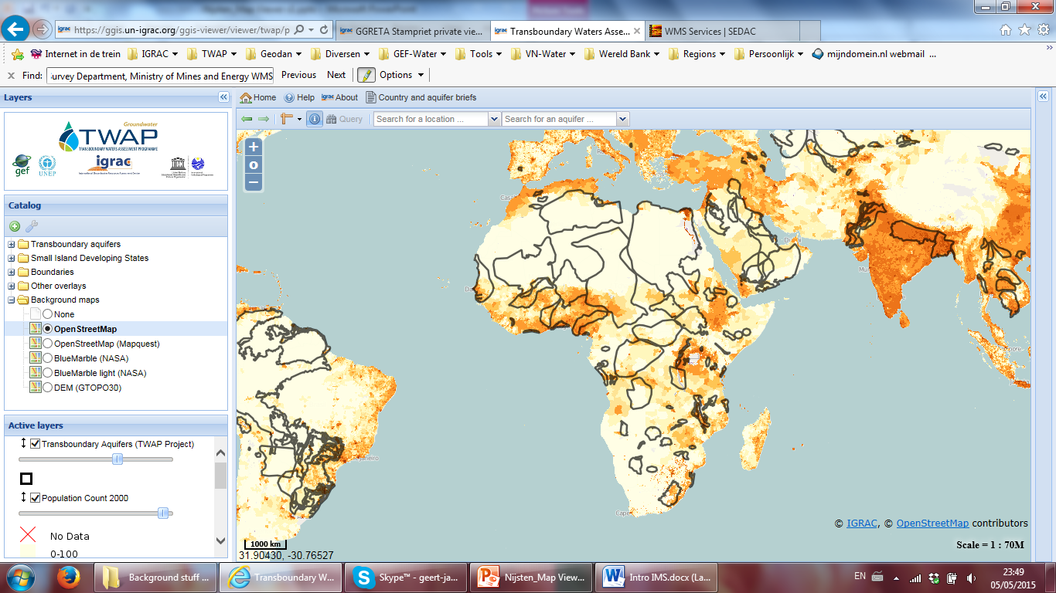
Add external data for analyses
International open standards (WMS/WFS),
enabling viewing of external maps.
For example from NASA database:
http://sedac.ciesin.columbia.edu/geoserver/wms

Slide 17
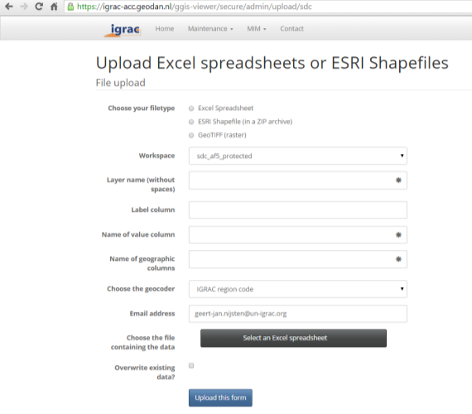
Data Upload – authorised users only
Point data (e.g. borehole locations with information on formation type, water quality): Excel spreadsheet
GIS-maps with points, lines and polygons (e.g: land use map): ESRI Shapefile
Geo-referenced images (e.g: satellite image, elevation data): geo-tiff
Documents: Reports, Images, etc.

Slide 18
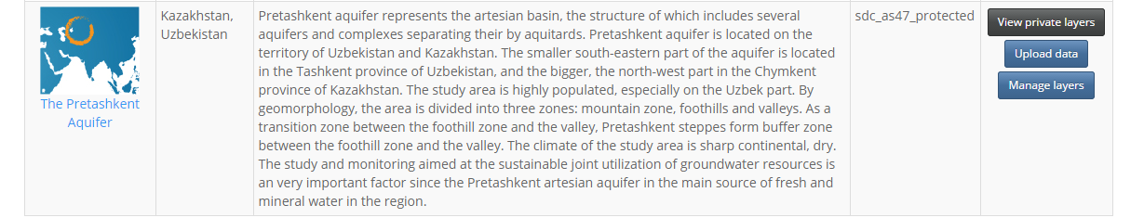
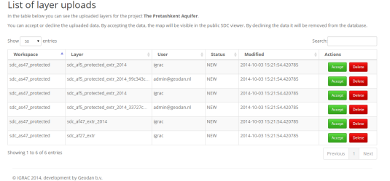
Publishing data – authorised users only copy maps from private to public viewer
Different roles can be defined. Currently:
GGRETA ‘Regional coordinator’
access protected viewer, upload data, manage data
GGRETA ‘National experts’
access protected viewer, upload data for their country

Slide 19
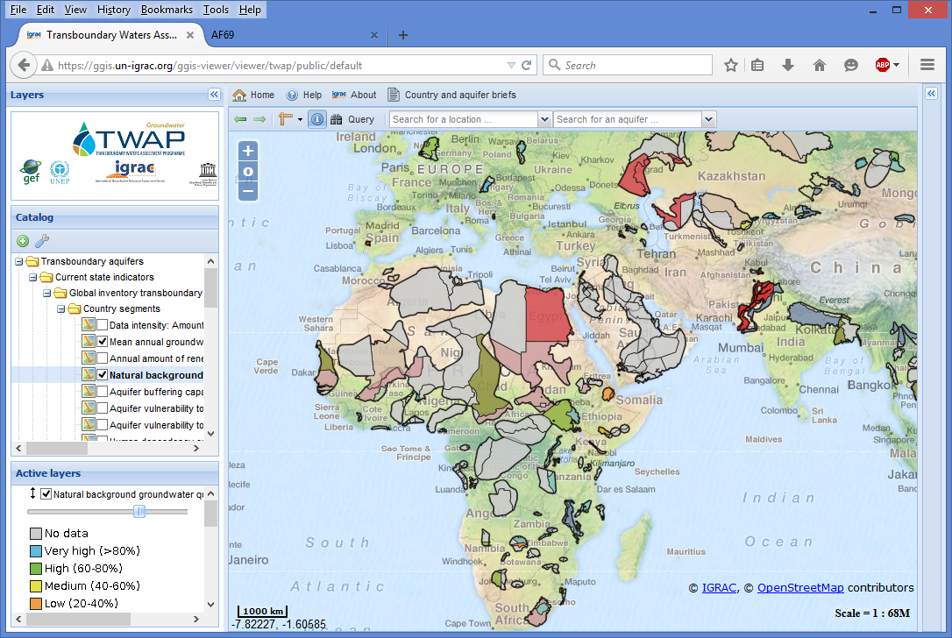
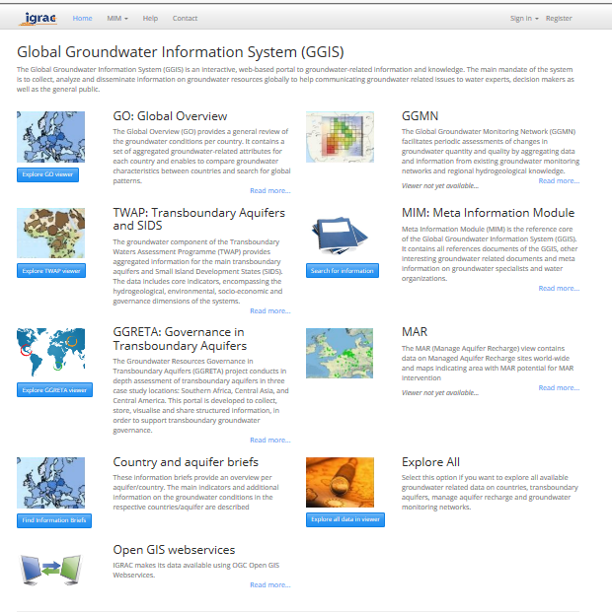
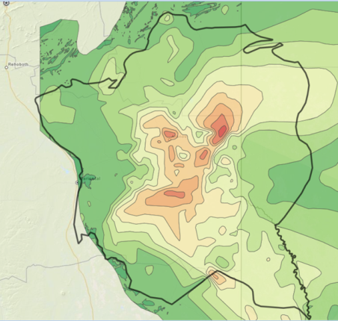
Integration into Global Groundwater Information System
https://ggis.un-igrac.org
GGRETA system is integrated into Global Groundwater Information System
Hosted & Maintained by IGRAC
Benefits:
Lots of groundwater data in one place
IGRAC committed to long term maintenance
Stampriet automatically benefits from future improvements

Slide 20
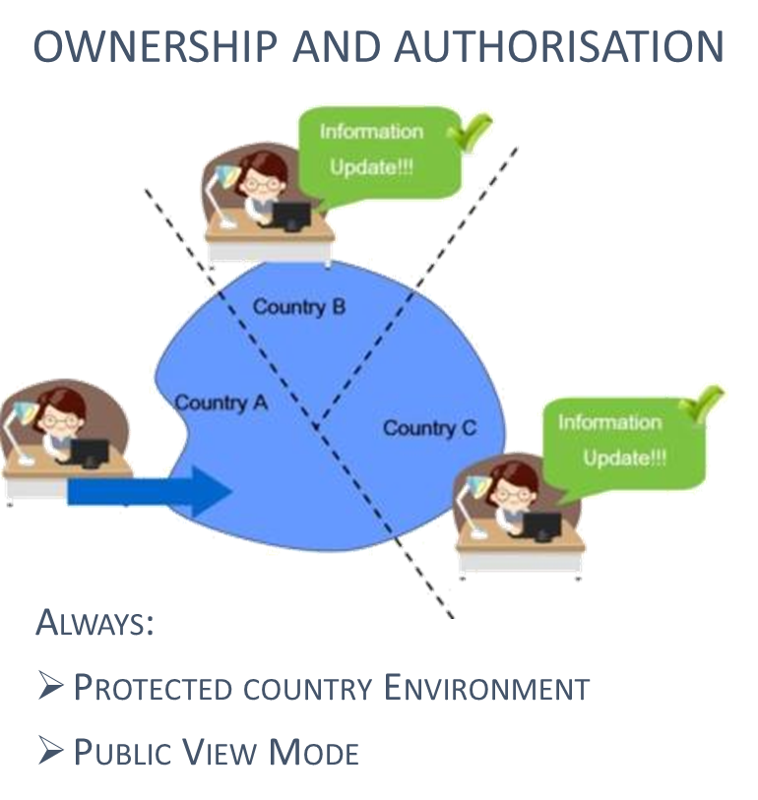
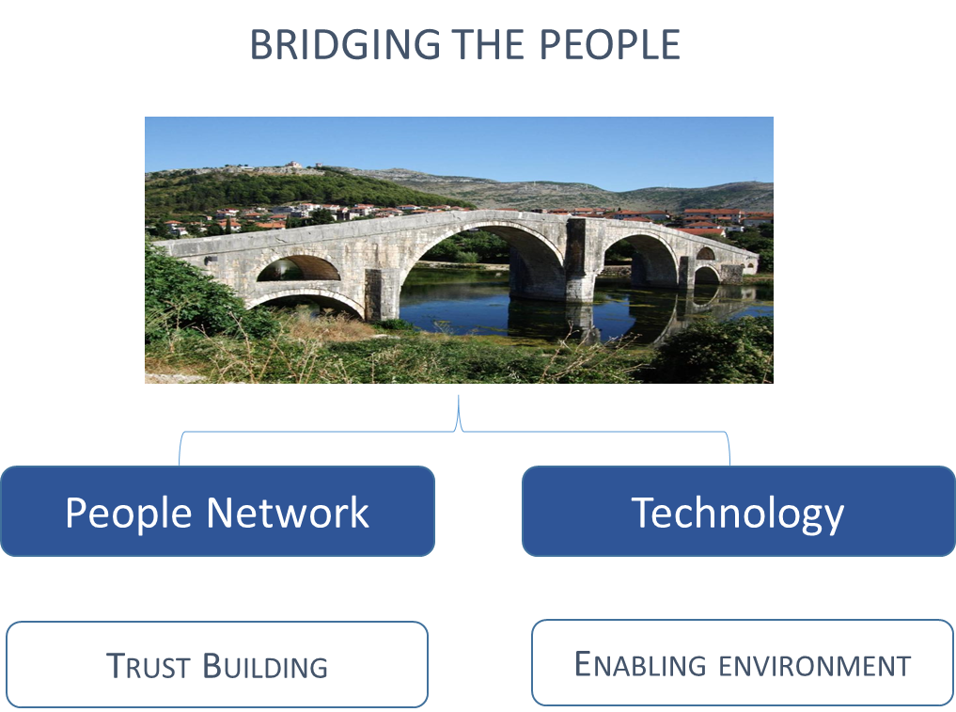
Summary: IMS to facilitate sharing of information
Connecting people
Notes:
IMS is easy accessible tool to support visualisations and analyses, which is intended to develop into an important working tool for all parties and stakeholders involved in the governance of this transboundary aquifer.
Countries decide about the content of the system and are able to upload new, additional information themselves. IGRAC will provide long-term support
Maps can be made publically available to anyone with an internet connection: all stakeholders can make use of the system for reference but also to create new insights by making overlays of maps and filtering / querying.
A password protected environment supports cooperation between countries and parties officially involved in the governance of the aquifer. It simply needs to be decided who is required to get access to the protected / private workspace.

Slide 21
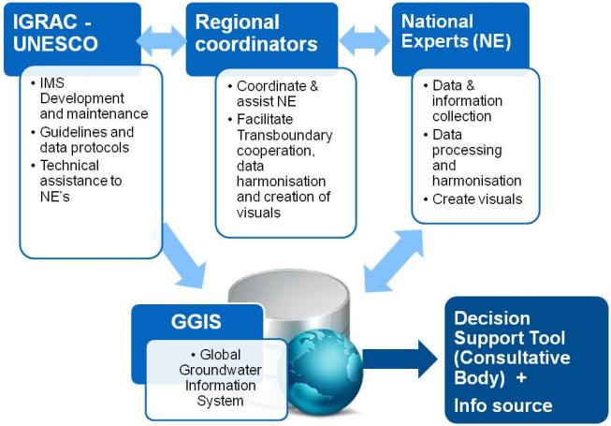
Stampriet Information Management System:
Support tool for transboundary governance

Slide 22
Follow up
Need to agree on:
Content for the system:
  Which maps to upload?
  Which data to include ‘behind the maps’?
  Which documents to upload?
All in public viewer or some in password protected viewer?
Who needs to get registered / authorised to upload and manage data in the system – especially for the future?

Slide 23
Thank you

Slide 24
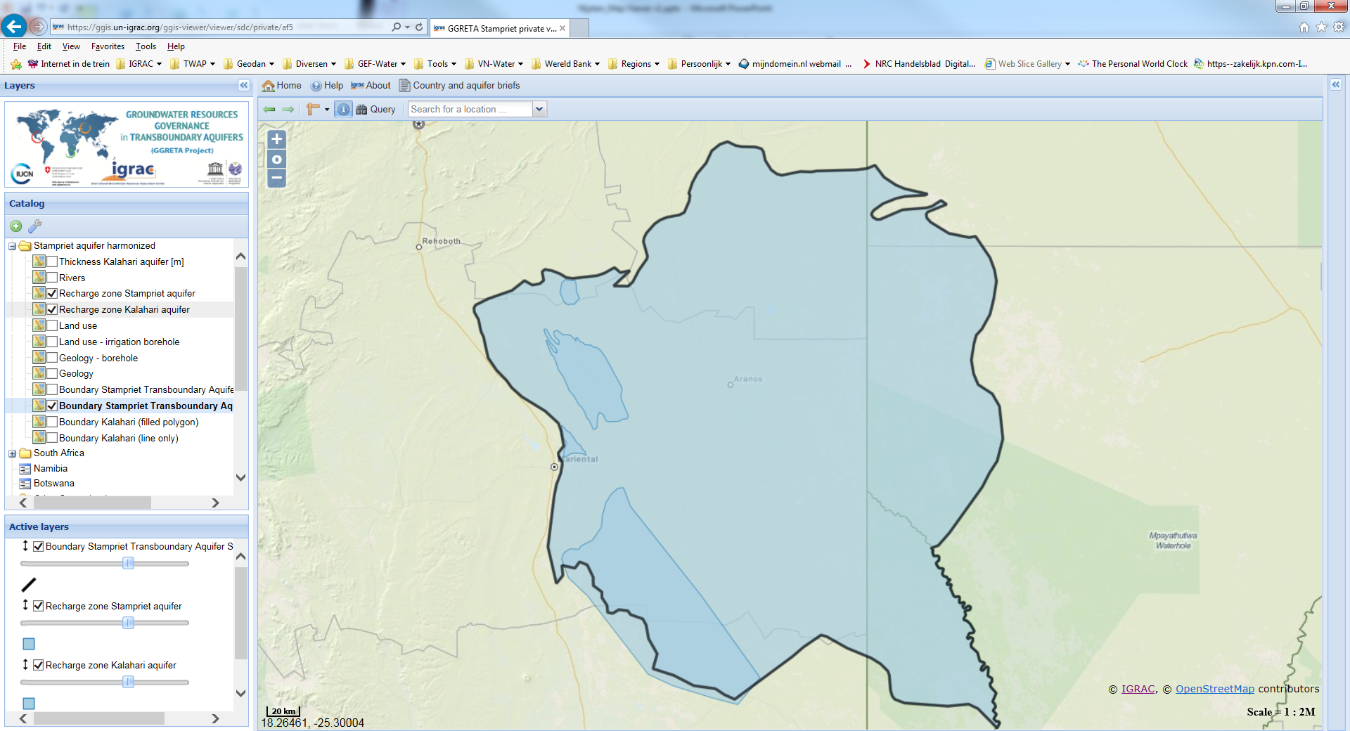

Slide 25
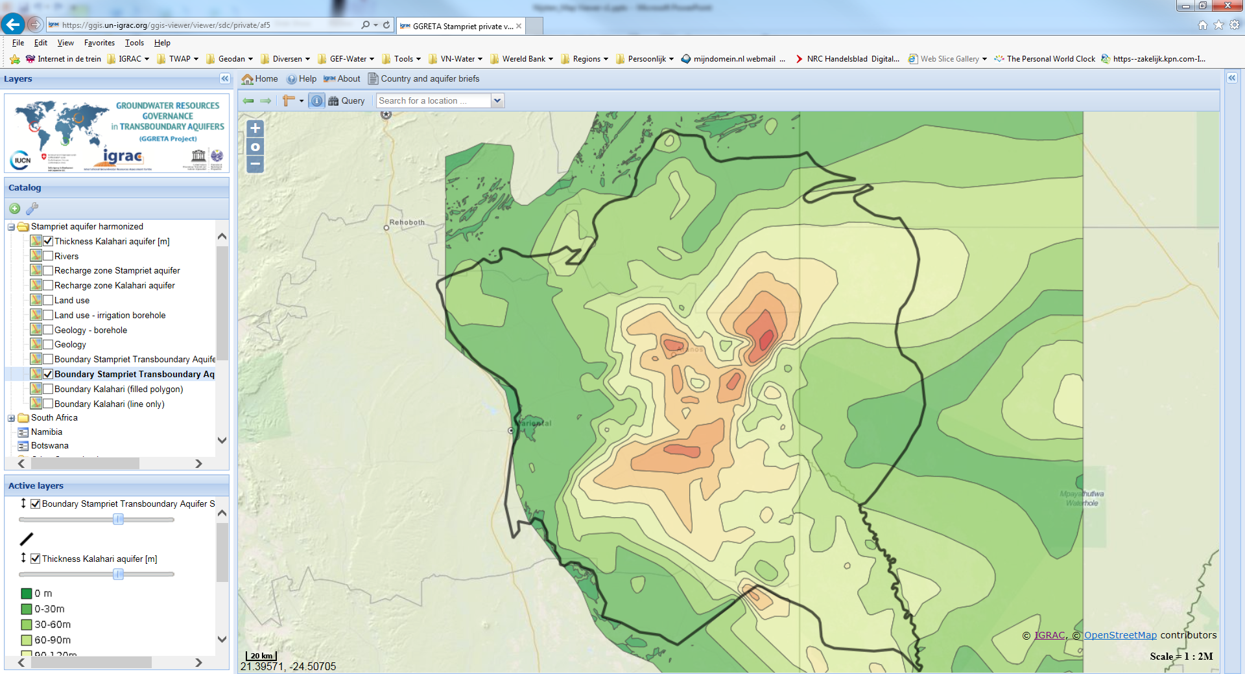

Slide 26
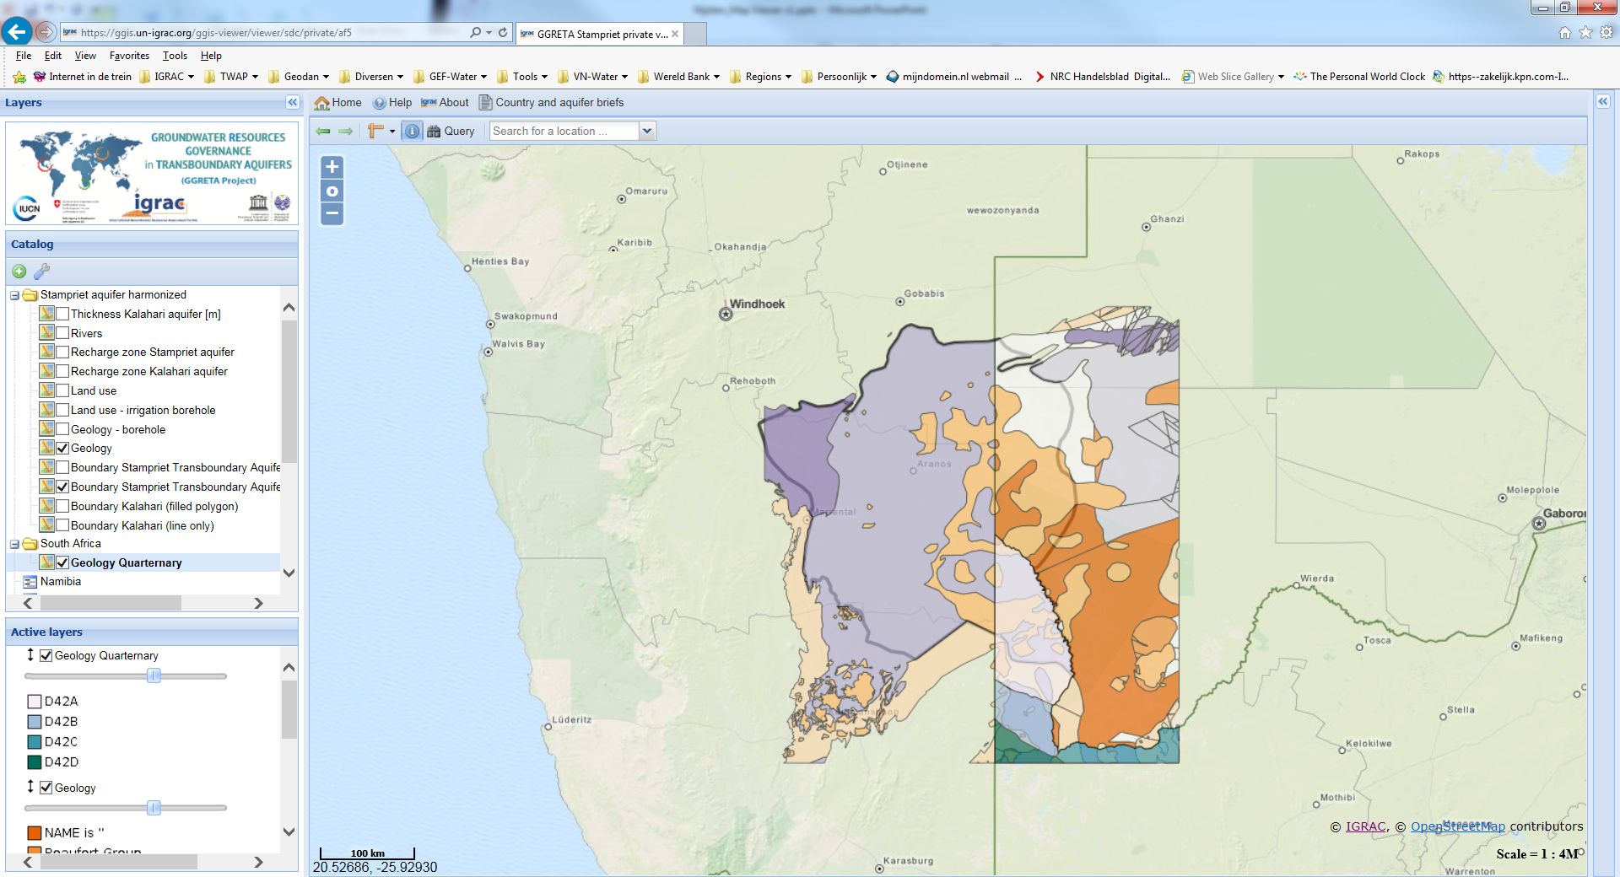

Slide 27
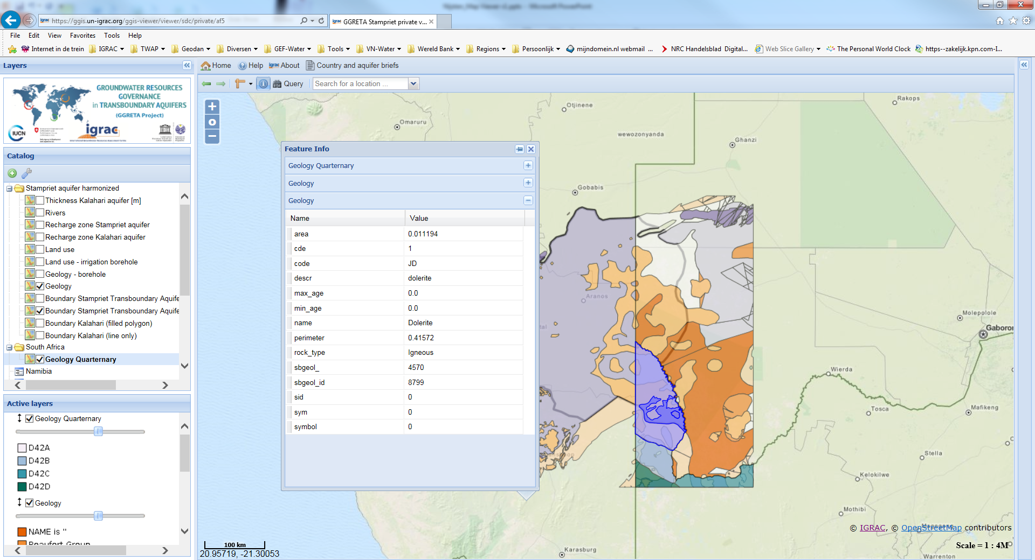

Slide 28
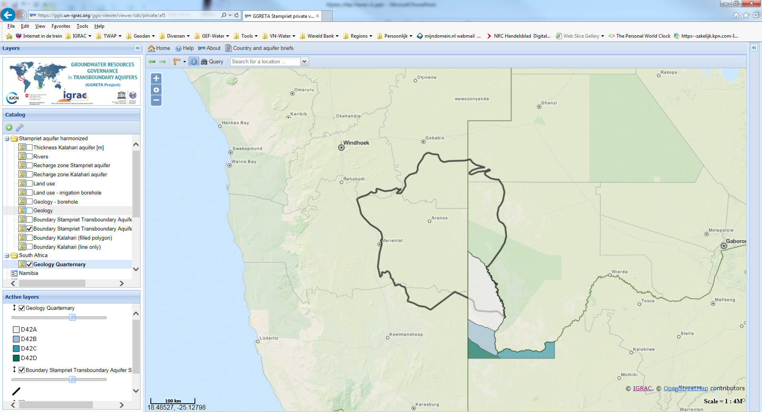

Slide 29
