Slide 1
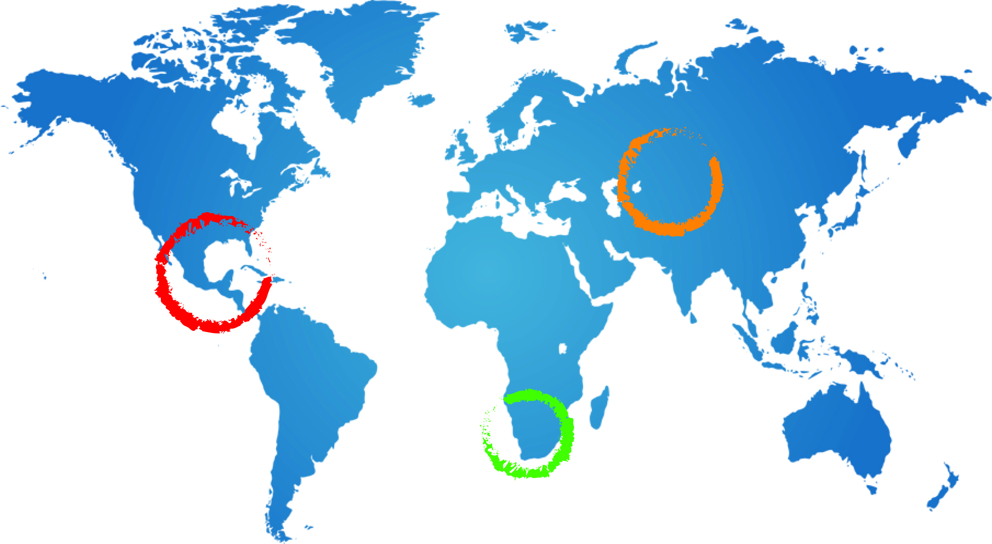
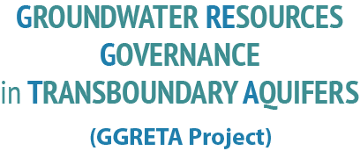
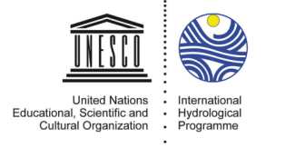
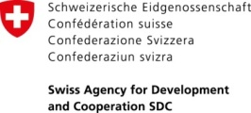
Day 1 wrap up and Recommendations
Hydrogeology and Socio-Economic/Environmental
Tales Carvalho Resende
6 May 2015
Gaborone, Botswana

Slide 2
Wrap up
Pollution:
As a whole, the STAS is not threatened by over abstraction or pollution at current levels of development. However, there are some pollution threats at local level (mainly for shallow Kalahari aquifers).
There is neither industry nor mining activities taking place currently in the STAS area. However, any kind of mining activities would lead to major pollution of the deep aquifers due to their friability.
Water efficiency:
Issue of water efficiency due to boreholes casting leaks and corrosion
Monitoring and maintenance:
Important gaps in long-term data series
Private/Public ownership / licensing
2

Slide 3
Recommendations for MCCM
Foster research to improve understanding:
Encourage local institutional to improve local knowledge.
Use of Information Management System (IMS) as a way to reliably capture; edit (update); store and process data.
Promote monitoring and maintenance
Raise awareness on “Sustainable Development”:
Promote water efficiency.
Assess potential for future development or limitations to future developments.
Potentially provide legal & institutional responses to:
Drilling and construction requirements
Obligations to measure and submit abstraction permits
Private/Public ownership/licensing
3

