Slide 1
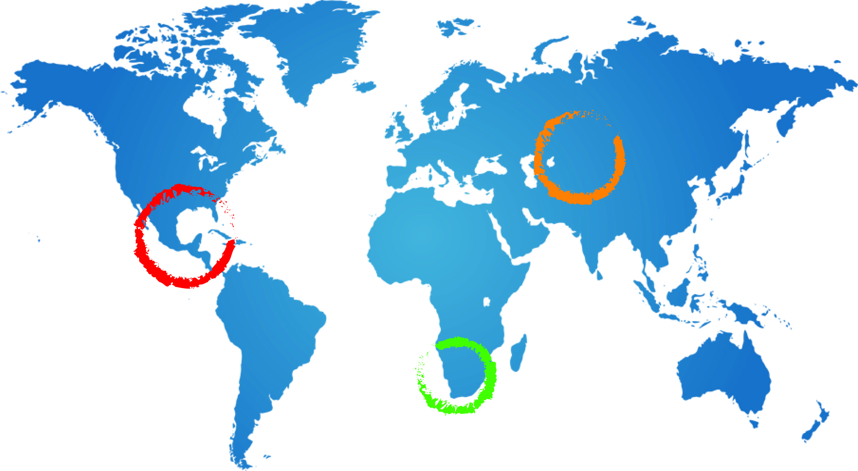
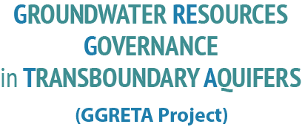
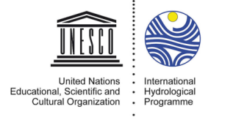
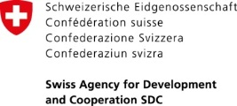
Overview of Chapter 4: State of the aquifer - legal and institutional setting
Viviane Kinyaga
Advocate Lebeloane, Odirile Itumeleng
GGRETA Technical Workshop: Gaborone: 5-7 May 2015

Slide 2
Take stock of current situation
Identify “strengths” and “weaknesses/shortcomings”
Draw out responses for the STAS

Slide 3
Level of assessment
Transboundary
The revised SADC Protocol on Shared Watercourses
ORASECOM agreement
Institutional provisions by Protocol and Agreement
Resolution 63/124 on the Law of Transboundary Aquifers
Domestic
National level policies, laws, regulations, strategies and institutions

Slide 4
Methodology
Scoring system – completeness of legal instruments for protection of the STAS
Specific instruments to STAS and/or groundwater
Water Utilisation/Abstraction/Well Drilling
Water Pollution Control
Settlement of disputes
Institutional arrangements
Other matters such as Environmental Protection and Preservation, Prevention of, Harmful Effects, Data Exchange, Prior Notification of Planned Measures, Emergency Situations)

Slide 6
Transboundary level - legal
There is no legal instrument that is specific to the management of transboundary aquifers
Groundwater management is integrated into the non-specific legal instruments namely; Revised SADC Protocol on Shared Watercourses and ORASECOM agreement
The two instruments scored high, implying that they include all the necessary elements that make them complete in terms of creating an enabling environment for transboundary aquifer management

Slide 7
Transboundary level - institutions
SADC Water Division
SADC Groundwater and Drought Management Project
SADC Groundwater Grey Data Project
ORASECOM
Council, Secretariat, Task teams (committees – hydrogeology)
Do they sufficiently take care of STAS? – from a transboundary perspective - Yes

Slide 8
Domestic - legal
Enabling legal framework exist
Varying degree of implementation and enforcement of regulations
Centralised government bodies – dealing with groundwater administration and management

Slide 9
Botswana
Legal instruments inclusive of groundwater
Regulations in place
Water Bill 2005 – administrative responsibility shifting from DWA to Water Utilities. DWA oversee and regulatory function
Coordination amongst sectoral laws?
Local level participation?

Slide 10
Namibia
Legal instruments inclusive of groundwater; section on groundwater protection in the Act
Provision of aquifers (water protection areas)
Weak/slow implementation; absence of regulations to enforce legal provisions
Geohydrology Division within DWAF
Provision for basin management committees

Slide 11
Thank you

