Slide 1
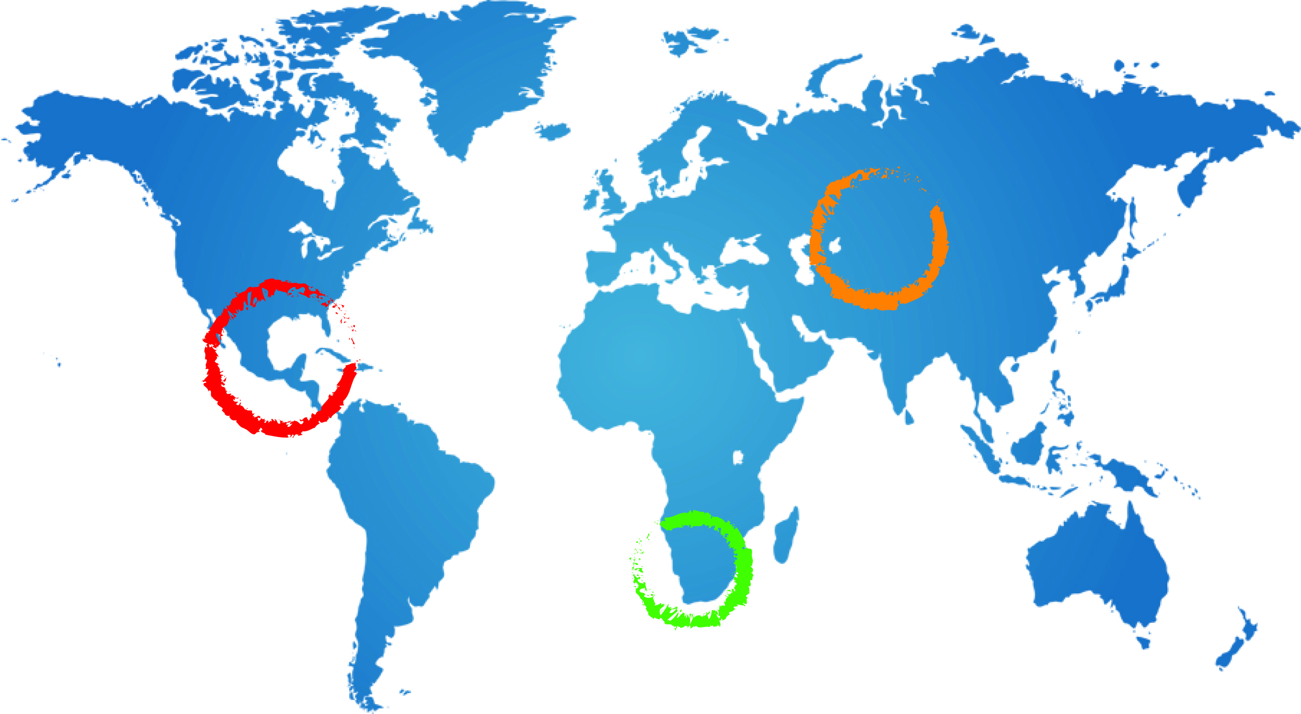
Information Management System
Daniela Benedicto van Dalen - IGRAC
Johannesburg- February 2015

Slide 2
Purpose of GGRETA IMS
Collect, store, visualise and share structured information
in order to:
Support transboundary groundwater governance
Allow replication of the detailed aquifer assessment

Slide 3
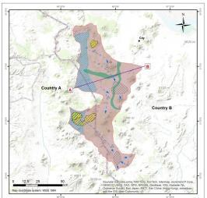
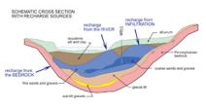
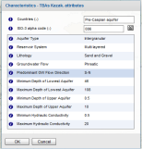
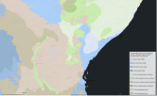
Information to be stored in IMS
A user can upload one of the following file types:
Excel Spreadsheet
ESRI Shapefile
GeoTIFF raster file
Metadata (documents)

Slide 4
GGRETA: geo-referenced data
Requirements for the SHAPE FILES
A valid shape archive contains at least three main files: shape definition (.shp), an index (.shx) and a dBASE-table (.dbf). Optional are the projection (.prj) or a spatial index (.qix, .sbn of .sbx).
The geographical coordinate system must be WGS_84. To convert from another system, use the ‘Projection’ tool.
All text must be in English. Columns names in the ‘Attribute Table’ are capital sensitive. Only use small caps!
The use of diacrits in the filenames causes errors. (‘, “, ^, /, &, - , ~, ˘, ¸ , ¨ , (underscore is compatible: 1103_boundary )
The Upload limit is 100 MB.

Slide 5
GGRETA: geo-referenced data
Requirements EXCEL FILES
Extension must be xls/xlsx
The first row of the spreadsheet determines the column names
The column names ( = headers) can only be letters, numbers or ‘_’
(use of diacritical not supported)
The column name may not be empty or contain any space
The column name may only be of type “text”.
It’s not allowed to use “NULL” cells (use ‘-9999’).
Requirements EXCEL FILES
The file must be a valid GeoTIFF file, coordinate system WGS_1984.
The Upload limit is 100 MB

Slide 6
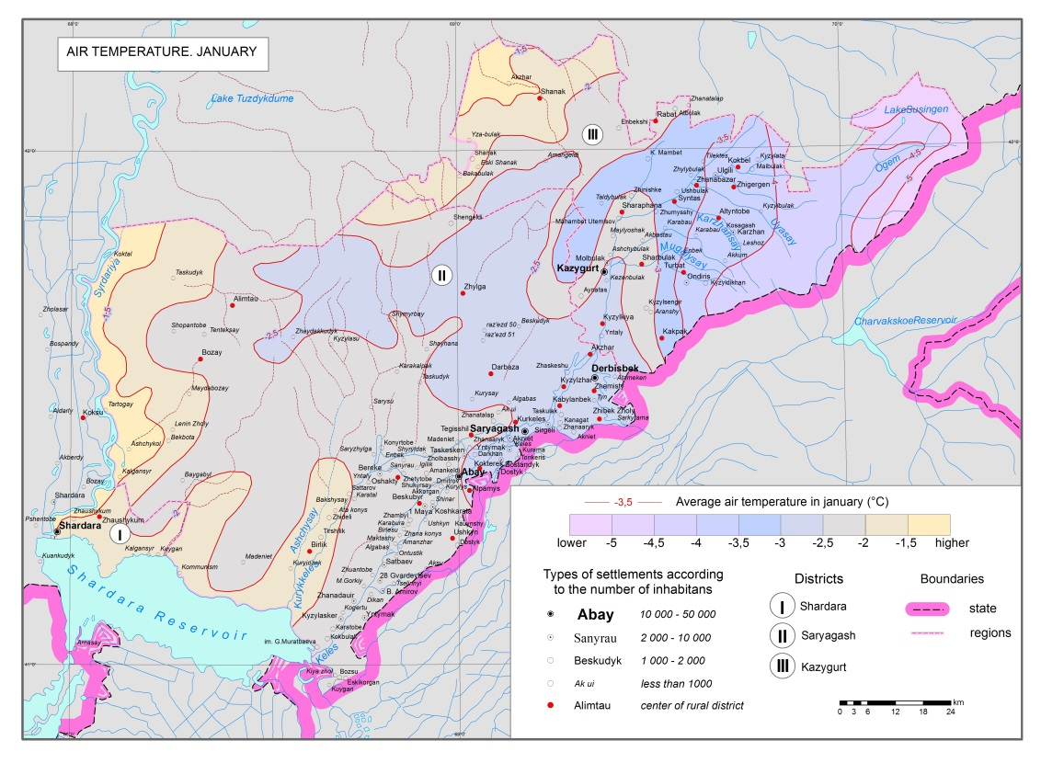
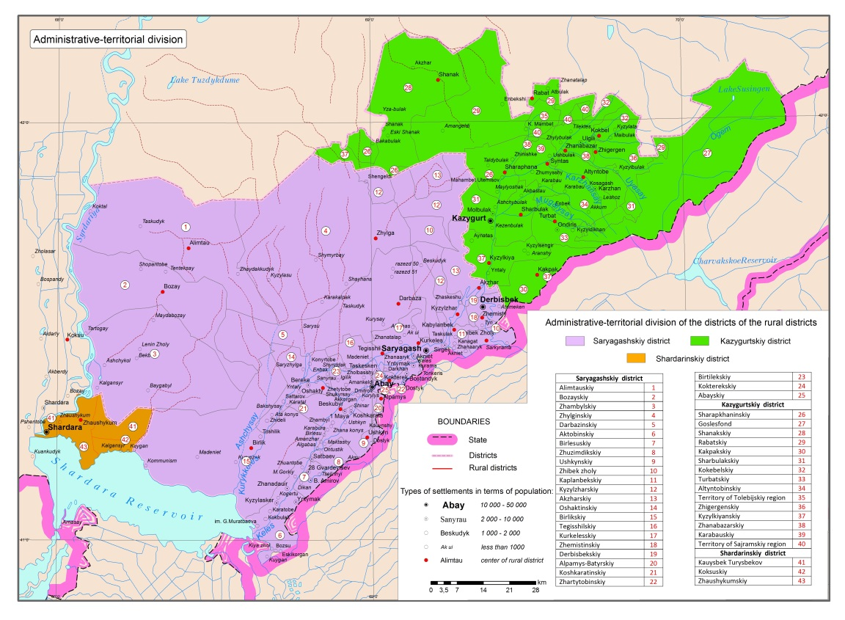
GGRETA: examples Pretashkent

Slide 7
Thank you

