Slide 1
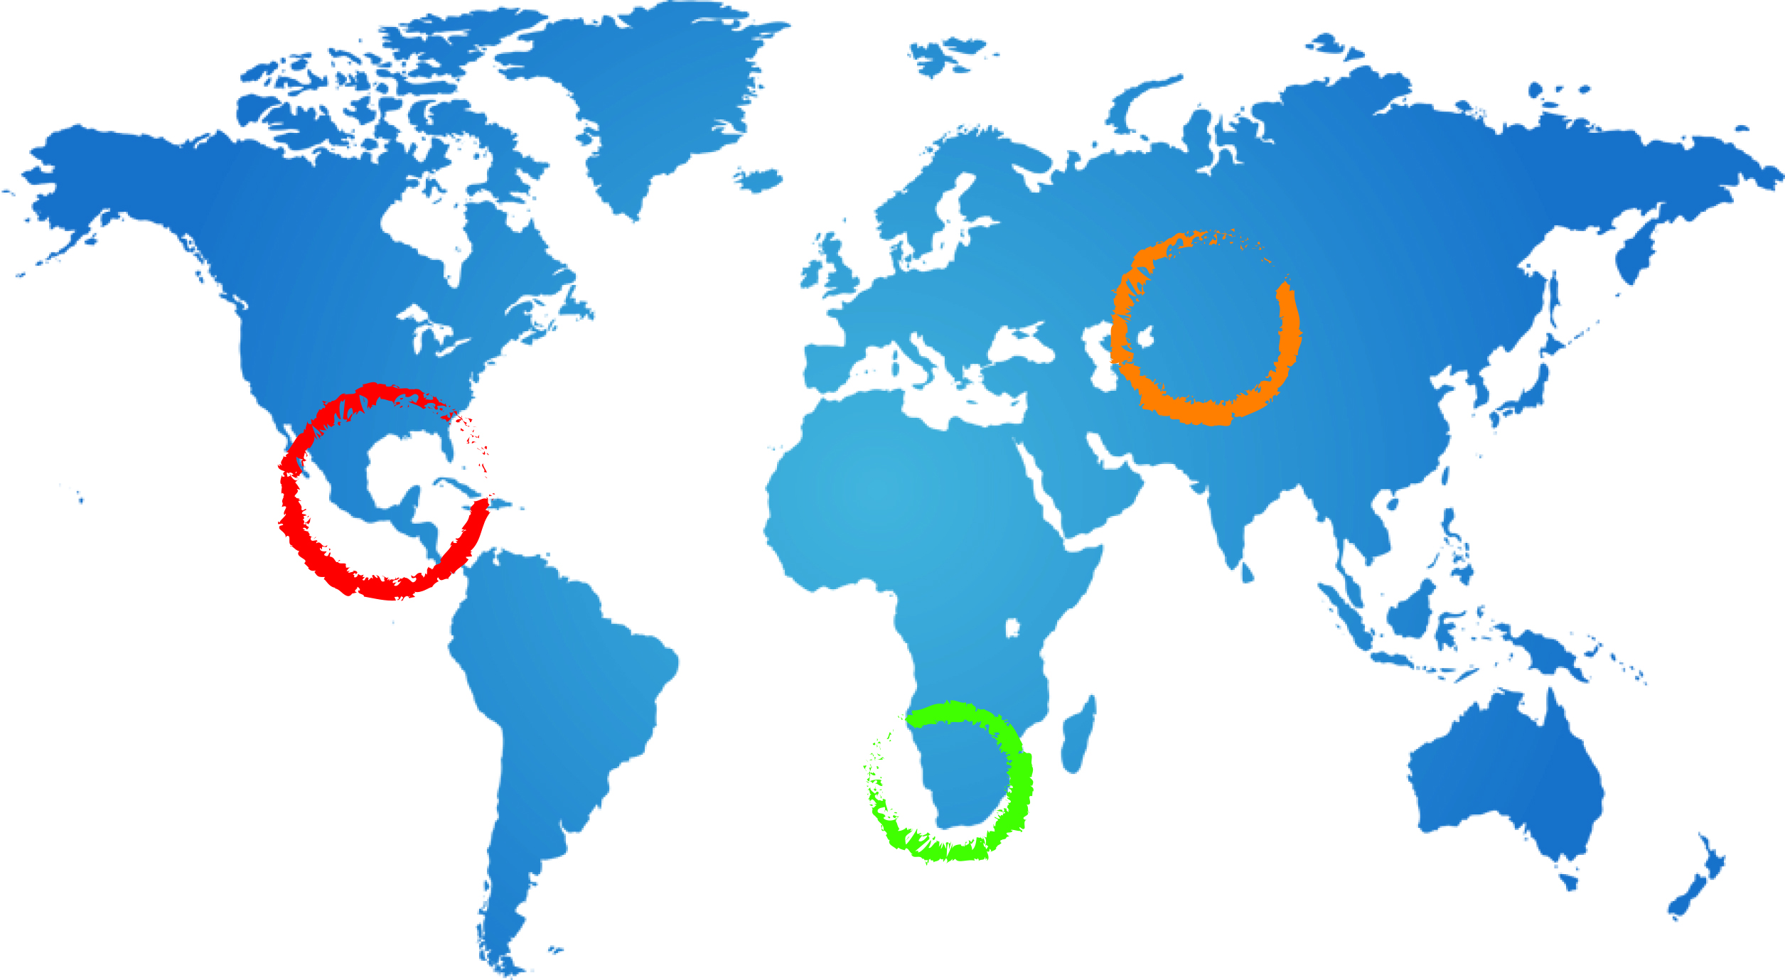








Integrated Aquifer Assessment-Process/Roles and Responsibilities—
(Updated>>Detailed Work Plan)
Piet Kenabatho
A Ross
24 February 2015
Johannesburg

Slide 2
Assessment Process(Reminder)
Interaction
Enhanced Team Work aiming to deliver together

Slide 3
Assessment Process Cont…
1. Data Harmonisation
(31st March)
2. Map production
(10th Apr)
3. Chapter Writing (24th Aprl)
4. Assessment Report (22nd May 2015)

Slide 4
Data Harmonisation & Mapping
 | Task | Responsibility(Specialists) | Product/ Deliverable | Deadline
1 | Data Format Harmonised at National level | Specialists supervised by RPC, PC, & Legal Expert | All national data in standardised format | 13th March 2015
2 | Data Harmonisation at TBA | Specialists supervised by RPC, PC, & Legal Expert | Harmonised data Report | 31st March 2015
3 | Producing Maps/Cross sections& other graphics | Specialists advised by CGS(Henk) & IGRAC | Maps | 10th April
4 | Data Exchange between national and specialist groups | Specialists supervised by RPC | All project data available to all Project team members | From 6th March onwards

Slide 5
Integrated Aquifer Assessment
Chapter | Responsible Person | Date
1-Intro/Background/objectives… | PK | Mar 13 2015
2-Drivers&Pressure on the Aquifer | BH&JL | Apr 24 2015
3-Hydrogeological characterisation & Conceptual Model of the Aquifer | Prof. JK | Apr 24 2015
4-Socioeconomic and environmental features | BM& BH (guid. From AR) | Apr 24 2015
5-Legal and Institutional Setting including gender related issues | VK (guid. From SB) | Apr 24 2015

Slide 6
Chapter | Responsible Person | Date
6-Impacts of changes in use, availability and quality of GW on resource dependent communities and the environment | Prof. JK, BM, with contributions from PK and PCU | May 8 2015
7-Policy, legal and institutional | VK, with contributions from the specialists & PK and PCU | May 8 2015
8,9-Conclusions from the assessment, and Recommendations for multicountry consultation and action | PK, Project Team and PCU | May 15 205

Slide 7
Outstanding issues
Critical data gaps?
Specialist ‘s capacity to make maps?
How to organise process of working in transboundary/interdisciplinary teams?
The process for engaging the team in chapters 8 and 9?
Gender considerations in the Assessment?
Scenarios?

Slide 8
Discussions

