Slide 1
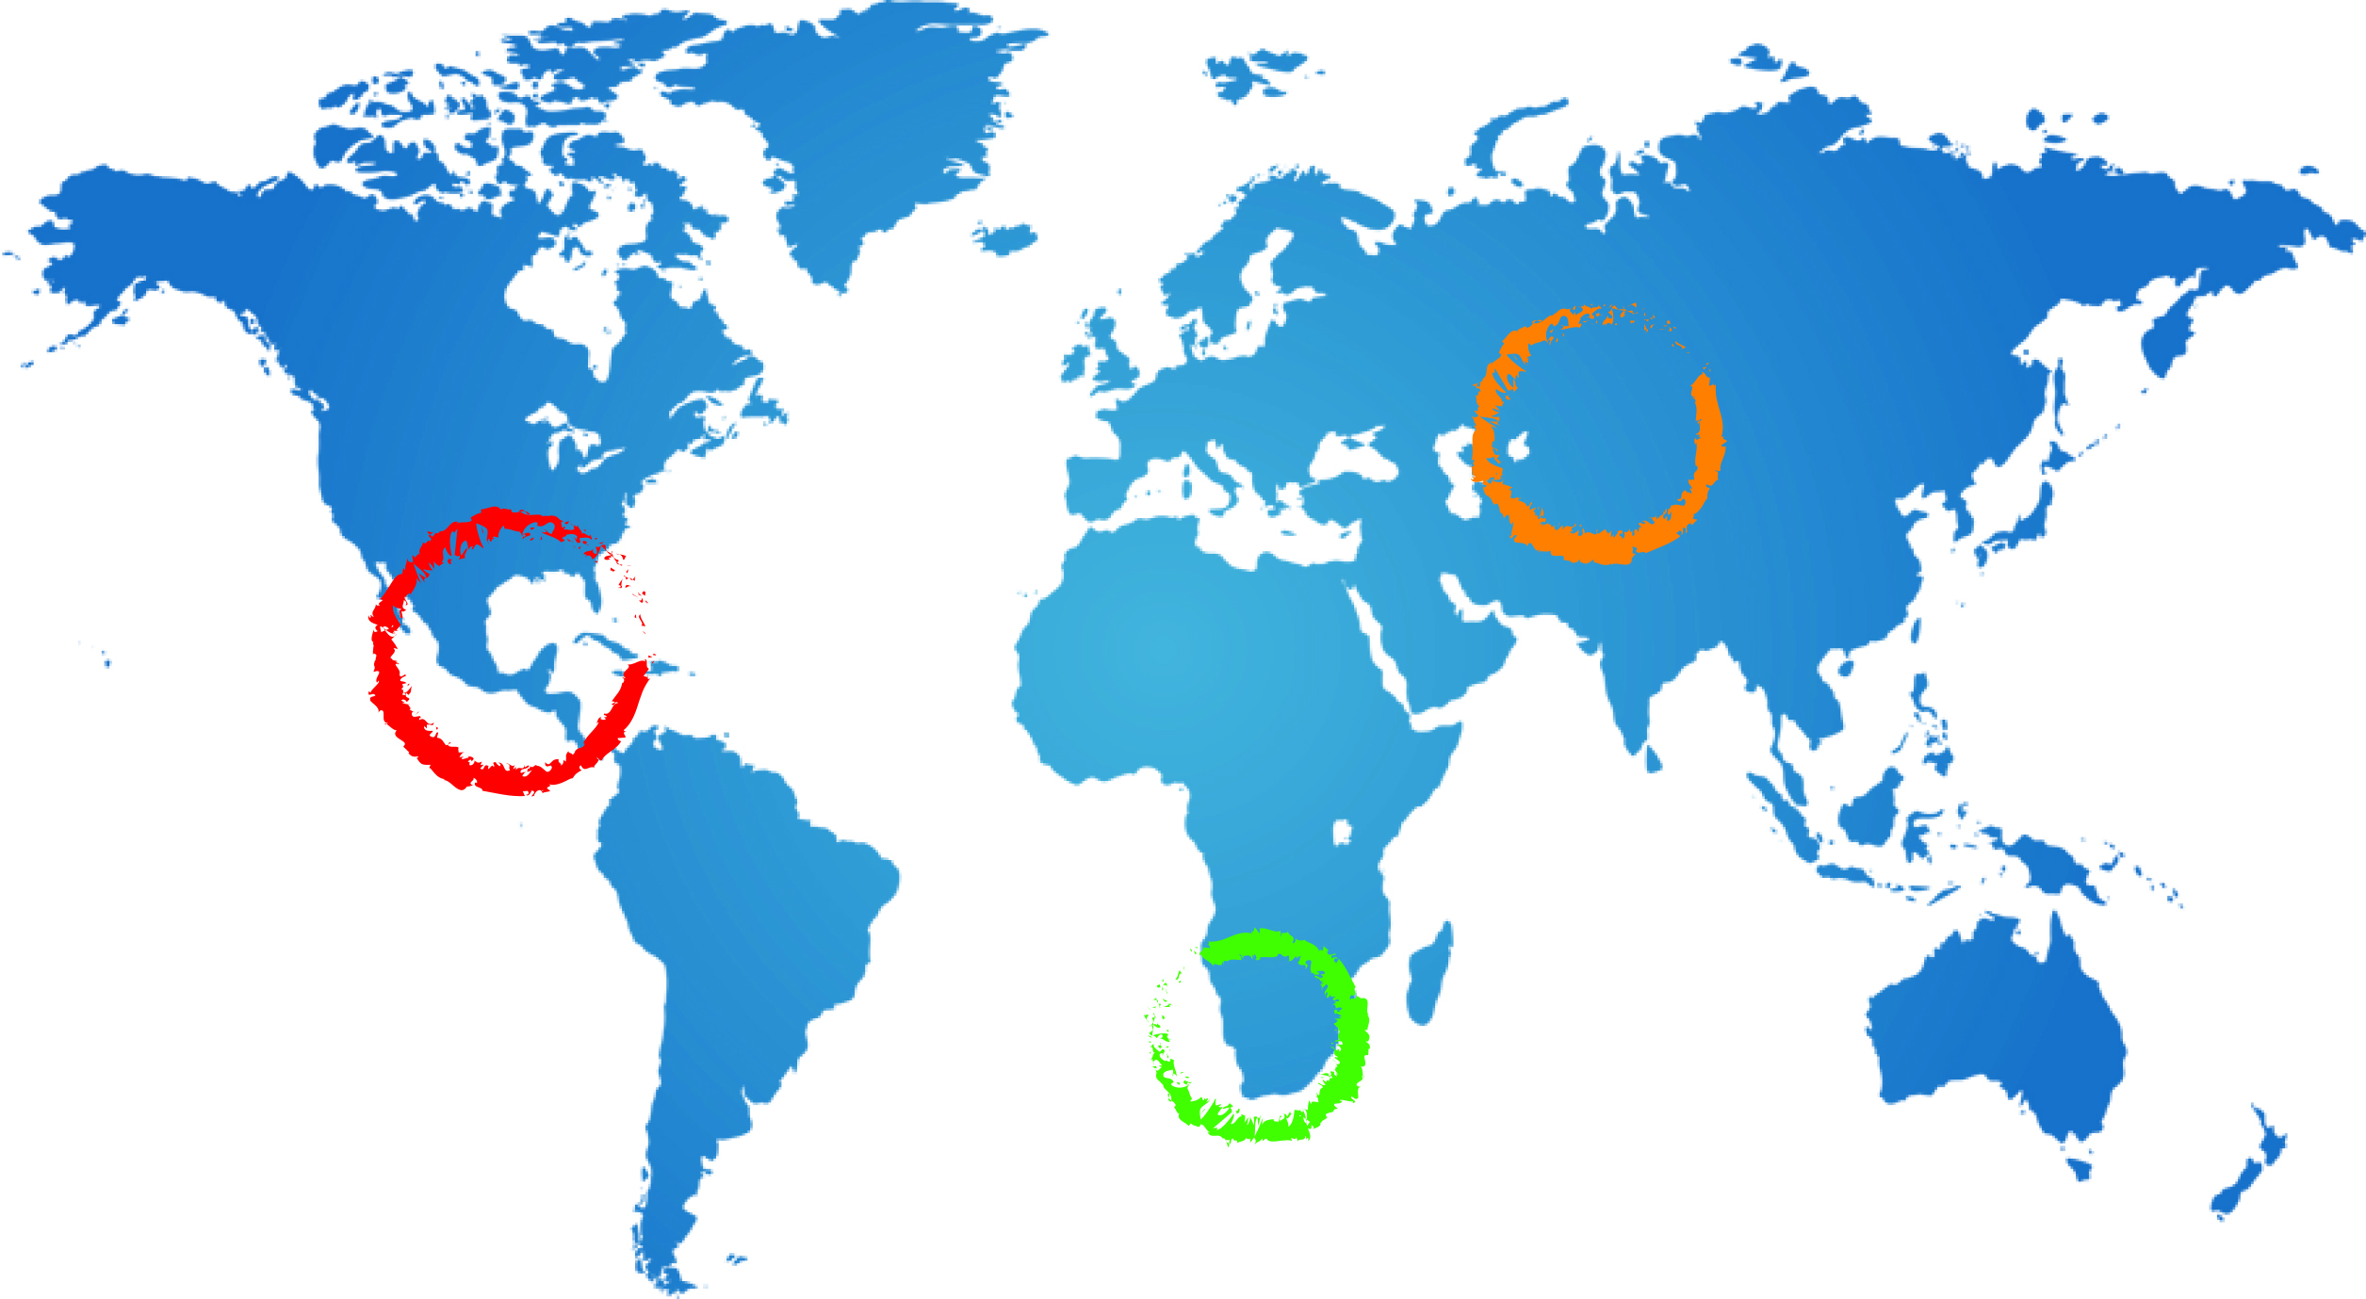
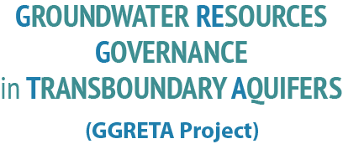
Stampriet case study: Integrated Aquifer Assessment
Andrew Ross
Senior groundwater specialist UNESCO
A Ross
24 February 2015
Johannesburg

Slide 2
Contents of this presentation
What is an integrated aquifer assessment?
The DPISR integrated assessment framework
Structure and contents of the assessment
Chapter by chapter contents

Slide 3
What is the integrated aquifer assessment?
A consideration of all the facts about the aquifer and a judgment or opinion of the state of the aquifer and impacts on the aquifer, taking account of current trends and what is likely to happen in future
a consideration of all the facts
about the aquifer
a judgment or opinion of the state
of the aquifer
Current trends and what is likely to happen in future
hydrogeological, socioeconomic, environmental, legal and institutional variables
Time series, projections and scenarios

Slide 4
A DPSIR framework for water
Water use restrictions
Alternative supplies
Subsidised water prices
Improved information
Demand side management
Voluntary agreements
Regional conflicts
Waste water treatment
Ban on products
Reservoirs
Responses
DDriversv
Industry
Energy
Agriculture
Aquaculture
Households
Tourism
Pressures
Climate change
Point source pollution
Diffuse source pollution
Water abstraction
Physical intrusions
Loss of habitat/species
ill/health
Droughts/floods
Desertification
Salinisation
Loss of amenity
Coastal erosion
Non-indigenous species
Eutrophication
Acidification
Water quantity
Groundwater status
Ecological status:
Chemical
Physcial
Biological
Impacts
State

Slide 5
Proposed Contents of Assessment (Ch 1-4)
Alignment DPSIR
Introduction | 1.Introduction project background, objectives, people and organizations involved, and project approach
Drivers and pressures | 2. Drivers and pressures on the aquifer including climate, population, household and industrial development, land use
State (1) | 3. Hydrogeological characterization, conceptual model of the aquifer system including aquifer boundary, size, volume and change in stored water, groundwater (GW) flow and depletion
State (2) | 4. Socioeconomic and environmental features GW quality and pollution, and GW use. Emerging trends

Slide 6
Proposed Contents of Assessment (Chs 5-9)
Alignment DPSIR | Chapter Headings
State (3) | 5. Legal and institutional settings
Impacts | 6. Impacts of changes in use, availability and quality of GW on communities and the environment
Responses | 7. Policy, legal and institutional responses
Conclusions | 8. Conclusions from the assessment
Recommend-ations | 9. Recommendations including multi-country consultation and action

Slide 10
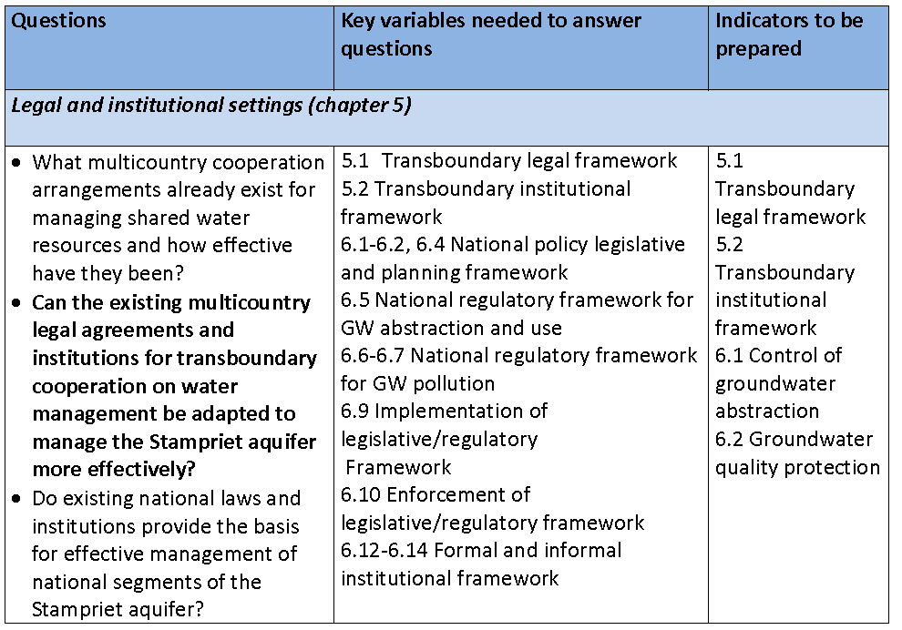

Slide 12
Chapter 7 Responses
What are the best practical responses to address impacts identified in Chapter 6?
Scale of responses: TB, national local
Types of responses: laws, regulations, market based, voluntary, information
Effectiveness, cost effectiveness, technical capacity, acceptability

Slide 13
Chapter 8 & 9 Questions
What are the key issues that need to addressed at a) multicountry b) national scale?
What practical responses can be used to address these issues?
What are your ideas about possible multicountry consultation and cooperation mechanisms?

Slide 15
Conclusions and recommendations (Chapter 8 and 9)
Appropriate to context
Policy relevant
Action oriented – assessable (measurable) results
Can be implemented - given capacity and resources
Project Outcome: Multi-country coordination and cooperation mechanisms

Slide 16
Key aquifer properties - more or less Static -
Aquifer location and 3D geometry
Countries sharing
Lithology of aquifer formations
Hydraulics: (un)confined, transmissivity, porosity
Hydrological: recharge rate, source and area, and an estimate of volume of groundwater resources
Natural water quality and vulnerability to pollution
Notes:
Aquifer assessment: a consideration of all the facts about the aquifer and a judgement or opinion of the position and of what is likely to happen.
1 – all the facts: Static data, not time dependent.
Aquifer location and geometry: Boundary, horizontal extend, thickness, depth
Countries sharing: names of countries, size of national segment
Lithology: predominant lithology
Hydraulic setting: type of voids, (un)confined, transmissivity
Hydrological setting: source of recharge, discharge type, recharge amount, recharge area, gw volume
Water quality: natural quality, vulnerability to polution

Slide 17
Time dependent variables
Drivers: demography, climate, water supply and sanitation, water scarcity
Pressures : abstraction (groundwater + blue water), pollution, sea water intrusion
State: water quality, water accessible for human consumption
Impact: human usage / dependency, impact on ecosystems
Responses: Institutional framework, laws & regulations, incentives and disincentives, infrastructure, voluntary actions
Notes:
Aquifer assessment: a consideration of all the facts about the aquifer and a judgement or opinion of the position and of what is likely to happen.
1 – all the facts:
The additional 67! Parameters are time dependent parameters describing the aquifer more in depth. The parameters can be grouped into 5 main categories, based on the DPSIR framework of analyses (optional additional slide in the end)

Slide 18
Day 2: Integrated Aquifer Assessment
Introduction to assessment methodology
assessment roles and responsibilities
refer to document circulated on x
Assessment based on DPSIR framework (further explanation tomorrow)
chapter headings 1-9 based on this framework
parallel sessions on chapters 2-5
plenary sessions on chapters 6 and 7
Roles and responsibilites
Piet to coordinate preparation of overall assessment report (20 pages)
Jurgen to coordinate preparation of hydrogeological assessment - a major task
Andrew to work with national specialists to coordinate socioeconomic and environmental assessment
Viviane will coordinate preparation of legal and institutional assessment under supervision of Stefano

Slide 21
