Slide 1
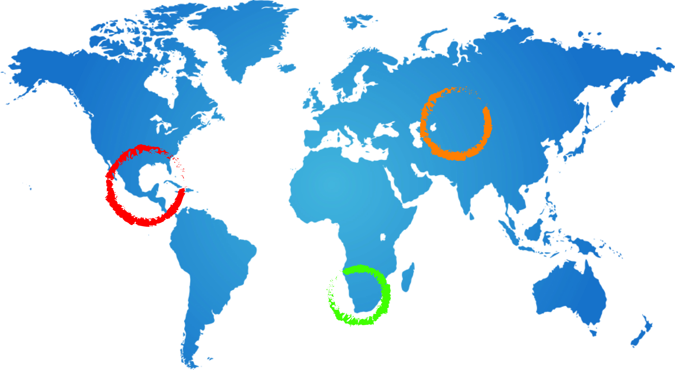
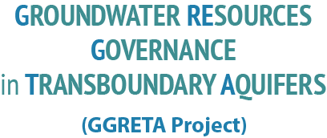







Chapter 7: Policy, legal and Institutional responses
Andrew Ross
Senior groundwater specialist UNESCO
A Ross
23 February 2015
Johannesburg

Slide 2
Scale of response
What are the best practical responses to address impacts identified in Chapter 6?
Responses (and impacts) take place at three scales:
  transboundary responses – including multicountry consultation and coordination mechanisms
  national responses – important in themselves, also influence transboundary responses
  local responses – critical implementing higher level responses

Slide 3
Type of response (instruments)
Laws and regulations
  Water laws, water use permitting regulations
Market based
  Water use charges, water trading systems (require underpinning laws or regulations)
Information
  water user registers, monitoring, accounts
“Voluntary action”
  water user associations watershed partnerships

Slide 4
Choosing between responses
Effectiveness - how much of an improvement in GW quantity or quality will this alternative produce?
Cost effectiveness - how much will it cost to improve the GW quantity or quality?
Technical capacity - do we have the equipment and know - how to put this into practice?
Community/Political acceptability?
Note: how do we measure effectiveness, cost effectiveness, capacity, acceptability

Slide 5
Questions?
What are the key issues that need to addressed at a) multicountry b) national scale?
What practical responses can be used to address these issues?
What are your ideas about possible multicountry consultation and cooperation mechanisms?

