Slide 1
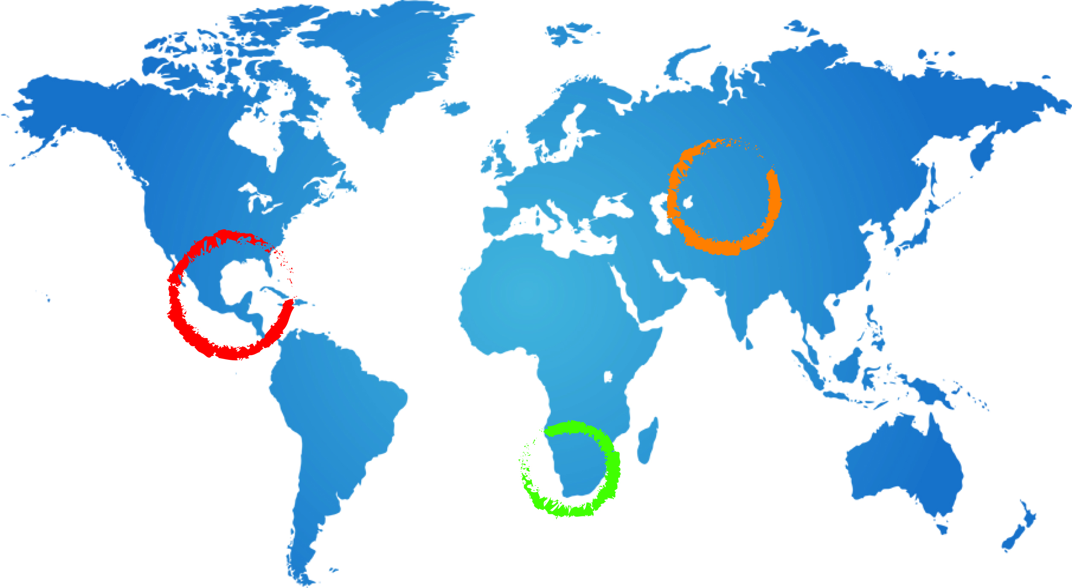








Integrated Aquifer Assessment-Process/Roles and Responsibilities
Piet Kenabatho
A Ross
24 February 2015
Johannesburg

Slide 2
Contents
Setting a Process
Identifying Roles and Responsibility
Timelines
Discussions

Slide 3
Assessment Process
Interaction
Enhanced Team Work aiming to deliver together

Slide 4
Assessment Process Cont…
1. Data Harmonisation
(31st March)
2. Map production
(10th Apr)
3. Chapter Writing (24th Aprl)
4. Assessment Report (22nd May 2015)

Slide 5
Roles/Responsibilities/Time
Towards Integrated Aquifer Assessment Report
 | Roles (Coords) | Responsibility | Product/ Deliverable | Timeline
1 | Hydrogeo | Oversee Harmonisation for Hydrogeo | Harmonised data Report | 31st March 2015
2 | Socioeco. | … | … | …
3 | Legal/Institutional | … | … | … …
4 | Assess. Coord. | Coord. Assessment | Integrated Aquifer Assessment Report | 22nd May 2015
5 | RPC & Project Coords | Supervision/Guidance | .. | Feb-May 2015
Map Production through GIS

Slide 6
Chapter-Responsibility
Chapter | Responsible Person | Date
1-Intro/Background/objectives… | Piet | Mar 13 2015
2-Drivers&Pressure on the Aquifer | TBD | Apr 24 2015
3-Hydrogeological characterisation & Conceptual Model of the Aquifer | Prof. Kirchner | Apr 24 2015
4-Socioeconomic and environmental features | Bothepha, Don & Bantu | Apr 24 2015
5-Legal and Institutional Setting including gender related issues | Vivian (guid. From Stefano) | Apr 24 2015

Slide 7
Chapter | Responsible Person | Date
6-Impacts of changes in use, availability and quality of GW on resource dependent communities and the environment | JK, BM, with contributions from PK and PCU | May 8 2015
7-Policy, legal and institutional | VK, with contributions from the specialists & PK and PCU | May 8 2015
8,9-Conclusions from the assessment, and Recommendations for multicountry consultation and action | PK, Study Team and PCU | May 15 205

Slide 8
Discussions

