Slide 1
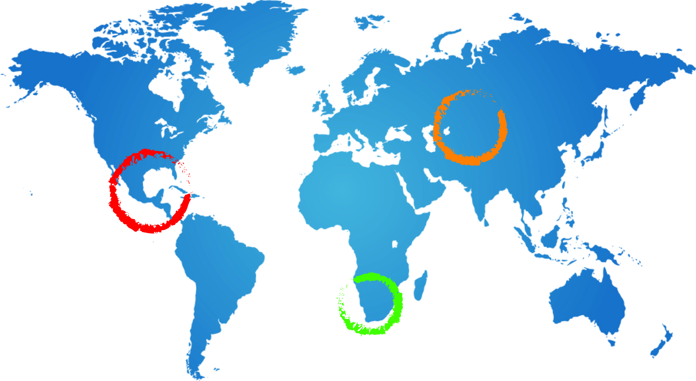
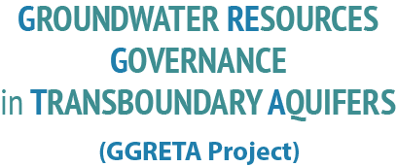
LEGAL AND INSTITUTIONAL ASPECTS – BOTSWANA Odirile Otto itumeleng
GGRETA PROJECT Regional Technical meeting; 21st OCTOBER 2014, PRETORIA, SOUTH AFRICA
Name Surname
Date
Location

Slide 2
REGIONAL LEGAL AND INSTITUTIONAL FRAMEWORK: GROUNDWATER RESOURCES
Revised SADC PROTOCOL ON SHARED WATERCOURSES 2000;
Article 1
Definition of “Watercourse”
“means a system of surface and ground waters consisting by virtue of their physical relationship a unitary whole normally flowing into a common terminus such as the sea, lake or aquifer”
The provisions of the Protocol are not textually specific to ground waters, however by virtue of the definition of watercourses, the provisions are inherently applicable to ground waters- i.e the Stampriet Aquifer in question

Slide 3
TRANSBOUNDARY LEGAL AND INSTITUTIONAL FRAMEWORK
Principles of Engagement for Utilization
Article 2(b)
“… this Protocol seeks to; (b) advance the sustainable, equitable and reasonable utilization of the shared watercourses…”
Article 3
Utilization of the shared Watercourse shall be in a manner that promotes the sustainability of such watercourse. To ensure that it continues to serve the purposes it was intended for without any misuse or harm to such efforts by misuse or lack of cooperation by Watercourse States.
This Article therefore makes provision for the general principles that Botswana, Namibia and South Africa adhere to promote effective utilization of the aquifer.

Slide 4
TRANSBOUNDARY LEGAL AND INSTITUTIONAL FRAMEWORK
Principles for Cooperation and Institutional Arrangements
The overall objective of this Protocol is to foster closer cooperation for judicious, sustainable and co-ordinated management, protection and utilization of shared watercourses and advance the SADC agenda of regional integration and poverty alleviation. (Article 2)
The General Principles provided for under Article 3 are instructive on how Member states shall, in perpetuating the common objective of the Protocol, maintain and promote cooperation.
Institutional Arrangements(IAs)
Special provision for IAs is found at Article 5 of the Protocol

Slide 5
TRANSBOUNDARY LEGAL AND INSTITUTIONAL FRAMEWORK
Principles for the protection of Aquifer waters from Pollution or other kinds of threats
Article 4 (Special Provisions); 4(2) (Environmental Protection and Preservation)
The Protocol makes provision for obligations and duties that Watercourse States shall be accorded for the;
Protection and preservation of ecosystems of shared watercourses(Article 4(2)(a))
Prevention, reduction and control of pollution (Article 4(2) (b))
Implementation of measures against the introduction of alien or new species into shared watercourses (Article 4(2) (c))
Protection and preservation of the aquatic environment (Article 4(2)(d))
Prevention and Mitigation of Harmful Conditions (Article 4 (4))

Slide 6
TRANSBOUNDARY LEGAL AND INSTITUTIONAL FRAMEWORK
Principles for Settlement of Disputes
Article 7 of the Protocol deals with the Settlement of disputes that may arise pertaining to these shared watercourse.
ORASECOM Agreement
Not specific to the aquifer;
Functions and obligations to water resources use and protection (Articles 5&7)
Institutional arrangements (Article 2)
Settlement of disputes (Article 8) – amicably through consultations/negotiations; Tribunal

Slide 7
INTERNATIONAL LEGAL AND INSTITUTIONAL INSTRUMENTS
International legal instruments on water law such as:
– the Helsinki rules, 1966
– the Dublin Principles, 1992
– Rio Earth Summit, Chapter 18, Agenda 21
– the UN Convention on the Law of the non
Navigational use of international watercourses, April 1997

Slide 8
INTERNATIONAL LEGAL AND INSTITUTIONAL INSTRUMENTS
Convention on the Law of Non-navigational Uses of International Waters 1997
Principles for water use – equity, reasonable utilisation and participation;
Protection and preservation of ecosystems – Article 20;
Prevention and reduction of pollution – Article 21;
Introduction of alien or new species – Article 22;

Slide 9
DOMESTIC LEGAL AND INSTITUTIONAL FRAMEWORK
WATER ACT (Cap 34:01)
AGROCHEMICALS ACT (Cap 35:09)
TOWN & COUNTRY PLANNING ACT (32:09)
WATERWORKS ACT (Cap 34:03)
BOREHOLE ACT (Cap 34:02)
WATER UTILITIES CORPORATION ACT (Cap 72:09)
ENVIRONMENTAL IMPACT ASSESSMENT ACT (Cap 65:07)
MINES, QUARRIES, WORKS AND MACHINERY ACT (Cap 44:02)

Slide 10
DOMESTIC LEGAL AND INSTITUTIONAL FRAMEWORK Regulations / Subsidiary Legislation
All the relevant subsidiary legal instruments have been procured in electronic format and the list is as follows;
Town and Country Planning Regulations – Subsidiary Legislation;
Land Survey Regulations – Subsidiary Legislation;
Water Regulations; Subsidiary Legislation;
Waterworks Regulations; Subsidiary Legislation;
Agro – Chemicals Regulations; Subsidiary Legislation;
Environmental Assessment Regulations; Subsidiary Legislation;
Water Utilities Corporation Regulations; Subsidiary Legislation;

Slide 11
DOMESTIC LEGAL AND INSTITUTIONAL FRAMEWORK: GROUNDWATER RESOURCES
RELEVANT STATUTES
From the Legislation identified, it is clear that the provisions made for surface water, freshwater resources apply to Groundwater .
A detailed analysis of the relevant provisions is outlined below;

Slide 12
DOMESTIC LEGAL AND INSTITUTIONAL FRAMEWORK: GROUNDWATER RESOURCES
WATER ACT (CAP 34:01)
Section 2: Interpretation
“Public Water” means all water flowing over the surface of the ground or contained in or flowing from any river, spring or stream or natural lake or pan or swamp or in or beneath a watercourse and all underground water made available by means of works, but does not include any water which is used solely for the purposes of extracting mineral substances therefrom or water which has been lawfully appropriated for use.
It is without doubt that groundwater is provided for explicitly by this Act.

Slide 13
Analysis of the Water Act Provisions
Abstraction and Use
Section 4
no right of property,
control and use shall be regulated as provided in the Act or in accordance with the provisions of the Waterworks Act (34:03)
Use without Licence
Section 5; domestic use of water
Section 6; alternative measures occupiers of land are entitled to in order to have access to water-e.g sinking of boreholes of specified depths so as to use the water for domestic purposes
Section 7; accords the rights under Section 6,to holders of rights under the Mines and Minerals Act.
Section 8; use of water is permitted for a holder of rights granted under the provisions of the Forest Act to take forest produce.

Slide 14
Analysis of the Water Act Provisions
Water Abstraction/Use subject to licensing
Section 15; Makes provision for the granting or acquiring of the right to abstract or use
Such right will be for a specified period;
whether definite or indefinite,
for such purpose as may be specified in the water right;
subject to such terms and conditions as it may deem fit.

Slide 15
Analysis of the Water Act Provisions
Abatement and Control of Pollution
Section 36
Pollution of public water is an offence if done;
(a) without the authority of this Act or any other written law; or
(b) without the permission of the Water Registrar
Penalties are outlined under Section 37 for enforcement against wrongdoers. These are comprise of fines and/or prescribed periods one may be imprisoned

Slide 16
Agrochemicals Act (CAP 35:09)
Control of Water Pollution (continued
Section 2
"agrochemical" means any organic, inorganic or live biological material intended or offered for sale for purposes of-
( a) destruction, control, repulsion, attraction or prevention of any undesirable life forms
injurious to plant and animal growth; or
( b) promotion or inhibition of plant growth such as fertilisers, growth regulators, hormones, defoliants or legume inoculants
Section 4(2) (e)
Makes provision for issuing of licences to persons for diposing agrochemicals as one of the functions of the “Registrar”

Slide 17
Agrochemicals Act
Section 22
(1) No person shall ….dispose of an agrochemical unless a
label is part of or securely attached to the container of the agrochemical ;
clearly and indelibly marked in English with such information as may be prescribed
(2) No person shall …dispose of an agrochemical otherwise than
in a container that conforms to the conditions and requirements as may be prescribed.
Violation of these is an offence under this Act.
The Act is not explicitly for groundwater, however, the disposal of agrochemicals in a manner specified by the Act impliedly protects groundwater.

Slide 18
Town & Country Planning Act (32:09)
The long title of the Act reiterates that;
This is an Act to make provision for the orderly and progressive development of land in both Urban and rural areas and to preserve and improve the amenities thereof; for the grant of permission to develop land and for other powers of control over the use of
land; and for purposes ancillary to or connected with the matters aforesaid;
Section 6(3) (b)
Land development is to be carried out in accordance with an approved development Plan.
A development plan may allocate land particularly for water resources.

Slide 19
Town & Country Planning Act
Section 10
Planning permission in urban and rural areas is granted at the discretion of the Board (as per the definition in the Act) with careful consideration to the impact and effects it will have.
Based on such consideration, the Board will either grant or refuse to grant permission, or grant such permission with conditions attached to it.
It is implicit therefore that in granting a development permit, where water resources are affected or likely to be affected, such will be taken into consideration, and a decision made in a manner suitable for the circumstances at that time.

Slide 20
Waterworks Act (34:03)
Waterworks Act
This Act is meant to encourage and protect public water supply systems.
Waterworks areas need to be delineated and gazetted and a Water Authority appointed.
The Water Authority receives the water development rights and has the duty to develop a water supply system. The Water Authority (WA) effectively the monopoly of water supply.
Water Utilities Corporation is the WA in Botswana.

Slide 21
Borehole Act (Cap 34:02)
In an effort to make provision for and/or to protect freshwater resources and ground water, the relevant provision in this Act is Section 4.
Section 4
Before a borehole, of a depth of 15metres and beyond is sunk, one must provide the Director of Geological services with such intention to.
The form provided for by the Director must be completed by recording the progress of the work which shall include measurements of the strata passed through and of the levels at which water is struck and subsequently rests.
Underground water is herein protected by the provisions herein.

Slide 22
Water Utilities Corporation Act (Cap 72:09)
Long Title
An Act to provide for the establishment of a Corporation to be known as the Water Utilities Corporation for the supply and distribution of water within the Shashe Development Area and elsewhere and to provide for matters incidental thereto and connected therewith.
In Botswana the distribution of water the Corporations main task. They ensure that freshwater resources as well as groundwater are made available to the furthest parts of the land.

Slide 23
Environmental Impact Assessment Act (Cap 65:07)
Long Title
An Act to provide for environmental impact assessment to be used to assess the potential effects of planned developmental activities; to determine and to provide mitigation measures for effects of such activities as may have a significant adverse impact on the environment; to put in place a monitoring process and evaluation of the environmental impacts of implemented activities; and to provide for matters incidental to the foregoing.

Slide 24
Mines, Quarries, Works And Machinery (Cap 44:02)
Provisions are made in this Act to ensure that the works carried out in the mining and quarrying operations do not result in a negative impact on, inter alia, freshwater resources, or water resources in their entirety.
Regulations; Section 11
The Minister may make regulations for the better carrying out of the objects and purposes of this Act and for giving effect to its principles and provisions, and in particular, but without prejudice to the generality of the foregoing, such regulations may, in relation to all mines, quarries and works or any mine, quarry or works, make provision concerning;
a) …

Slide 25
Mines, Quarries, Works And Machinery (Cap 44:02)
e) the protection and preservation of the surface of mines, quarries and works and adjoining land, of buildings, roads, railways and other structures and enclosures on or above the surface of such land, and of water resources, the conditions under which any such surface, buildings, roads, railways, structures or enclosures may be undermined, and the conditions under which mining may be carried on, under and in the vicinity of such water resources;

Slide 26
Ownership of Groundwater
According to the 1968 water Act, the State owns all water resources. The State has delegated water user and development rights to various stakeholders:
The Water Utilities Corporation (WUC) has the duty to provide safe drinking water to urban and rural areas in so-called water work areas. WUC has a monopoly in these areas; others are, for example, not allowed to drill boreholes in these areas. The WUC has to break even, i.e. charge the full resource costs to end users.
The District Councils (DCs) operate and maintain the water supply systems in all other rural villages, usually through the Water and Sanitation Division;

Slide 27
Ownership of Groundwater
Self-providers, including livestock owners, arable farmers and mining companies that operate outside villages and settlements. Self-providers apply for surface or groundwater rights to the Water Apportionment Board (WAB).
The WAB grant such rights with an abstraction ceiling and the duty to return as much water as possible of the original quality. Details of boreholes (e.g. yields, depth, water quality etc.) are recorded in the National Borehole Registry.

Slide 28
Botswana Bureau of Standards (BOBS)
Standards of Effluent Quality
In addition to the Legal provisions, The Botswana Bureau of Standards has developed countrywide standards for drinking water and as such must be adhered to, and further that in disposal of waste one must ensure that they do not affect the quality of water or violate laws in place regarding disposal of waste.

