Slide 1
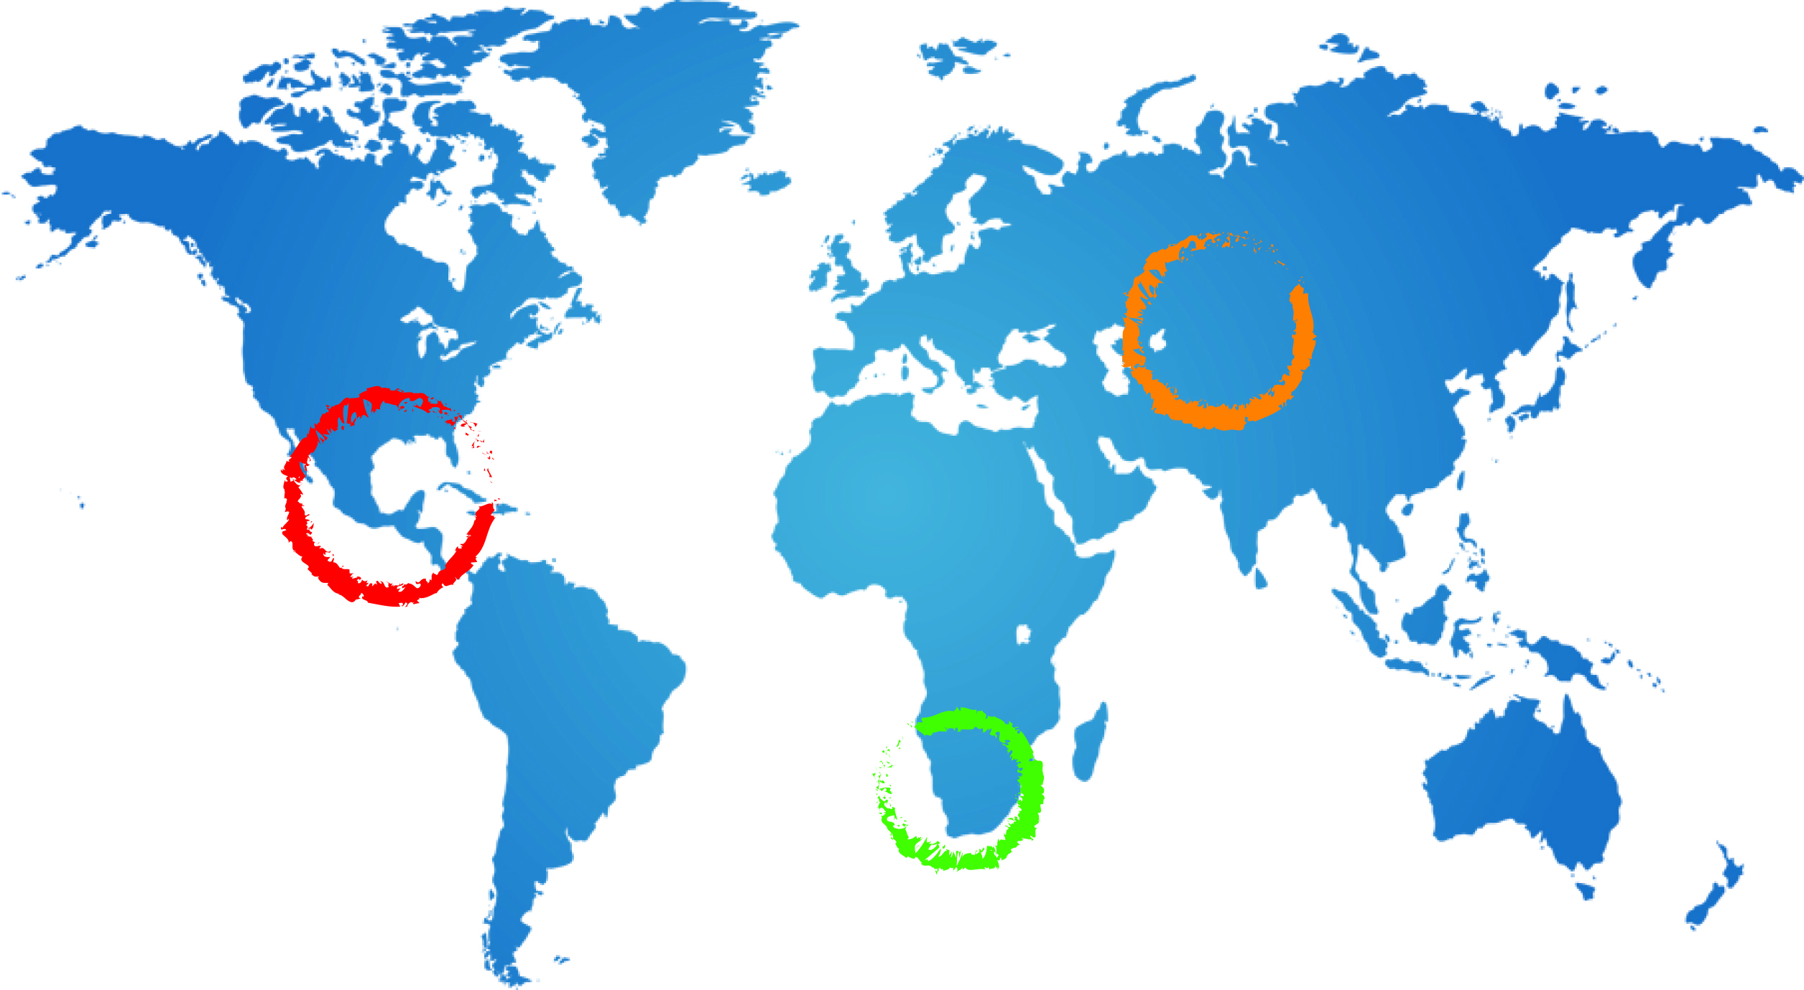
South African
Socio-economic and Environmental Aspects BE Hanise
Bantu Hanise
21 October2014
South Africa

Slide 2
Socio Economic and Environmental Aspects
Table of contents
Profile of the study area
Demographics
Socio-economics and infrastructure
Environmental Aspects
Aspects around the available data sources, types and sources

Slide 3
Profile of Study area
Demographic Aspects
- The area is in the Mier Local Municipality part of the
Siyanda District Municipality and has land area 22.468 km²
Total Population of 7,003 individuals ,62.4% of the population is below 35 years and population density
of 0.31/km²
- Population distribution : 69.2% urban and 30.9% Farms
Local Gender ratio: 49.6% Females and 51.4% Males
Water and Sanitation Sources
Water sources: 63.3% Municipality water schemes and 36.7% other sources such as boreholes, springs,
rain water storing tanks etc
Sanitation sites: 11% have no toilets, 88.7% have toilets
(36.9% Pits and Bucket toilets)

Slide 4
Profiling of the study area
Data Aggregates :
Youth unemployment rate: 35.2%
No schooling aged 20+: 9.1%
Higher education aged 20+ : 5.1%
Matric aged 20+ 14.9%
Number of households: 1784
Number of Agricultural households: 583
Average household size: 3.7
Female headed households: 29.7%
Formal dwellings: 89.9%
Housing owned/paying off: 57.9%
Economic sectors include Agriculture: crop and livestock; tourism; mining (salt) and community services (professionals which include nurses, teachers, municipality officials)
Young population (62% below 35 years) of the 7003 in area 22,658 km² with density of 0.31/km²;
Area’s Gender Ratio: F (49.6%) and M (51.4%);
Urban to rural gender distribution: Rural F (21.1%) and M (64.1%); Urban: F (78.9%) and M (21.1%)

Slide 5
Environmental Aspects
Savanna and Grassland vegetation
Shrubby Gordonia and Thorny Kalahari Duneveld
Alien Shrub invasion
Dominated by Prosopis “suidwesdoring”
3-18m root system
Thrives in sandy and saline soils
Tolerant to very low and very high temperatures
(Min-12 to Max 40) degrees Celsius
Thrives in arid conditions
Altitude: 300-1200m

Slide 6
Socio-economic Indicators | Data source | Accessibility | Data form and Sources
Total Area | Stats SA, IDP | YES | Numerical, Census Reports
Total Population | Stats SA, IDP | YES | Numerical, Census Reports
Population Density | Stats SA, IDP | YES | Numerical, Census Reports
Sex Ratio (Female to Male) | Stats SA, IDP | YES | Numerical, Census Reports
Households | Stats SA, IDP | YES | Numerical, Census Reports
Economic sectors and drivers | Stats SA, IDP | YES | Numerical, Census Reports
Human dependence on groundwater | Stats SA, IDP, DWAS-NC | YES | Numerical, Census Reports
Human dependence on groundwater for domestic water supply | Stat SA, Local Municipality, DWAS | YES-Incomplete | Numerical, Census Reports
Human dependence on groundwater for agricultural water supply: Percentage of population covered by public water supply | Stats SA, DWAS-NC, AgriSA NC | YES- Incomplete | Numerical, Census Reports, Digital Data
Human dependence on groundwater for Industrial water supply: Surface water use; Total volume fresh water use | Stats SA, DWAS-NC, Mier Municipality | YES- Incomplete | Numerical, Census Reports,
Environmental Aspects: Natural groundwater quality, including suitability for different uses (human consumption, livestock watering, agriculture, industry); Landuses, Biome/vegetation distribution | SANBI, PUBLICATIONS,DWAS | YES-Incomplete | Published Reports (Thesis)
Ecosystem dependence on groundwater | DWAS, SANBI | No | Reports, digital information
Aquifer vulnerability to pollution | DWAS | No | Reports, digital information
Groundwater pollution | DWAS, Mier Local Municipality | YES | Reports, digital information
Groundwater development stress | DWAS, Mier Local Municipality | YES- Incomplete | Reports, digital information
Control of groundwater abstraction | DWAS-National and Regional, Mier Local Municipality | YES- Incomplete | Reports, digital information
Groundwater quality protection | DWAS-National and Regional, Mier Local Municipality | No | Reports, digital information

Slide 7
THANK YOU

