Slide 1
Hydrogeology Report
Botswana

Slide 2
A. Physiography and climate
A.1. Temperature
Data collected from 1959 to 2012 (monthly to annual)
(Tshane and Tshabong Weather Stations in the Kgalagadi District.

Slide 3
A.2 Precipitation
The data was collected at 7 Stations spread across the aquifer.
The data was collections from 1971 to 2012 at 4 weather stations (Ghanzi Airport, Kalkfontein Police, Mamuno Police, and Ncojane Police Station.
Tshane Weather Station and Tshabong Airport has data from 1979 to 2012 and
Some data from Kang Agrometerological Station covers the period 1981 to 2012.

Slide 4
A.3 Evapo-transpiration
Data available at 2 stations
Tshane: from 1959 to 2009
Tshabong: from 1959 to 2007.

Slide 5
A.4 Land use / land cover
The data has not been collected so far, but relevant departments have been contacted
Esp. the Ministry of Agriculture, Department of Forestry and Range Resources

Slide 6
A.5 Topography and elevation
Data has been collected from the Department of Surveys and Mapping
Data format: Shape files, with the coordinate system of WGS 1984.
Digital Elevation Model (DEM) will also be used to augment the data

Slide 7
A.6 Surface water network
Data has been collected from the Department of Surveys and Mapping
Data format: Shape files, with the coordinate system of WGS 1984.

Slide 8
B. Aquifer Geometry
B.1. Hydrogeological map
The map is available, and contains geology and groundwater potential of important aquifers at a scale of 1:1000000

Slide 9
B.2 Geo-referenced boundary of Transboundary Aquifer / Aquifer System
Delineation has been done showing the boundary of Botswana’s side of SAB
Done based on lithology / geology (i.e. considering the extent of Karoo formations within the Auob and Nossob catchments).

Slide 10
Georeference Map (updated)
The green dots show boreholes within the Aquifer

Slide 11
The aquifer is multi layered.
  Karoo aquifer overlain by Kalahari Beds.

Slide 12
Depth of water table
/ piezometric surface and groundwater flow direction
A 1:1000000 hard copy map of Botswana shows Groundwater flow directions.
Hard copies of borehole completion certificates available and
Show the level below ground surface where water was intersected during drilling.

Slide 13
The map and the borehole completion certificates have sufficient data needed to understand the general flow direction of the groundwater in the region.
10 out of 65 captured boreholes do not have record of the water strike.

Slide 14
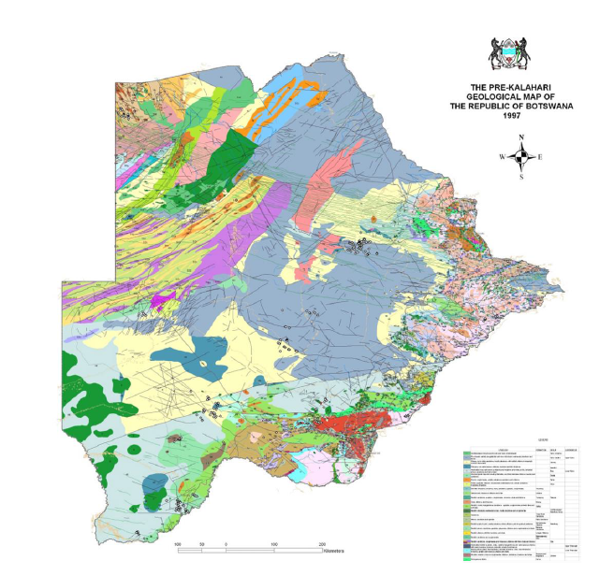
Maps available
Pre-Kalahari Geological Map

Slide 15
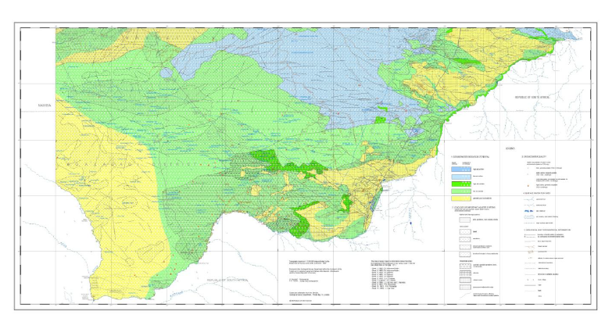
Groundwater Map
(Hydrogeology and Geology, and Quality (points))
Maps done around 1987. So recent Projects will give more information to improve the situation

Slide 16
B.4 Depth to top of aquifer formation [m]
Borehole completion certificates have the data that can be use to deduce the depth to top of aquifer formation.
The accuracy of the information will depend on the quality of the data recorded during drilling of the boreholes

Slide 17
B.5 Vertical thickness of the aquifer (system) including aquitards / aquicludes
The boreholes were only drilled as deep as the water could be intersected. Therefore it will not be easy to determine vertical thickness of the aquifer. (but inference could be made from other pieces of information)

Slide 18
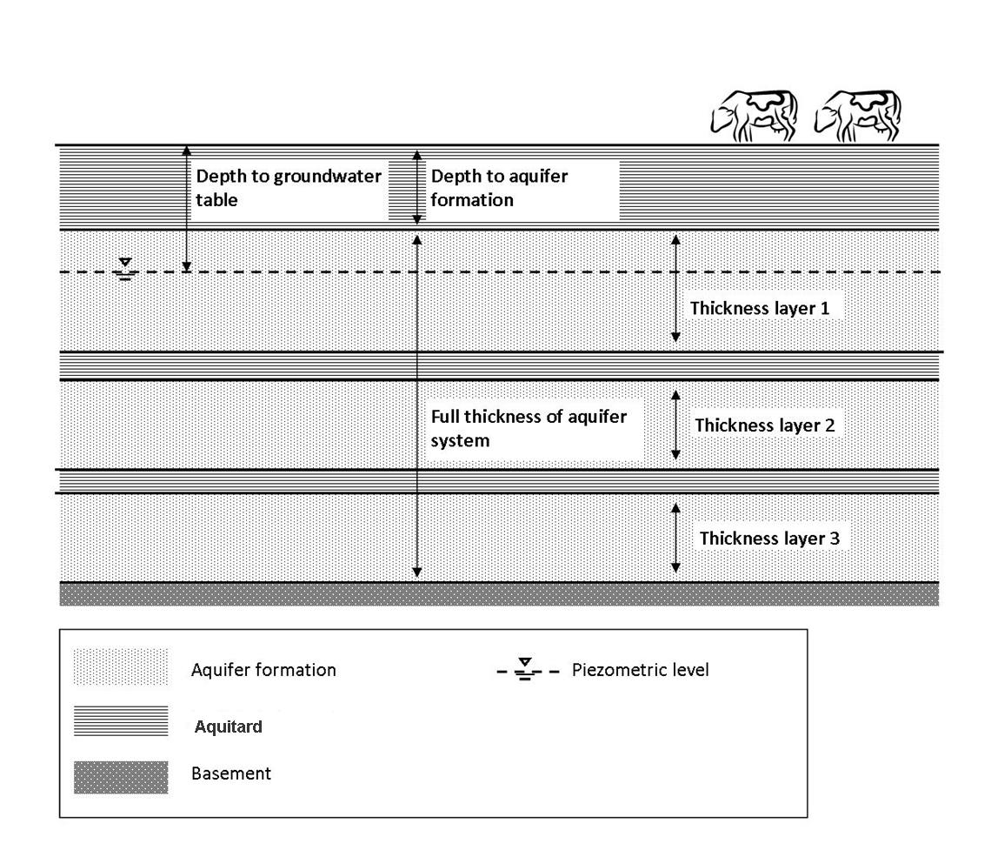
Schematic diagram
(Vertical thickness)

Slide 19
B.6 Degree of confinement
From the Geology map and its description reports, the geological history could be used to derive the degree of confinement of the aquifer.
This data can be refined/augmented by the use of lithological logs recorded in the borehole completion certificates

Slide 20
B.7 Representative cross-sections
The available National map from which cross sections will be produced contains mainly
  aquifer formations,
  general groundwater flow,
  main geologic features only.
Hydrogeological features such as
  recharge zones, discharge zones, zones of major groundwater abstractions, and zones of groundwater pollutions are not included in the map, so far no record of these features is known.
  The information from the Geology map could be refined by incorporating data from form aeromagnetic geophysical surveys

Slide 21
C. Hydrogeological characteristics
C.1 Aquifer recharge
Precipitation is the most prominent source of recharge in the Stampriet TBA (localised)
Runoff into aquifer area
Infiltration from surface water body
Recharge is mainly from infiltration from sand dunes and surface water bodies
There is no recharge of TBA aquifers.
Recharge values were estimated over the Orange-Senqu River Basin, Molopo River Bed as well as over the entire Kalahari area.

Slide 22
Recharge Estimates for Orange-Senqu Basin Area source (ORASECOM 004/2007)
WELLFIELD | METHOD | RECHARGE (mm/yr) | AUTHOR | RECHARGE AREA
Matsheng | Chloride Mass Balance | 0.1-23 | Wellfield Consulting Services, for DGS (1996) | Orange-Senqu River Basin
Werda Sekoma | Isotopes | 6-8.6 | Resources Services (Pty) Ltd for DWA (2003) | Widespread over Kalahari area
Molopo River Bed | CRD | 0.1-2.3 | Wellfield Consulting Services, for DGS (2003) | Molopo River Bed

Slide 23
Further analysis is needed on the data to study the spatial distribution of recharge within the aquifer.
The information revealed by the Orange-Senqu River Basin study too generalized.

Slide 24
C.2 Aquifer lithology
Groundwater Potential Maps and Geology maps are good sources for aquifer lithology.
Borehole completion certificates, regional studies like Morosini (1996), National Water Master Plan 1991 Volume 5: Groundwater (2006, Vol 4), Matsheng Groundwater Development Project 2001-2002 (GRES Reports)

Slide 25
Groundwater Potential Maps show lithology of important aquifers.
The maps are available at 1: 1000 000.
More detailed maps are needed to improve the quality of data, particularly aeromagnetic data which can be processed to show the lithological boundaries within the aquifer

Slide 26
C.3 Soil types
Soil maps are available from the Ministry of Agriculture
Major soil units shown on the maps
Recent maps show detailed soil information and classification
Available in shape files

Slide 27
Soil Map for the Kgalagadi District

Slide 28
Land use Map

Slide 29
VEGETATION MAPS

Slide 30
VEGETATION MAPS

Slide 31
C.4 Porosity
Some information available from reports
According to ORASECOM 004/2007 and Jennings (1974) the Kalahari beds (top part) and the underlying as having both Primary and Secondary porosities.
However further analysis needed to confirm the information from these reports

Slide 32
C.5 Transmissivity and vertical connectivity
Piezometric water levels available
The Piezometric water levels of the TBA aquifers are higher than those in the Kalahari.
Therefore Karoo aquifer drains into Kalahari aquifers.
The reports contain sufficient data on transmissivity and vertical connectivity

Slide 33
C.6 Total groundwater volume
In Botswana there are no reports on total groundwater volume for the country
However, studies related to the Project area may have information on GW total volume
  i.e. Matsheng GW Reports
  Tsabong GW studies
  Kang-Phuduhudu GW study
  National Water Master Plan –Vol 4

Slide 34
C.7 Groundwater depletion
Information on abstraction based on human population and number of animals still need to be determined
Taking into consideration the GW volume estimates (from available reports).
This data has not been collected, but are available at various departments.

Slide 35
C.8 Natural discharge mechanisms
According to National Water Master Plan 1991(vol5), 2006(vol4), elaborate on the discharge mechanisms in Botswana to occur through evaporation, after Karoo aquifer drains into Kalahari aquifer.
Data is available as hard copies, and some PDFs

Slide 36
C.9 Discharge by springs
There are no springs in this area, but only pans which are seasonal.

