Slide 1
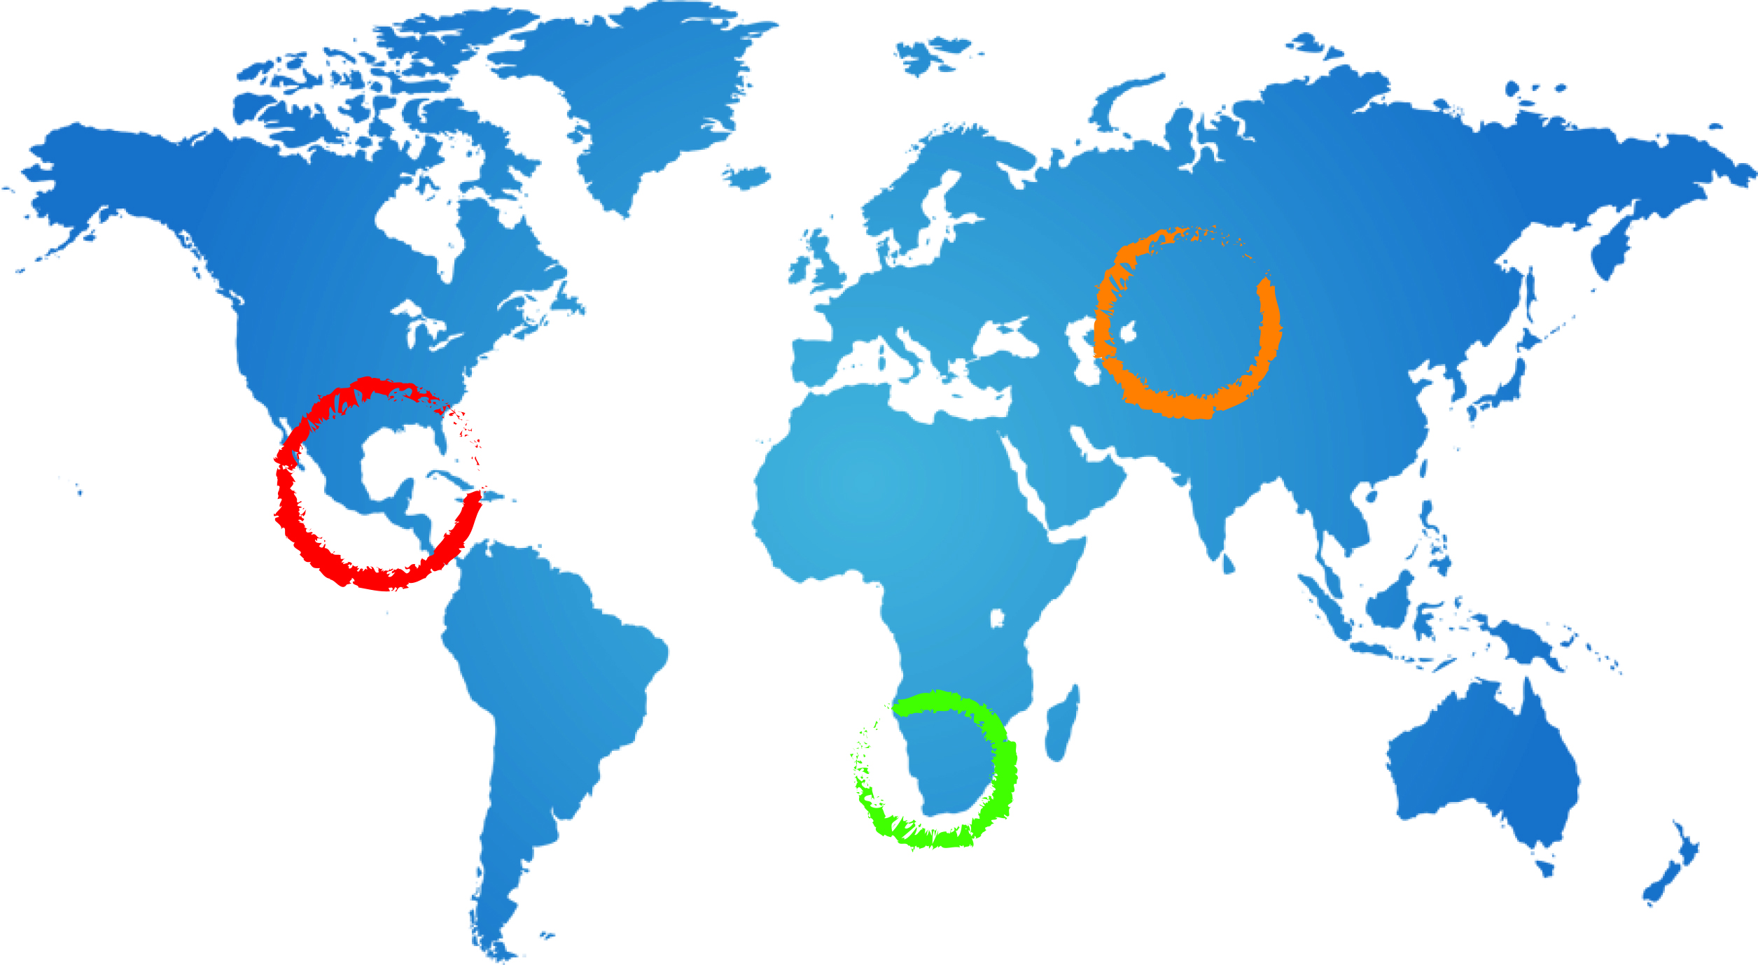
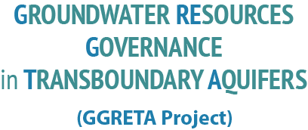







Stampriet – Kalahari/Karoo Aquifer Case Study
Third Regional Technical Meeting
Data processing & harmonisation
Geert-Jan Nijsten – IGRAC
20 October 2014
Pretoria

Slide 2
GGRETA-Stampriet project at a glance
Recap from
Windhoek meeting
May 2013
2

Slide 3
GGRETA-Stampriet project at a glance
Multi-disciplinary assessment
    Hydrogeology
    Environmental
    Socio-economic
    Legal & Institutional
Existing data
Target group for outputs is non-technical:
    Managers, Decision makers, Stake holders incl. general Public
3

Slide 4
Transboundary assessment:
What’s so special ?
Sharing knowledge and data between countries
Harmonising information
Focus on transboundary issues
And ultimately to agree on:
Most important issues for priority action, and
Agree on the actions to be taken
Notes:
Data harmonisation in particular, we will talk about in more detail tomorrow, but I thought it is good to get a clear understanding of groundwater assessment in general and transboundary assessment in particular.
Now let’s move on to the proposed assessment methodology

Slide 5

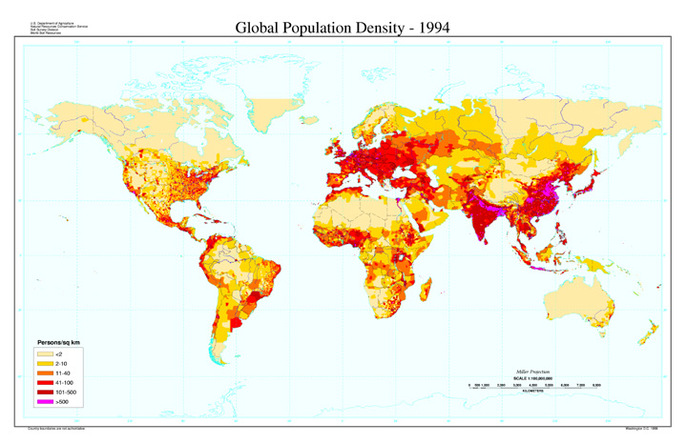

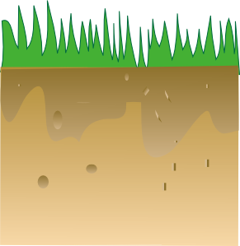
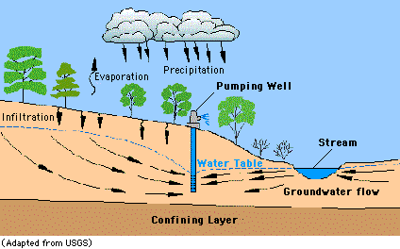

Building blocks for the assessment
Indicators
Groundwater
River water
Rain water

Slide 6
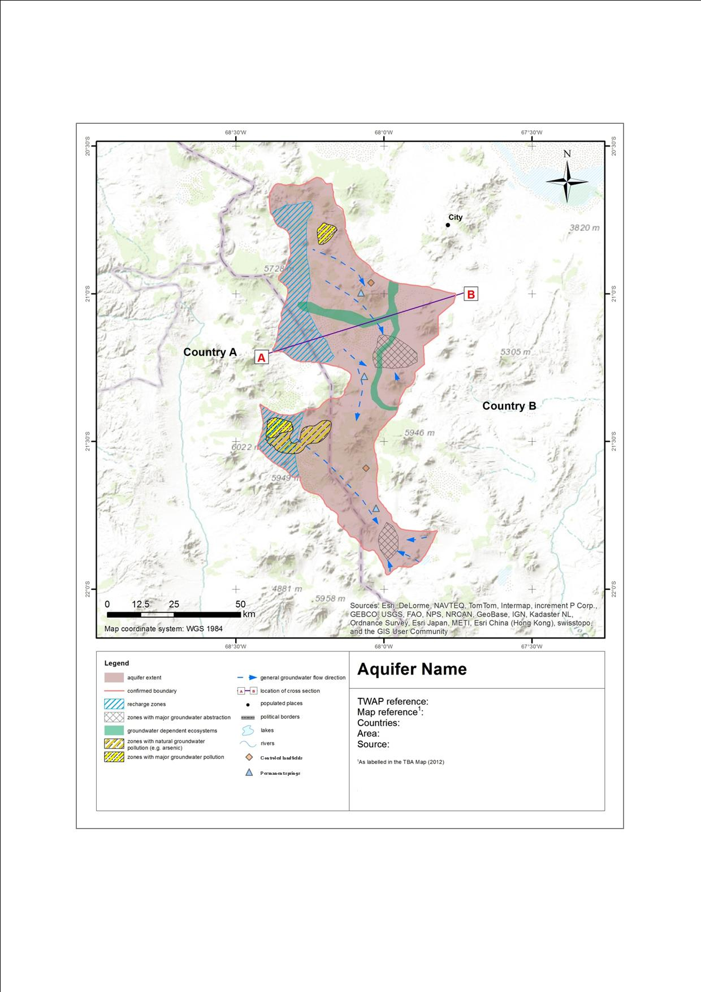
Building blocks for the assessment
THEMATIC MAPS

Slide 7
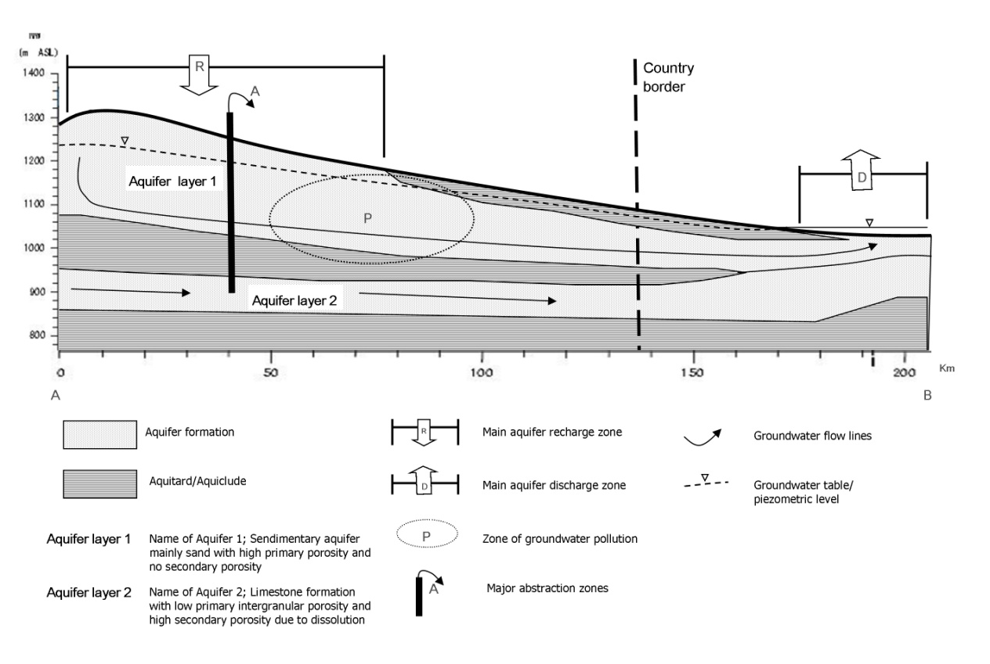
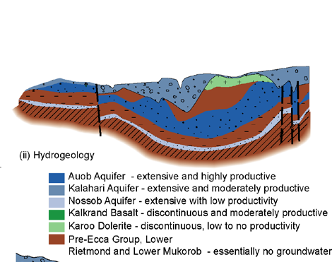
Building blocks for the assessment
Cross-sections

Slide 8
Building blocks for the assessment
Indicators
Thematic maps
Cross-sections - conceptual
Overview tables
Illustrative graphs of time dependent data
Block-diagrams
Assessment report
  Current situation
  Outlook for the future
  Root-cause analyses of issues
  Suggestions for action
Focus on transboundary management / governance issues

Slide 9
How to get to these building blocks and assessment?
9

Slide 10
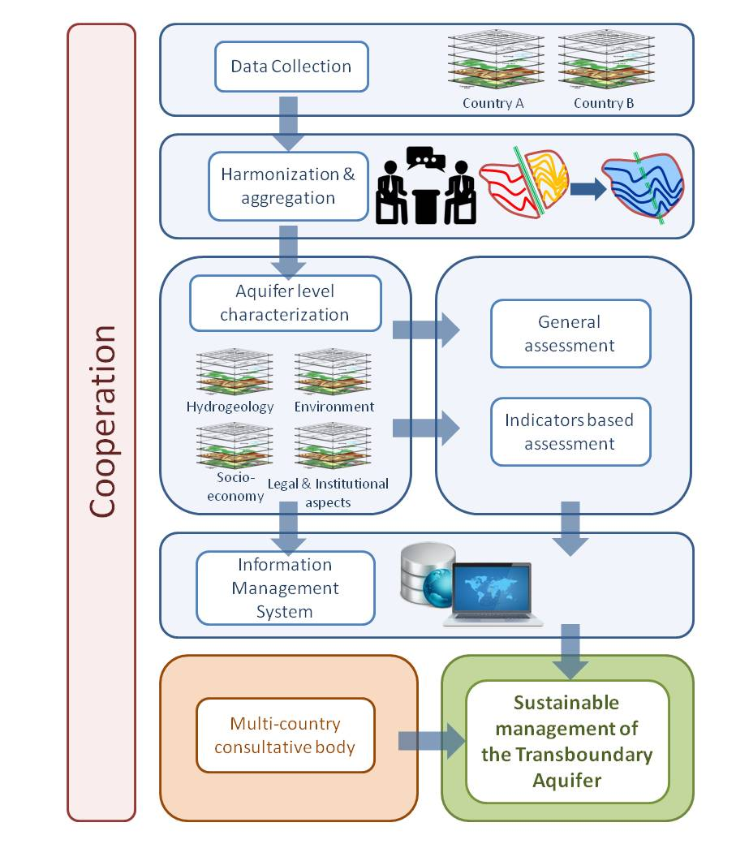
Project workflow and outputs
Structured and harmonised data sets (excel tables)
Indicators
Thematic maps
Overview tables and images
Illustrative graphs (time dependent data)
Conceptual model (cross-sections etc)
Assessment report
Information Management System
10

Slide 11
Project workflow / tasks
Important elements for October workshop
Data collection (incl. data entry and digitising of relevant information)
Taking stock (which data are available and which not) and fine-tuning of methodology (data & indicators)
Structuring of data
Harmonising data
Producing outputs: Indicators, thematic maps, overview tables, illustrative graphs, conceptual model, assessment report

Slide 12
Proposed next steps – Taking stock
Need to create a clear overview of what we have per country
Parameters and variables to be collected | Botswana | Namibia | South Africa
A. Physiography and Climate
A1
A2
A…
B Aquifer geometry
B1
 | Data exist and available
 | Data exist but incomplete or not up to date, or have to be inferred
 | No data available

Slide 13
Proposed next steps – Taking stock
But also:
Fine-tuning of methodology:
  Are all relevant elements included?
  → eg: risk of aquifer collapse related to groundwater abstraction
  Indicators (using overview table of data collected):
  → Which Indicators can be calculated?
  → Which indicators can be spatially differentiated?

Slide 14
Proposed next steps – Structuring data
Start creating tables in formats agreed between NE’s
→ e.g. from individual borehole information to overview tables per municipality
→Decide on time-periods for reporting
Start producing digital maps
→ from point maps to interpolated maps
→ digitise and geo-reference paper information

Slide 15
Proposed next steps – Harmonisation
Goal:
Make data usable at a higher level of aggregation or generalisation, finding ‘agreeable’ correspondence between data sets
Why is it needed?
Because datasets from different countries will have ‘unwanted variability’ as result of differences in data acquisition, processing and classification procedures

Slide 16

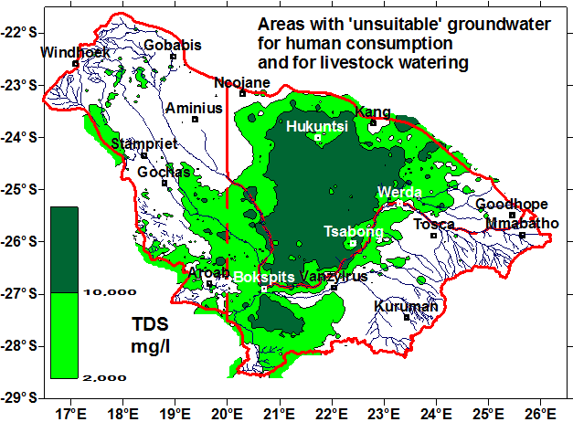
From ‘technical’ maps to simplified thematic maps

Slide 17
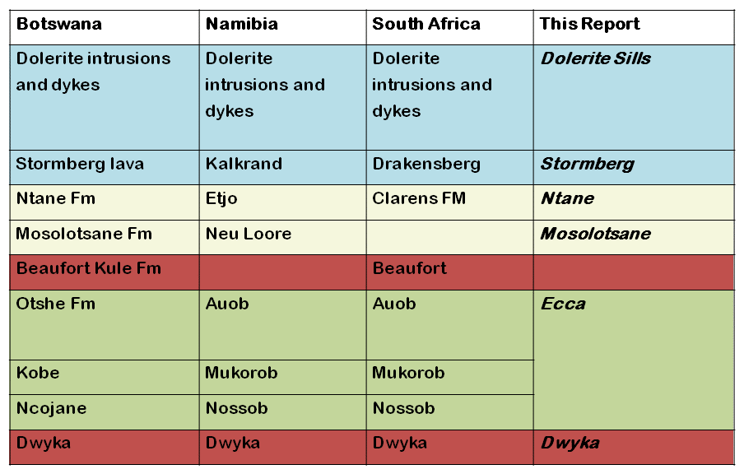
Harmonisation - Formations

Slide 18
Harmonisation: Agree on units
Borehole yield
m³/hr (Namibia) ←→, l/s (South Africa)

Slide 19
Harmonisation – map information
1 TBA
2 Countries
2 data sets
Harmonised data
Countries need consensus
on delineation of TBA
National data sets may differ in format
Harmonised TBA map,
based on national data sets.
Transboundary aquifer
For example information on
Aquifer productivity (Namibia) and
Groundwater potential (Botswana)

Slide 20
Harmonisation – Agree on classifications
 | WHO 1993 | Botswana, 2000
 | Guide- line Value | Class 1 Ideal | Class 2 Acceptable | Class 3 Max. Allowable
 | mg/l | mg/l | mg/l | mg/l
Namibia, 1991 |  |  |  | South Africa, 2006
Group A Excellent | Group B Good | Group C Low Health Risk | Group D Unsuitable | Class I Operational | Class II Max allowable for limited duration
mg/l | mg/l | mg/l | mg/l | mg/l | mg/l

Slide 21
Harmonisation
Harmonisation is all about developing a
common language and terminology
October 2013
Stampriet
Kalahari-Karoo
South East Kalahari Karoo Basin
May 2014
Stampriet ?!

Slide 22
Proposed next steps – Harmonising outputs
Agree on classifications
(e.g. suitability for water consumption, land use types, water use types, stratigraphy, etc. etc.)
But also:
Delineation of aquifer
Which aquifer layers are included?
Can they be matched between
all countries?
Base map, projection, scale
Study area? (buffer around TBA?)
Reporting units? (e.g. municipalities)
Next few days:
define priorities and tasks for structuring and harmonising data

Slide 23
Thank you

