Slide 1

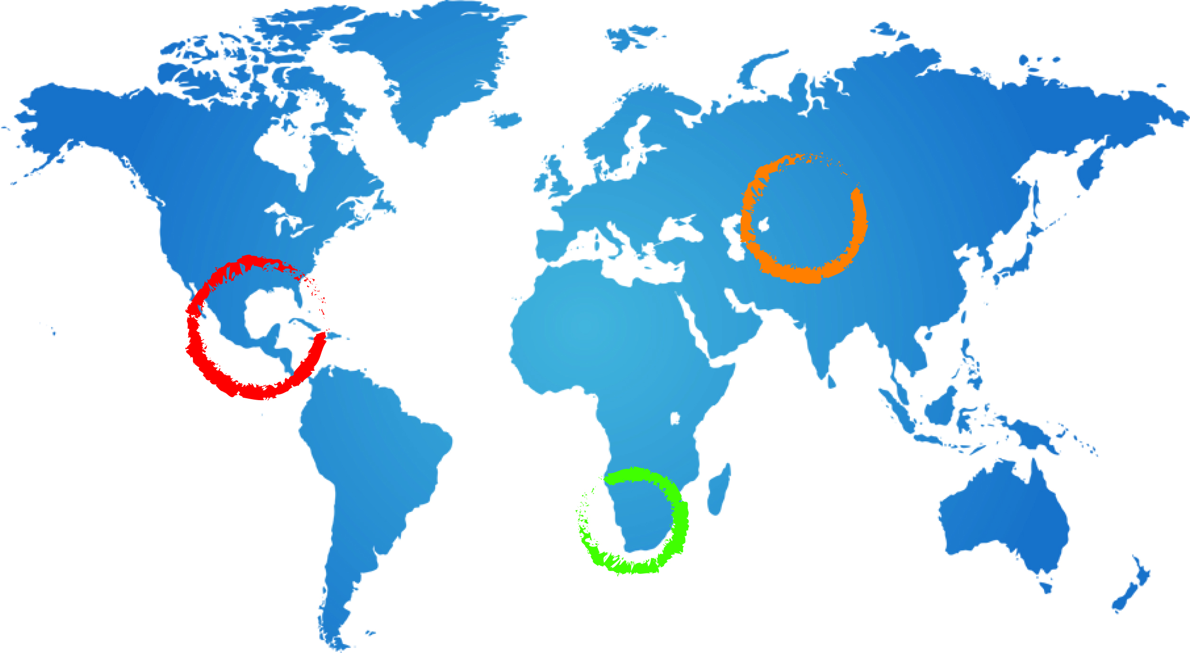
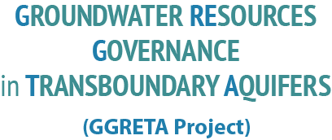


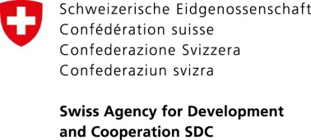

UN WWAP UNESCO strategy for gender sensitive water monitoring, assessment and reporting within the framework of the GGRETA Project :
INDICATORS AND METHODOLOGY
Francesca Greco, UN WWAP UNESCO
20-22 October 2014
Pretoria, South Africa

Slide 2
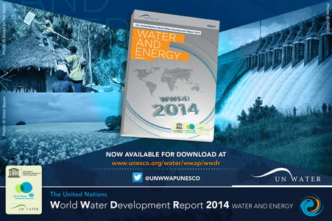


Background information on UN WWAP UNESCO Gender Strategy
WWAP has been a leader in mainstreaming gender into all of its projects and publications such as:
the 2012 edition of the World Water Development Report
( WWDR) “Managing Water Under Uncertainties and Risks”,
the 2014 annual report ( WWDR2014) “Water and Energy”
and all side publications.
WWAP now breaks new ground with a project on
gender sensitive methodology for water indicators

Slide 3
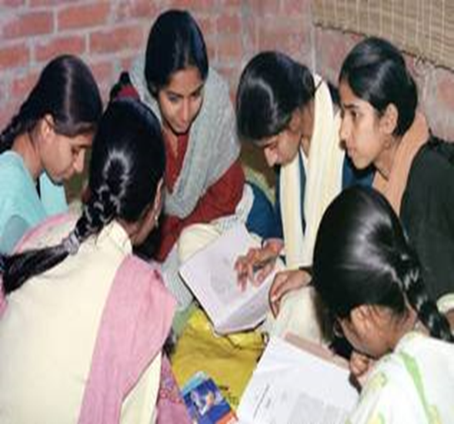
WWAP Project on Gender Sensitive Water Monitoring
The UN WWAP UNESCO project :
will develop through 4 phases,
with the help of international experts in the Working Group on Gender Sensitive Water Monitoring Assessment and Reporting
WWAP is currently in PHASE I – Production of
the Toolkit for gender sensitive water
monitoring (January 2014 – January 2015)

Slide 4
The main output of Phase I will be the Toolkit on Gender Sensitive Water Monitoring Assessment and Reporting.
The Toolkit will be composed of 4 tools:
4 - 5 high-priority water indicators and related components, identified by the international expert group
specific methodologies for collecting and assessing such data;
a guideline manual for “in-the –field” data gathering with specific insights for different world regions and final users;
a questionnaire for practitioners on gender-disaggregated interviews and data collection

Slide 5
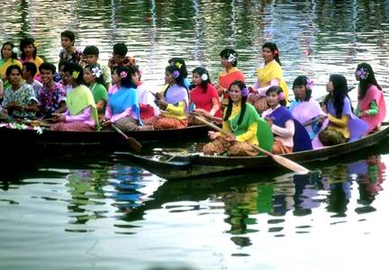
PHASE I – Production of the Toolkit for gender sensitive water
monitoring (January 2014 – January 2015)
PHASE II - Pilot projects in the field ( February 2015- February 2016)
.
PHASE III: Validation of results and Dissemination (February 2016 – June 2016)
PHASE IV: Capacity development (from July 2016)
Integration with GGRETA
assessment

Slide 6

SDC Gender guidelines and coherence with UN WWAP UNESCO gender component in the GGRETA project
Coherence of Gender Strategies
SDC gender toolkit
and guidelines*:
Gender analysis as a minimum requirement
Gender relations are a transversal theme in the project analysis
Gender disaggregated data on water are providing a “snapshot”of current situation and
will enable the measurement of changes in the situation of women and men and(in)equality through time
the gender sensitive assessment tackles power relations between men and women in the water sector
UN WWAP- UNESCO “GEM”
Gender Equality Marker in
major programs&workplans
 | 0 Gender-unaware | 1 Gender-sensitive | 2 Gender-responsive | 3 Gender-transformative
Gender analysis in the implementation strategy
Sex-disaggregated data
At least one gender equality-specific performance indicator(s) and corresponding target(s)
Gender equality expertise
At least one gender-related expected result(s)
* Principles from SDC Toolkit webpage, in particular: Gender Strategies : “Sheet 2 Gender Approaches” , Gender analysis “Sheet 3 Gener Analysis” Gender in Programmes and Projects ”Sheet 8a”

Slide 7
Integration into GGRETA Analysis
SOCIO ECONOMIC
ASPECTS
GGRETA
LEGAL AND INSTITUTIONAL
ASPECTS
GGRETA
Gender Sensitive Water Indicators
UN WWAP UNESCO
Central America
Trifinio
Transboundary Aquifer
El Salvador, Guatemala, Honduras
Central Asia
Pretashkent Transboundary Aquifer
Kazakhstan, Uzbekistan
Southern Africa
Stampriet
Transboundary Aquifer
Namibia, Botswana, South Africa

Slide 8
GGRETA Gender Analysis : Timeline and deliverables
The 2014 and 2015 time frame
2014
The preparatory work consists essentially in the:
identification of a very limited number of generic indicators ( ongoing)
preparation of the detailed work program related to gender ( ongoing)
2015
The fieldwork will consist in the:
implementation of data gathering
data analysis and portraying of the “water and gender” issues in the 3 aquifers as a
“snapshot”

Slide 9

SPECIAL INNOVATIONS AND CONTRIBUTIONS TO THE GGRETA PROJECT FROM UN WWAP UNESCO : COMPONENT ON GENDER SENSITIVE INDICATORS FOR WATER MONITOING ASSESSMENT AND REPORTING
• most of the indicators identified are not ‘on the agenda’ of other entities or are not
systematically collected;
• most of the themes are distinctive, and many unique: the emphasis on
‘unaccounted-for water-related labour,’ gender equality in decision-making, power
in institutions, women’s representation in knowledge-generating and scientific
knowledge-dependent activities, for example;
• ‘lifting the roof off household’ and scrutinizing intra-household dynamics and powers
is extremely innovative;
• the inclusion of “intensity” measures for women’s participation (not just “presence”)
in water-related institutions, is a unique effort to assess the gender component of
policy implementations and ”institutional framework” dynamics

Slide 10
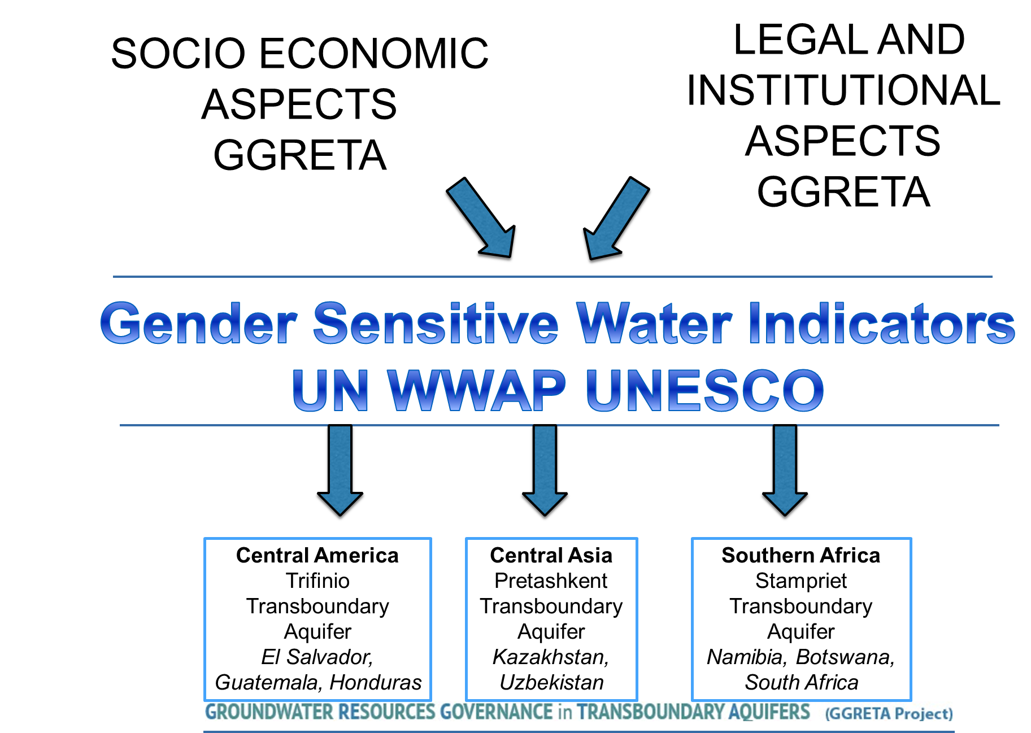


Slide 11

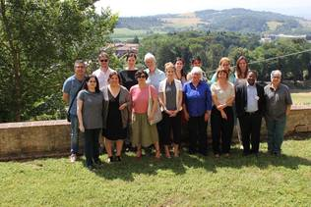
Inception meeting of the UN WWAP UNESCO
Project for Gender Sensitive Water Monitoring
Assessment and Reporting
Working group members as of July 2014:
Amber Fletcher, Ph.D., WWAP expert, Postdoctoral Research Fellow, Regina Uni, Canada
Alice Centrone, CISAO,University of Turin, Italy.
Alice M. Bouman-Dentener, Honorary Founding President, Women for Water Partnership
Angela Calvo, Professor at University of Turin
Anton Earle, Director African Regional Centre ,SIWI
Asma El Kasmi, UNESCO Chair “ Water, Women and Decision Making”, Morocco
Barbara Van Koppen, International Water Management Institute ( IMWI)
Christiane Froelich, University of Hamburg
Carolyn Sachs, Professor at Penn State University
Eiman Karar, Water Resources management, Water Research Commission, South Africa
Elisabetta Aurino, Oxford University
Emily Deschaine, Water Supply & Sanitation Collaborative Council (WSSCC)
Evelyne Lyons, Academie de l’Eau
Giovanna Gioli,University of Hamburg
Frederique Holle, Women for Water Partnership
Ilaria Sisto, FAO
Inga Jacobs, Water Research Commission
Joni Seager, WWAP Expert, Professor at Bentley University
Lesha (B.M. ) Witmer, Business & Professional Women International
Lyliose Umupfasoni,African Ministerial Council on Water (AMCOW) Secretariat
Marcia Brewster, President of United Nations Association
Moa Cortobius, UNDP-SIWI
Aishwarya Nair, Editor-in-Chief wH2O Journal
Rosemary Rop, Water and Sanitation Program - World Bank
Susan Bazilli, Director, International Women's Rights Project, Vancouver, BC, Canada
Tom Williams, Program Director, International Water Association (IWA)
Vasudha Pangare, Independent consultant and member of Gender and Water Alliance (GWA)
Viviana Re, Marie Curie Research FellowSfax, Tunisia and Ca’ Foscari University of Venice
WWAP experts contributing to the specific elaborations of outputs and publications are:
Dr Joni Seager, Professor & Chair,Global Studies Department, Bentley University
Dr Amber Fletcher, PhD,University of Regina
WWAP intern contributing to the Gender and Water strategy of UN WWAP UNESCO:
Mr Alessio Lilli, University of Perugia, Italy
UN WWAP Secretariat, UNESCO Office for Global Water Assessment, Villa La Colombella (Perugia), Italy, June 12-13 2014

Slide 12
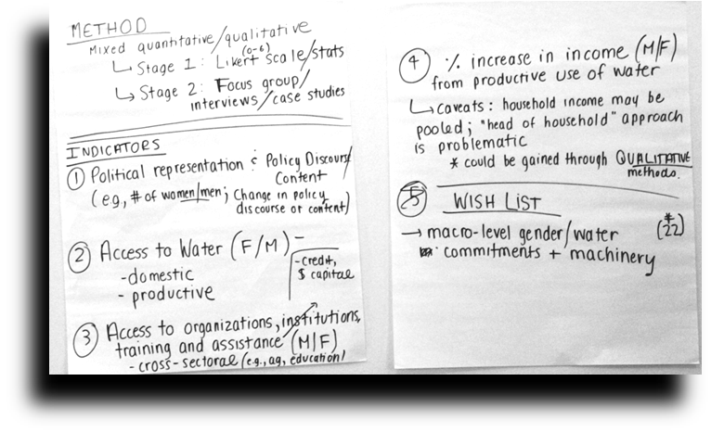
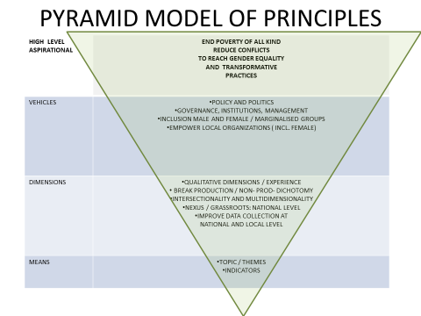
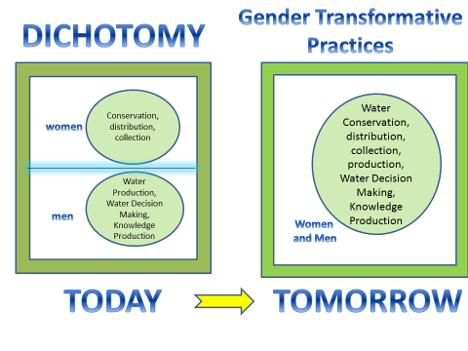
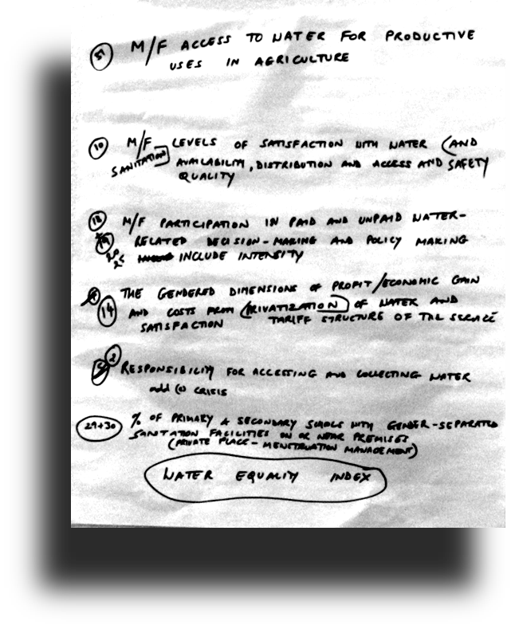
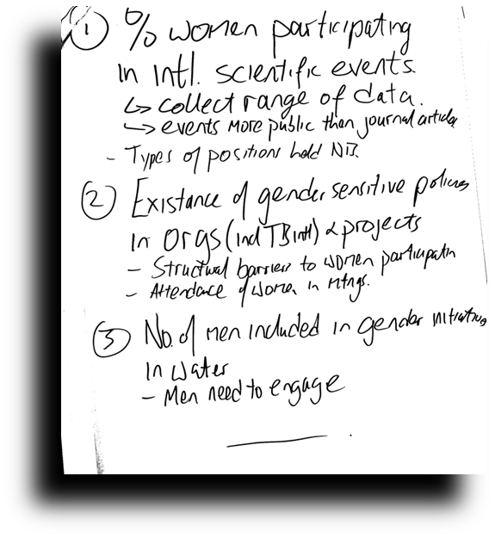

Slide 13
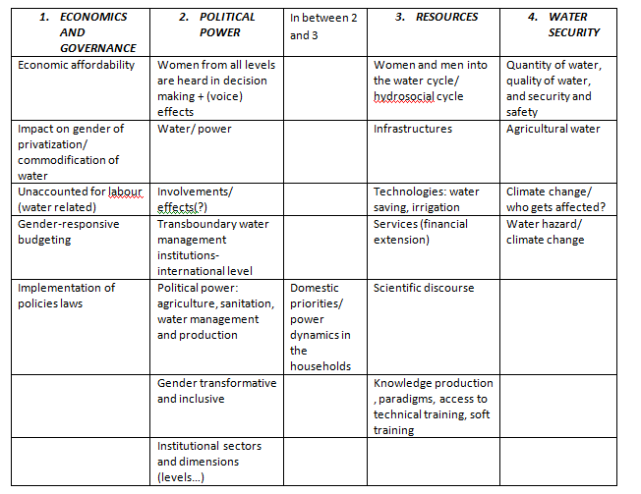
THE “CLUSTER OF TOPICS” TABLE

Slide 14
WATER GOVERNANCE INDICATORS
COMPONENTS
1a. Number of M/F paid staff in public water-governance agencies, disaggregated by job category/level and decision-making capacity (and salary, if available), at: • national level • county/ province/state level • town/ village level (sample)
1b. Number of M/F in paid and unpaid positions in local water governance formally-structured entities (water users associations, etc) at town/ village level (sample) • disaggregated by nature of relationship to the entity (e.g., “member”, “board”, “executive”, “leadership,” decision-making group, etc) and types of tasks
1c. Intensity of M/F participation in (sample/representative) meetings of public entity bodies sampled at national, sub-national, and local levels, including outcomes such as: ratio of contributions in decision-making meetings by women and men; percentage of decisions adopted from women’s contributions in meetings.
2b. M/F expressed priorities for water use within households
1d. M/F perceptions of gender discrimination (or equality) regarding women’s participation in decision-making entities.
4b. Intensity of M/F participation in (sample/representative) meetings of transboundary meetings, including outcomes such as: ratio of contributions in decision-making meetings by women and men; percentage of decisions adopted from women’s contributions in meetings.
3c. Budget allocations (if any) at national level for gender mainstreaming in water and sanitation.
3d. Designated ministerial responsibility for gender in relation to WASH policies; • are gender-specific machineries included in WASH sector decision-making.
3g. Presence and nature of gender sensitive training within responsible ministries/ lead agencies.Participation of M/F staff
3h. The extent to which gender outcomes and gender-sensitive accountability indicators are included in M&E/ impact statements/ benefits analyses of national-level WASH-sector projects (project proposals and/or outcomes assessments). Sample projects.
3b. The presence and nature of gender-specific objectives and commitments (or gender strategy) in national and sector-level water policies.

Slide 15
SAFE DRINKING WATER, SANITATION AND HYGIENE
COMPONENTS
2a. Percentage of households without water on premises, by sex of main person responsible for collecting drinking water and by type of household.• rural/ urban samples
2f. M/F perceptions of household gender equality in WASH decisions
2g. Unpaid time spent by individual household members in supplying water, making it safe for use, and managing it (M/F informants).
2h. M/F perceptions of the adequacy of current water supply/ availability in both quality and quantity.
2i. Percent households with access to “improved” sanitation facility, by household structure and by nature of the “improved” facility
2j. Intra-household M/F use of /access to improved sanitation facilities
2k. M/F prioritization of gaining access to improved sanitation facilities • willingness to allocate household budgets for such access
2l. M/F perceptions of the safety of sanitation facilities that are located outside the house • identified particular safety concerns
4g. Gender audit of WHO/ UNICEF “Joint Monitoring Program.”
3e. Number of staff responsible for WASH issues, (disaggregated by sex and job level) in gender ministry/ lead agency.
3f. Number of staff responsible for gender issues (disaggregated by sex and job level) in lead agency for WASH.

Slide 16
3.DECISION MAKING AND KNOWLEDGE PRODUCTION
COMPONENTS
3a. The nature and extent of gender-disaggregated data related to water and sanitation collected by responsible public entities at national and local levels (in relation to the totality of social indicators on water and sanitation collected).
4f. M/F participation in past decade of two major global international water meetings (and nationally-significant comparable meetings):• World Water Week (Stockholm)• World Water Forum (World Water Council)
3i. M/F perceptions of gender discrimination (or equality) regarding women’s participation in decision-making entities.
2c. M/F perceptions of: • the nature of their household decision-making process for water priorities and use; • the primary decision-maker within the household (if any); • how intra-household conflicts related to water (if any) are resolved.
2d. M/F perceptions of/ knowledge of current total household use of water, by category of use and by primary user
2e. Household member primarily responsible for managing the household’s use and supply of water, by nature of use (M/F informants/ perceptions).

Slide 17
WATER RESOURCES MANAGEMENT
COMPONENTS
4a. Number of M/F staff on transboundary water commissions (sample for pilot countries), disaggregated by job category/level and decision-making capacity (and salary, if available).
4e. The extent to which gender outcomes and gender-sensitive accountability indicators are included in M&E/ impact statements/ benefits analyses of transboundary agreements/ activities.
4c. M/F inclusion on nationally and internationally convened scientific panels and advisory boards.
4d. The presence and nature of gender-specific objectives and commitments (or gender strategy) in transboundary agreements

Slide 18
WATER FOR INCOME GENERATION IN
INDUSTRIAL AND AGRICULTURAL USES, INCLUDING
UNACCOUNTED-FOR AGRICULTURAL LABOUR
COMPONENTS
5a. % irrigated farms in region under survey; % irrigated farms managed by/ owned by M/F.
5b. Average size of irrigated farms run by/ owned by women/ men
5c. Gendered division of labor related to irrigated farming: • gender- specific tasks related to irrigated crops, by nature of tasks;• gender differentiated daily time-use of household members involved in irrigated farming work.
5d. Decision-makers and participants in household-based decision-making process regarding irrigation (M/F informants/ perceptions)• decisions re allocation of time and financial resources; crops to be irrigated
5e. Decision-makers and participants in community-based decision-making process (if any) regarding irrigation (M/F informants/ perceptions)• decisions re allocation of time and financial resources; crops to be irrigated
5f. M/F perceptions of gender discrimination (or equality) regarding women’s participation in decision-making in relation to irrigation.
5g. M/F access to support services for irrigation:• participation in technical training• M/F access to bank loans/ credit, and incentives for the development of irrigated agriculture
5h. M/F membership in and intensity of participation in community-based irrigation committees.
5i. M/F ratio of engineers and technicians trained in agricultural water management (national level).

Slide 19
The preliminary choice of indicators was presented in September 2014 and it has been incorporated into the GGRETA Progress Report Document in October 2014
The completion of the Toolkit
( Indicators +Methodology+GuidelineManual+Questionnaire) by January 2015
Cooperation with partners and institutions on implementation of Phase II,III and IV ( including GGRETA) ongoing
Contribution to global monitoring mechanisms ( post-2015 indicators debate on water goals, AMCOW, etc…) ongoing
NEXT STEPS

Slide 20
UN WWAP UNESCO:
GENDER SENSITIVE WATER MONITORING AND RELATED METHODOLOGY
September/October 2014 update

Slide 21
Overview of methodological approaches required to implement a gender sensitive water monitoring strategy as per UN WWAP UNESCO
METHODS OF ENQUIRY
Fact-finding interviews and official records
Perception interviews-
M/F
Participant-observer of group/public activities
( qualitative measures)
Household and Intra-household level surveys
COMPONENTS OF GGRETA project
SOCIO ECONOMIC
LEGAL AND INSTITUTIONAL

Slide 22
METHODOLOGY/1
FACT FINDING INTERVIEWS AND OFFICIAL RECORDS
This investigation will require interviews with a variety of people, including key informants and respondents
These are interviews of a selected (nonrandom) group of experts who are thought to be most knowledgeable of the organization or issue and who can provide “objective” information about that issue
Respondents (participants) are the individuals whose lives and activities the survey tries to capture. Unlike the key informants who are interviewed because they can provide specific non-personal information, the main purpose of talking with “respondents” is to get information about those respondents’ lives.
EXAMPLE: number of M/F staff in water-governance agencies,
disaggregated by job-category

Slide 23
METHODOLOGY / 2
PERCEPTION INTERVIEWS M/F
The WWAP expert group recognizes and emphasizes that “presence” of women in any organizational activity is not the same as “influence” or “contribution.”
Presence is a quantitative indicator;
“participation” is a qualitative measure.
For example, the number of men/ women staff employed in a Ministry of Water may be an important indicator in itself, but it does not reveal any information about dynamics of gender equality/ inequality/ discrimination at work within those agencies or Ministries.
Another lens is the perceptions of the women and men themselves who are involved in these activities ( sample survey for women and men)
EXAMPLE: perceptions of gender discrimination (or equality) regarding women’s participation in national-level public water-governance agencies.
Perception of discrimination rank: from 1 to 10 , where 1 is absence of perceived discrimination and 10 is highly perceived discrimination.

Slide 24
METHODOLOGY/3
PARTICIPANT-OBSERVER OF GROUP/
PUBLIC ACTIVITIES (INTENSITY MEASURES)
Various dimensions of “empowerment” are particularly hard to capture in a single indicator or with a quantitative measure
Empowerment measures often reduced to ‘counting heads’ – an undeniably important indicator – but this is not the same as “empowerment” in the real world.
Many women attend meetings or sit on Councils but never speak; or, if they speak, they are seldom listened to
This investigation requires participant-observer methodology
EXAMPLE: Intensity of M/F participation in (sample/representative) meetings of public entity bodies sampled at national, sub-national, and local levels, including outcomes such as: ratio of contributions in decision-making meetings by women and men; percentage of decisions adopted from women’s contributions in meetings.

Slide 25
METHODOLOGY/4:HOUSEHOLD AND
INTRA-HOUSEHOLD LEVEL SURVEYS
The household has long been the standard unit of social analysis;it is conventionally viewed as a single decision-making unit in the water sector, as elsewhere
All available evidence makes clear that within a household, resources use, priorities, and decisions are negotiated (or imposed) across gender divides
This enquiry requires unstructured or semi-structured interviews
EXAMPLE: Decision-makers and participants in household-based decision-making process regarding irrigation (women/men informants/perceptions):
- decisions re-allocation of time and financial resources
- crops to be irrigated

Slide 26
GGRETA PROGRESS REPORT
OCTOBER 2014 AND GENDER ASPECTS
SOCIO-ECONOMIC ASPECTS
All methodologies ( 1, 2, 3, 4) are present. Implementation depending on GGRETA experts in the field and their time-constraints
LEGAL AND INSTITUTIONAL ASPECTS
Prevalence of methodology 1 (Fact-finding interviews and official records) , with the exception of the qualitative analysis regarding participation in institutions ( women and men): implementation is easier

Slide 27
CONCLUSIONS
Methodologies for gender component need to be verified and tested for compatibility with GGRETA
Even if a minority of these indicators or methodologies will be implemented, this will constitute a great innovation in water monitoring
Great upscaling potential with UN WWAP UNESCO PROJECT on gender sensitive water monitoring, assessment and reporting
AIMING AT A GLOBAL STANDARD

Slide 28

Thank you for your attention
f.greco@unesco.org
Twitter : @UNWWAPUNESCO
http://www.unesco.org/new/en/natural-sciences/environment/water/wwap/water-and-gender/

