Slide 1
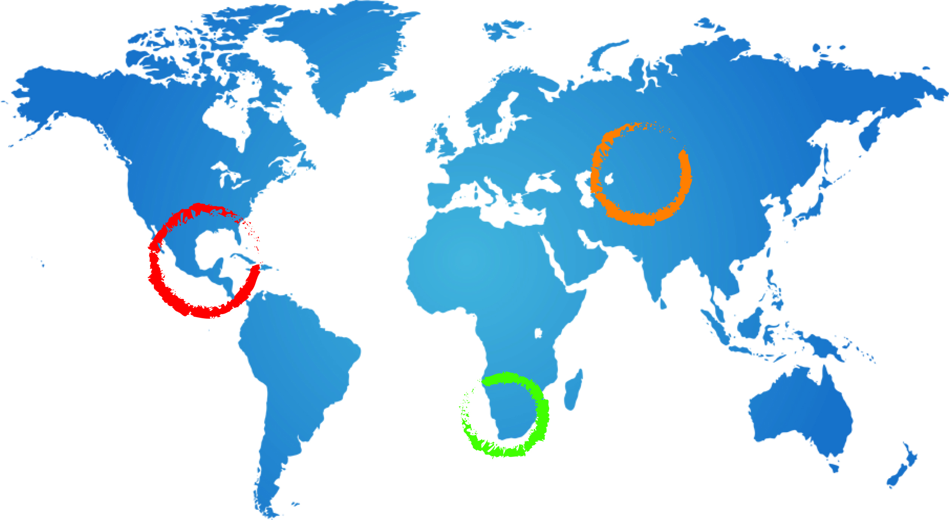
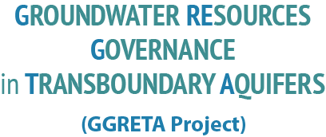







Stampriet – Kalahari/Karoo Aquifer Case Study
Technical Seminar on Project Implementation
Dealing with data
Information Management System
Processing & Harmonisation
Team cooperation
Geert-Jan Nijsten - IGRAC
21 May 2014
Windhoek

Slide 2
Set-up of the presentation
Information Management System
Data processing and harmonisation
Internal communication

Slide 3

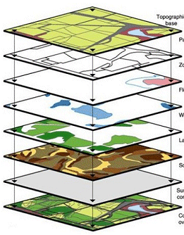
Information Management System

Slide 4
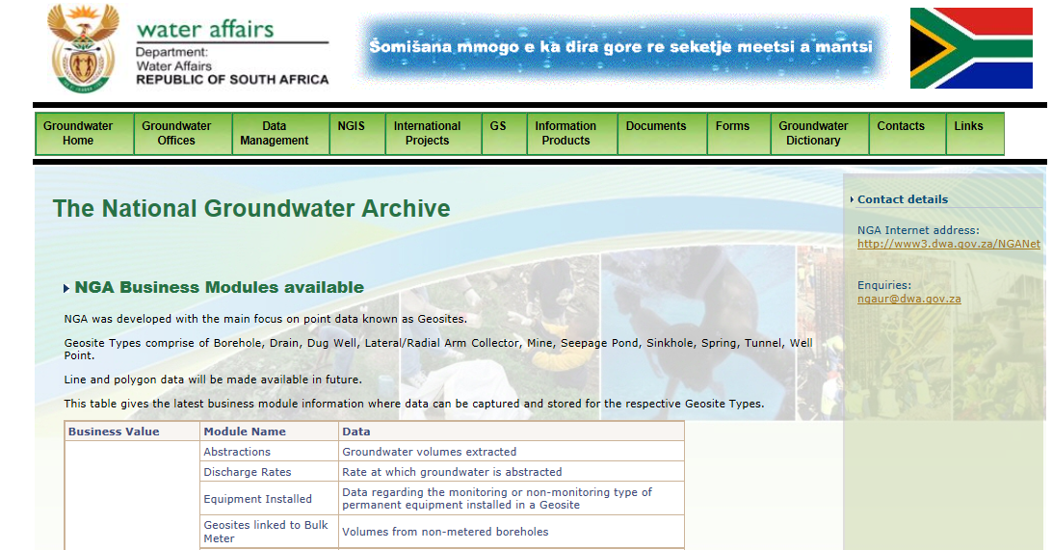
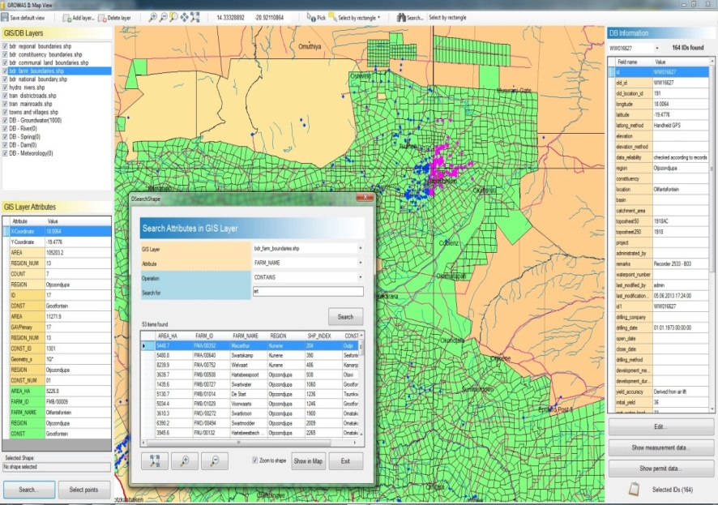
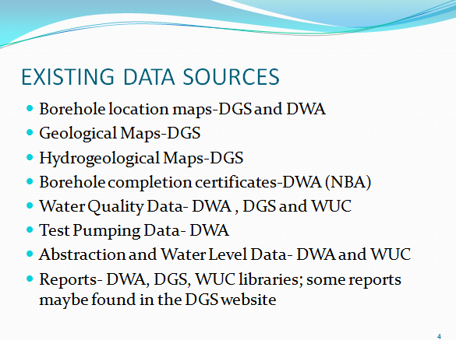
What will the GGIS NOT be ?
But it can be an information management system for interpreted data and documents
to support transboundary management

Slide 5


Purpose of Information Management System
  Collect, store, visualise and share structured information
  in order to:
  Support transboundary groundwater governance
  Allow replication of the assessment

Slide 6

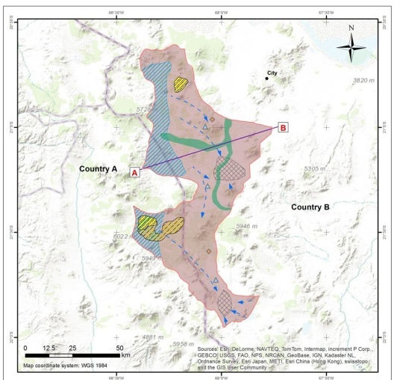
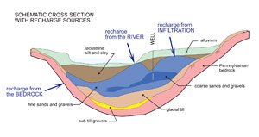
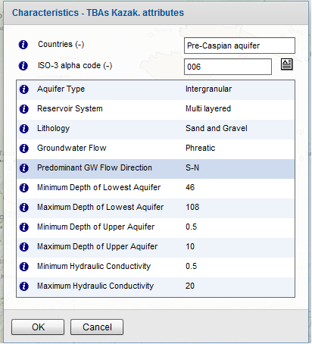
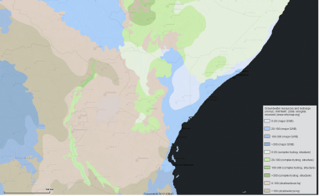
What types of information can be stored?
Indicators
Parameters/variables
Tabular data
Thematic maps
Background maps
Documents
Images
And:
Meta information
Projections
(WaterGap)

Slide 7

GGIS Functionalities
Public View
Overlay layers of information
Point data
Vectors
Polygon data
TIFF imagines

Slide 8

Actors and roles in Data Flow
IGRAC - UNESCO
Regional coordinators (RC)
National Experts (NE)
  IMS Development and maintenance
  Guidelines and data protocols
  Technical assistance to NE’s
  Coordinate & assist NE
  Facilitate Transboundary cooperation, data harmonisation and creation of visuals
  Data & information collection
  Data processing and harmonisation
  Create visuals
  GGIS
Management tool for consultative body
  Global Groundwater Information System

Slide 9
Data processing & Harmonisation

Slide 10

Data Processing
From ‘raw’ data to consistently structured data
Data collection
Paper maps
Paper reports
    Text, tabular data, images, maps
Digital data
    Tables, maps, reports
Structured data
Standardised formats:
Digital maps
Tables (excel)
Text

Slide 11
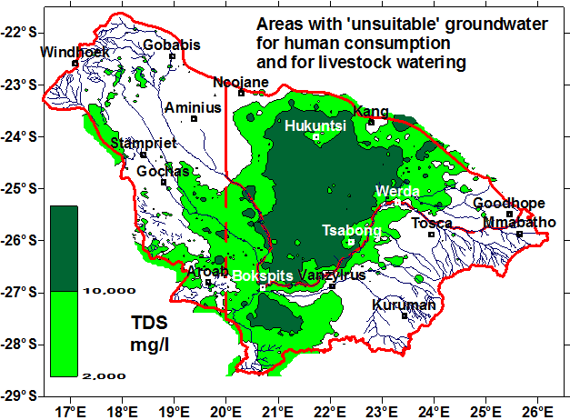
Data Processing
From ‘technical’ maps to simplified thematic maps

Slide 12
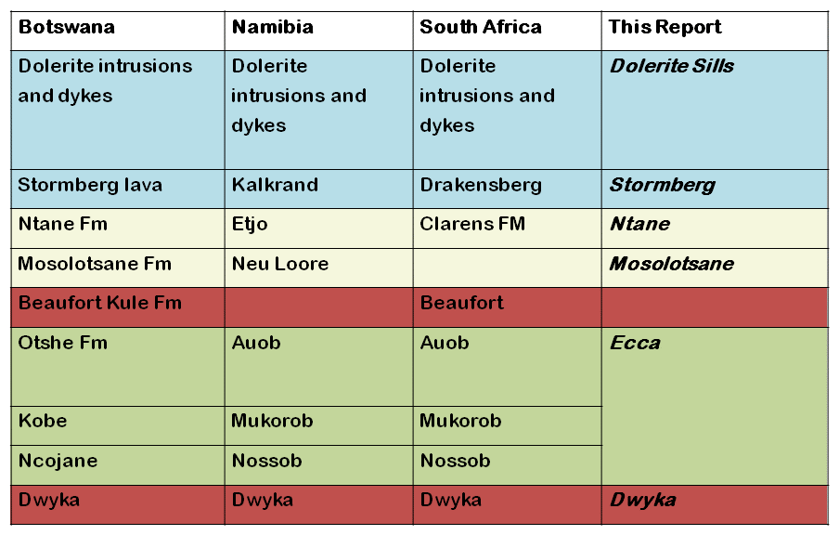
Harmonisation - Formations

Slide 13
Harmonisation: Agree on units
Borehole yield
m³/hr (Namibia) ←→, l/s (South Africa)

Slide 14
Harmonisation – map information
1 TBA
2 Countries
2 data sets
Harmonised data
Countries need consensus
on delineation of TBA
National data sets may differ in format
Harmonised TBA map,
based on national data sets.
Transboundary aquifer
For example information on
Aquifer productivity (Namibia) and
Groundwater potential (Botswana)

Slide 15
Harmonisation – Agree on classifications
 | WHO 1993 | Botswana, 2000
 | Guide- line Value | Class 1 Ideal | Class 2 Acceptable | Class 3 Max. Allowable
 | mg/l | mg/l | mg/l | mg/l
Namibia, 1991 |  |  |  | South Africa, 2006
Group A Excellent | Group B Good | Group C Low Health Risk | Group D Unsuitable | Class I Operational | Class II Max allowable for limited duration
mg/l | mg/l | mg/l | mg/l | mg/l | mg/l

Slide 16
Data processing & Harmonisation
Agree on:
classifications (suitability for water consumption, land use types, water use types, stratigraphy, etc. etc.)
map scale and map projection
areal sub-divisions for reporting (eg report per local municipality or per district?)
units
table formats
report format
additions/modifications to the methodology (eg: Groundwater community management)
….
….

Slide 17
Harmonisation
Harmonisation is all about developing a
common language and terminology
October 2013
Stampriet
Kalahari-Karoo
South East Kalahari Karoo Basin
May 2014
Stampriet ?!

Slide 18
Project workflow / tasks
Data collection (incl. data entry and digitising of relevant information)
Taking stock (which data are available and which not) and fine-tuning of methodology (data & indicators)
Structuring of data (data processing)
Harmonising data in a consistent way across the aquifer
Producing outputs: Indicators, thematic maps, overview tables, illustrative graphs, conceptual model, assessment report

Slide 19
Team cooperation
Internal project communication

Slide 20
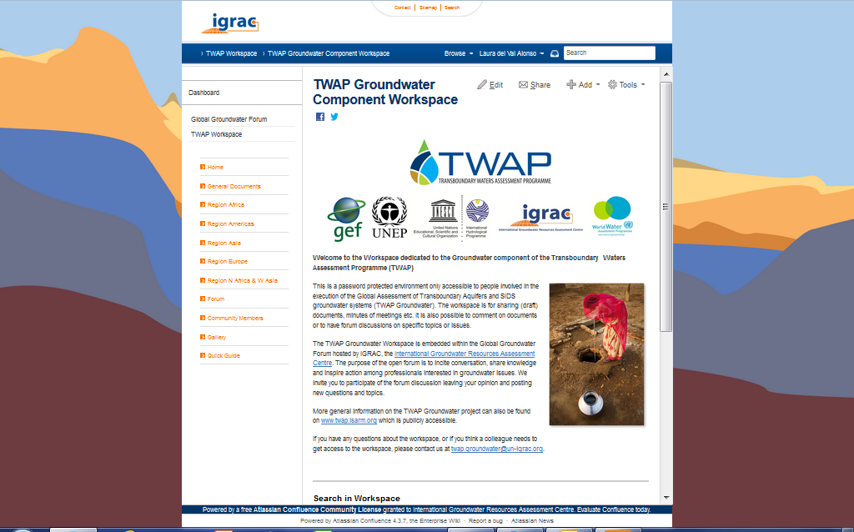
Project Workspace
Password protected

Slide 21
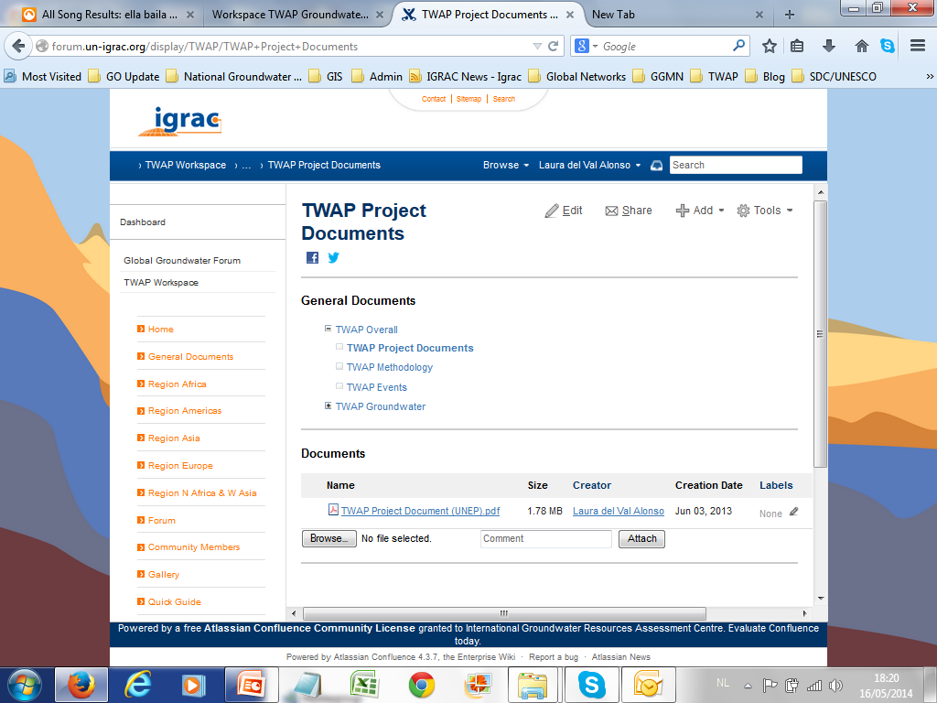
File exchange
Exchange information between country experts
Follow up on authors, versions, etc

Slide 22
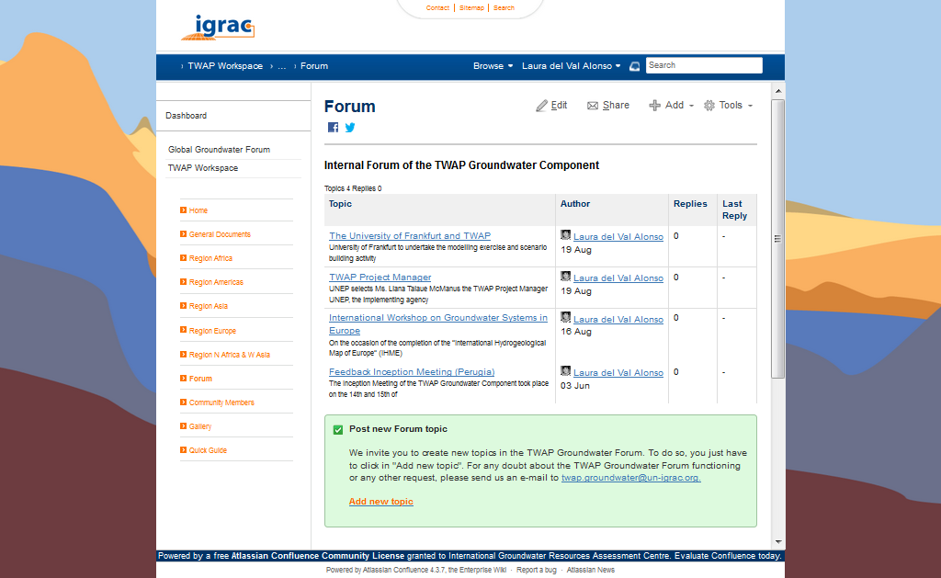
Forum functionalities
Forum functionalities
Forum for discussions, sharing ideas, etc.

Slide 23
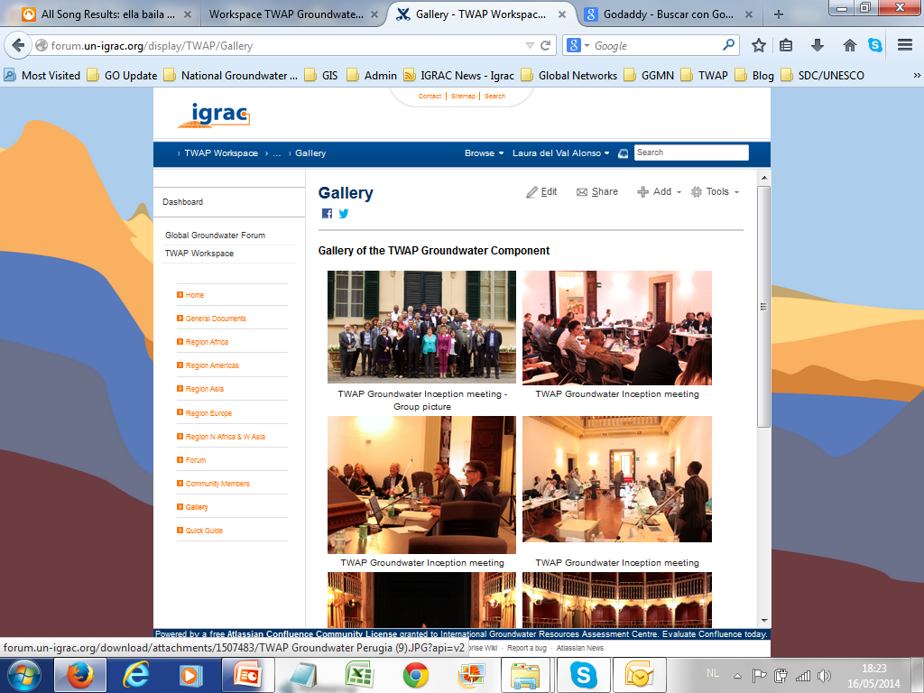
Community development
Sharing images and foto’s

Slide 24


Thank you

Slide 25
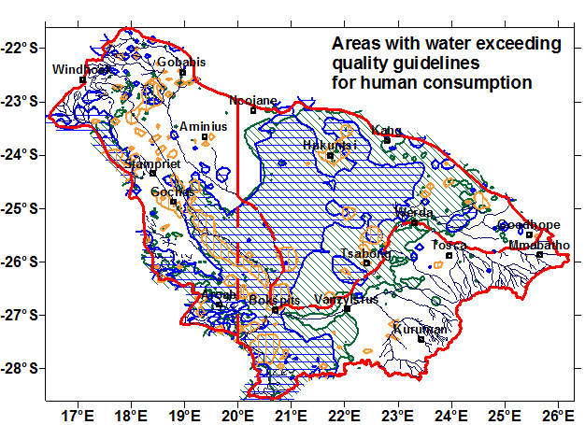
Visualising:
Maps with a clear message

Slide 26
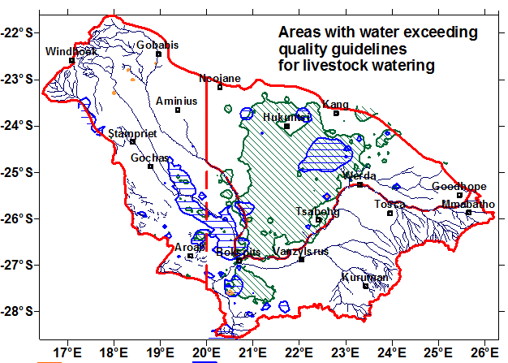
Visualising:
Maps with a clear message

Slide 27
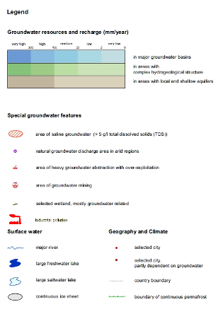
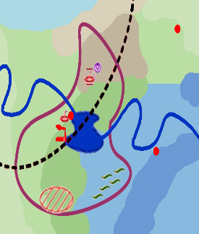
Visualising:
Conceptualising → simplified maps

Slide 28
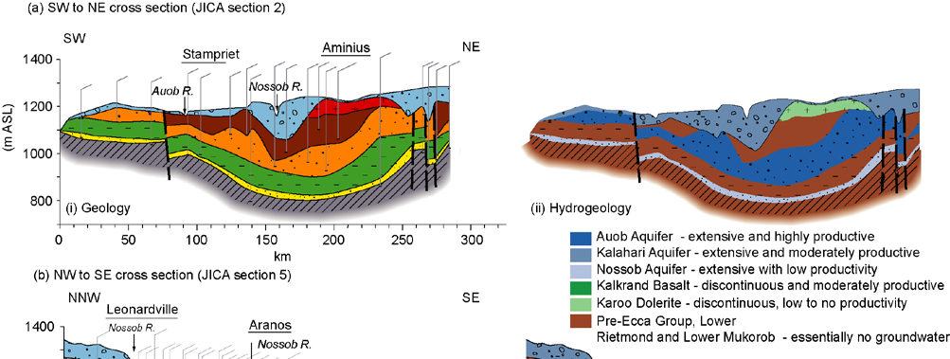
Visualising: Cross sections
Visualising:
Cross-sections

Slide 29
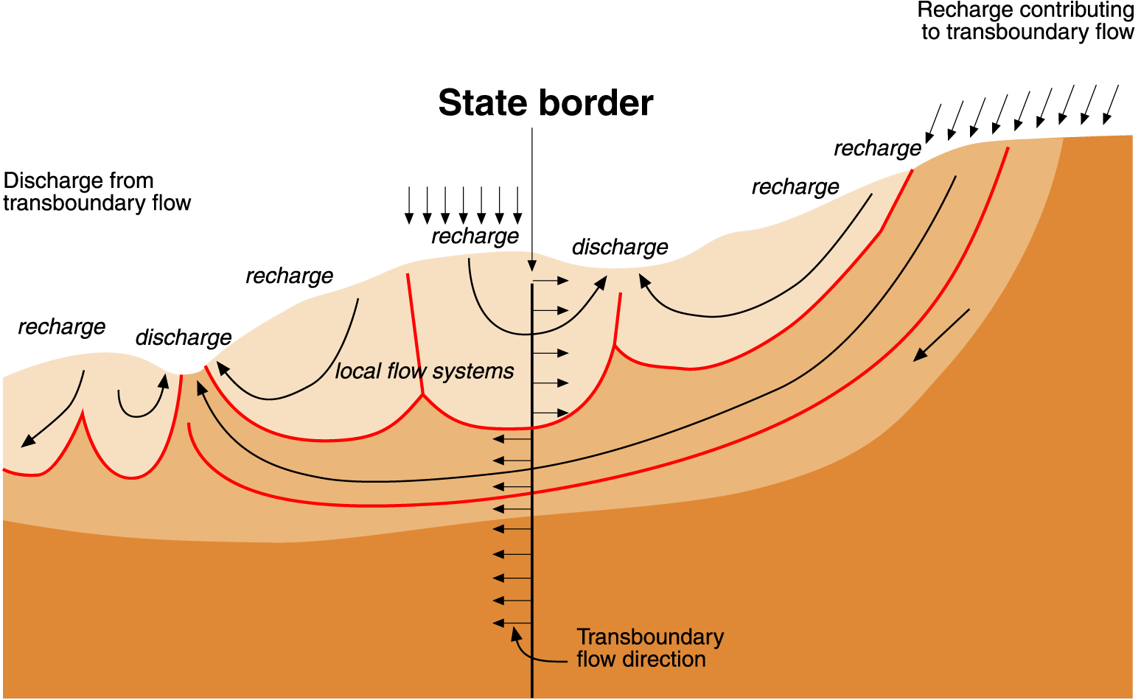
Visualising:
Simplified diagrams with a message
Notes:
Together with regional hydrogeologists, IGRAC is working on assessment of transboundary aquifers. The results are stored in the Global Groundwater Information System. GGIS shows delineation of the aquifers and the main aquifer attributes. It has two basic functions: to overview and compare, by browsing and searching.

Slide 30
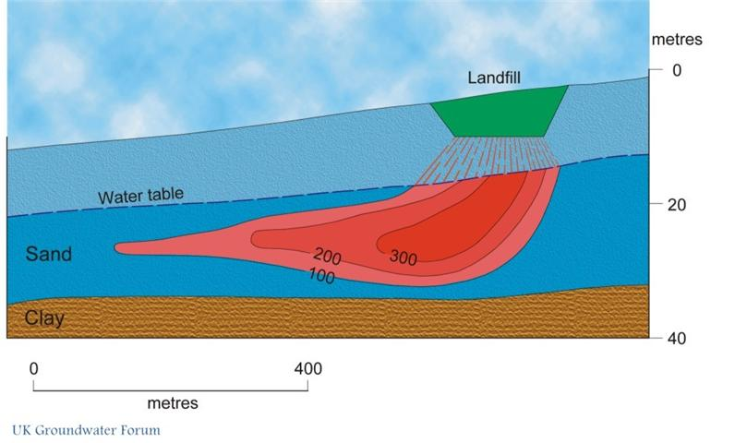
Visualising:
Simplified diagrams with a message

Slide 31
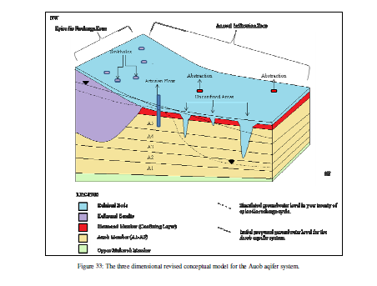
Visualising: Block diagrams with a message
Visualising: Block diagrams with a message

