Slide 1
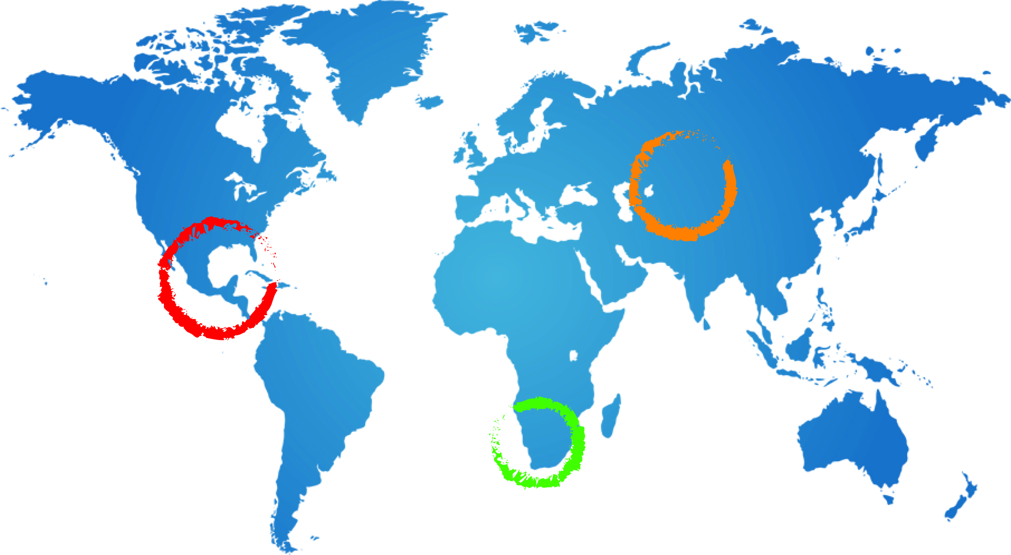
Regional Technical Seminar on Project Implementation
Socio-Economic & Environmental Aspects – Existing Data
Name Surname
Date
Location

Slide 2
Stampriet Botswana Socio-Economic Data
Variable | Data / Variable Indicators | Status of the Existing Data | Data Sources
Population Density | Number of people in the aquifer catchment (overall & per settlement) Male/female percentages Number of households | Readily Available & Reliable Available at settlement l& district level | CSO (Census Reports)
Settlement Types | Urban, rural, ungazetted or unrecognized (RAD settlements, cattleposts / lands areas, etc.) | Readily Available & Reliable | CSO (Census Reports) DA Sources District Council Sources
Development Direction / Plans | Settlement development plans, strategy & projections | Available & reliable at district level Settlement level? | District Development Plans (DDP) Baseline Rpts

Slide 3
Stampriet Botswana Socio-Economic Data
Variable | Data / Variable Indicators | Status of the Existing Data | Data Sources
Ground Water Use Ground Water Use | Types of use (… and user groups within each type) Domestic (private or public) Livestock (cattlepost or ranch system, i.e., communal or private uses) Commercial / Industrial (mineral exploration, wildlife ranching & tourism development uses) Environmental Use (wildlife / ecosystem conservation related uses) | Available, Reliable but Scattered | Census Reports DDP, DWA, WUC, MoA, DWNP Users??? Baseline Rpts - (to be identified and sourced)
 | Levels of use (abstraction levels) per each type and user group | Available, but sketchy & Scattered | DWA, MoA, DoM, District Council, DA Users??? Baseline Rpts - (to be identified and sourced)

Slide 4
Stampriet Botswana Socio-Economic Data
Variable | Data / Variable Indicators | Status of the Existing Data | Data Sources
Ground Water Use | Water Access , Ownership or Distribution Aspects (Social Equity): Distribution by type of use Distribution by user group Distribution by gender | 1 available, but Scattered 2 limited & scattered 3 very limited | Census Reports DDP, DWA, WUC, MoA, DWNP, DA, District Council Users??? Baseline Rpts - (to be identified and sourced)

Slide 5
Stampriet Botswana Socio-Economic Data
Variable | Data / Variable Indicators | Status of the Existing Data | Data Sources
Groundwater Community Management | Community based (user group) management initiatives | Availability (Y&N) Necessary??? | DWA, MoA, DoM, District Council, DA Users??? Baseline Rpts - (to be identified and sourced)
Surface Water Use | Use levels in respect of the above categories, and in comparison with ground water use | Available but sketchy and scattered | Census Reports, DDP DWA, MoA, DoM, District Council, DA Users??? Baseline Rpts - (to be identified and sourced)

Slide 6
Stampriet Botswana Land Use & Environmental Data
Variable | Data / Variable Indicators | Status of the Existing Data | Data Sources
Land Use | Types, intensities (e.g., # of cattle per borehole) | Sketchy, scattered, limited | Census Rpts, Dept. of Lands, MoA, DWNP, DA Baseline Rpts - (to be identified and sourced)
Solid waste & waste water management (Human Related Sources of Pollution) | Type of solid waste disposal facilities (landfills or dumping sites / burning) Type of human waste disposal systems (pit latrines, septic tank system, bush droppings, sewer lines Levels of both solid waste and waste water | Sketchy, scattered | Census Rpts, DDP, DWM&S, DA Baseline Rpts - (to be identified and sourced)
Ground Water Ecosystem | Vegetation type |  | MOA, DWNP

Slide 7
Stampriet Botswana Land Use & Environmental Data
Variable | Data / Variable Indicators | Status of the Existing Data | Data Sources
Solid waste & waste water management (Human Related Sources of Pollution) | Type of solid waste disposal facilities (landfills or dumping sites / burning) Type of human waste disposal systems (pit latrines, septic tank system, sewer lines Levels of both solid waste and waste water | Sketchy, scattered | Census Rpts, DDP, DWM&S, DA Baseline Rpts - (to be identified and sourced)

Slide 8
Stampriet Botswana – Community Perceptions & Snapshot Surveys
Variable | Data / Variable Indicators | Status of the Existing Data | Data Sources
Local Community Ground Water Knowledge & Perceptions | Knowledge & Perceptions about ground water sources, use trends, factors underlying the trends, pollutions aspects, causes and factors underlying these, as well as the way forward about sustainable use and control of the water resource | Availability & Reliability (Y&N) Primary Data Collections | District Council, DA Users Baseline Rpts - (to be identified and sourced)
 | Use Levels, Availability, Trends | As above | As above

Slide 9
Thank You

