Slide 1
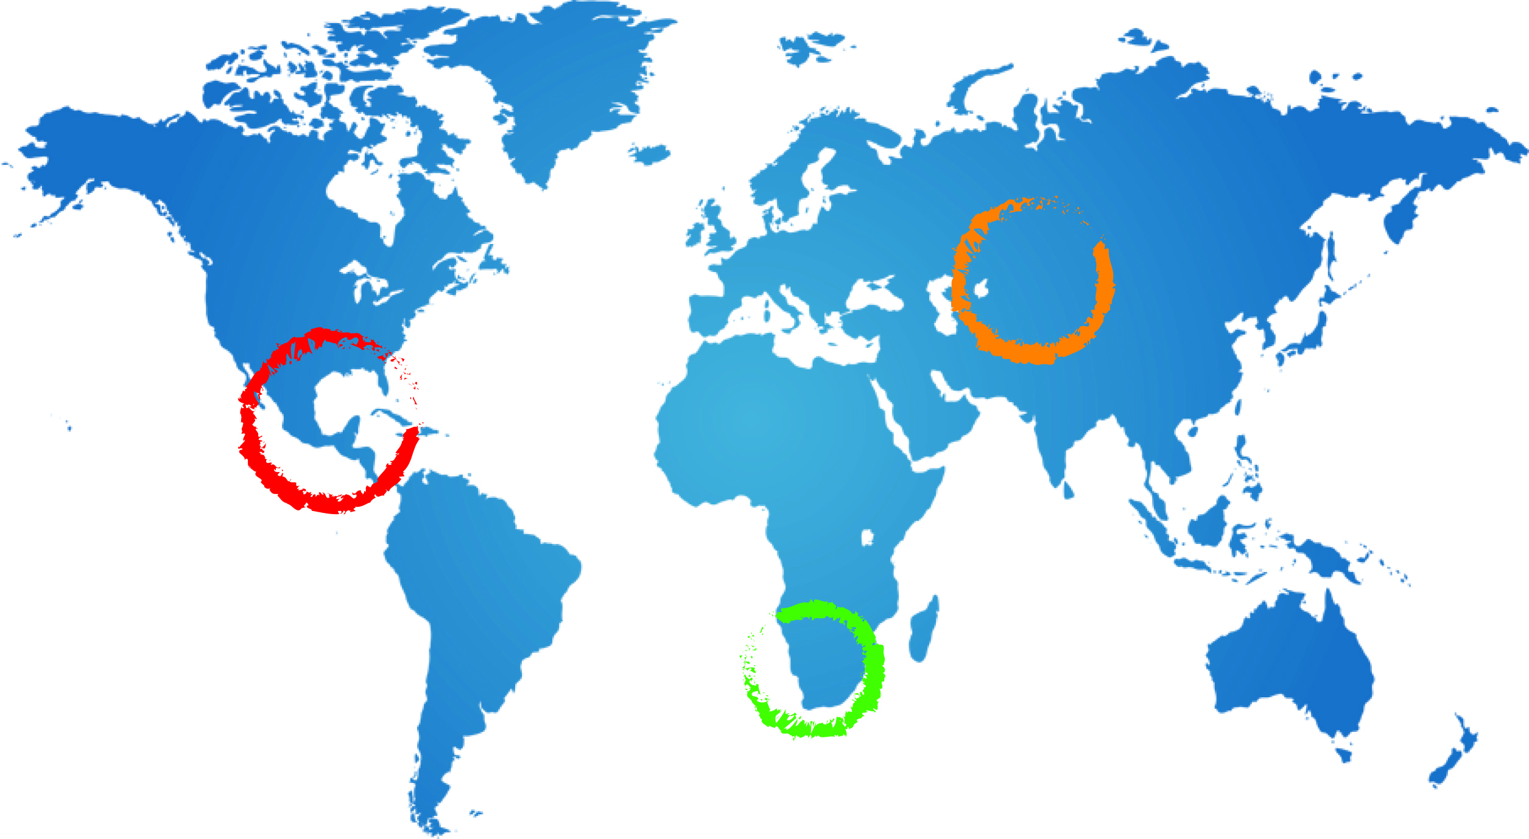
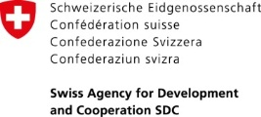
South African
Socio-economic and Environmental Aspect BE Hanise
Bantu Hanise
22 May 2014
Namibia

Slide 2
Socio Economic and Environmental Aspects
Table of contents
Profile of the study area
Aspects around the Identified indicators and available data sources
Question and suggestions

Slide 3
Profile of Study area
Socio-economic
The area is in the Mier Local Municipality part of the Siyanda District Municipality
Total Population of 7,003 individuals on an area of 22.468 km² and population density of 0.31/km²
69.2% urban and 30.9% Farms;
63.3% Municipality water schemes and 36.7% other sources such as boreholes, springs, rain water storing tanks etc
11% have no toilets, 88.7% have toilets ( 36.9% Pits and Bucket toilets)
Economic sectors include Agriculture, tourism, manufacturing, transport and community services (professionals which include nurses, teachers, municipality officials)

Slide 4
Profile….cont.
Natural environmental aspects
The area is semi arid to arid climate
Biodiversity
Fauna includes insects, arachnids, reptiles, small and large mammals etc
Flora- dominated by succulents, dwarf shrubs and bushes

Slide 5
Identified Indicators
Socio-economic
Human dependence on groundwater;
Population density;
Human dependence on groundwater for domestic water supply;
Human dependence on groundwater for agricultural water supply;
Human dependence on groundwater for industrial water supply;
Gender Issues

Slide 6
Identified Indicators
Natural Environment
Ecosystem dependence on groundwater;
Aquifer vulnerability to pollution;
Groundwater pollution;
Groundwater development stress;
Control of groundwater abstraction;
Groundwater quality protection.

Slide 7
Socio-economic Indicators | Data source | Data availability | Accessibility | Dta form and Sources
Total Area | Stats SA, IDP | Yes | Yes | Census Reports, Maps, Shape files
Total Population | Stats SA, IDP | Yes | Yes | Census Reports, Maps, Shape files
Population Density | Stats SA, IDP | Yes | Yes | Census Reports, Maps, Shape files
Sex Ratio (male to Female) | Stats SA, IDP | Yes | Yes | Census Reports, Maps, Shape files
Households | Stats SA, IDP | Yes | Yes | Census Reports, Maps, Shape files
Economic sectors and drivers | Stats SA, IDP | Yes | Yes | Census Reports, Maps, Shape files
Human dependence on groundwater | Stats SA, IDP, DWA | YES | YES | Census Reports, Maps, Shape files
Human dependence on groundwater for domestic water supply | Stats SA, Local Municipality, DWA |  |  | Census Reports, Maps, Shape files
Human dependence on groundwater for agricultural water supply | Stats SA,DWA-NC, AgriSA NC | Uncertain | Uncertain | Census Reports, Maps, Shape files
Human dependence on groundwater for Industrial water supply | Stats SA, DMR,DWA-NC | Uncertain | Uncertain | Census Reports, Maps, Shape files
Environmental Aspects | Data source | Data availability | Accessibility | Dta form and Sources
Ecosystem dependence on groundwater | SANBI, DEA, DWA | Yes | Yes | Reports, digital information, Maps, Shape files
Aquifer vulnerability to pollution | SANBI, DEA, DWA,DMR | Yes | Yes | Reports, digital information, Maps, Shape files
Groundwater pollution | SANBI, DEA,DWA,DMR, Local Municipality | Yes | Yes | Reports, digital information, Maps, Shape files
Groundwater development stress | SANBI, DEA,DWA,DMR, Local Municipality | Yes | Yes | Reports, digital information, Maps, Shape files
Control of groundwater abstraction | SANBI, DEA,DWA,DMR, Local Municipality | Yes/No | Yes/No | Reports, digital information, Maps, Shape files
Groundwater quality protection | SANBI, DEA,DWA,DMR, Local Municipality | Yes/No | Yes/No | Reports, digital information, Maps, Shape files

Slide 8
Questions and suggestions
THANK YOU

