Slide 1
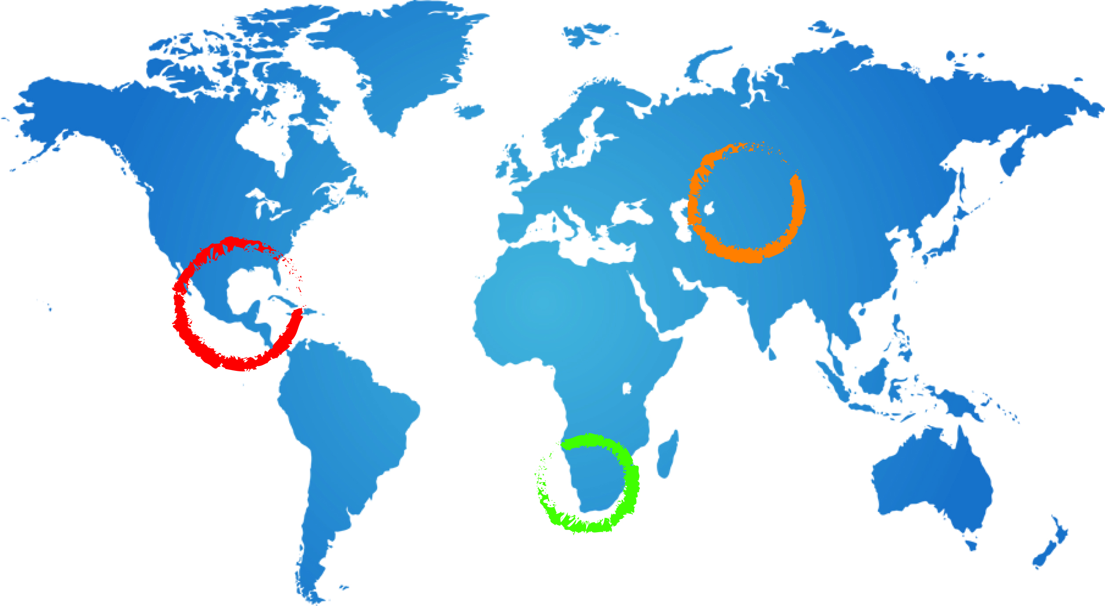
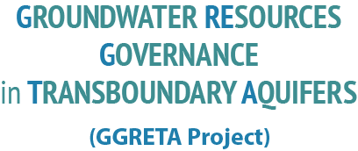

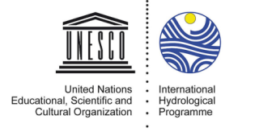
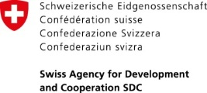




The GGRETA Project: Context and Introduction
Andrew Ross
Senior groundwater specialist UNESCO
A Ross
21 May 2014
Windhoek

Slide 2
Contents of this presentation
Introduction
UNESCO’s water activities
SDC project on transboundary groundwater governance

Slide 3
Context - importance and complexity of groundwater resources
GW supplies most of the worlds unfrozen freshwater
2.5 billion people depend solely on GW for their daily needs
Groundwater has a number of special features
  Invisibility, Information gaps, difficulties and costs of monitoring and financing, weakness of institutions, inadequacy of infrastructure and tools, lack of transboundary governance models
Issues and challenges include
  Overexploitation, decision-making under uncertainty and risk, achieving groundwater security under hydrological scarcity, impacts of climate change and globalization

Slide 4
Opening comments
This case study belongs to Namibia Botswana and South Africa
  The role of UNESCO is to facilitate what the countries agree to do
The overall aim is to facilitate sustainable development of the transboundary resource
  by combining hydrogeological, environmental, socio-economic, legal and institutional knowledge and perspectives

Slide 5
International Hydrological Programme
The only global intergovernmental scientific programme on water resources in the UN system
Created in 1975 after the International Hydrological Decade
6 year phases, one unifying theme
Member States define needs and plans of phases
Growing emphasis on management and social aspects
Focus on gender equality and Africa

Slide 6
UNESCO‘s water familiy
UNESCO-IHP
UNESCO-IHE
UN WWAP
UNESCO regional offices
IHP national committees
Category 2 centres: IGRAC
Academia: UNESCO chairs,
research institutes, universities

Slide 7
IHP VII and VIII
IHP VII (2008-2013): Water dependencies: Systems under Stress and Societal Responses
Groundwater resources activities
  Transboundary Aquifers Management (ISARM); Global Hydrogeological Map (WHYMAP); Groundwater and Climate Change (GRAPHIC); Groundwater for Emergency Situations (GWES); GEF projects executed by UNESCO – regional and global
IHP VIII (2014- 2012): “Water Security: Responses to Local, Regional, and Global Challenges”
Includes a separate GW component:
  Sustainable groundwater management, managed aquifer recharge, impacts of climate change on aquifers, groundwater quality protection, transboundary aquifer management

Slide 8
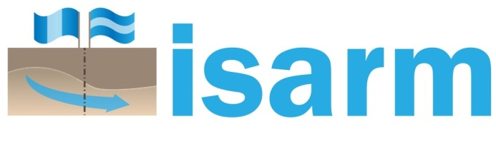
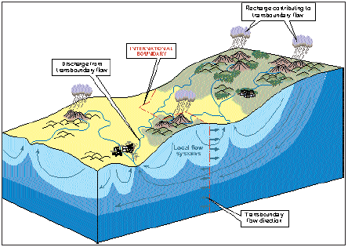
Internationally Shared Aquifer Resources Management Initiative (ISARM)
Flagship programme on transboundary aquifers
Global inventory
Guidelines for the management of groundwater resources shared between two or more States

Slide 9
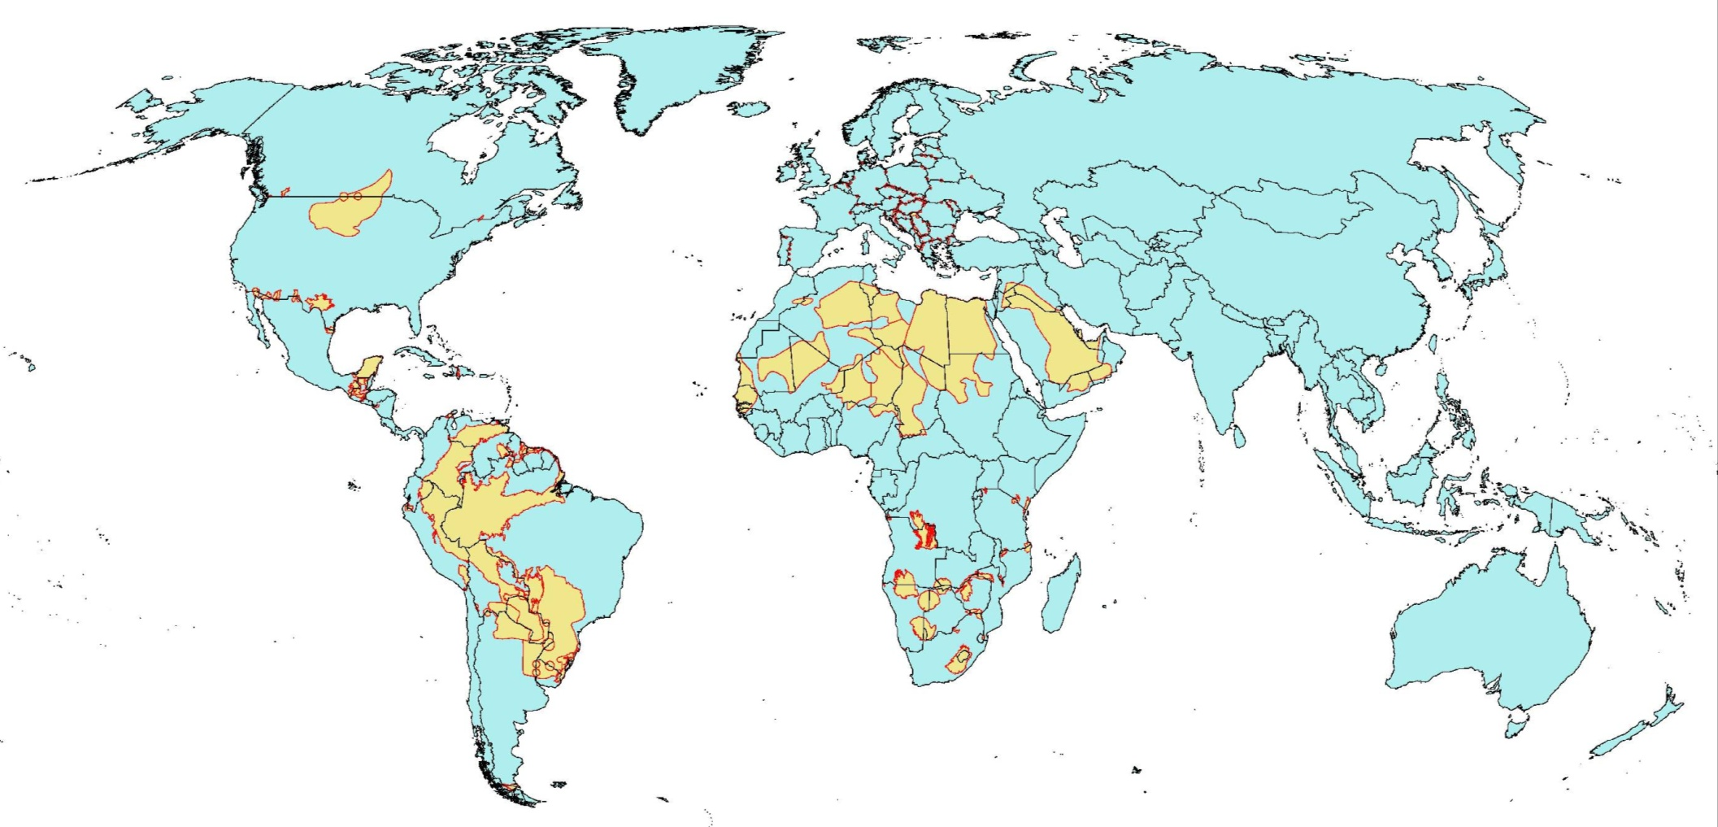
Global Overview of ISARM activities
Notes:
9

Slide 10
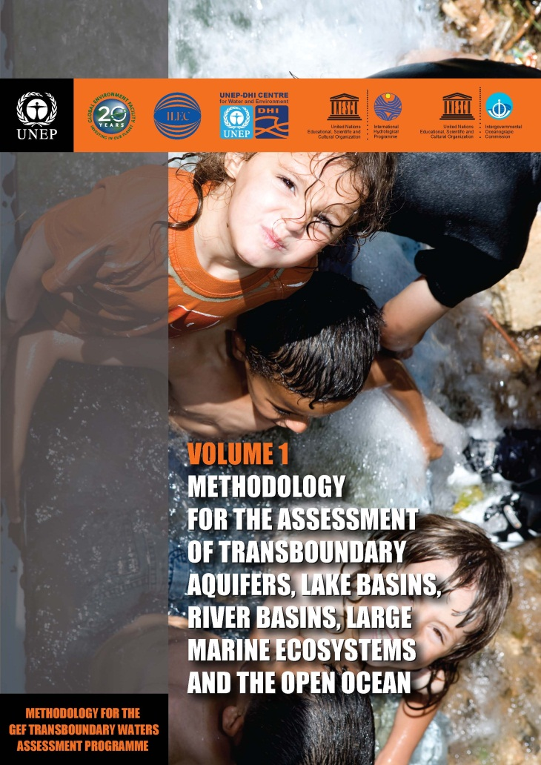
GEF Transboundary Waters Assessment Programme (TWAP)
Indicator-based global assessments of 5 transboundary water systems: Aquifers, Rivers, Lakes, LMEs, Open Oceans
Largely based on existing data
Carried out in cooperation with partners at national, regional and global level
Provide guidance to the GEF for science-based allocation of funds

Slide 11
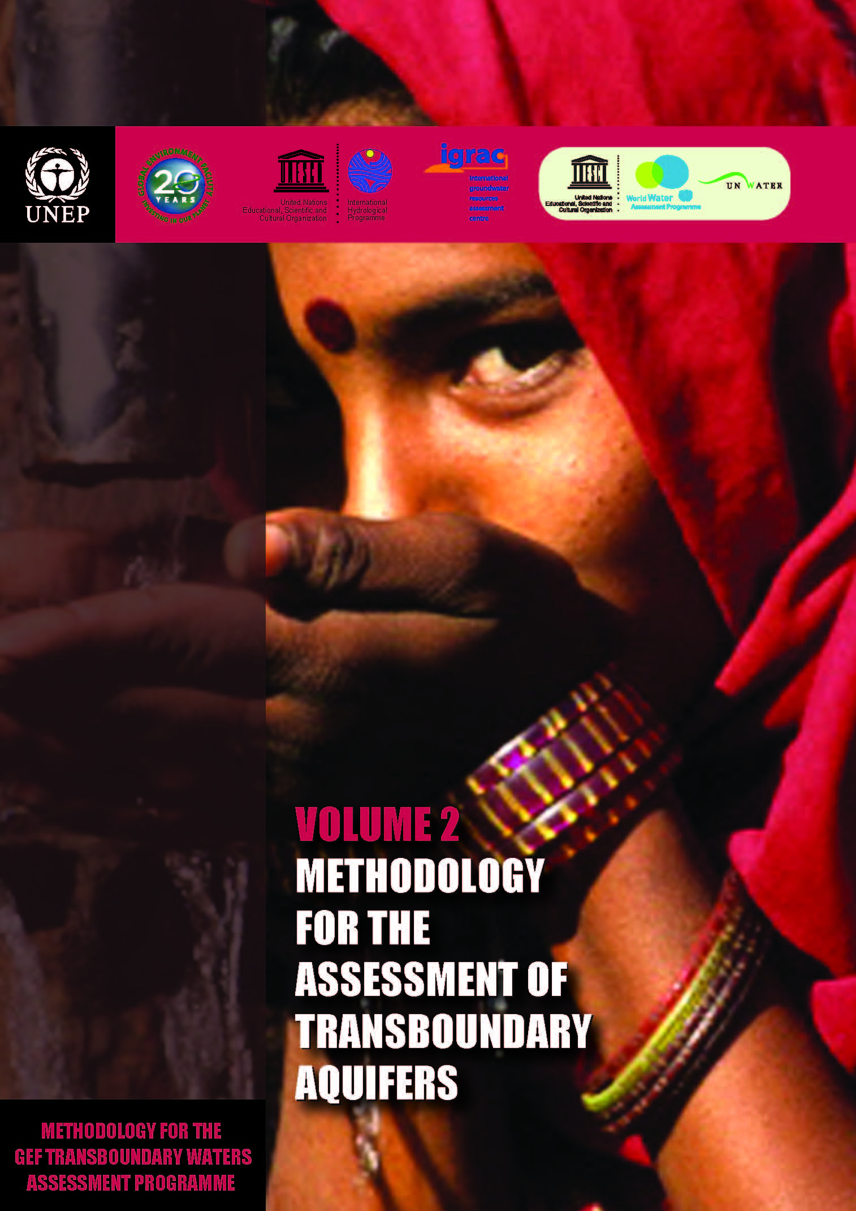
TWAP – Assessment of TBAs and SIDS
UNESCO-IHP: executing agency for the global assessment of transboundary aquifers and SIDS groundwater systems
Methodology developed by an international expert group led by UNESCO

Slide 12
TWAP Transboundary Aquifers - Objectives
(1) Provide an inventory and description of the present conditions of transboundary aquifers (TBA) and aquifers in Small Island Developing States (SIDS)
(2) Bring to the global attention the potentialities and the vulnerability of transboundary aquifer systems, and catalyze action.
TWAP Transboundary Aquifers builds on the achievements of the Internationally Shared Aquifer Resources Management Initiative (ISARM)
Notes:
Issues to be addressed by TWAP transboundary aquifers include:
What human and ecosystem uses of the groundwater resources are currently affected or impaired (use conflicts, depletion, and degradation)?
Future groundwater conditions and uses, as more water is used during the next decades for food security, as more nitrogen used, as seawater intrusion along coastal zones increases?
Which groundwater systems are likely to buffer or mitigate impacts of increasing climatic and other global stresses during the coming decades?

Slide 13
TheTWAP assessment of Transboundary Aquifers will be carried out at 2 levels:
Level 1: global baseline assessment
Level 2: in-depth assessment in pilot TBAs (case studies)
Reduced set of indicators
Covering 166 TBAs and 43 SIDS
Funded by the GEF and partner co-financing contributions
Full set of indicators
Applied in three selected TBAs:
Funded by SDC

Slide 14
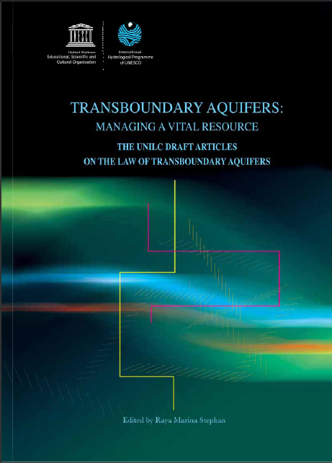
UN GA Resolution on the
Law of Transboundary Aquifers
In December 2008, the UN General
Assembly adopted the Resolution
(A/RES/63/124) on the
‘Law of Transboundary Aquifers'.
Legal Framework for the sustainable management of shared groundwater resources
A tool of international law that provides recommendations to Member States
UNESCO-IHP provided technical expertise to the UN General Assembly
The UNGA called upon UNESCO to support Member states in the implementation of the resolution

Slide 15
SDC project on Groundwater resources governance in transboundary aquifers (GGRETA)
Water Diplomacy Cluster of Swiss Development Cooperation (SDC)
3 aquifers: Central America (Trifinio), Central Asia (Pretashkent), Southern Africa (Stampriet)
8 countries
Project targets:
  Improve knowledge and recognition of importance and vulnerability of TBAs
  Enhance cooperation and water security
Two components

Slide 16
Two-step approach
Building recognition of the shared nature of the resource, and mutual trust through joint fact finding and science based diagnostics (Component 1); and
Reaching consensus on transboundary governance mechanisms (Component 2).

Slide 17
Component 1
Builds on Transboundary Waters Assessment Programme (TWAP) methodology for the assessment of TBAs,
Encompasses hydrogeological, environmental, socio-economic and governance dimensions of the aquifer systems
The aquifer sharing states in each TBA should agree on a joint monitoring programme, harmonized in terms of classifications, reference systems, language, format, software, etc., and lead to the establishment of a common dynamic information system.

Slide 18
Component 2
Initiating the consultation process among countries
Facilitating the process of agreeing on priority issues, and
Laying the foundations to establish cooperation mechanisms among countries.
PHASE 2 ?

Slide 19
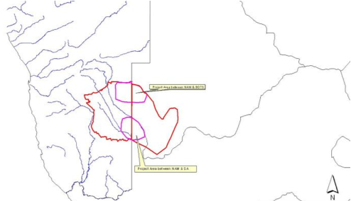
Why Stampriet?

Slide 20
History of cooperation
Regional cooperation in the water sector was established in 2000 through the Revised Protocol on Shared Watercourses in the Southern Africa Development Community.
Of the 15 major river basins which are shared by two or more nations, 11 have a Commission or Technical Committee.
ISARM-SADC became operative in 2007 in a network covering all SADC countries. By 2011 twenty-nine transboundary aquifer systems had been identified and broadly described in the region.
Resolution in 2007 by the African Ministers Council on Water (AMCOW) to ‘promote the institutionalisation of groundwater management by river basin organisations.
In 2007, the ORASECOM became the first river basin commission in SADC to establish a Groundwater Technical Committee.
In 2008 the ISARM-SADC decided on the Kalahari-Karoo aquifer system as the first pilot area in which to test transboundary aquifer management principles.

Slide 21
Concluding remarks
Groundwater has gained a lot of weight on the political agenda in Africa
Knowledge base is constantly growing, but not always sufficiently communicated and shared
Growing number of projects and activities related to groundwater , but not always well coordinated
Capacity in groundwater resources management remains limited and needs to be strenghened
IWRM and Conjunctive Use - moving away from silo mentality

