Slide 1
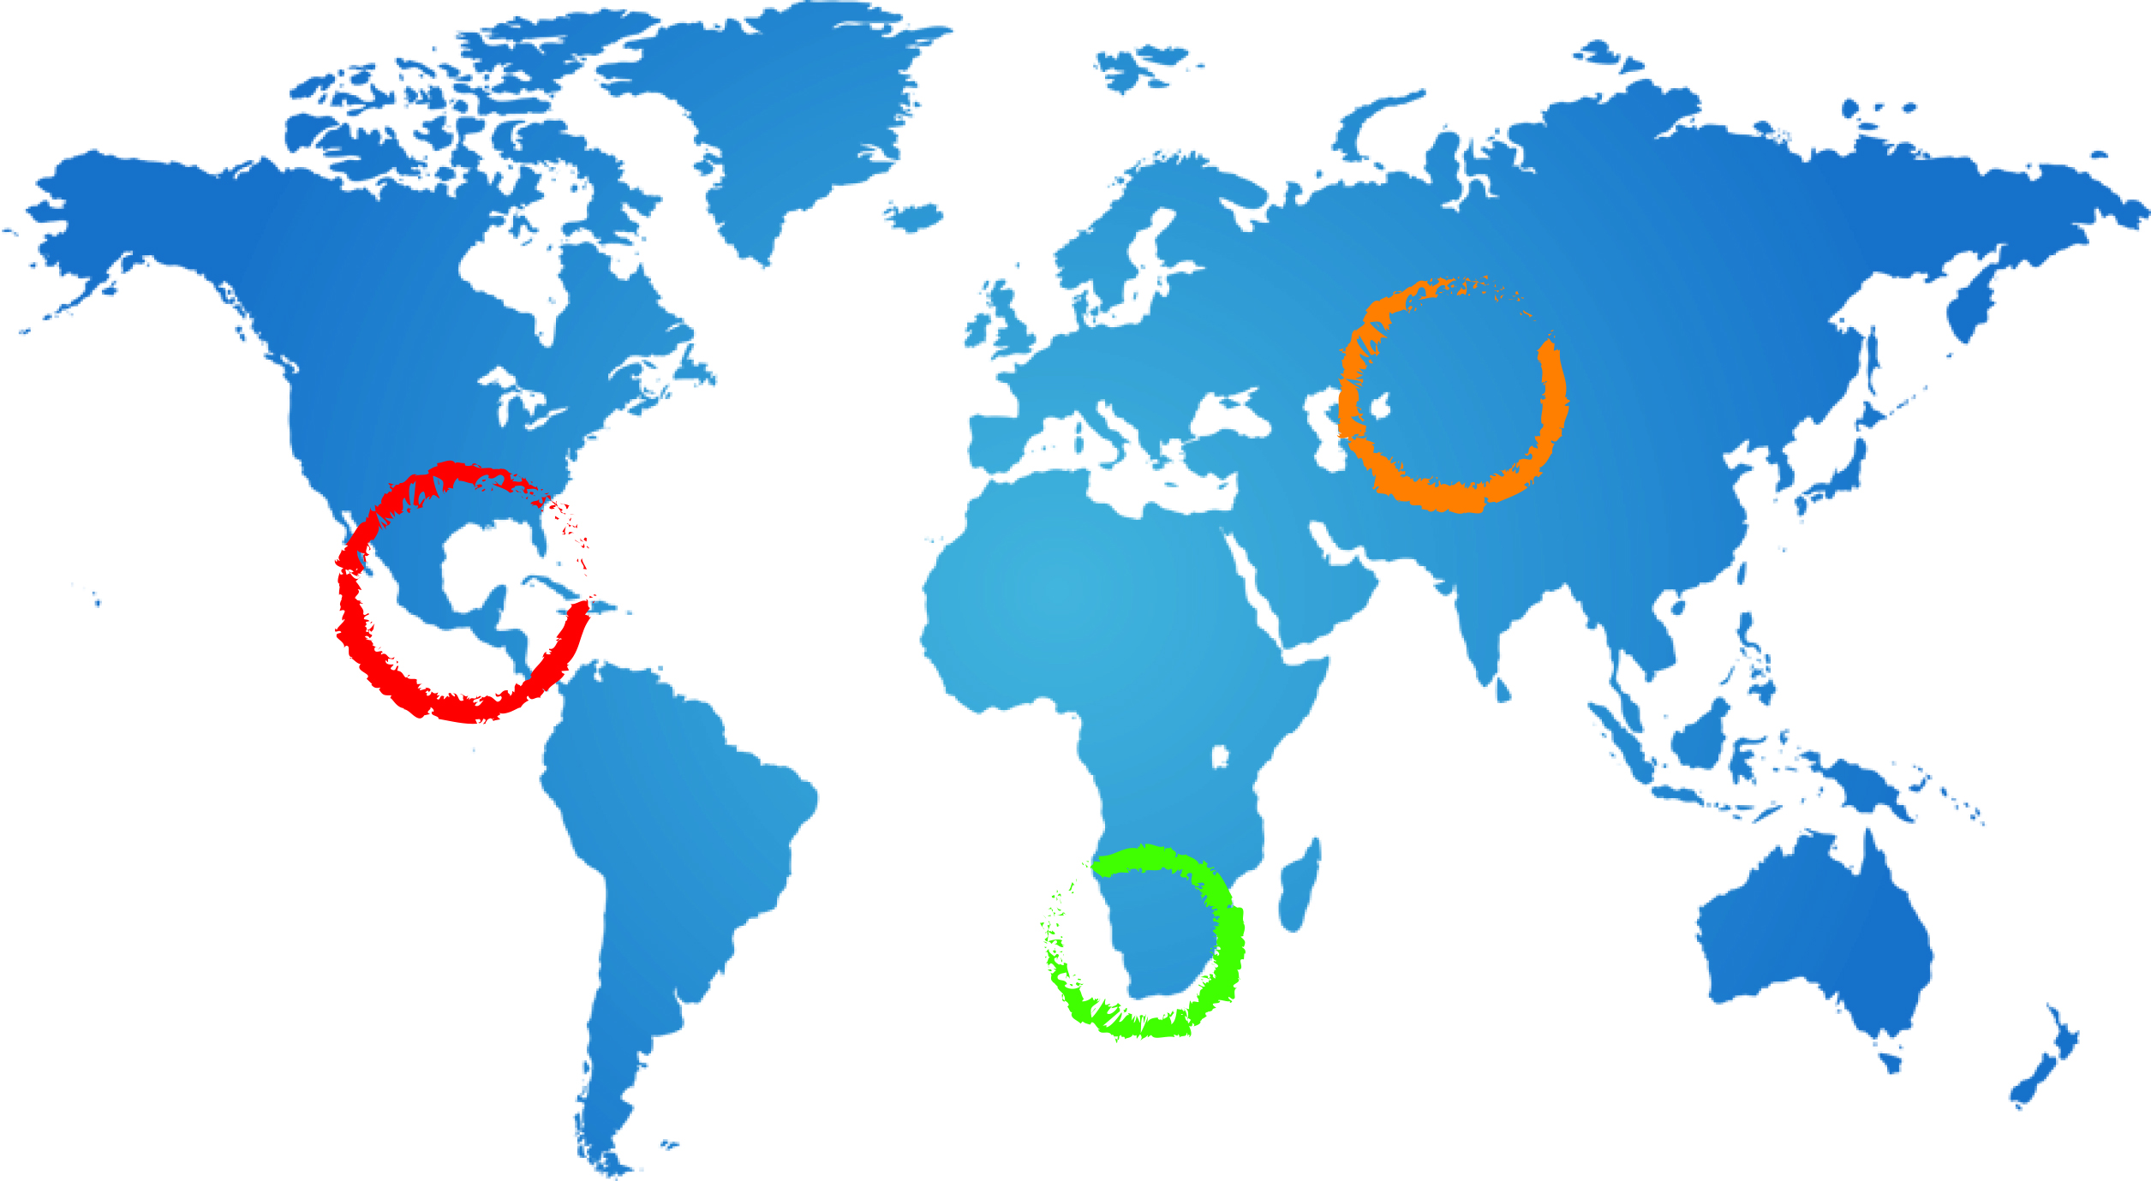
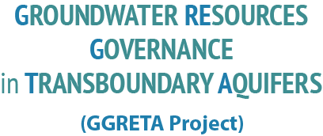

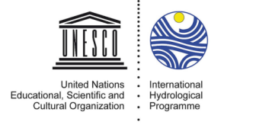
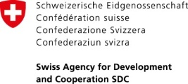




The GGRETA Project: Activities and Execution Arrangements
Andrew Ross
Senior groundwater specialist UNESCO
A Ross
21 May 2014
Windhoek

Slide 2
Outline
Project outputs and activites
Execution and management arrangements
  Roles

Slide 3
Project design & activities
Component 1:
Building recognition of the shared nature of the resource, and mutual trust through an assessment based on joint fact finding and science based diagnostics
Component 2:
Reaching consensus on transboundary governance mechanisms for transboundary groundwater management
In depth assessment of the transboundary aquifer
Establishment of multi country consultation bodyawareness of countries on the UNGA Resolution on the Law of Transboundary Aquifers

Slide 4
Output 1.1 – Indicator based assessment
Activities:
1.1.1. Elaboration of aquifer specific methodology
  Review of indicators and final decision on adopted set of indicators
  Definition of data collection needs, and methodology for the aquifer characterization and diagnostic analysis, including questionnaires
  Definition of new surveys (geophysical, remote sensing, etc.) possibly needed to fill information gaps
1.1.2 Assessment kick-off workshop
  To present a preliminary estimate of current state of data availability, quality, gaps, required harmonization, formatting, etc..
  To agree on final set of indicators for the assessment, and the Aquifer Characterization and Diagnostic methodology
  To define and adopt Questionnaires, and possible plan of new surveys

Slide 5
Output 1.1 – Assessment (cont‘d)
Activities:
1.1.3 Data and information collection and processing
  Collection and processing of existing data and information: climate; geology; hydrogeology; environmental (quality/quantity); socio-economic ; regulations and laws, policies and practices including monitoring.
  Fill data gaps - possible small field-surveys in the aquifer area
Technical seminar
  To start the project data collection and processing activities and provide training in the project methodology
Technical review meeting
  Evaluate the progress of data gathering activities, and level of data harmonization

Slide 6
Output 1.1 – Assessment (cont‘d)
1.1.4 Carry out the assessment
  In depth assessment of transboundary aquifer based on collected information, consisting of:
    a. Development of the conceptual model of the aquifer and characterization of aquifer properties
    b. Visualization of the aquifer through (i) geological map, (ii) cross sections, (iii) block diagram
    c. Application of indicators, including governance, socio-economic, and legal issues (whole aquifer, national segments)
    d. Visualization of indicator distribution through thematic maps (and cross sections, if needed)
    e. To assess groundwater resources and potential issues of TB concern based on agreed indicators
1.1.5 Proposal for Harmonized Monitoring Network
  Agreement between countries on the design of a harmonized monitoring network based on results from assessment

Slide 7
Output 1.2 – Information Management System
Activities
1.2.1 System design
  Software requirement specifications including functional design, reference system, data formats and processing tools, presentation/graphics, etc
1.2.2 System development & testing
1.2.3 Data harmonization, processing and input
  Process and harmonize data at regional/aquifer level, prepare input information and calculate indicators, upload data & info into the aquifer information system
1.2.4 Training/ technical capacity building
  Capacity building on data collection, processing (GIS) and use of the system and Groundwater management.

Slide 8
Output 2.1 – Establishment of Multi-Country Consultative Body (CB)
Consultative body with the mandate to facilitate information exchange among aquifer countries on aquifer resources management, established and operational
Activities 2.1.1
Review existing institutions/mechanisms & their mandate
Analyze elements for technical and organizational synergy
Define the operational manual
Capacity assessment and development

Slide 9
Output 2.2 – Enhanced awareness on the UNGA Resolution on the Law of Transboundary Aquifers
Activities
2.2.1. Training on International Law related to TBAs
  Conduct training workshop on International Law related to TBAs within the context of the multi-country consultative body - with the objective to inform Governments and regional mechanisms on the International Law Instruments related to TBAs and opportunities for their implementation
  2.2.2 Capacity Building activities

Slide 10
Outlook to Phase 2 (post 2015)
Support cooperation mechanisms among countries sharing the aquifers and facilitate priority actions and policy reforms
  Multi-country consultative body established.
  Implement Monitoring Programme & agree on environmental quality targets
  Cooperation on priority actions and policy reforms
  Partnership Conferences to consolidate international support

Slide 11
Project activities in 2014

Slide 12
Execution arrangements

Slide 13
Case study project team
Regional project coordinator
National contact points/coordinators in each country
National specialists from each country:
  Hydrogeology
  Environment and Socio-Economics
  Legal and Institutional Frameworks
Supported by: UNESCO-IHP & Windhoek office, IGRAC

Slide 14
BOTSWANA
NAMIBIA
SOUTH AFRICA
Mr Obolokile Obakeng
(Botswana Political Head)
Director of Department of Water Affairs
Mr Mbangiseni Nepfumbada
(South Africa Political Head)
Director of Water Resources Information Management at Department of Water Affairs & Forestry
Mr Abraham Nehemia
(Namibia Political Head)
Director of Department of Water Affairs
Mr Piet Kenabatho
(Botswana National Coordinator)
University of Botswana
Ms Aina Ileka
(Namibia National Coordinator)
Chief Hydrogeologist at Department of Water Affairs
Mr Fortress Netili
(South Africa National Coordinator)
Manager Water Geoscience Business Unit at Council for Geoscience
Mr Gaolatlhe Lentswe (Technical Specialist-Hydrogeology)
Ms Bothepha Mosetle (Technical Specialist- (Socioeconomic and environmental)
Mr Odirile Itumeleng (Technical Specialist - Legal and institutional)
Ms Lydia Joel
(Technical Specialist – Hydrogeology)
Mr Don Muroua
(Technical Specialist – Socioeconomic and environmental)
Ms Viviane Kinyaga
(Technical Specialist - Legal and institutional)
Ms Joyce Leshomo
(Technical Specialist – Hydrogeology)
Council for Geoscience
Mr Bantu Hanise
(Technical Specialist – Socioeconomic and environmental)
Council for Geoscience
TBA
(Technical Specialist - Legal and institutional)
Council for Geoscience
Prof. Jurgen Kirchner
(Regional Coordinator)
Technical support
UNESCO / IGRAC

Slide 15
Regional project coordinator
Coordinate implementation of GGRETA methodology
Coordinate assessment of the Stampriet aquifer
Help to organise case study meetings
Coordinate communication and capacity building activities
Help to ensure that expected outputs of the project are delivered, and on time
Prepare and supervise preparation of project reports

Slide 16
National coordinator
Support technical specialists
  Knowledge based: concepts, source materials, interpretation
  Logistics and operational: contacts, access to people and data, facilities and equipment
Liaison
  National - ministries, other stakeholders
  Trans-national - other national coordinators, regional coordinator

Slide 17
National technical specialists (2014)
Collect data and information on relevant parameters and variables for the national segment of the Stampriet Aquifer
  based on the GGRETA project methodology
  following the guidance of the case study project coordinator and experts from IGRAC/UNESCO
Assist in delineation and assessment of the national segment of the Stampriet Aquifer
Assist in data harmonization
Assist in uploading relevant information into the Information Management System
Participate in project meetings
Reporting

Slide 18
Thank you for your attention
a.ross@unesco.org
Telephone 33 (0)1 45 68 39 43

Slide 20
Groundwater Resources Governance in Transboundary Aquifers - SDC
Objectives:
improve the knowledge and recognition of the importance and vulnerability of transboundary groundwater resources,
establish cross-border dialogue and cooperation
develop shared management tools; and
facilitate governance reforms focused on improving livelihoods, economic development and environmental sustainability.

Slide 21
History
Eberhard‘s slides (Ivica to cover this?)
IHP council resolution
SDC agreed to provide funding for three case studies (detailed TBA assessments, contributing to the TWAP project)
Preparation phase, mission to BO, NA and SA in March 2013
Preparation of the project document → basis for this presentation

Slide 22
Tentative budget breakdown
506,000 US$ allocation for Stampriet-Kalahari/Karoo
National experts & regional coordinator (collection and harmonization of data, data management system, stakeholder analysis, transboundary mapping, diagnostic report & assessment: 261k
Data collection and field campaigns 70k
Meetings & Capacity building 150k
Communication 25k
Component 1: 460k US$ - Component 2 – 46k US$

