Slide 1
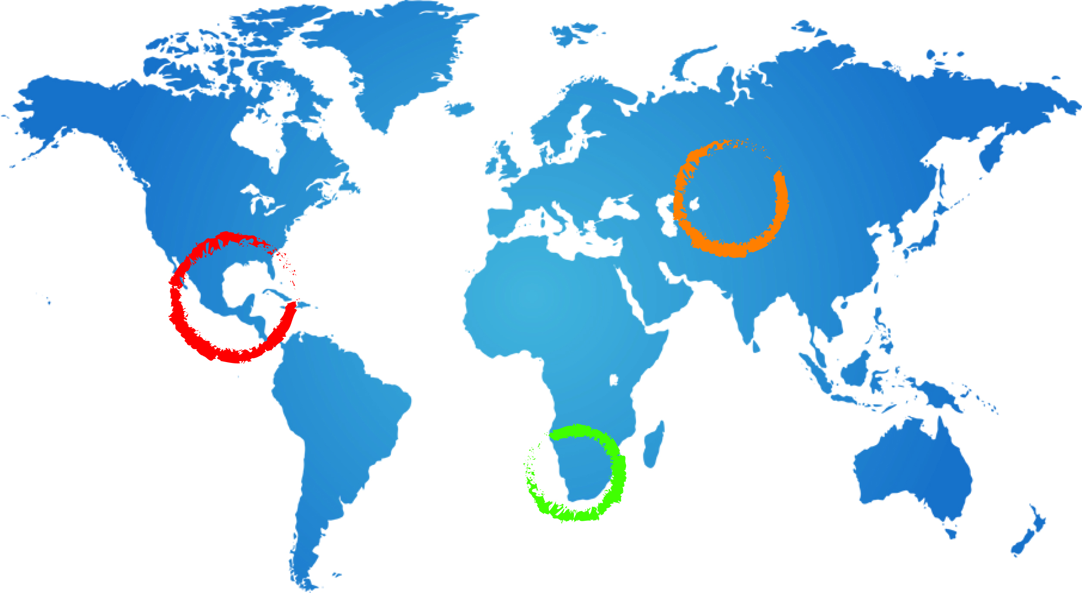
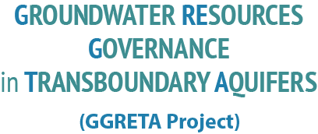







Stampriet – Kalahari/Karoo Aquifer Case Study
Technical Seminar on Project Implementation
Project Methodology
Geert-Jan Nijsten - IGRAC
21 May 2014
Windhoek

Slide 2
GGRETA-Stampriet project at a glance
Multi-disciplinary assessment
    Hydrogeology
    Environmental
    Socio-economic
    Legal & Institutional
Existing data
Target group for outputs is non-technical:
    Managers, Decision makers, Stake holders incl. general Public
2

Slide 3
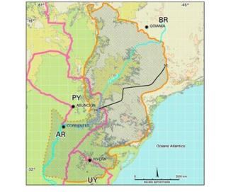
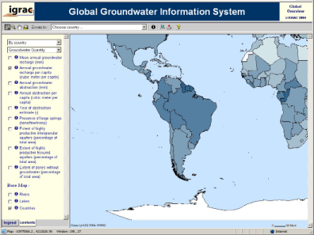
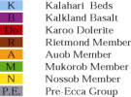





Groundwater assessment in general
Hydrogeological Aspects
  Delineation and description
  Static data and time-variable
  Classification, diagnostic analysis and zoning
  Data harmonisation and information management
Environmental issues
Socio-economic aspects
Institutional setting (separate session)
Legal framework (separate session)

Slide 4
Transboundary assessment:
What’s so special ?
Sharing knowledge and data between countries
Harmonising information
Focus on transboundary issues
And ultimately to agree on:
Most important issues for priority action, and
Agree on the actions to be taken
Notes:
Data harmonisation in particular, we will talk about in more detail tomorrow, but I thought it is good to get a clear understanding of groundwater assessment in general and transboundary assessment in particular.
Now let’s move on to the proposed assessment methodology

Slide 5
Aquifer Assessment - a definition
This project:
Data
a consideration of all the facts about it (=the aquifer) and
a judgement or opinion of the position and of
what is likely to happen.
source: Collins – English language dictionary
Indicators
Assessment report
Projections
Notes:
Aquifer assessment: a consideration of all the facts about the aquifer and a judgement or opinion of the position and of what is likely to happen.
all the facts: describing an aquifer in many parameters as already touched upon by Jac: Different categories of variables: Static ←→ time dependent. “administrative, hydrogeological, usage, governance etc)
judgement: indicators
what is likely to happen: projections through modelling + expert judgement
Will use this definition as a guide or general outline for my presentation.

Slide 6
Aquifer Assessment - 1: a consideration of all the facts about the aquifer and a judgement or opinion of the position and of what is likely to happen.

Slide 7
Data
A Physiography and Climate
  Temperature**
  Precipitation**
  Evapo-transpiration
  Land use**
    Groundwater-fed agricultural land
    Groundwater irrigated land
    Groundwater supported wetlands and ecosystems
    Areas with land subsidence
  Topography: Elevation data (incl. slopes) **
  Surface water network
Notes:
Data harmonisation in particular, we will talk about in more detail tomorrow, but I thought it is good to get a clear understanding of groundwater assessment in general and transboundary assessment in particular.
Now let’s move on to the proposed assessment methodology

Slide 8
Data
B Aquifer Geometry
  Hydrogeological map
  Geo-referenced boundary of the Transboundary Aquifer
  Depth of water table/piezometric surface
  Depth to top of aquifer formation
  Vertical thickness of the aquifer
  Degree of confinement
  Aquifer's cross section
Notes:
Data harmonisation in particular, we will talk about in more detail tomorrow, but I thought it is good to get a clear understanding of groundwater assessment in general and transboundary assessment in particular.
Now let’s move on to the proposed assessment methodology

Slide 9
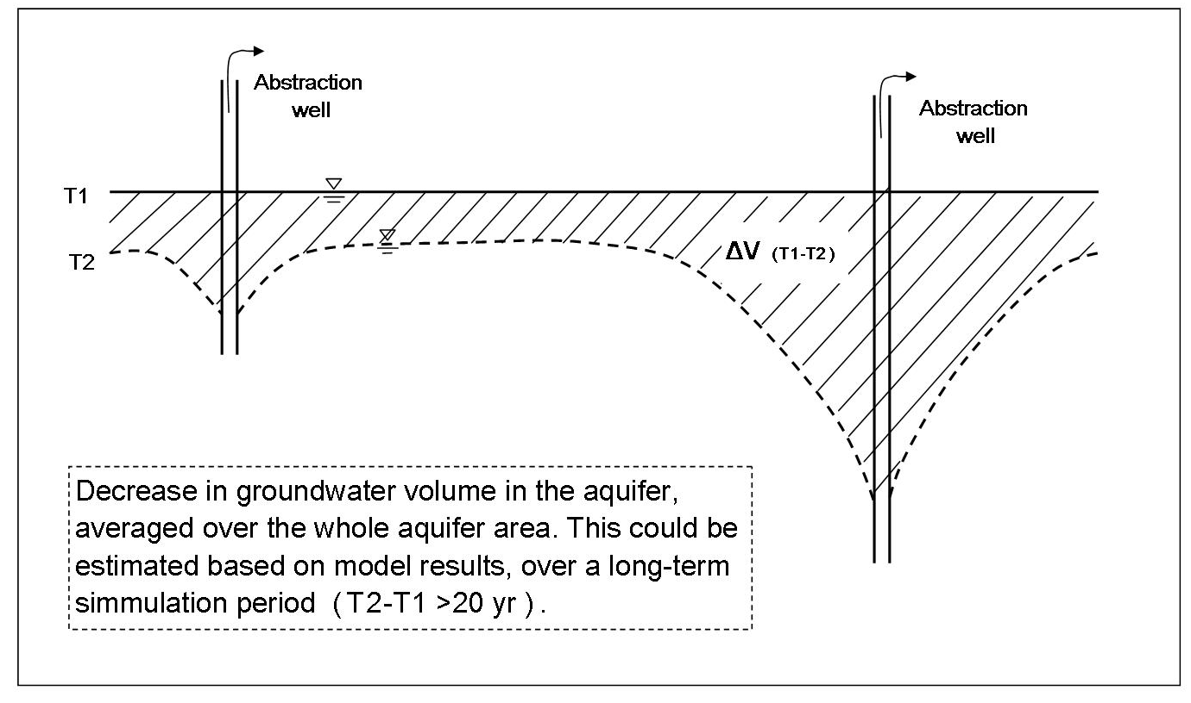
Data
C Hydrogeological Characteristics
  Aquifer recharge
    Natural recharge
    Return flows from irrigation
    Managed aquifer recharge
    Induced recharge
    Extent recharge zones
    Sources of recharge
  Aquifer lithology
  Soil types
  Porosity
  Transmissivity and vertical connectivity
  Total groundwater volume
  Groundwater depletion
  Natural discharge mechanism
  Discharge by springs
Notes:
Data harmonisation in particular, we will talk about in more detail tomorrow, but I thought it is good to get a clear understanding of groundwater assessment in general and transboundary assessment in particular.
Now let’s move on to the proposed assessment methodology

Slide 10
Data
D Environmental aspects
  Suitability for human consumption (natural groundwater quality)
  Groundwater pollution
  Solid Waste and waste water control
    Waste water being collected in sewerage systems
    Waste water treated
    Solid waste being stored in controlled land fields
  Shallow groundwater table
Notes:
Data harmonisation in particular, we will talk about in more detail tomorrow, but I thought it is good to get a clear understanding of groundwater assessment in general and transboundary assessment in particular.
Now let’s move on to the proposed assessment methodology

Slide 11
Data
E Socio-economic aspects
  Population (total and density)**
  Groundwater use
    Total volume groundwater abstraction
    Groundwater abstraction for domestic use
    Groundwater abstraction for us in agriculture and livestock
    Groundwater abstraction for commercial and industrial use
  Surface water use **
    Total volume of surface water use
    Surface water for domestic use
    Surface water use for agriculture / livestock
    Surface water for commercial and industrial use
  Dependence of industry and agriculture on groundwater
  Percentage of population covered by public water supply
  Percentage of population covered by public sanitation
Notes:
Data harmonisation in particular, we will talk about in more detail tomorrow, but I thought it is good to get a clear understanding of groundwater assessment in general and transboundary assessment in particular.
Now let’s move on to the proposed assessment methodology

Slide 12
Data
F Legal & Institutional
  - Separate session -
Notes:
Data harmonisation in particular, we will talk about in more detail tomorrow, but I thought it is good to get a clear understanding of groundwater assessment in general and transboundary assessment in particular.
Now let’s move on to the proposed assessment methodology

Slide 13
Aquifer Assessment - 2:
a consideration of all the facts about the aquifer and a judgement or opinion of the position and of what is likely to happen.

Slide 14
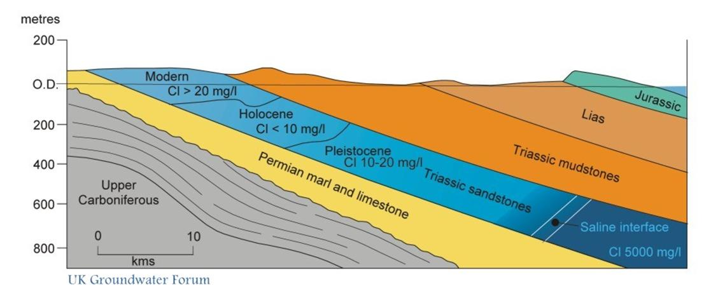
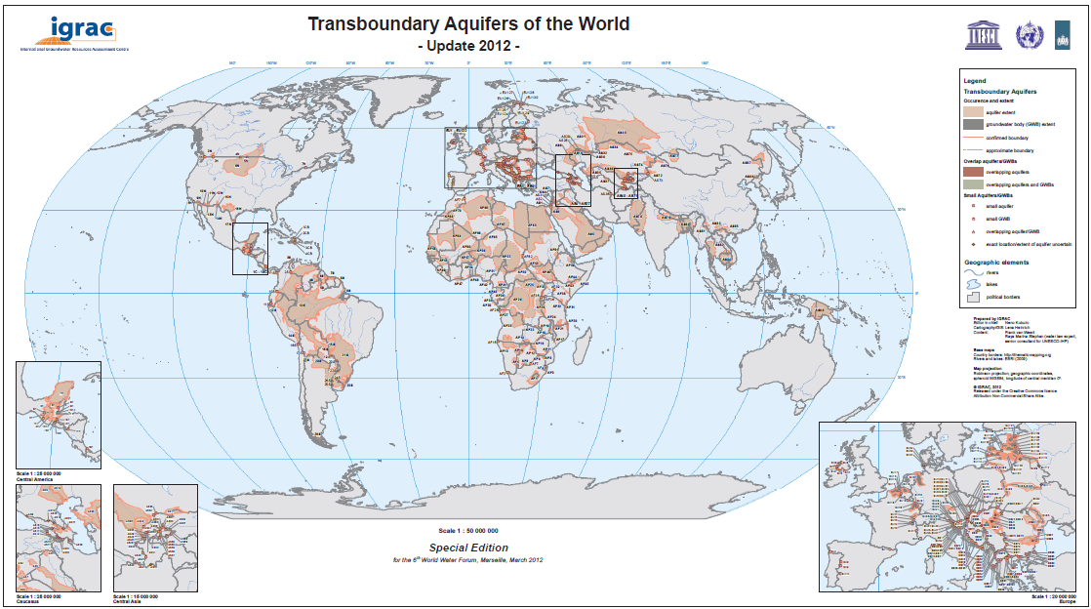
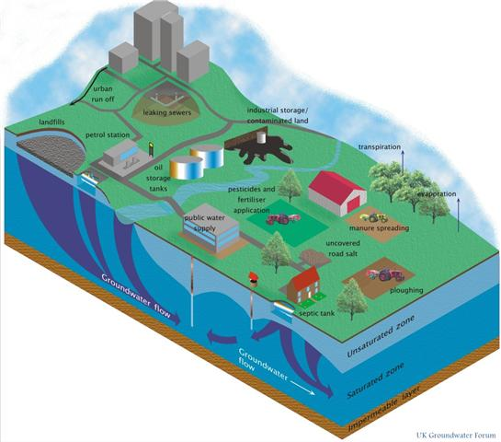
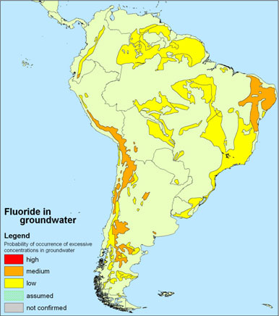
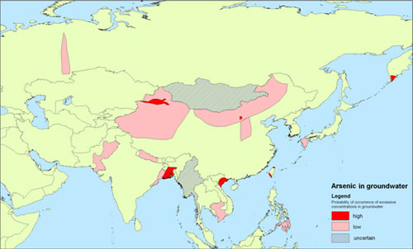
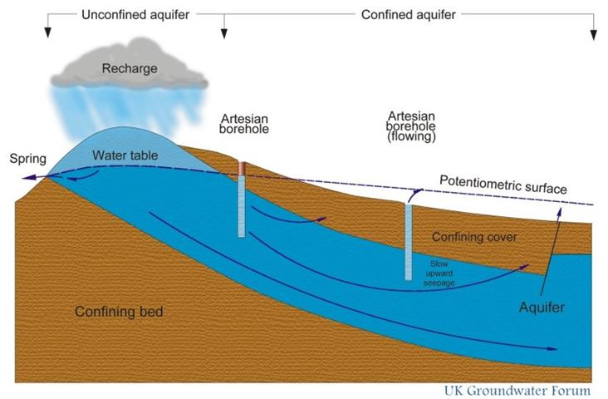
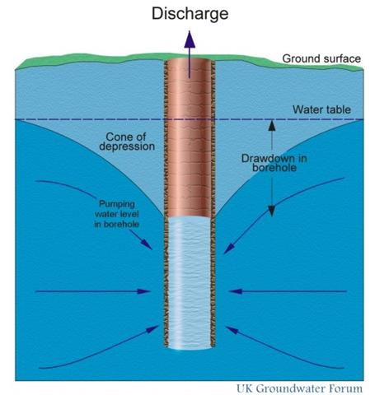
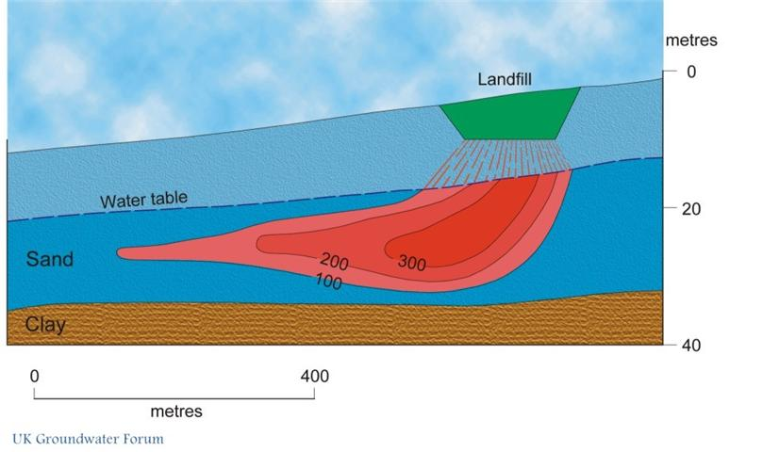
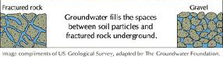
How to judge or give an opinion?
Notes:
Explain the reasoning behind indicators:
We’ll have more than 150 aquifers, some 50 Small Island Developing States and for each one of these we’re looking for 84 parameters → MORE THAN 15000 data!
How to go into part two of an assessment: judge or give an opinion of the position?

Slide 15


Using indicators
To simplify
complex systems
Notes:
Role of indicators: to simplify AND to bring a message across to none-hydrogeologists: policy makers / decision makers

Slide 16
20 indicators in 6 categories
Defining or constraining the value of aquifers and their potential functions
Role and importance of groundwater for humans & environment
Changes in groundwater state
Drivers of change and pressures
Enabling environment for
TBA/SIDS resource
management
Implementation of
groundwater resources
management measures
The indicators presented are used in a parallel world-wide assessment - TWAP.
For Stampriet they can be modified to
aquifer specific needs/relevance!
Notes:
Explain that in total 20 indicators have been developed, but that we will use only 10 of them as the core indicators
For budgetary reasons cut down from 20 to 10. Between Medium sized project and start of Full size project the methodology has been reviewed → in this process the 20 indicators have been divided into two groups

Slide 17


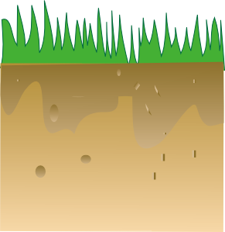
Long term mean groundwater recharge, incl. man-made components.
Indicator group 1: Defining or constraining the value of aquifers and their potential functions
1.1 Recharge
Rate
1. Very low: < 2 mm/yr
2. Low: 2 -20 mm/yr
3. Medium: 20-100 mm/yr
4. High: 100-300 mm/yr
5. Very high: > 300 mm/yr
Notes:
Recharge rate: Long-term mean ground-water recharge, including man-made components (return-flows, induced recharge, artificial recharge), divided by area
Example:
Netherlands groundwater recharge in the order of 300 – 350 mm
Remember some research I took part in in the Kalahari desert: recharge rates in an order of magnitude of 10th of mm to mm.
REASON FOR CLASSIFICATIONS: Again to simplify to get the message across!

Slide 18

Long term mean gw recharge volume, incl. man-made components, divided by inhabitants on aquifer.
Indicator group 1: Defining or constraining the value of aquifers and their potential functions
1.2 Renewable groundwater per capita
1. Low: < 1000 m³/yr/capita
2. Medium: 1000 – 5000 m³/yr/capita
3. High: > 5000 m³/yr/capita
Notes:
Renewable groundwater resources per capita: Long-term mean ground-water recharge (VOLUME), including man-made components, divided by the number of inhabitants of the area occupied by the aquifer
This gives an indication of the sustainability of the system and the carrying capacity of the groundwater system in relation to the population.

Slide 19
Percentage of aquifer area with natural groundwater quality satisfying local drinking water standards.
Indicator group 1: Defining or constraining the value of aquifers and their potential functions
1.3 Natural Background Quality
1. Very low: < 20%
2. Low: 20 - 40%
3. Medium: 40-60%
4. High: 60-80%
5. Very high: > 80%
fresh
Saline Arsenic
fresh
Notes:
Natural background quality: Percentage of the area occupied by the aquifer where groundwater is found of which natural quality satisfies local drinking water standards

Slide 20

Percentage of groundwater in total water abstraction for all human water uses.
Indicator group 2: Role and importance of groundwater for humans & environment
2.1 Human dependancy on Groundwater
1. Very low: < 20%
2. Low: 20 -40%
3. Medium: 40-60%
4. High: 60-80%
5. Very high: > 80%
Groundwater
Groundwater
Groundwater
River water
Lake water
Groundwater
Notes:
Definitions:
Human dependency on groundwater: Percentage of groundwater in total water abstraction for all human water uses. So this includes: domestic, agricultural and industrial

Slide 21
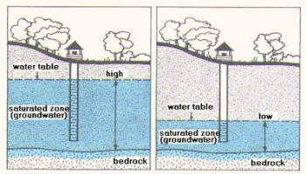
Current rate of long term decrease of groundwater storage averaged over aquifer area.
Indicator group 3: Changes in groundwater state
3.1 Groundwater depletion
1. Absent to very low: < 2 mm/yr
2. Low: 2 -20 mm/yr
3. Medium: 20-50 mm/yr
4. High: 50-100 mm/yr
5. Very high: > 100 mm/yr
Notes:
Groundwater depletion: Observed current rate of long-term progressive decrease of groundwater storage (accompanied by steadily declining ground-water levels), expressed as an equivalent depth of water averaged over the aquifer.
NOTE: depletion is NOT the same as water level decline or cone of depression!

Slide 22
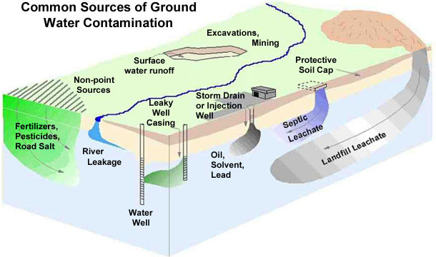
Observed polluted zones as percentage of total aquifer.
Indicator group 3: Changes in groundwater state
3.2 Groundwater Pollution
1. Very low: < 5%
2. Low: 5 – 10%
3. Medium: 10-25%
4. High: 25-50%
5. Very high: > 50%
Notes:
Groundwater pollution: Observed polluted zones as a percentage of total aquifer area (due to pollution caused water quality to exceed drinking water quality standards)

Slide 23
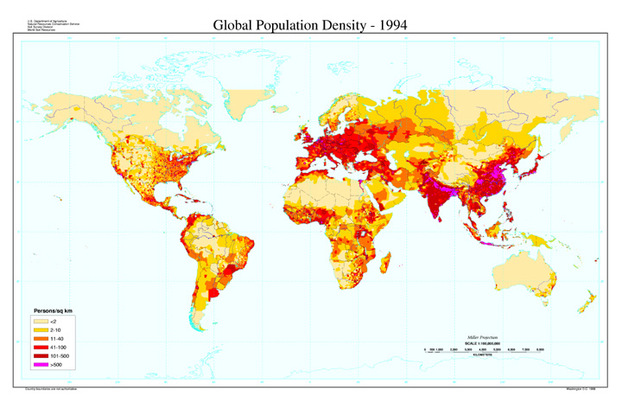
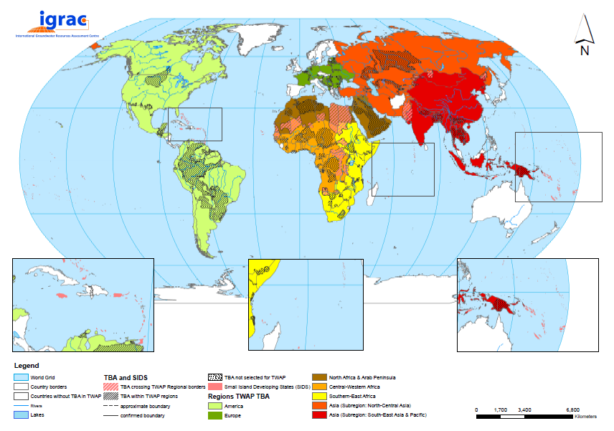
Number of people on top of aquifer per unit of area.
Indicator group 4: Drivers of change and pressures
4.1 Population Density on Transboundary Aquifer
Very low: < 1 p/km²
2. Low: 1-10 p/km²
3. Medium: 10-100 p/km²
4. High: 100-1000 p/km²
5. Very high: > 1000 p/km²
Notes:
Population density: Number of people per unit of area on top of the aquifer
All components will be using the same data of “Gridded population of the world” a 10 x 10 km2 grid?! → consistency between the TWAP components

Slide 24

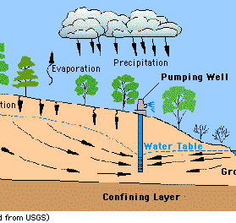
Total annual groundwater abstraction divided by long-term mean annual recharge.
Indicator group 4: Drivers of change and pressures
4.2:
1. Very low: < 2%
2. Low: 2-20%
3. Medium: 20-50%
4. High: 50-100%
5. Very high: > 100%
Notes:
Groundwater development stress: Total annual groundwater abstraction divided by long-term mean annual groundwater recharge
Note: It’s not by definition “good enough” to stay below 100% It depends on the system what is a critical value. In some systems 20% might already cause problems.

Slide 25
Indicator group 5:
Enabling environment for Transboundary Aquifer resource management:
Legal & Institutional framework
Indicator group 6:
Implementation of groundwater resources management measures
Legal and Institutional – separate session
Notes:
Explain that in total 20 indicators have been developed, but that we will use only 10 of them as the core indicators
For budgetary reasons cut down from 20 to 10. Between Medium sized project and start of Full size project the methodology has been reviewed → in this process the 20 indicators have been divided into two groups

Slide 26
Aquifer Assessment - 3:
a consideration of all the facts about the aquifer and a judgement or opinion of the position and of what is likely to happen.
Notes:
Aquifer assessment: a consideration of all the facts about the aquifer and a judgement or opinion of the position and of what is likely to happen.
3 – what is likely to happen: projections through modelling + expert judgement

Slide 27
Indicative Projections for 2030 and 2050
Annual amount of renewable groundwater resources per capita (indicator 1.2)
Human dependency on groundwater (indicator 2.1)
Population density (indicator 4.1)
Groundwater development stress (indicator 4.2)
Groundwater
River water
Rain water
Notes:
In the TWAP project the university of Frankfurt is working with a

Slide 28
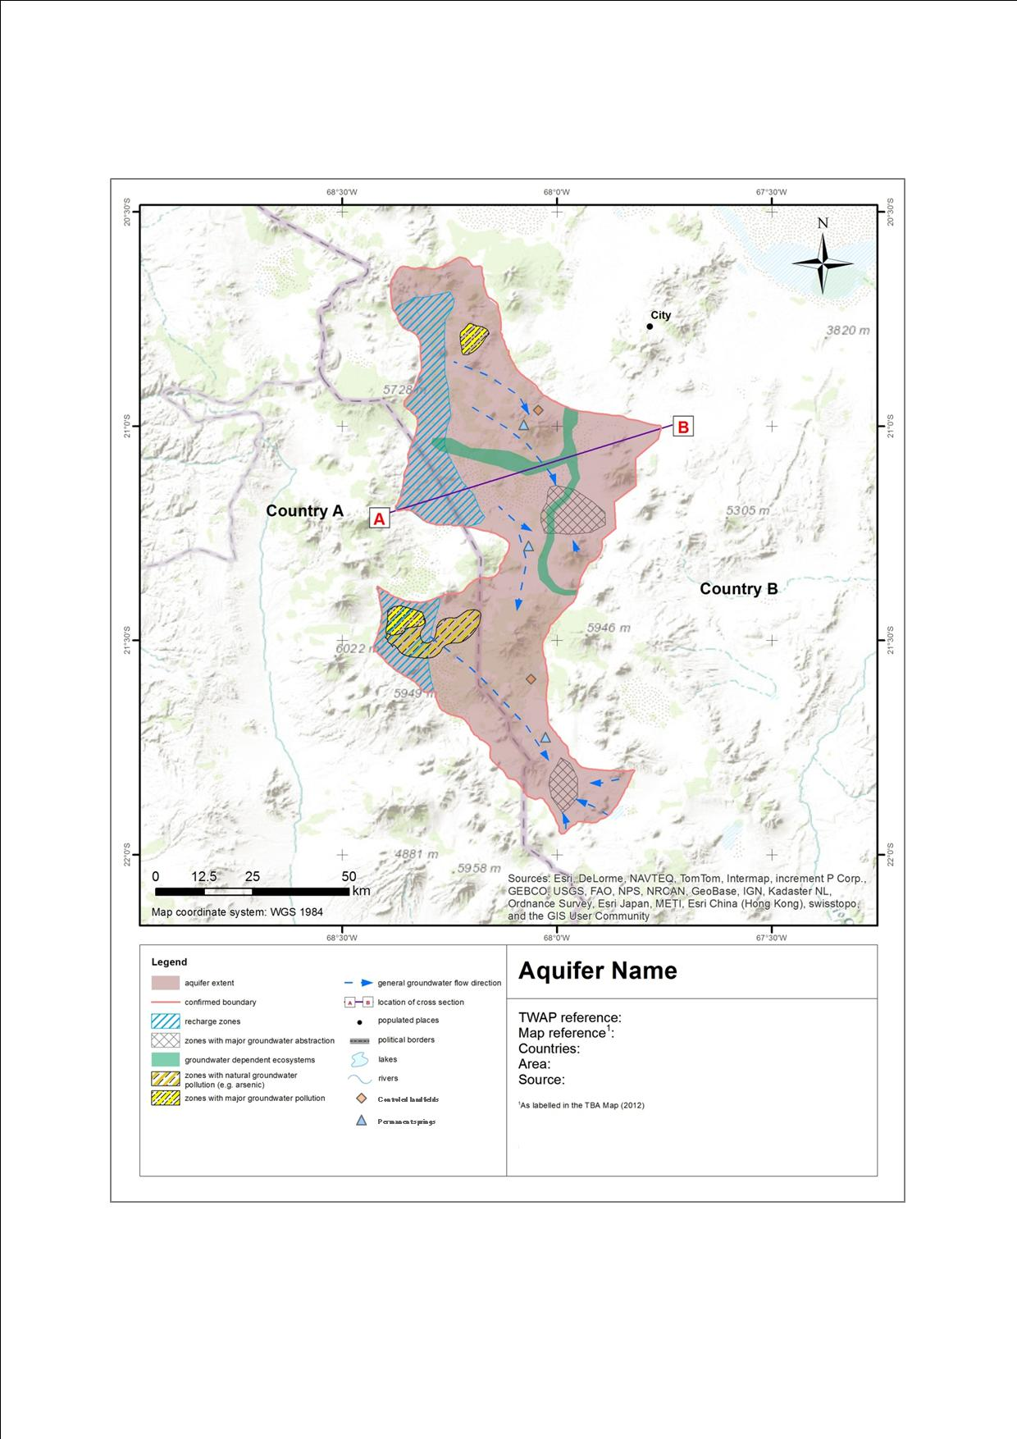
Additional building blocks for the assessment:
THEMATIC MAPS

Slide 29
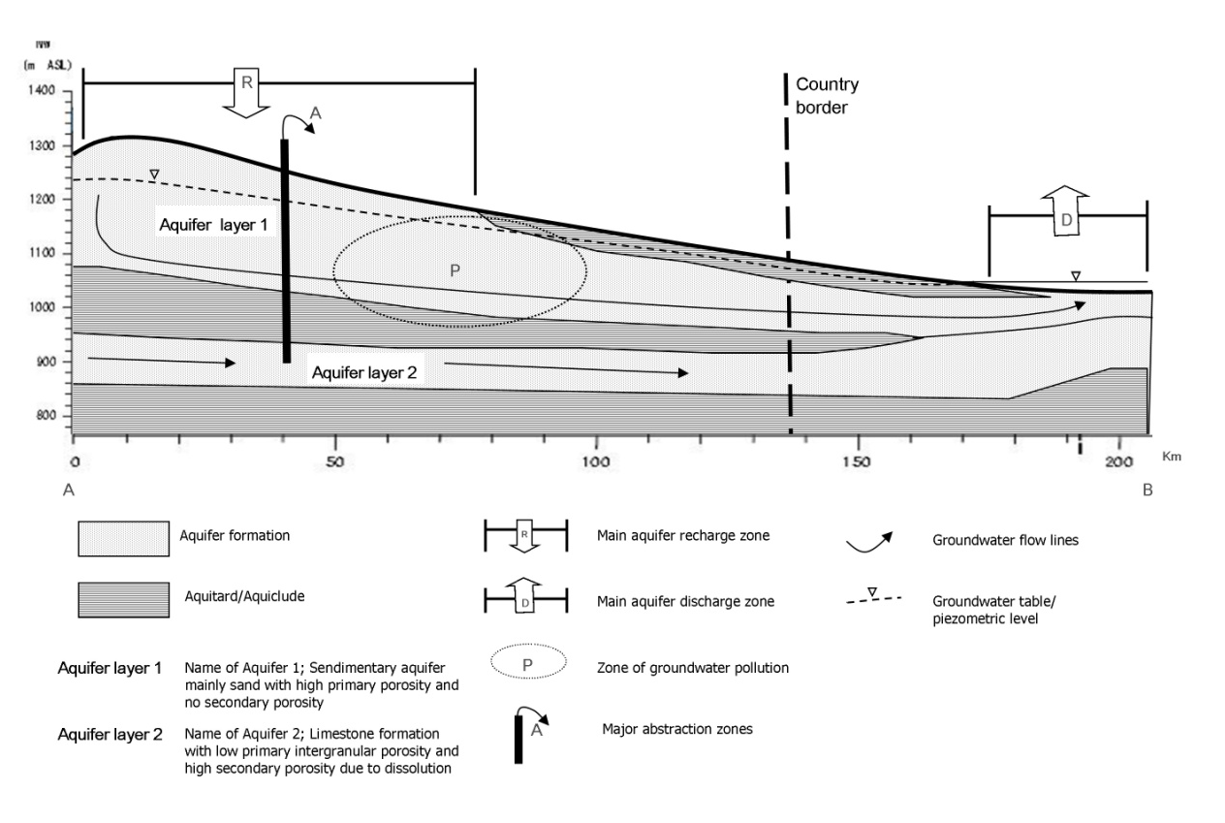
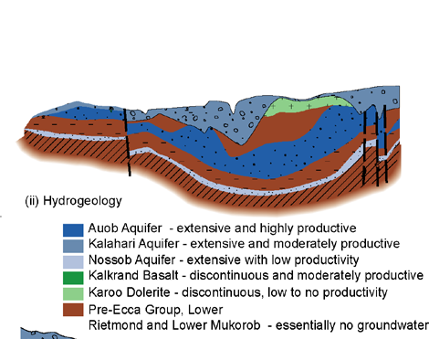
Additional building blocks for the assessment:
Cross-sections

Slide 30
Additional building blocks for the assessment
Illustrative graphs of time dependent data
Overview tables
Block-diagrams
Assessment report
  Current situation
  Outlook for the future
  Root-cause analyses of issues
  Suggestions for action

Slide 31
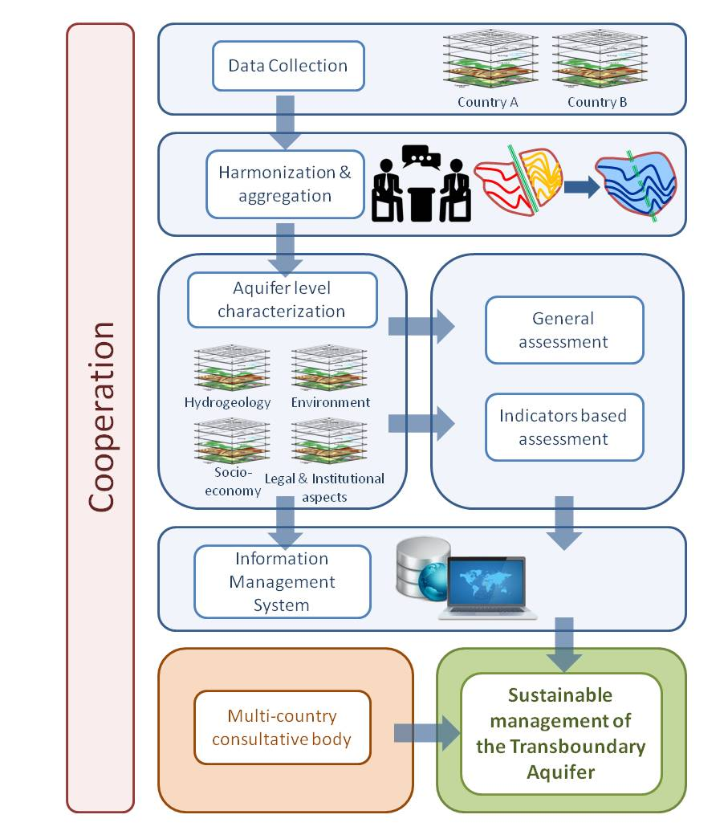
Project workflow and outputs
Structured and harmonised data sets (excel tables)
Indicators
Thematic maps
Overview tables and images
Illustrative graphs (time dependent data)
Conceptual model (cross-sections etc)
Assessment report
Information Management System
31

Slide 32
Project workflow / tasks
Data collection (incl. data entry and digitising of relevant information)
Taking stock (which data are available and which not) and fine-tuning of methodology (data & indicators)
Structuring of data
Harmonising data
Producing outputs: Indicators, thematic maps, overview tables, illustrative graphs, conceptual model, assessment report

Slide 33

Thank you

