Slide 1
CAPACITY BUILDING ACTIVITIES

Slide 2
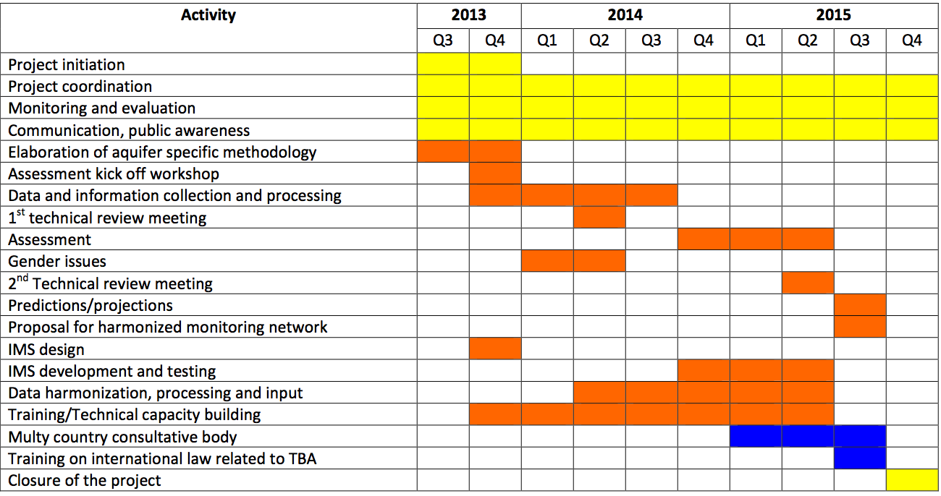

Slide 3
CAPACITY DEVELOPMENT
UNDP: Process through which individuals, organisations, and societies obtain, strengthen, and maintain the capabilities to set and achieve their own development objectives over time.
OECD: Process whereby people, organisations and society as a whole unleash, strengthen, create, adapt and maintain capacity over time.
Capacity development takes place at 3 different levels: individual, organizational/institutional and societal.

Slide 4
PLANNED IN THE PROJECT
Technical instructive workshop on data harmonization
IMS implementation workshop
Training on international law related to TBA

Slide 5
DISCUSSION
Which are the key capacities required in a multi-country team to successfully manage transboundary groundwater resources?
What capacities do you think need to be developed to improve groundwater governance of the Stampriet? Prioritize.
Identify key actors in the development of the capacity building activities.

